Slide 1
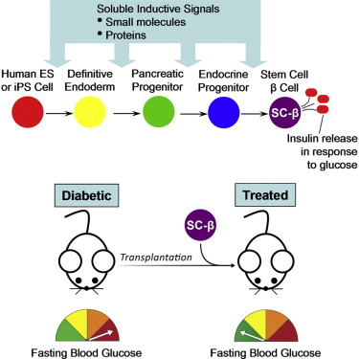
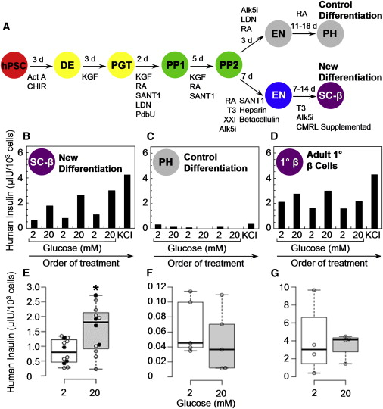
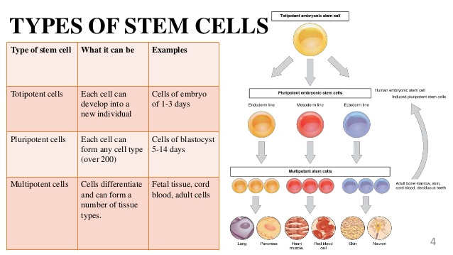
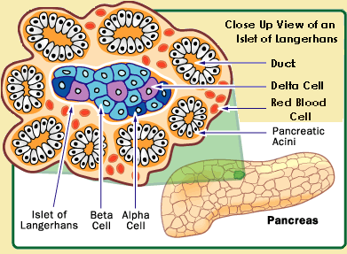
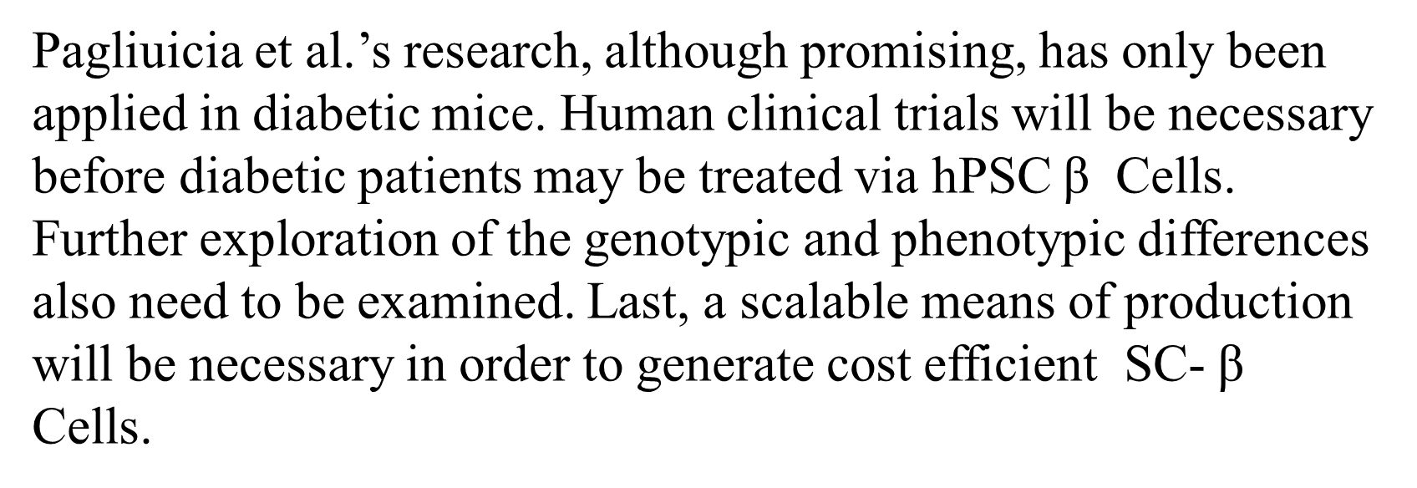
Generation of Functional Human Pancreatic β Cells In Vitro
Grant Morgan | School of Natural Sciences | University of California, Merced
Abstract
Procedures
Results
Conclusion
The generation of insulin-producing pancreatic b cells from stem cells in vitro would provide an unprecedented cell source for drug discovery and cell transplantation therapy in diabetes. However, insulin-producing cells previously generated from human pluripotent stem cells (hPSC) lack many functional characteristics of bona fide b cells. Here, we report a scalable differentiation protocol that can generate hundreds of millions of glucose-responsive b cells from hPSC in vitro. These stem-cell-derived β cells (SC-b) express markers found in mature b cells, flux Ca2+ in response to glucose, package insulin into secretory granules, and secrete quantities of insulin comparable to adult b cells in response to multiple sequential glucose challenges in vitro. Furthermore, these cells secrete human insulin into the serum of mice shortly after transplantation in a glucose-regulated manner, and transplantation of these cells ameliorates hyperglycemia in diabetic mice.
Methods
Pagluicia et al. utilized hESC cells exposed to more than 150 combinations of more than 70 compounds of inhibitors and others in vitro with the purpose of reprogramming hESC cells into iPSC cells before arriving to a combination that effectively develops healthy pancreatic β cells in mice. There are many ways to nuclearly reprogram a β cell, however. Pagluicia et al. devised several “sequential high-glucose challenges” trials to test the authenticity of the 12 most promising batches of iPSC β cells and their similarity to human β cells.
Pagliucia et al. have created hPSC derived SC-B cells that are expressly similar to human β Cells. Additionally, after testing implementation in mice, they have determined that their SC-β cells do not suffer the same fate as previous work; after several months Pagliucia et al.’s SC-β Cells mature and function similarly to human (1deg b) cells. The cells generated in vitro can be produced reliably of quality and in large numbers (billions of cells.)
Pagliucia et al. Used several different procedures to measure the authenticity of Stem Cell derived Pancreatic B Cells, focusing on a selection of responses:
Insulin Response to High Glucose Challenges
Calcium Flux Response in B Cells
Cell Marker Expression at Protein and Gene
Insulin Granule Structural Similarity
Ability to function In Vivo
Patient Treatment
Utilizing a renewable cell source and a scalable method, with cells grown 300 million at a time in suspension in a single 500 ml flask. Thus, one or two flasks may be sufficient for treatment of a patient. An additional clinical advantage of SC-β cells compared to previously proposed therapies using pancreatic progenitors is that these cells do not require an extended posttransplantation period before observing insulin production. Immediate insulin production makes it theoretically possible to reduce patient exogenous insulin requirements from the first few days posttransplantation. These cells also present new opportunities for b cell studies. A single flask could provide enough cells for screening 30,000 compounds in a 384-well format seeded with 10,000 cells per well. Unlike primary human b cells, SC-b cells can also be generated from pluripotent cells of any desired genetic background.
Background
A stem cell is an undefined cell that has the potential to take on a number of functions during its early growth before maturing into an adult cell with a defined function. Stem cells are capable of renewing themselves via cellular division to create two or more copies of themselves; one copy is reserved (immature) while the other copies irreversibly mature into adult cells with specialized functions.
Discussion
Diabetes affects greater than 300 million people to date. Currently, type 1 Diabetic patients can be cured for 5 years or less via the only long term treatment option, cadaveric islet transplantation. Scarcity of viable transplantation donors combined with limited relief from other treatment options reveal the need for a long term treatment to diabetes.
Acknowledgements
Department of Stem Cell and Regenerative Biology, Harvard Stem Cell Institute, Harvard University
.

