Slide 1
Collaborative Filtering By Yaohang Li, Ph.D. Department of Computer Science Old Dominion University
Some slides and figures are adopted from Karatzoglou

Slide 2
Content-based Recommendations
Recommendations are based on the information on the content of items rather than on other users’ opinions.
Use a machine learning algorithm to model the users' preferences from examples based on a description of the content.

Slide 3
Content of an Item
Explicit attributes or characteristics
For a movie
Genre: Action/adventure
Actors: Bruce Willis
Year: 1995
Textual content
For a book
Title
Description
Category
Table of content

Slide 4
Content-based Recommendations
The recommended items for a user are based on the profile built up by analyzing the content of the items the user has liked in the past

Slide 5
Content-based Recommendations
Suitable for text-based products (web pages, books)
Items are “described” by their features (e.g. keywords)
Users are described by the keywords in the items they bought
Recommendations based on the match between the content (item keywords) and user keywords
The user model can also be a classifier (Neural Networks, SVM, Deep Learning)

Slide 6
Pros and Cons of Content-based Recommendation
Advantages
No need for data on other users.
No cold-start or sparsity problems.
Can recommend to users with unique tastes.
Can recommend new and unpopular items
Can provide explanations of recommended items by listing content-features that caused an item to be recommended.
Disadvantages
Only for content that can be encoded as meaningful features.
Some types of items (e.g. movies, music)are not amenable to easy feature extraction methods
Even for texts, IR techniques cannot consider multimedia information, aesthetic qualities, download time: a positive rating could be not related to the presence of certain keywords
Users’ tastes must be represented as a learnable function of these content features.
Hard to exploit quality judgements of other users.
Difficult to implement serendipity

Slide 7
Item Content Profile
Item-Content(s)
item profile, i.e. a set of attributes/keywords characterizing item s
weight w_{ij} measures the 'Importance” (or “informativeness”) of word k_{j} in document d_{j}
term frequency/inverse document frequency(TF-IDF) is a popular weighting technique

Slide 8
User Content Profile
User-Content(u) is the profile of user u by:
analyzing the content of the previous items
using keyword analysis techniques
e.g., User-Content(u):=(w₁, . . . , w_{k}) a vector of weights, where w_{i} denotes the importance of keyword k_{i} to user u

Slide 9
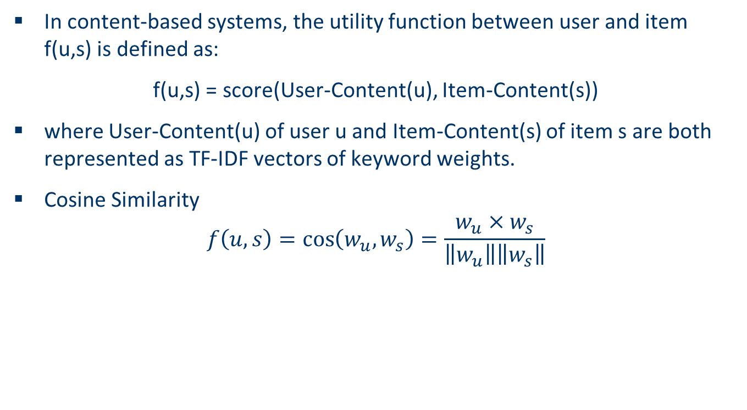
Similarity between Item Content Profile and User Content Profile
In content-based systems, the utility function between user and item f(u,s) is defined as:
f(u,s) = score(User-Content(u), Item-Content(s))
where User-Content(u) of user u and Item-Content(s) of item s are both represented as TF-IDF vectors of keyword weights.
Cosine Similarity
$$f\left(u,s\right)=\cos\left(w_{u},w_{s}\right)=\frac{w_{u}×w_{s}}{\left\|w_{u}\right\|\left\|w_{s}\right\|}$$

Slide 10
An Example
How to compute recommendations of books based only on their title?
A customer buys the book: Building data mining applications for CRM
7 Books are possible candidates for a recommendation:
Accelerating Customer Relationships: Using CRM and Relationship Technologies
Mastering Data Mining: The Art and Science of Customer Relationship Management
Data Mining Your Website
Introduction to marketing
Consumer behavior
Marketing research, a handbook
Customer knowledge management

Slide 11
The Count Matrix

Slide 12
Similarity

Slide 13
Example
Computes distances between this book & all others and recommends the “closest” books:
#1: Data Mining Your Website
#2: Accelerating Customer Relationships: Using CRM and Relationship Technologies
#3: Mastering Data Mining: The Art and Science of Customer Relationship Management

Slide 14
The Filter Bubble Problem
The greatest predicted rating might be a wrong recommendation as it „overfits” to the user’s preferences
E.g. if the user rated only Hungarian and Chinese restaurants the system won’t recommend a Greek restaurant (even it’s the best in the town)

Slide 15
Hybrid recommender systems
Content-based → collaborative
We can use content-based prediction at users with many training examples and collaboration at others
The prediction of content-based models can be used in recursive collaborative filtering
Collaborative → content-based
Features can be extracted from other users’ ratings

Slide 16
Hybrid Model
A hybrid model of several individual models usually performs better than the best individual model (even weaker models can contribute)
voting
Weights of votes can be calibrated on a validation set
stacking
Predictions of the individual models can form features in a second-phase classifier

