Slide 1
An Introduction to Recommender Systems By Yaohang Li, Ph.D. Department of Computer Science Old Dominion University
Some slides and figures are adopted from Karatzoglou

Slide 2
Schedule of the semester
Week 1 | Introduction to Recommendation Systems | Li
Week 2 | Basic Linear Algebra | Li
Week 3 | Content-based Filtering and Collaborative Filtering | Li
Week 4 | Randomized Algorithms and Matrix Completion | Li
Week 5 | Regularization using l0, l1, l2, and nuclear norms | Li
Week 6 | Alternative Least Square (ALS) | Student
Week 7 | SVD++ Algorithm | Student
Week 8 | Singular Value Thresholding Algorithm | Student
Week 9 | Expectation-Maximization Algorithm | Student
Week 10 | Alternating Direction Method of Multipliers (ADMM) | Student
Week 11 | Accelerated Proximal Gradient (APG) | Student
Week 12 | Fixed Point Continuation (FPG) | Student
Week 13 | Nonlinear Successive Over-Relaxation (LMaFit) | Student
Week 14 | Stochastic Gradient Descent | Student

Slide 3
What we are going to do?
Read and Present Classic and Latest Recommender System Algorithm Papers
Build your Recommender System Algorithm
Apply to Applications
MovieLens
Drug-Disease Associations Prediction
Jokes
Image Processing

Slide 4
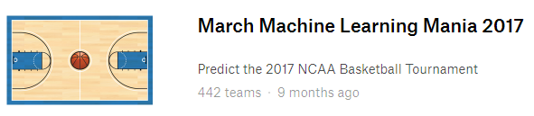
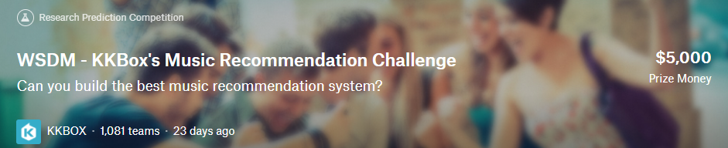
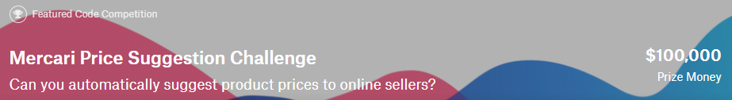
What we are going to do (cont.)?
Participate in Kaggle Competition

Slide 5
What we are going to do (cont.)?
Software Package
Integrating multiple recommendation algorithms
Project Report
Report recommender systems on applications
May lead to potential publications

Slide 6
Agenda
Introduction
What is a Recommender System?
Paradigms of recommender systems
Collaborative Filtering
Content-based Filtering
Context-aware Recommendation
Other Approaches
Knowledge-Based Recommendations
Hybrid Recommender Systems
Applications

Slide 7
From Search to Discovery
The Web is leaving the era of search and entering the era of discovery
Search
You are looking for something you know existing
Discovery
“Something wonderful that you didn’t know existed, or didn’t know how to ask for, finds you”
CNN Money, the race to create a “Smart” Google

Slide 8
The Importance of Recommendations
Netflix
2/3 of the movies watched are recommended
Google News
recommendations generate 38% more click-throughs
Amazon
35% sales from recommendations
Choicestream
28% of the people would buy more music if they found what they liked
Drug Discovery
Approximately 2/3 of the “new” drug-disease associations are recommended from the known drugs

Slide 9



Problem domain
Recommender systems (RS) help to match users with items
Ease information overload
Sales assistance (guidance, advisory, persuasion,…)
Different system designs / paradigms
Based on availability of exploitable data
Implicit and explicit user feedback
Domain characteristics

Slide 10
The Recommendation Problem
Estimate a utility function to predict how a user will prefer a particular item

Slide 11
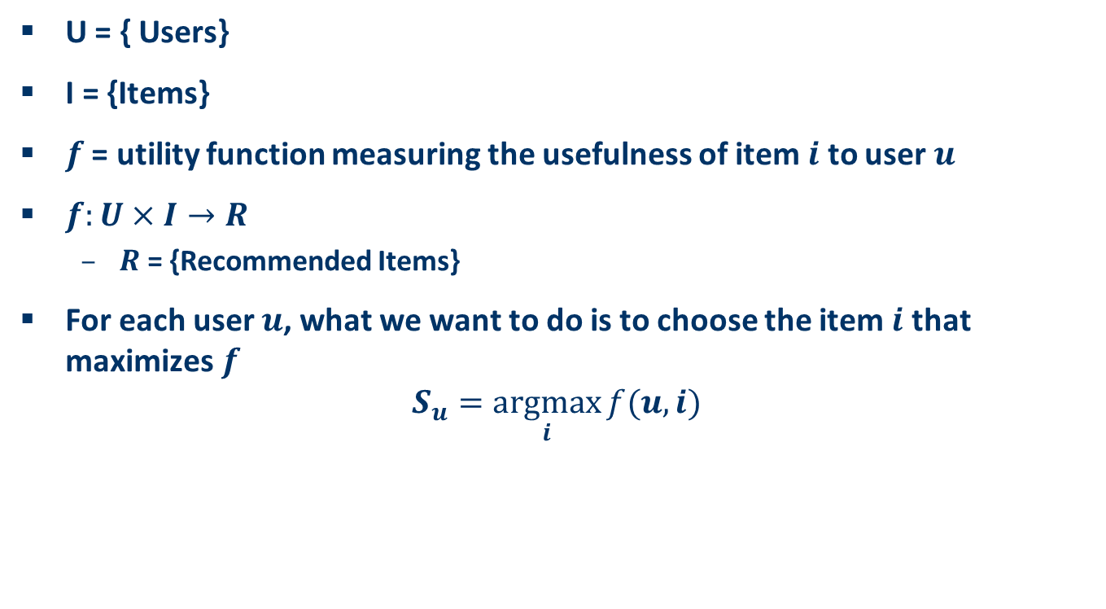
The Recommendation Problem
U = { Users}
I = {Items}
$f$ = utility function measuring the usefulness of item $i$ to user $u$
$f:U×I→R$
$R$ = {Recommended Items}
For each user $u$, what we want to do is to choose the item $i$ that maximizes $f$
$$S_{u}=\underset{i}{argmax}{f(u,i)}$$

Slide 12
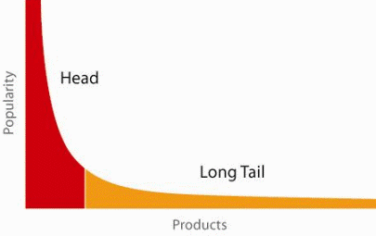
When does a RS do its job well?
"Recommend widely unknown items that users might actually like!"
20% of items accumulate 74% of all positive ratings
Items rated > 3 in MovieLens 100K dataset
Recommend items from the long tail

Slide 13
The Long Tail Problem
Long Tail
The items in the long tail are rare, obscure items
Novel Discovery: if the recommender system does recommend items in the long tail and the user actually likes it
Challenges
Ranking Problem
The recommendation algorithm may find many items to recommend
Which ones to recommend
In what order
Solution
Effective ranking
Diversity
Show items of different types or categories to the user
Not all items in your recommendation should be similar

Slide 14
Good Recommendation
Personalized

Slide 15
Good Recommendation
Diversified
Represent all possible interests of a particular user

Slide 16
Good Recommendation
Serendipity
Does not recommend items the user already knew or would have known anyway
Expand the user’s taste into neighboring areas

Slide 17
Summary
Course Syllabus
Introduction to Recommender Systems

