Slide 1
Regularization By Yaohang Li, Ph.D. Department of Computer Science Old Dominion University
Some slides and figures are adopted from Karatzoglou

Slide 2
The Overfitting Problem
The Overfitting Problem
Performing a machine learning task on a “small” dataset
The model accurately remembers all training data
Including noise and unrelated features
An overfitting model often performs badly on new test or real data that have not been seen before
Treat the training data too seriously
Simply memorizing everything it has seen
Fail to learn any meaningful pattern out of it

Slide 3
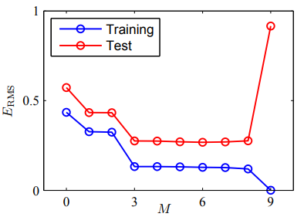
Typical Overfitting Phenomenon

Slide 4


A Trivial Learning Example
Classification of Chinese Characters
Correct Classification

Slide 5

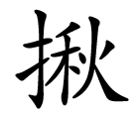
Overfitting in the Trivial Learning Problem
A “too smart” machine learning algorithm
Completely memorize the five characters (too good memory)
as a vector [把, 打, 扒, 捕, 拉]
For a new input
Not in the memory, classify in class 2
Our solution – make the machine learning algorithm “dumber”
[扌, 0, 0, 0, 0]
Sparse vector

Slide 6
Regularization
Reduce overfitting by adding a complexity penalty
Regularization
Add penalty on the parameters of the model
Reduce the freedom of the model
The model will be less likely to fit the noise of the training data
Improve generalization abilities of the model

Slide 7

L_{p}-norm
L_{p}-norm Definition
$${\left\|x\right\|}_{p}={({\left|x_{1}\right|}^{p}+{\left|x_{2}\right|}^{p}+…+{\left|x_{n}\right|}^{p})}^{1/p}$$
L∞-norm
$${\left\|x\right\|}_{∞}=max(\left|x_{1}\right|,\left|x_{2}\right|,…,\left|x_{n}\right|)$$
L₀-norm
$${\left\|x\right\|}_{0}=(\#x_{i}≠0)$$

Slide 8
Regularization Model
L1 regularization (Lasso)
L2 regularization (Ridge)
L1/L2 regularization (Elastic net)

Slide 9
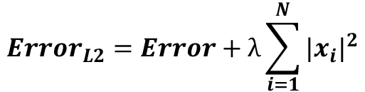
L2 Regularization (Ridge Penalization)
L2 regularization will force the parameters to be relatively small
The bigger penalization, the smaller the coefficients are
$${Error}_{L2}=Error+λ\sum_{i=1}^{N}{{|x_{i}|}^{2}}$$

Slide 10
Example of Auto Price Prediction

Slide 11
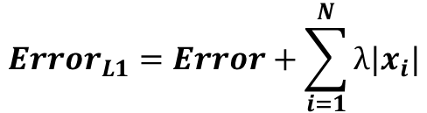
L1 regularization (Lasso Penalization)
L1 regularization will lead to sparse solution
$${Error}_{L1}=Error+\sum_{i=1}^{N}{λ|x_{i}|}$$

Slide 12
Example of Auto Price Prediction

Slide 13
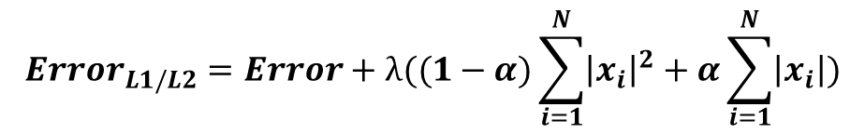
L1/L2 Regularization (Elastic Net)
A combination of L1 and L2 Regularization
Hybrid Behavior of L1 and L2 Regularization
$${Error}_{L1/L2}=Error+λ((1−α)\sum_{i=1}^{N}{{\left|x_{i}\right|}^{2}}+α\sum_{i=1}^{N}{\left|x_{i}\right|})$$

Slide 14
Example of Auto Price Prediction

Slide 15
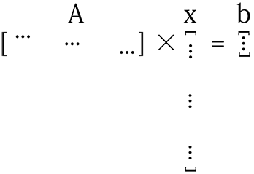
Why L1 Regularization leads to sparse solution?
Let’s consider the problem of optimizing
Ax = b
A is not tall enough
x is very long

Slide 16
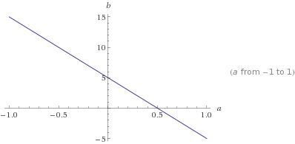
Why L1 Regularization leads to sparse solution?
In particular, consider a 2D system, we only know one data point (training sample)
(10, 5)
The possible solutions lie on the line of b = 10-5*a
Under L1 Regularization, we want to find the solution of the line of b = 10-5*a yielding the smallest L1 norm

Slide 17
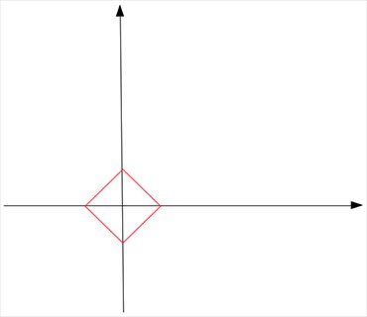
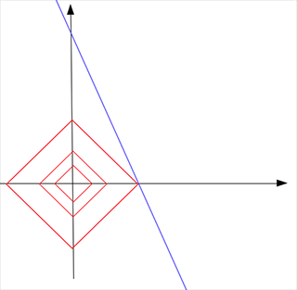
Why L1 Regularization leads to sparse solution?
Now L1 norm looks like
The optimal solution occurs when the L1-norm and b = 10-5*a touch

Slide 18
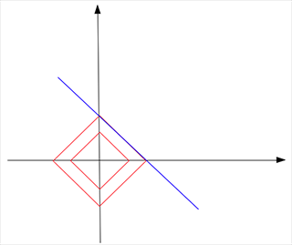
Why L1 Regularization leads to sparse solution?
The optimal solution under L1 Regularization is (0.5, 0)
The solution is sparse because L1 norm is spiky
However, in some situations

Slide 19
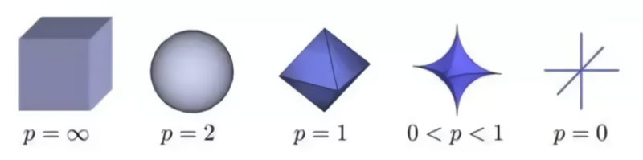
How about more spiky norms?

Slide 20
Reference
L1 Norm Regularization and Sparsity Explained for Dummies, Shi Yan

