Slide 1
North American Infection and Mortality Rates for COVID-19
Grant Jackson
Sylvia Nyakundi
Francis Duffy
Samantha Harding

Slide 2
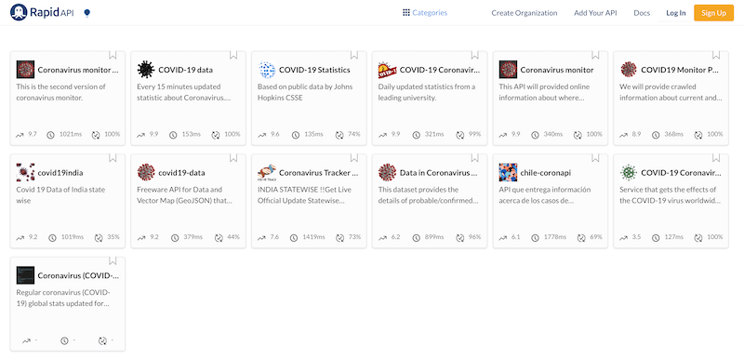
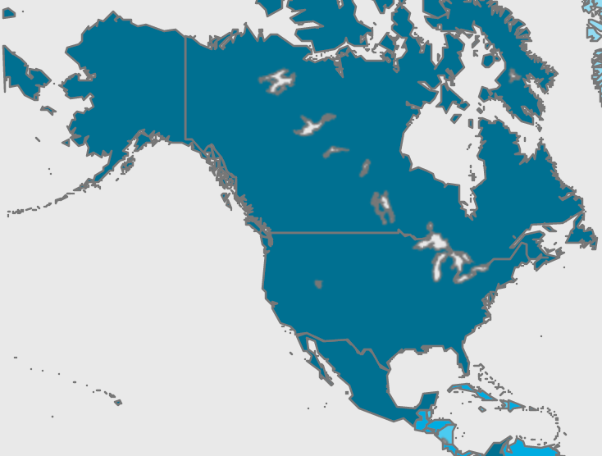
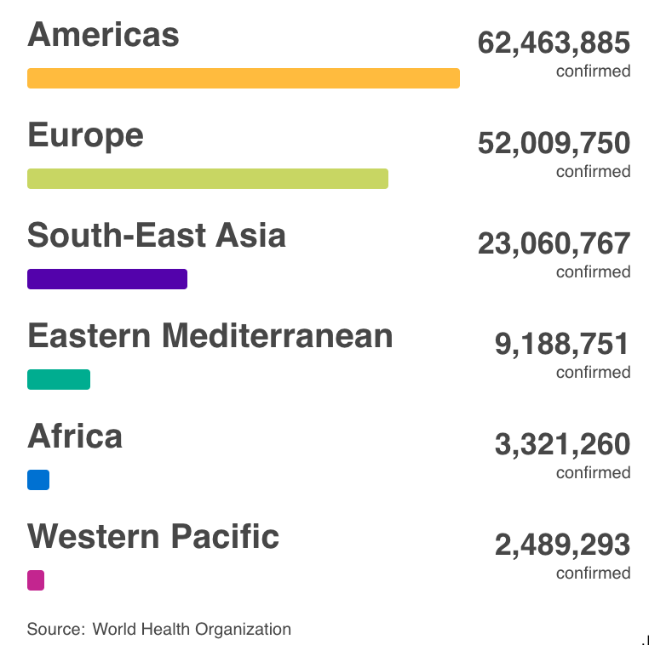
Motivation, Summary, and Data
Healthcare data in the US is notoriously difficult to find. There are currently a select few sources able to report accurate and timely statistics, at least in pa rt due to HIPPA regulations and the availability of claims data.
COVID-19 has seen a surge in the prevalence of data, with many APIs and downloadable sources offering statistics on the spread and mortality rates of the virus. While these APIs are sourced and visualized differently, most of them call on the same sources—they do not generate data, but rather increase awareness and utility.
Our group examined one such API, pulling its available statistics for countries in North America. We hoped to look at international trends in COVID-19 infection and morbidity rates by country and check for correlations between these measures and included demographic factors.
Source: Rapid API
Source: World Health Organization

Slide 3
Questions
COVID-19 sources generally contain the same fundamental statistics surrounding infection and mortality counts, and are often combined with raw population descriptors such as pop density and life expectancy. Our group wanted to see how well we could profile trends in infection and mortality throughout North America based on these offered statistics, specifically:
Which countries in North America have the highest infection rates? Mortality rates?
Do any of the provided demographic statistics have strong correlations with infection or mortality rate?
Can discrepancies between infection rate and mortality rate—such as a country with a high infection rate but a low mortality rate—be explained based on the given statistics?
What are the limitations of this dataset? Could existing external sources help to fix these limitations, or is further surveying required?

Slide 4
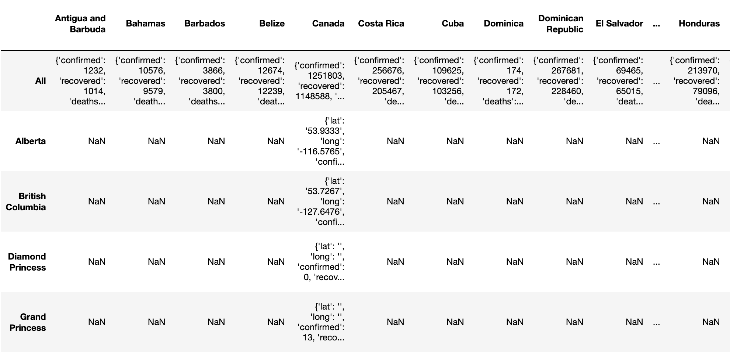
Data Cleanup and Exploration
One of the most interesting problems we encountered with this dataset was its structure—fields were grouped geographically rather than by summary value, so the json could not be directly loaded into a dataframe without the loss of target statistics. Instead, we ran a loop that pulled only those geographies with values for all available columns and appended each result to an initially empty list.
Our dataset contained a column that was depreciated, which would have skewed results had we included it in our analyses. The problem was easily solved by excluding said column from working dataframes, but the process of working through why its statistics looked suspect was valuable.
Add in the fact that smaller “nested” geographies did not contain all statistics, so filtering for regions with “all” both gave more fields to work with and narrowed down geography type to “country”
Add in that we created per capita and pop density columns based on given population columns
Geographies
Geographies

Slide 5
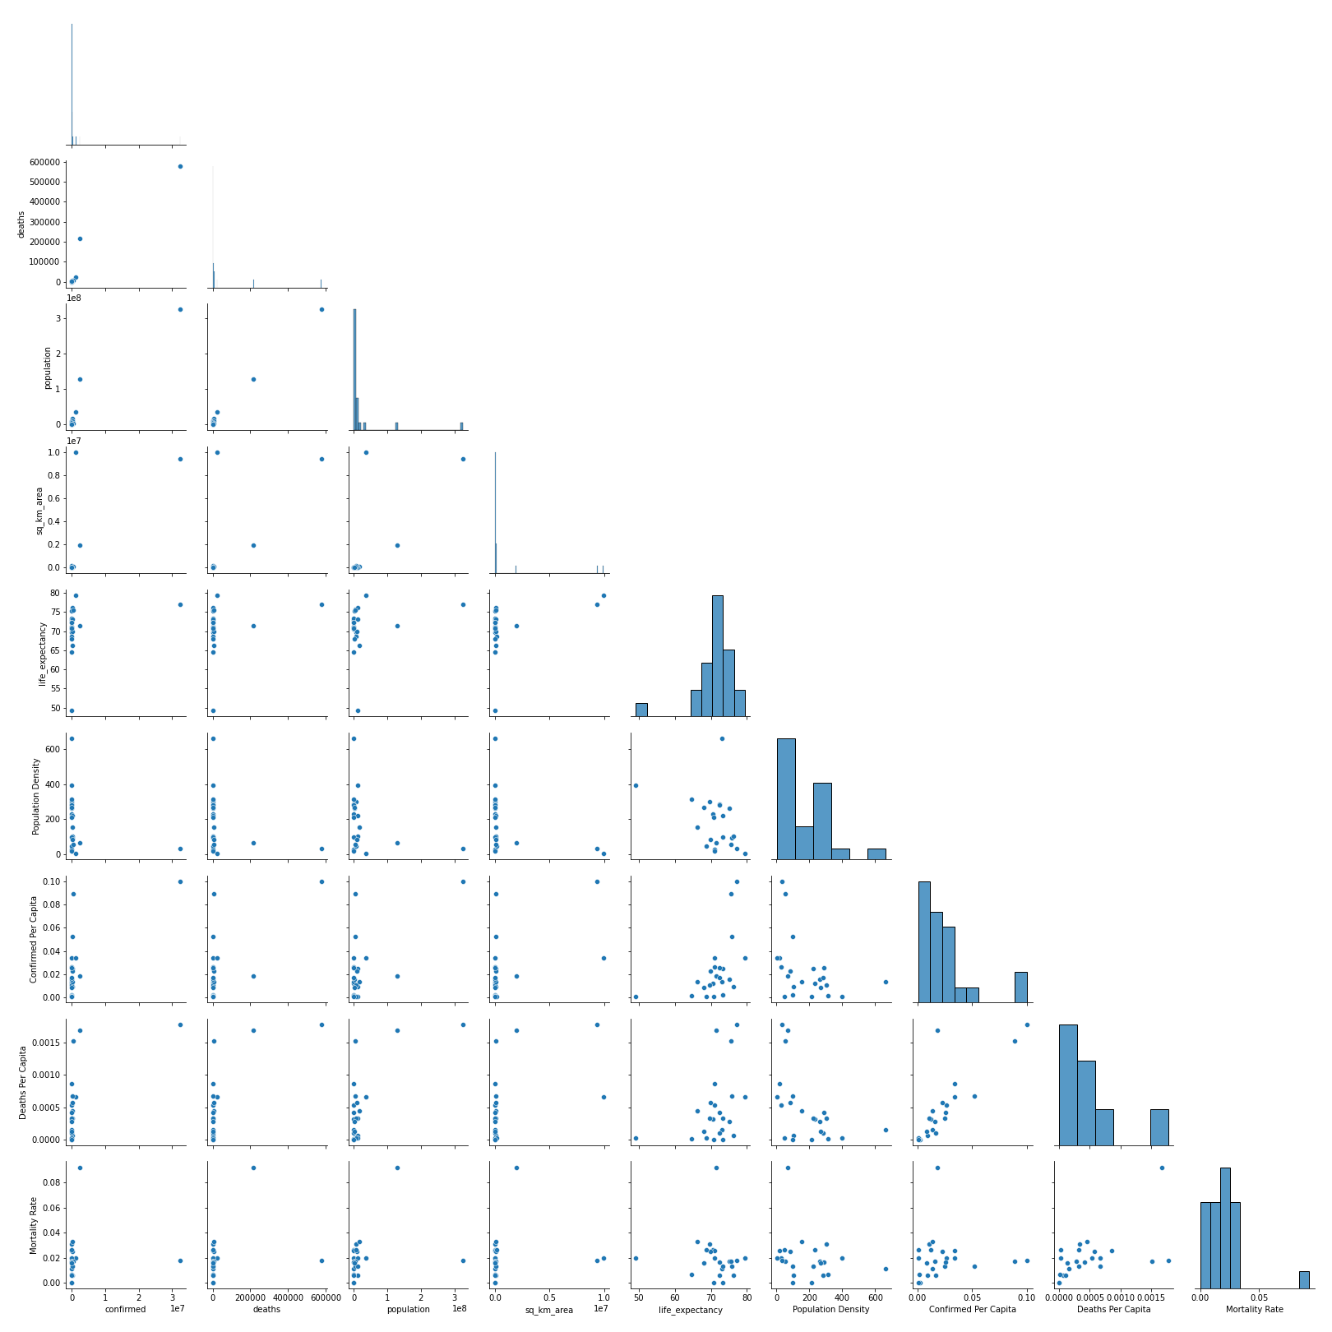
Data Analysis
* Discuss the steps you took to analyze the data and answer each question you asked in your proposal
Question | Available Data | Visualization | Interpretation
Which countries in North America have the highest infection rates? Mortality rates? | Columns on infection and morbidity | Bar charts displaying infection and morbidity rates by country
Do any of the provided demographic statistics have strong correlations with infection or mortality rate? | Columns on infection and morbidity combined with population, population density, and life expectancy | Scatter plots with demographic variables as x-axis values and COVID-19 statistics as y-axis values, with trendline included
Can discrepancies between infection rate and mortality rate—such as a country with a high infection rate but a low mortality rate—be explained based on the given statistics?

Slide 6
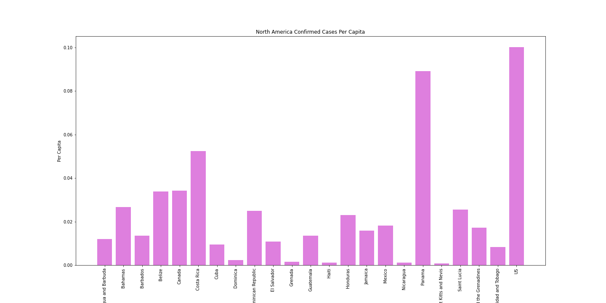
Data Analysis
* Present and discuss interesting figures developed during analysis, ideally with the help of Jupyter Notebook Which countries in North America have the highest infection rates? Mortality rates?
North American Confirmed Cases per Capita

Slide 7
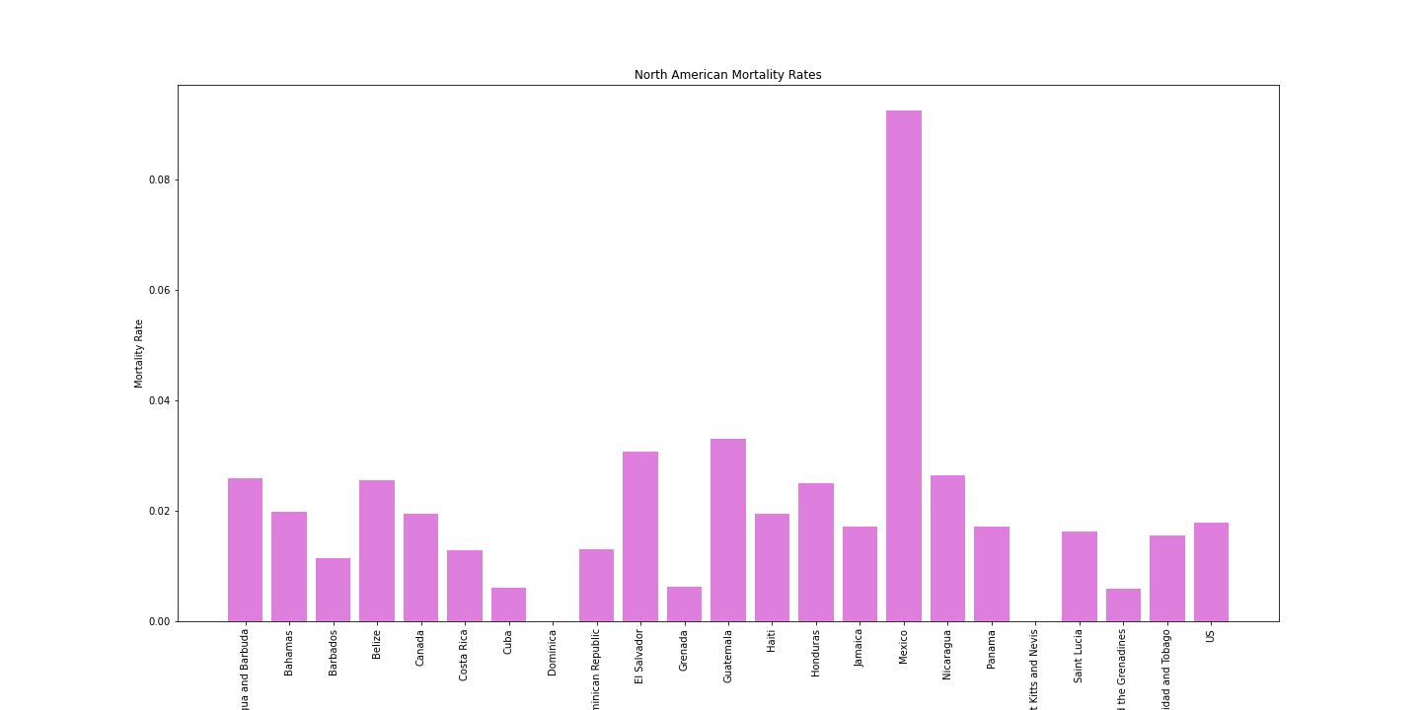
Data Analysis
North American Mortality Rates

Slide 8
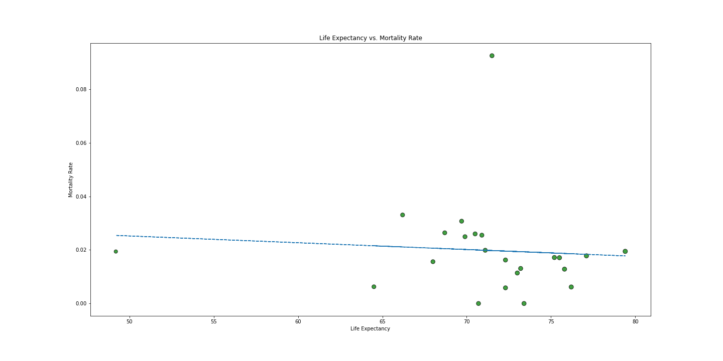
Data Analysis
* Present and discuss interesting figures developed during analysis, ideally with the help of Jupyter Notebook Do any of the provided demographic statistics have strong correlations with infection or mortality rate?
Life Expectancy vs. Mortality Rate

Slide 9
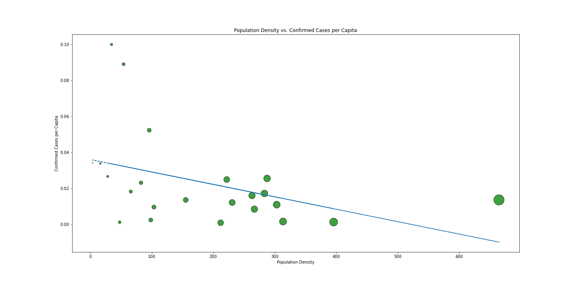
Data Analysis
* Present and discuss interesting figures developed during analysis, ideally with the help of Jupyter Notebook Do any of the provided demographic statistics have strong correlations with infection or mortality rate?
Population vs. Confirmed Cases per Capita

Slide 10
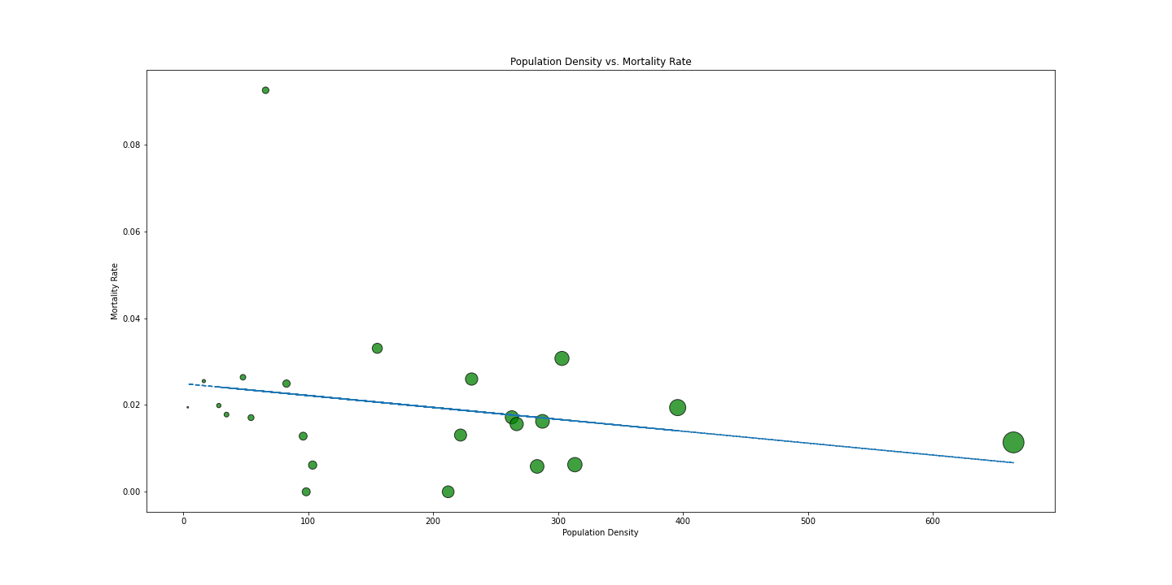
Data Analysis
* Present and discuss interesting figures developed during analysis, ideally with the help of Jupyter Notebook Do any of the provided demographic statistics have strong correlations with infection or mortality rate?
Population Density vs. Mortality Rate

Slide 11
Data Analysis
* Present and discuss interesting figures developed during analysis, ideally with the help of Jupyter Notebook
Can discrepancies between infection rate and mortality rate—such as a country with a high infection rate but a low mortality rate—be explained based on the given statistics?

Slide 12
Discussion
* Discuss your findings. Did you find what you expected to find? If not, why not? What inferences or general conclusions can you draw from your analysis?

Slide 13
Post-Mortem
Discuss any difficulties that arose, and how you dealt with them
Mortality rates in non-covid years
Compare to 1918 pandemic
With two more weeks, two possible project extensions would be interesting to explore:
The M-Media-Group API had several other categories of data available—history and vaccines—which would be interesting to add to our existing data
History data would solve the problem of not being able to track infection and deaths over time, bringing this API’s utility closer to more established sources
Vaccine data would decrease one of the variables that is currently unchecked in our dataset, especially when combined with infection rates over time and additional sources on vaccine distribution dates by country
Comparing more established international healthcare data sources across the same geographies as were examined with the M-Media-Group API would give an interesting view of each source’s differences, as we could contrast their breadth and utility

Slide 14
Questions
Please ask questions if you have them.

Slide 15
Sources
API provided open-source by M-Media-Group, available at https://github.com/M-Media-Group/Covid-19-API
COVID-19 stock image is public domain, provided by the CDC and available at https://www.cdc.gov/media/subtopic/images.htm
Information on the WHO Coronavirus (COVID-19) Dashboard was pulled from https://covid19.who.int/

