Slide 1
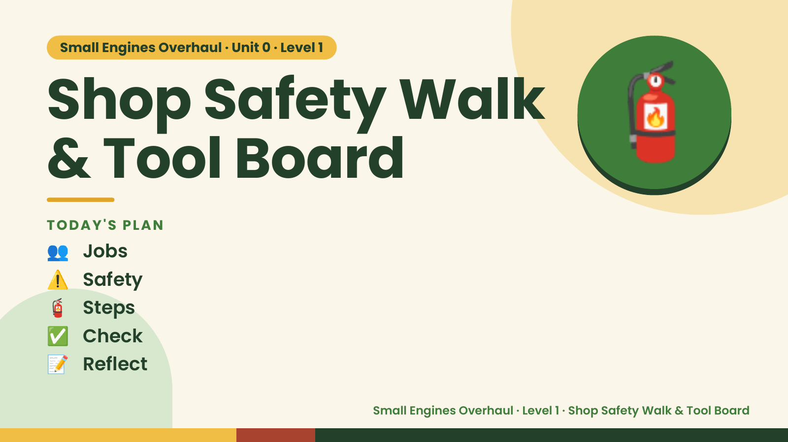
Notes:
Small Engines Overhaul · Unit 0 · Level 1
Shop Safety Walk
& Tool Board
👥 Jobs
TODAY'S PLAN
🧯
⚠️ Safety
🧯 Steps
✅ Check
📝 Reflect
Small Engines Overhaul · Level 1 · Shop Safety Walk & Tool Board

Slide 2

Notes:
Get ready
Jobs
🔧 Mechanic
fixes 🧰 Tool helper
gets tools
📋 Recorder
writes 🧽 Clean-up
captain
cleans
Small Engines Overhaul · Level 1 · Shop Safety Walk & Tool Board

Slide 3
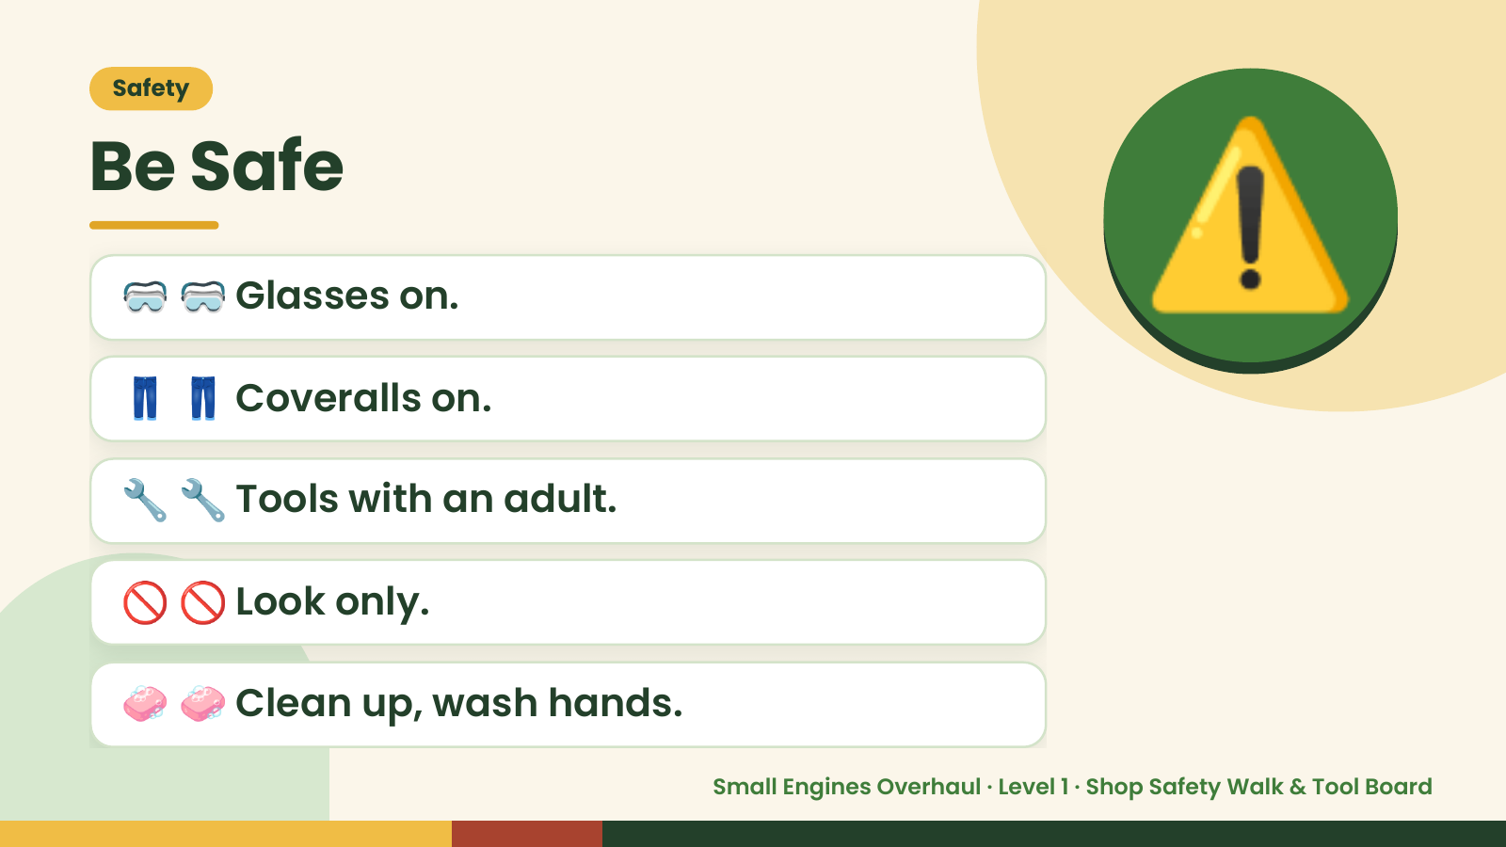
Notes:
Safety
Be Safe
🥽 🥽 Glasses on.
👖 👖 Coveralls on.
⚠️
🔧 🔧 Tools with an adult.
🚫 🚫 Look only.
🧼 🧼 Clean up, wash hands.
Small Engines Overhaul · Level 1 · Shop Safety Walk & Tool Board

Slide 4
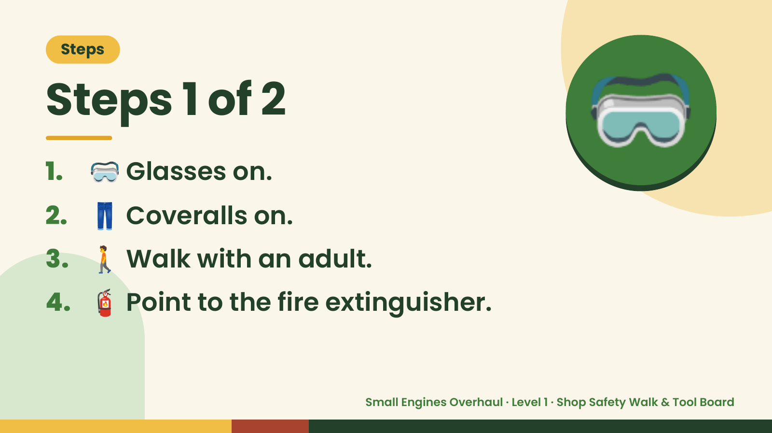
Notes:
Steps
Steps 1 of 2
1. 🥽 Glasses on.
2. 👖 Coveralls on.
🥽
3. 🚶 Walk with an adult.
4. 🧯 Point to the fire extinguisher.
Small Engines Overhaul · Level 1 · Shop Safety Walk & Tool Board

Slide 5
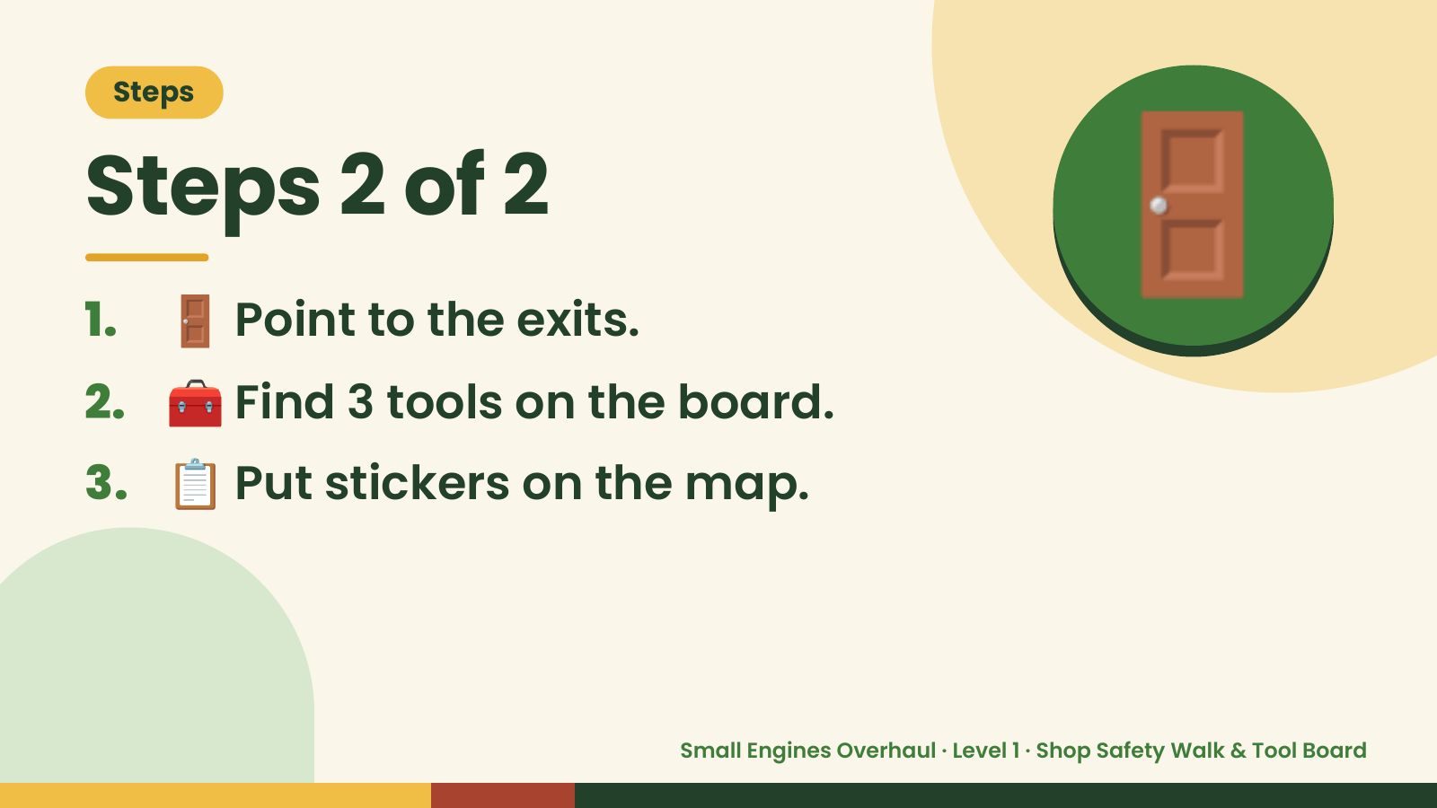
Notes:
Steps
Steps 2 of 2
1. 🚪 Point to the exits.
2. 🧰 Find 3 tools on the board.
🚪
3. 📋 Put stickers on the map.
Small Engines Overhaul · Level 1 · Shop Safety Walk & Tool Board

Slide 6
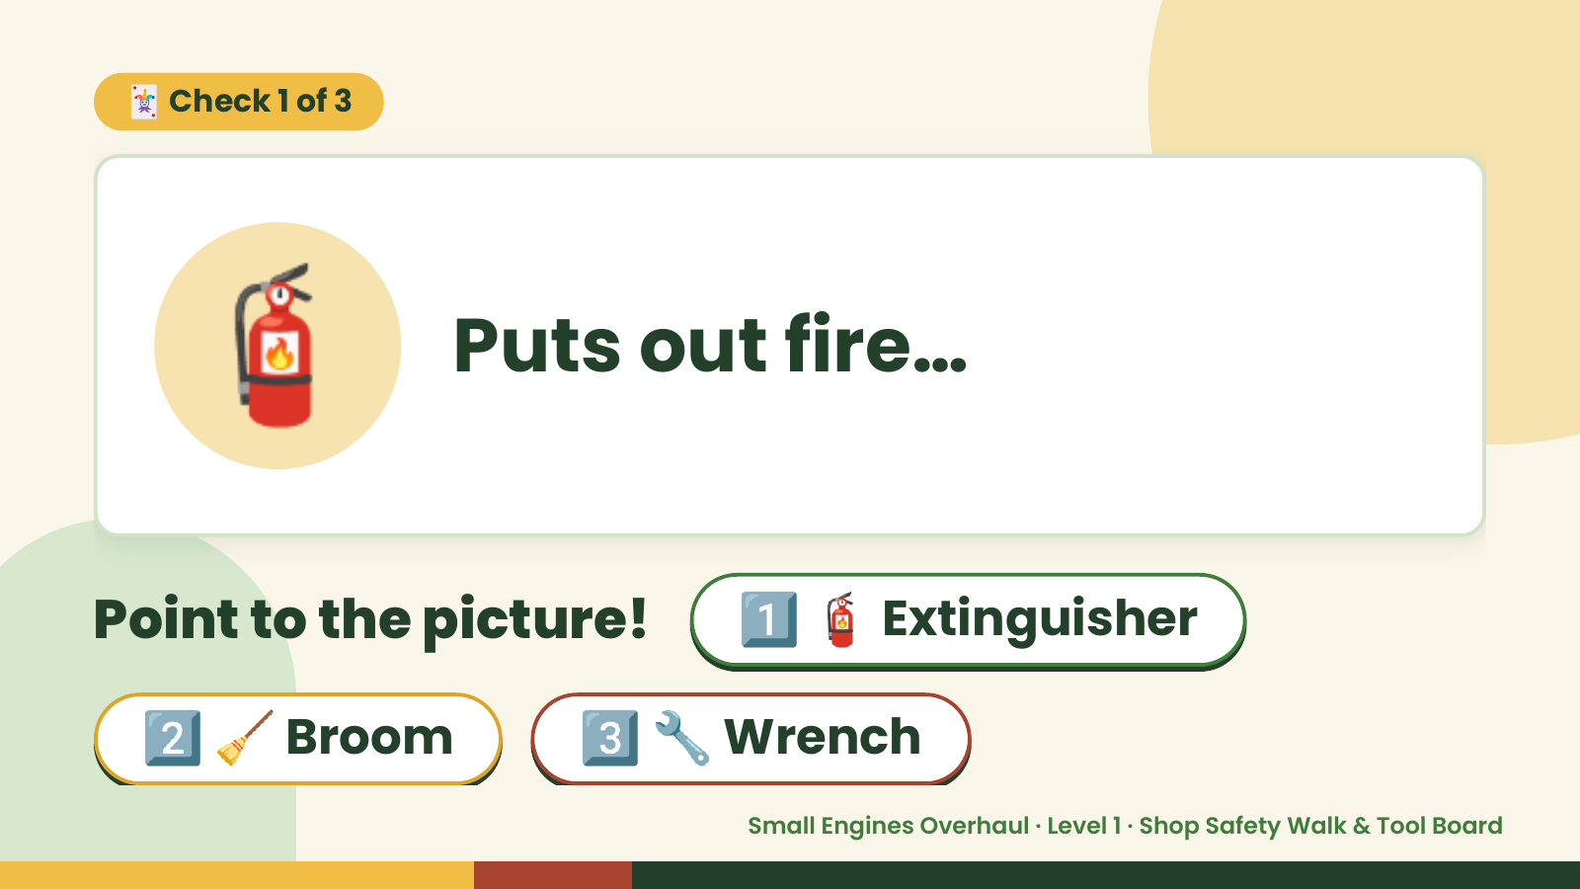
Notes:
🃏 Check 1 of 3
🧯 Puts out fire…
Point to the picture! 1️⃣ 🧯 Extinguisher
2️⃣ 🧹 Broom 3️⃣ 🔧 Wrench
Small Engines Overhaul · Level 1 · Shop Safety Walk & Tool Board

Slide 7
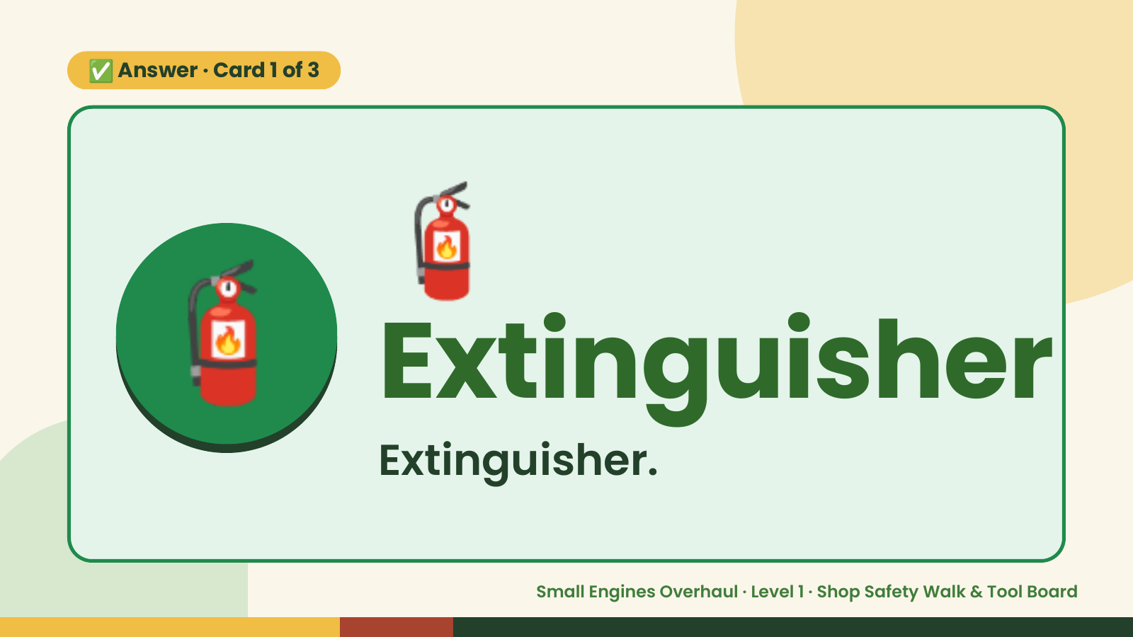
Notes:
🧯
✅ Answer · Card 1 of 3
🧯 Extinguisher Extinguisher.
Small Engines Overhaul · Level 1 · Shop Safety Walk & Tool Board

Slide 8
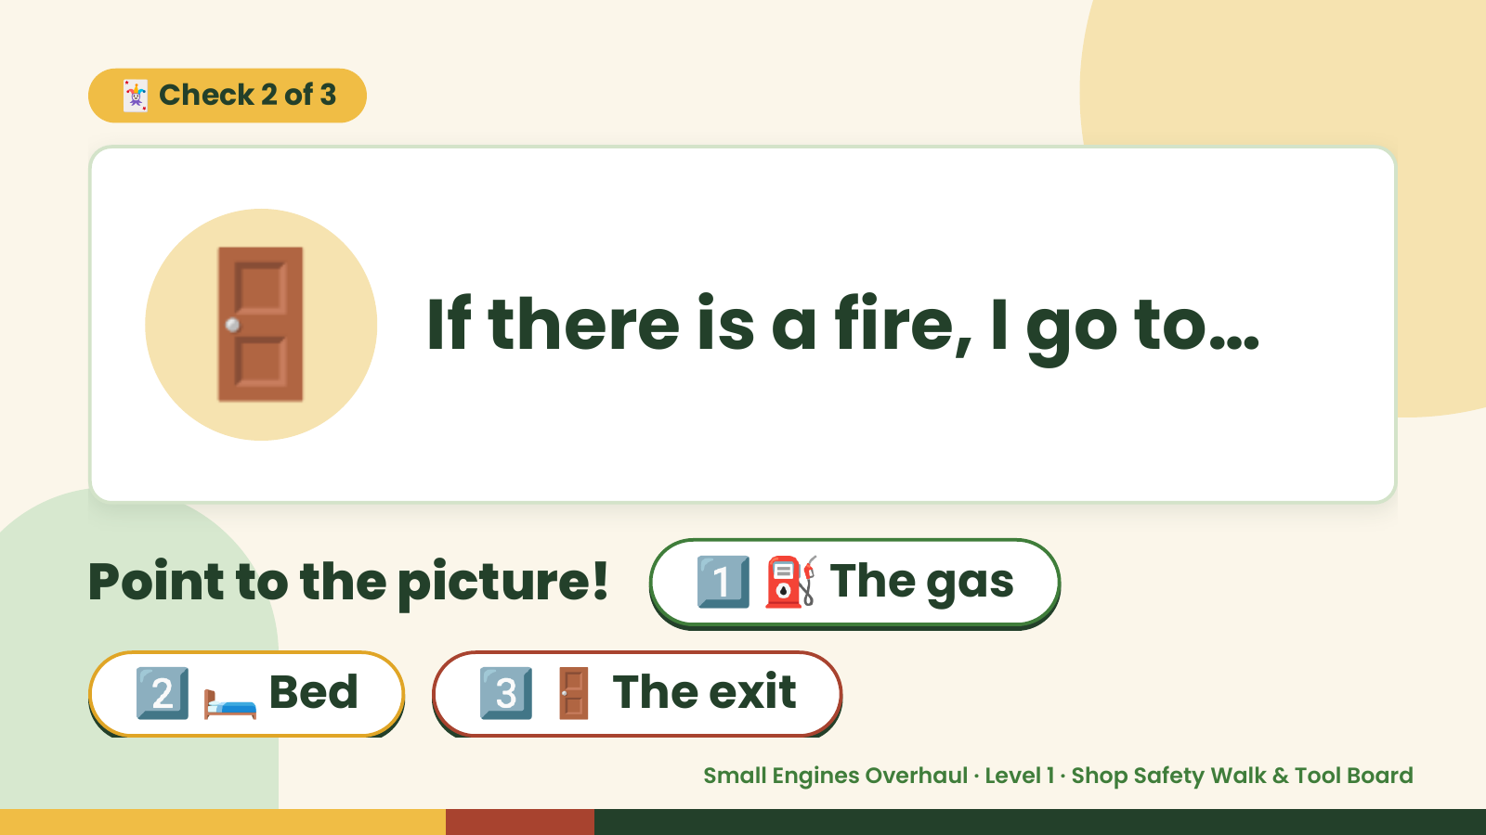
Notes:
🃏 Check 2 of 3
🚪 If there is a fire, I go to…
Point to the picture! 1️⃣ ⛽ The gas
2️⃣ 🛏️ Bed 3️⃣ 🚪 The exit
Small Engines Overhaul · Level 1 · Shop Safety Walk & Tool Board

Slide 9
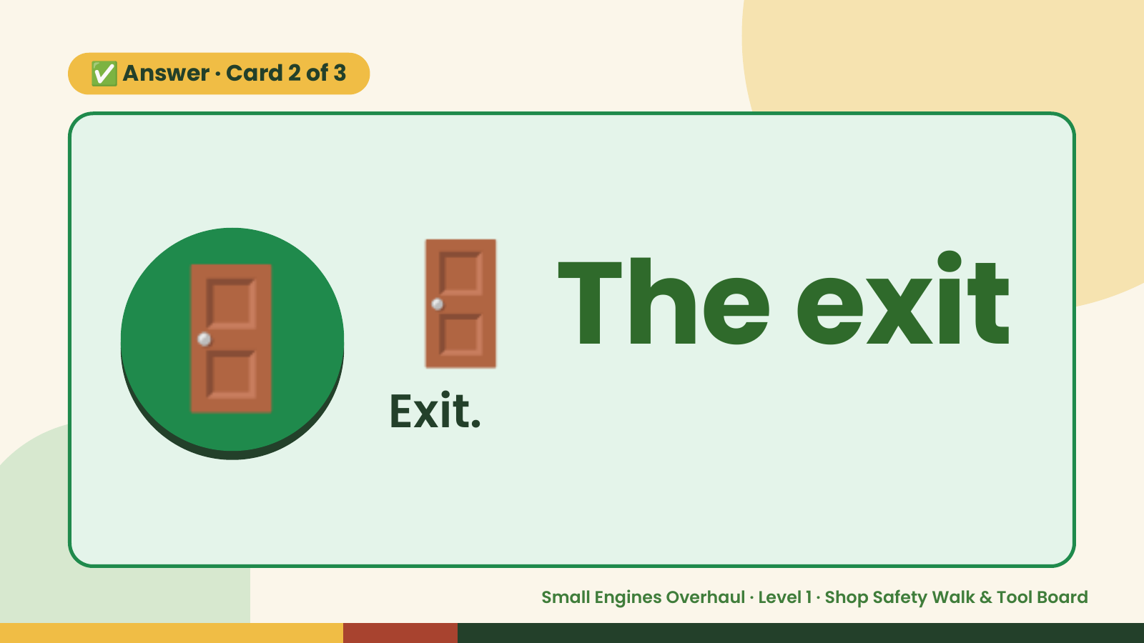
Notes:
✅ Answer · Card 2 of 3
🚪 🚪 The exit
Exit.
Small Engines Overhaul · Level 1 · Shop Safety Walk & Tool Board

Slide 10
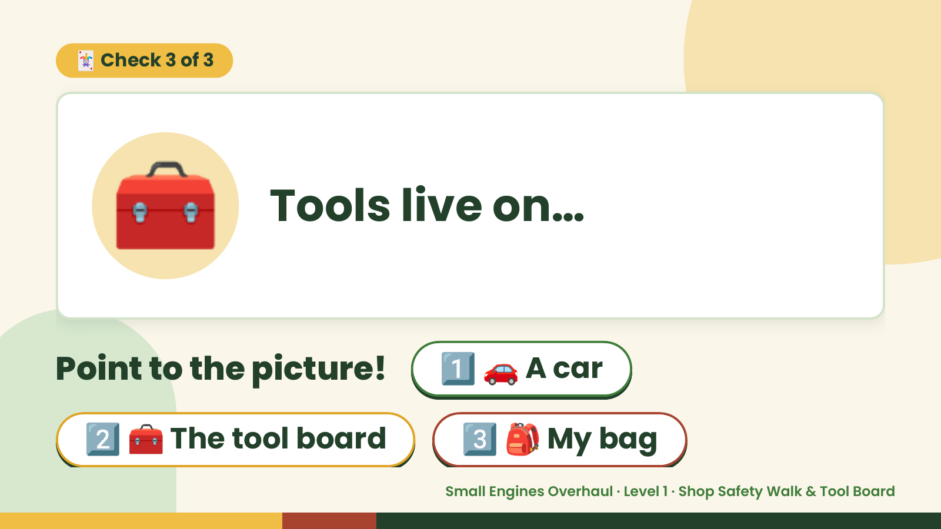
Notes:
🃏 Check 3 of 3
🧰 Tools live on…
Point to the picture! 1️⃣ 🚗 A car
2️⃣ 🧰 The tool board 3️⃣ 🎒 My bag
Small Engines Overhaul · Level 1 · Shop Safety Walk & Tool Board

Slide 11
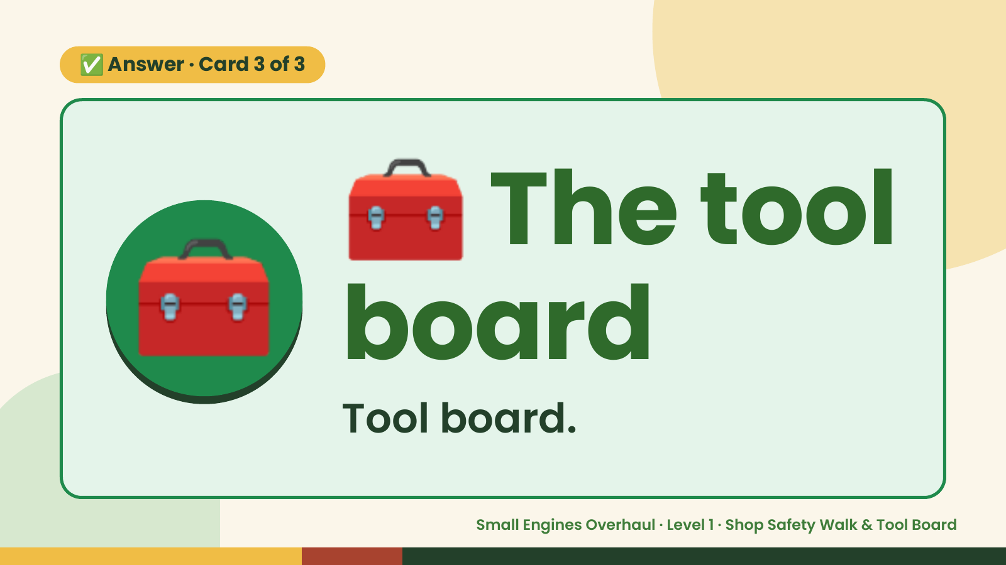
Notes:
🧰
✅ Answer · Card 3 of 3
🧰 board
The tool
Tool board.
Small Engines Overhaul · Level 1 · Shop Safety Walk & Tool Board

Slide 12

Notes:
Wrap-Up
Clean Up +
Reflect
🧽
🧽 Wipe the bench.
🧰 Give tools back.
🧼 Wash hands.
Small Engines Overhaul · Level 1 · Shop Safety Walk & Tool Board

