Slide 1

Notes:
Small Engines Overhaul · Unit 0 · Level 1
Shop Start-Up
& Safety
🛡️
📝 Class rules
TODAY'S PLAN
🥽 Safety gear
⛽ Fire safety
🧰 Clean up
Small Engines Overhaul · Level 1 · Shop Start-Up & Safety

Slide 2
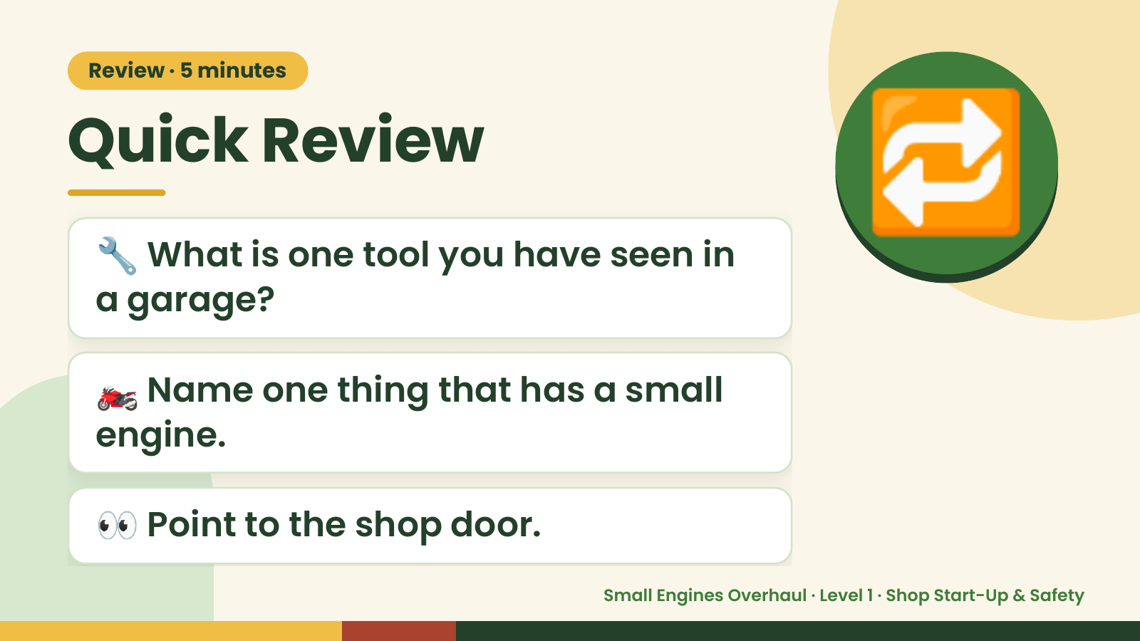
Notes:
Review · 5 minutes
Quick Review
🔧 What is one tool you have seen in
a garage?
🔁
🏍️ Name one thing that has a small
engine.
👀 Point to the shop door.
Small Engines Overhaul · Level 1 · Shop Start-Up & Safety

Slide 3
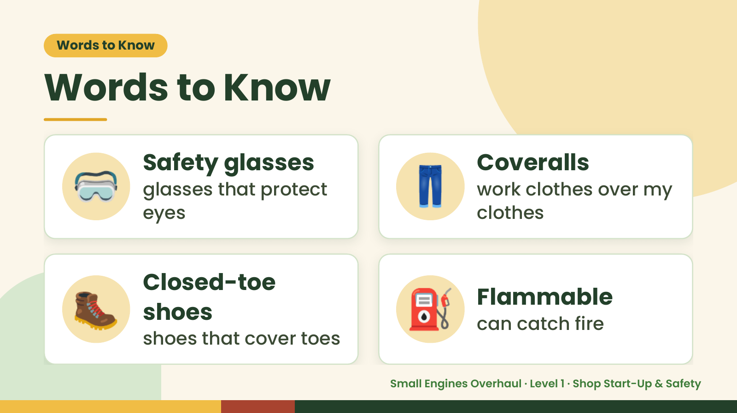
Notes:
Words to Know
Words to Know
🥽 Safety glasses
glasses that protect
eyes
👖 Coveralls
work clothes over my
clothes
🥾 Closed-toe
shoes
shoes that cover toes
⛽ Flammable
can catch fire
Small Engines Overhaul · Level 1 · Shop Start-Up & Safety

Slide 4
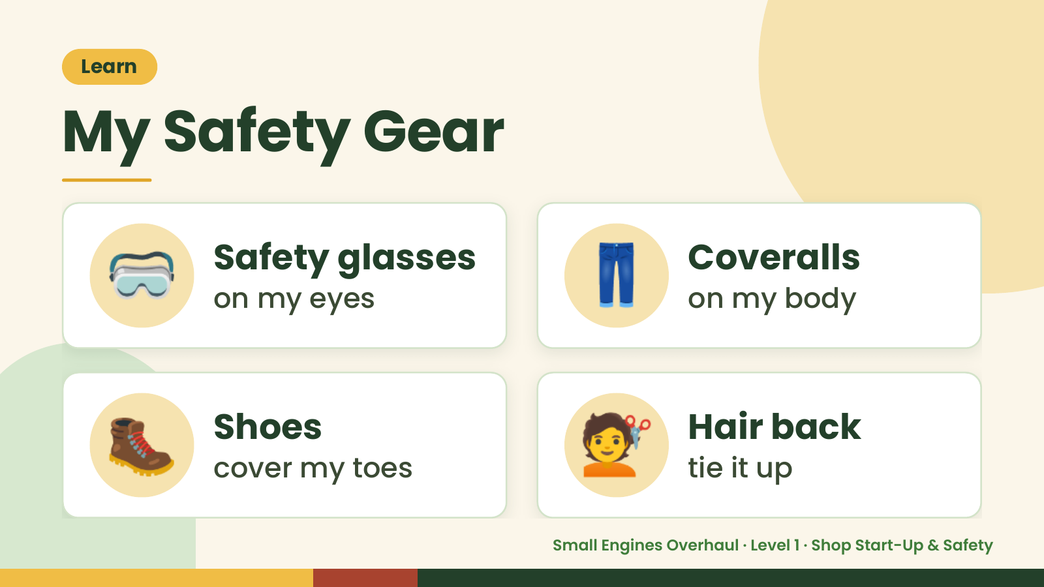
Notes:
Learn
My Safety Gear
🥽 Safety glasses
on my eyes 👖 Coveralls
on my body
🥾 Shoes
cover my toes 💇 Hair back
tie it up
Small Engines Overhaul · Level 1 · Shop Start-Up & Safety

Slide 5
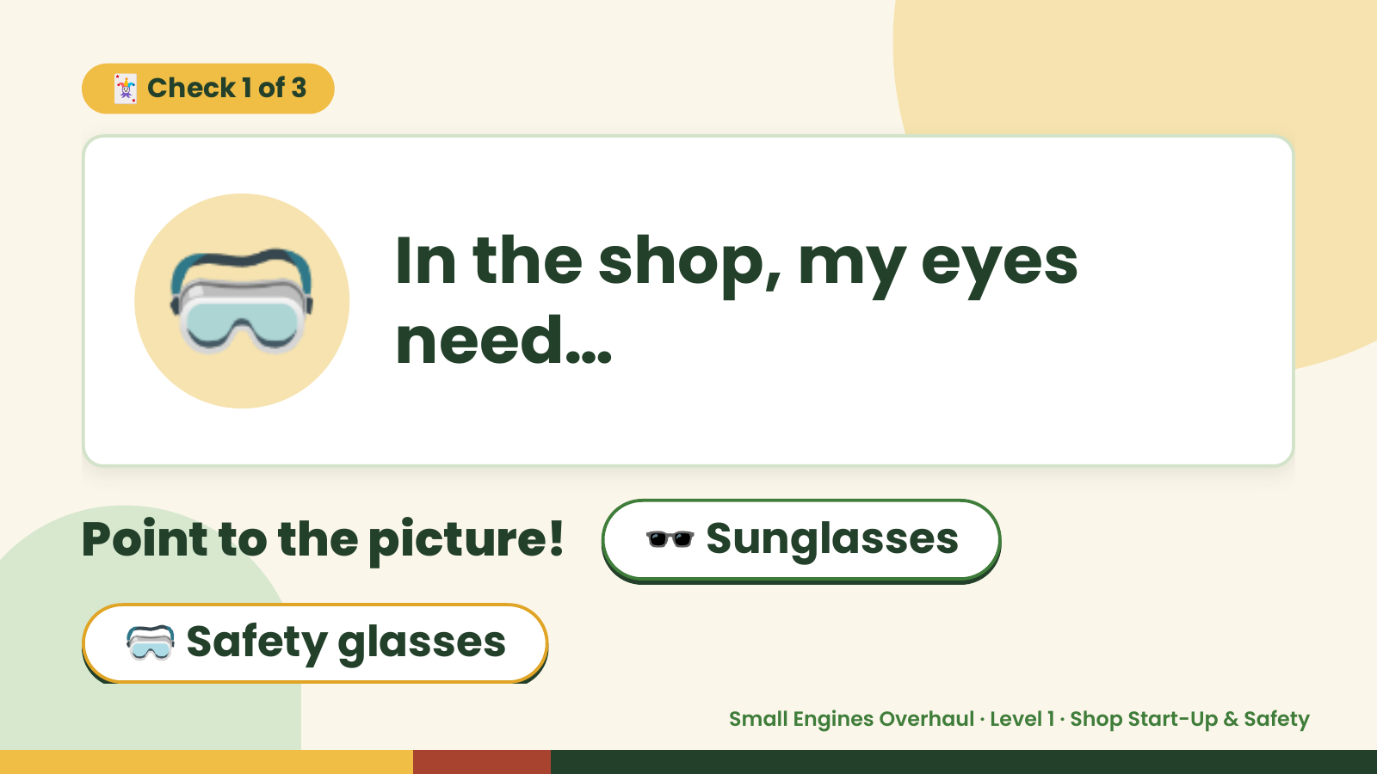
Notes:
🃏 Check 1 of 3
🥽 In the shop, my eyes
need…
Point to the picture! 🕶️ Sunglasses
🥽 Safety glasses
Small Engines Overhaul · Level 1 · Shop Start-Up & Safety

Slide 6
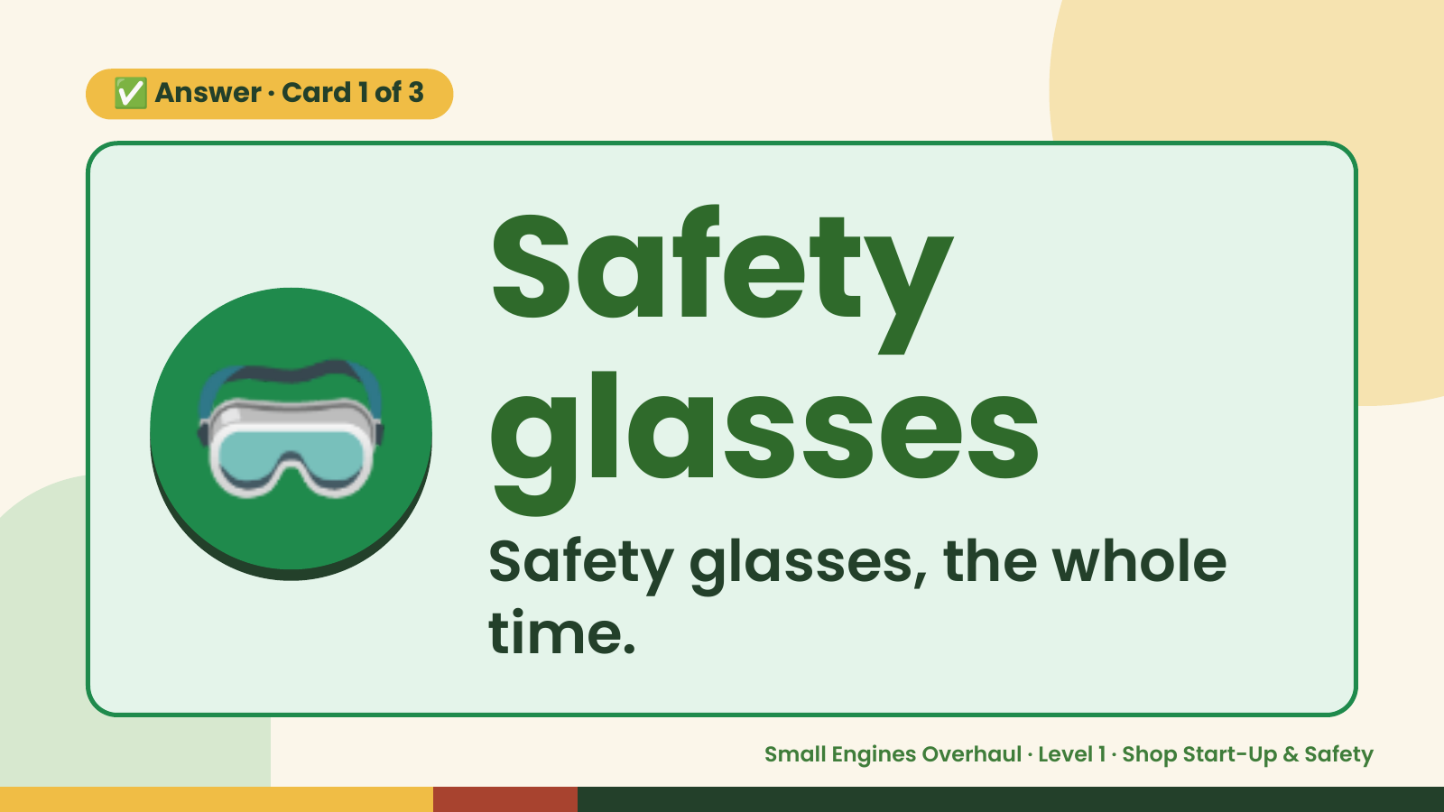
Notes:
✅ Answer · Card 1 of 3
🥽 Safety
glasses
Safety glasses, the whole
time.
Small Engines Overhaul · Level 1 · Shop Start-Up & Safety

Slide 7
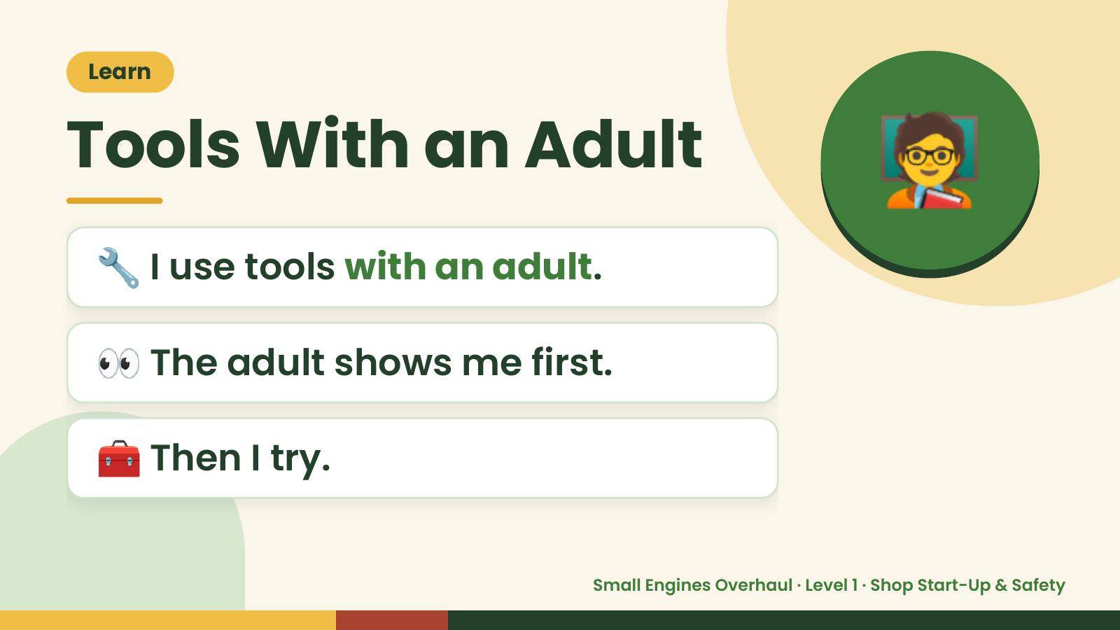
Notes:
🧑‍🏫
Learn
Tools With an Adult
🔧 I use tools with an adult.
👀 The adult shows me first.
🧰 Then I try.
Small Engines Overhaul · Level 1 · Shop Start-Up & Safety

Slide 8
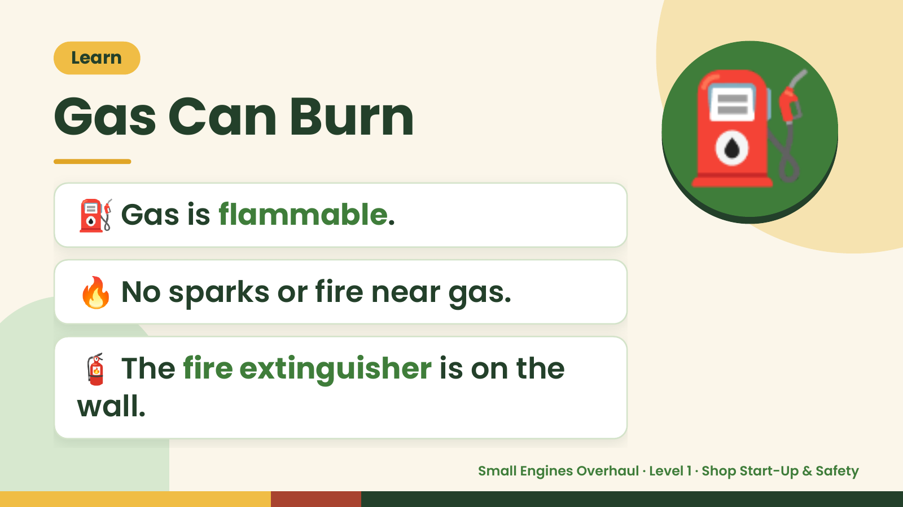
Notes:
Learn
Gas Can Burn
⛽ Gas is flammable.
⛽
🔥 No sparks or fire near gas.
🧯 The fire extinguisher is on the
wall.
Small Engines Overhaul · Level 1 · Shop Start-Up & Safety

Slide 9
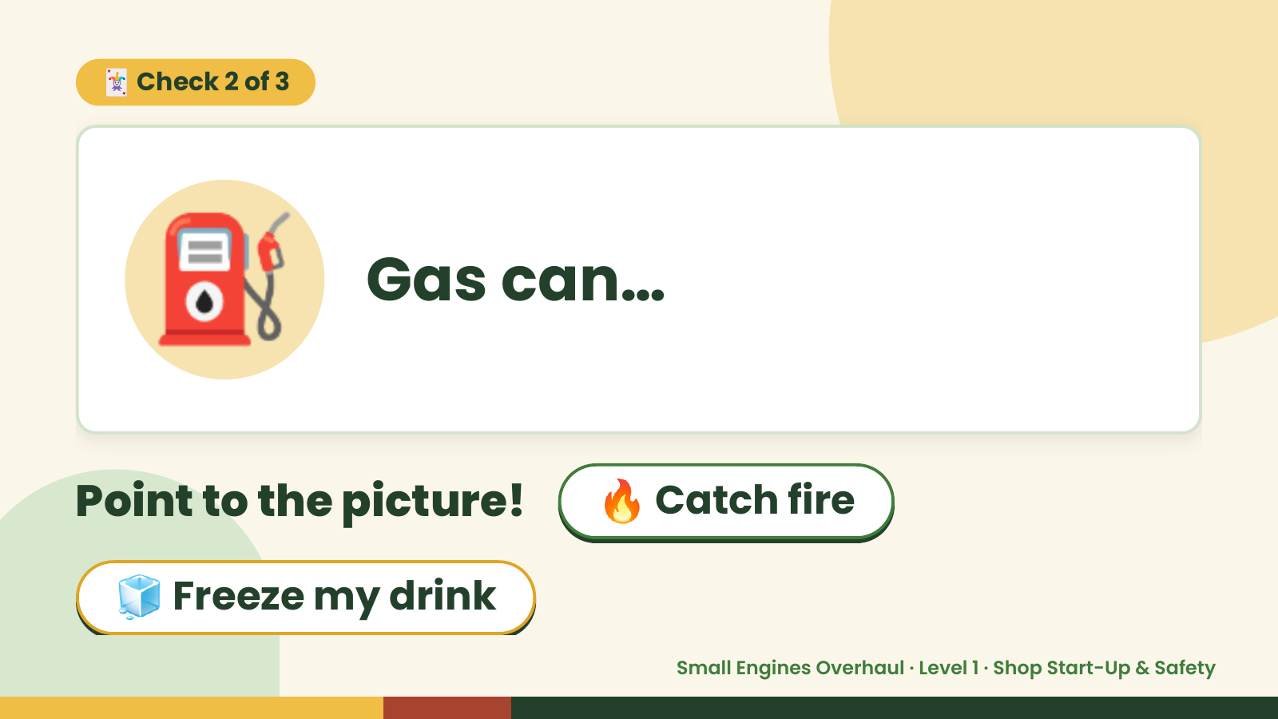
Notes:
🃏 Check 2 of 3
⛽ Gas can…
Point to the picture! 🔥 Catch fire
🧊 Freeze my drink
Small Engines Overhaul · Level 1 · Shop Start-Up & Safety

Slide 10
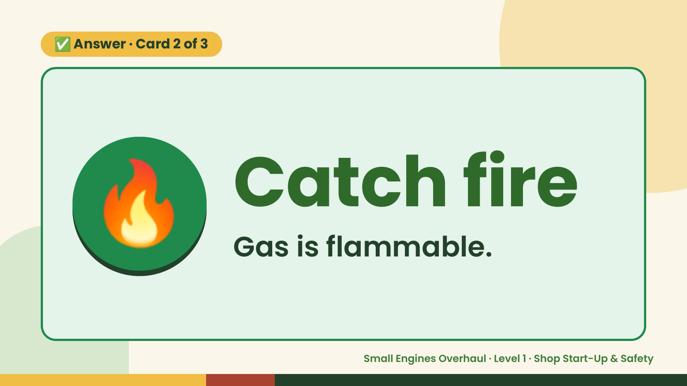
Notes:
✅ Answer · Card 2 of 3
🔥 Catch fire
Gas is flammable.
Small Engines Overhaul · Level 1 · Shop Start-Up & Safety

Slide 11
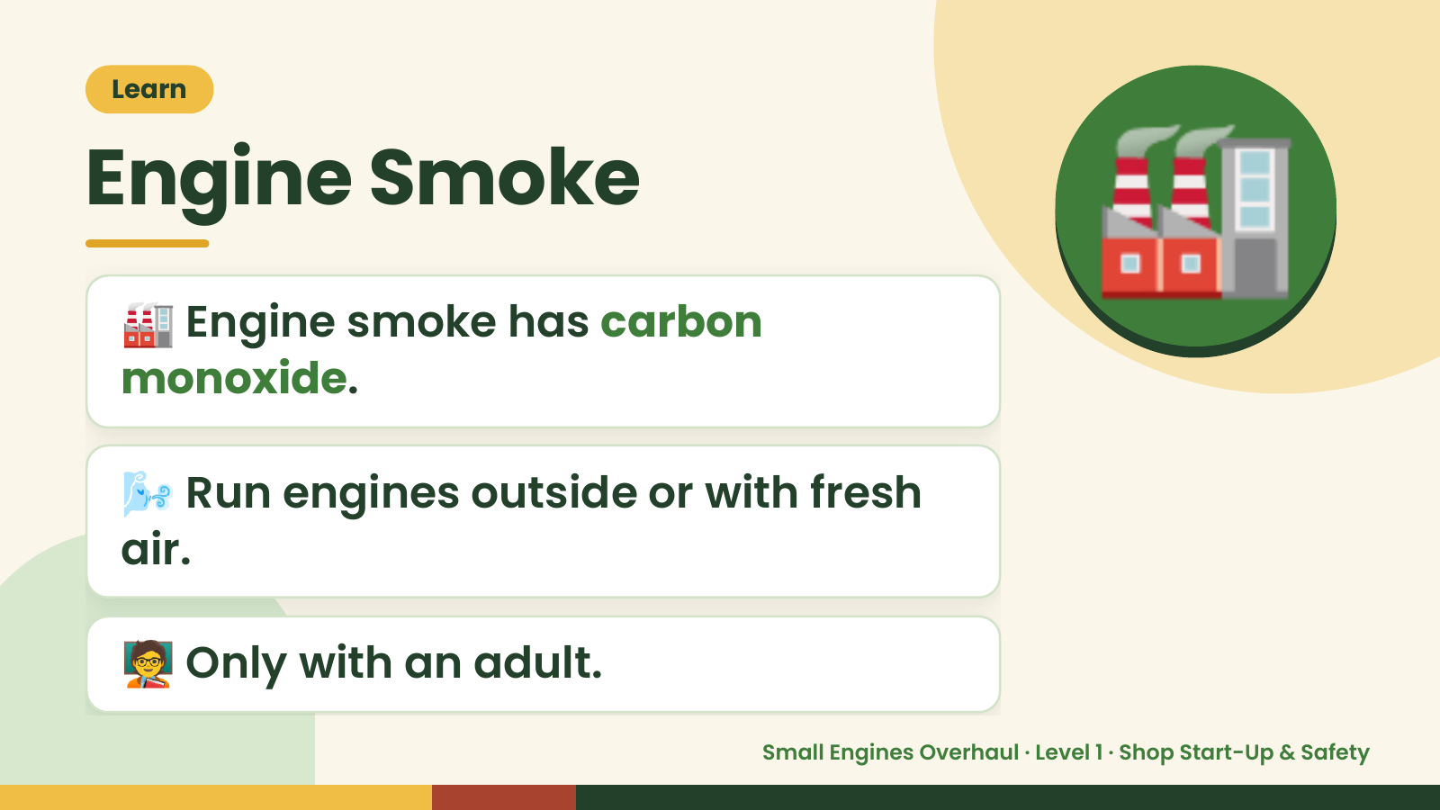
Notes:
Learn
Engine Smoke
🏭 Engine smoke has carbon
monoxide.
🏭
🌬️ Run engines outside or with fresh
air.
🧑‍🏫 Only with an adult.
Small Engines Overhaul · Level 1 · Shop Start-Up & Safety

Slide 12
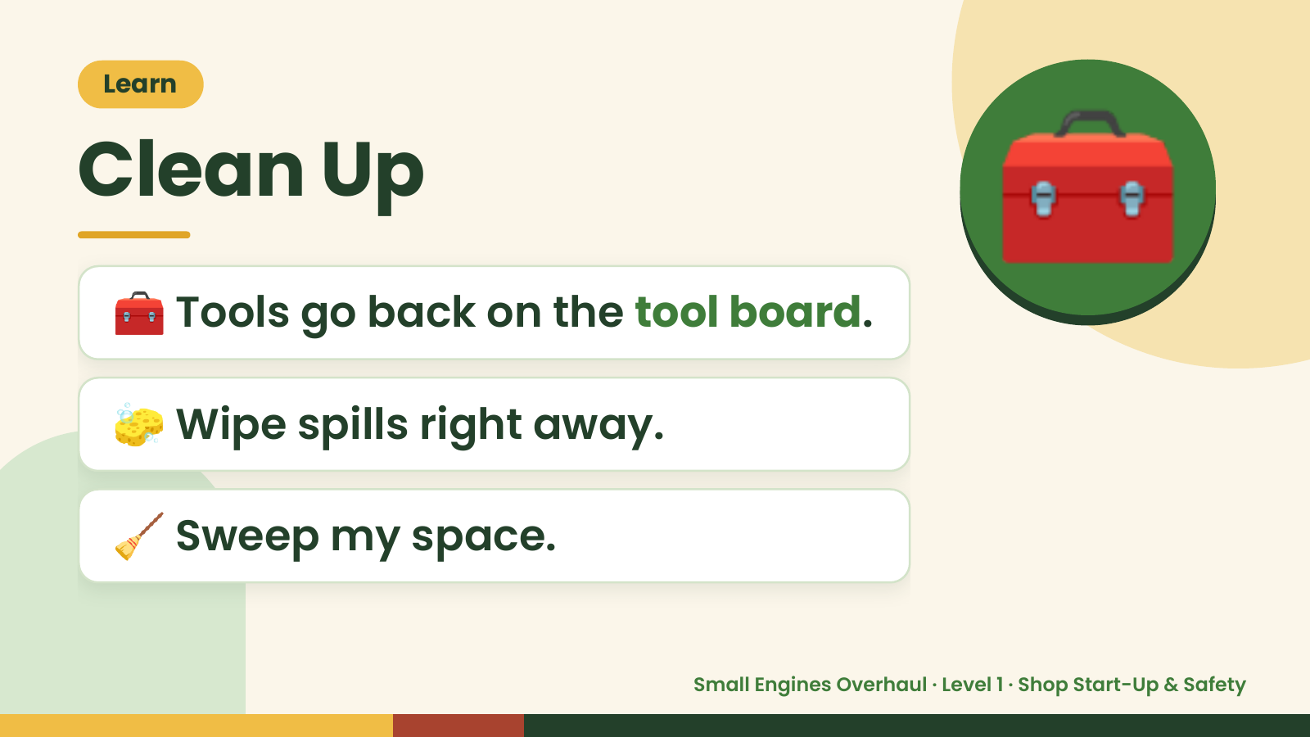
Notes:
Learn
Clean Up
🧰 Tools go back on the tool board.
🧰
🧽 Wipe spills right away.
🧹 Sweep my space.
Small Engines Overhaul · Level 1 · Shop Start-Up & Safety

Slide 13
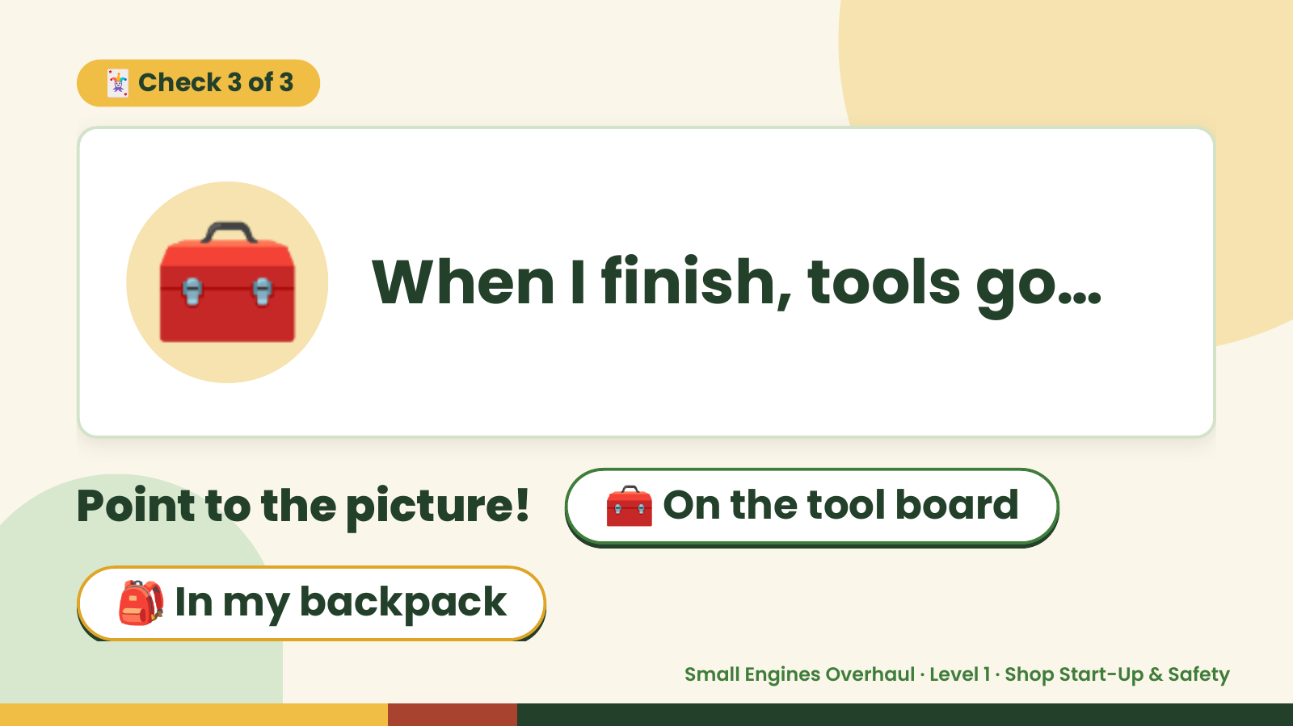
Notes:
🃏 Check 3 of 3
🧰 When I finish, tools go…
Point to the picture! 🧰 On the tool board
🎒 In my backpack
Small Engines Overhaul · Level 1 · Shop Start-Up & Safety

Slide 14
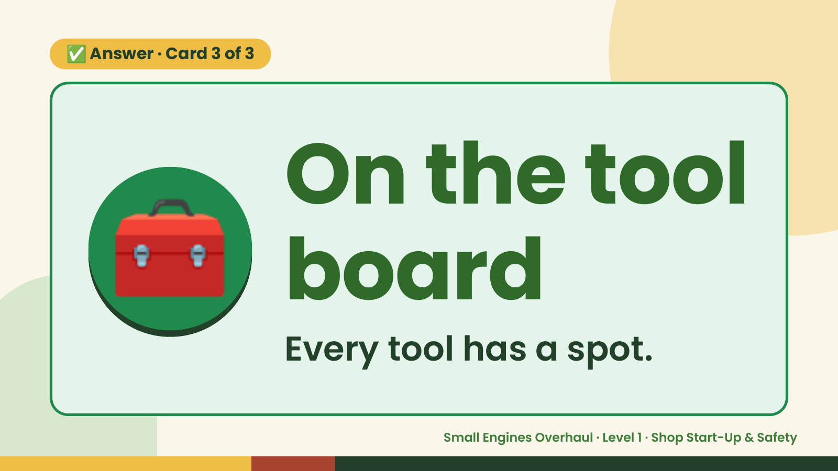
Notes:
✅ Answer · Card 3 of 3
🧰 On the tool
board
Every tool has a spot.
Small Engines Overhaul · Level 1 · Shop Start-Up & Safety

Slide 15
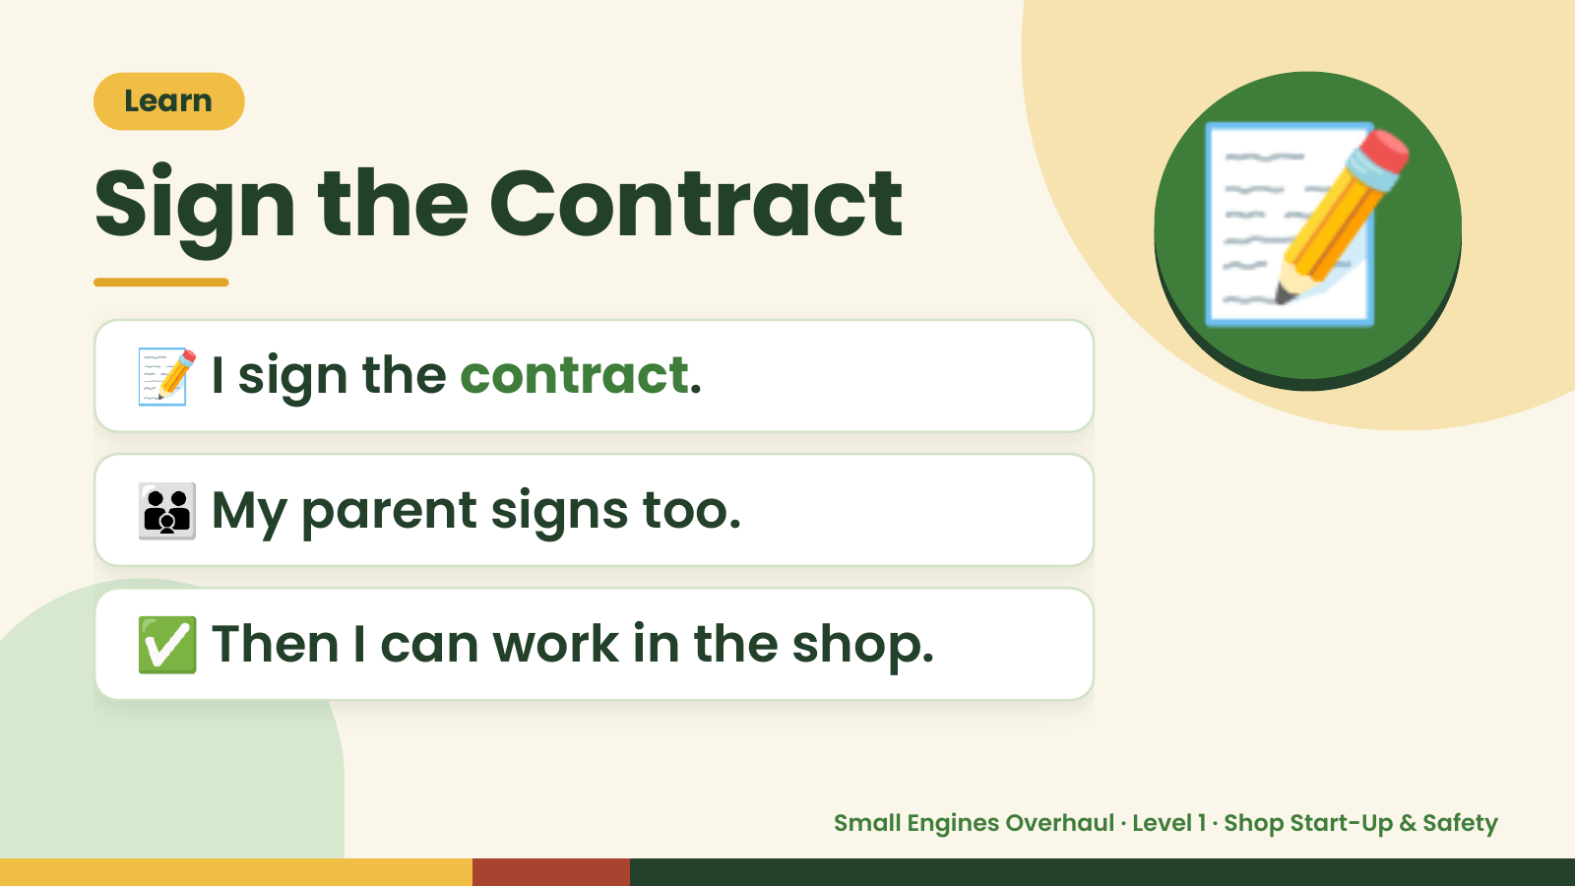
Notes:
Learn
Sign the Contract
📝 I sign the contract.
📝
👪 My parent signs too.
✅ Then I can work in the shop.
Small Engines Overhaul · Level 1 · Shop Start-Up & Safety

Slide 16
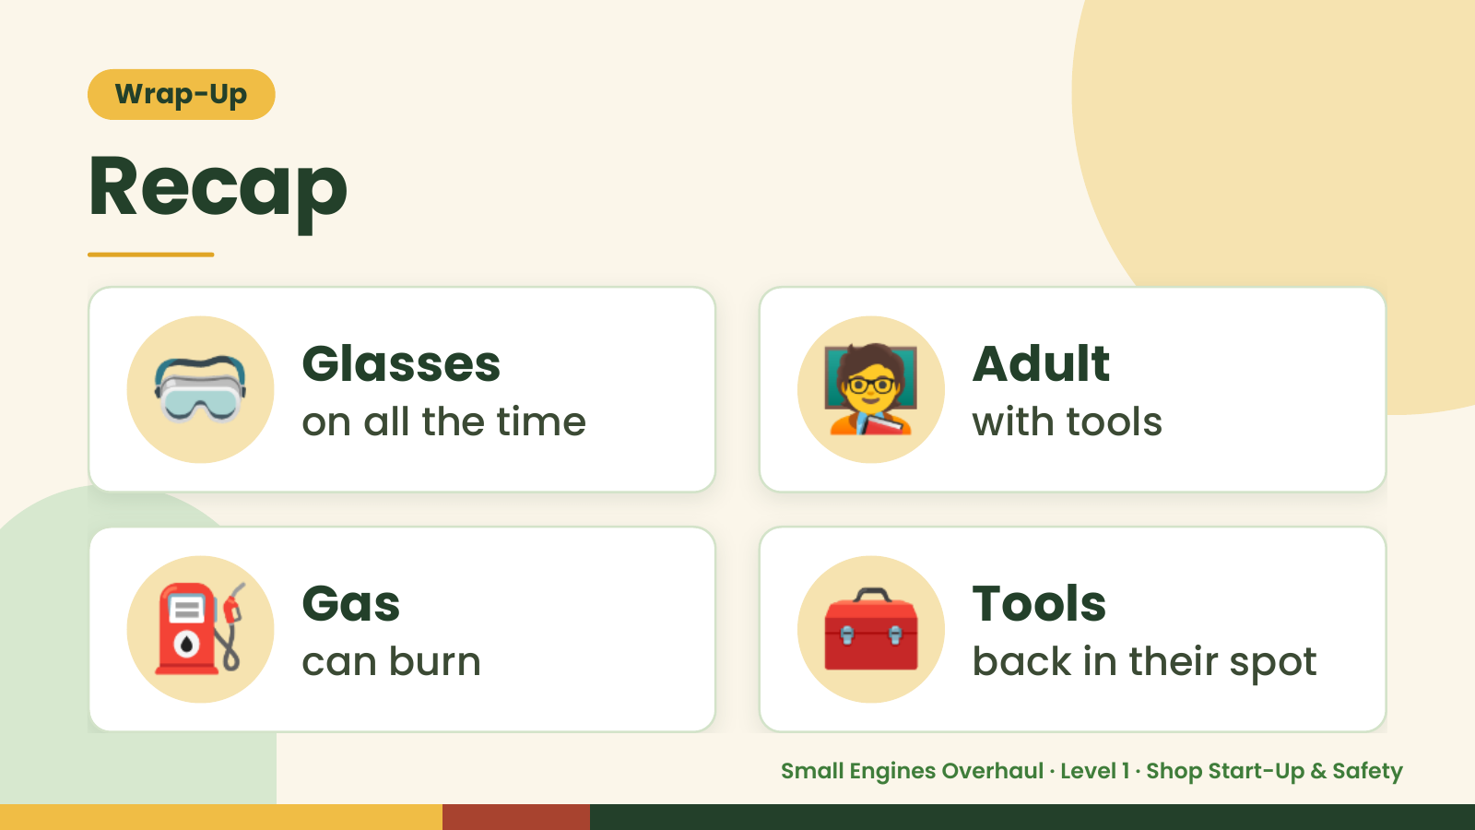
Notes:
Wrap-Up
Recap
🥽 Glasses
on all the time 🧑‍🏫 Adult
with tools
⛽ Gas
can burn 🧰 Tools
back in their spot
Small Engines Overhaul · Level 1 · Shop Start-Up & Safety

Slide 17
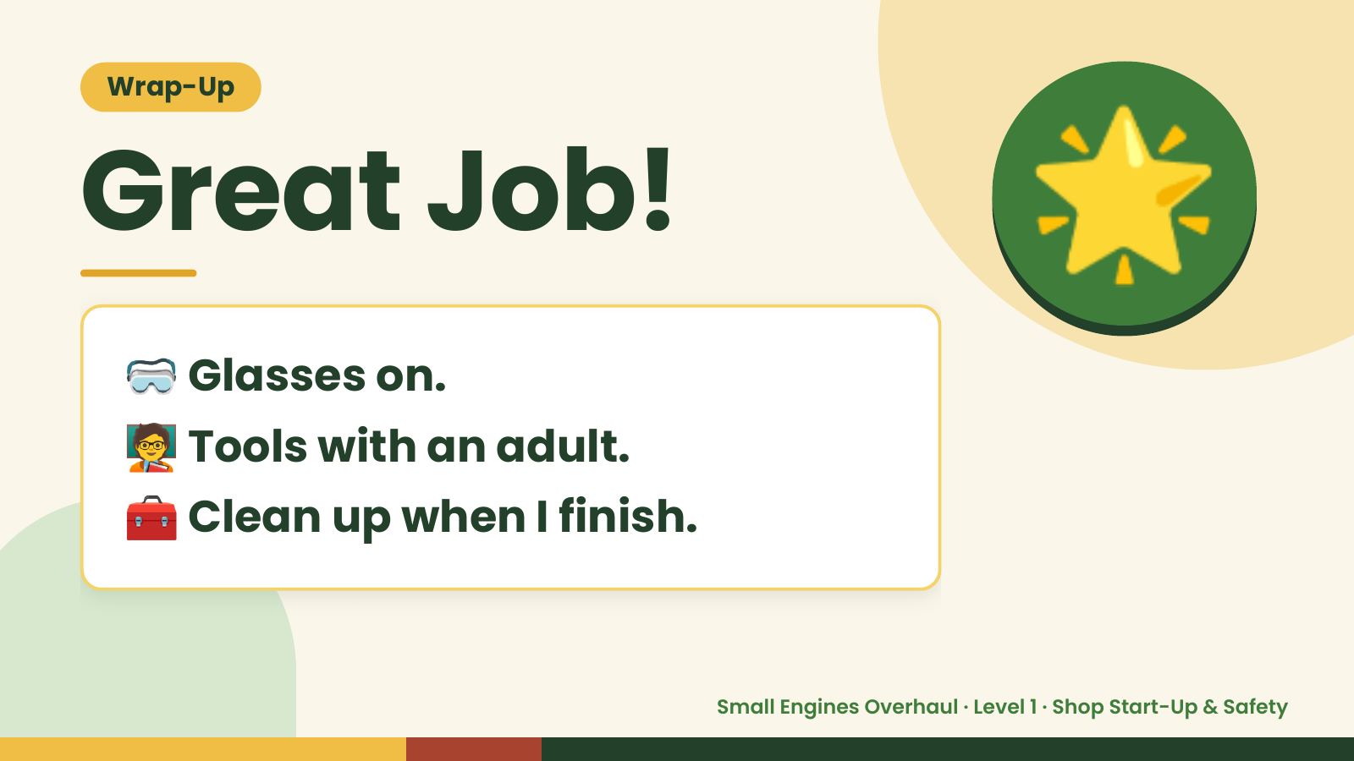
Notes:
Wrap-Up
Great Job!
🥽 Glasses on.
🌟
🧑‍🏫Tools with an adult.
🧰 Clean up when I finish.
Small Engines Overhaul · Level 1 · Shop Start-Up & Safety

