Slide 1
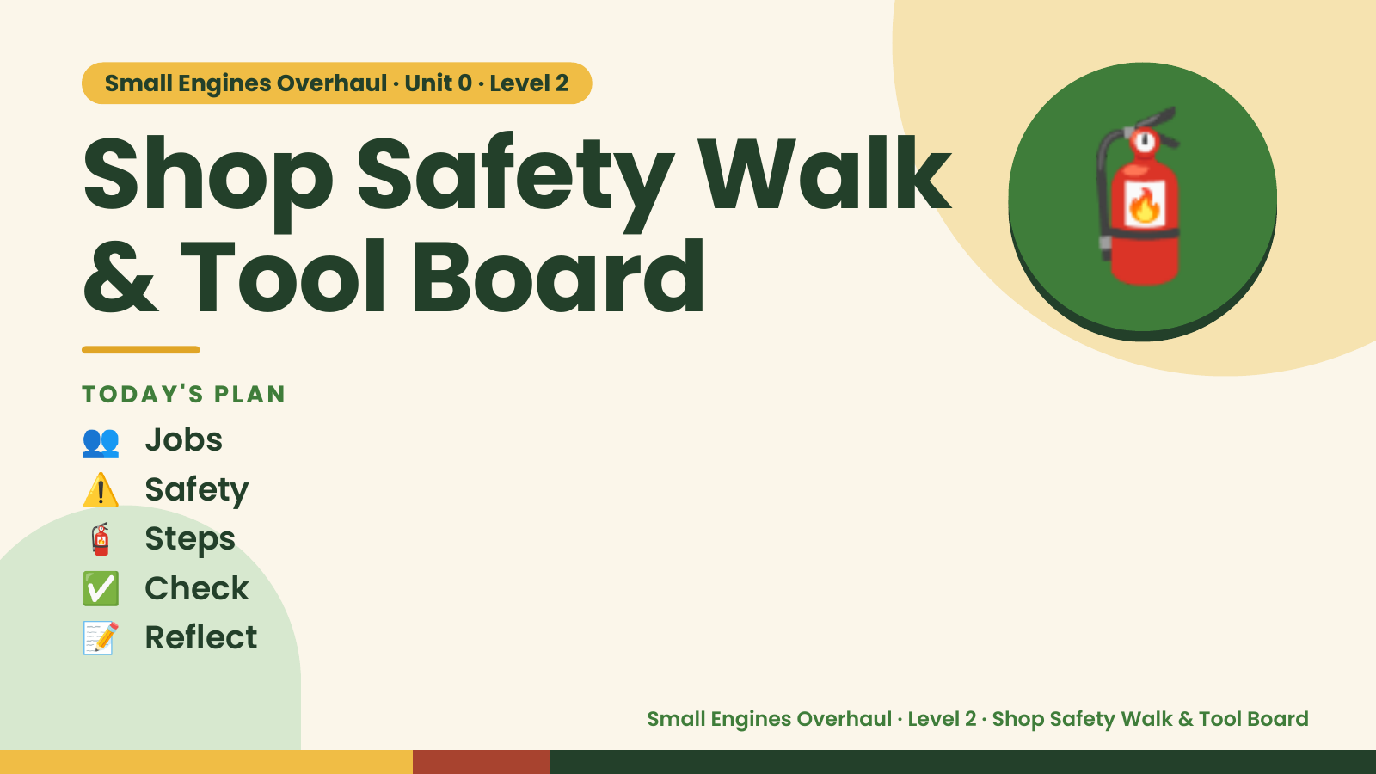
Notes:
Small Engines Overhaul · Unit 0 · Level 2
Shop Safety Walk
& Tool Board
👥 Jobs
TODAY'S PLAN
🧯
⚠️ Safety
🧯 Steps
✅ Check
📝 Reflect
Small Engines Overhaul · Level 2 · Shop Safety Walk & Tool Board

Slide 2
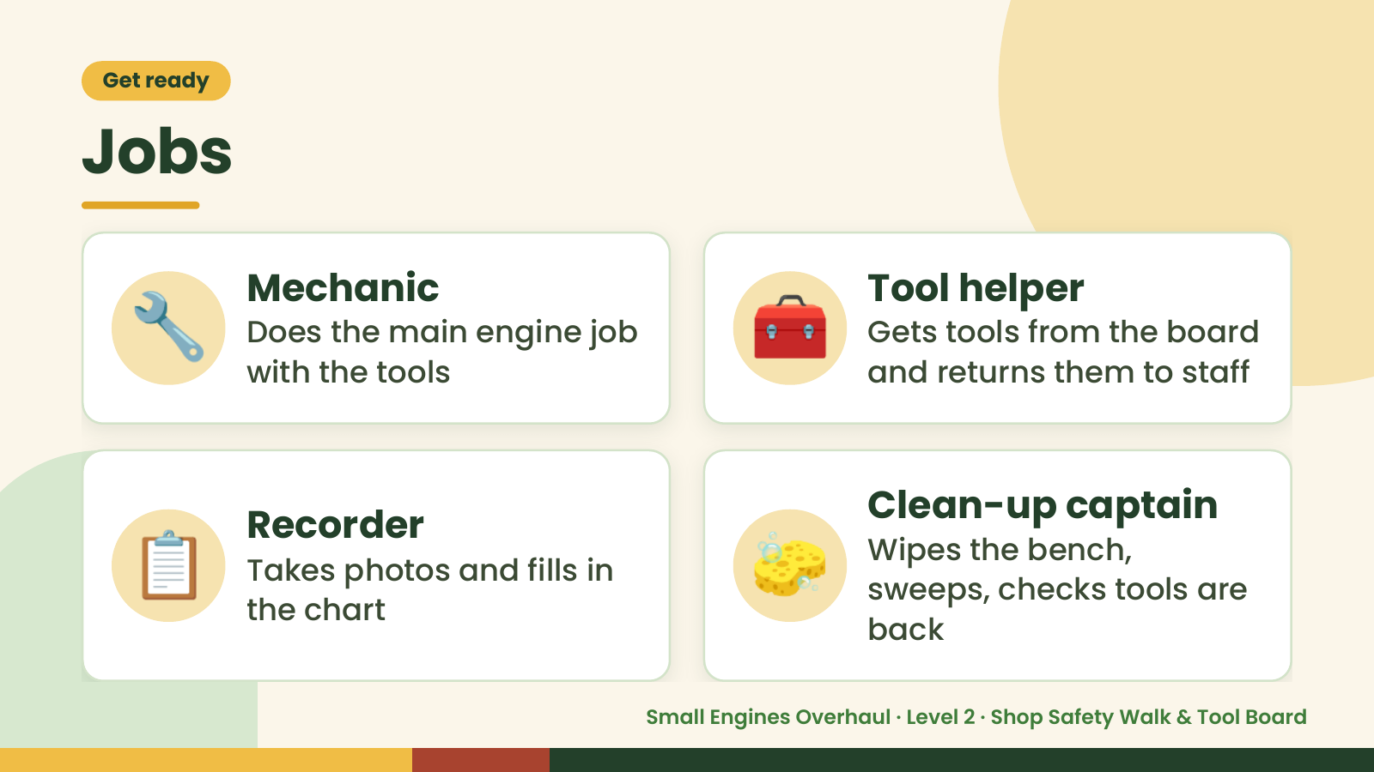
Notes:
Get ready
Jobs
🔧 Mechanic
Does the main engine job
with the tools
🧰 Tool helper
Gets tools from the board
and returns them to staff
📋 Recorder
Takes photos and fills in
the chart
🧽 Clean-up captain
Wipes the bench,
sweeps, checks tools are
back
Small Engines Overhaul · Level 2 · Shop Safety Walk & Tool Board

Slide 3
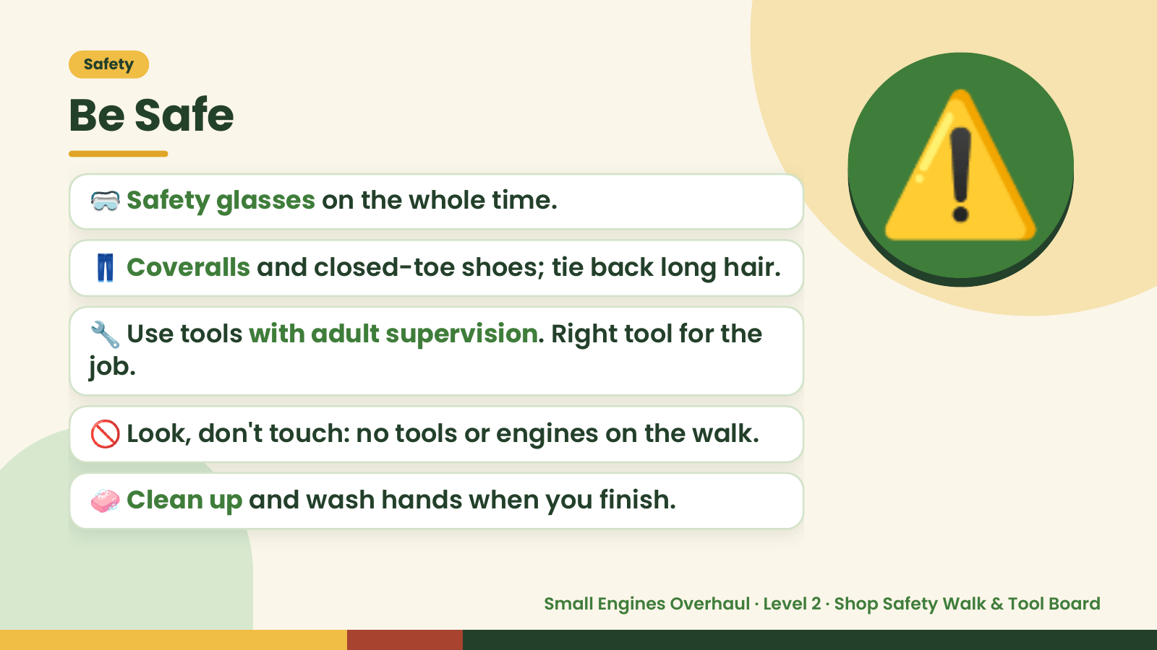
Notes:
Safety
Be Safe
🥽 Safety glasses on the whole time.
👖 Coveralls and closed-toe shoes; tie back long hair.
🔧 Use tools with adult supervision. Right tool for the
job.
⚠️
🚫 Look, don't touch: no tools or engines on the walk.
🧼 Clean up and wash hands when you finish.
Small Engines Overhaul · Level 2 · Shop Safety Walk & Tool Board

Slide 4
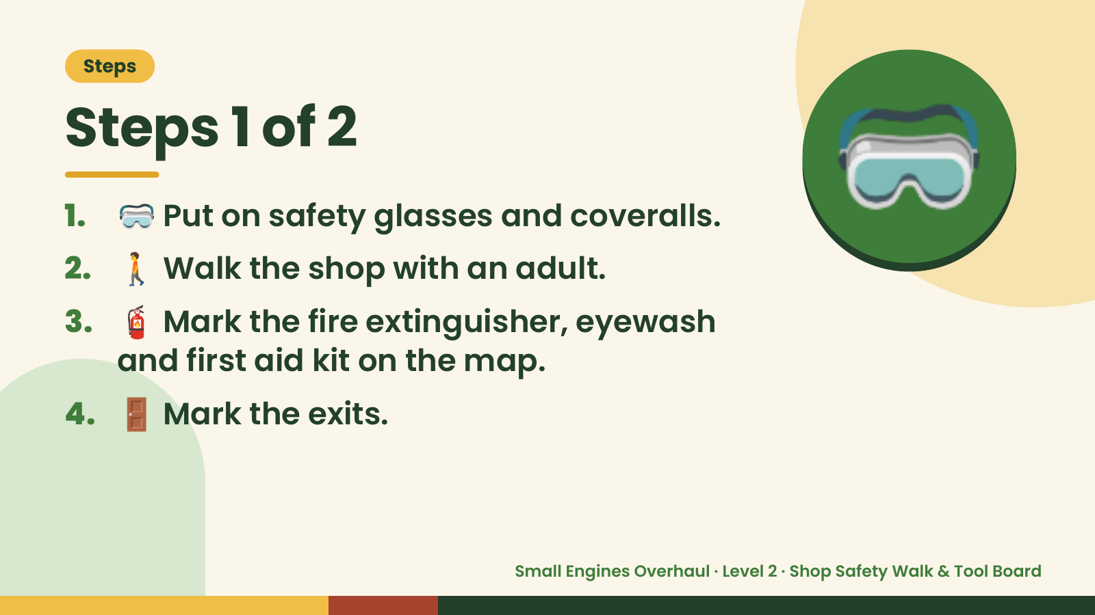
Notes:
Steps
Steps 1 of 2
1. 🥽 Put on safety glasses and coveralls.
2. 🚶 Walk the shop with an adult.
3. 🧯 Mark the fire extinguisher, eyewash
🥽
and first aid kit on the map.
4. 🚪 Mark the exits.
Small Engines Overhaul · Level 2 · Shop Safety Walk & Tool Board

Slide 5
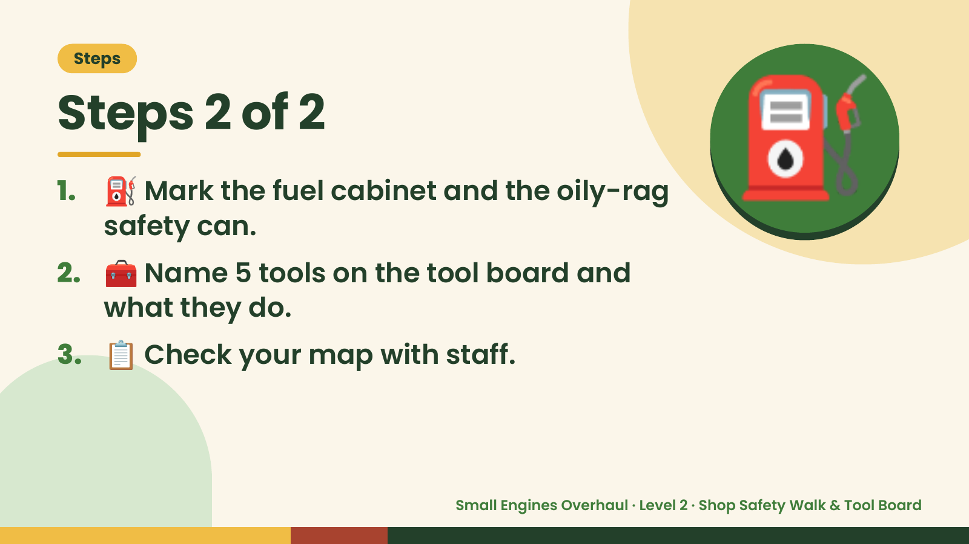
Notes:
Steps
Steps 2 of 2
1. ⛽ Mark the fuel cabinet and the oily-rag
safety can.
2. 🧰 Name 5 tools on the tool board and
what they do.
⛽
3. 📋 Check your map with staff.
Small Engines Overhaul · Level 2 · Shop Safety Walk & Tool Board

Slide 6
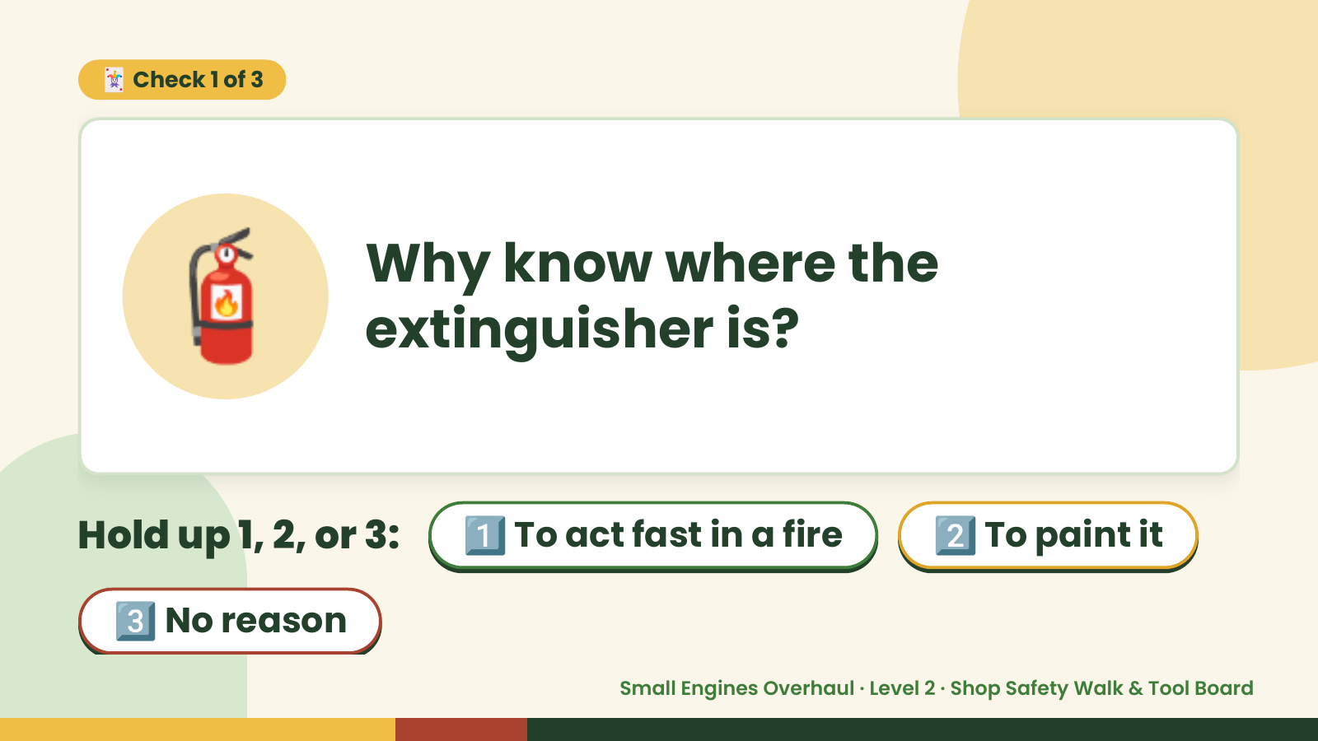
Notes:
🃏 Check 1 of 3
🧯 Why know where the
extinguisher is?
Hold up 1, 2, or 3: 1️⃣ To act fast in a fire 2️⃣ To paint it
3️⃣ No reason
Small Engines Overhaul · Level 2 · Shop Safety Walk & Tool Board

Slide 7
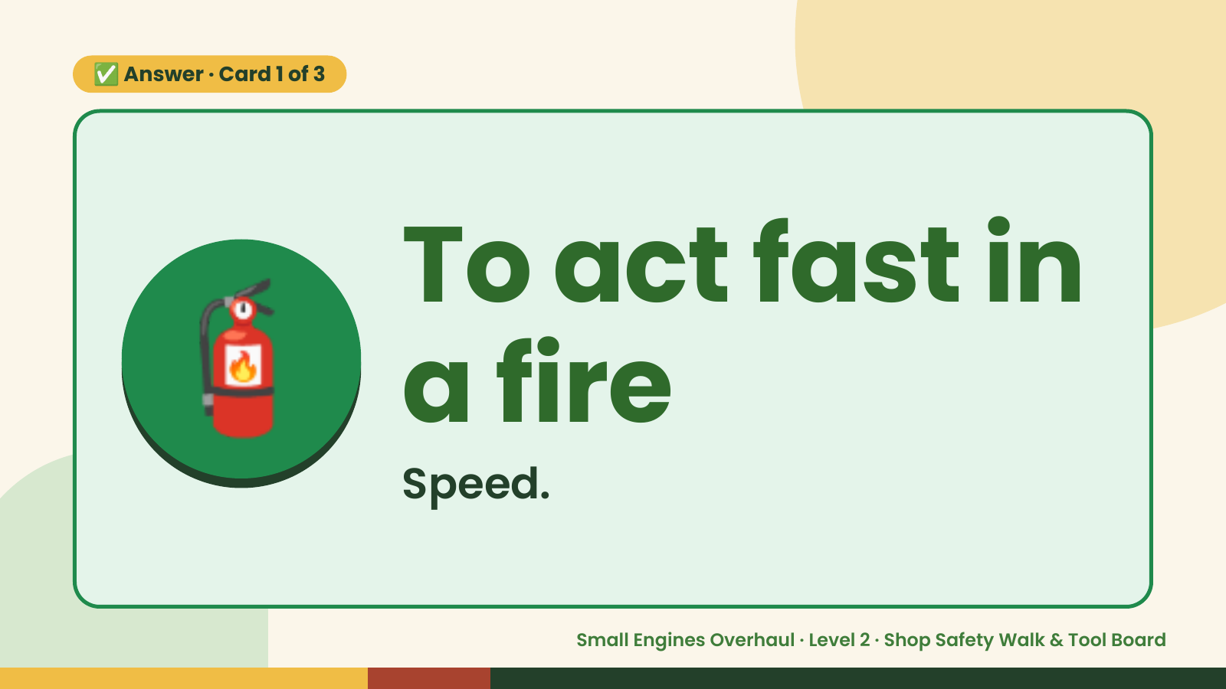
Notes:
✅ Answer · Card 1 of 3
🧯 To act fast in
a fire
Speed.
Small Engines Overhaul · Level 2 · Shop Safety Walk & Tool Board

Slide 8
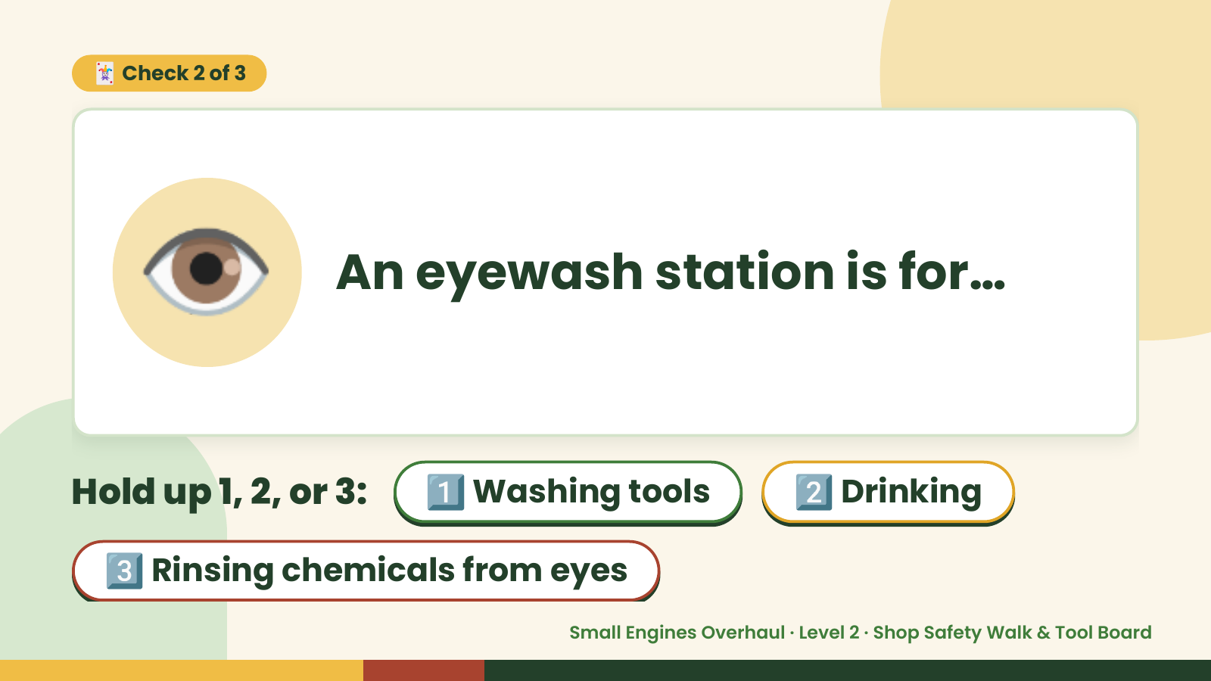
Notes:
🃏 Check 2 of 3
👁️ An eyewash station is for…
Hold up 1, 2, or 3: 1️⃣ Washing tools 2️⃣ Drinking
3️⃣ Rinsing chemicals from eyes
Small Engines Overhaul · Level 2 · Shop Safety Walk & Tool Board

Slide 9

Notes:
✅ Answer · Card 2 of 3
👁️ Rinsing
chemicals
from eyes
Flush eyes.
Small Engines Overhaul · Level 2 · Shop Safety Walk & Tool Board

Slide 10
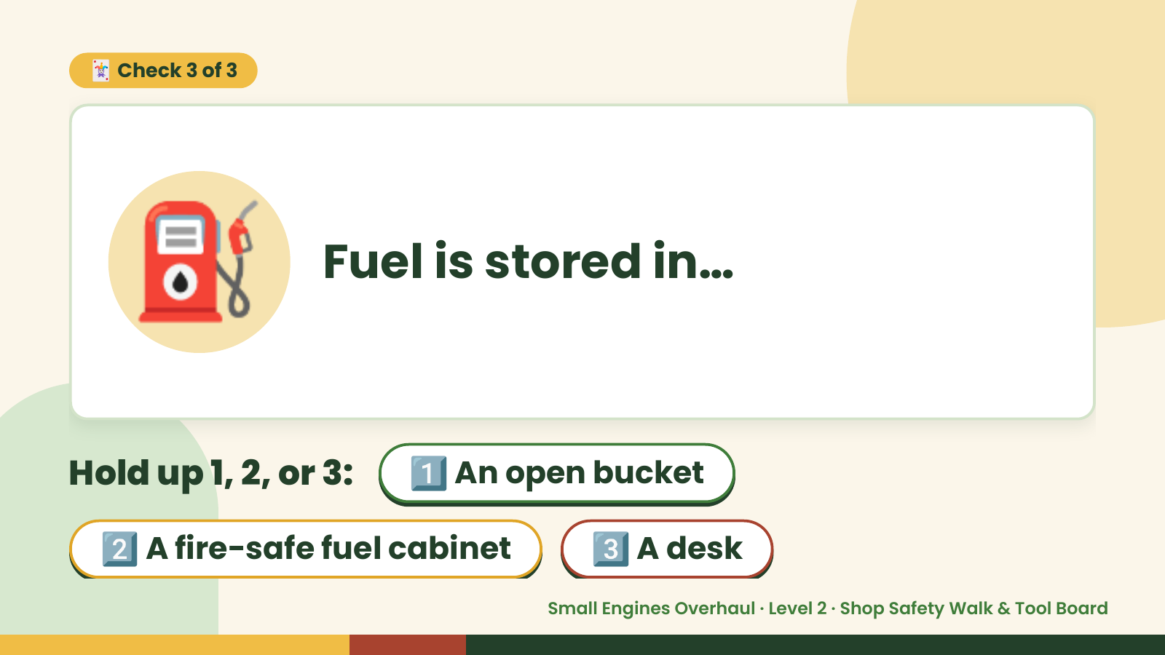
Notes:
🃏 Check 3 of 3
⛽ Fuel is stored in…
Hold up 1, 2, or 3: 1️⃣ An open bucket
2️⃣ A fire-safe fuel cabinet 3️⃣ A desk
Small Engines Overhaul · Level 2 · Shop Safety Walk & Tool Board

Slide 11
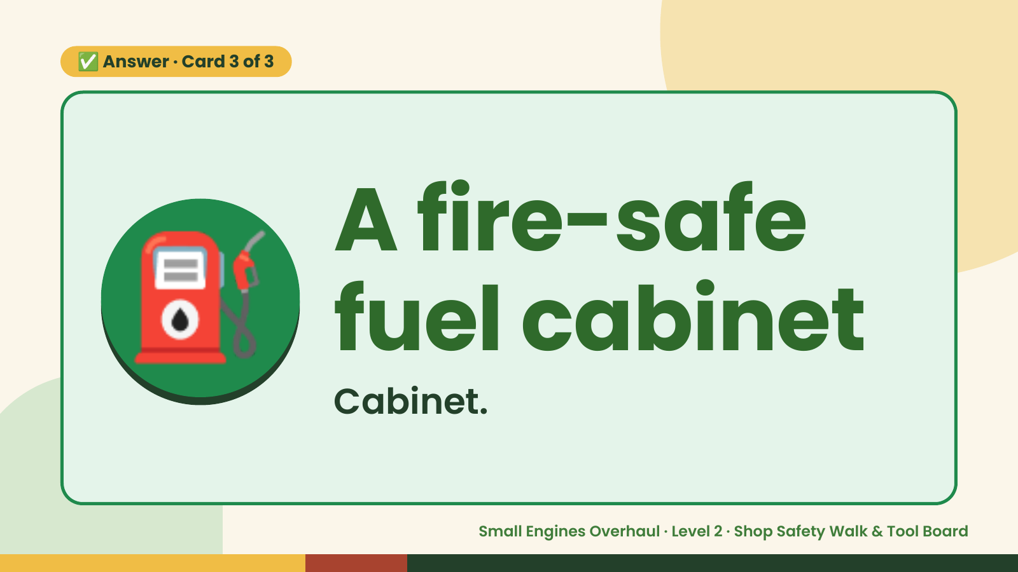
Notes:
✅ Answer · Card 3 of 3
⛽ A fire-safe
fuel cabinet
Cabinet.
Small Engines Overhaul · Level 2 · Shop Safety Walk & Tool Board

Slide 12

Notes:
Wrap-Up
Clean Up +
Reflect
🧽
Return and count tools.
Sweep and wipe your bench.
Wash hands, then do the reflection.
Small Engines Overhaul · Level 2 · Shop Safety Walk & Tool Board

