Slide 1
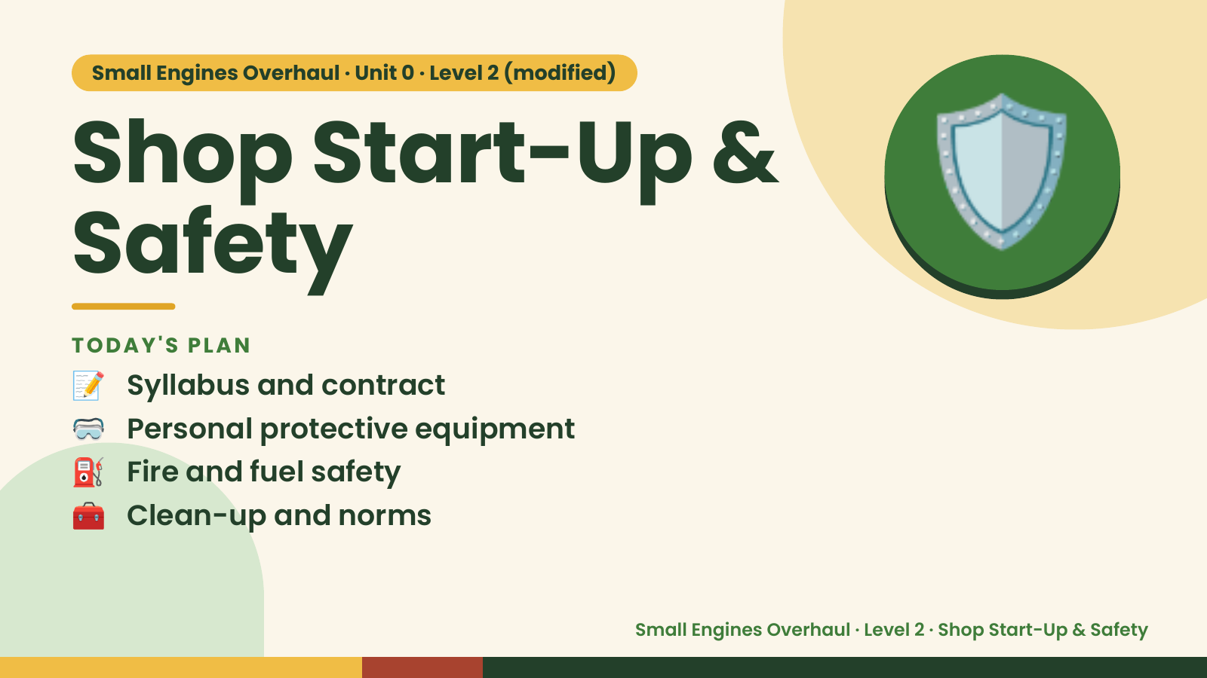
Notes:
Small Engines Overhaul · Unit 0 · Level 2 (modified)
Shop Start-Up &
Safety
📝 Syllabus and contract
TODAY'S PLAN
🛡️
🥽 Personal protective equipment
⛽ Fire and fuel safety
🧰 Clean-up and norms
Small Engines Overhaul · Level 2 · Shop Start-Up & Safety

Slide 2
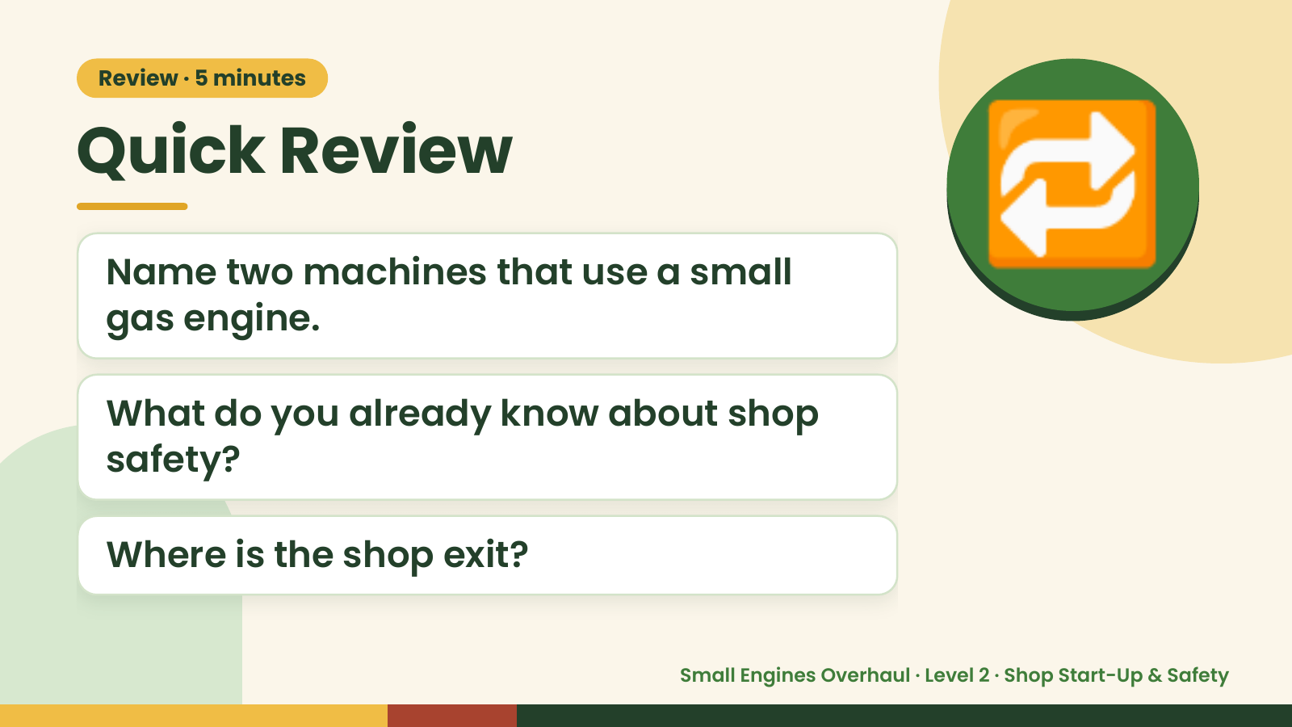
Notes:
Review · 5 minutes
Quick Review
Name two machines that use a small
gas engine.
🔁
What do you already know about shop
safety?
Where is the shop exit?
Small Engines Overhaul · Level 2 · Shop Start-Up & Safety

Slide 3
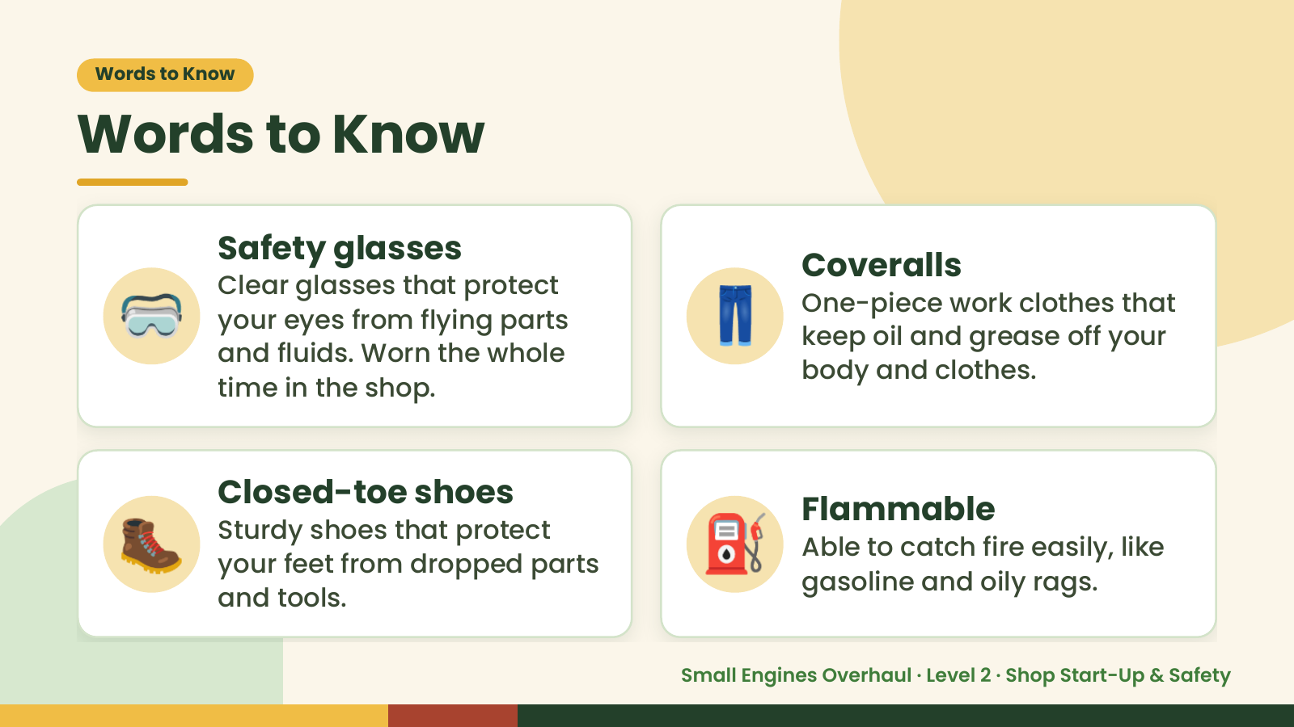
Notes:
Words to Know
Words to Know
🥽 👖
Safety glasses
Coveralls
Clear glasses that protect
One-piece work clothes that
your eyes from flying parts
keep oil and grease off your
and fluids. Worn the whole
body and clothes.
time in the shop.
🥾 Closed-toe shoes
Sturdy shoes that protect
your feet from dropped parts
and tools.
⛽ Flammable
Able to catch fire easily, like
gasoline and oily rags.
Small Engines Overhaul · Level 2 · Shop Start-Up & Safety

Slide 4
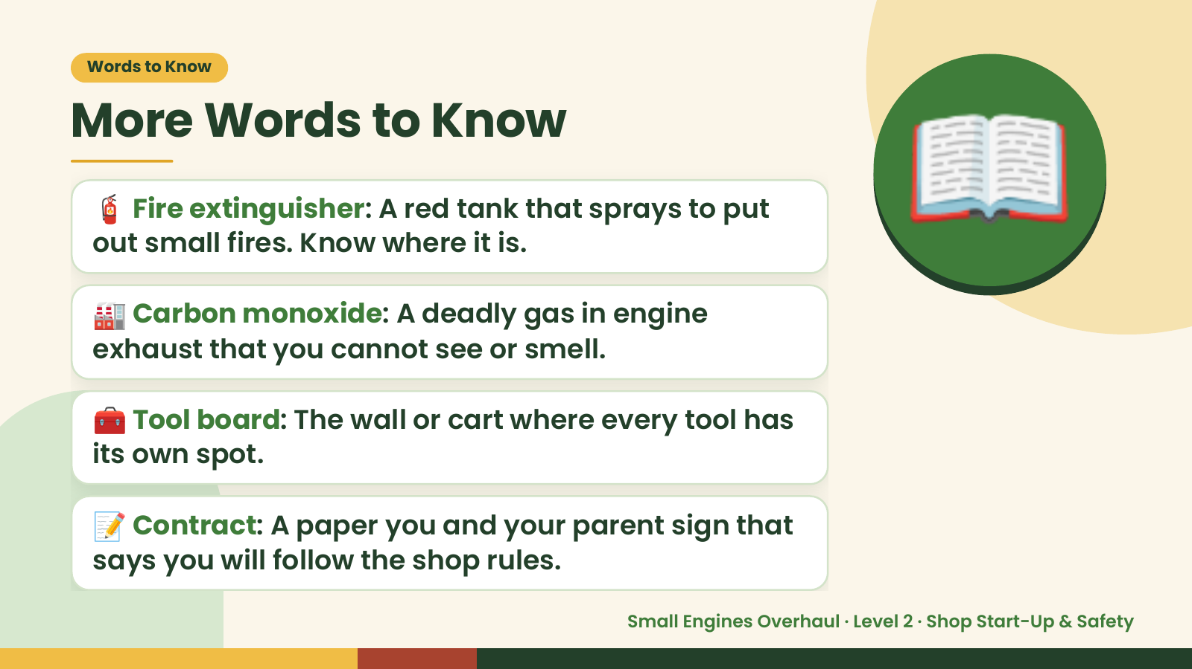
Notes:
Words to Know
More Words to Know
🧯 Fire extinguisher: A red tank that sprays to put
out small fires. Know where it is.
🏭 Carbon monoxide: A deadly gas in engine
exhaust that you cannot see or smell.
📖
🧰 Tool board: The wall or cart where every tool has
its own spot.
📝 Contract: A paper you and your parent sign that
says you will follow the shop rules.
Small Engines Overhaul · Level 2 · Shop Start-Up & Safety

Slide 5
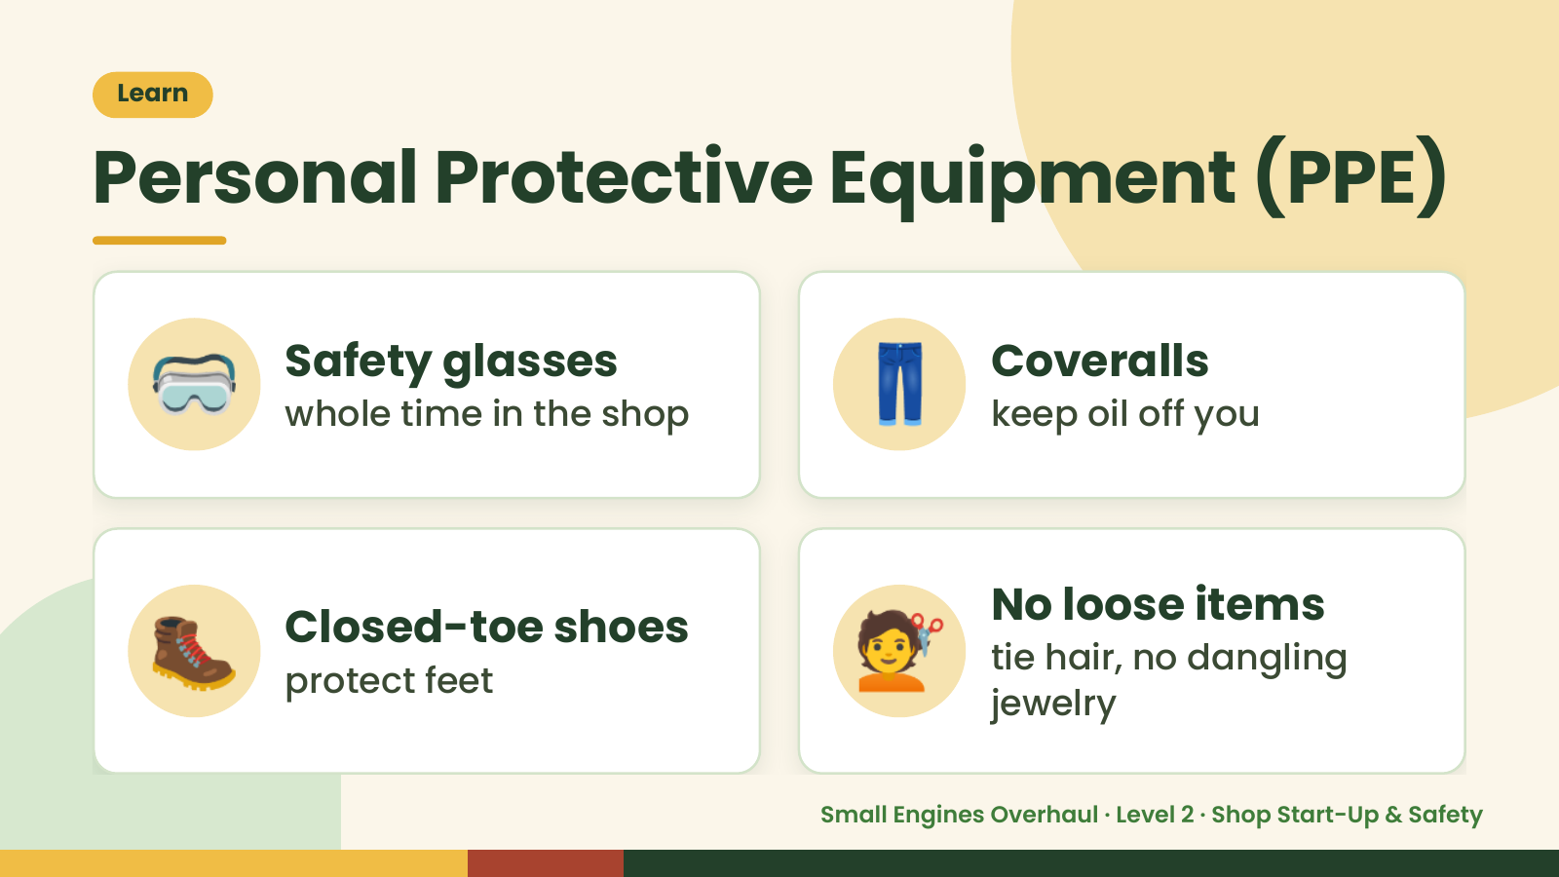
Notes:
Learn
Personal Protective Equipment (PPE)
🥽 Safety glasses
whole time in the shop 👖 Coveralls
keep oil off you
🥾 Closed-toe shoes
protect feet 💇 No loose items
tie hair, no dangling
jewelry
Small Engines Overhaul · Level 2 · Shop Start-Up & Safety

Slide 6
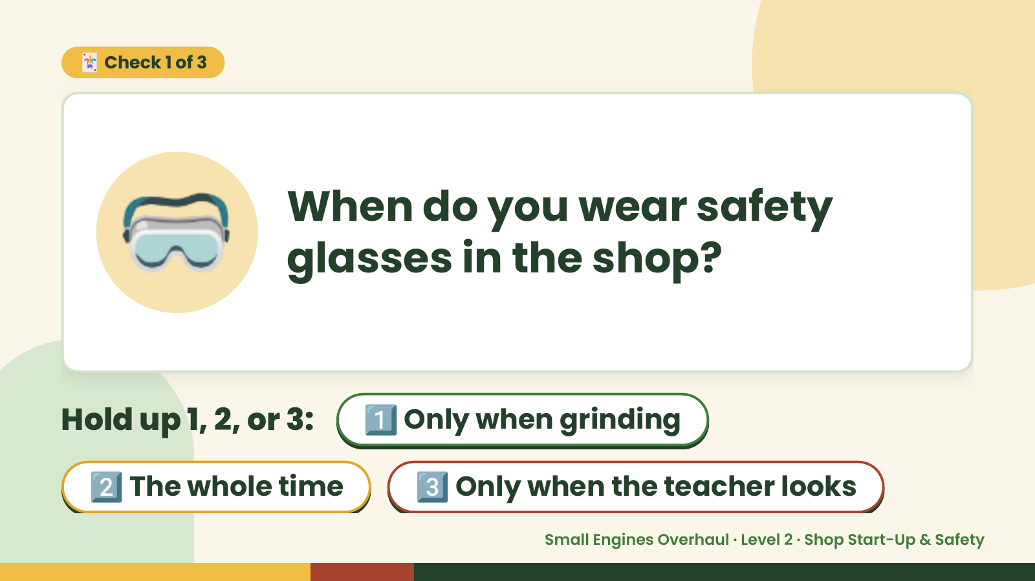
Notes:
🃏 Check 1 of 3
🥽 When do you wear safety
glasses in the shop?
Hold up 1, 2, or 3: 1️⃣ Only when grinding
2️⃣ The whole time 3️⃣ Only when the teacher looks
Small Engines Overhaul · Level 2 · Shop Start-Up & Safety

Slide 7
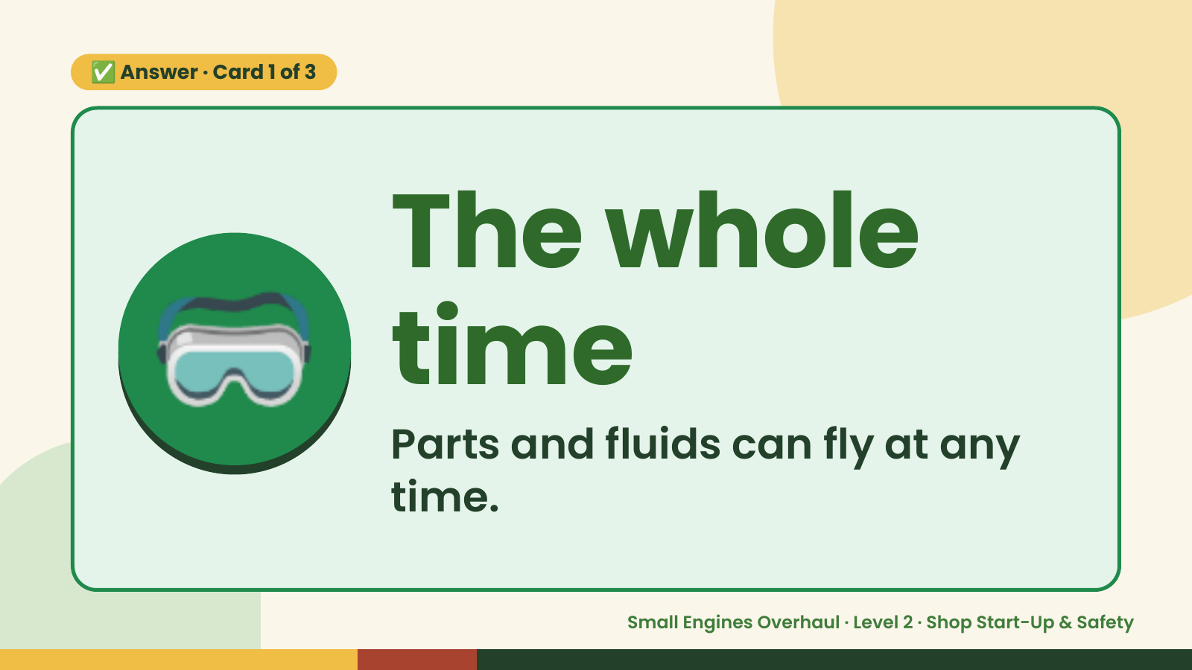
Notes:
✅ Answer · Card 1 of 3
🥽 The whole
time
Parts and fluids can fly at any
time.
Small Engines Overhaul · Level 2 · Shop Start-Up & Safety

Slide 8
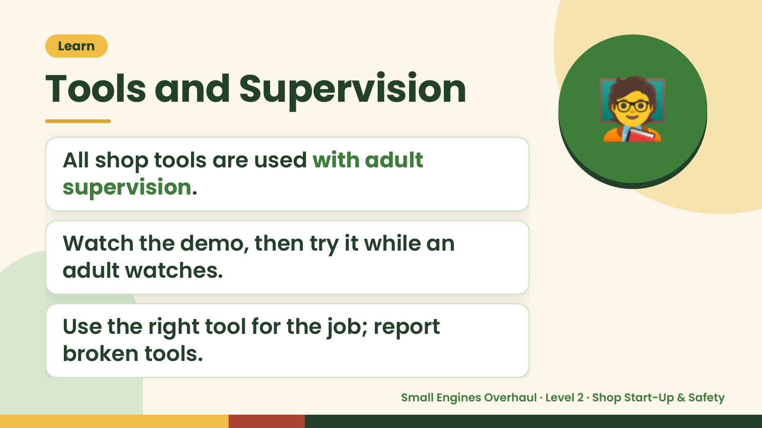
Notes:
🧑‍🏫
Learn
Tools and Supervision
All shop tools are used with adult
supervision.
Watch the demo, then try it while an
adult watches.
Use the right tool for the job; report
broken tools.
Small Engines Overhaul · Level 2 · Shop Start-Up & Safety

Slide 9
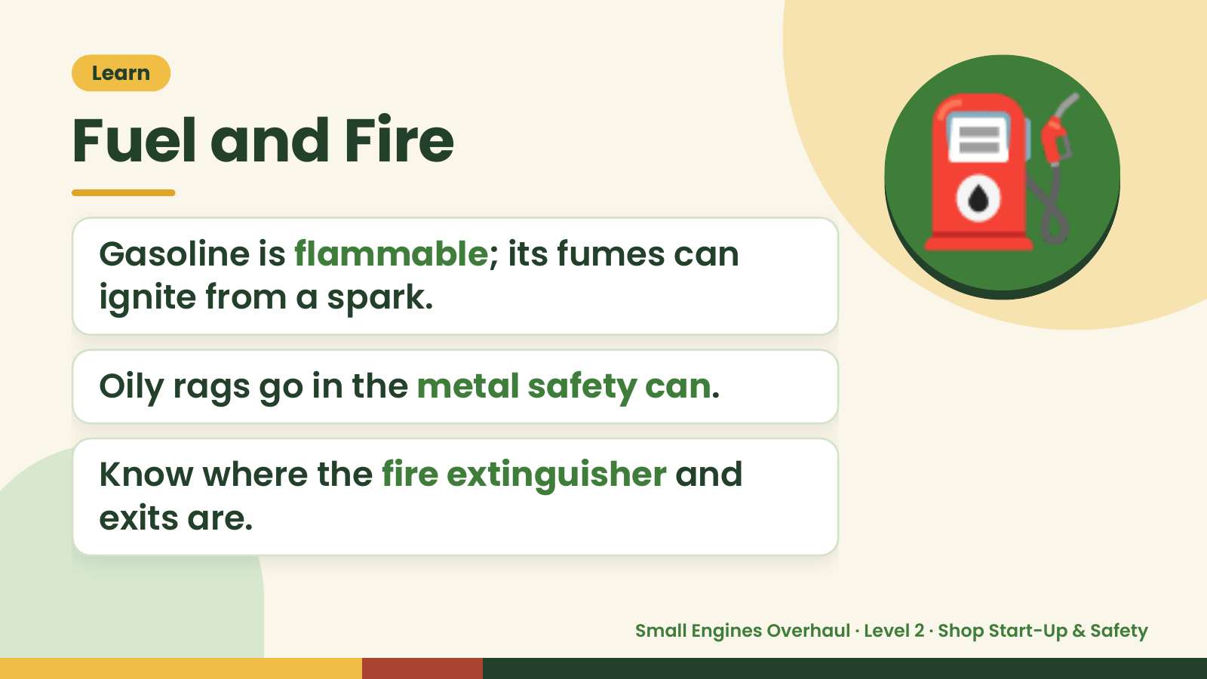
Notes:
Learn
Fuel and Fire
Gasoline is flammable; its fumes can
ignite from a spark.
⛽
Oily rags go in the metal safety can.
Know where the fire extinguisher and
exits are.
Small Engines Overhaul · Level 2 · Shop Start-Up & Safety

Slide 10
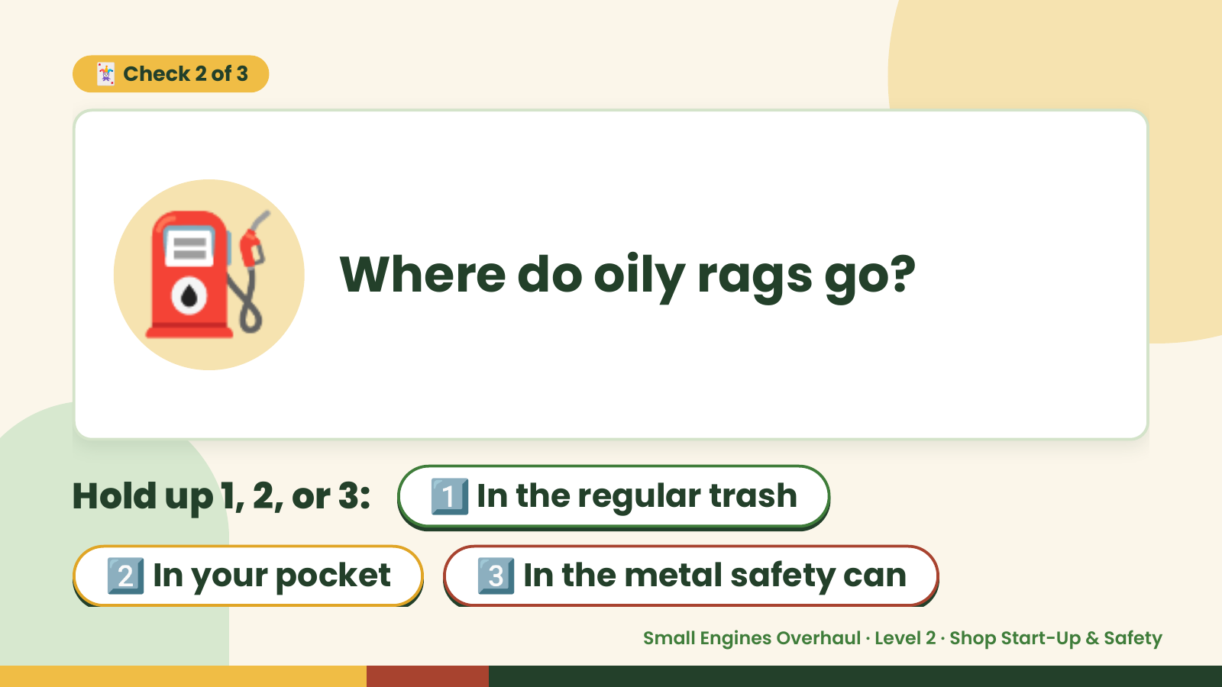
Notes:
🃏 Check 2 of 3
⛽ Where do oily rags go?
Hold up 1, 2, or 3: 1️⃣ In the regular trash
2️⃣ In your pocket 3️⃣ In the metal safety can
Small Engines Overhaul · Level 2 · Shop Start-Up & Safety

Slide 11
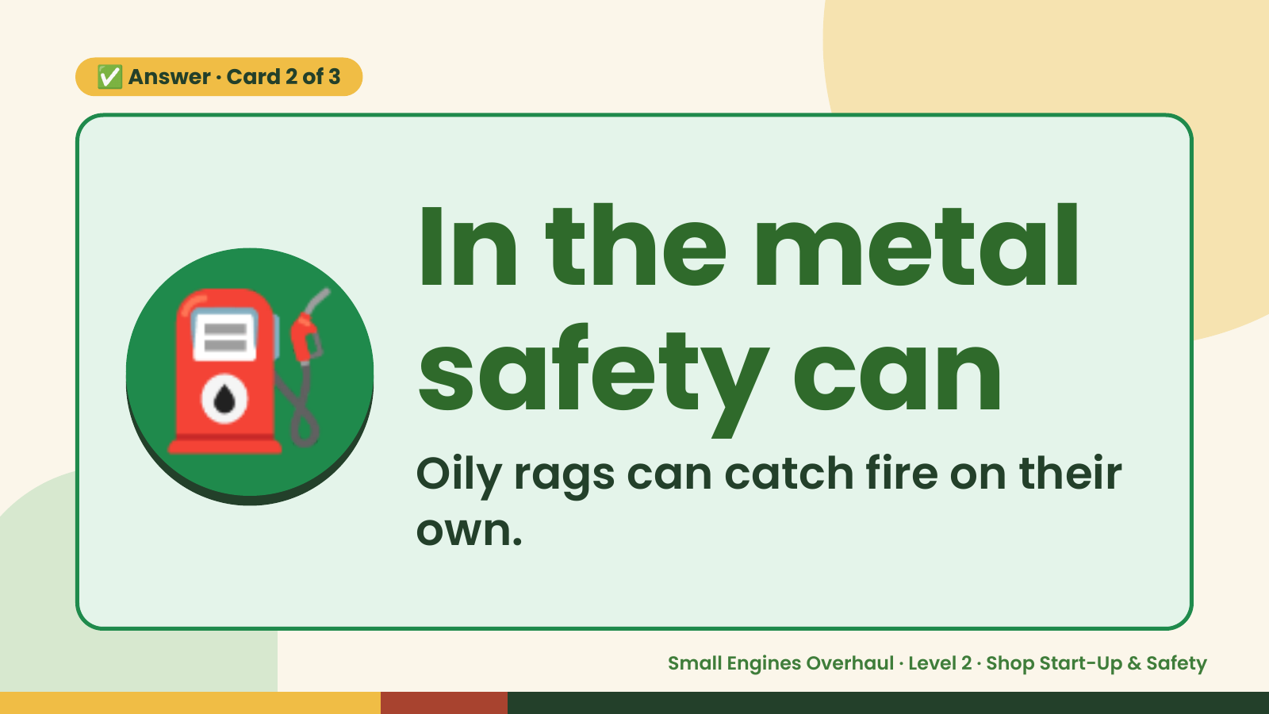
Notes:
✅ Answer · Card 2 of 3
⛽ In the metal
safety can
Oily rags can catch fire on their
own.
Small Engines Overhaul · Level 2 · Shop Start-Up & Safety

Slide 12
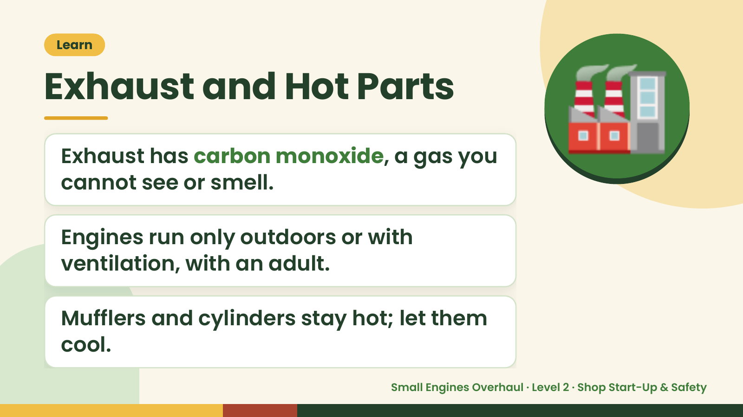
Notes:
Learn
Exhaust and Hot Parts
Exhaust has carbon monoxide, a gas you
cannot see or smell.
🏭
Engines run only outdoors or with
ventilation, with an adult.
Mufflers and cylinders stay hot; let them
cool.
Small Engines Overhaul · Level 2 · Shop Start-Up & Safety

Slide 13
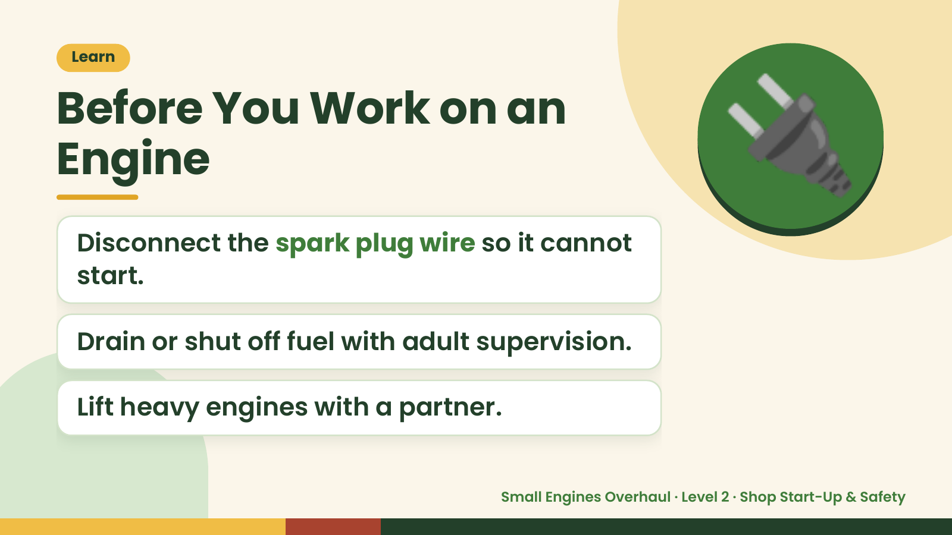
Notes:
Learn
Before You Work on an
Engine
Disconnect the spark plug wire so it cannot
start.
🔌
Drain or shut off fuel with adult supervision.
Lift heavy engines with a partner.
Small Engines Overhaul · Level 2 · Shop Start-Up & Safety

Slide 14
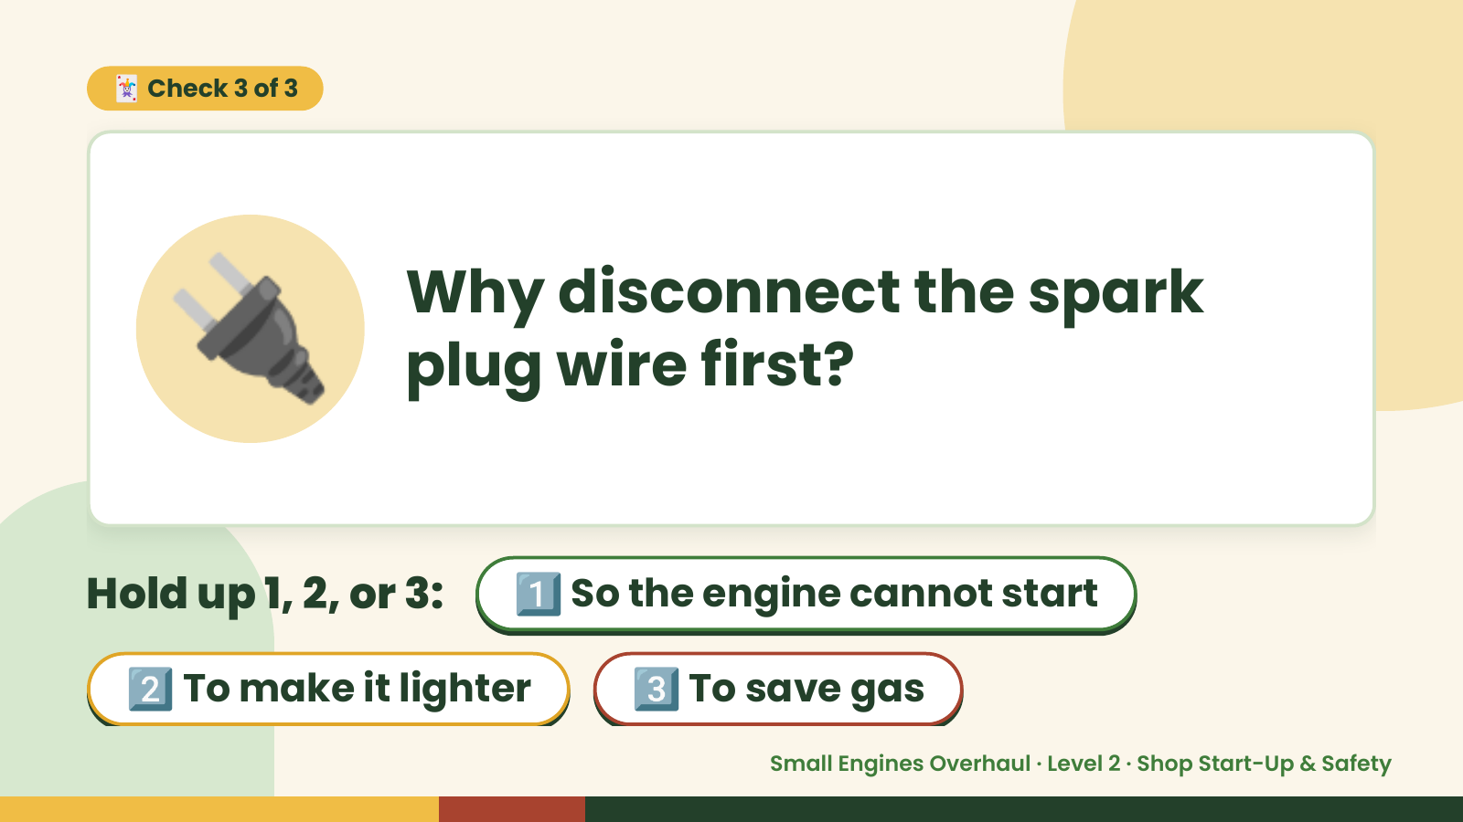
Notes:
🃏 Check 3 of 3
🔌 Why disconnect the spark
plug wire first?
Hold up 1, 2, or 3: 1️⃣ So the engine cannot start
2️⃣ To make it lighter 3️⃣ To save gas
Small Engines Overhaul · Level 2 · Shop Start-Up & Safety

Slide 15
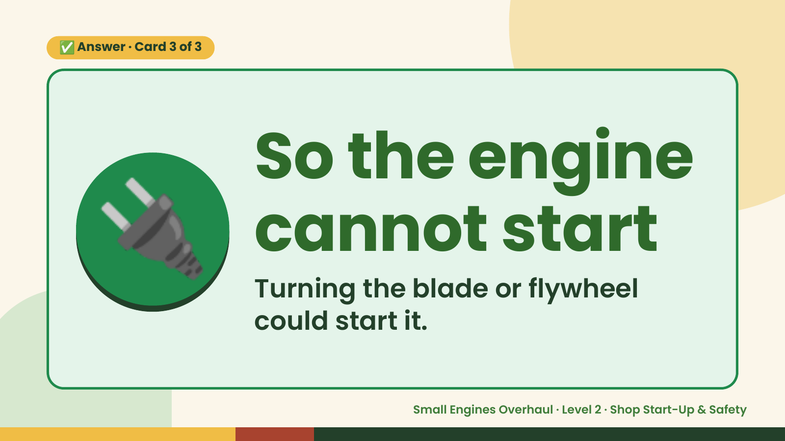
Notes:
✅ Answer · Card 3 of 3
🔌 So the engine
cannot start
Turning the blade or flywheel
could start it.
Small Engines Overhaul · Level 2 · Shop Start-Up & Safety

Slide 16
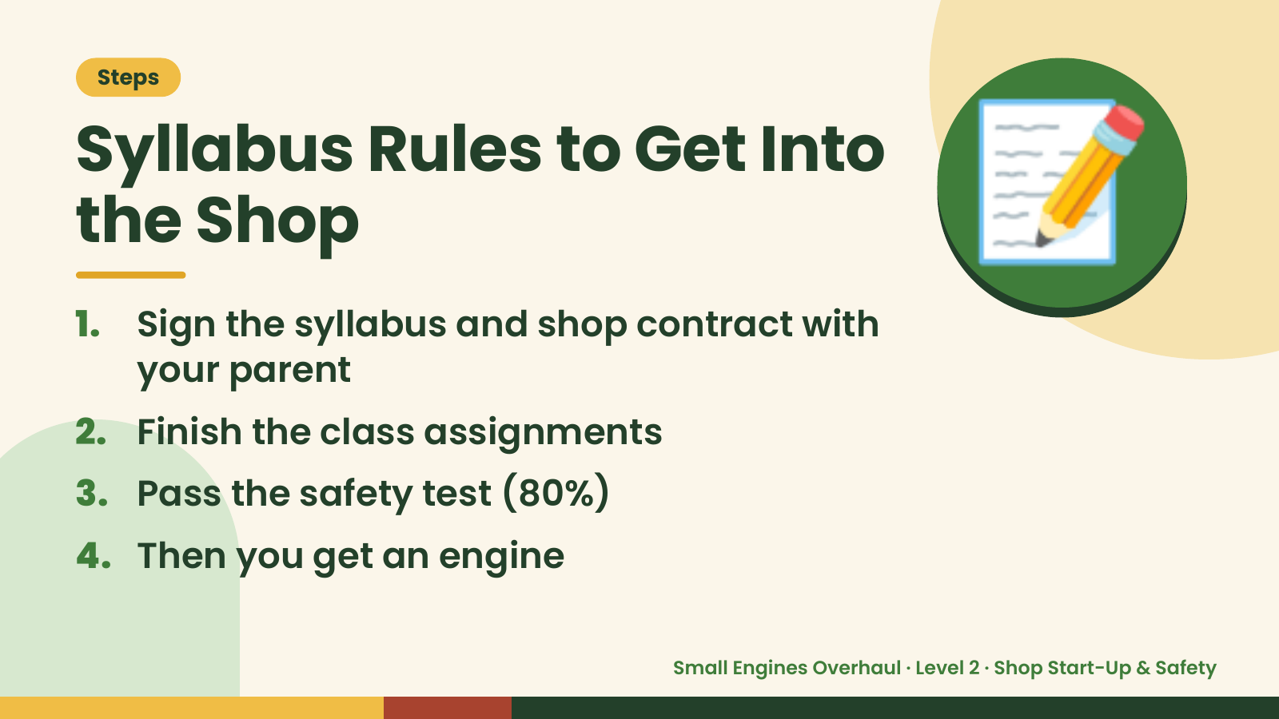
Notes:
Steps
Syllabus Rules to Get Into
the Shop
1. Sign the syllabus and shop contract with
your parent
📝
2. Finish the class assignments
3. Pass the safety test (80%)
4. Then you get an engine
Small Engines Overhaul · Level 2 · Shop Start-Up & Safety

Slide 17
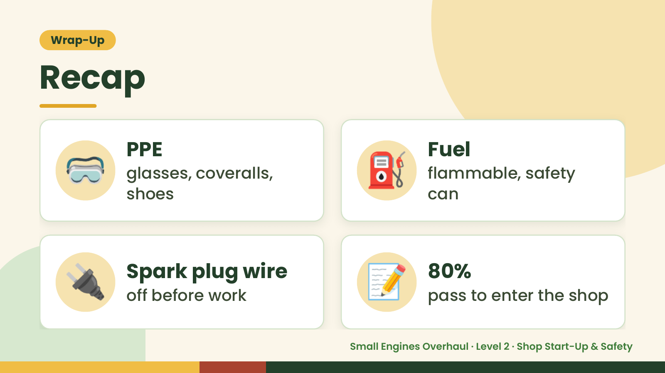
Notes:
Wrap-Up
Recap
🥽 PPE
glasses, coveralls,
shoes
⛽ Fuel
flammable, safety
can
🔌 Spark plug wire
off before work 📝 80%
pass to enter the shop
Small Engines Overhaul · Level 2 · Shop Start-Up & Safety

Slide 18
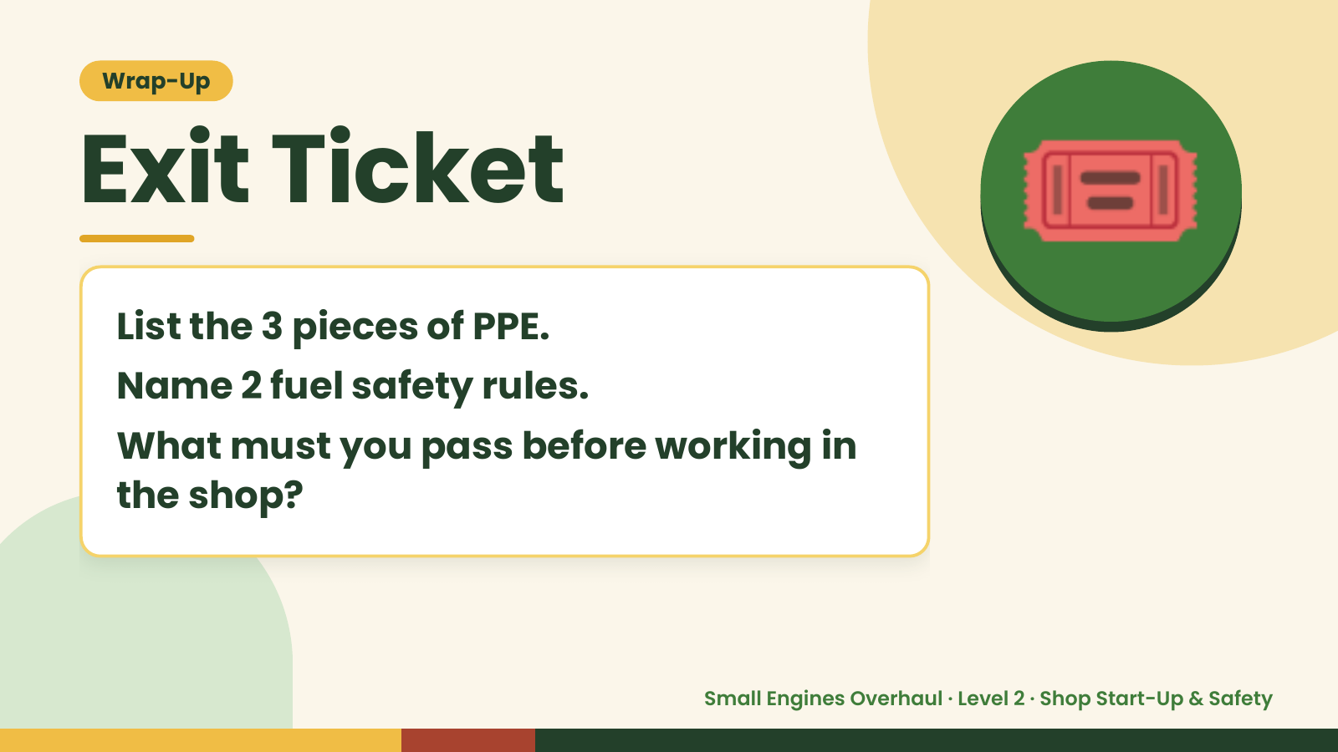
Notes:
Wrap-Up
Exit Ticket
List the 3 pieces of PPE.
Name 2 fuel safety rules.
🎟️
What must you pass before working in
the shop?
Small Engines Overhaul · Level 2 · Shop Start-Up & Safety

