Slide 1
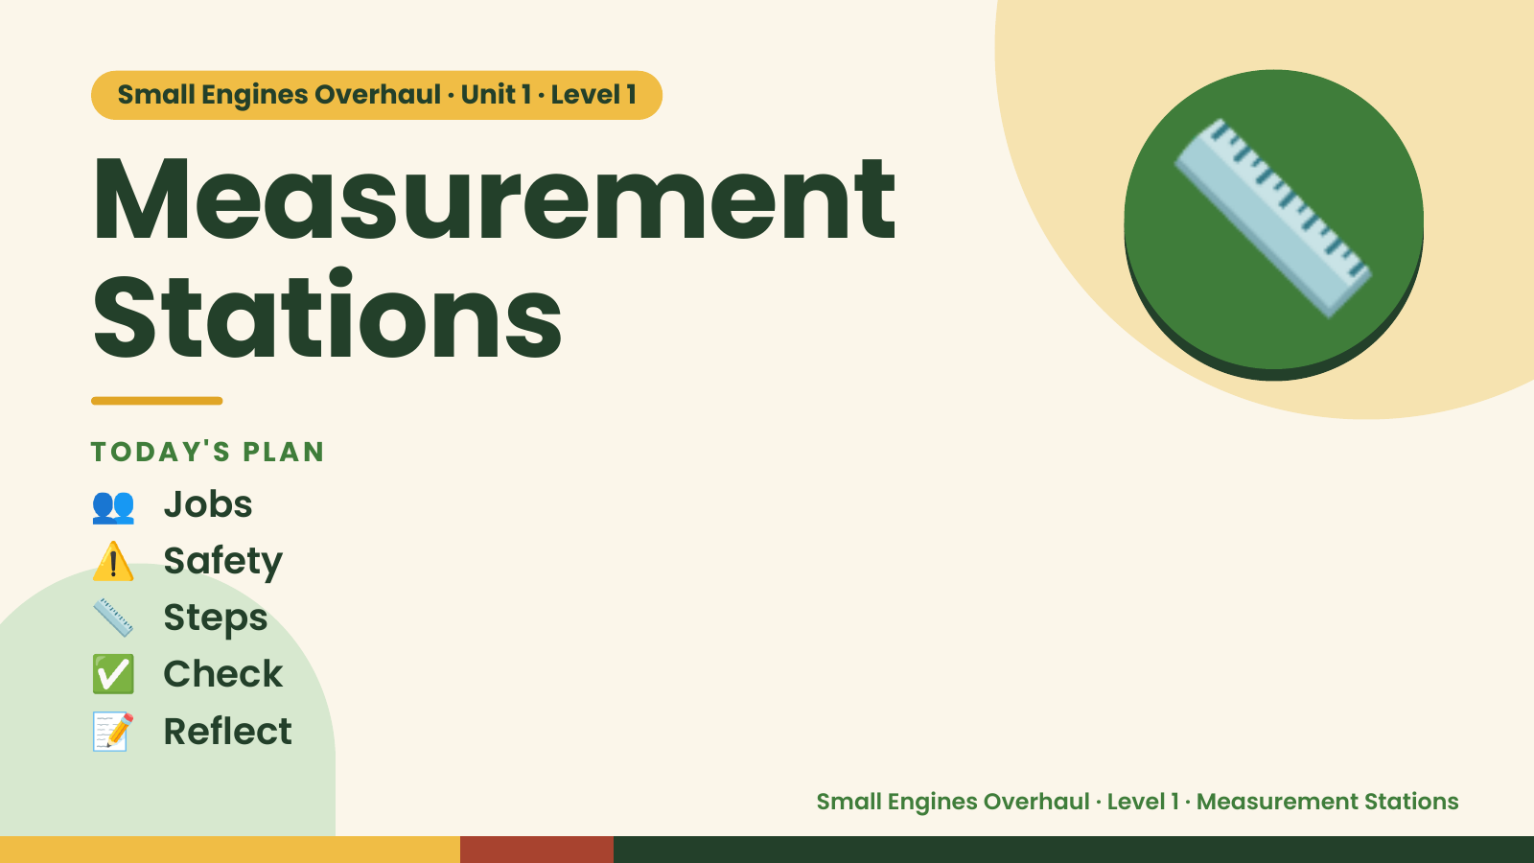
Notes:
Small Engines Overhaul · Unit 1 · Level 1
Measurement
Stations
TODAY'S PLAN
📏
👥 Jobs
⚠️ Safety
📏 Steps
✅ Check
📝 Reflect
Small Engines Overhaul · Level 1 · Measurement Stations

Slide 2

Notes:
Get ready
Jobs
🔧 Mechanic
fixes 🧰 Tool helper
gets tools
📋 Recorder
writes 🧽 Clean-up
captain
cleans
Small Engines Overhaul · Level 1 · Measurement Stations

Slide 3
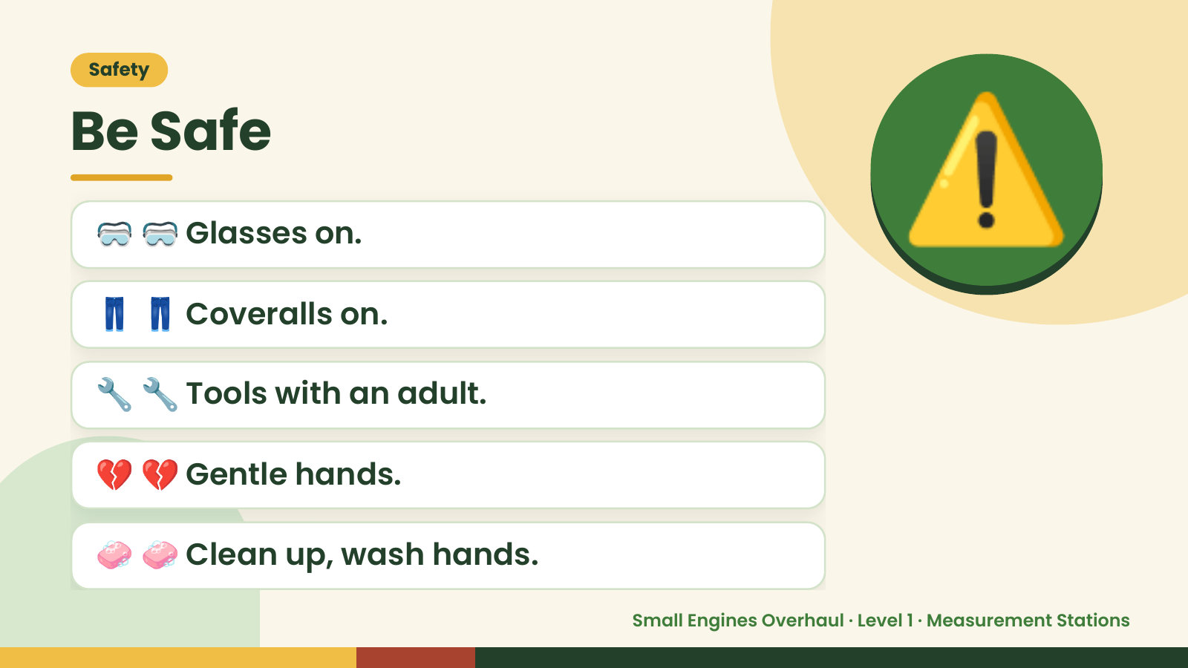
Notes:
Safety
Be Safe
🥽 🥽 Glasses on.
👖 👖 Coveralls on.
⚠️
🔧 🔧 Tools with an adult.
💔 💔 Gentle hands.
🧼 🧼 Clean up, wash hands.
Small Engines Overhaul · Level 1 · Measurement Stations

Slide 4
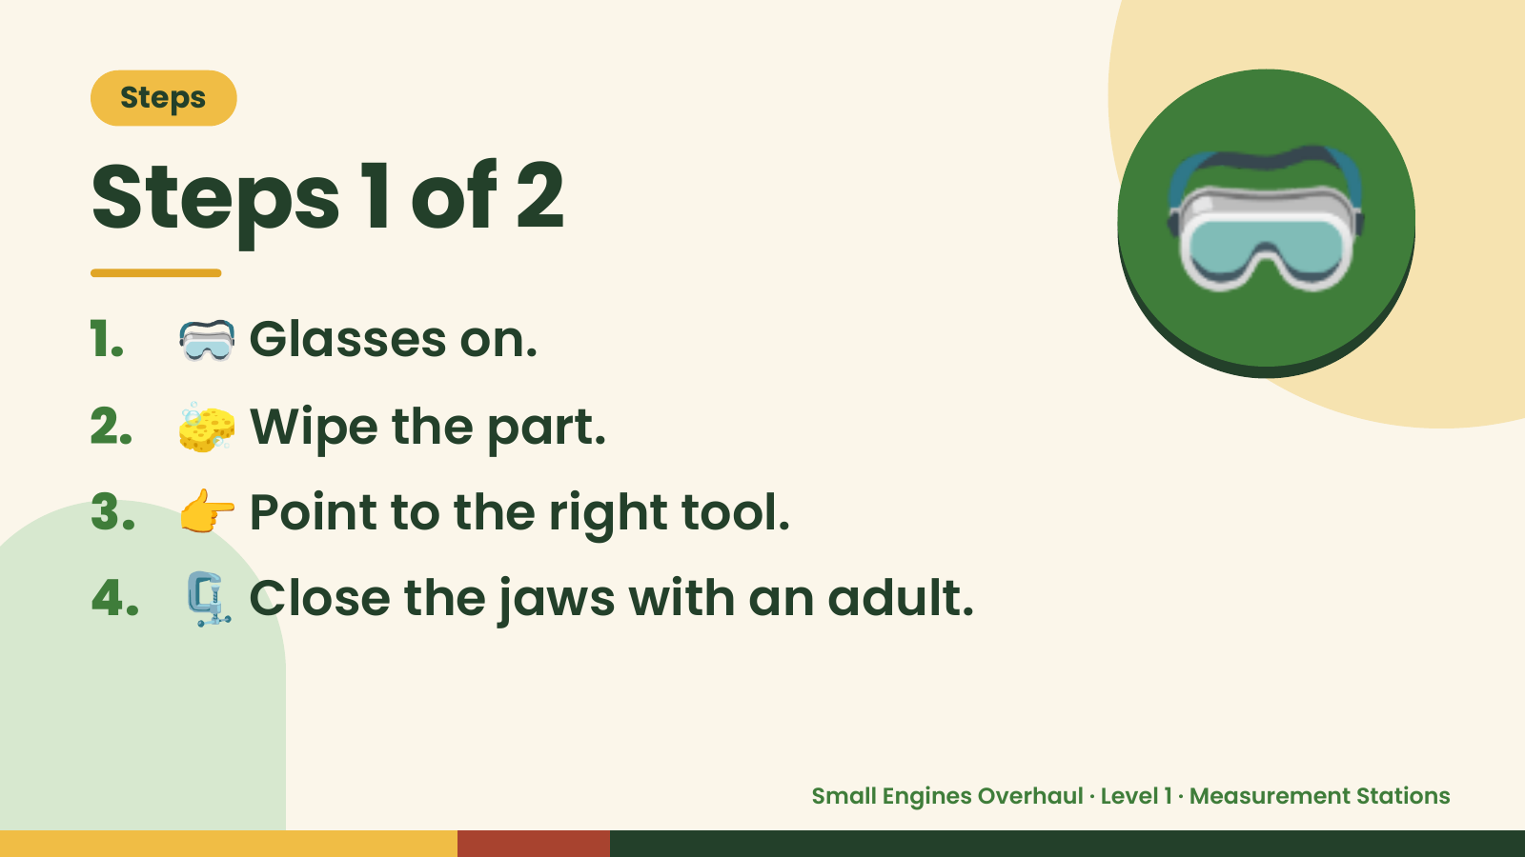
Notes:
Steps
Steps 1 of 2
1. 🥽 Glasses on.
2. 🧽 Wipe the part.
🥽
3. 👉 Point to the right tool.
4. 🗜️ Close the jaws with an adult.
Small Engines Overhaul · Level 1 · Measurement Stations

Slide 5
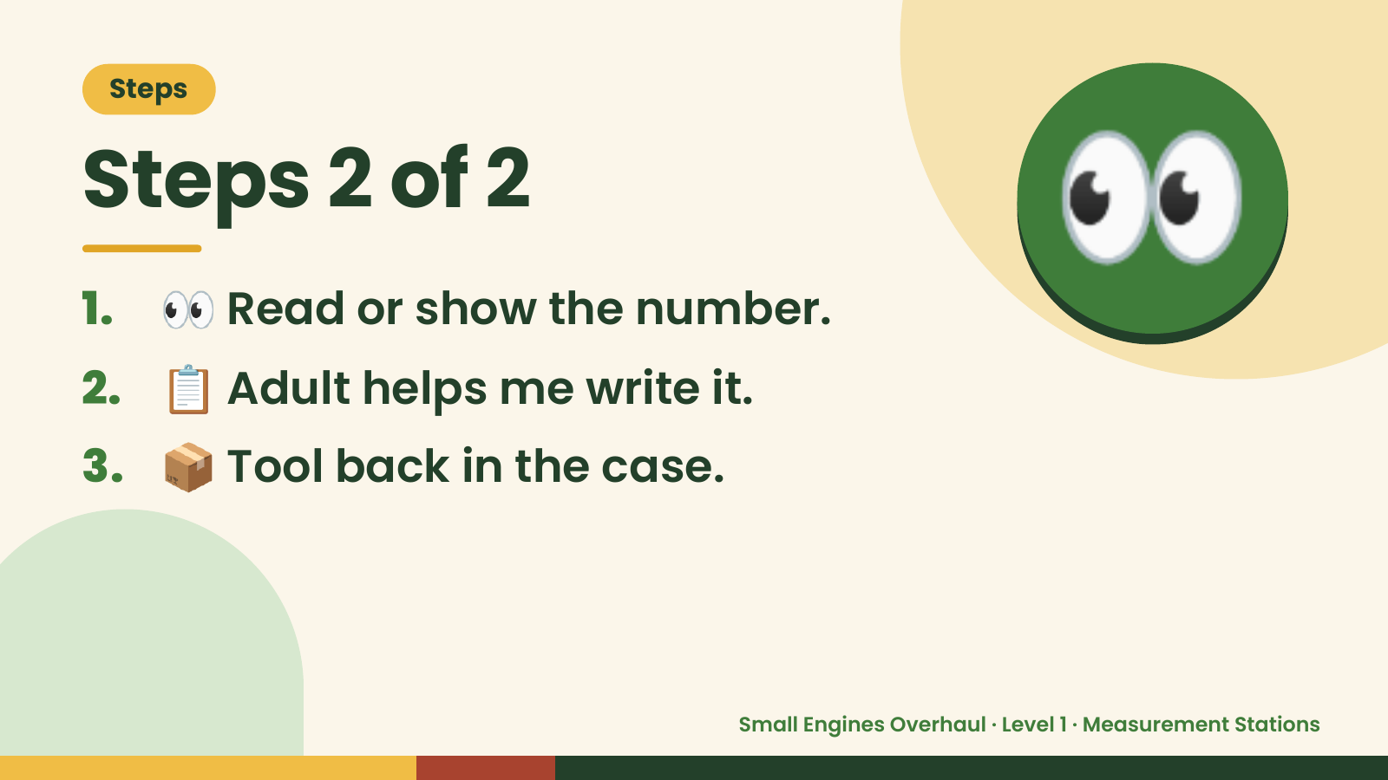
Notes:
Steps
Steps 2 of 2
1. 👀 Read or show the number.
2. 📋 Adult helps me write it.
👀
3. 📦 Tool back in the case.
Small Engines Overhaul · Level 1 · Measurement Stations

Slide 6
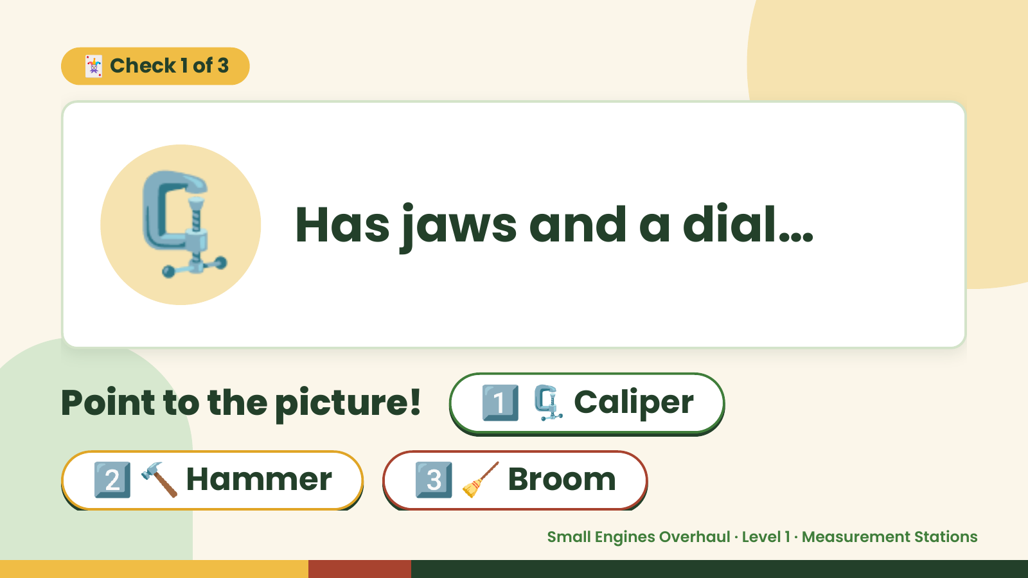
Notes:
🃏 Check 1 of 3
🗜️ Has jaws and a dial…
Point to the picture! 1️⃣ 🗜️ Caliper
2️⃣ 🔨 Hammer 3️⃣ 🧹 Broom
Small Engines Overhaul · Level 1 · Measurement Stations

Slide 7
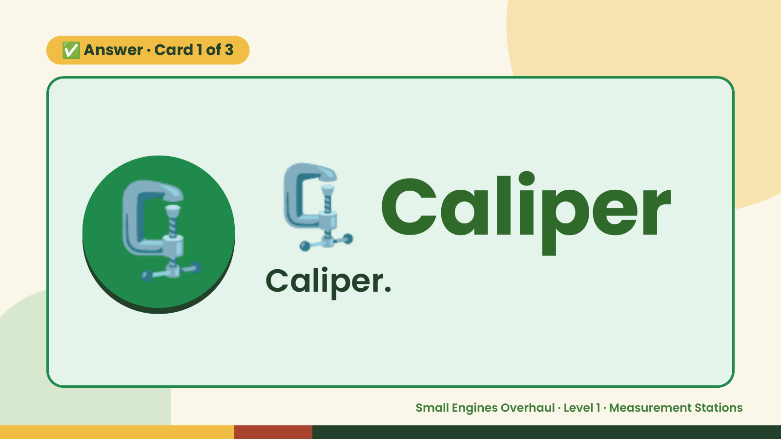
Notes:
✅ Answer · Card 1 of 3
🗜️ 🗜️ Caliper
Caliper.
Small Engines Overhaul · Level 1 · Measurement Stations

Slide 8
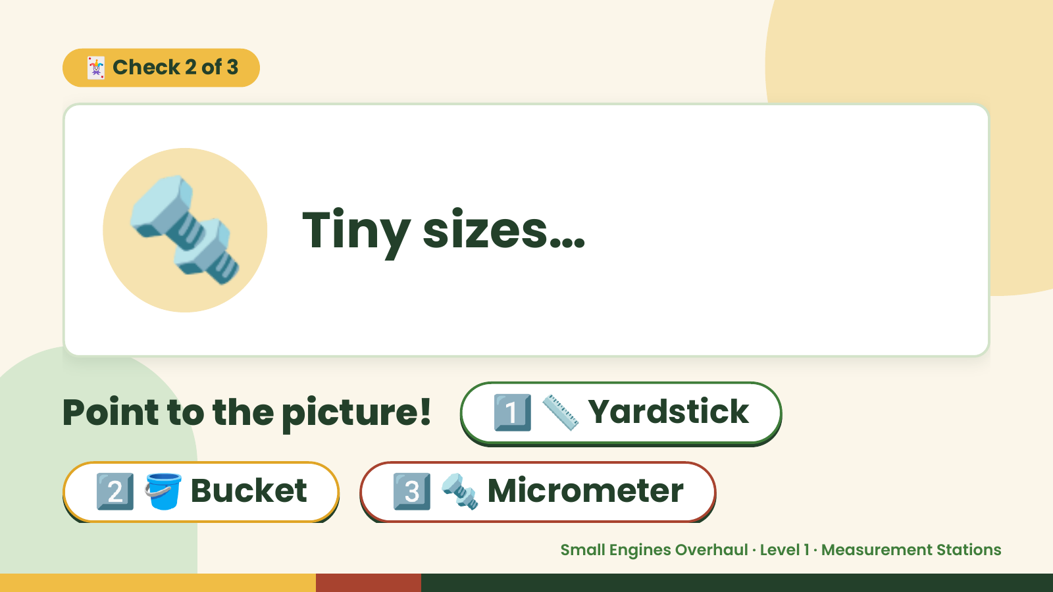
Notes:
🃏 Check 2 of 3
🔩 Tiny sizes…
Point to the picture! 1️⃣ 📏 Yardstick
2️⃣ 🪣 Bucket 3️⃣ 🔩 Micrometer
Small Engines Overhaul · Level 1 · Measurement Stations

Slide 9
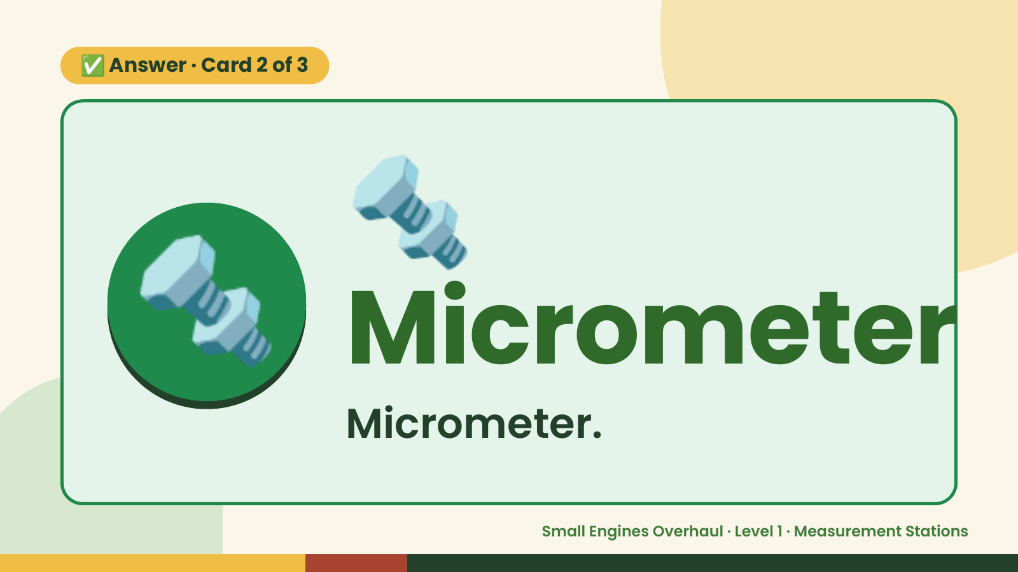
Notes:
🔩
✅ Answer · Card 2 of 3
🔩 Micrometer Micrometer.
Small Engines Overhaul · Level 1 · Measurement Stations

Slide 10
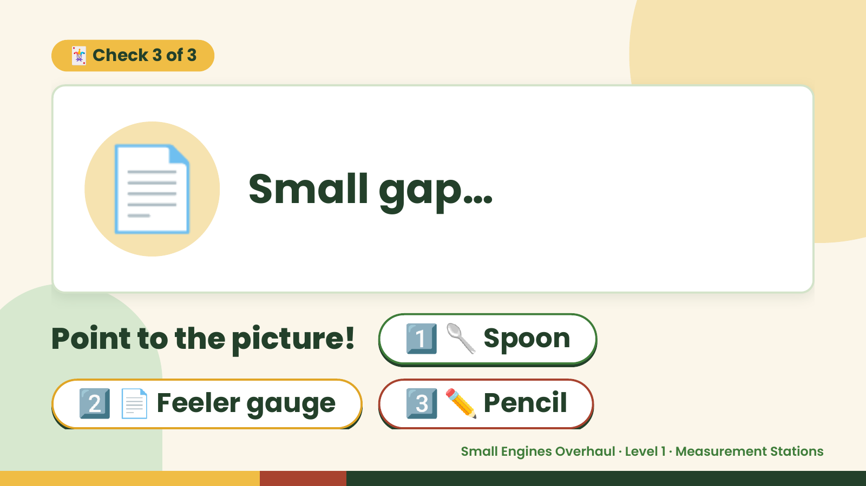
Notes:
🃏 Check 3 of 3
📄 Small gap…
Point to the picture! 1️⃣ 🥄 Spoon
2️⃣ 📄 Feeler gauge 3️⃣ ✏️ Pencil
Small Engines Overhaul · Level 1 · Measurement Stations

Slide 11
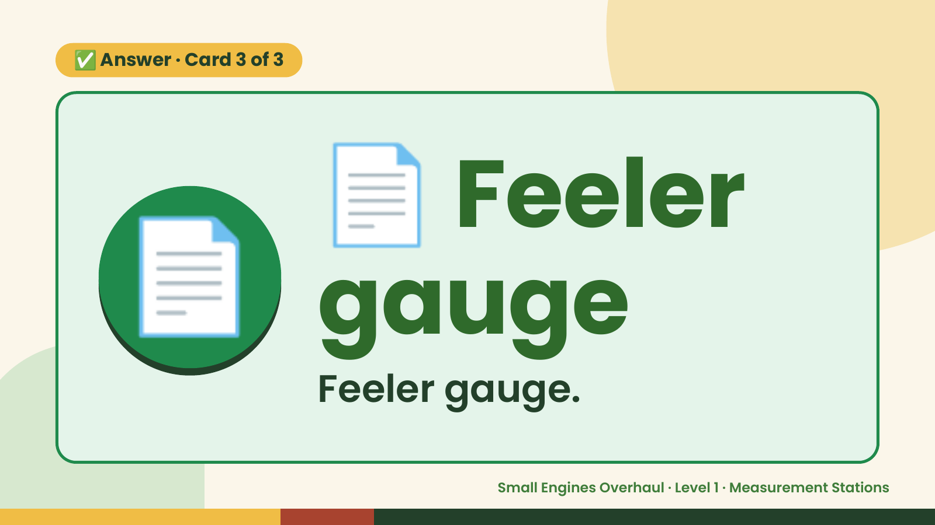
Notes:
📄
✅ Answer · Card 3 of 3
📄 gauge
Feeler
Feeler gauge.
Small Engines Overhaul · Level 1 · Measurement Stations

Slide 12

Notes:
Wrap-Up
Clean Up +
Reflect
🧽
🧽 Wipe the bench.
🧰 Give tools back.
🧼 Wash hands.
Small Engines Overhaul · Level 1 · Measurement Stations

