Slide 1
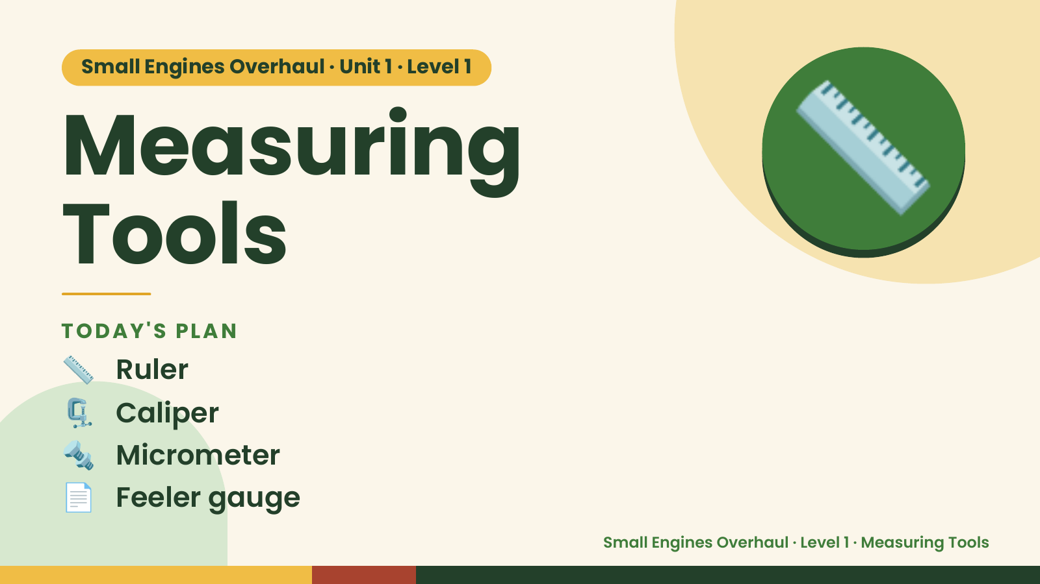
Notes:
Small Engines Overhaul · Unit 1 · Level 1
Measuring
Tools
📏
📏 Ruler
TODAY'S PLAN
🗜️ Caliper
🔩 Micrometer
📄 Feeler gauge
Small Engines Overhaul · Level 1 · Measuring Tools

Slide 2
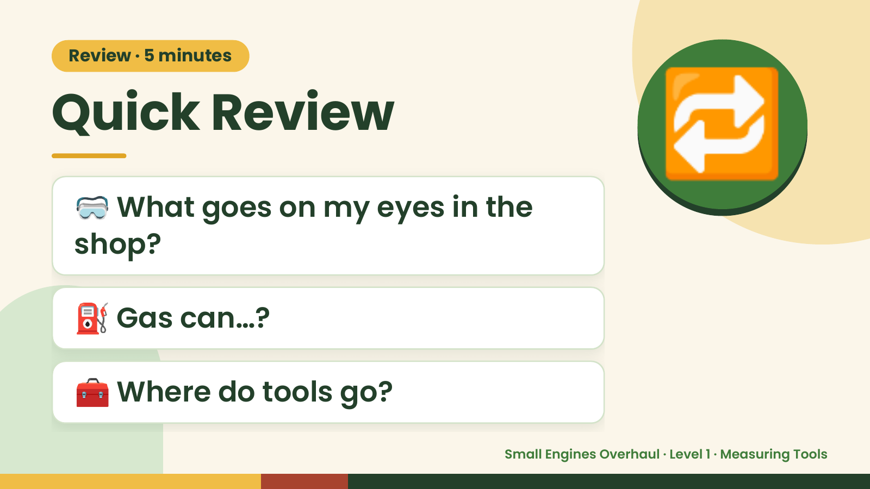
Notes:
Review · 5 minutes
Quick Review
🥽 What goes on my eyes in the
shop?
🔁
⛽ Gas can…?
🧰 Where do tools go?
Small Engines Overhaul · Level 1 · Measuring Tools

Slide 3
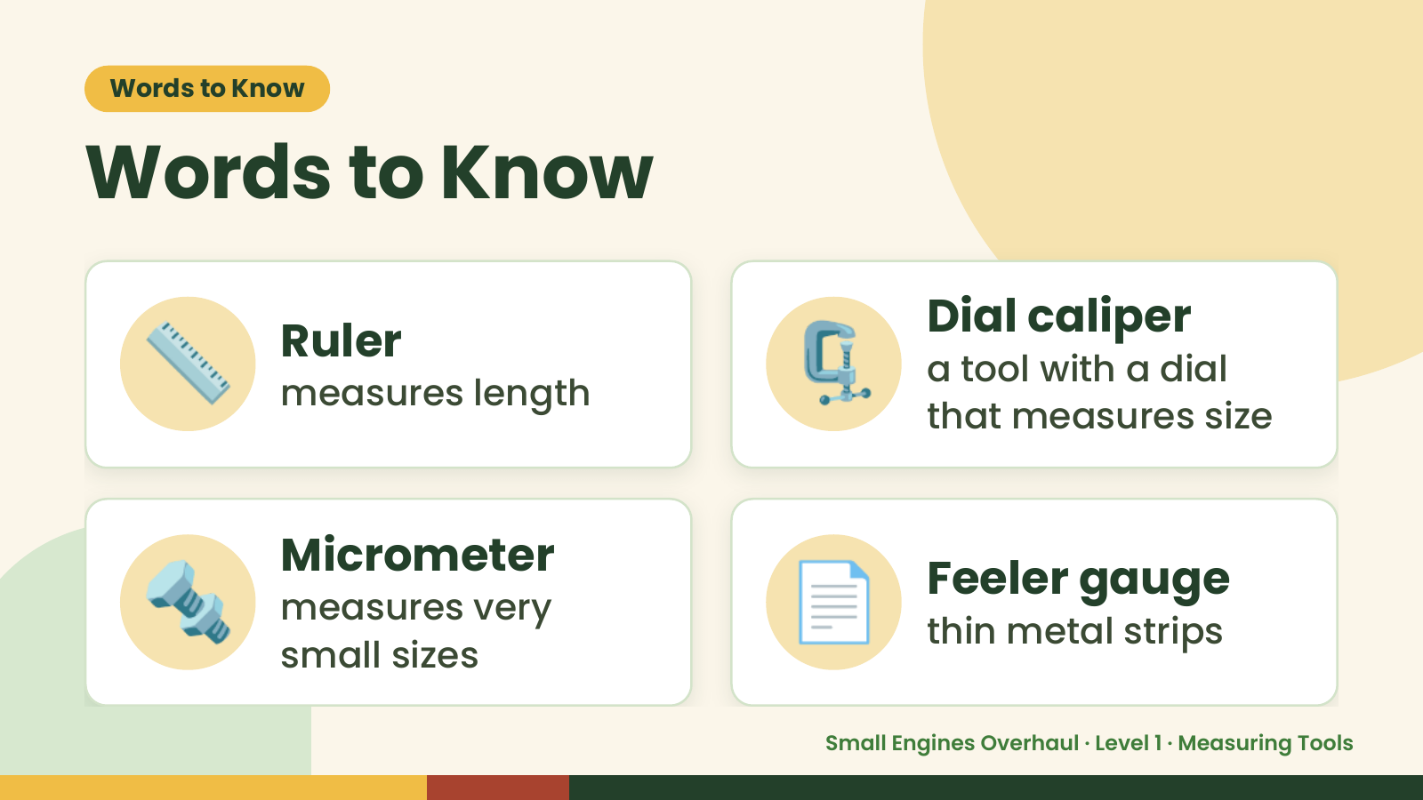
Notes:
Words to Know
Words to Know
📏 Ruler
measures length 🗜️ Dial caliper
a tool with a dial
that measures size
🔩 Micrometer
measures very
small sizes
📄 Feeler gauge
thin metal strips
Small Engines Overhaul · Level 1 · Measuring Tools

Slide 4
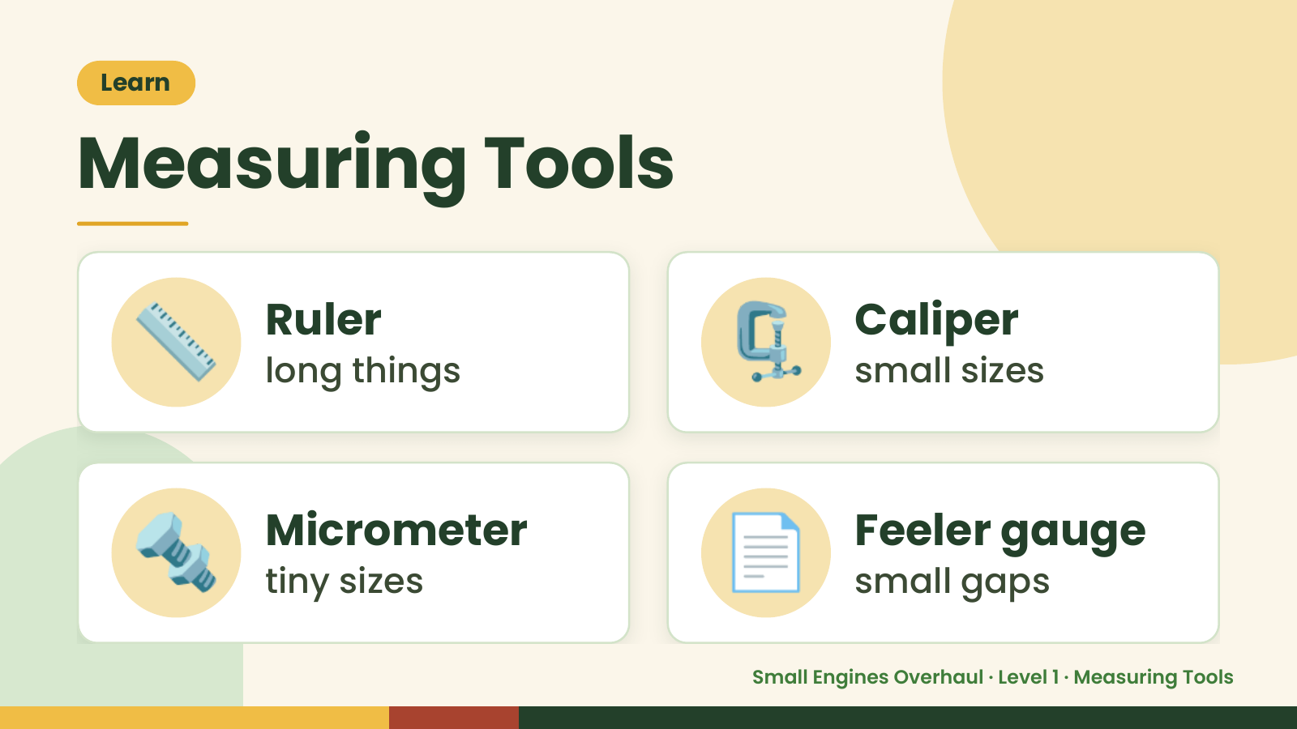
Notes:
Learn
Measuring Tools
📏 Ruler
long things 🗜️ Caliper
small sizes
🔩 Micrometer
tiny sizes 📄 Feeler gauge
small gaps
Small Engines Overhaul · Level 1 · Measuring Tools

Slide 5
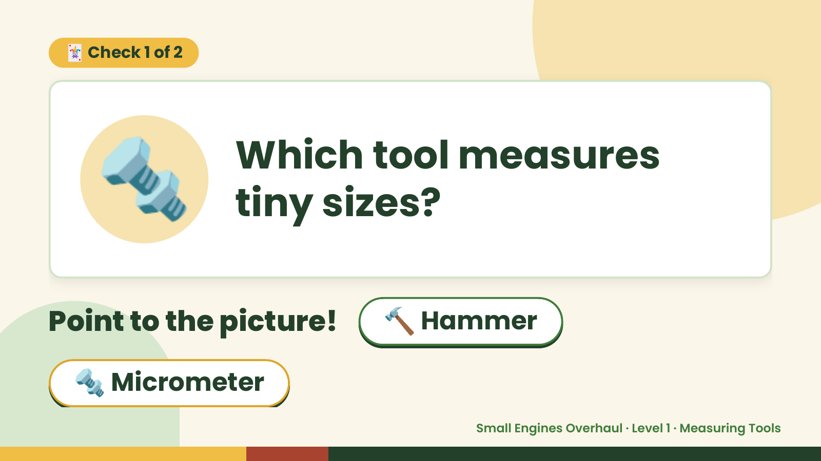
Notes:
🃏 Check 1 of 2
🔩 Which tool measures
tiny sizes?
Point to the picture! 🔨 Hammer
🔩 Micrometer
Small Engines Overhaul · Level 1 · Measuring Tools

Slide 6
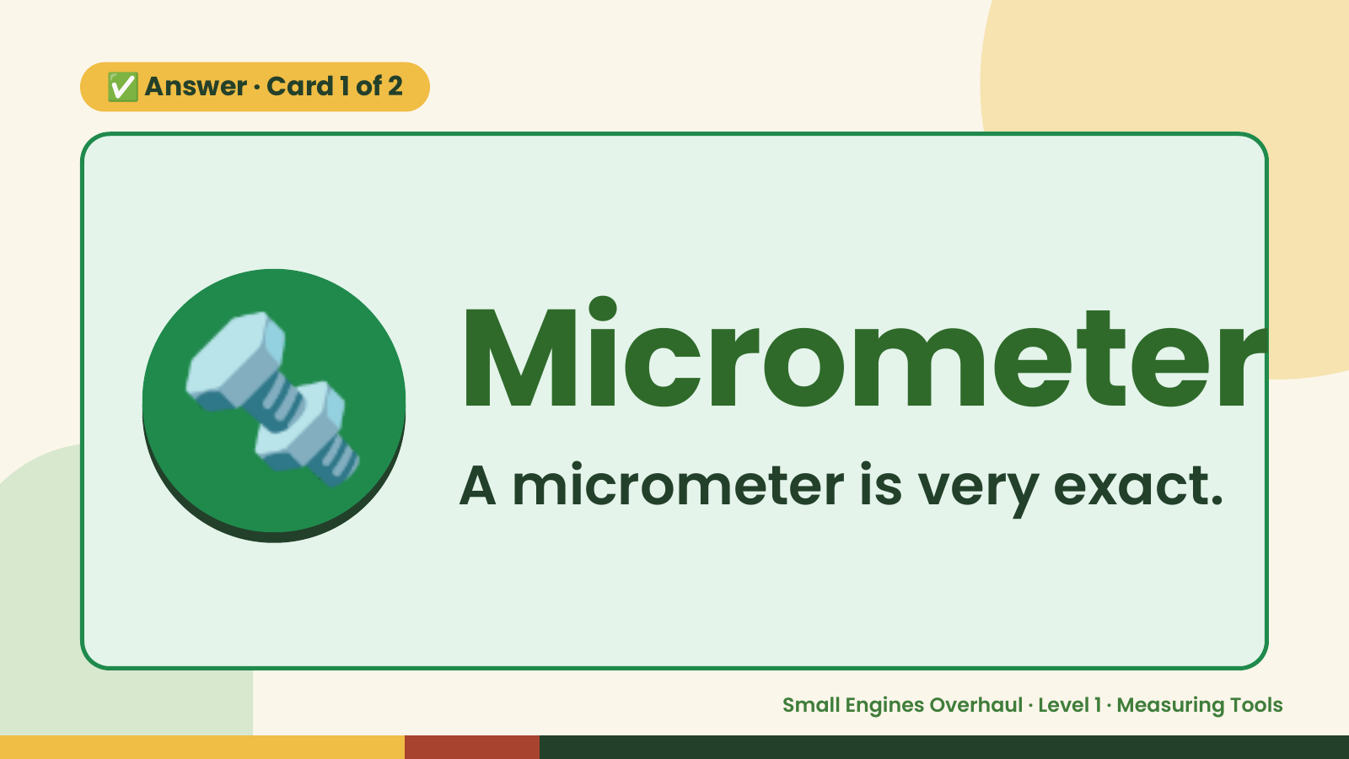
Notes:
✅ Answer · Card 1 of 2
🔩 Micrometer
A micrometer is very exact.
Small Engines Overhaul · Level 1 · Measuring Tools

Slide 7
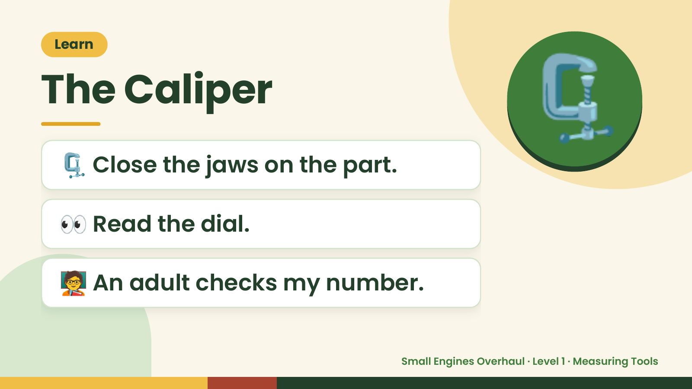
Notes:
Learn
The Caliper
🗜️ Close the jaws on the part.
🗜️
👀 Read the dial.
🧑‍🏫 An adult checks my number.
Small Engines Overhaul · Level 1 · Measuring Tools

Slide 8
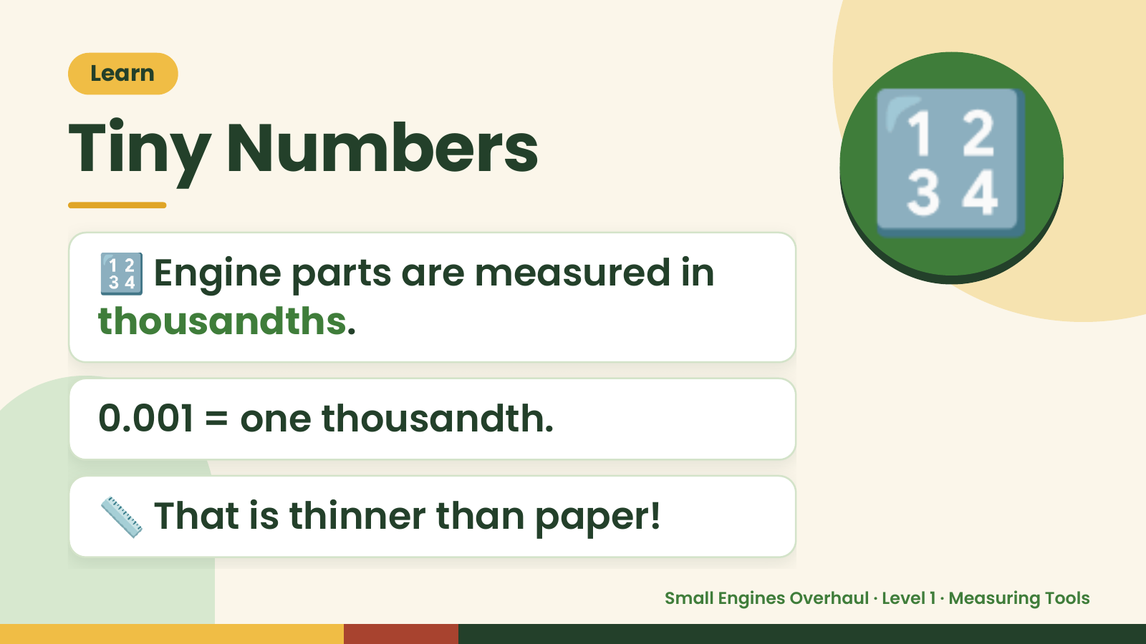
Notes:
Learn
Tiny Numbers
🔢 Engine parts are measured in
thousandths.
🔢
0.001 = one thousandth.
📏 That is thinner than paper!
Small Engines Overhaul · Level 1 · Measuring Tools

Slide 9
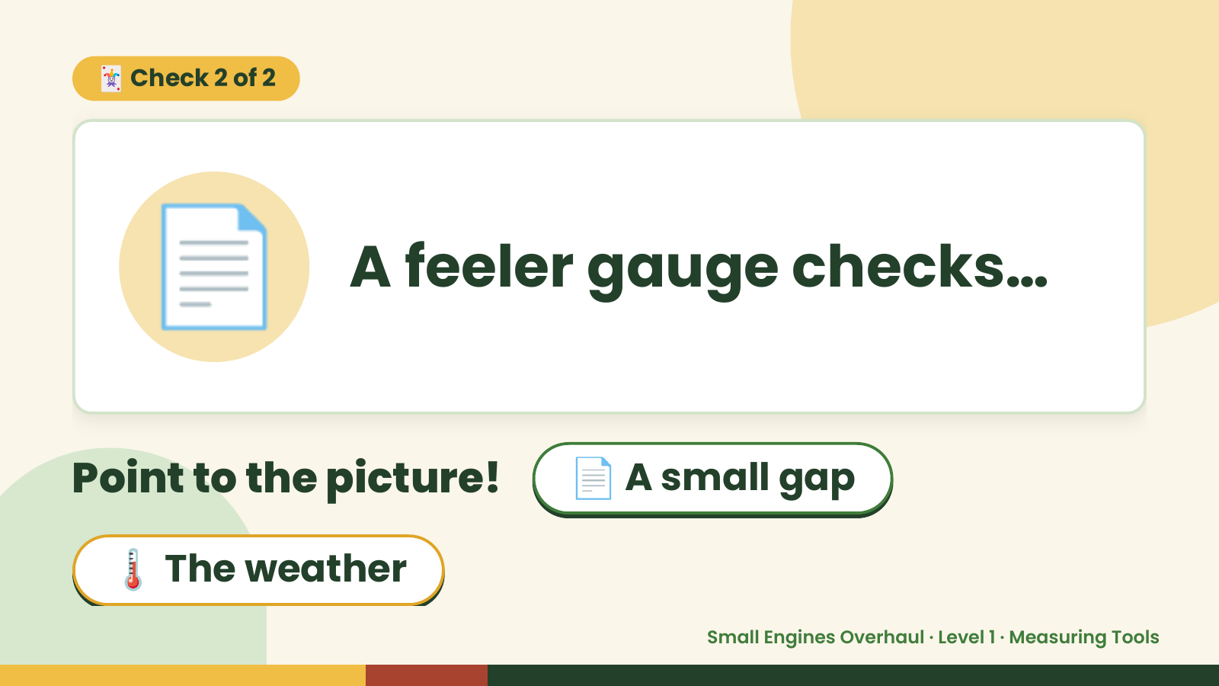
Notes:
🃏 Check 2 of 2
📄 A feeler gauge checks…
Point to the picture! 📄 A small gap
🌡️ The weather
Small Engines Overhaul · Level 1 · Measuring Tools

Slide 10
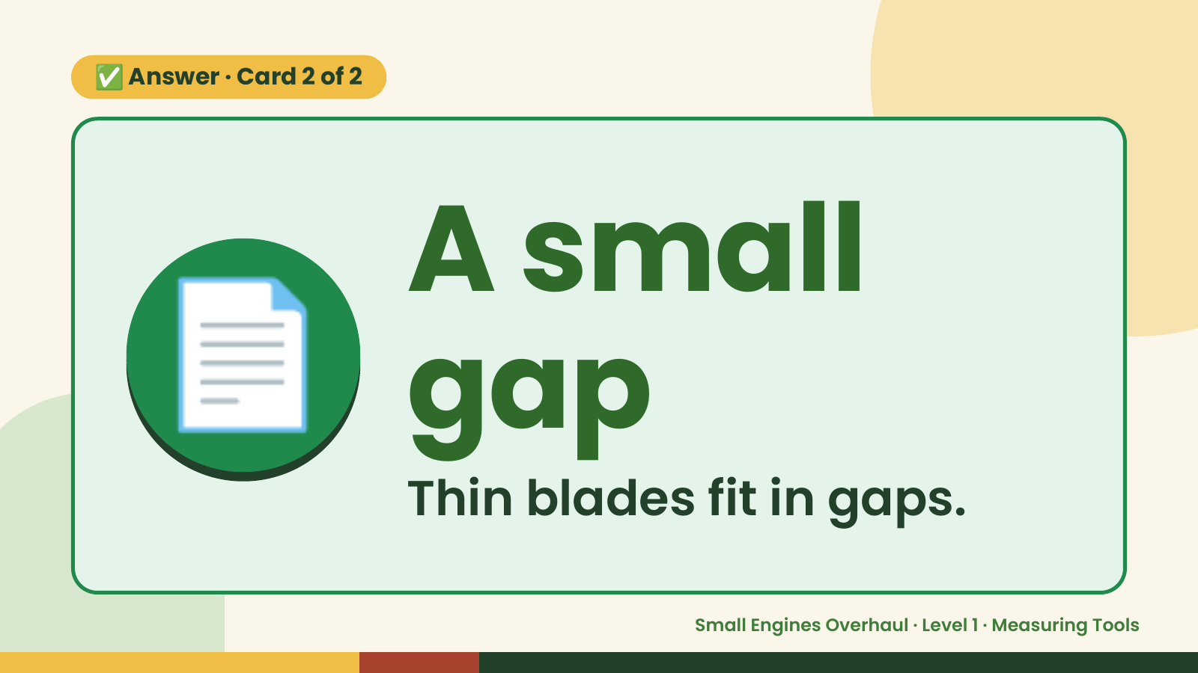
Notes:
✅ Answer · Card 2 of 2
📄 A small
gap
Thin blades fit in gaps.
Small Engines Overhaul · Level 1 · Measuring Tools

Slide 11
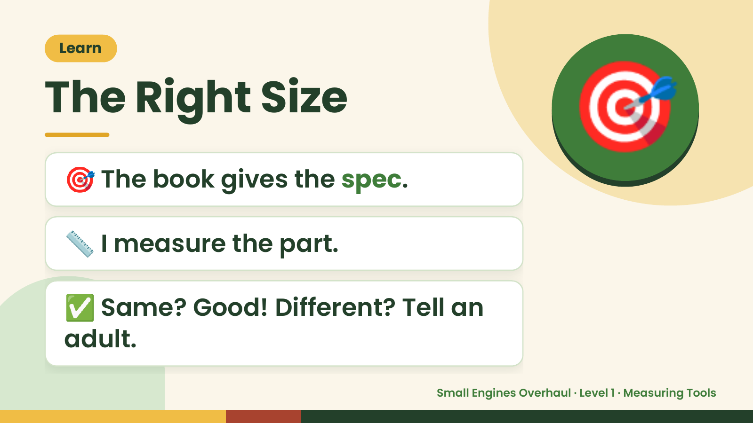
Notes:
Learn
The Right Size
🎯 The book gives the spec.
🎯
📏 I measure the part.
✅ Same? Good! Different? Tell an
adult.
Small Engines Overhaul · Level 1 · Measuring Tools

Slide 12
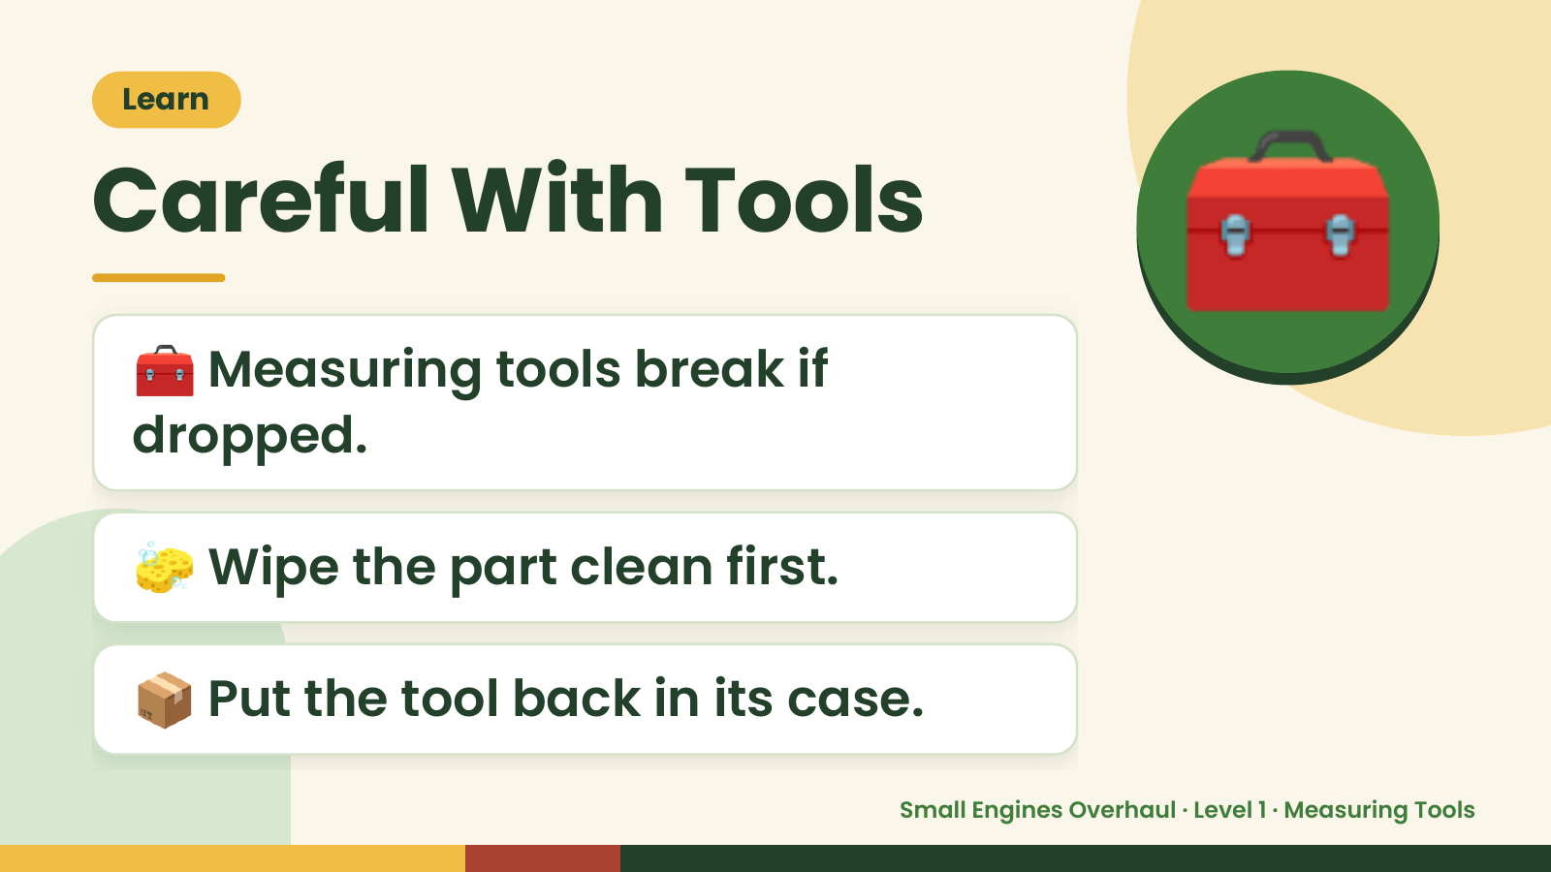
Notes:
Learn
Careful With Tools
🧰 Measuring tools break if
dropped.
🧰
🧽 Wipe the part clean first.
📦 Put the tool back in its case.
Small Engines Overhaul · Level 1 · Measuring Tools

Slide 13
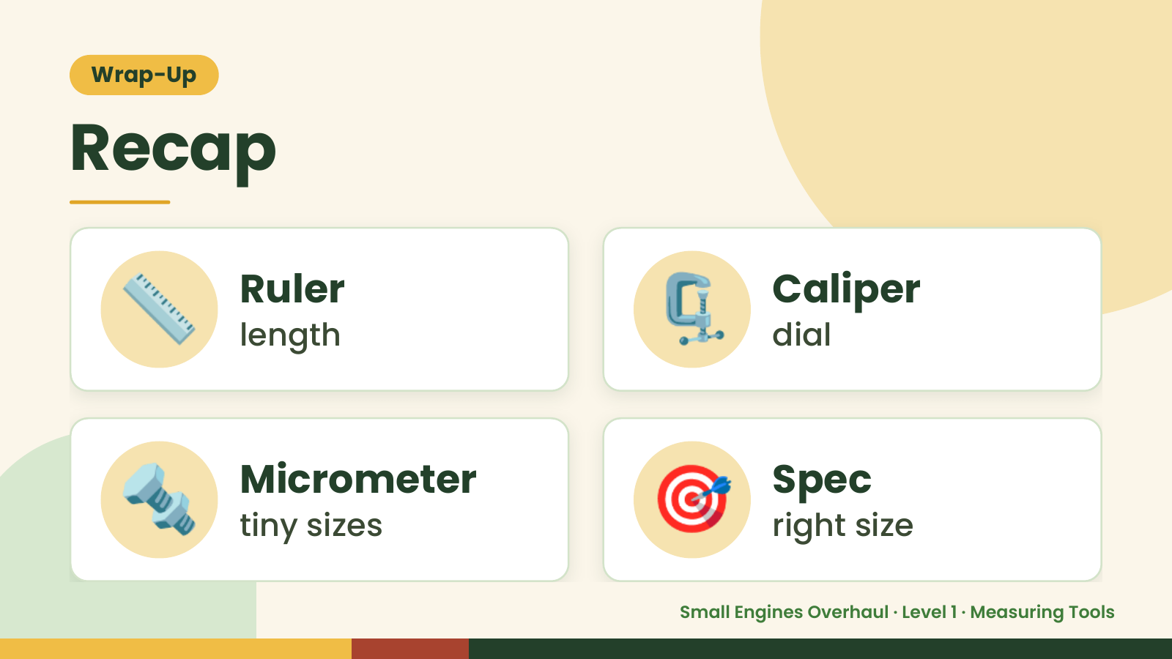
Notes:
Wrap-Up
Recap
📏 Ruler
length 🗜️ Caliper
dial
🔩 Micrometer
tiny sizes 🎯 Spec
right size
Small Engines Overhaul · Level 1 · Measuring Tools

Slide 14
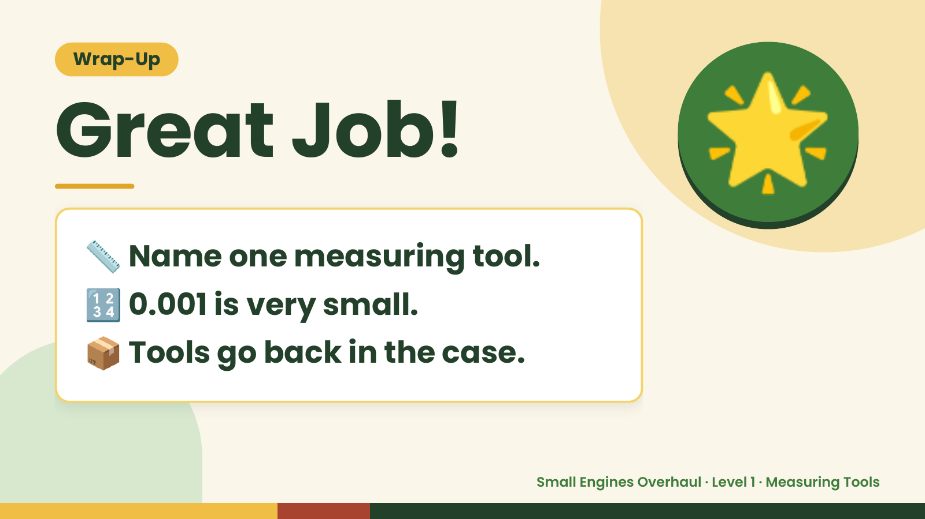
Notes:
Wrap-Up
Great Job!
📏 Name one measuring tool.
🌟
🔢 0.001 is very small.
📦 Tools go back in the case.
Small Engines Overhaul · Level 1 · Measuring Tools

