Slide 1
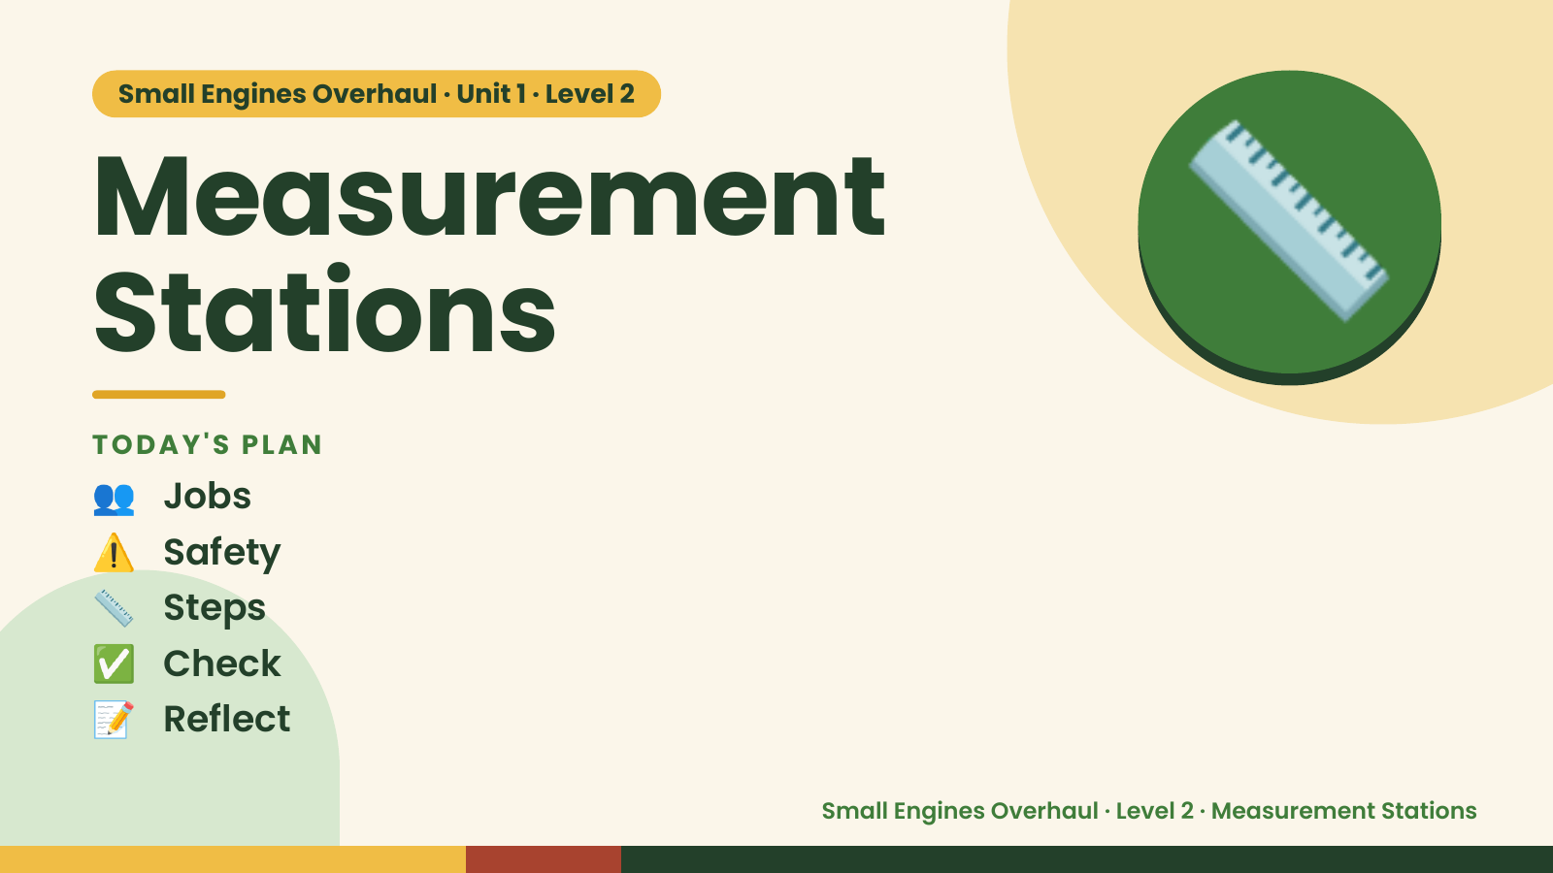
Notes:
Small Engines Overhaul · Unit 1 · Level 2
Measurement
Stations
👥 Jobs
TODAY'S PLAN
📏
⚠️ Safety
📏 Steps
✅ Check
📝 Reflect
Small Engines Overhaul · Level 2 · Measurement Stations

Slide 2

Notes:
Get ready
Jobs
🔧 Mechanic
Does the main engine job
with the tools
🧰 Tool helper
Gets tools from the board
and returns them to staff
📋 Recorder
Takes photos and fills in
the chart
🧽 Clean-up captain
Wipes the bench,
sweeps, checks tools are
back
Small Engines Overhaul · Level 2 · Measurement Stations

Slide 3
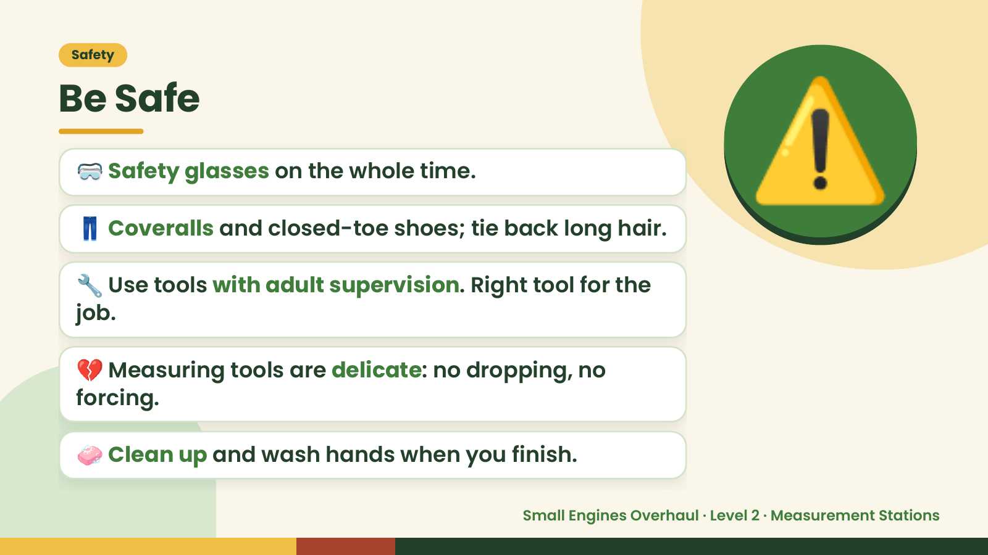
Notes:
Safety
Be Safe
🥽 Safety glasses on the whole time.
👖 Coveralls and closed-toe shoes; tie back long hair.
🔧 Use tools with adult supervision. Right tool for the
job.
⚠️
💔 Measuring tools are delicate: no dropping, no
forcing.
🧼 Clean up and wash hands when you finish.
Small Engines Overhaul · Level 2 · Measurement Stations

Slide 4
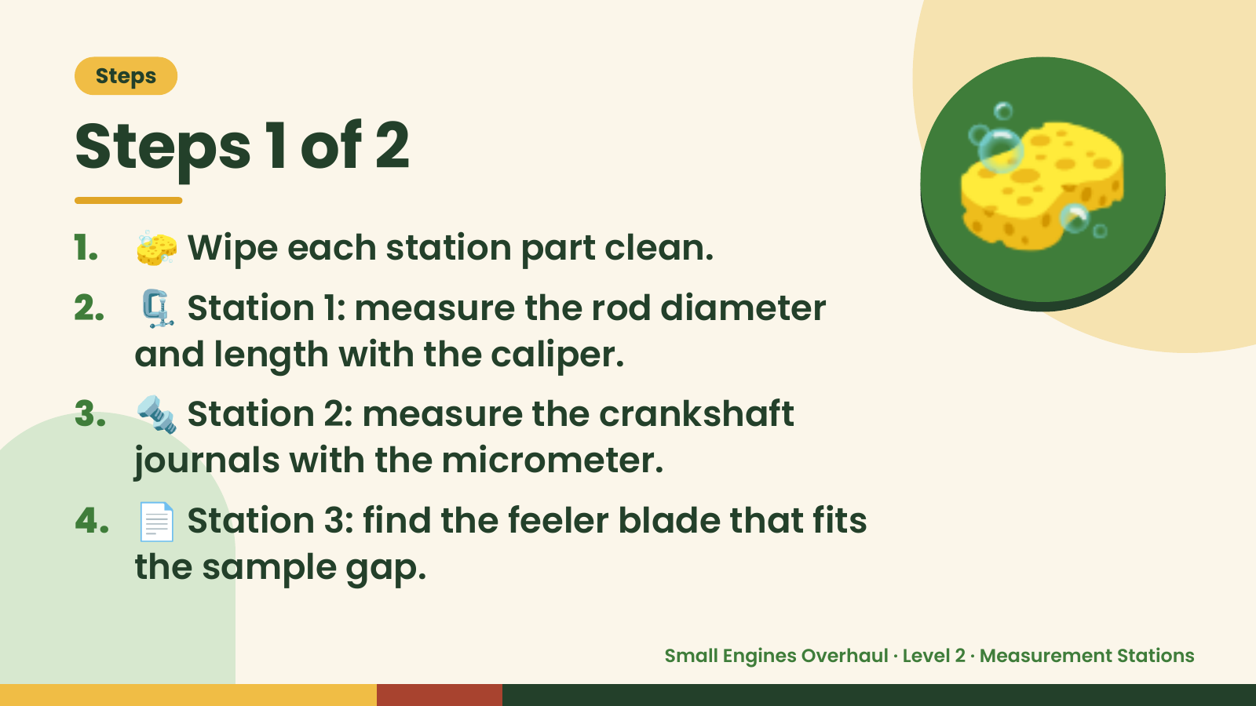
Notes:
Steps
Steps 1 of 2
1. 🧽 Wipe each station part clean.
2. 🗜️ Station 1: measure the rod diameter
and length with the caliper.
🧽
3. 🔩 Station 2: measure the crankshaft
journals with the micrometer.
4. 📄 Station 3: find the feeler blade that fits
the sample gap.
Small Engines Overhaul · Level 2 · Measurement Stations

Slide 5
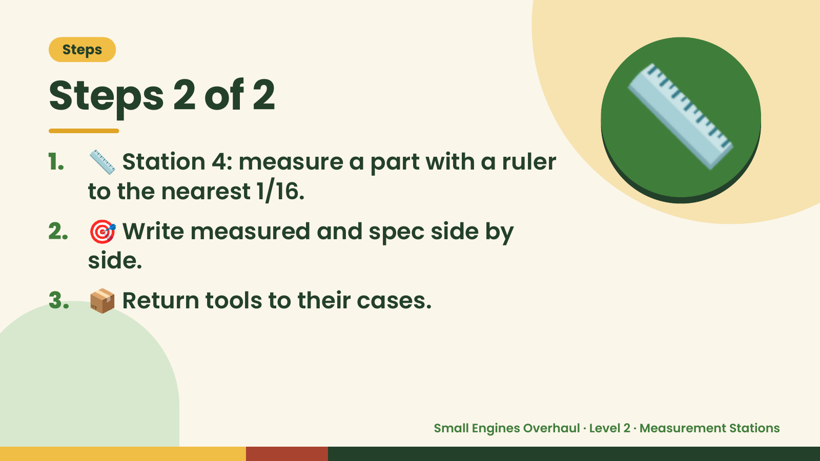
Notes:
Steps
Steps 2 of 2
1. 📏 Station 4: measure a part with a ruler
to the nearest 1/16.
2. 🎯 Write measured and spec side by
side.
📏
3. 📦 Return tools to their cases.
Small Engines Overhaul · Level 2 · Measurement Stations

Slide 6
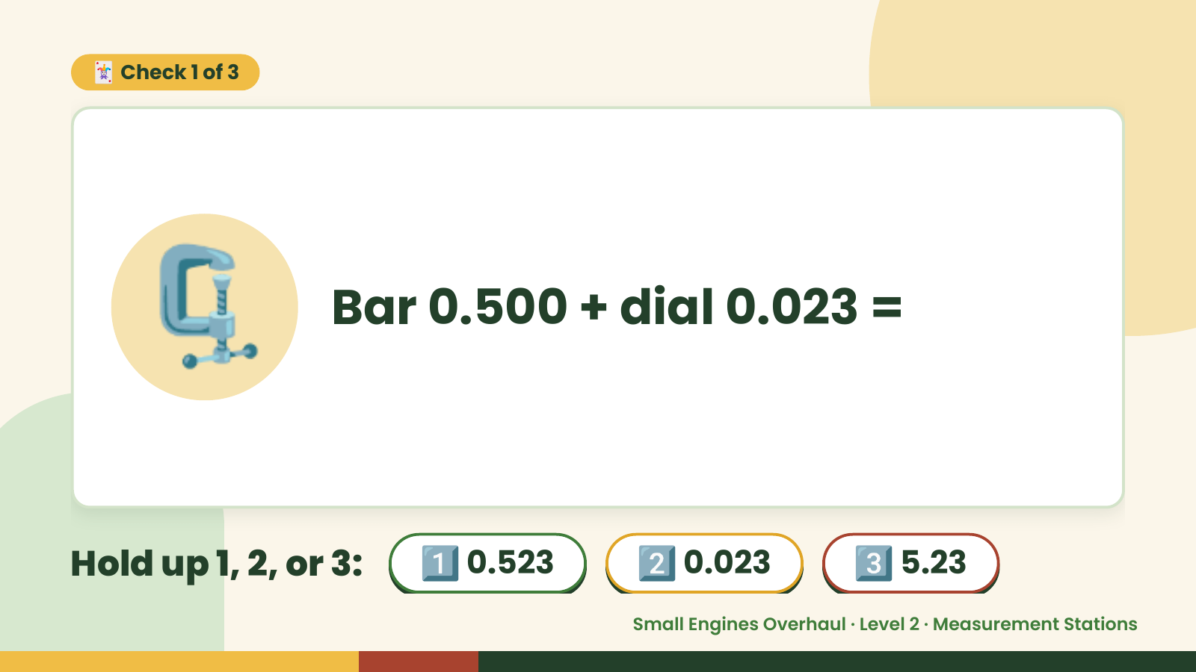
Notes:
🃏 Check 1 of 3
🗜️ Bar 0.500 + dial 0.023 =
Hold up 1, 2, or 3: 1️⃣ 0.523 2️⃣ 0.023 3️⃣ 5.23
Small Engines Overhaul · Level 2 · Measurement Stations

Slide 7
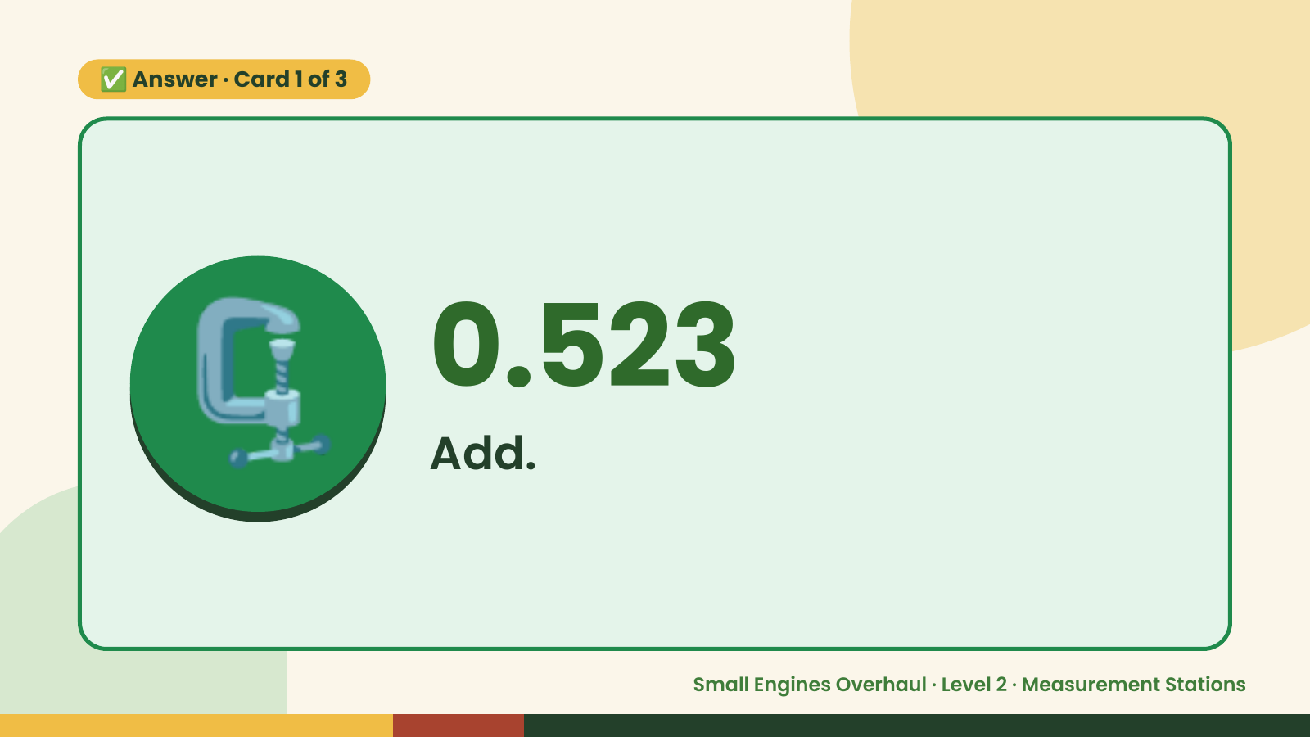
Notes:
✅ Answer · Card 1 of 3
🗜️ 0.523
Add.
Small Engines Overhaul · Level 2 · Measurement Stations

Slide 8
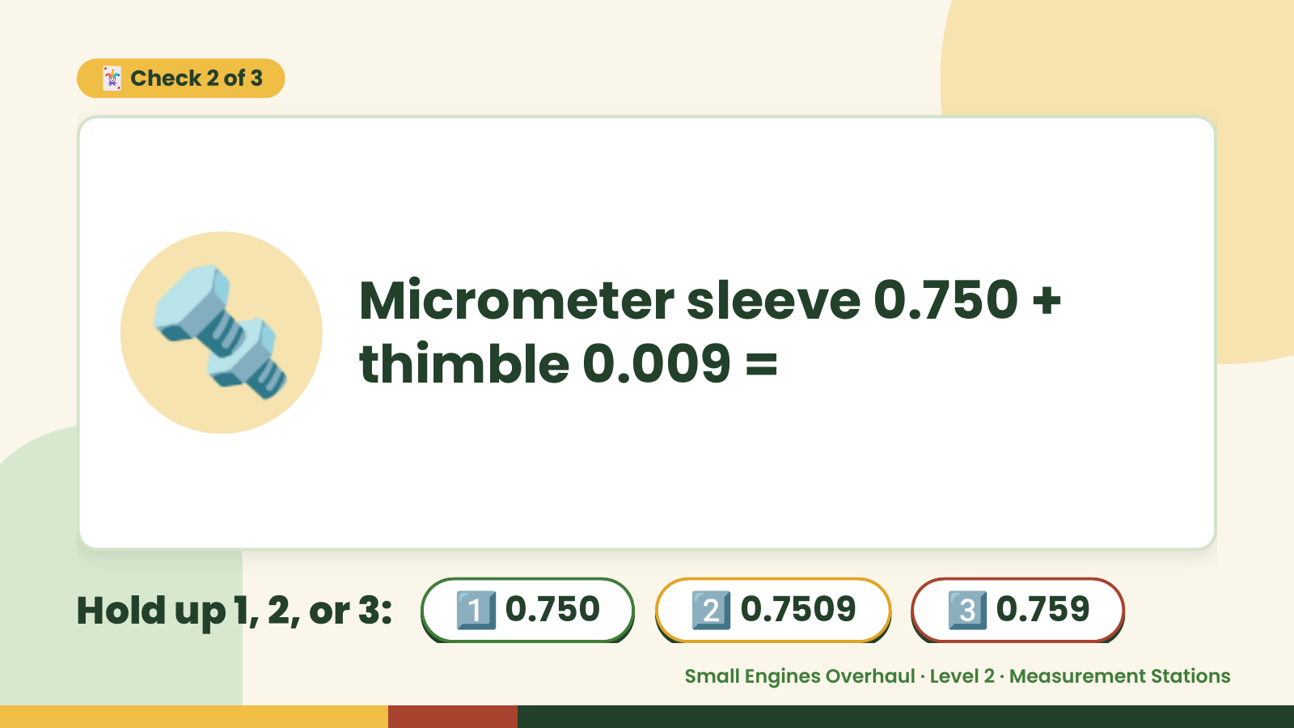
Notes:
🃏 Check 2 of 3
🔩 Micrometer sleeve 0.750 +
thimble 0.009 =
Hold up 1, 2, or 3: 1️⃣ 0.750 2️⃣ 0.7509 3️⃣ 0.759
Small Engines Overhaul · Level 2 · Measurement Stations

Slide 9
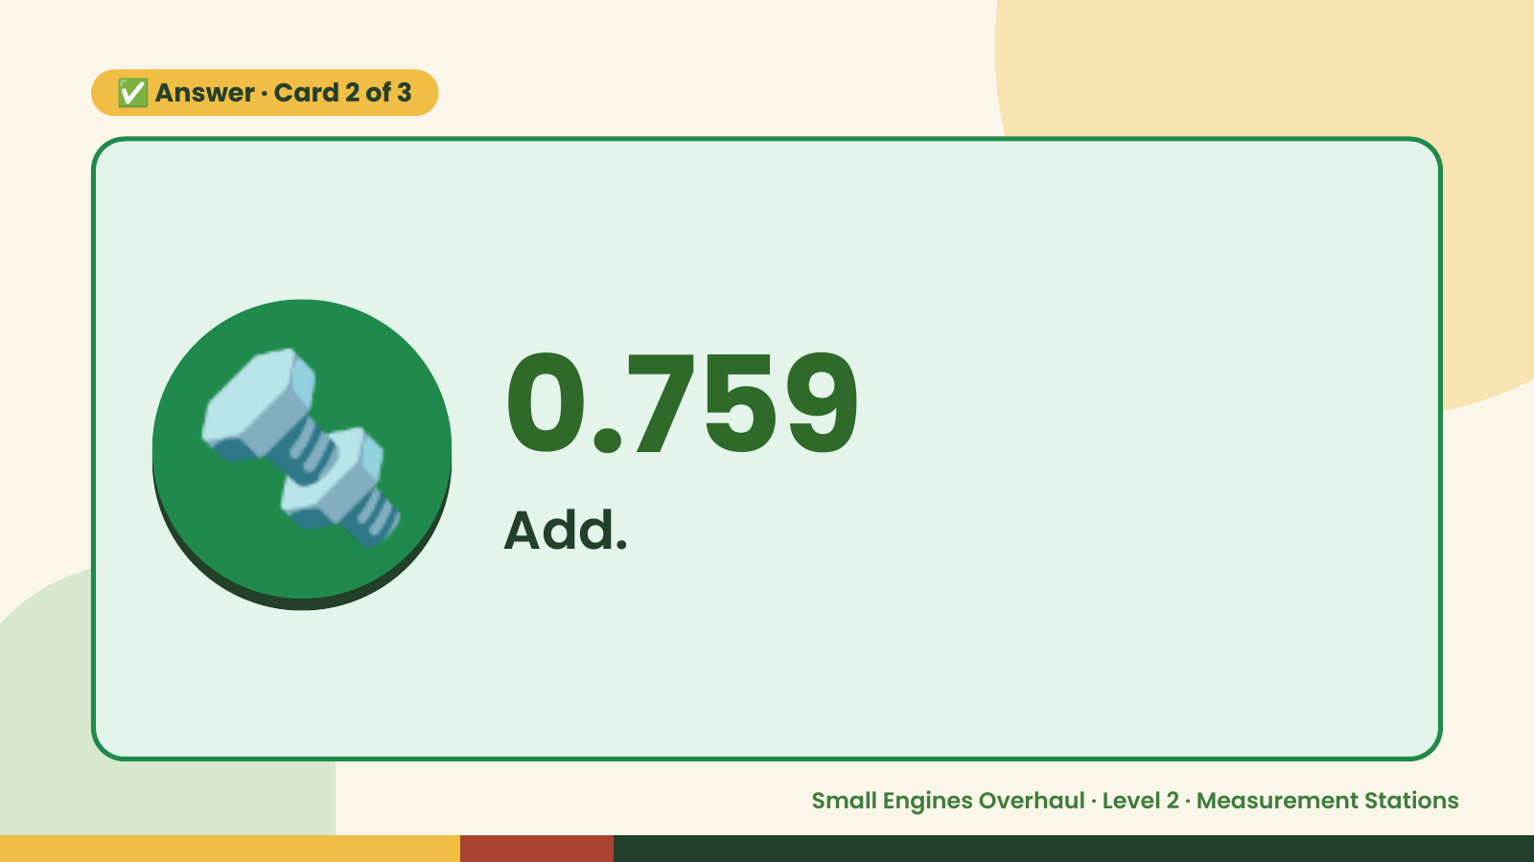
Notes:
✅ Answer · Card 2 of 3
🔩 0.759
Add.
Small Engines Overhaul · Level 2 · Measurement Stations

Slide 10
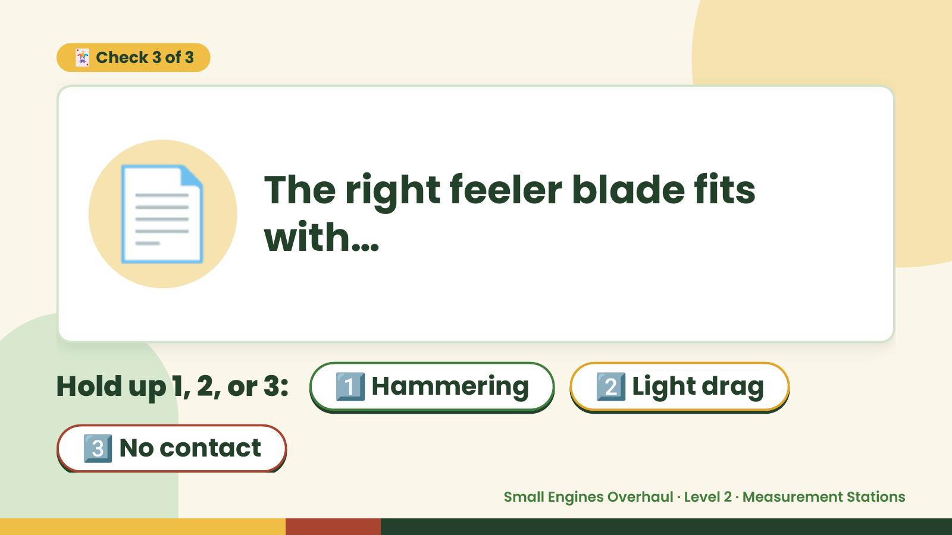
Notes:
🃏 Check 3 of 3
📄 The right feeler blade fits
with…
Hold up 1, 2, or 3: 1️⃣ Hammering 2️⃣ Light drag
3️⃣ No contact
Small Engines Overhaul · Level 2 · Measurement Stations

Slide 11
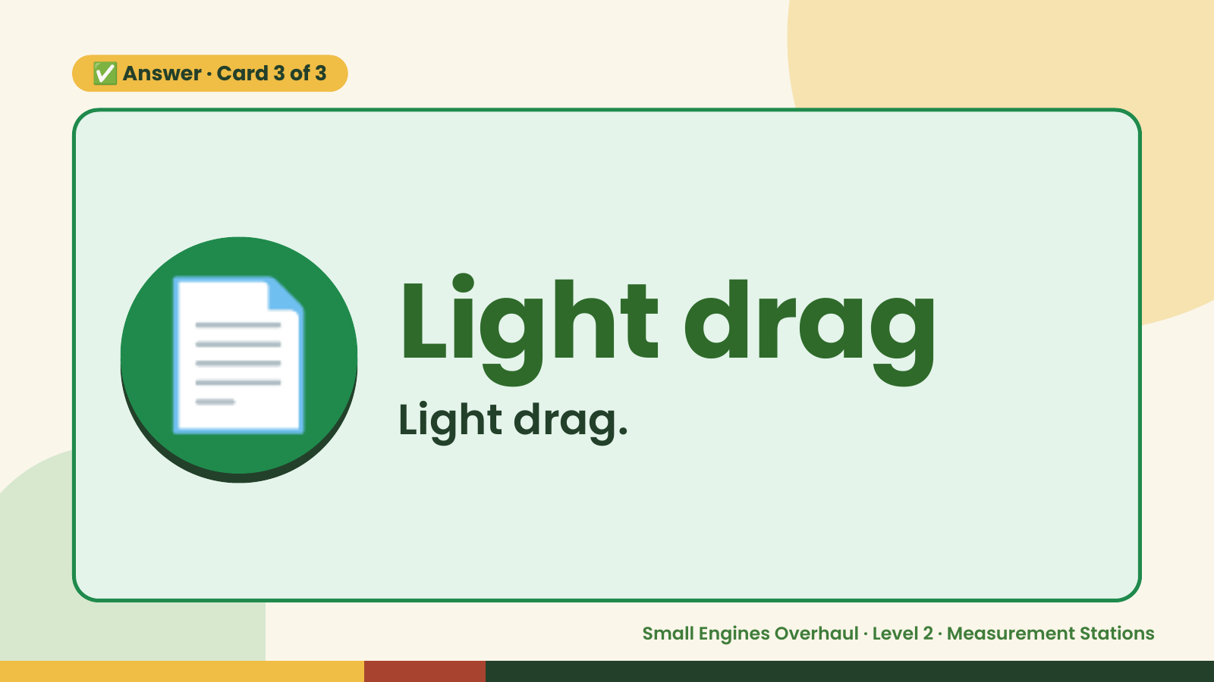
Notes:
✅ Answer · Card 3 of 3
📄 Light drag
Light drag.
Small Engines Overhaul · Level 2 · Measurement Stations

Slide 12

Notes:
Wrap-Up
Clean Up +
Reflect
🧽
Return and count tools.
Sweep and wipe your bench.
Wash hands, then do the reflection.
Small Engines Overhaul · Level 2 · Measurement Stations

