Slide 1
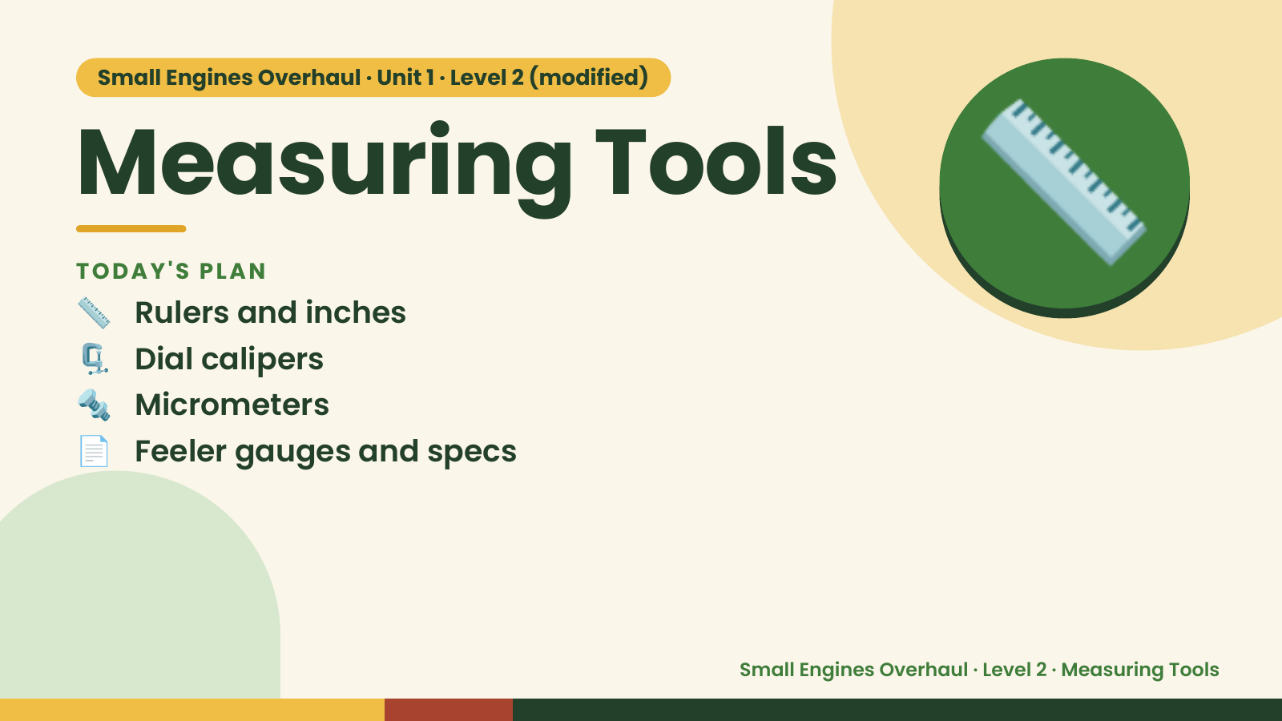
Notes:
Small Engines Overhaul · Unit 1 · Level 2 (modified)
Measuring Tools
📏 Rulers and inches
TODAY'S PLAN
🗜️ Dial calipers
🔩 Micrometers
📏
📄 Feeler gauges and specs
Small Engines Overhaul · Level 2 · Measuring Tools

Slide 2
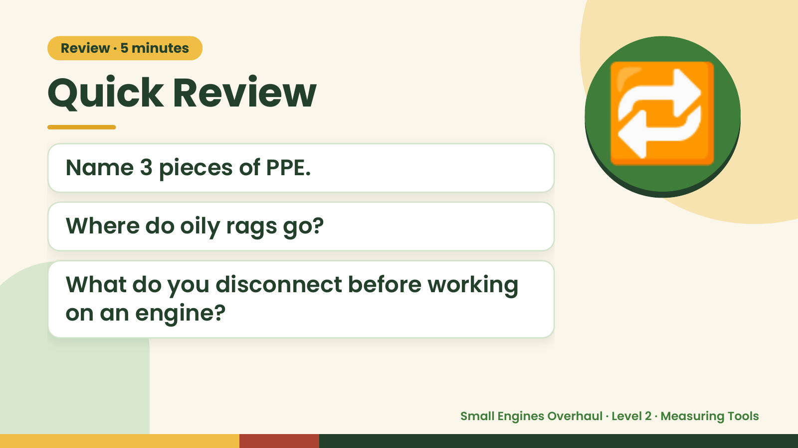
Notes:
Review · 5 minutes
Quick Review
Name 3 pieces of PPE.
Where do oily rags go?
🔁
What do you disconnect before working
on an engine?
Small Engines Overhaul · Level 2 · Measuring Tools

Slide 3
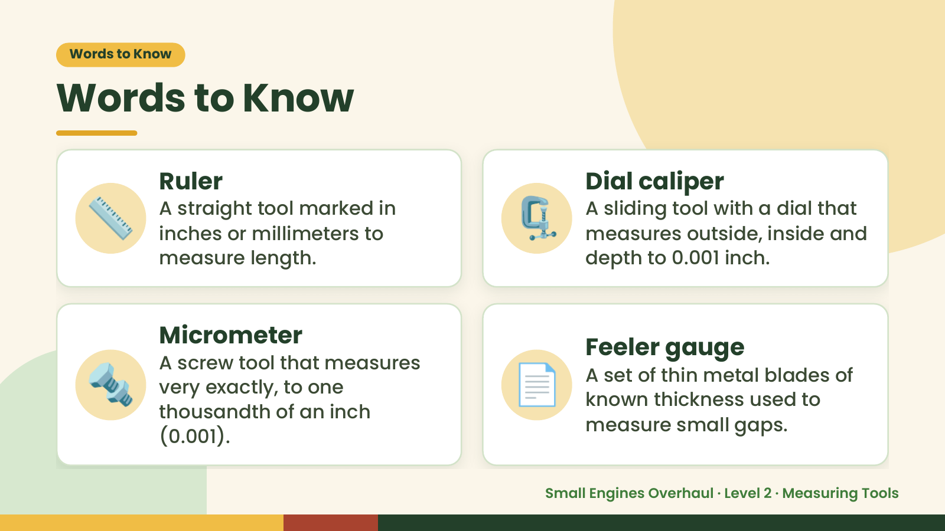
Notes:
Words to Know
Words to Know
📏 Ruler
A straight tool marked in
inches or millimeters to
measure length.
🗜️ Dial caliper
A sliding tool with a dial that
measures outside, inside and
depth to 0.001 inch.
🔩 📄
Micrometer Feeler gauge
A screw tool that measures
A set of thin metal blades of
very exactly, to one
known thickness used to
thousandth of an inch
measure small gaps.
(0.001).
Small Engines Overhaul · Level 2 · Measuring Tools

Slide 4
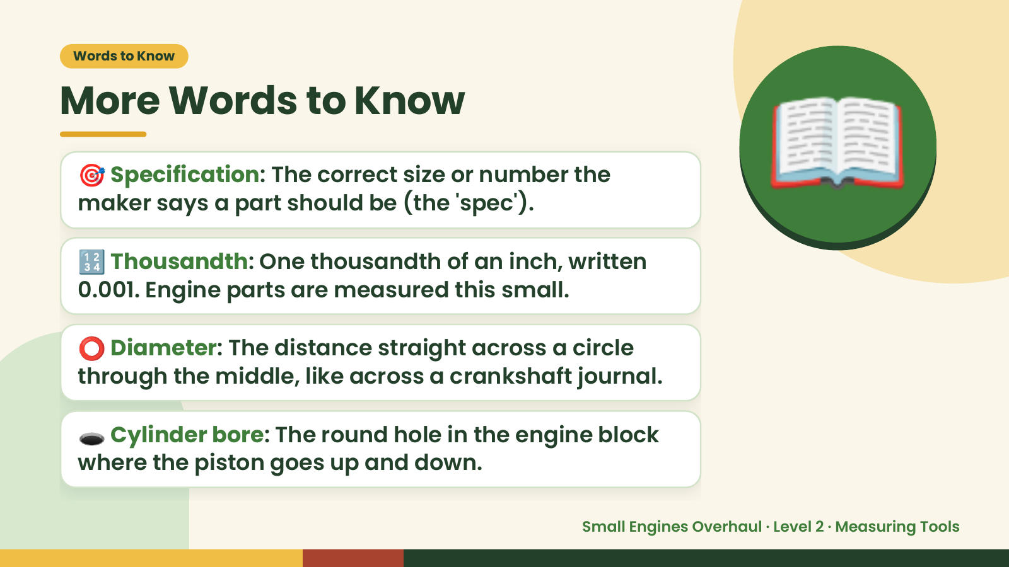
Notes:
Words to Know
More Words to Know
🎯 Specification: The correct size or number the
maker says a part should be (the 'spec').
🔢 Thousandth: One thousandth of an inch, written
0.001. Engine parts are measured this small.
📖
⭕ Diameter: The distance straight across a circle
through the middle, like across a crankshaft journal.
🕳️ Cylinder bore: The round hole in the engine block
where the piston goes up and down.
Small Engines Overhaul · Level 2 · Measuring Tools

Slide 5
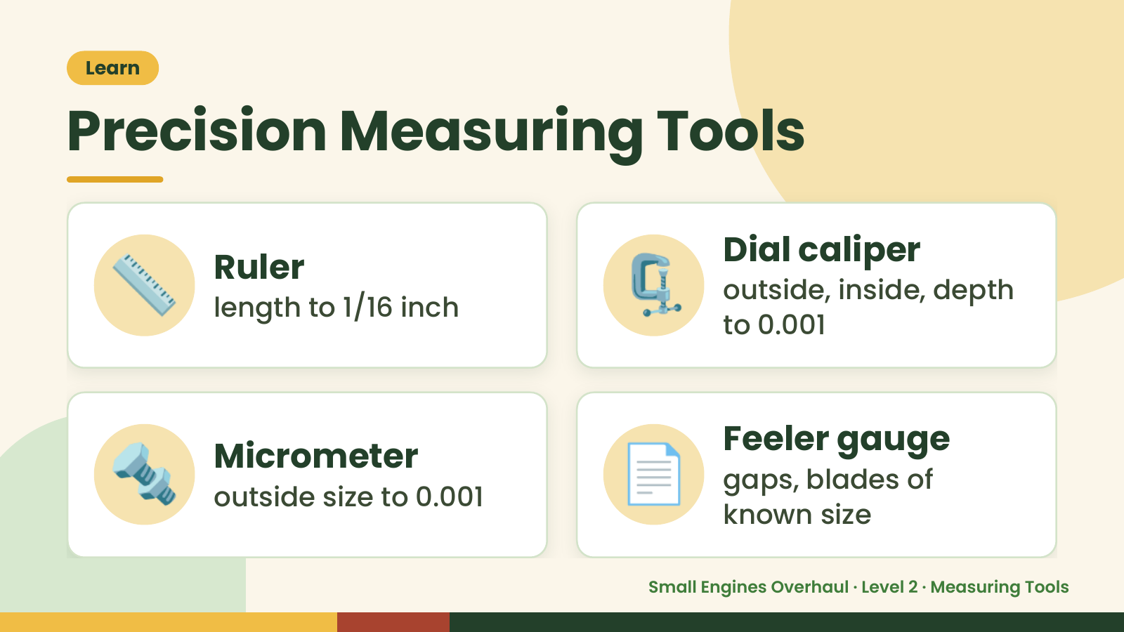
Notes:
Learn
Precision Measuring Tools
📏 Ruler
length to 1/16 inch 🗜️ Dial caliper
outside, inside, depth
to 0.001
🔩 Micrometer
outside size to 0.001 📄 Feeler gauge
gaps, blades of
known size
Small Engines Overhaul · Level 2 · Measuring Tools

Slide 6
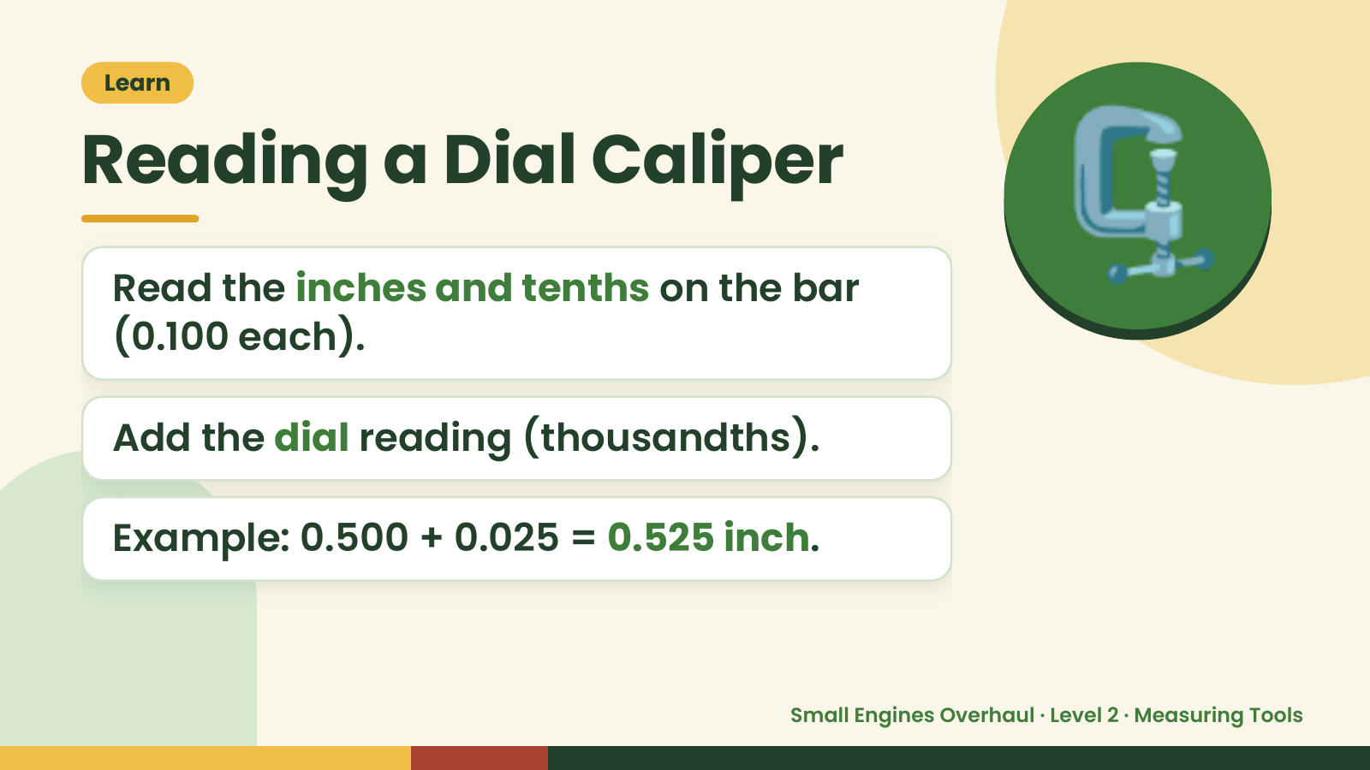
Notes:
Learn
Reading a Dial Caliper
Read the inches and tenths on the bar
(0.100 each).
🗜️
Add the dial reading (thousandths).
Example: 0.500 + 0.025 = 0.525 inch.
Small Engines Overhaul · Level 2 · Measuring Tools

Slide 7
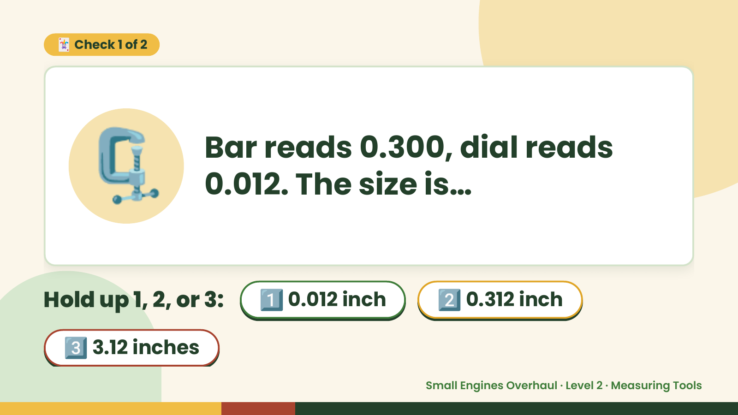
Notes:
🃏 Check 1 of 2
🗜️ Bar reads 0.300, dial reads
0.012. The size is…
Hold up 1, 2, or 3: 1️⃣ 0.012 inch 2️⃣ 0.312 inch
3️⃣ 3.12 inches
Small Engines Overhaul · Level 2 · Measuring Tools

Slide 8
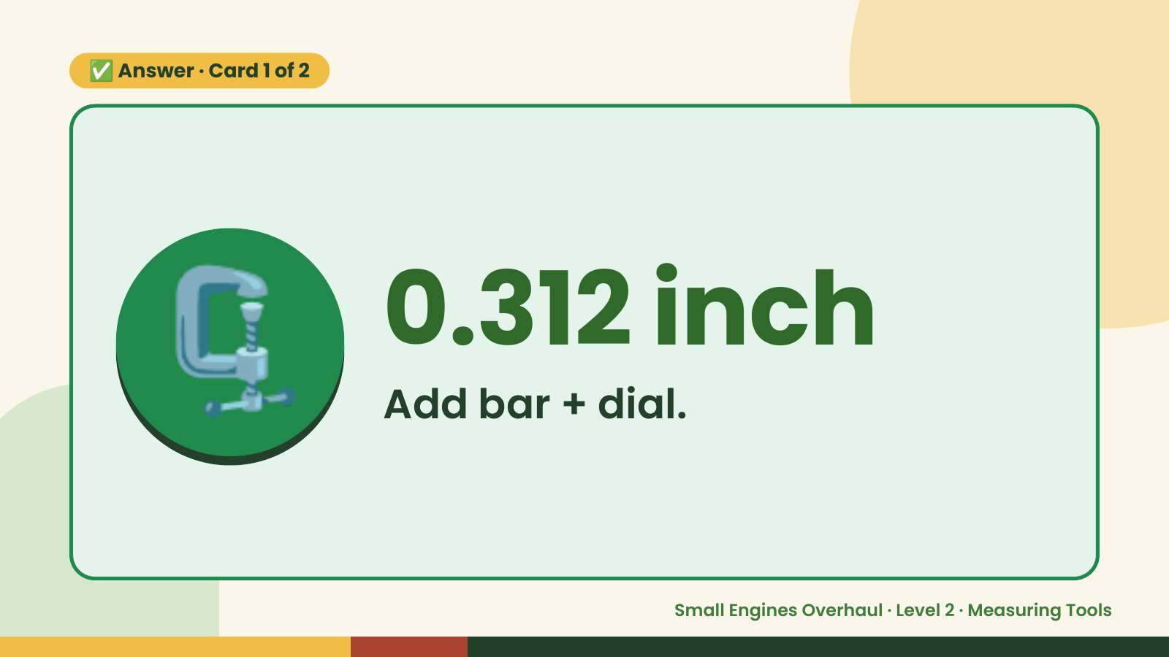
Notes:
✅ Answer · Card 1 of 2
🗜️ 0.312 inch
Add bar + dial.
Small Engines Overhaul · Level 2 · Measuring Tools

Slide 9
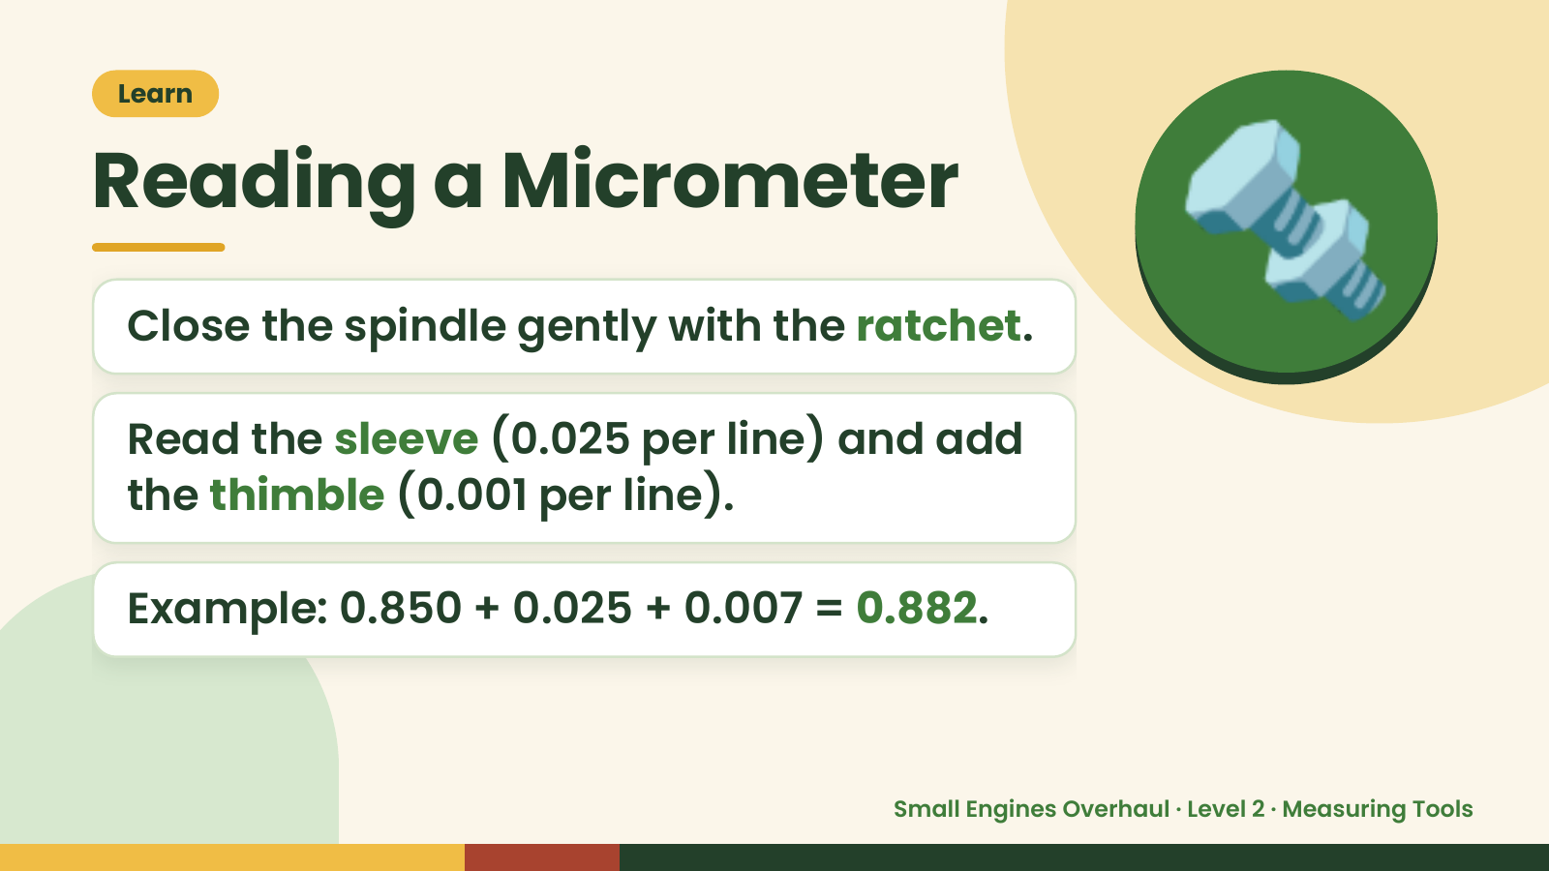
Notes:
Learn
Reading a Micrometer
Close the spindle gently with the ratchet.
Read the sleeve (0.025 per line) and add
🔩
the thimble (0.001 per line).
Example: 0.850 + 0.025 + 0.007 = 0.882.
Small Engines Overhaul · Level 2 · Measuring Tools

Slide 10
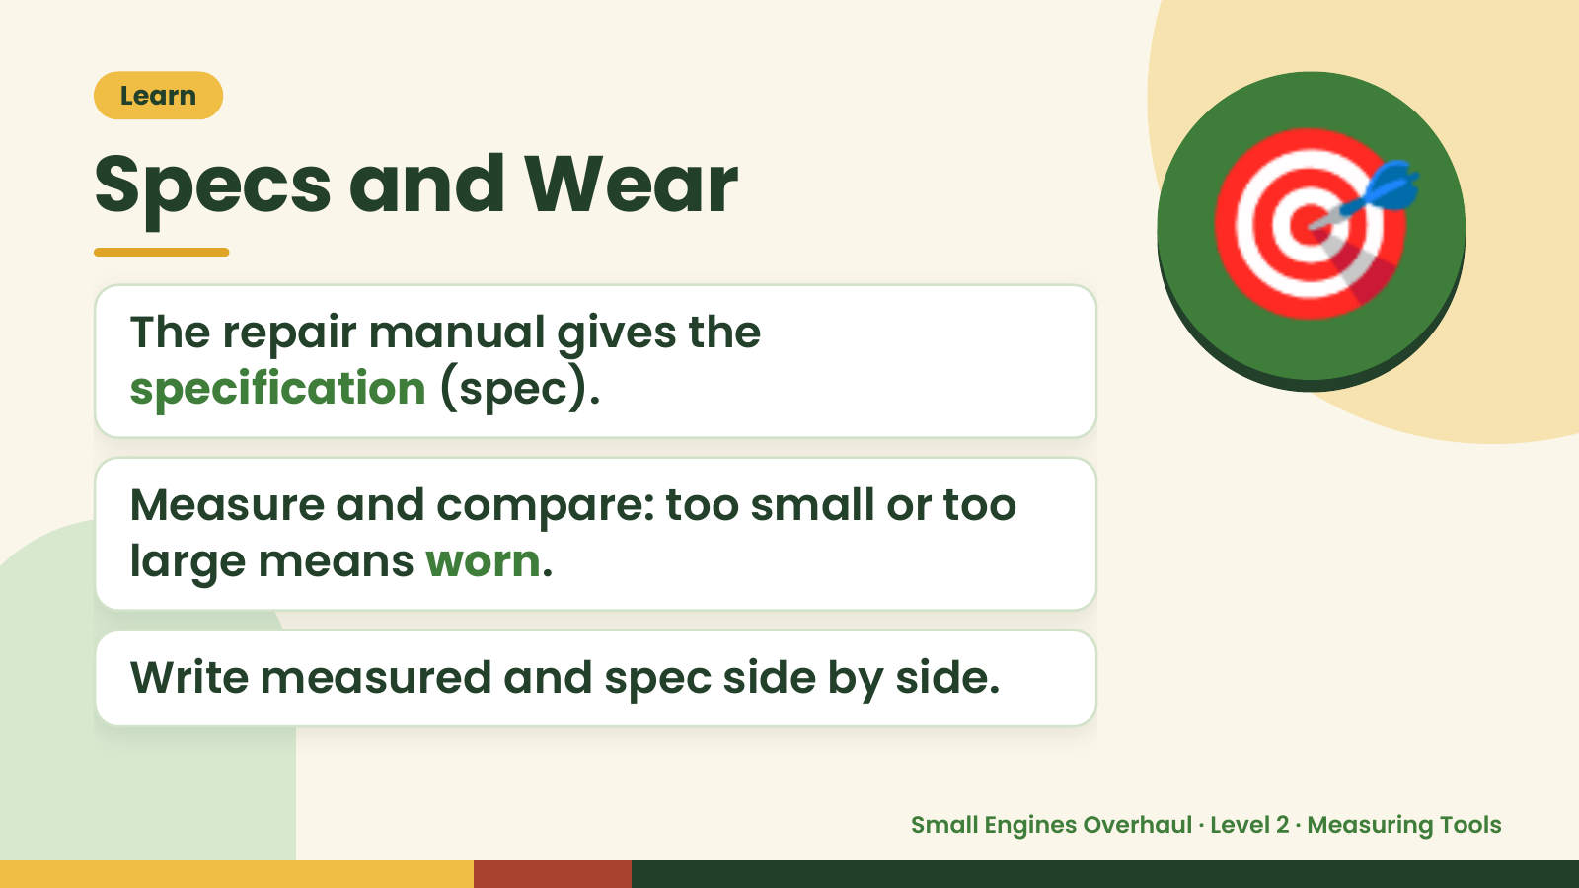
Notes:
Learn
Specs and Wear
The repair manual gives the
specification (spec).
🎯
Measure and compare: too small or too
large means worn.
Write measured and spec side by side.
Small Engines Overhaul · Level 2 · Measuring Tools

Slide 11
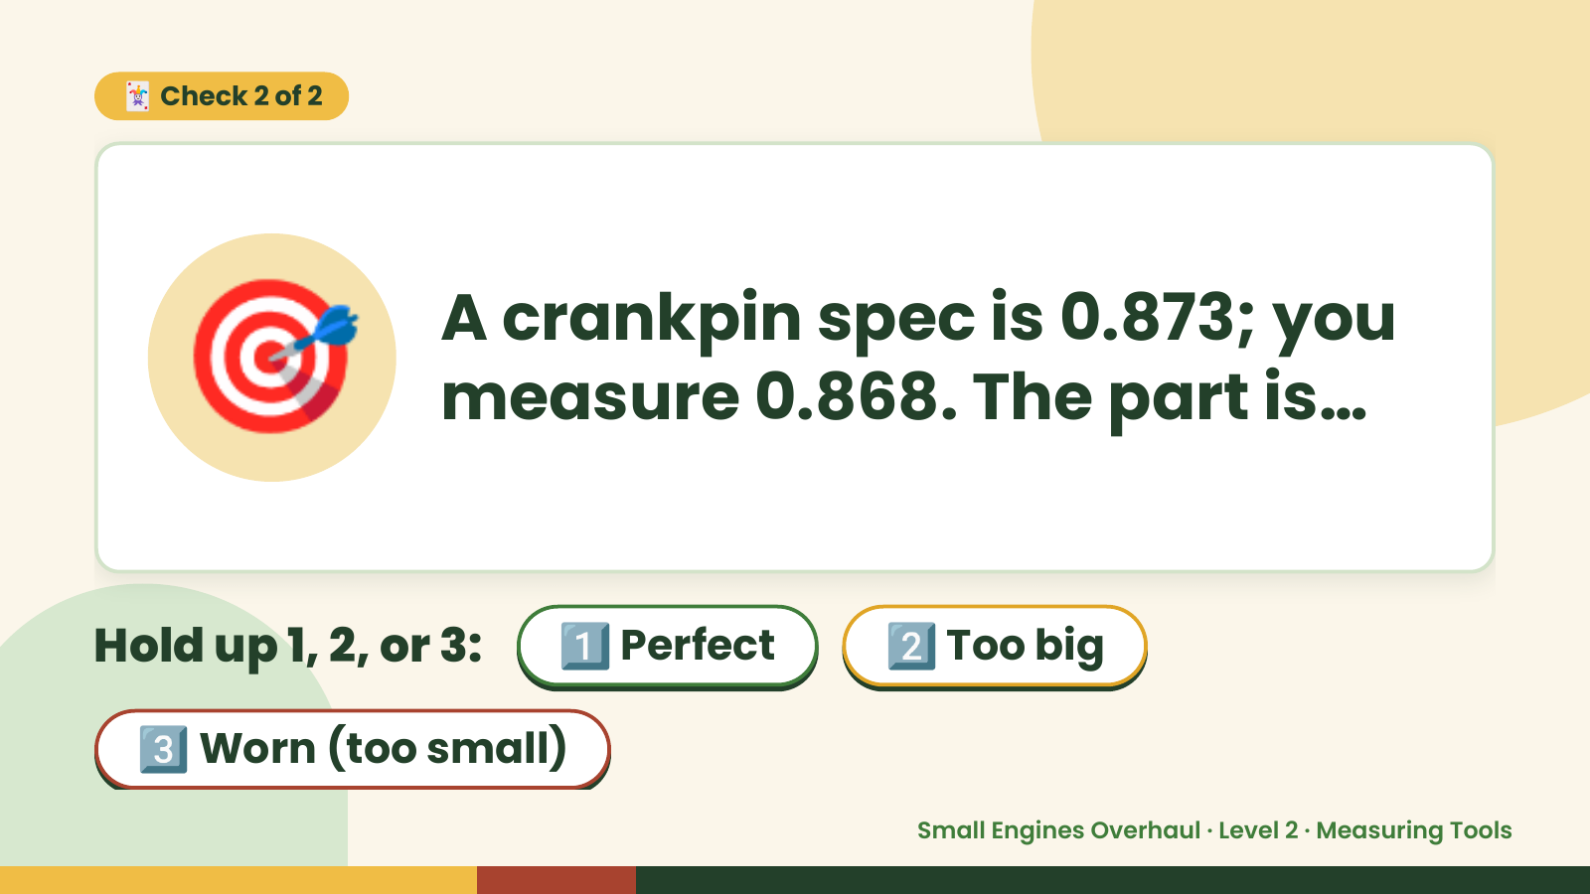
Notes:
🃏 Check 2 of 2
🎯 A crankpin spec is 0.873; you
measure 0.868. The part is…
Hold up 1, 2, or 3: 1️⃣ Perfect 2️⃣ Too big
3️⃣ Worn (too small)
Small Engines Overhaul · Level 2 · Measuring Tools

Slide 12
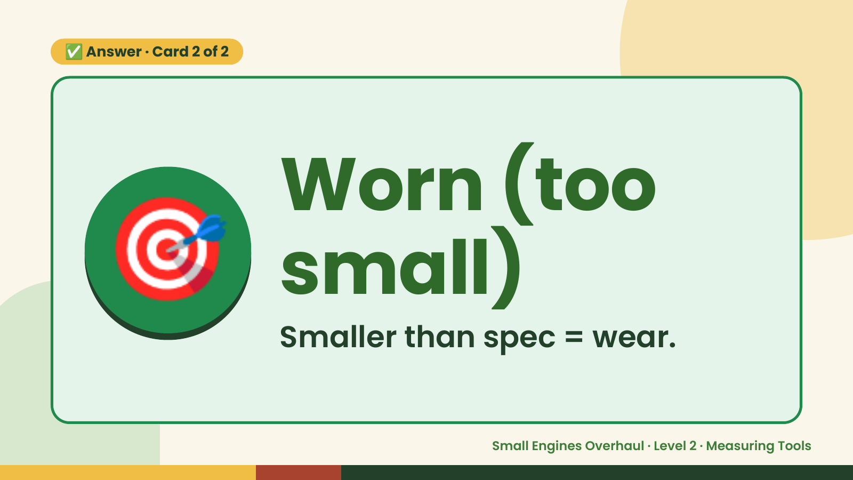
Notes:
✅ Answer · Card 2 of 2
🎯 Worn (too
small)
Smaller than spec = wear.
Small Engines Overhaul · Level 2 · Measuring Tools

Slide 13
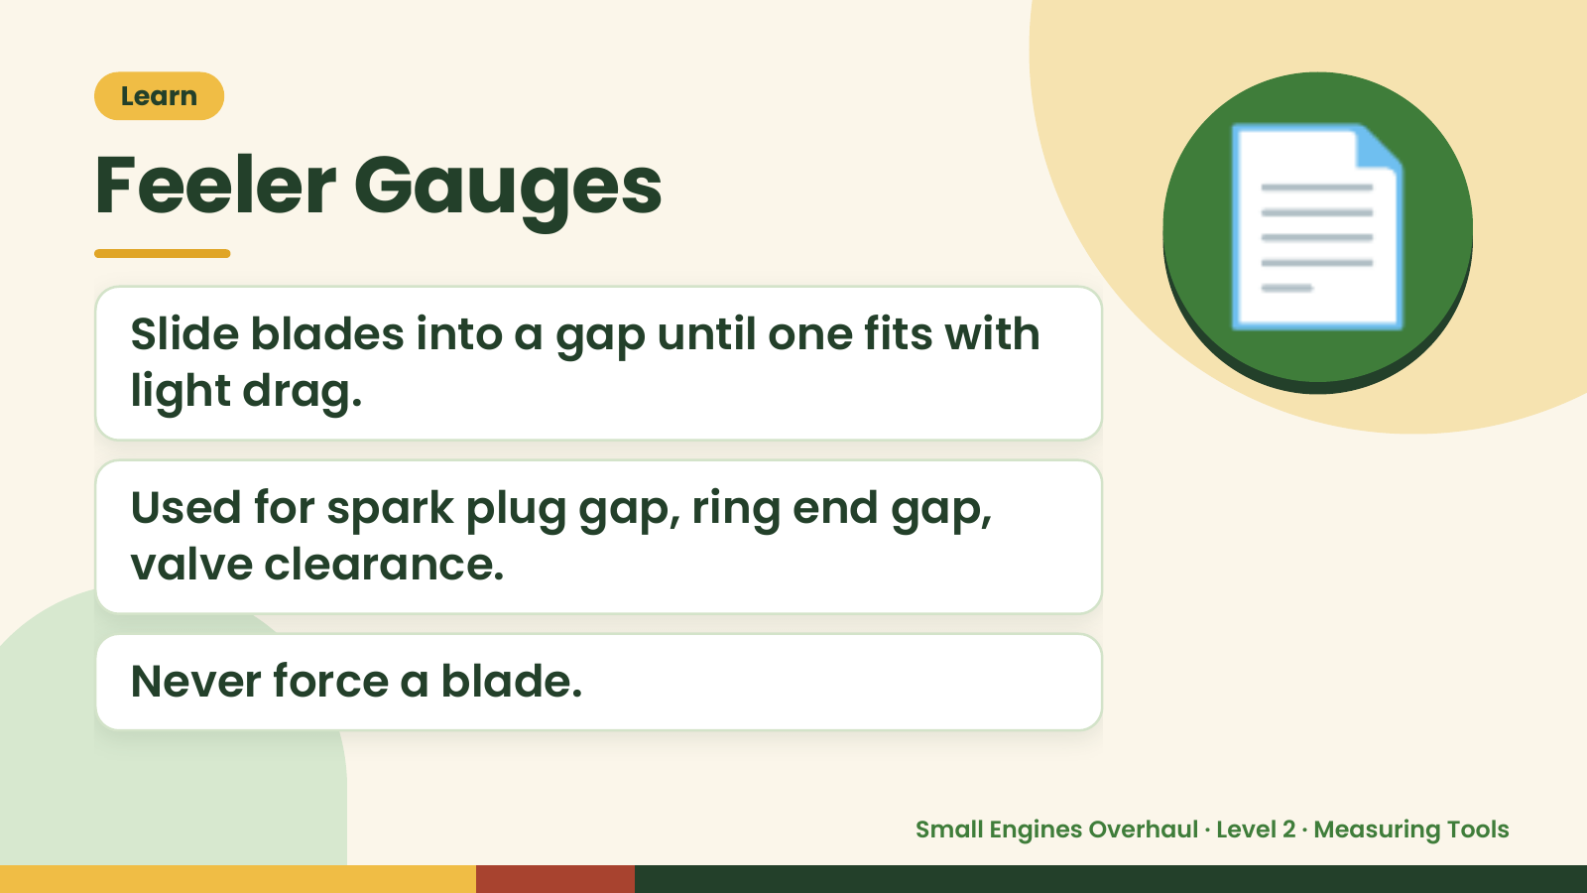
Notes:
Learn
Feeler Gauges
Slide blades into a gap until one fits with
light drag.
📄
Used for spark plug gap, ring end gap,
valve clearance.
Never force a blade.
Small Engines Overhaul · Level 2 · Measuring Tools

Slide 14
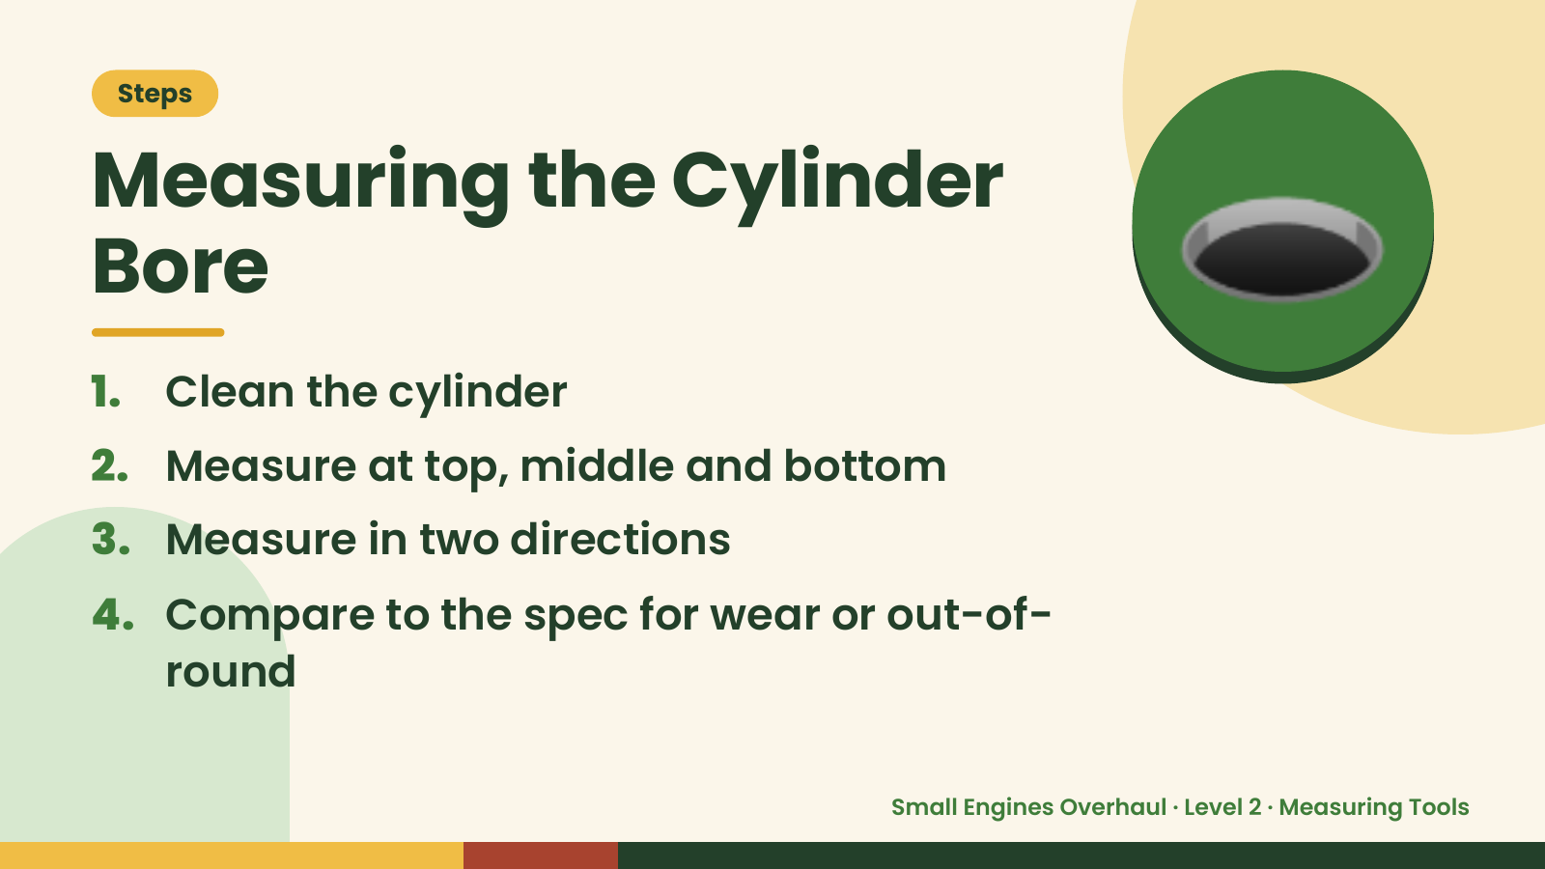
Notes:
Steps
Measuring the Cylinder
Bore
1. Clean the cylinder
2. Measure at top, middle and bottom
🕳️
3. Measure in two directions
4. Compare to the spec for wear or out-of-
round
Small Engines Overhaul · Level 2 · Measuring Tools

Slide 15
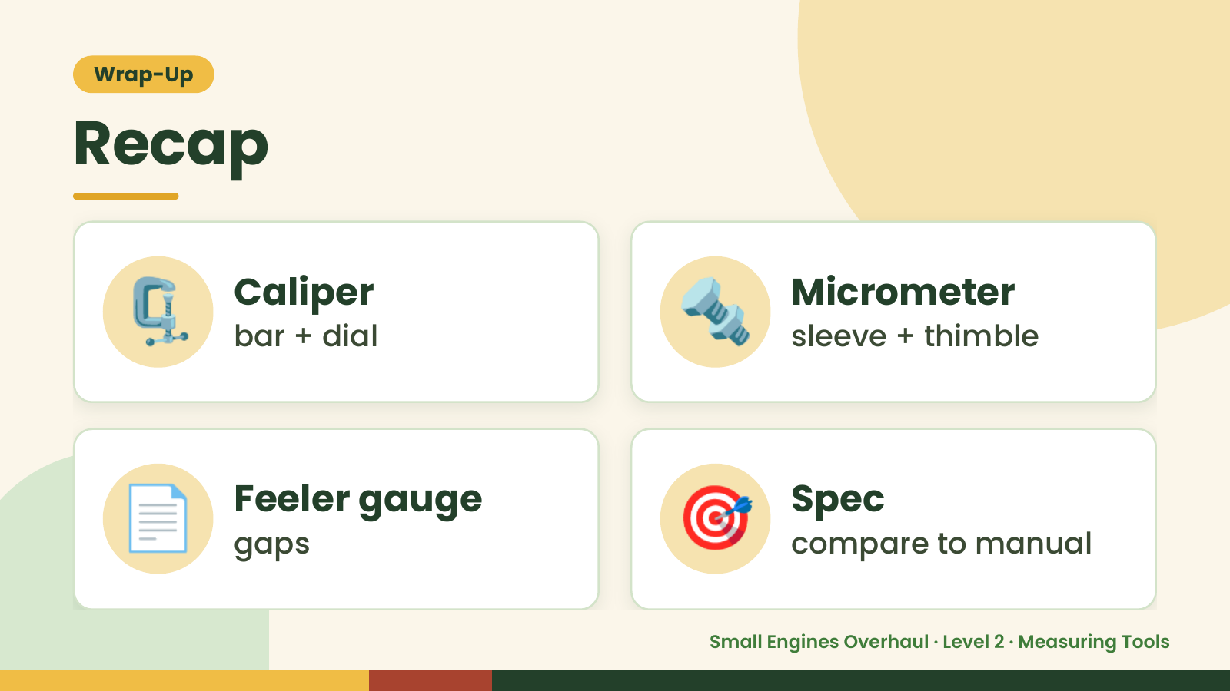
Notes:
Wrap-Up
Recap
🗜️ Caliper
bar + dial 🔩 Micrometer
sleeve + thimble
📄 Feeler gauge
gaps 🎯 Spec
compare to manual
Small Engines Overhaul · Level 2 · Measuring Tools

Slide 16
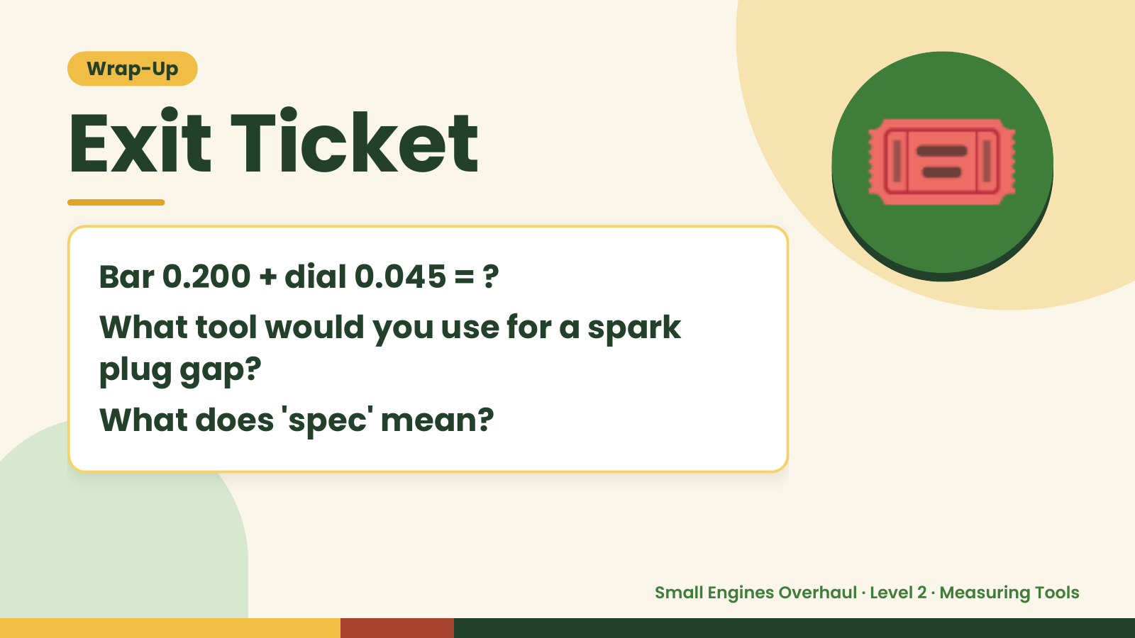
Notes:
Wrap-Up
Exit Ticket
Bar 0.200 + dial 0.045 = ?
What tool would you use for a spark
🎟️
plug gap?
What does 'spec' mean?
Small Engines Overhaul · Level 2 · Measuring Tools

