Slide 1
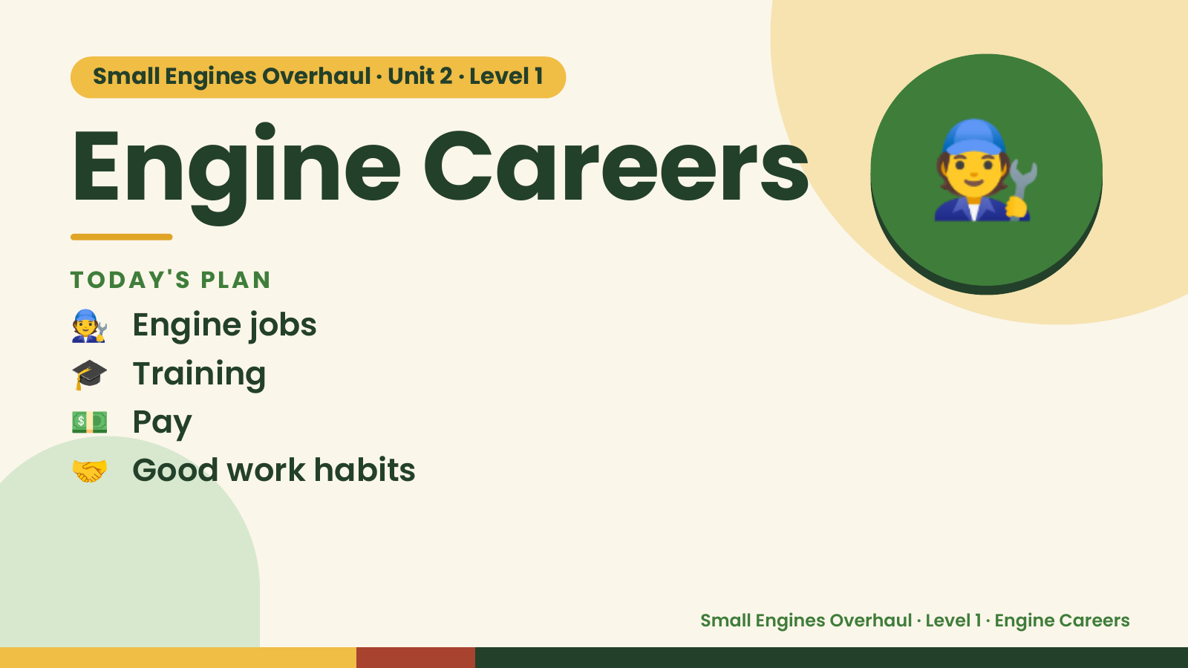
Notes:
🧑‍🔧
Small Engines Overhaul · Unit 2 · Level 1
Engine Careers
TODAY'S PLAN
🧑‍🔧 Engine jobs
🎓 Training
💵 Pay
🤝 Good work habits
Small Engines Overhaul · Level 1 · Engine Careers

Slide 2
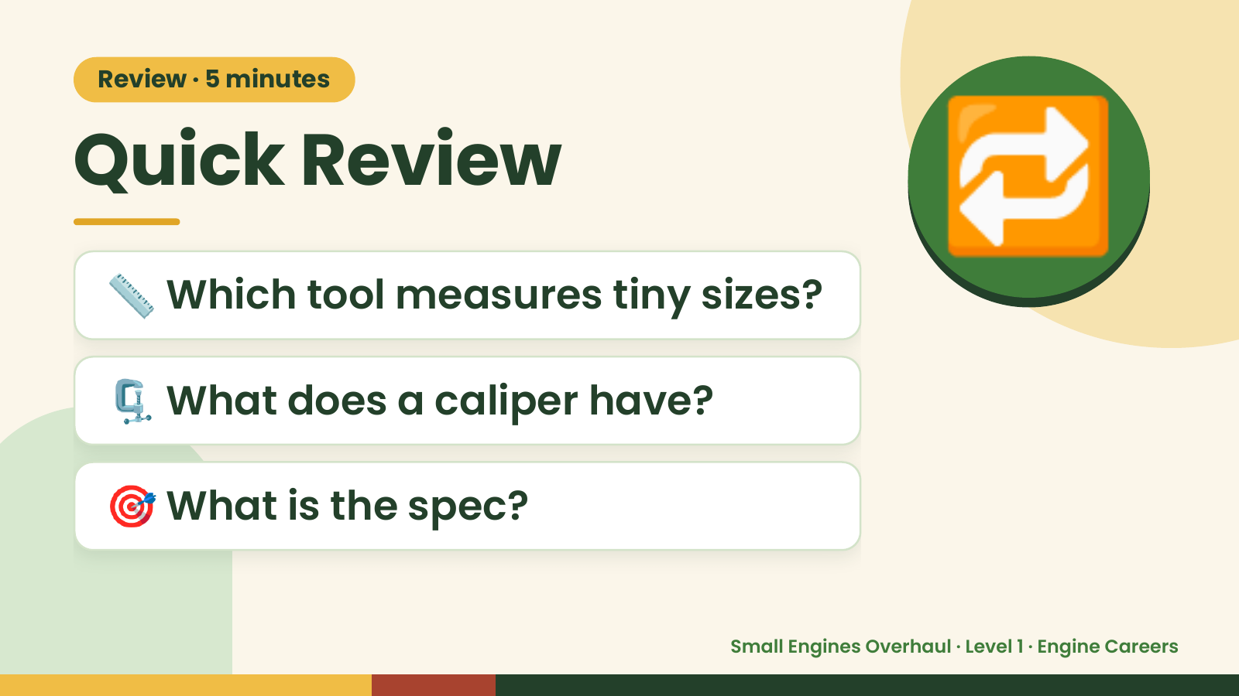
Notes:
Review · 5 minutes
Quick Review
📏 Which tool measures tiny sizes?
🔁
🗜️ What does a caliper have?
🎯 What is the spec?
Small Engines Overhaul · Level 1 · Engine Careers

Slide 3
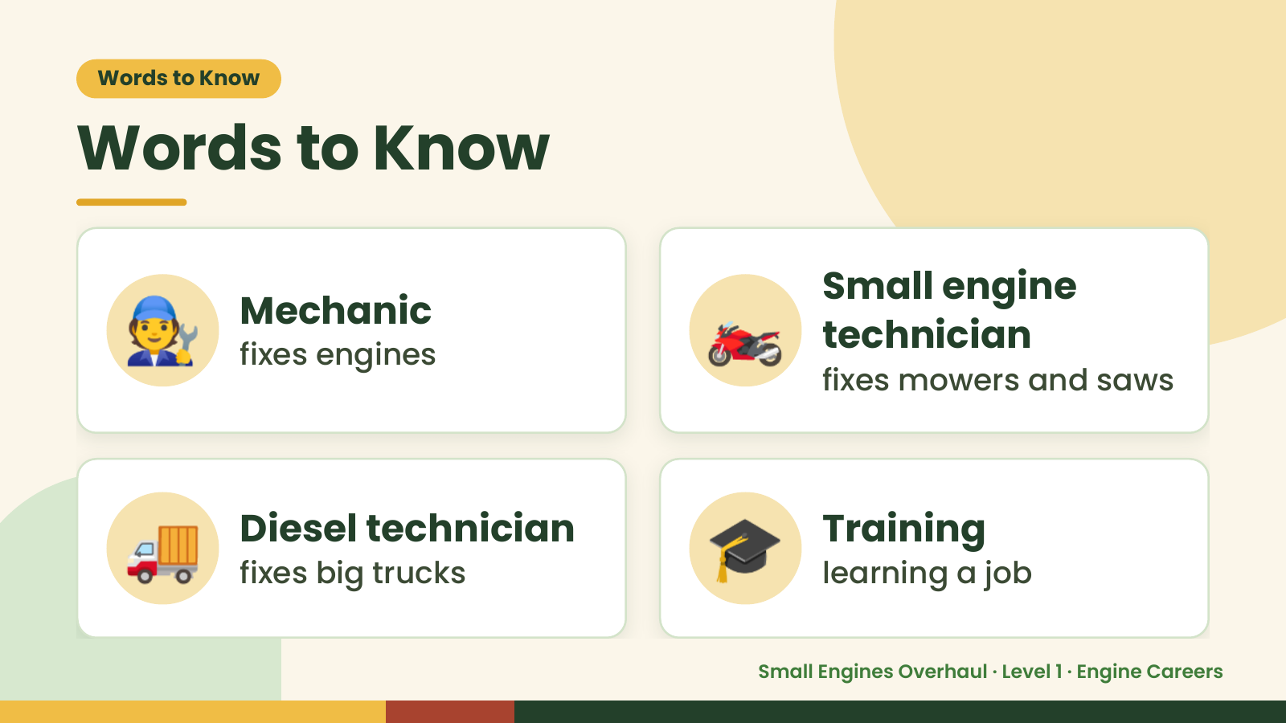
Notes:
Words to Know
Words to Know
🧑‍🔧 Mechanic
fixes engines 🏍️ Small engine
technician
fixes mowers and saws
🚚 Diesel technician
fixes big trucks 🎓 Training
learning a job
Small Engines Overhaul · Level 1 · Engine Careers

Slide 4
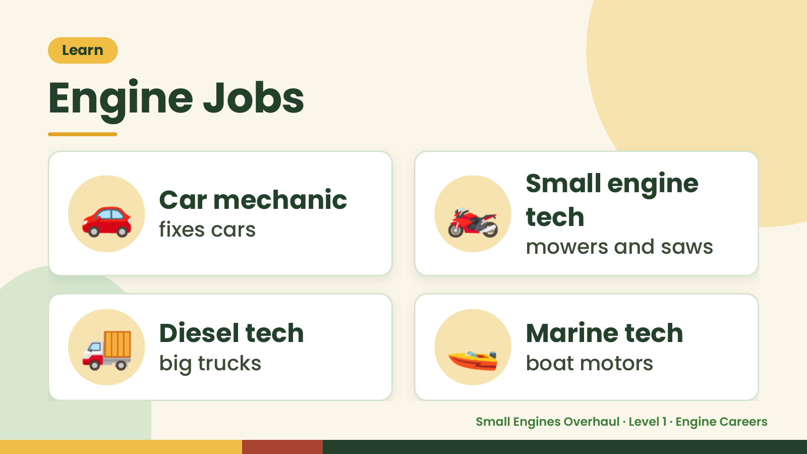
Notes:
Learn
Engine Jobs
🚗 Car mechanic
fixes cars 🏍️ Small engine
tech
mowers and saws
🚚 Diesel tech
big trucks 🚤 Marine tech
boat motors
Small Engines Overhaul · Level 1 · Engine Careers

Slide 5
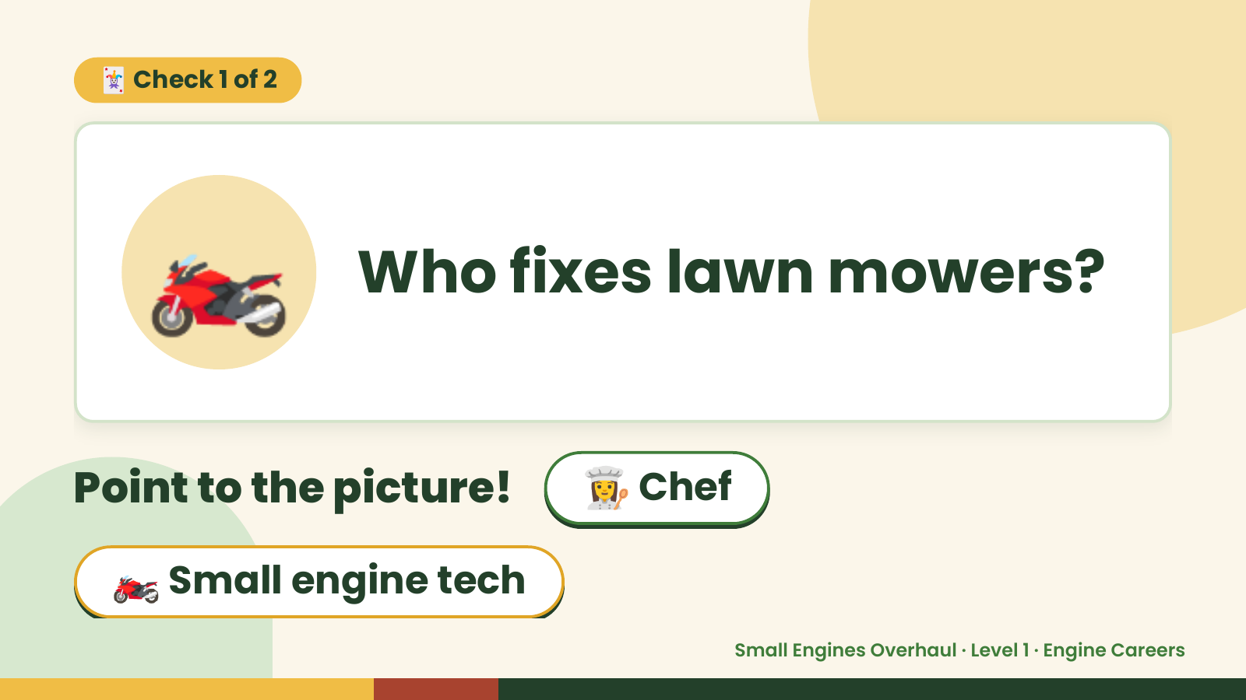
Notes:
🃏 Check 1 of 2
🏍️ Who fixes lawn mowers?
Point to the picture! 👩‍🍳 Chef
🏍️ Small engine tech
Small Engines Overhaul · Level 1 · Engine Careers

Slide 6
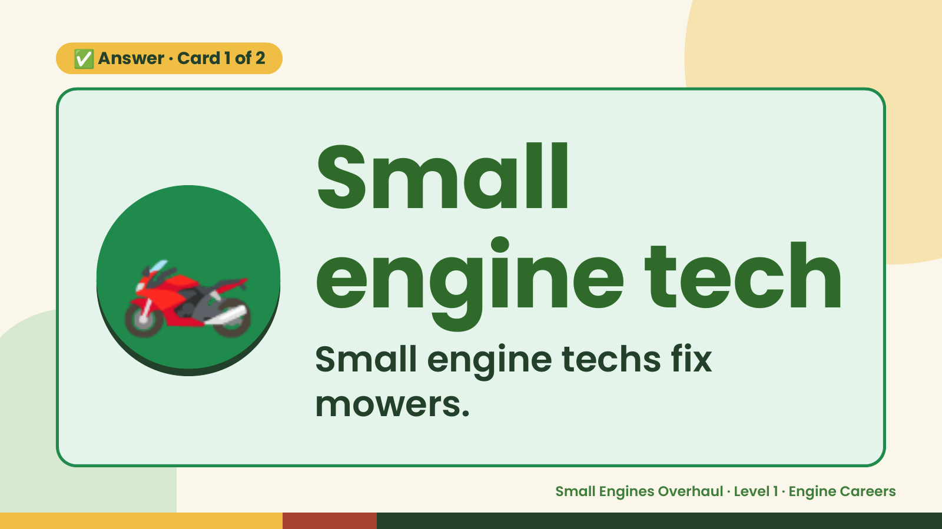
Notes:
✅ Answer · Card 1 of 2
🏍️ Small
engine tech
Small engine techs fix
mowers.
Small Engines Overhaul · Level 1 · Engine Careers

Slide 7
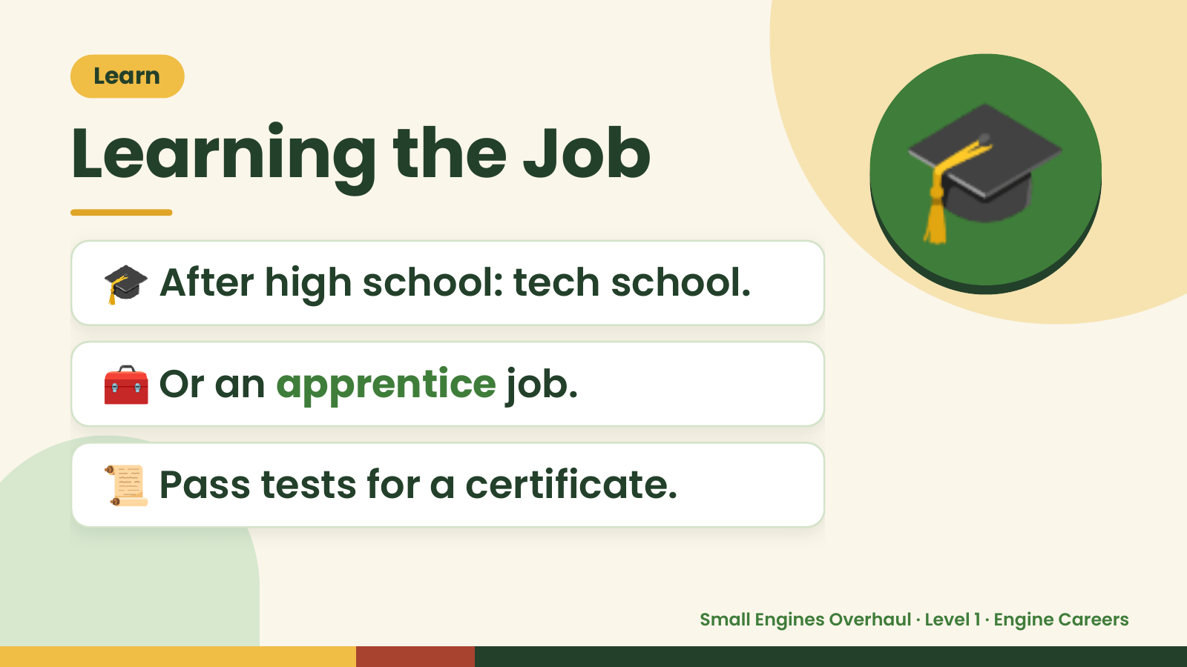
Notes:
Learn
Learning the Job
🎓 After high school: tech school.
🎓
🧰 Or an apprentice job.
📜 Pass tests for a certificate.
Small Engines Overhaul · Level 1 · Engine Careers

Slide 8
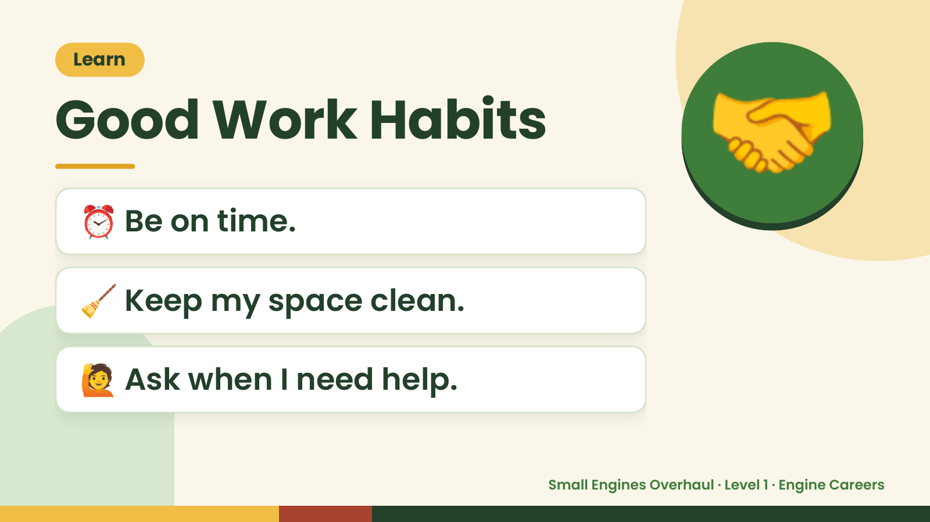
Notes:
Learn
Good Work Habits
⏰ Be on time.
🤝
🧹 Keep my space clean.
🙋 Ask when I need help.
Small Engines Overhaul · Level 1 · Engine Careers

Slide 9
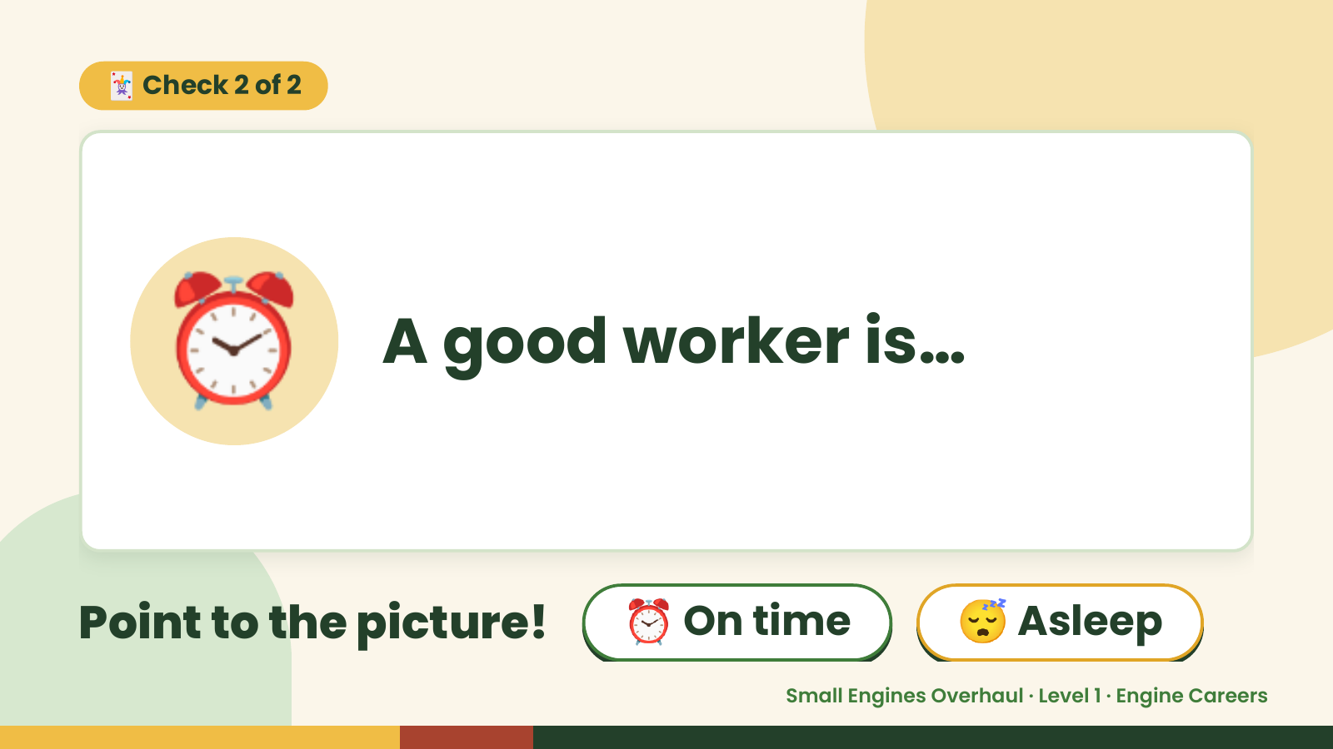
Notes:
🃏 Check 2 of 2
⏰ A good worker is…
Point to the picture! ⏰ On time 😴 Asleep
Small Engines Overhaul · Level 1 · Engine Careers

Slide 10
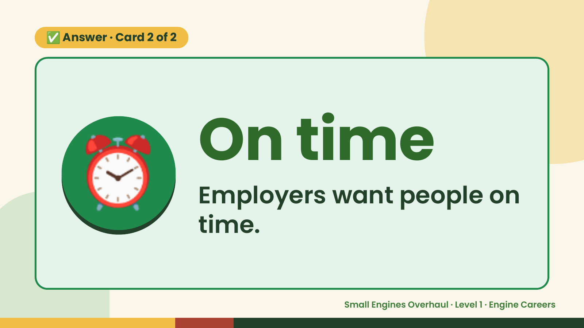
Notes:
✅ Answer · Card 2 of 2
⏰ On time
Employers want people on
time.
Small Engines Overhaul · Level 1 · Engine Careers

Slide 11
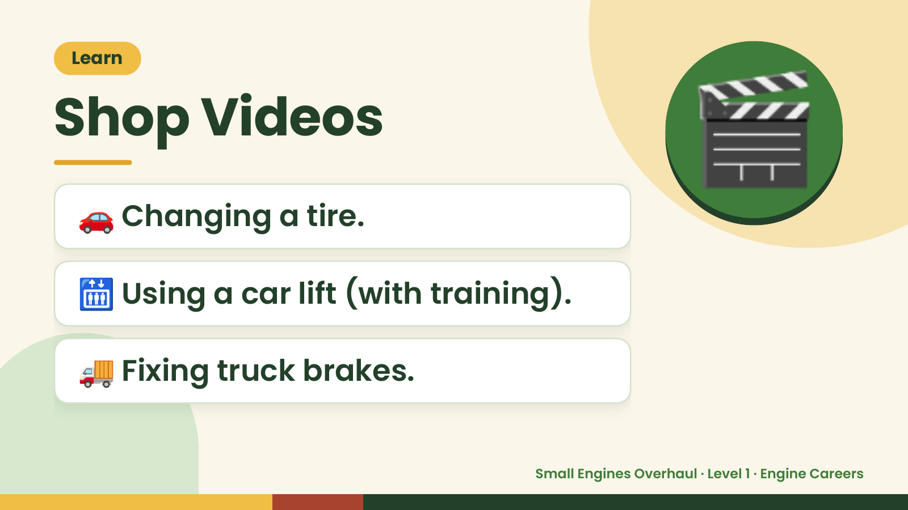
Notes:
Learn
Shop Videos
🚗 Changing a tire.
🎬
🛗 Using a car lift (with training).
🚚 Fixing truck brakes.
Small Engines Overhaul · Level 1 · Engine Careers

Slide 12
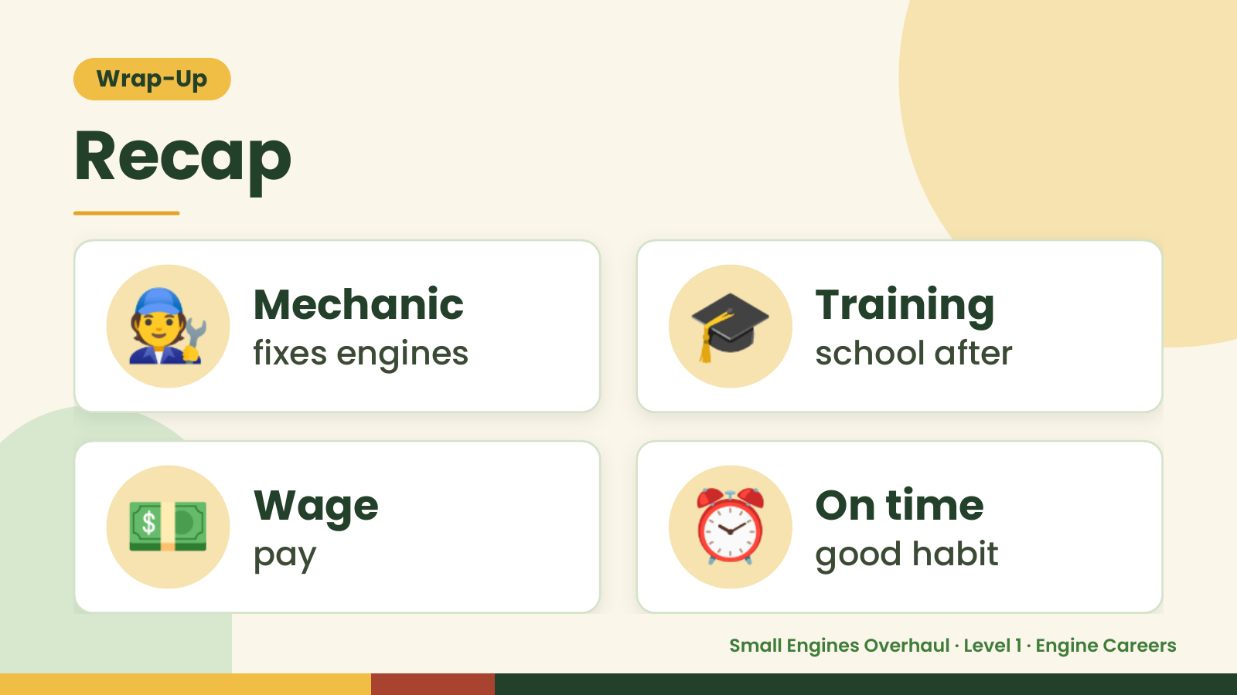
Notes:
Wrap-Up
Recap
🧑‍🔧 Mechanic
fixes engines 🎓 Training
school after
💵 Wage
pay ⏰ On time
good habit
Small Engines Overhaul · Level 1 · Engine Careers

Slide 13
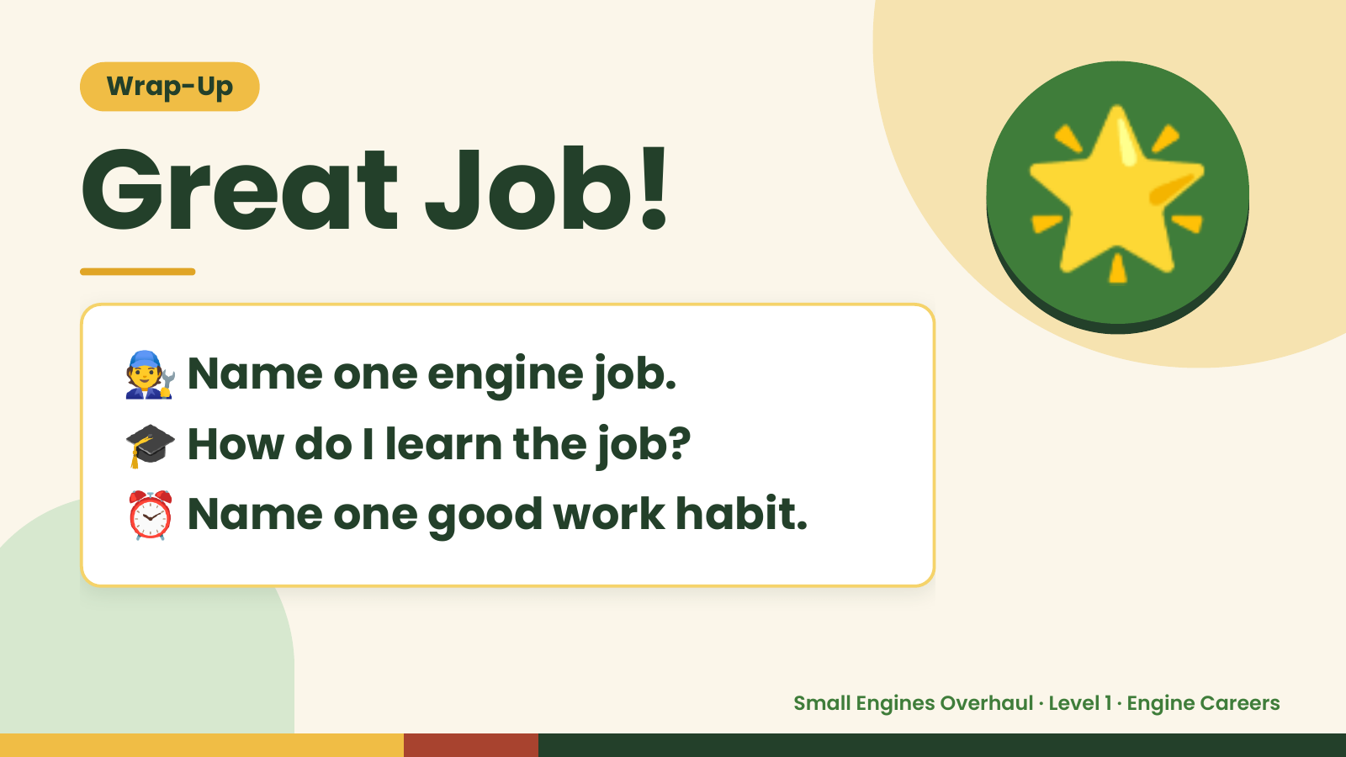
Notes:
Wrap-Up
Great Job!
🧑‍🔧Name one engine job.
🌟
🎓 How do I learn the job?
⏰ Name one good work habit.
Small Engines Overhaul · Level 1 · Engine Careers

