Slide 1
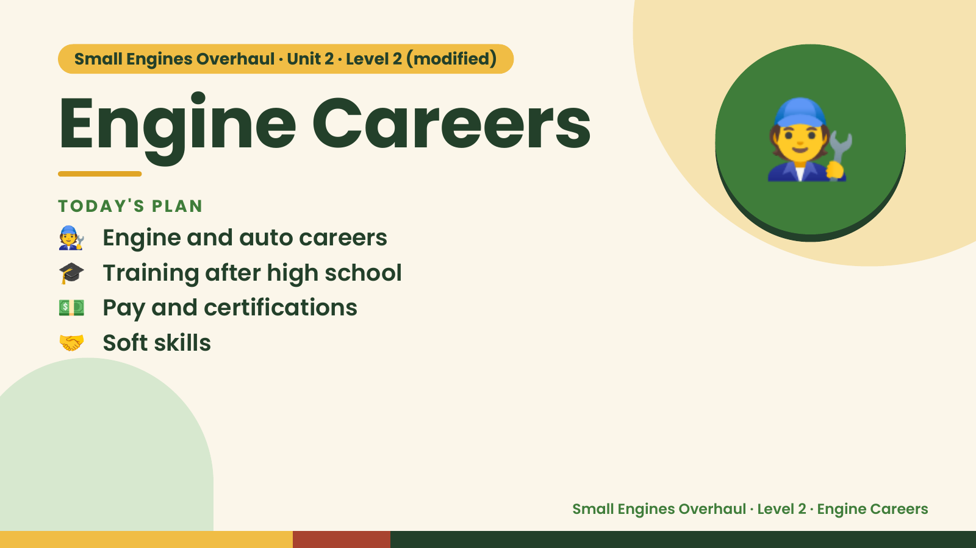
Notes:
🧑‍🔧
Small Engines Overhaul · Unit 2 · Level 2 (modified)
Engine Careers
🧑‍🔧 Engine and auto careers
TODAY'S PLAN
🎓 Training after high school
💵 Pay and certifications
🤝 Soft skills
Small Engines Overhaul · Level 2 · Engine Careers

Slide 2
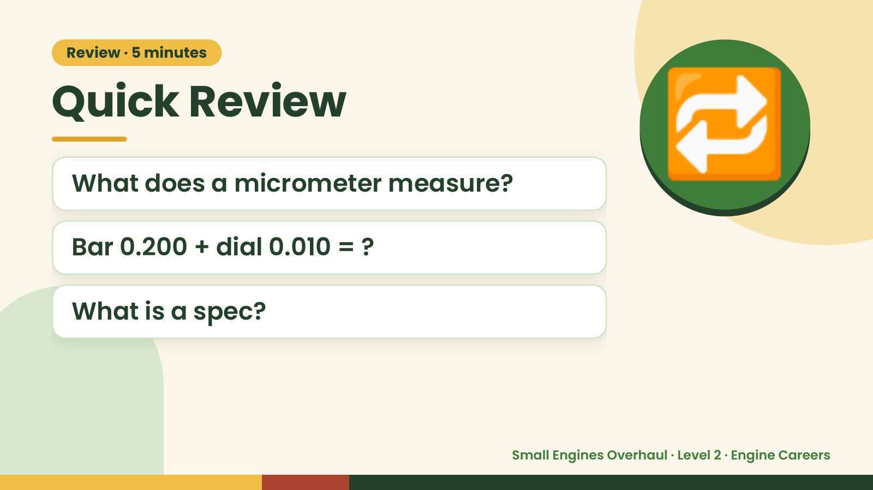
Notes:
Review · 5 minutes
Quick Review
What does a micrometer measure?
Bar 0.200 + dial 0.010 = ?
🔁
What is a spec?
Small Engines Overhaul · Level 2 · Engine Careers

Slide 3
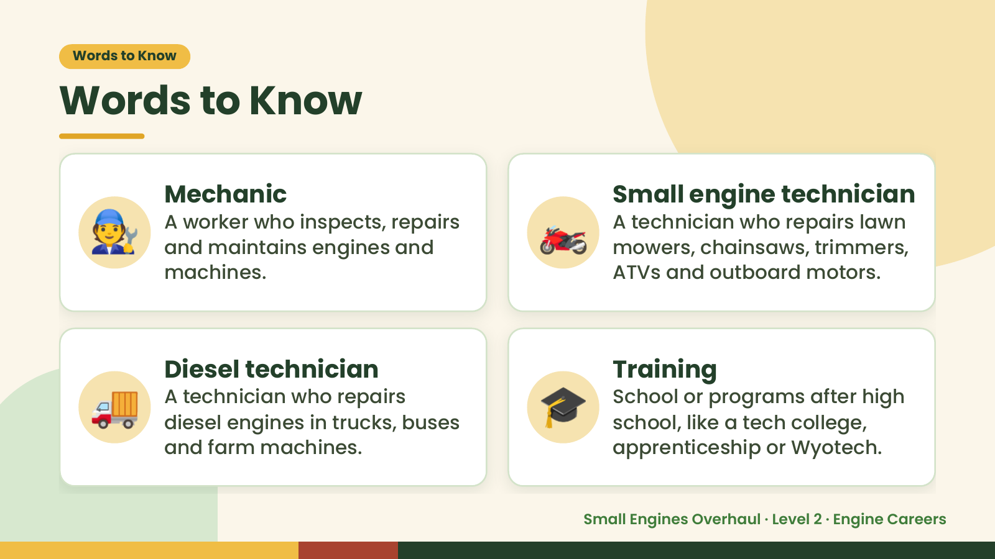
Notes:
Words to Know
Words to Know
🧑‍🔧 Mechanic
A worker who inspects, repairs
and maintains engines and
machines.
🏍️ Small engine technician
A technician who repairs lawn
mowers, chainsaws, trimmers,
ATVs and outboard motors.
🚚 Diesel technician
A technician who repairs
diesel engines in trucks, buses
and farm machines.
🎓 Training
School or programs after high
school, like a tech college,
apprenticeship or Wyotech.
Small Engines Overhaul · Level 2 · Engine Careers

Slide 4
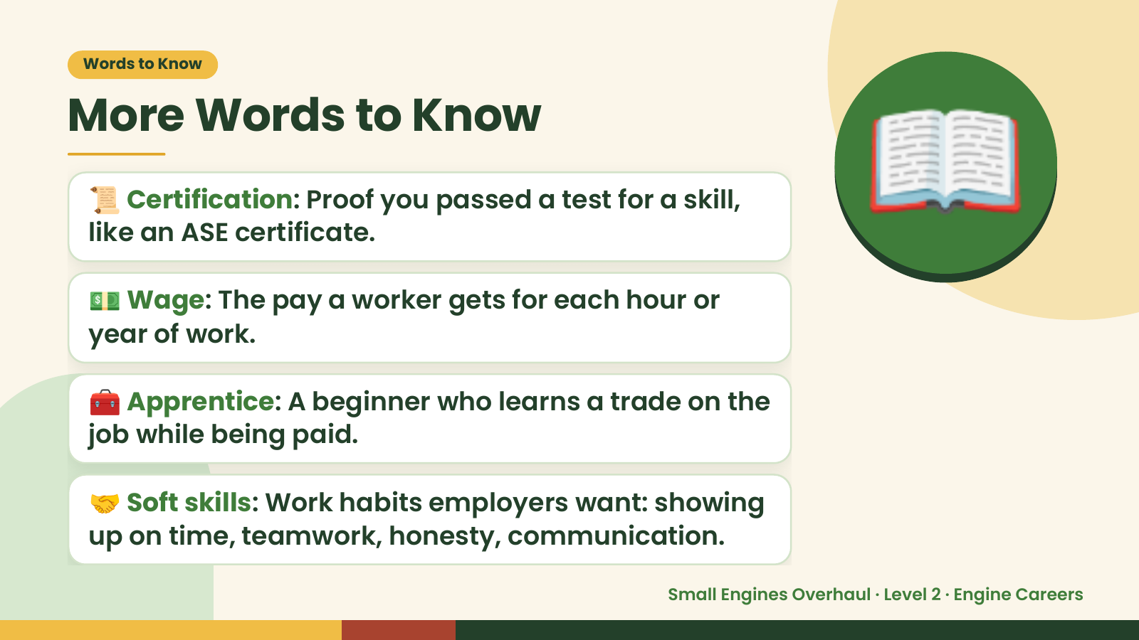
Notes:
Words to Know
More Words to Know
📜 Certification: Proof you passed a test for a skill,
like an ASE certificate.
💵 Wage: The pay a worker gets for each hour or
year of work.
📖
🧰 Apprentice: A beginner who learns a trade on the
job while being paid.
🤝 Soft skills: Work habits employers want: showing
up on time, teamwork, honesty, communication.
Small Engines Overhaul · Level 2 · Engine Careers

Slide 5
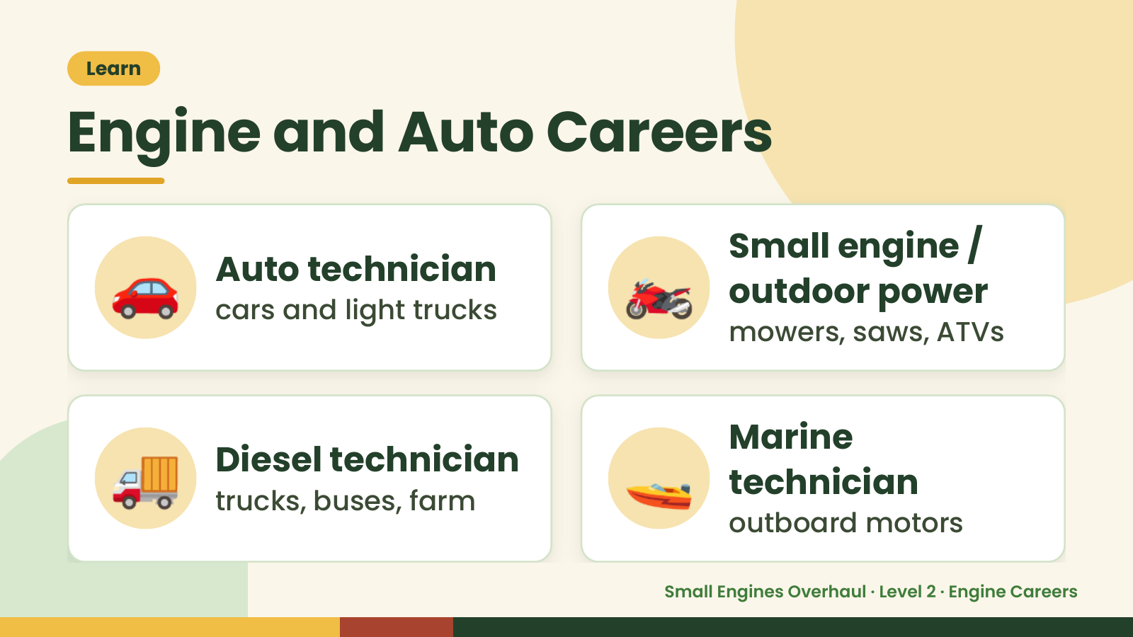
Notes:
Learn
Engine and Auto Careers
🚗 Auto technician
cars and light trucks 🏍️ Small engine /
outdoor power
mowers, saws, ATVs
🚚 Diesel technician
trucks, buses, farm 🚤 Marine
technician
outboard motors
Small Engines Overhaul · Level 2 · Engine Careers

Slide 6
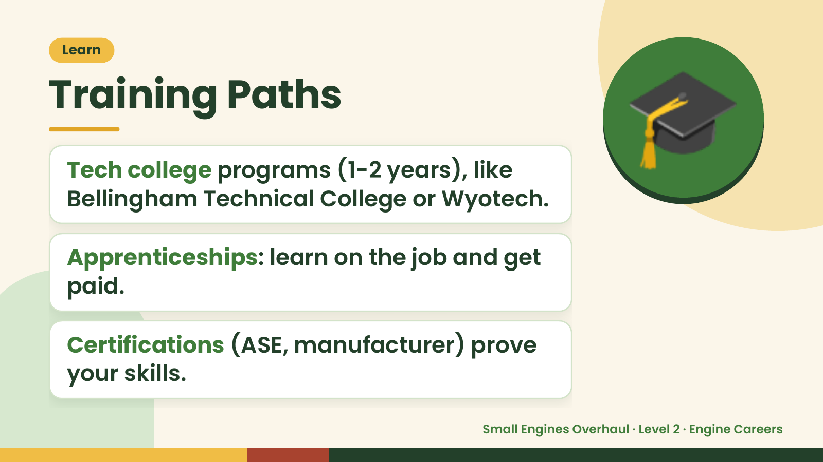
Notes:
Learn
Training Paths
Tech college programs (1-2 years), like
Bellingham Technical College or Wyotech.
Apprenticeships: learn on the job and get
🎓
paid.
Certifications (ASE, manufacturer) prove
your skills.
Small Engines Overhaul · Level 2 · Engine Careers

Slide 7
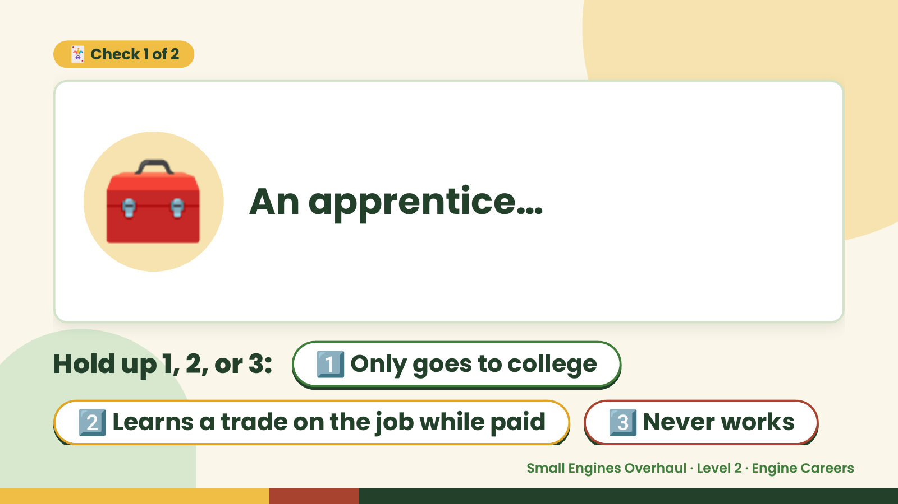
Notes:
🃏 Check 1 of 2
🧰 An apprentice…
Hold up 1, 2, or 3: 1️⃣ Only goes to college
2️⃣ Learns a trade on the job while paid 3️⃣ Never works
Small Engines Overhaul · Level 2 · Engine Careers

Slide 8
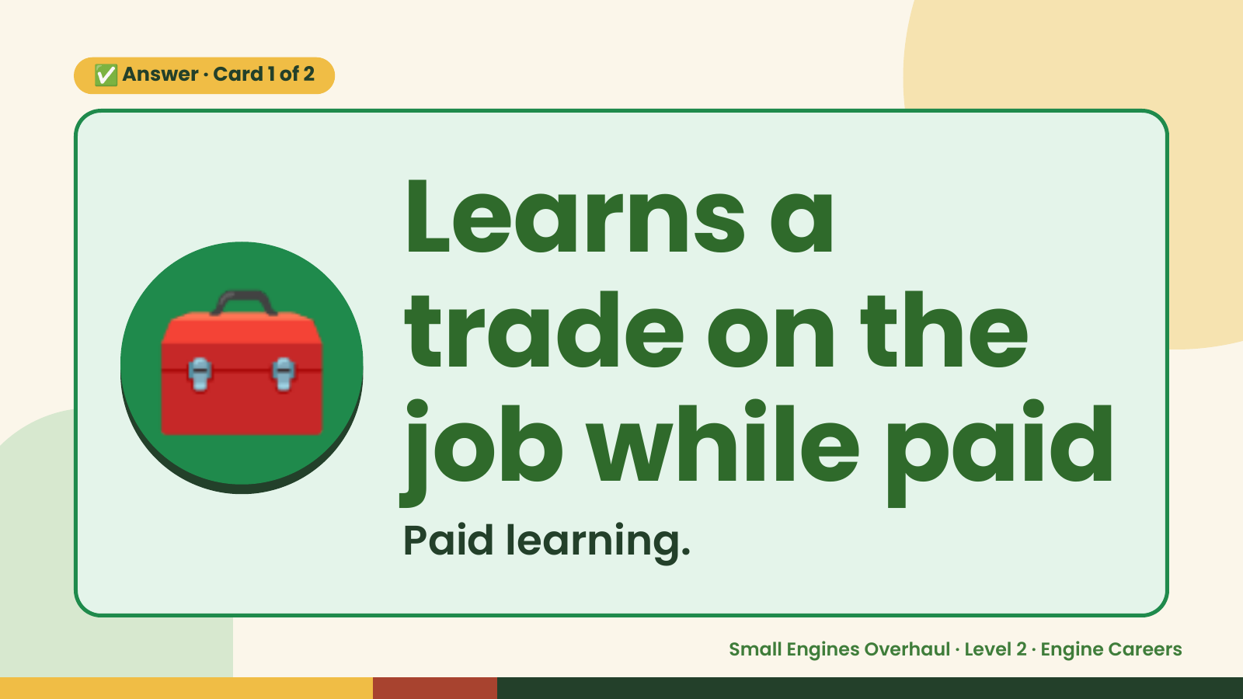
Notes:
✅ Answer · Card 1 of 2
🧰 Learns a
trade on the
job while paid
Paid learning.
Small Engines Overhaul · Level 2 · Engine Careers

Slide 9
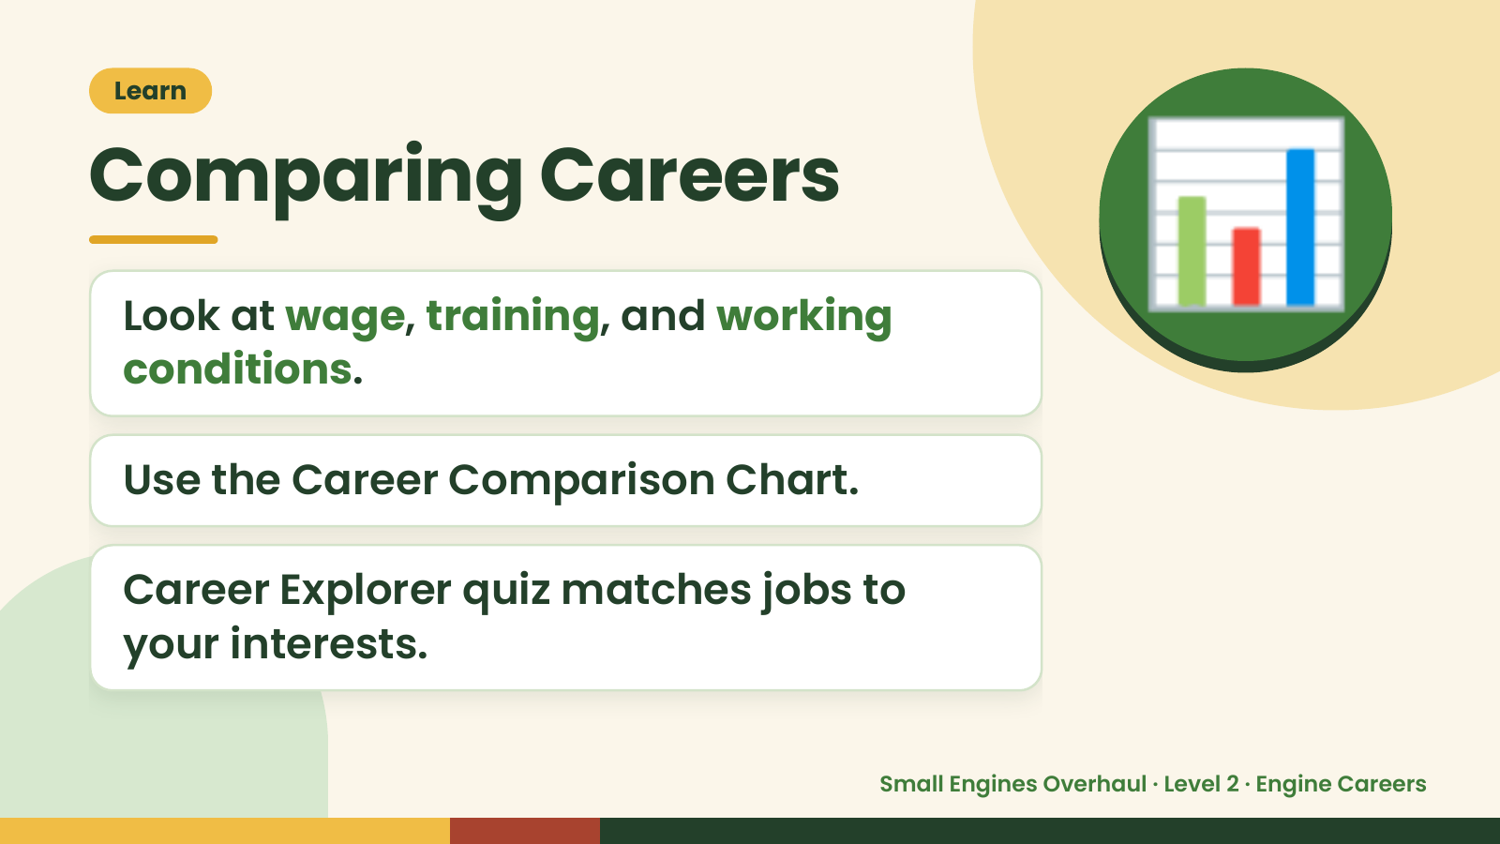
Notes:
Learn
Comparing Careers
Look at wage, training, and working
conditions.
📊
Use the Career Comparison Chart.
Career Explorer quiz matches jobs to
your interests.
Small Engines Overhaul · Level 2 · Engine Careers

Slide 10
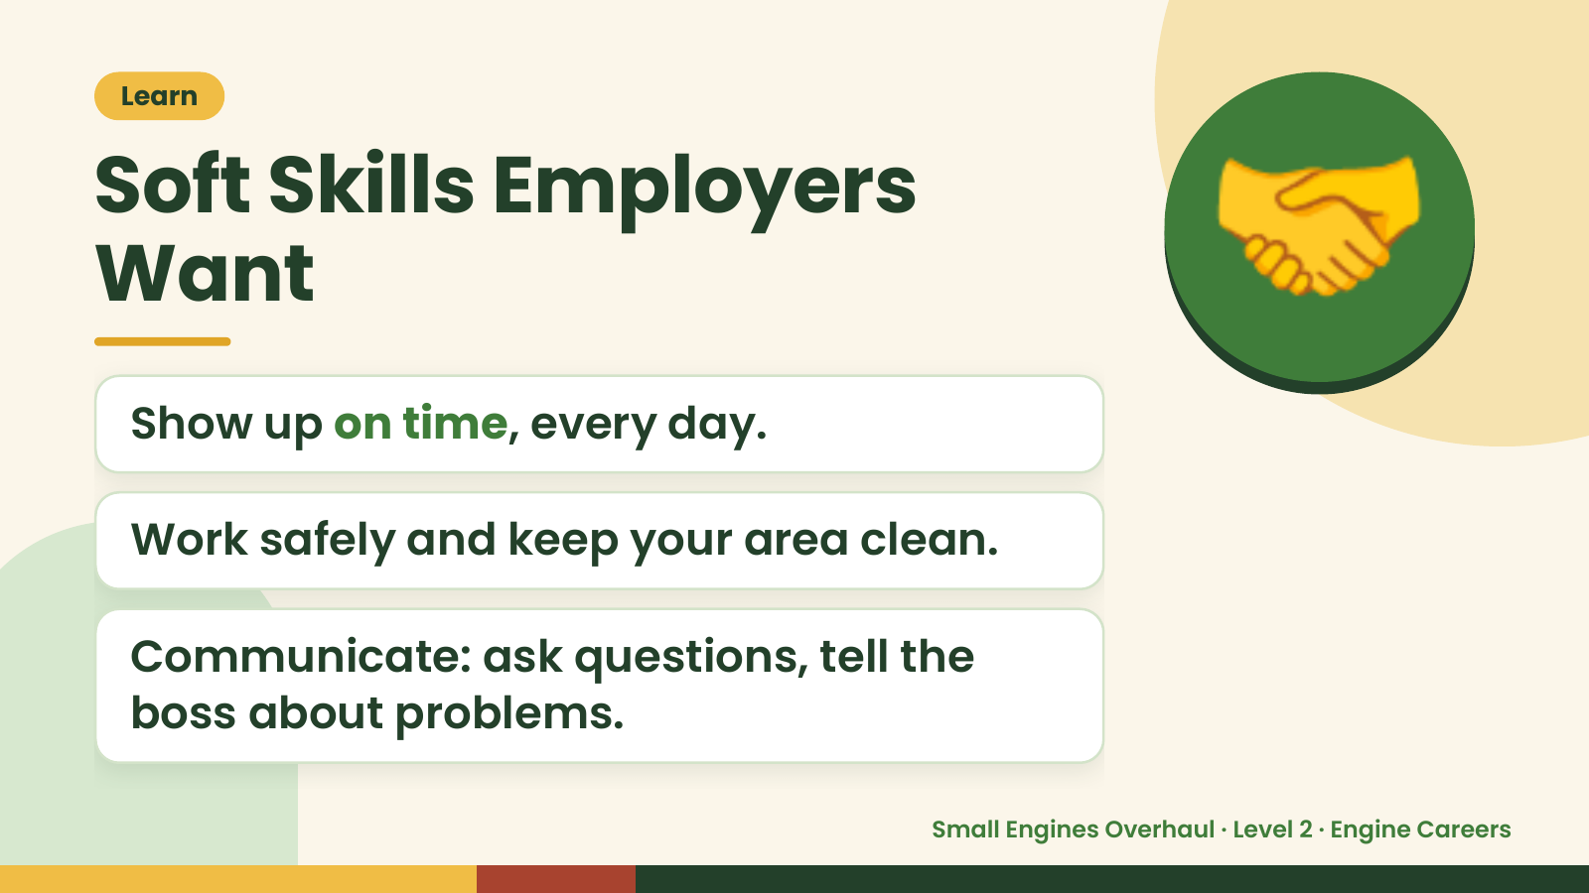
Notes:
Learn
Soft Skills Employers
Want
Show up on time, every day.
🤝
Work safely and keep your area clean.
Communicate: ask questions, tell the
boss about problems.
Small Engines Overhaul · Level 2 · Engine Careers

Slide 11
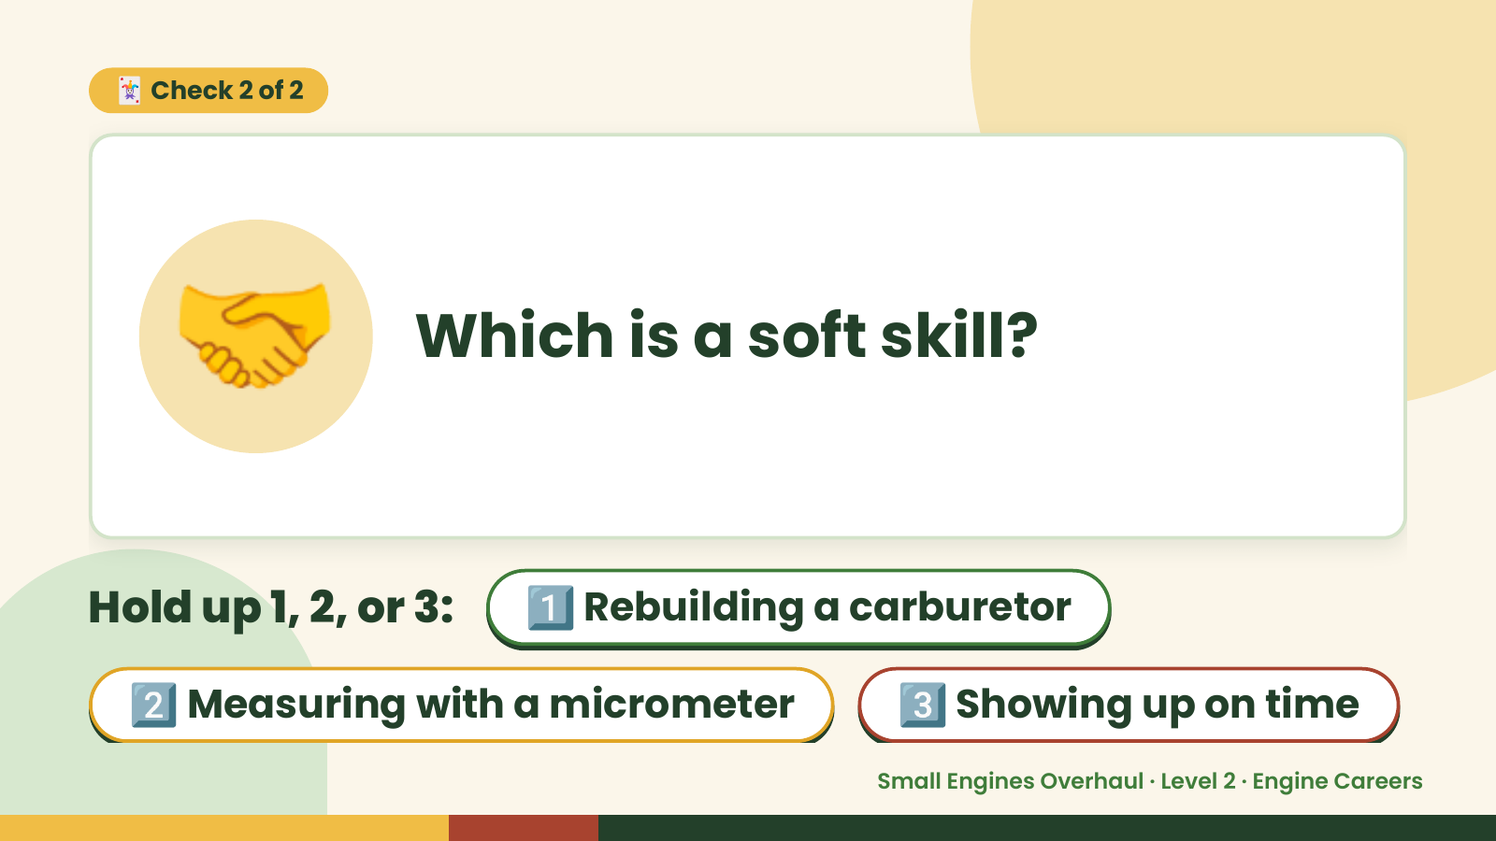
Notes:
🃏 Check 2 of 2
🤝 Which is a soft skill?
Hold up 1, 2, or 3: 1️⃣ Rebuilding a carburetor
2️⃣ Measuring with a micrometer 3️⃣ Showing up on time
Small Engines Overhaul · Level 2 · Engine Careers

Slide 12
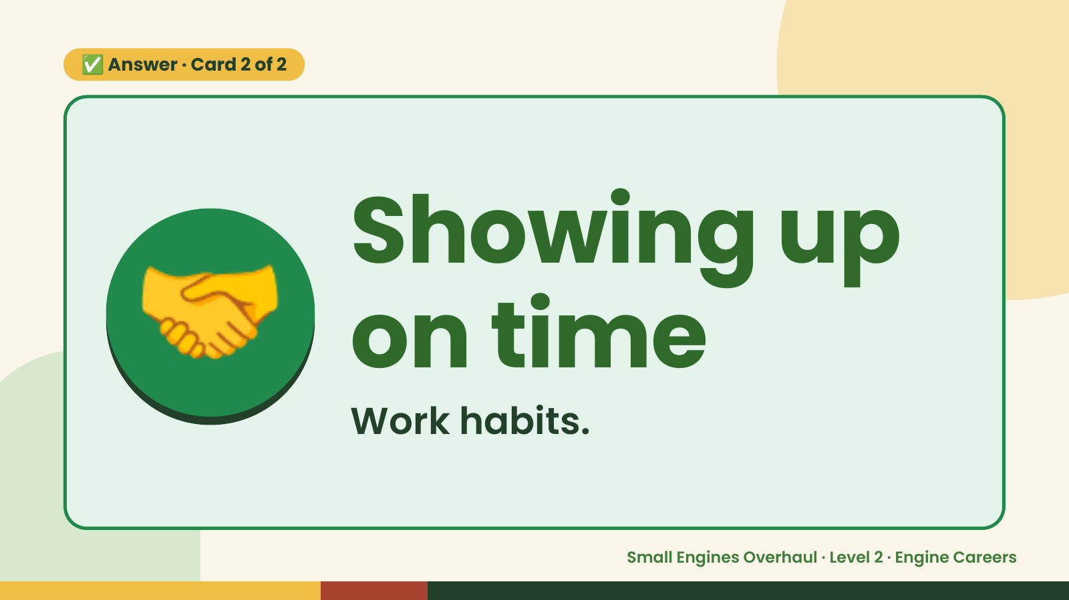
Notes:
✅ Answer · Card 2 of 2
🤝 Showing up
on time
Work habits.
Small Engines Overhaul · Level 2 · Engine Careers

Slide 13
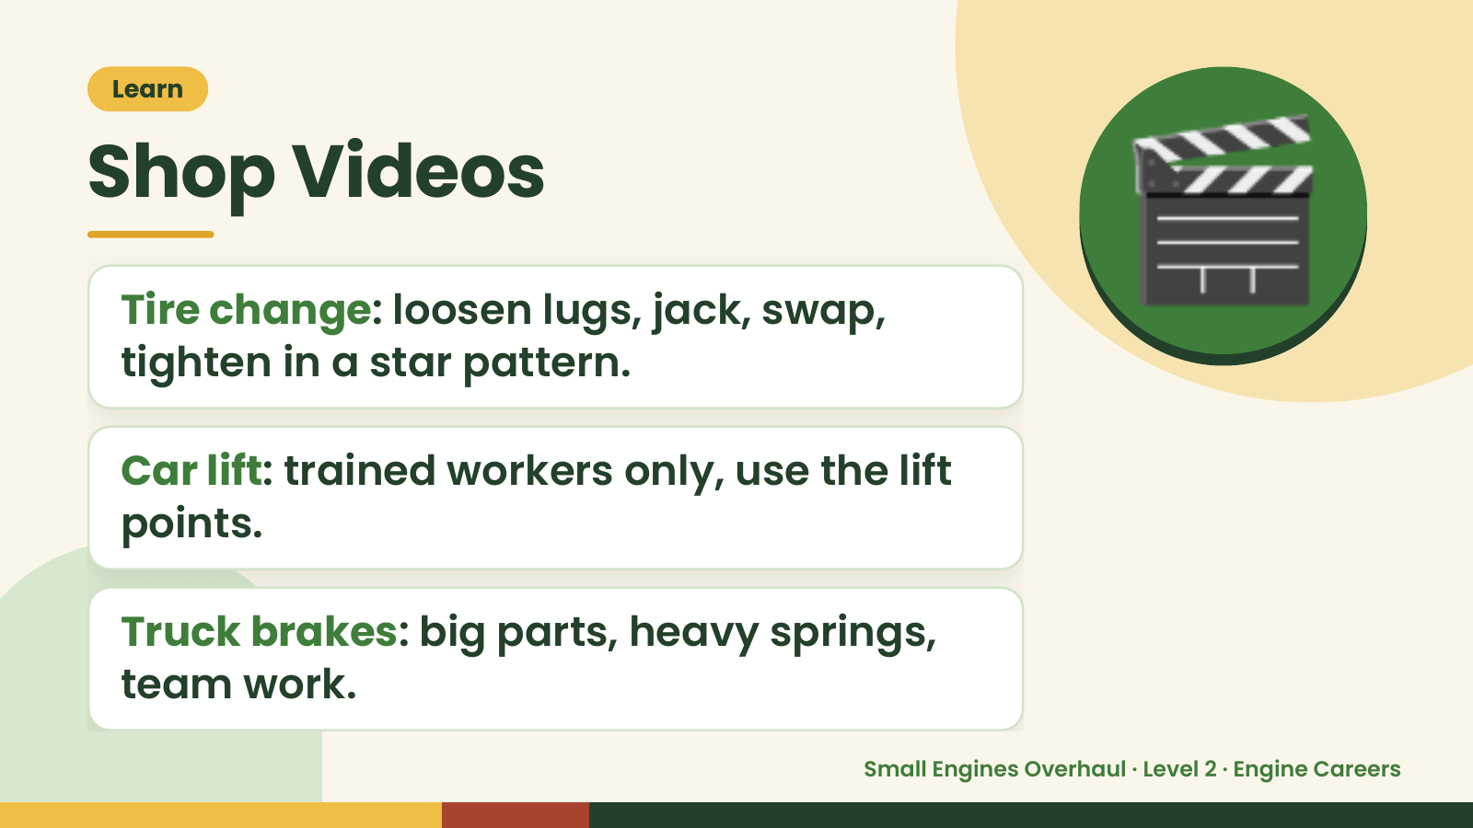
Notes:
Learn
Shop Videos
Tire change: loosen lugs, jack, swap,
tighten in a star pattern.
🎬
Car lift: trained workers only, use the lift
points.
Truck brakes: big parts, heavy springs,
team work.
Small Engines Overhaul · Level 2 · Engine Careers

Slide 14
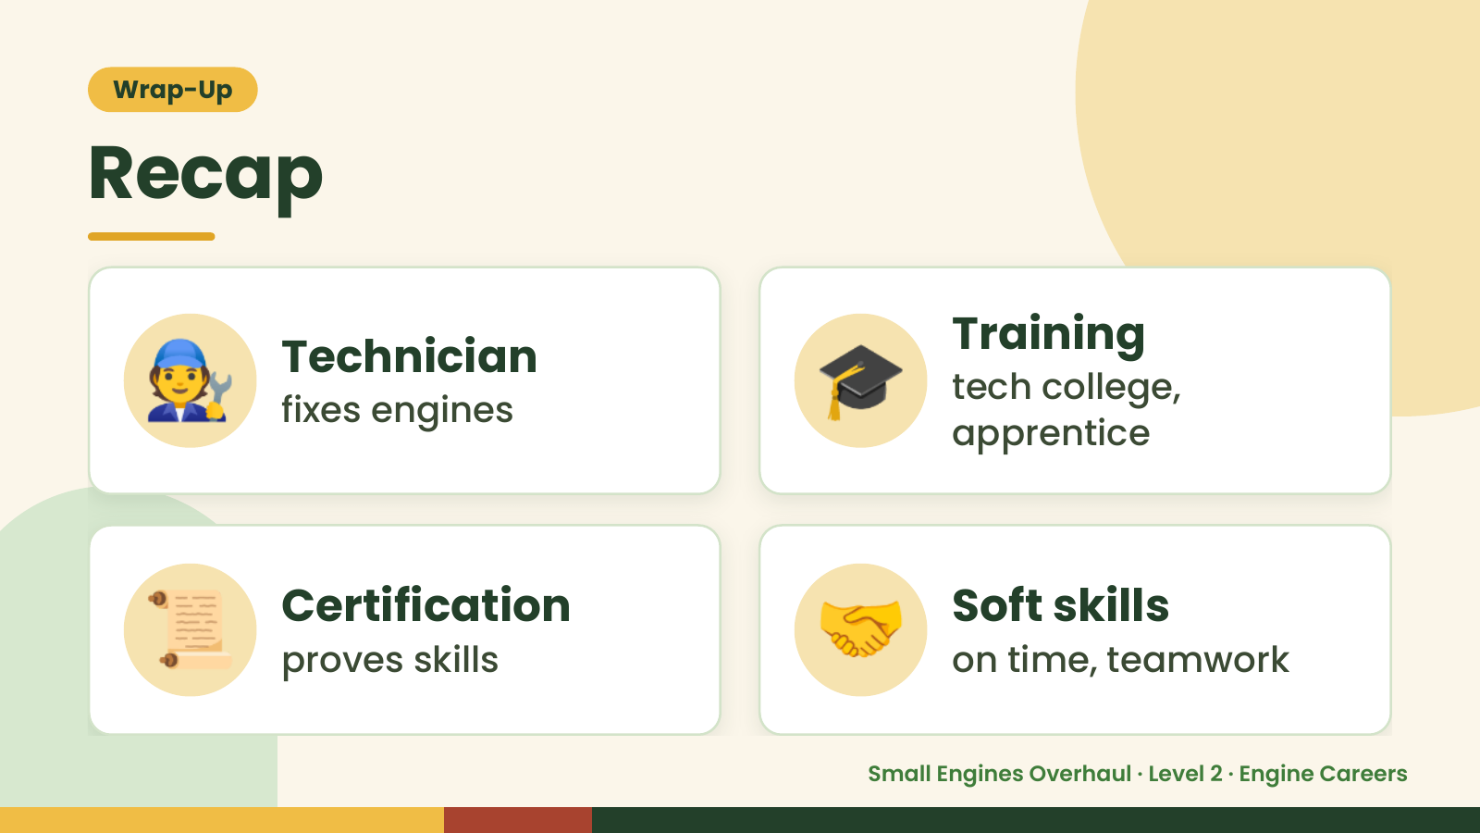
Notes:
Wrap-Up
Recap
🧑‍🔧 Technician
fixes engines 🎓 Training
tech college,
apprentice
📜 Certification
proves skills 🤝 Soft skills
on time, teamwork
Small Engines Overhaul · Level 2 · Engine Careers

Slide 15
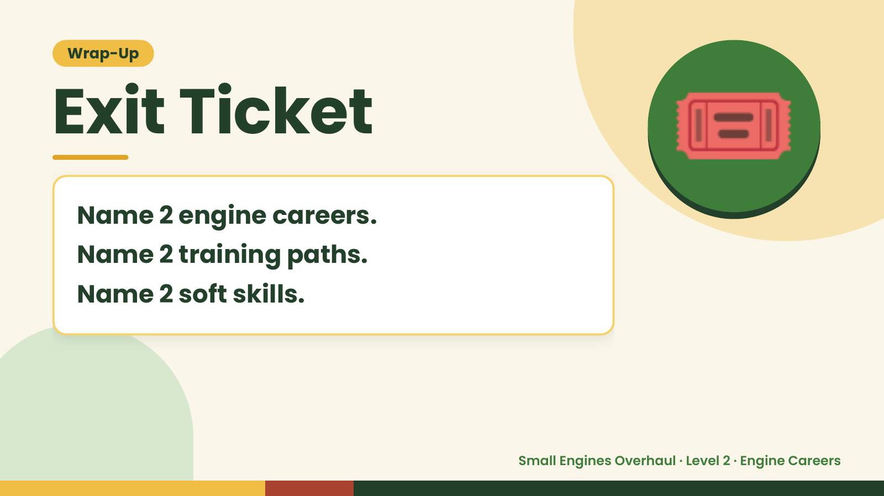
Notes:
Wrap-Up
Exit Ticket
Name 2 engine careers.
Name 2 training paths.
🎟️
Name 2 soft skills.
Small Engines Overhaul · Level 2 · Engine Careers

