Slide 1

Notes:
Small Engines Overhaul · Unit 3 · Level 1
Engine Parts ID
TODAY'S PLAN
👥 Jobs
🔩
⚠️ Safety
🔩 Steps
✅ Check
📝 Reflect
Small Engines Overhaul · Level 1 · Engine Parts ID

Slide 2
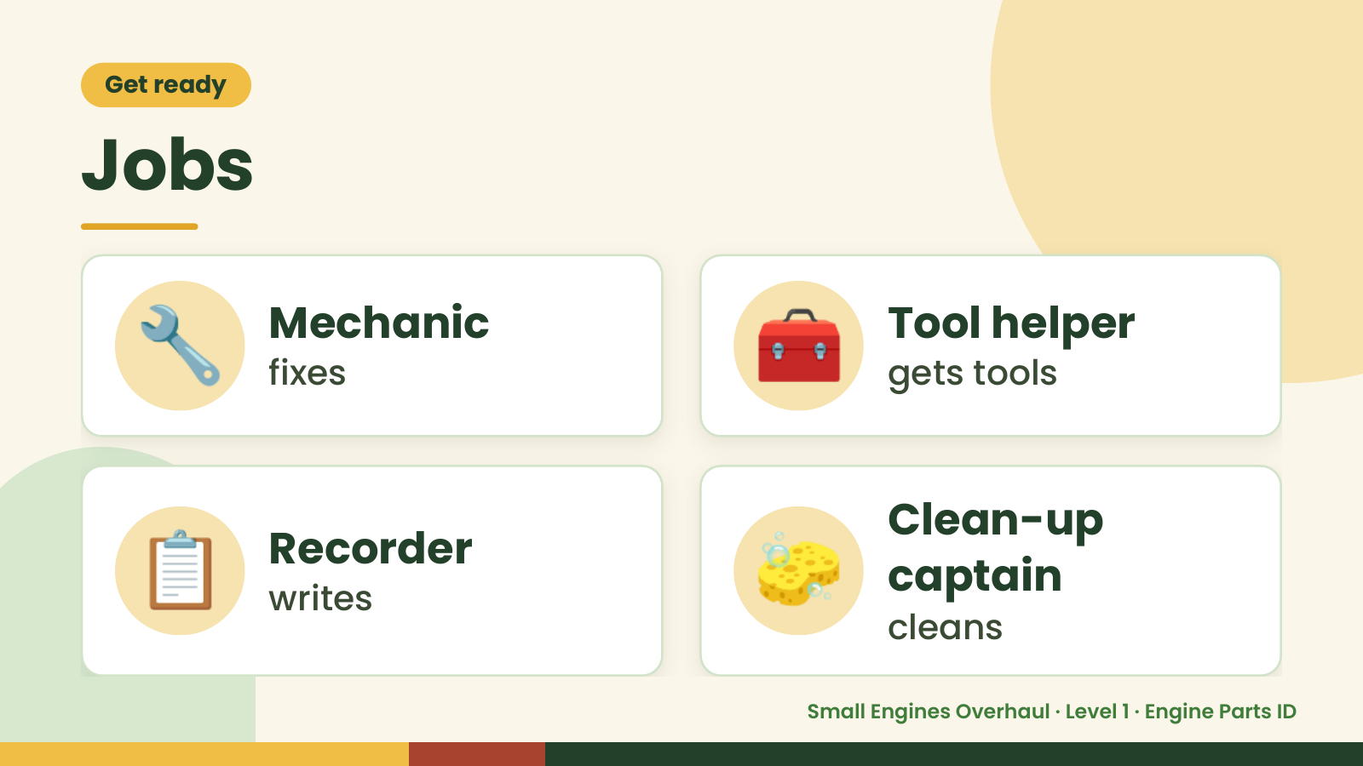
Notes:
Get ready
Jobs
🔧 Mechanic
fixes 🧰 Tool helper
gets tools
📋 Recorder
writes 🧽 Clean-up
captain
cleans
Small Engines Overhaul · Level 1 · Engine Parts ID

Slide 3
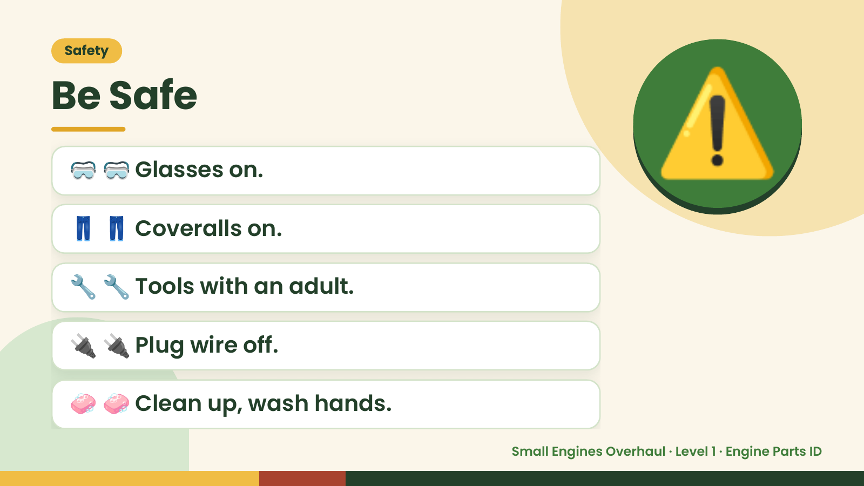
Notes:
Safety
Be Safe
🥽 🥽 Glasses on.
👖 👖 Coveralls on.
⚠️
🔧 🔧 Tools with an adult.
🔌 🔌 Plug wire off.
🧼 🧼 Clean up, wash hands.
Small Engines Overhaul · Level 1 · Engine Parts ID

Slide 4
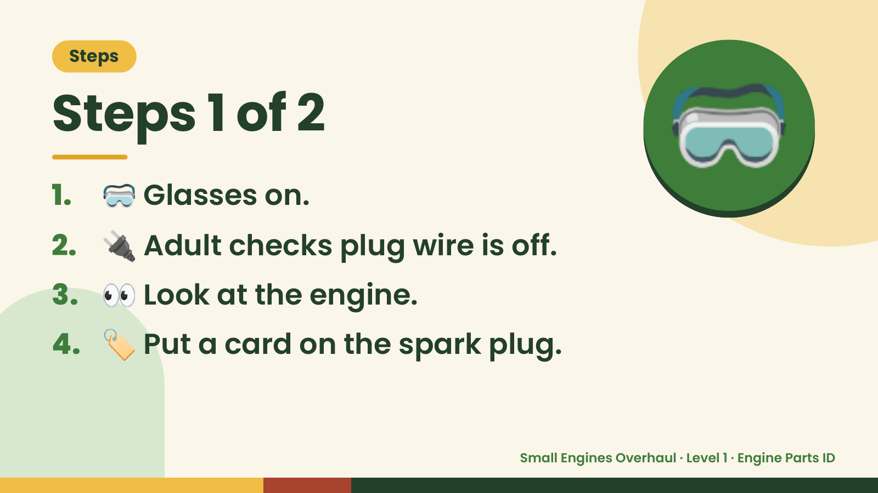
Notes:
Steps
Steps 1 of 2
1. 🥽 Glasses on.
2. 🔌 Adult checks plug wire is off.
🥽
3. 👀 Look at the engine.
4. 🏷️ Put a card on the spark plug.
Small Engines Overhaul · Level 1 · Engine Parts ID

Slide 5
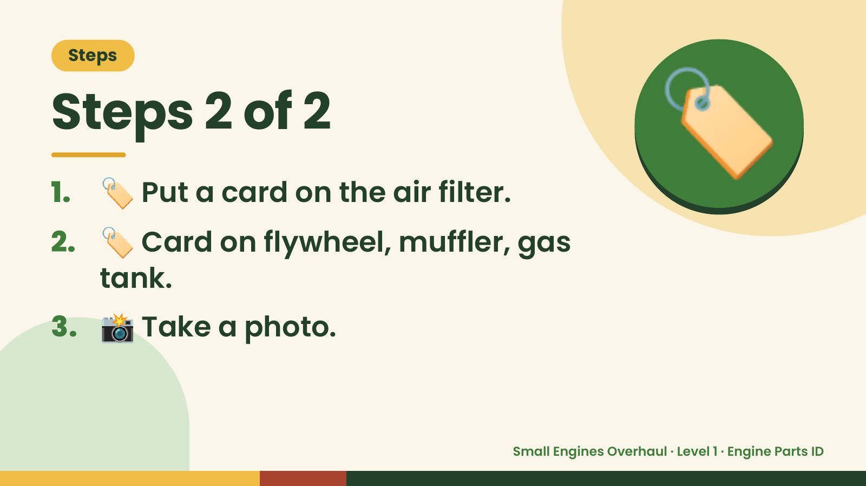
Notes:
Steps
Steps 2 of 2
1. 🏷️ Put a card on the air filter.
2. 🏷️ Card on flywheel, muffler, gas
🏷️
tank.
3. 📸 Take a photo.
Small Engines Overhaul · Level 1 · Engine Parts ID

Slide 6
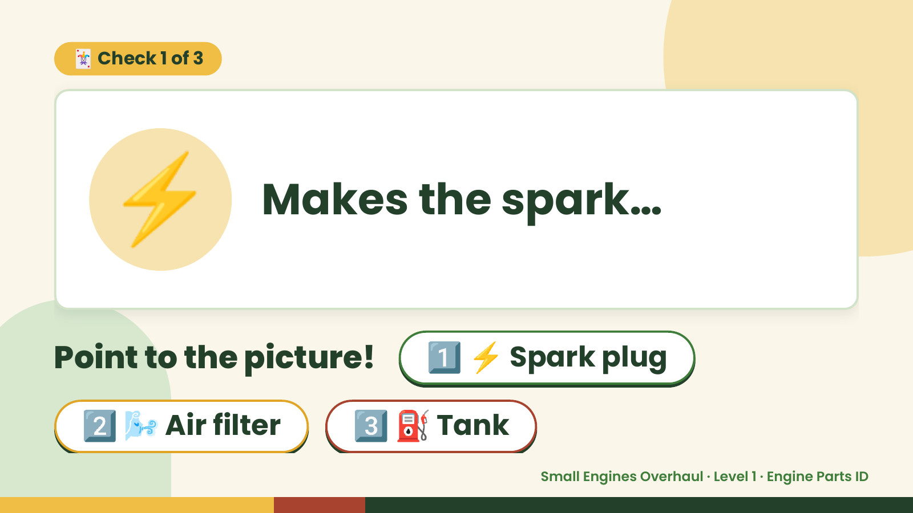
Notes:
🃏 Check 1 of 3
⚡ Makes the spark…
Point to the picture! 1️⃣ ⚡ Spark plug
2️⃣ 🌬️ Air filter 3️⃣ ⛽ Tank
Small Engines Overhaul · Level 1 · Engine Parts ID

Slide 7

Notes:
⚡
✅ Answer · Card 1 of 3
⚡ plug
Spark
Spark plug.
Small Engines Overhaul · Level 1 · Engine Parts ID

Slide 8
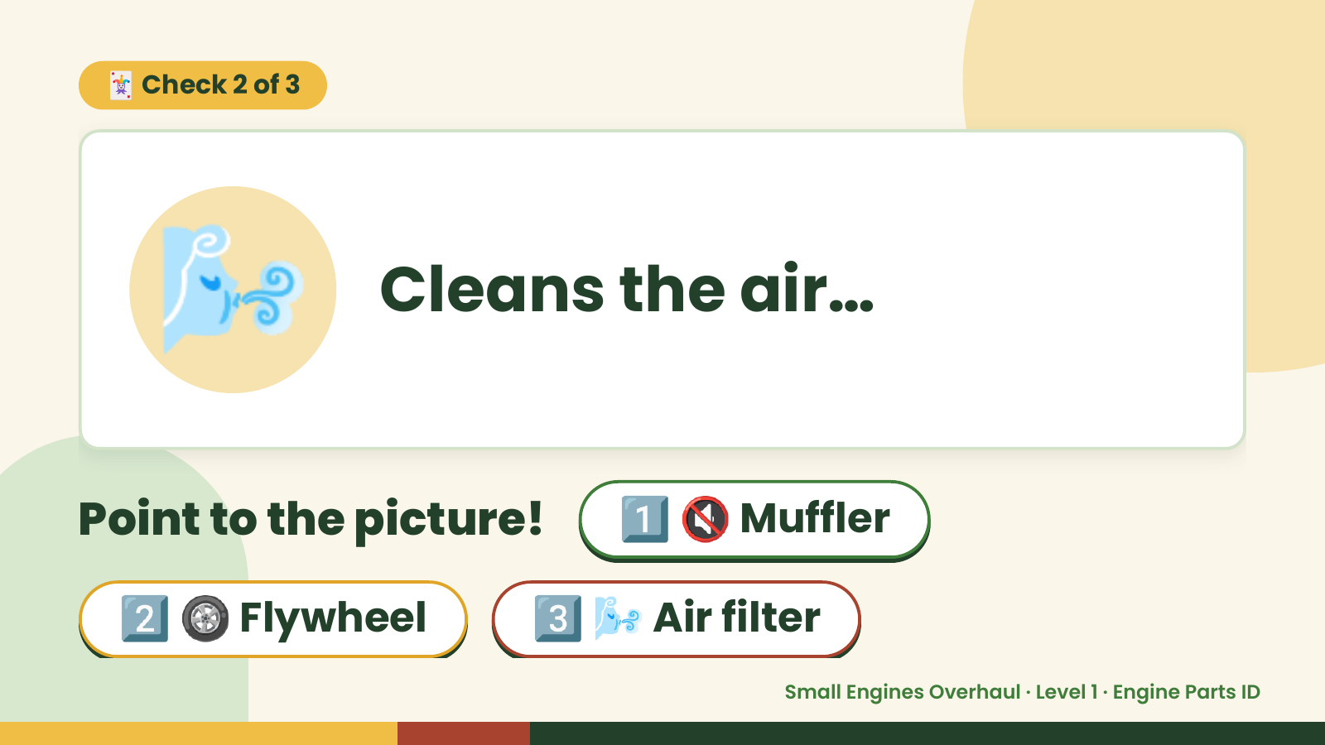
Notes:
🃏 Check 2 of 3
🌬️ Cleans the air…
Point to the picture! 1️⃣ 🔇 Muffler
2️⃣ 🛞 Flywheel 3️⃣ 🌬️ Air filter
Small Engines Overhaul · Level 1 · Engine Parts ID

Slide 9
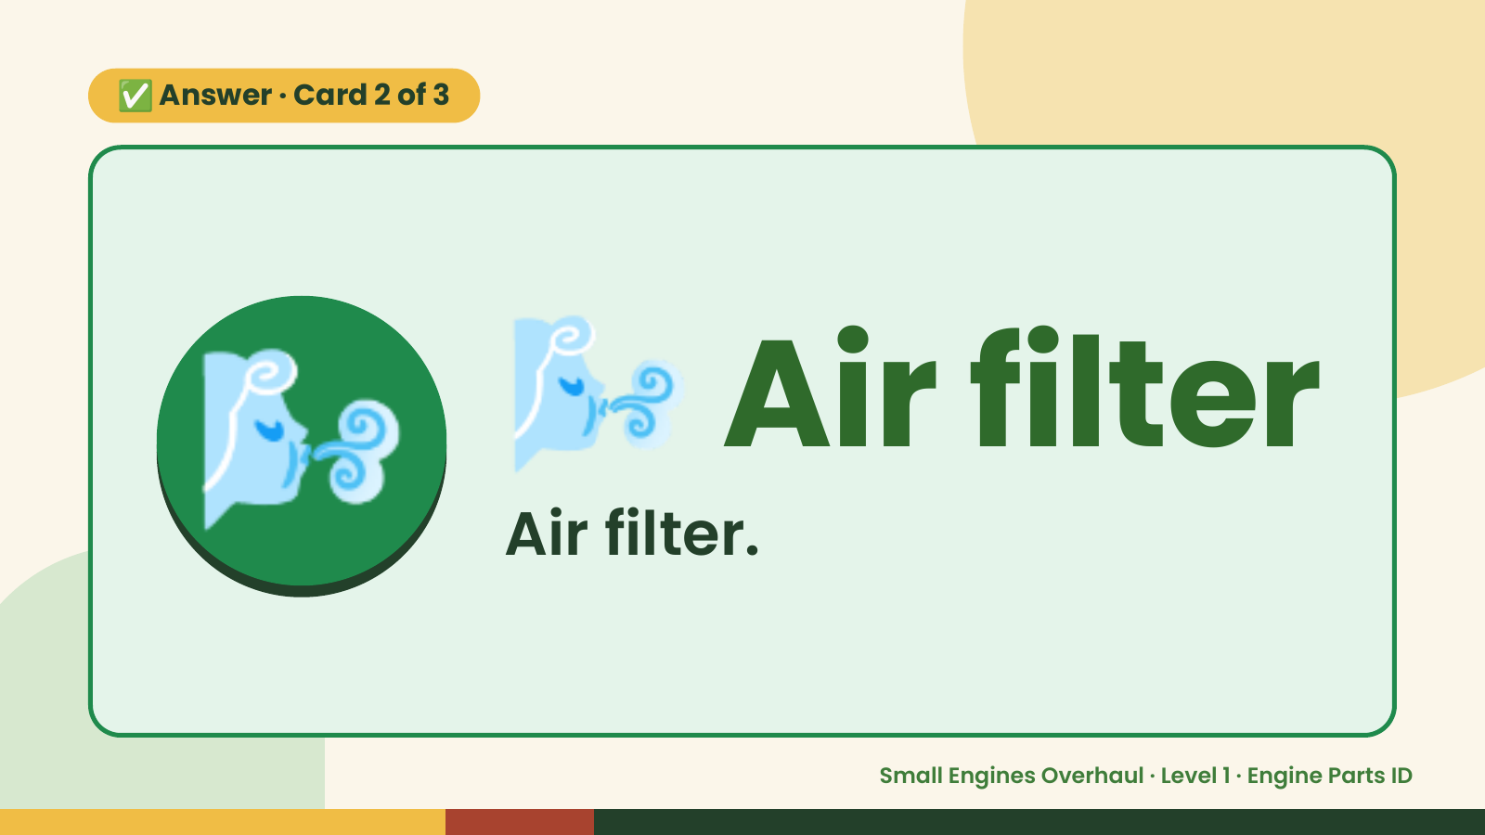
Notes:
✅ Answer · Card 2 of 3
🌬️ 🌬️ Air filter
Air filter.
Small Engines Overhaul · Level 1 · Engine Parts ID

Slide 10
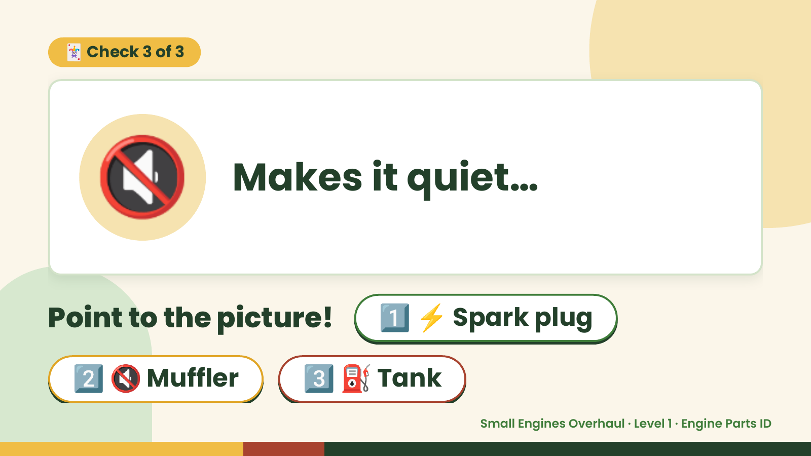
Notes:
🃏 Check 3 of 3
🔇 Makes it quiet…
Point to the picture! 1️⃣ ⚡ Spark plug
2️⃣ 🔇 Muffler 3️⃣ ⛽ Tank
Small Engines Overhaul · Level 1 · Engine Parts ID

Slide 11
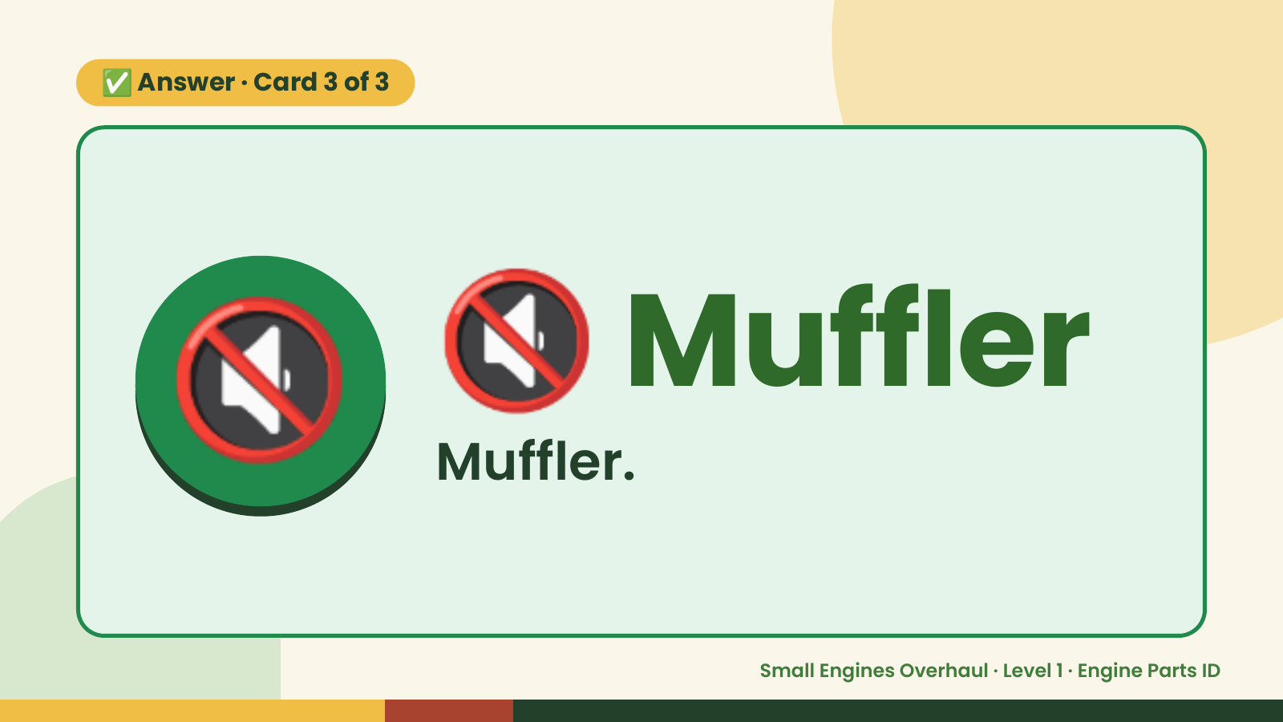
Notes:
✅ Answer · Card 3 of 3
🔇 🔇 Muffler
Muffler.
Small Engines Overhaul · Level 1 · Engine Parts ID

Slide 12

Notes:
Wrap-Up
Clean Up +
Reflect
🧽
🧽 Wipe the bench.
🧰 Give tools back.
🧼 Wash hands.
Small Engines Overhaul · Level 1 · Engine Parts ID

