Slide 1

Notes:
Small Engines Overhaul · Unit 3 · Level 1
4-Stroke Theory
& Engine Parts
TODAY'S PLAN
⚙️
⬇️ Intake
🗜️ Squeeze
💥 Power
💨 Exhaust
Small Engines Overhaul · Level 1 · 4-Stroke Theory & Engine Parts

Slide 2
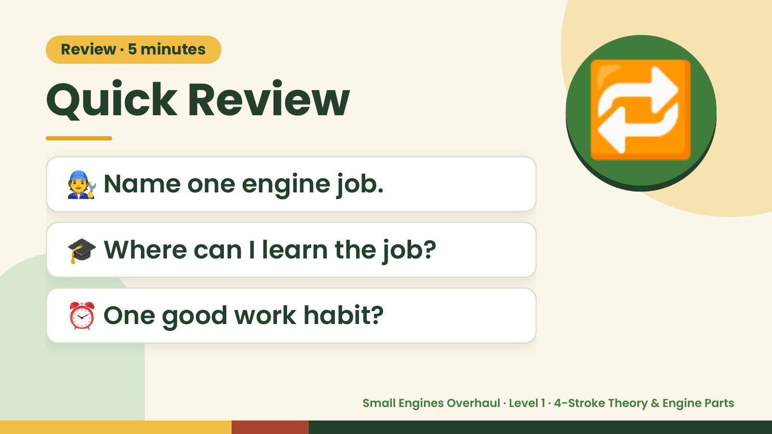
Notes:
Review · 5 minutes
Quick Review
🧑‍🔧 Name one engine job.
🔁
🎓 Where can I learn the job?
⏰ One good work habit?
Small Engines Overhaul · Level 1 · 4-Stroke Theory & Engine Parts

Slide 3
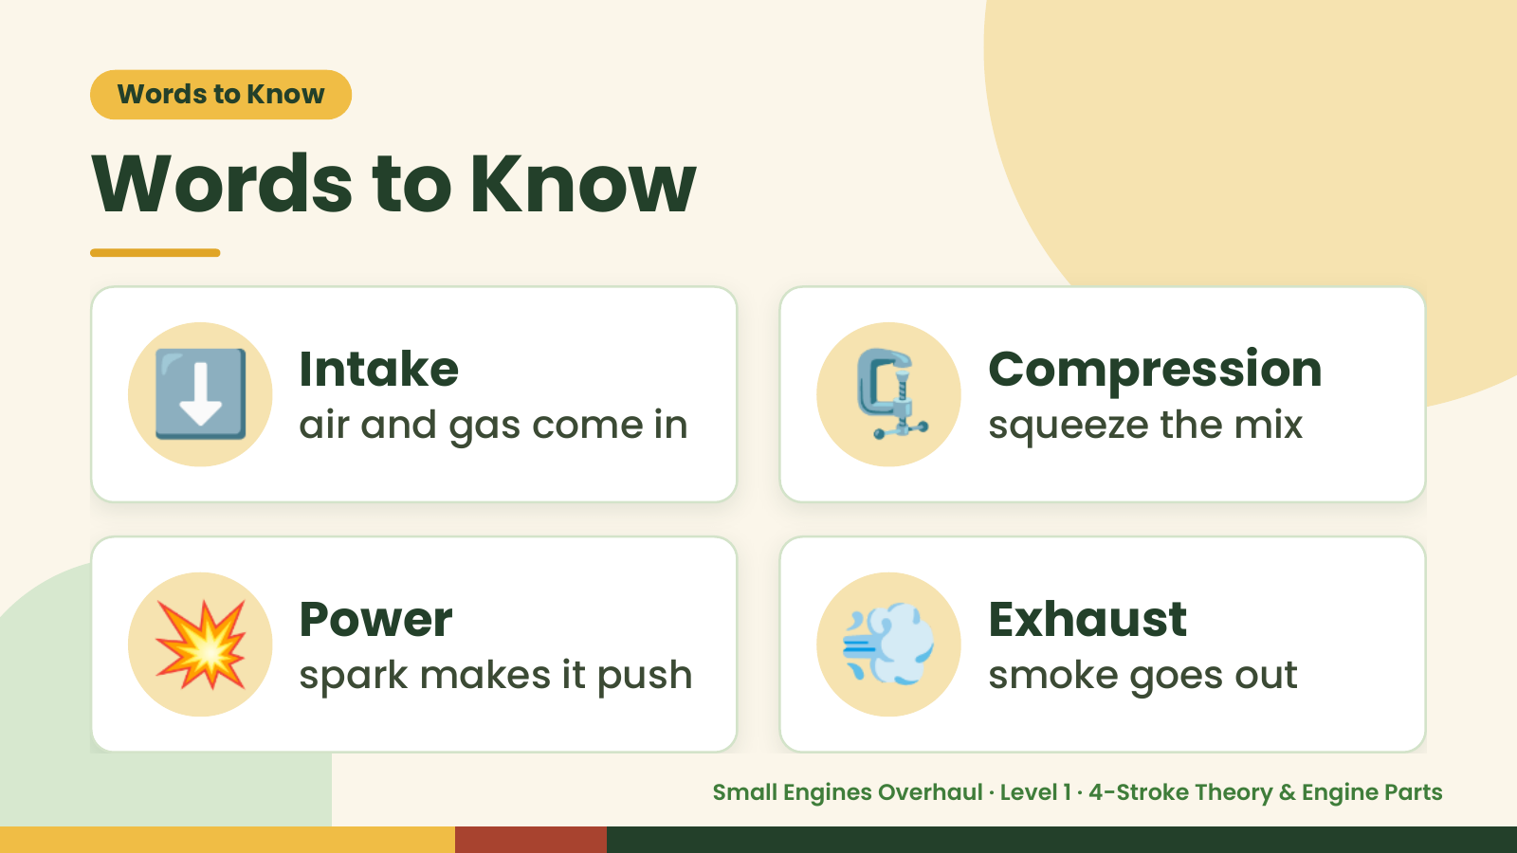
Notes:
Words to Know
Words to Know
⬇️ Intake
air and gas come in 🗜️ Compression
squeeze the mix
💥 Power
spark makes it push 💨 Exhaust
smoke goes out
Small Engines Overhaul · Level 1 · 4-Stroke Theory & Engine Parts

Slide 4
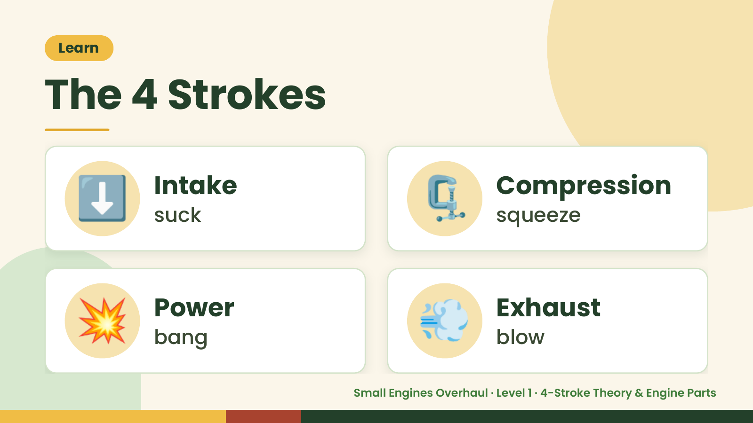
Notes:
Learn
The 4 Strokes
⬇️ Intake
suck 🗜️ Compression
squeeze
💥 Power
bang 💨 Exhaust
blow
Small Engines Overhaul · Level 1 · 4-Stroke Theory & Engine Parts

Slide 5
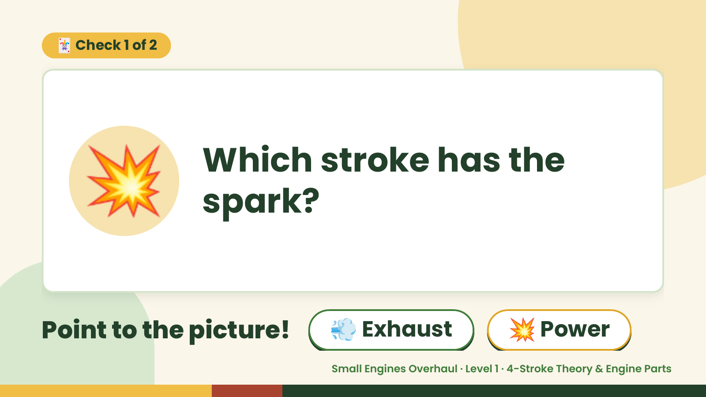
Notes:
🃏 Check 1 of 2
💥 Which stroke has the
spark?
Point to the picture! 💨 Exhaust 💥 Power
Small Engines Overhaul · Level 1 · 4-Stroke Theory & Engine Parts

Slide 6
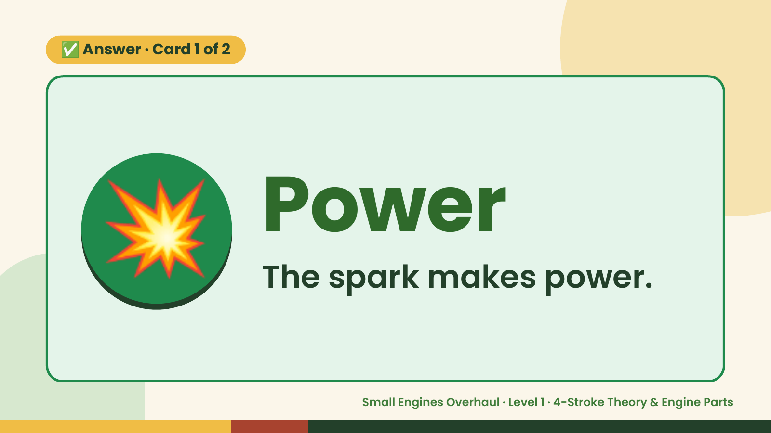
Notes:
✅ Answer · Card 1 of 2
💥 Power
The spark makes power.
Small Engines Overhaul · Level 1 · 4-Stroke Theory & Engine Parts

Slide 7
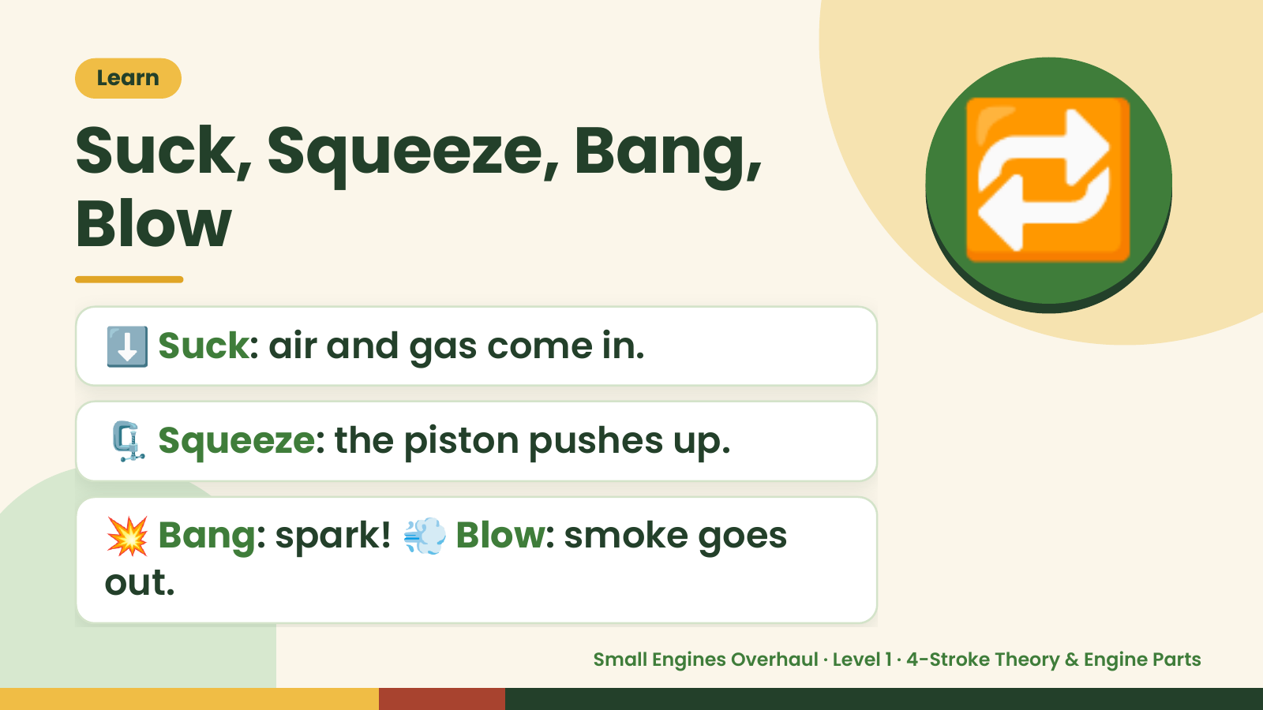
Notes:
Learn
Suck, Squeeze, Bang,
Blow
⬇️ Suck: air and gas come in.
🔁
🗜️ Squeeze: the piston pushes up.
💥 Bang: spark! 💨 Blow: smoke goes
out.
Small Engines Overhaul · Level 1 · 4-Stroke Theory & Engine Parts

Slide 8
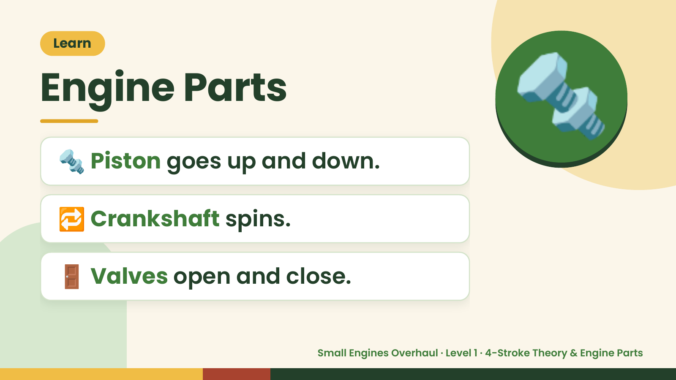
Notes:
Learn
Engine Parts
🔩 Piston goes up and down.
🔩
🔁 Crankshaft spins.
🚪 Valves open and close.
Small Engines Overhaul · Level 1 · 4-Stroke Theory & Engine Parts

Slide 9
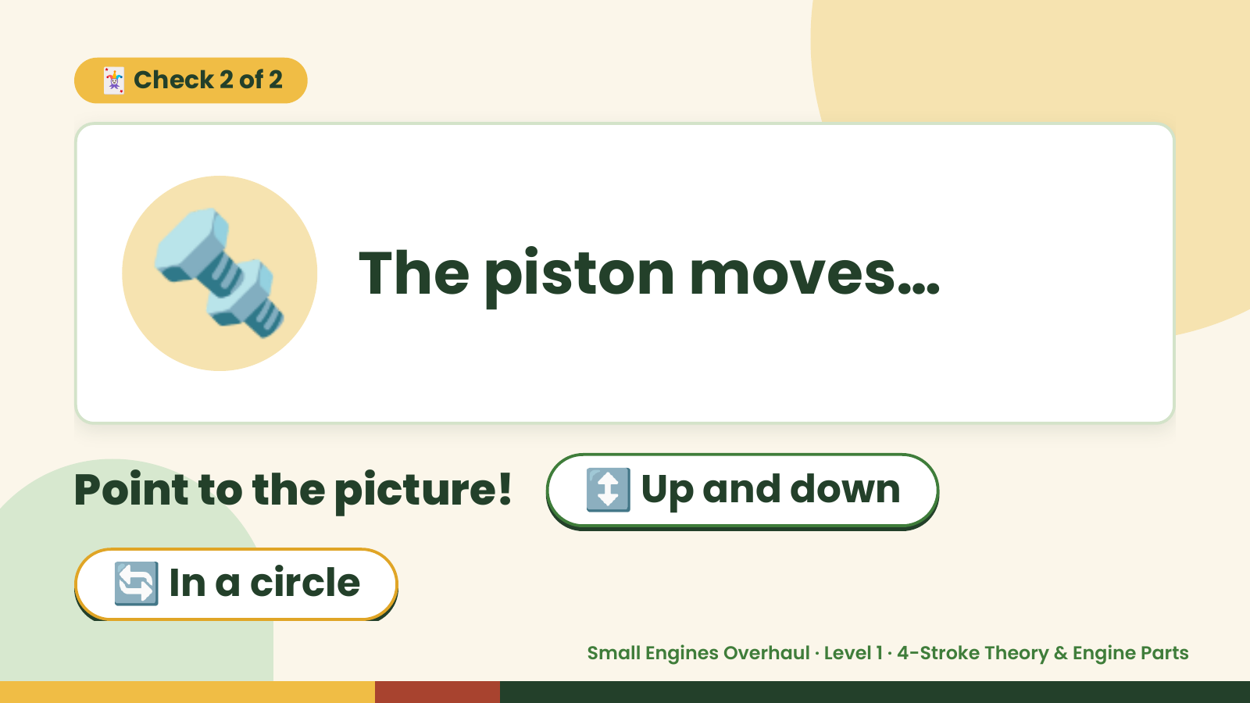
Notes:
🃏 Check 2 of 2
🔩 The piston moves…
Point to the picture! ↕️ Up and down
🔄 In a circle
Small Engines Overhaul · Level 1 · 4-Stroke Theory & Engine Parts

Slide 10
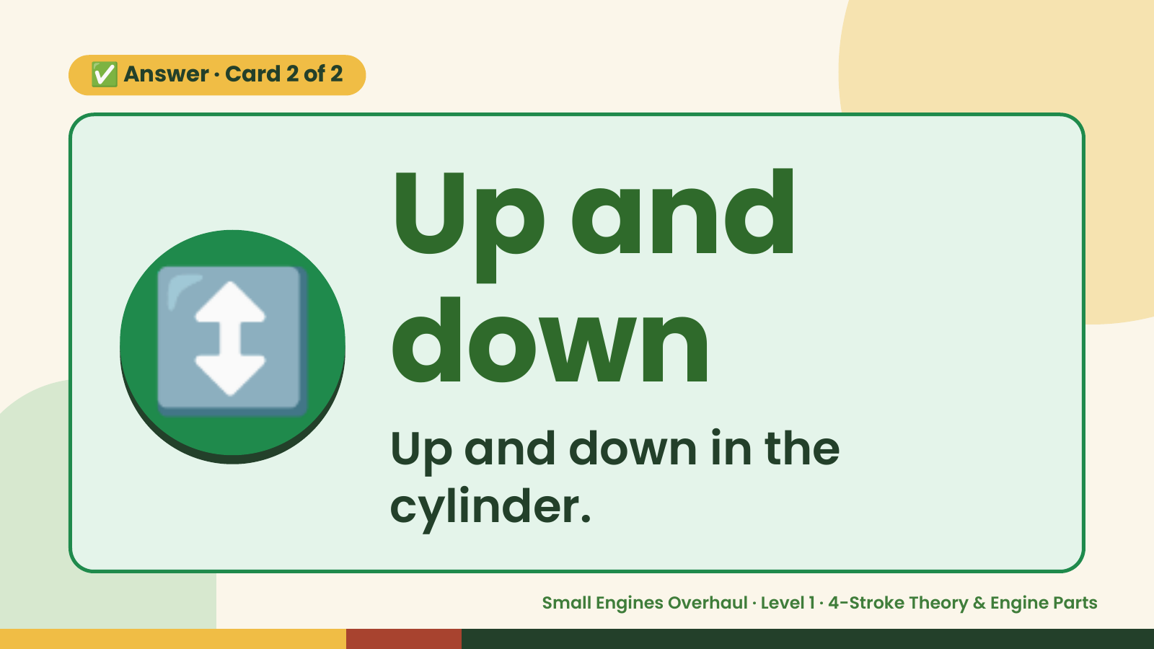
Notes:
✅ Answer · Card 2 of 2
↕️ Up and
down
Up and down in the
cylinder.
Small Engines Overhaul · Level 1 · 4-Stroke Theory & Engine Parts

Slide 11
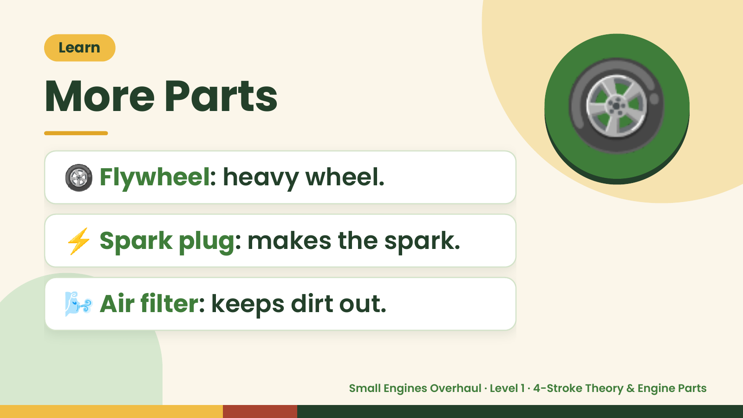
Notes:
Learn
More Parts
🛞 Flywheel: heavy wheel.
🛞
⚡ Spark plug: makes the spark.
🌬️ Air filter: keeps dirt out.
Small Engines Overhaul · Level 1 · 4-Stroke Theory & Engine Parts

Slide 12
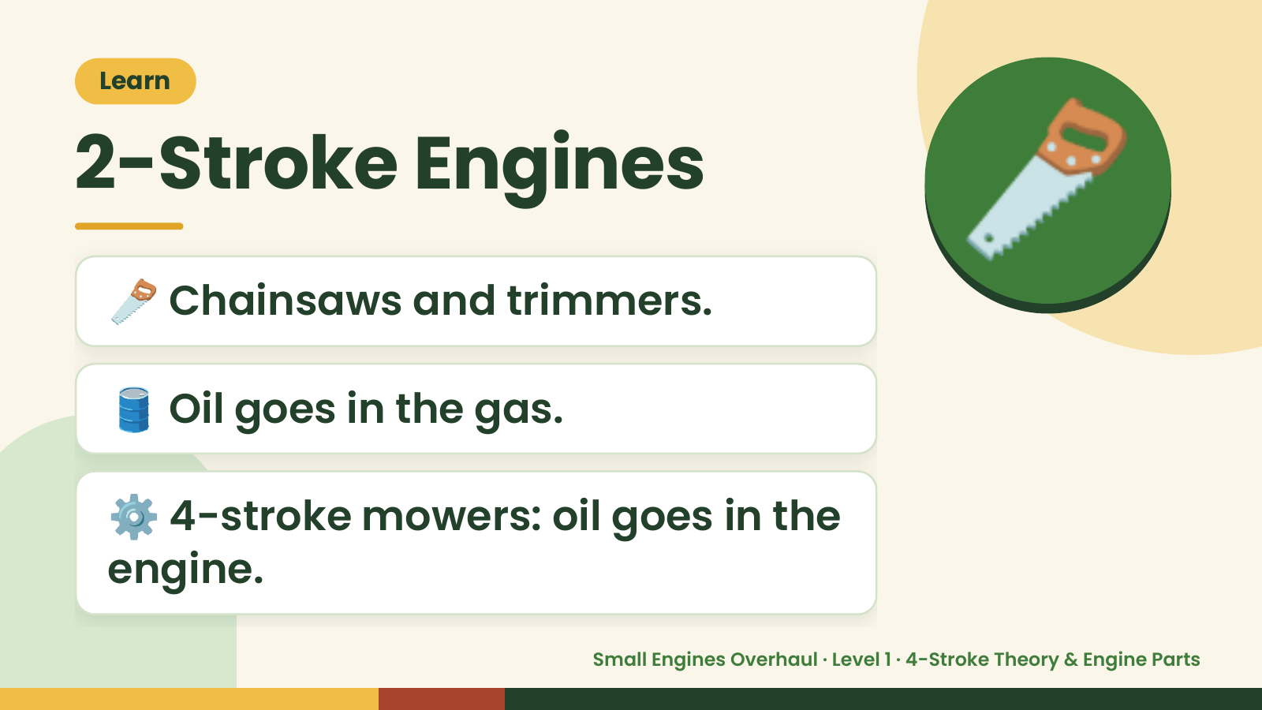
Notes:
Learn
2-Stroke Engines
🪚 Chainsaws and trimmers.
🪚
🛢️ Oil goes in the gas.
⚙️ 4-stroke mowers: oil goes in the
engine.
Small Engines Overhaul · Level 1 · 4-Stroke Theory & Engine Parts

Slide 13
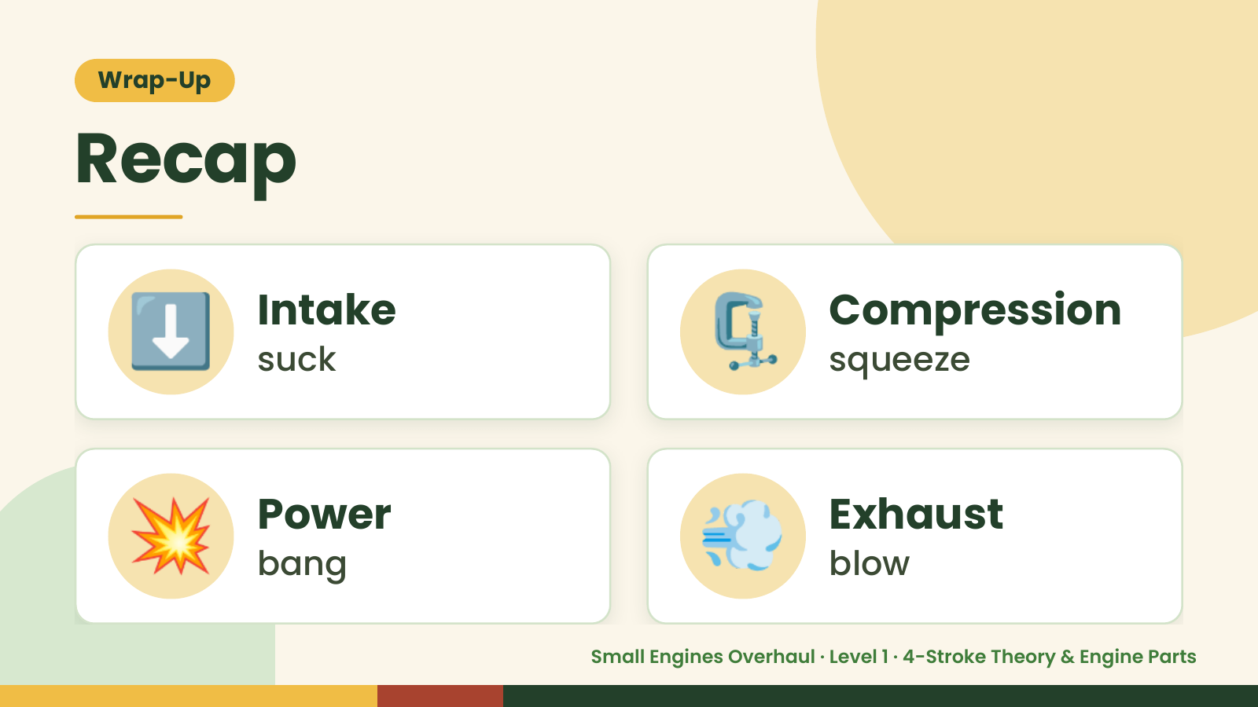
Notes:
Wrap-Up
Recap
⬇️ Intake
suck 🗜️ Compression
squeeze
💥 Power
bang 💨 Exhaust
blow
Small Engines Overhaul · Level 1 · 4-Stroke Theory & Engine Parts

Slide 14

Notes:
Wrap-Up
Great Job!
⚙️
Say the 4 strokes: suck,
🌟
squeeze, bang, blow.
🔩 Point to the piston.
⚡ What makes the spark?
Small Engines Overhaul · Level 1 · 4-Stroke Theory & Engine Parts

