Slide 1

Notes:
Small Engines Overhaul · Unit 3 · Level 2
Engine Parts ID
👥 Jobs
TODAY'S PLAN
⚠️ Safety
🔩 Steps
🔩
✅ Check
📝 Reflect
Small Engines Overhaul · Level 2 · Engine Parts ID

Slide 2

Notes:
Get ready
Jobs
🔧 Mechanic
Does the main engine job
with the tools
🧰 Tool helper
Gets tools from the board
and returns them to staff
📋 Recorder
Takes photos and fills in
the chart
🧽 Clean-up captain
Wipes the bench,
sweeps, checks tools are
back
Small Engines Overhaul · Level 2 · Engine Parts ID

Slide 3
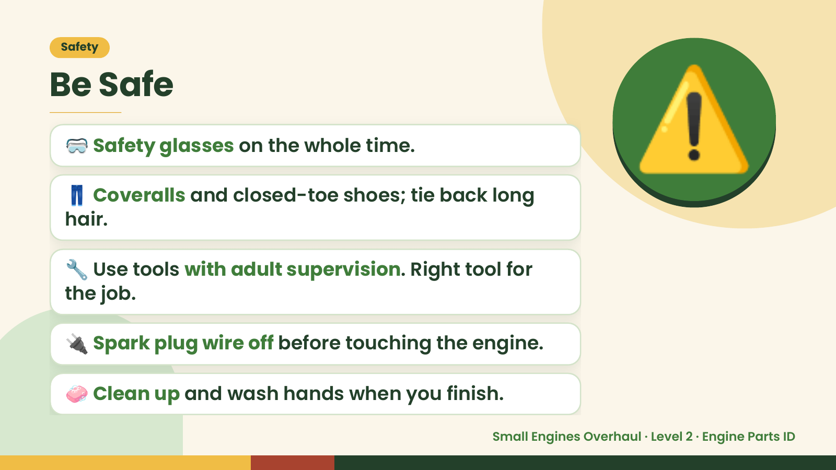
Notes:
Safety
Be Safe
🥽 Safety glasses on the whole time.
👖 Coveralls and closed-toe shoes; tie back long
hair.
⚠️
🔧 Use tools with adult supervision. Right tool for
the job.
🔌 Spark plug wire off before touching the engine.
🧼 Clean up and wash hands when you finish.
Small Engines Overhaul · Level 2 · Engine Parts ID

Slide 4
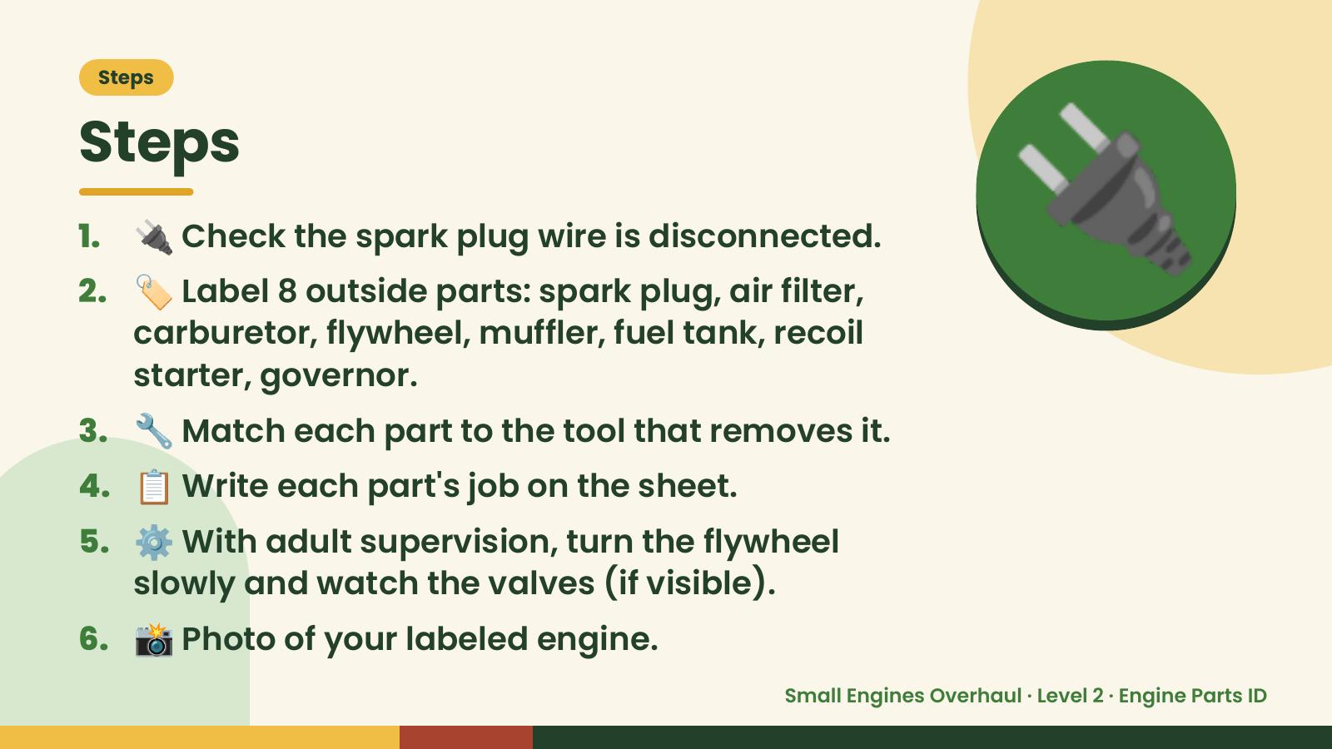
Notes:
Steps
Steps
1. 🔌 Check the spark plug wire is disconnected.
2. 🏷️ Label 8 outside parts: spark plug, air filter,
carburetor, flywheel, muffler, fuel tank, recoil
starter, governor.
🔌
3. 🔧 Match each part to the tool that removes it.
4. 📋 Write each part's job on the sheet.
5. ⚙️ With adult supervision, turn the flywheel
slowly and watch the valves (if visible).
6. 📸 Photo of your labeled engine.
Small Engines Overhaul · Level 2 · Engine Parts ID

Slide 5
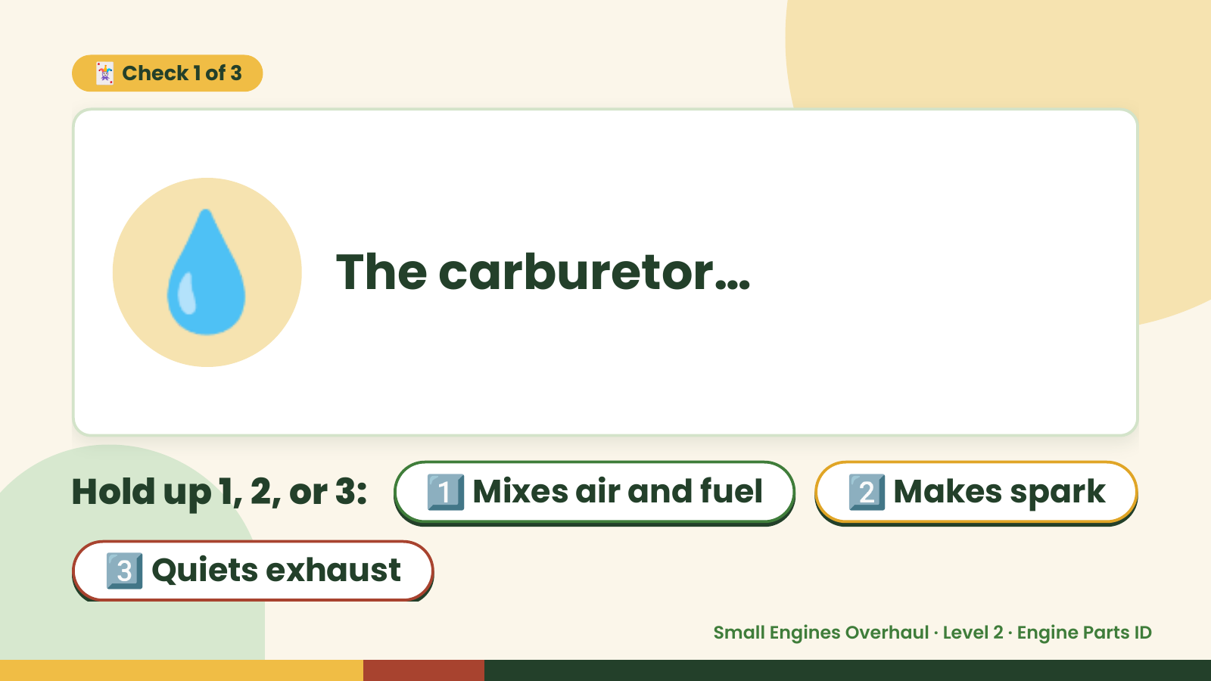
Notes:
🃏 Check 1 of 3
💧 The carburetor…
Hold up 1, 2, or 3: 1️⃣ Mixes air and fuel 2️⃣ Makes spark
3️⃣ Quiets exhaust
Small Engines Overhaul · Level 2 · Engine Parts ID

Slide 6
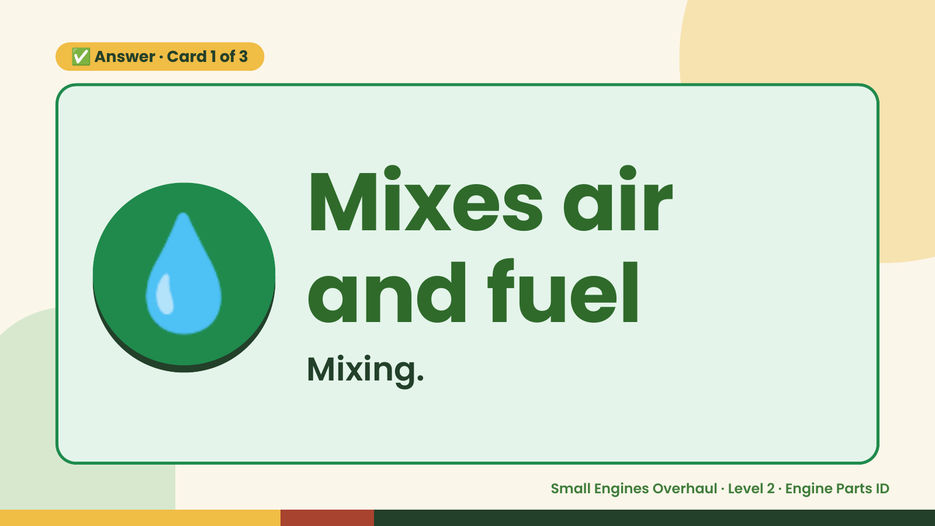
Notes:
✅ Answer · Card 1 of 3
💧 Mixes air
and fuel
Mixing.
Small Engines Overhaul · Level 2 · Engine Parts ID

Slide 7
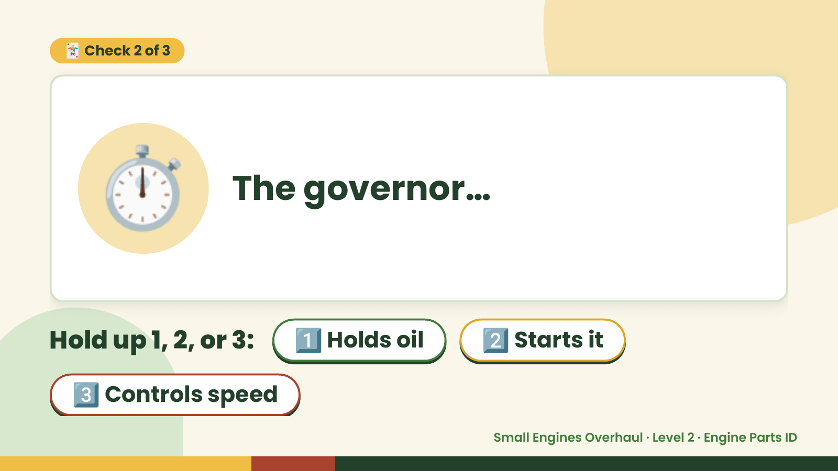
Notes:
🃏 Check 2 of 3
⏱️ The governor…
Hold up 1, 2, or 3: 1️⃣ Holds oil 2️⃣ Starts it
3️⃣ Controls speed
Small Engines Overhaul · Level 2 · Engine Parts ID

Slide 8
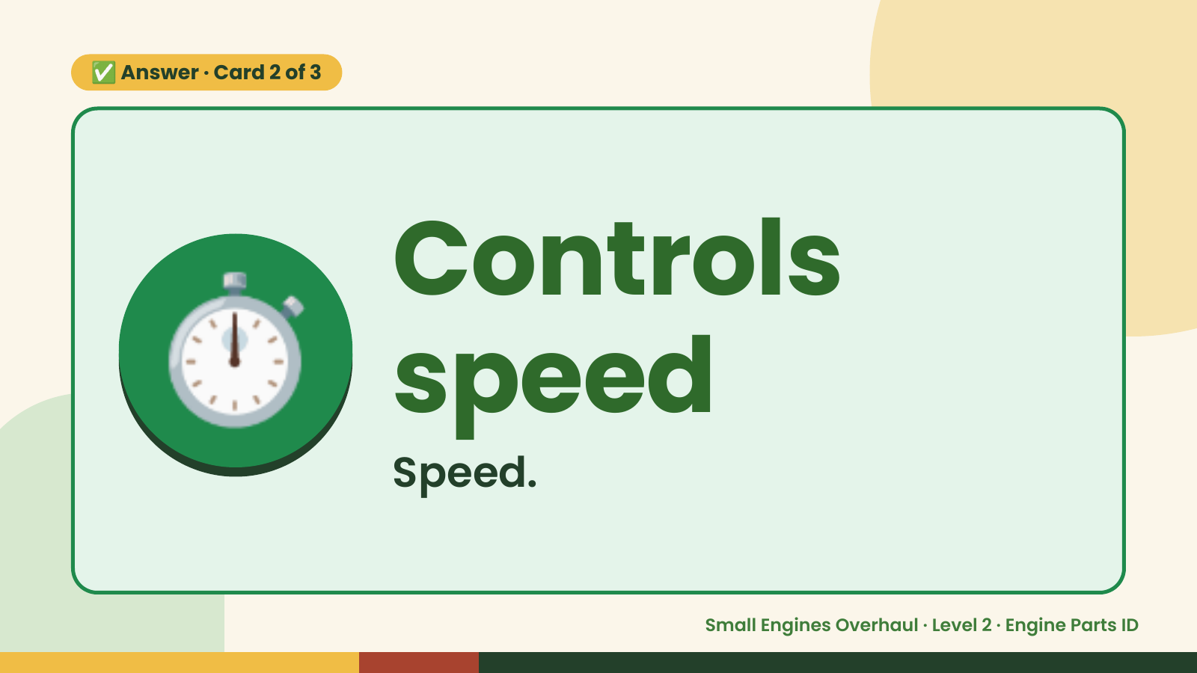
Notes:
✅ Answer · Card 2 of 3
⏱️ Controls
speed
Speed.
Small Engines Overhaul · Level 2 · Engine Parts ID

Slide 9
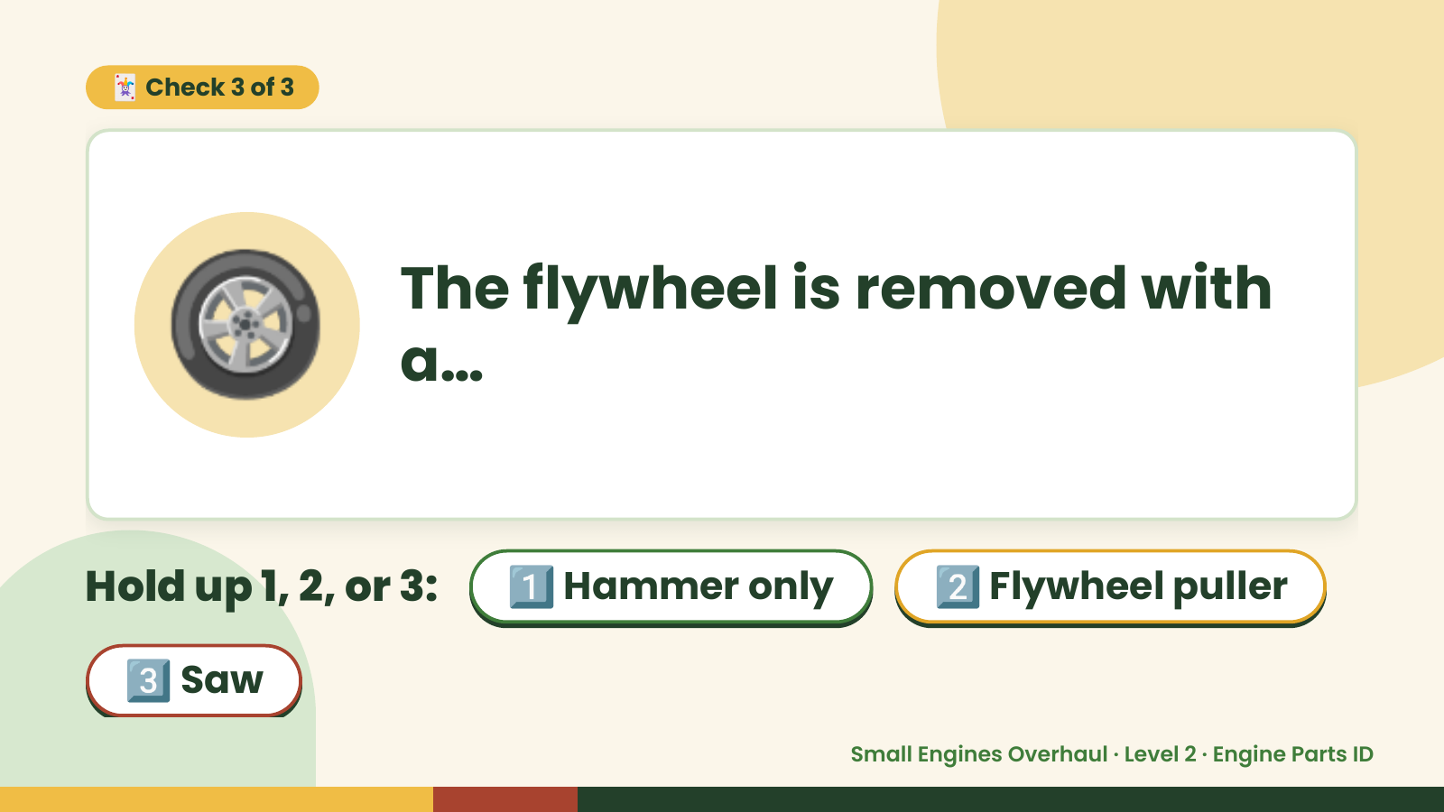
Notes:
🃏 Check 3 of 3
🛞 The flywheel is removed with
a…
Hold up 1, 2, or 3: 1️⃣ Hammer only 2️⃣ Flywheel puller
3️⃣ Saw
Small Engines Overhaul · Level 2 · Engine Parts ID

Slide 10

Notes:
✅ Answer · Card 3 of 3
🛞 Flywheel
puller
Puller.
Small Engines Overhaul · Level 2 · Engine Parts ID

Slide 11

Notes:
Wrap-Up
Clean Up +
Reflect
🧽
Return and count tools.
Sweep and wipe your bench.
Wash hands, then do the reflection.
Small Engines Overhaul · Level 2 · Engine Parts ID

