Slide 1
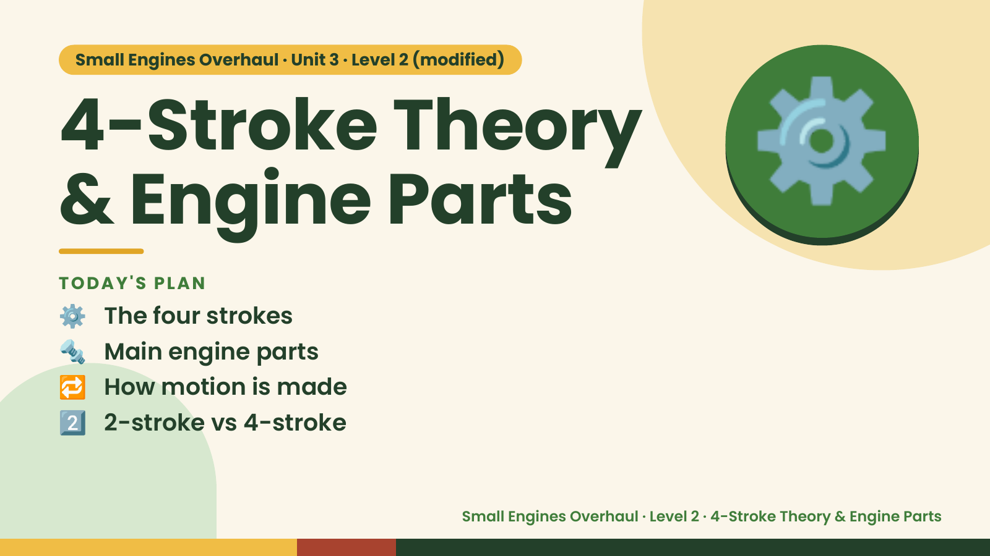
Notes:
Small Engines Overhaul · Unit 3 · Level 2 (modified)
4-Stroke Theory
& Engine Parts
⚙️ The four strokes
TODAY'S PLAN
⚙️
🔩 Main engine parts
🔁 How motion is made
2️⃣ 2-stroke vs 4-stroke
Small Engines Overhaul · Level 2 · 4-Stroke Theory & Engine Parts

Slide 2
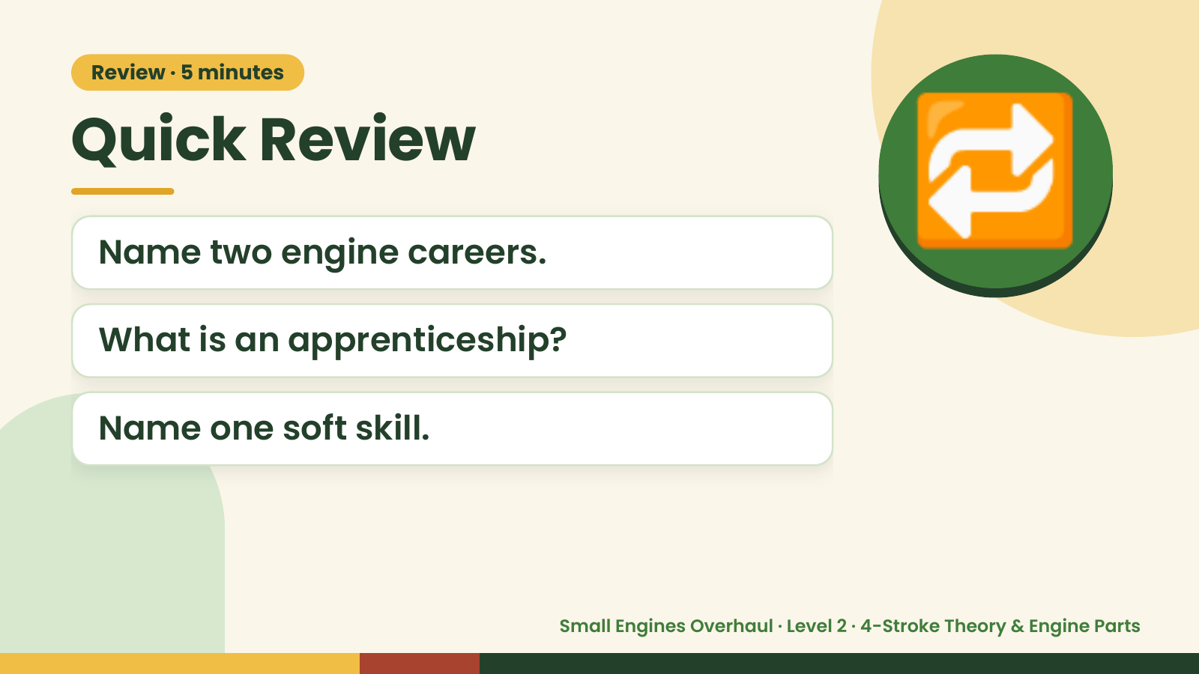
Notes:
Review · 5 minutes
Quick Review
Name two engine careers.
What is an apprenticeship?
🔁
Name one soft skill.
Small Engines Overhaul · Level 2 · 4-Stroke Theory & Engine Parts

Slide 3
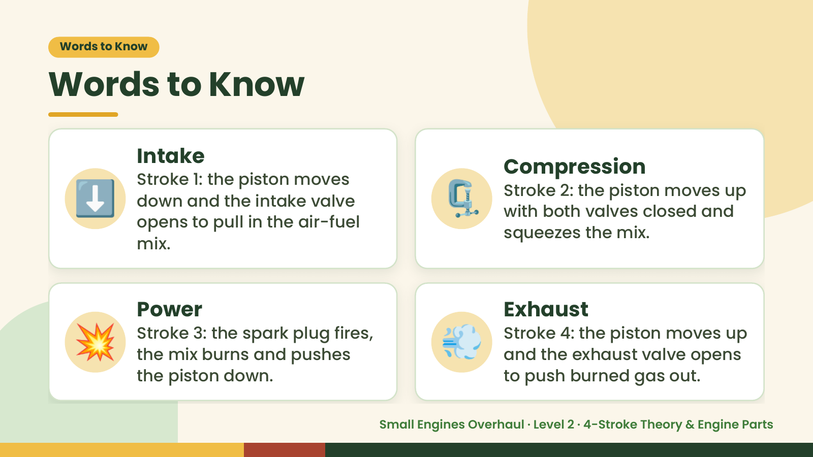
Notes:
Words to Know
Words to Know
⬇️ 🗜️
Intake
Compression
Stroke 1: the piston moves
Stroke 2: the piston moves up
down and the intake valve
with both valves closed and
opens to pull in the air-fuel
squeezes the mix.
mix.
💥 Power
Stroke 3: the spark plug fires,
the mix burns and pushes
the piston down.
💨 Exhaust
Stroke 4: the piston moves up
and the exhaust valve opens
to push burned gas out.
Small Engines Overhaul · Level 2 · 4-Stroke Theory & Engine Parts

Slide 4
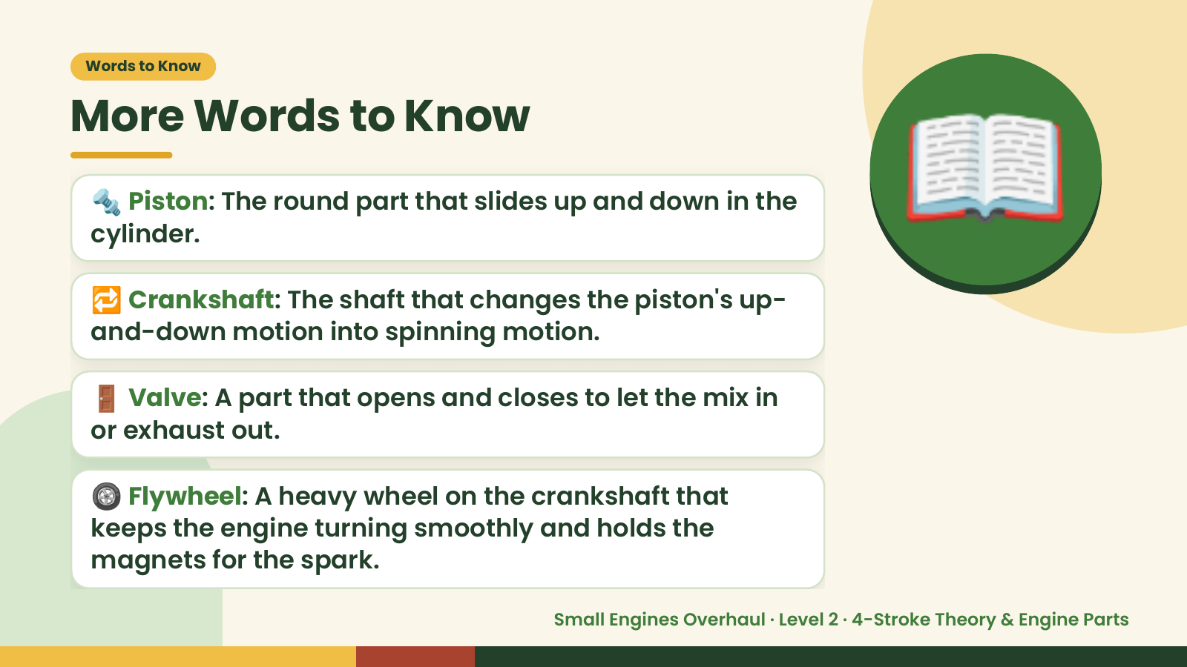
Notes:
Words to Know
More Words to Know
🔩 Piston: The round part that slides up and down in the
cylinder.
🔁 Crankshaft: The shaft that changes the piston's up-
and-down motion into spinning motion.
📖
🚪 Valve: A part that opens and closes to let the mix in
or exhaust out.
🛞 Flywheel: A heavy wheel on the crankshaft that
keeps the engine turning smoothly and holds the
magnets for the spark.
Small Engines Overhaul · Level 2 · 4-Stroke Theory & Engine Parts

Slide 5
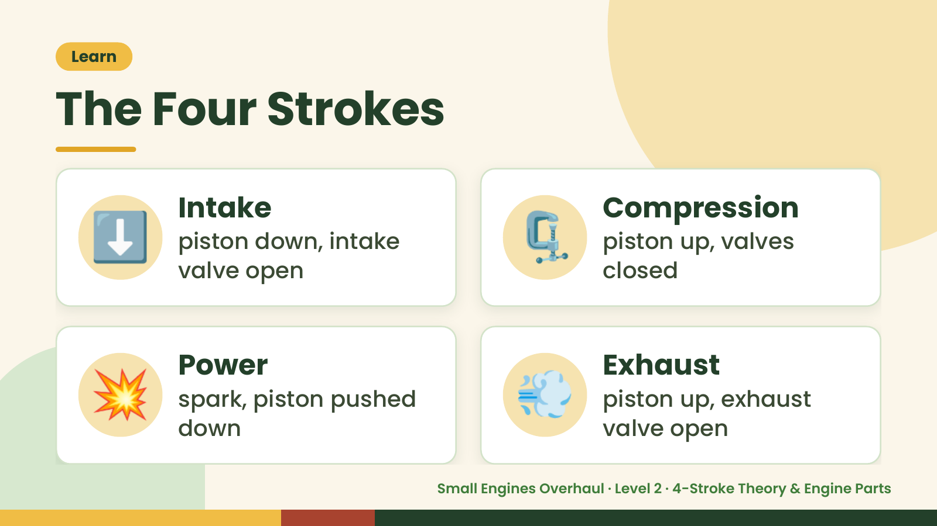
Notes:
Learn
The Four Strokes
⬇️ Intake
piston down, intake
valve open
🗜️ Compression
piston up, valves
closed
💥 Power
spark, piston pushed
down
💨 Exhaust
piston up, exhaust
valve open
Small Engines Overhaul · Level 2 · 4-Stroke Theory & Engine Parts

Slide 6
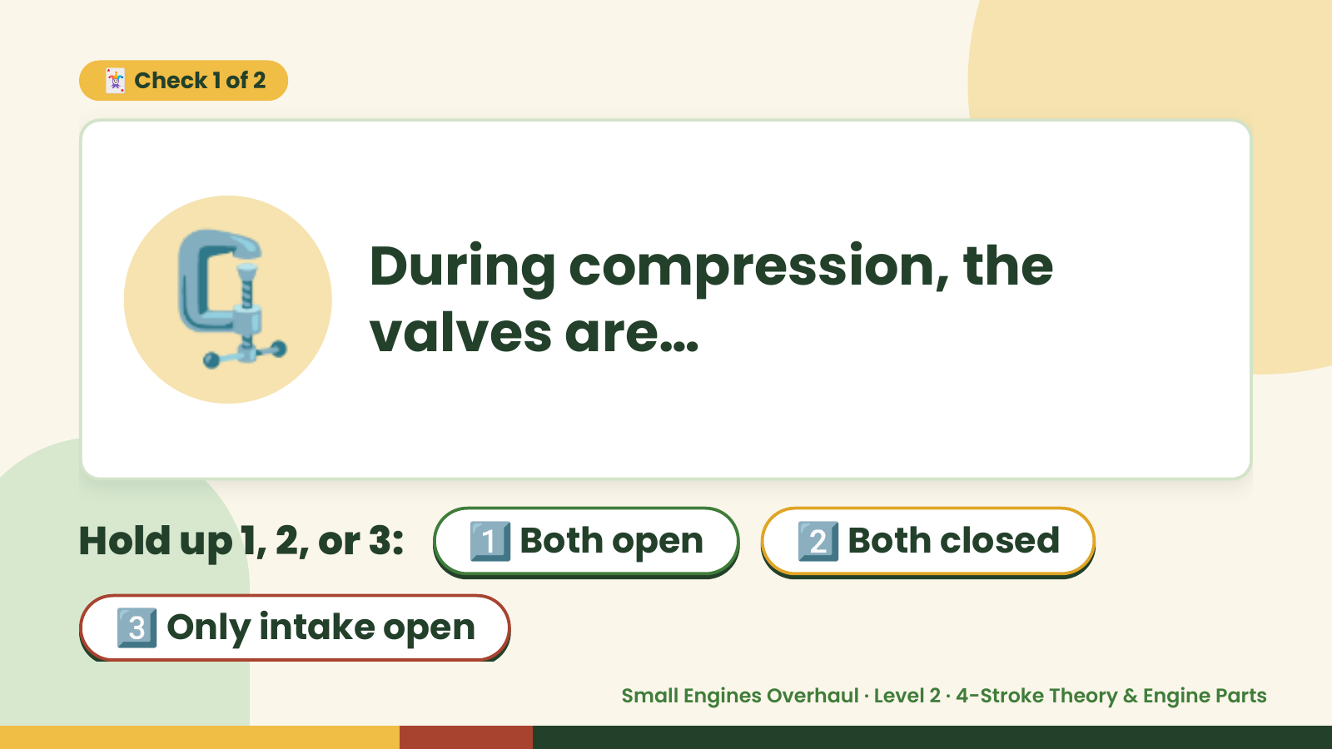
Notes:
🃏 Check 1 of 2
🗜️ During compression, the
valves are…
Hold up 1, 2, or 3: 1️⃣ Both open 2️⃣ Both closed
3️⃣ Only intake open
Small Engines Overhaul · Level 2 · 4-Stroke Theory & Engine Parts

Slide 7
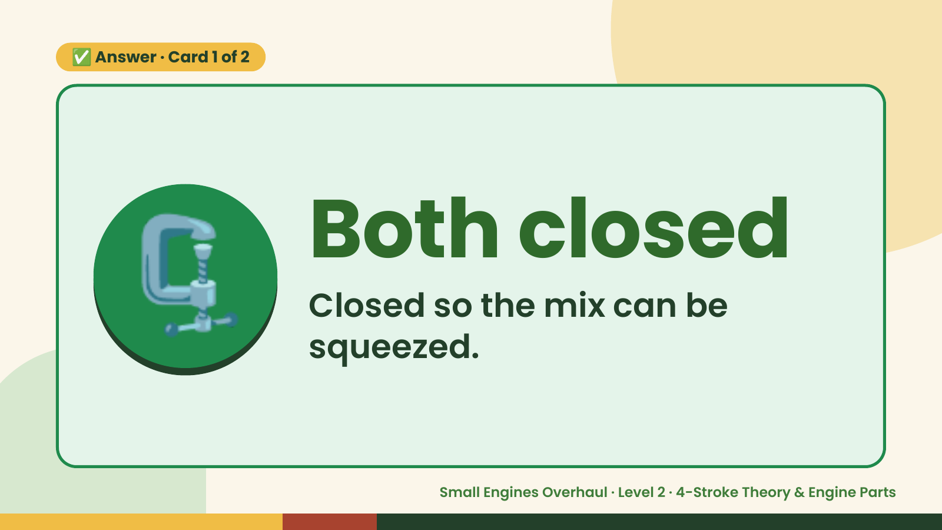
Notes:
✅ Answer · Card 1 of 2
🗜️ Both closed
Closed so the mix can be
squeezed.
Small Engines Overhaul · Level 2 · 4-Stroke Theory & Engine Parts

Slide 8
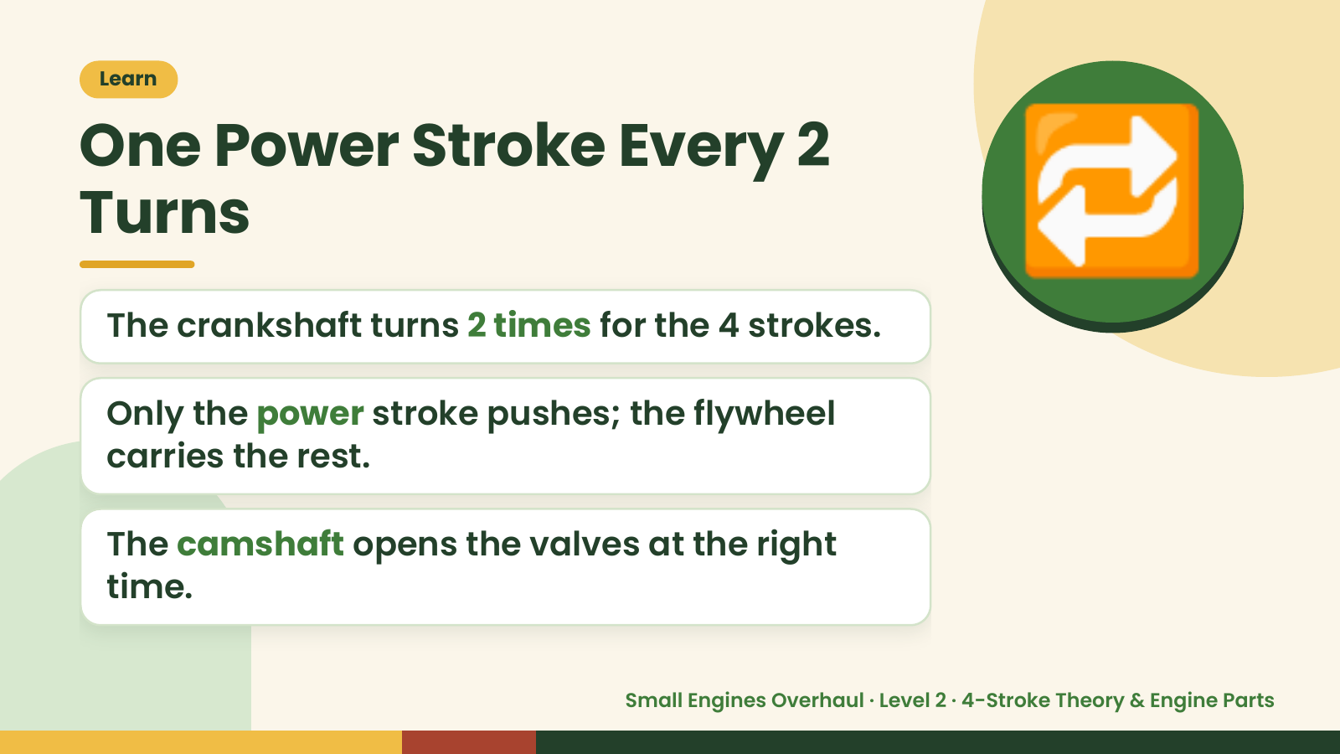
Notes:
Learn
One Power Stroke Every 2
Turns
The crankshaft turns 2 times for the 4 strokes.
Only the power stroke pushes; the flywheel
🔁
carries the rest.
The camshaft opens the valves at the right
time.
Small Engines Overhaul · Level 2 · 4-Stroke Theory & Engine Parts

Slide 9
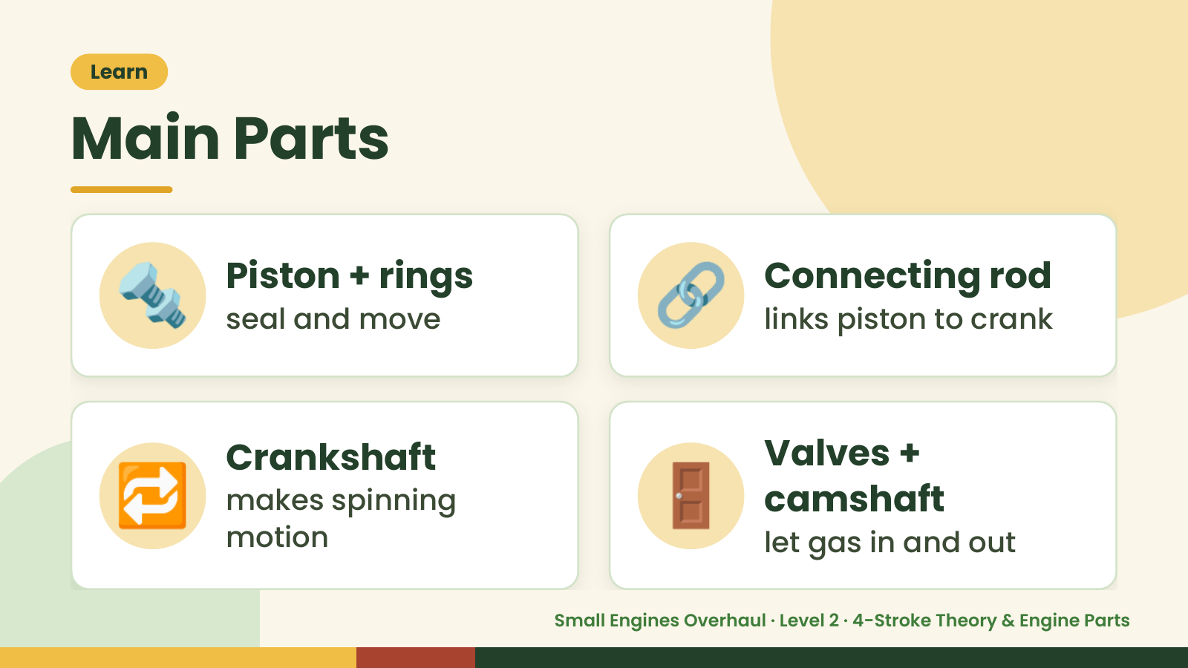
Notes:
Learn
Main Parts
🔩 Piston + rings
seal and move 🔗 Connecting rod
links piston to crank
🔁 Crankshaft
makes spinning
motion
🚪 Valves +
camshaft
let gas in and out
Small Engines Overhaul · Level 2 · 4-Stroke Theory & Engine Parts

Slide 10
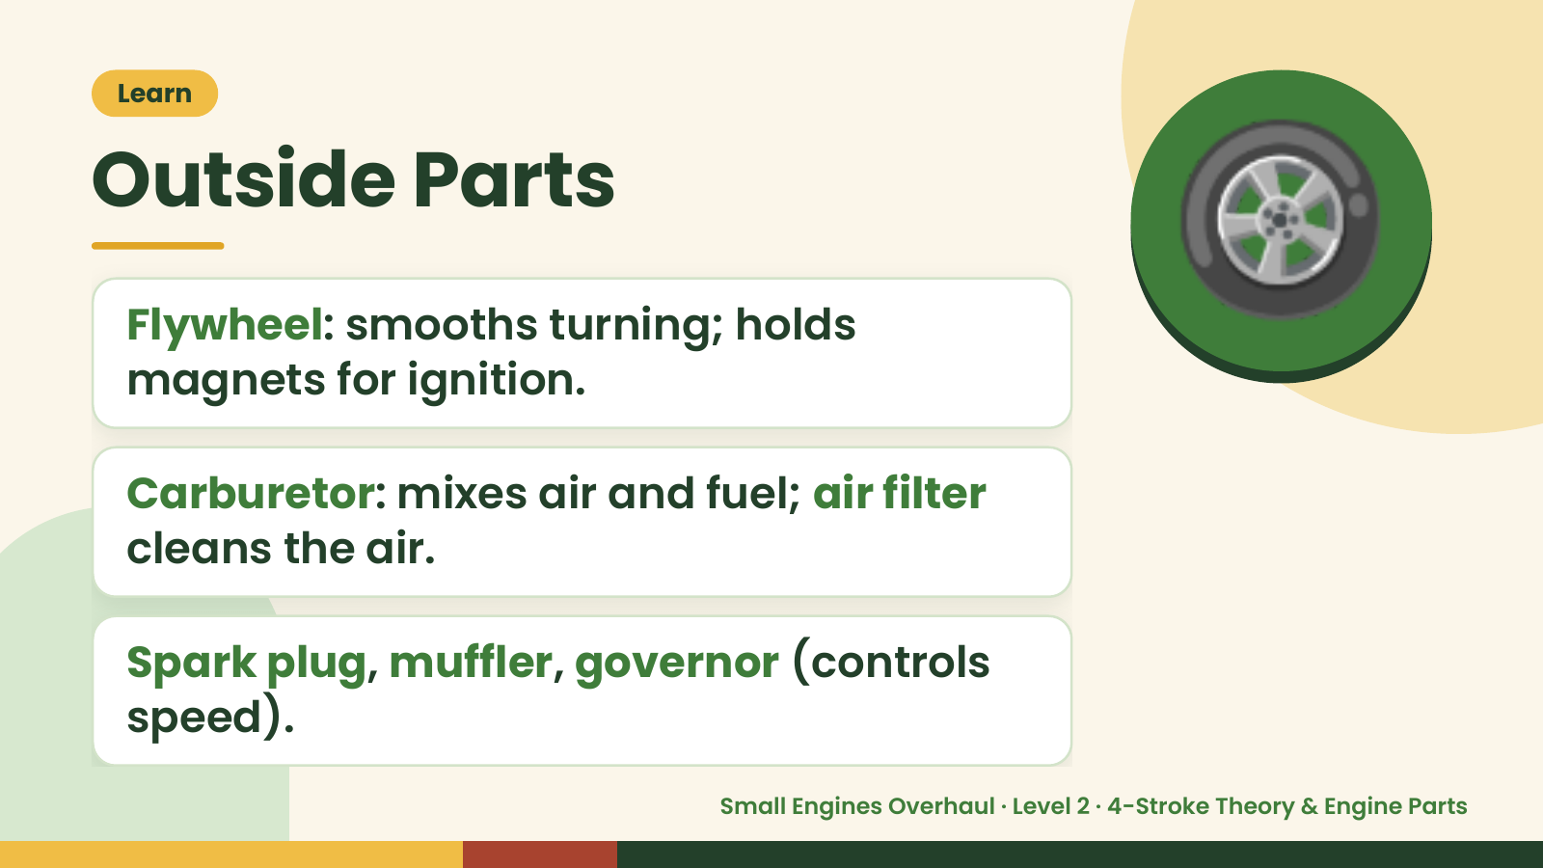
Notes:
Learn
Outside Parts
Flywheel: smooths turning; holds
magnets for ignition.
🛞
Carburetor: mixes air and fuel; air filter
cleans the air.
Spark plug, muffler, governor (controls
speed).
Small Engines Overhaul · Level 2 · 4-Stroke Theory & Engine Parts

Slide 11
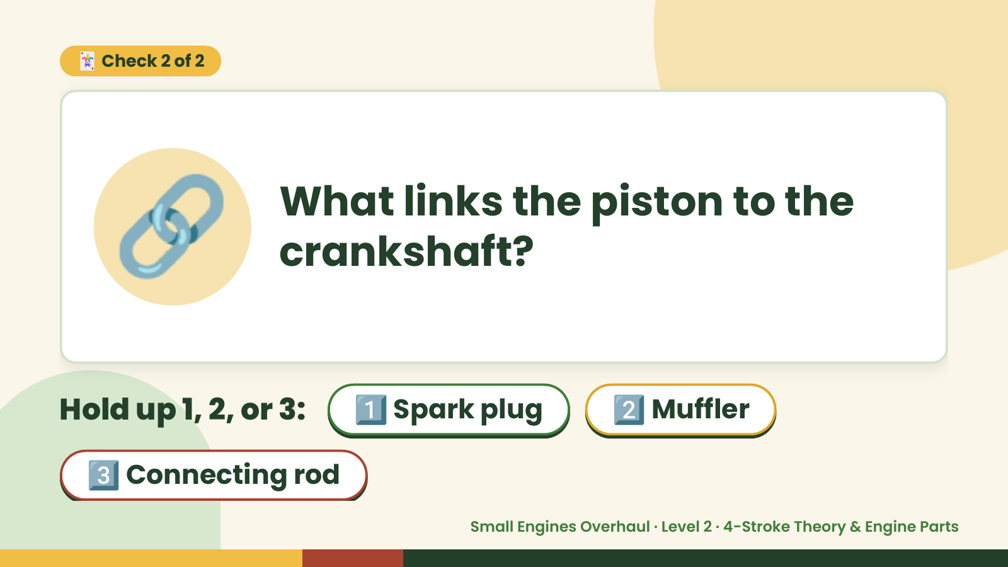
Notes:
🃏 Check 2 of 2
🔗 What links the piston to the
crankshaft?
Hold up 1, 2, or 3: 1️⃣ Spark plug 2️⃣ Muffler
3️⃣ Connecting rod
Small Engines Overhaul · Level 2 · 4-Stroke Theory & Engine Parts

Slide 12
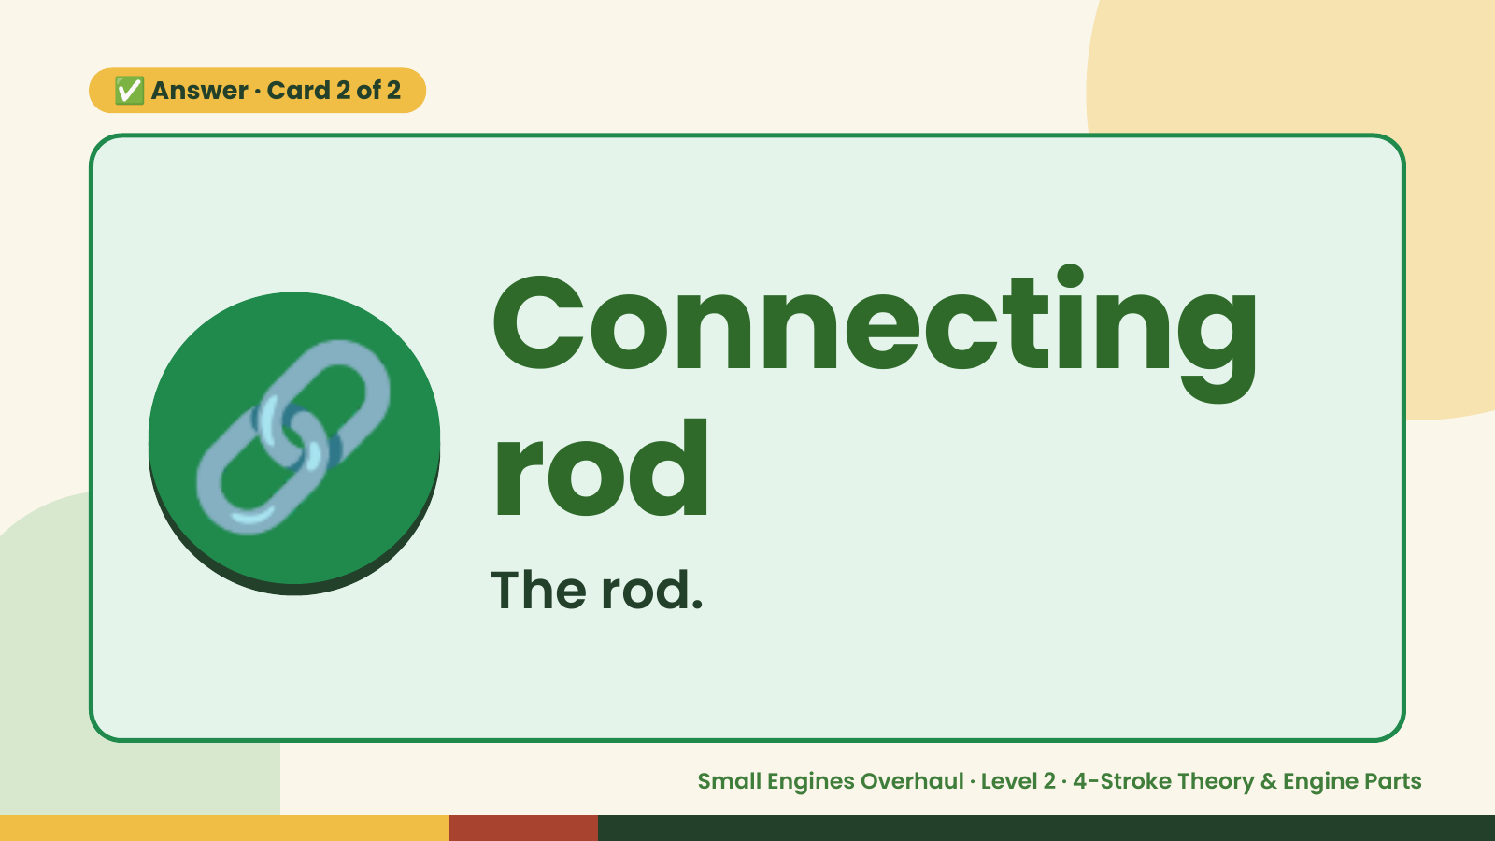
Notes:
✅ Answer · Card 2 of 2
🔗 Connecting
rod
The rod.
Small Engines Overhaul · Level 2 · 4-Stroke Theory & Engine Parts

Slide 13
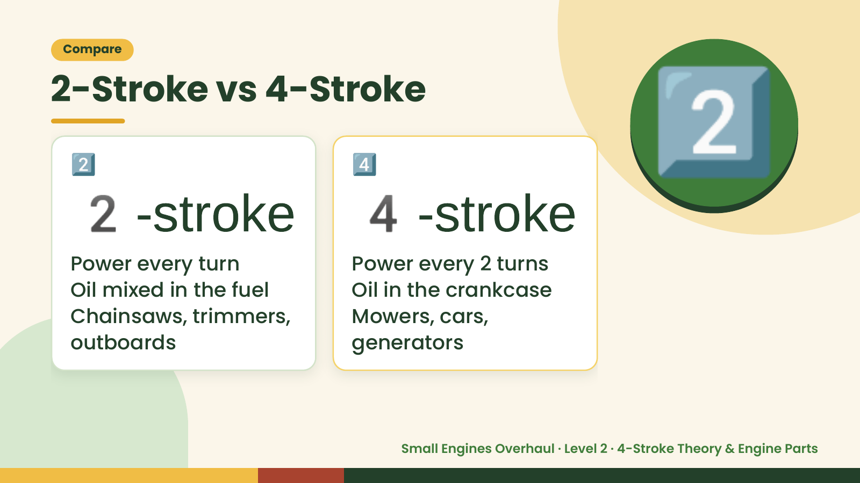
Notes:
Compare
2-Stroke vs 4-Stroke
2-stroke 4-stroke
2️⃣
Power every turn
4️⃣
Power every 2 turns
2️⃣
Oil mixed in the fuel Oil in the crankcase
Chainsaws, trimmers, Mowers, cars,
outboards generators
Small Engines Overhaul · Level 2 · 4-Stroke Theory & Engine Parts

Slide 14
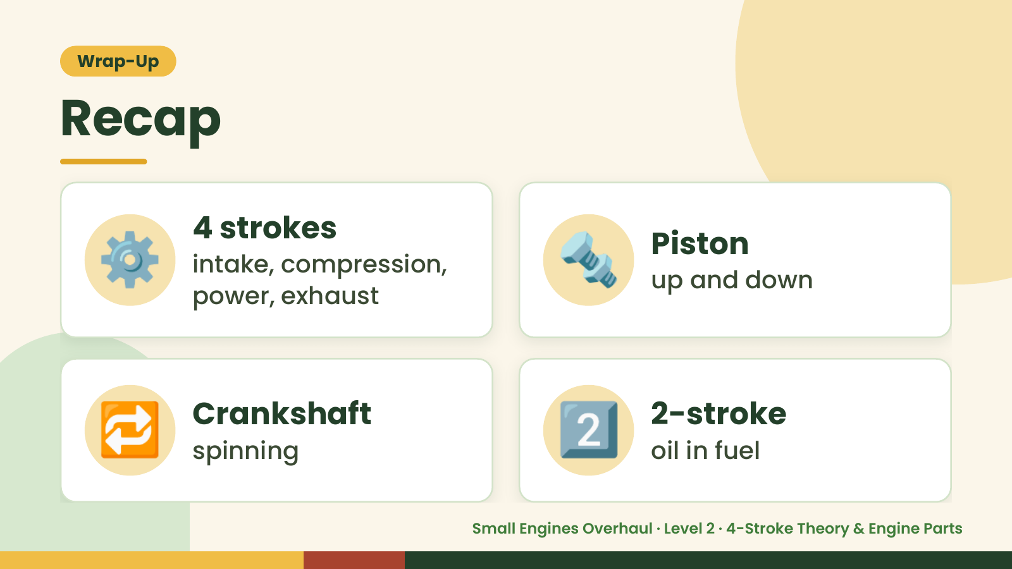
Notes:
Wrap-Up
Recap
⚙️ 4 strokes
intake, compression,
power, exhaust
🔩 Piston
up and down
🔁 Crankshaft
spinning 2️⃣ 2-stroke
oil in fuel
Small Engines Overhaul · Level 2 · 4-Stroke Theory & Engine Parts

Slide 15
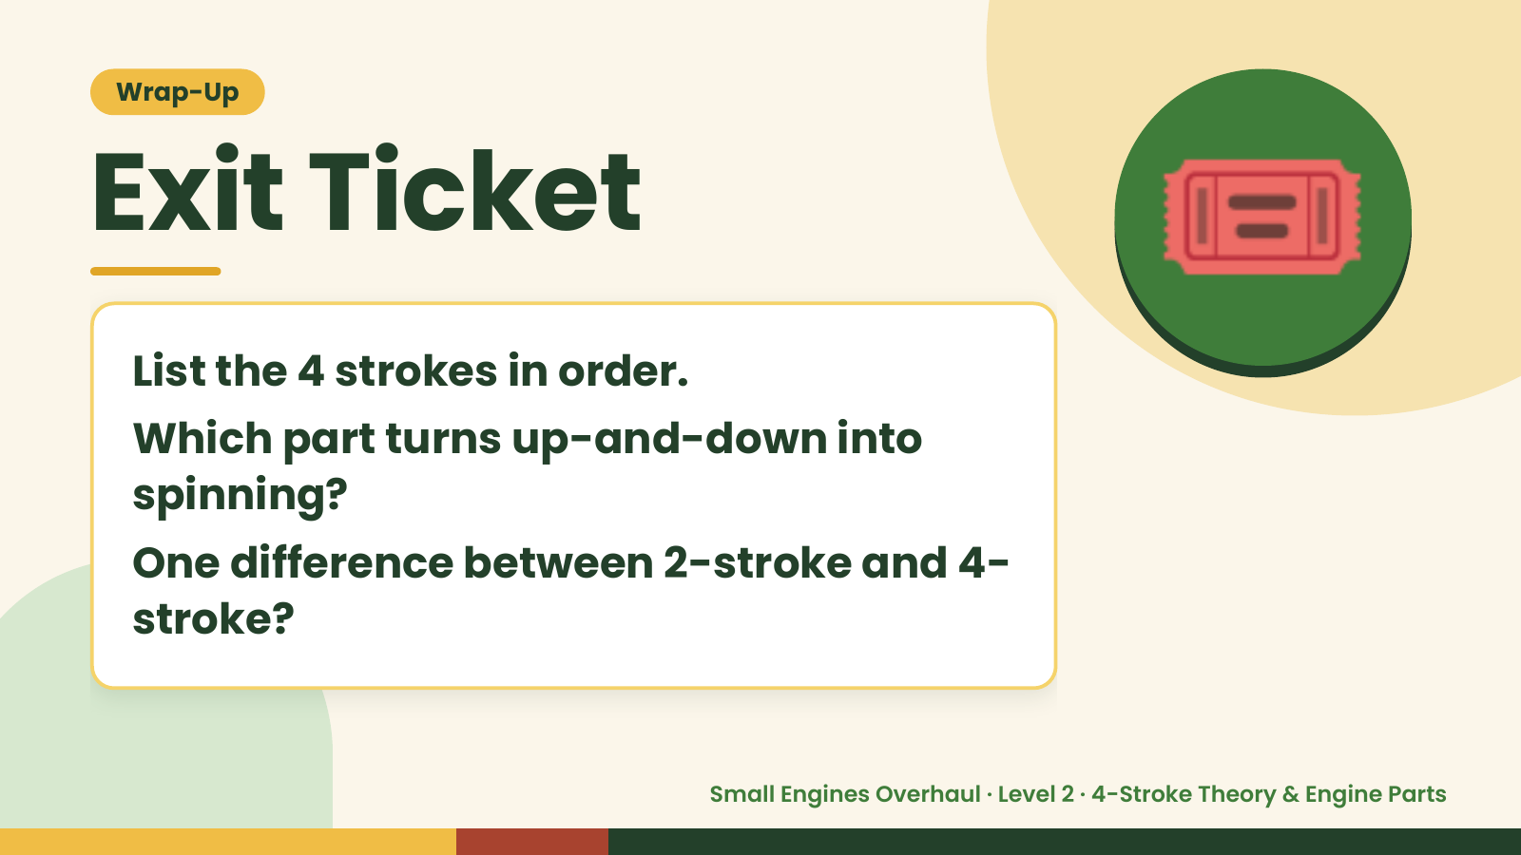
Notes:
Wrap-Up
Exit Ticket
List the 4 strokes in order.
Which part turns up-and-down into
🎟️
spinning?
One difference between 2-stroke and 4-
stroke?
Small Engines Overhaul · Level 2 · 4-Stroke Theory & Engine Parts

