Slide 1
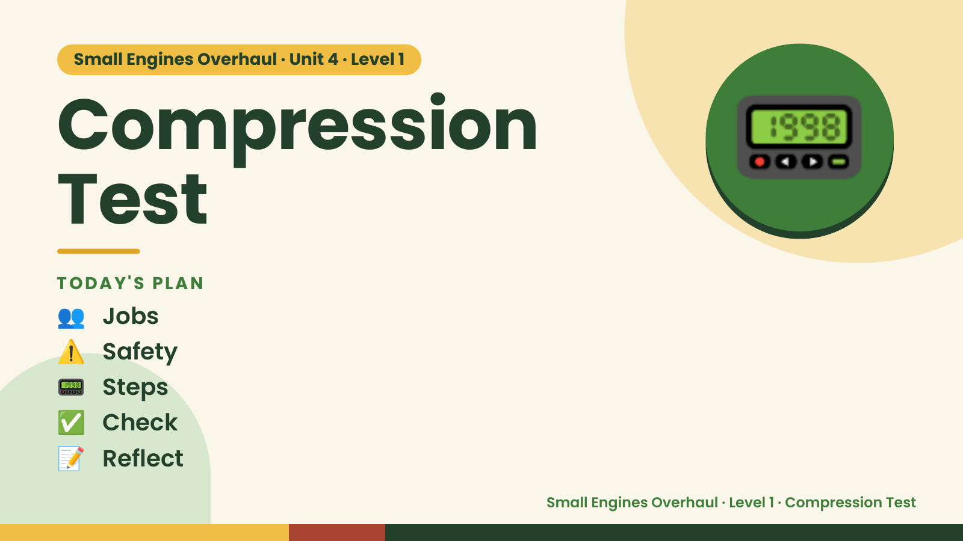
Notes:
Small Engines Overhaul · Unit 4 · Level 1
Compression
Test
TODAY'S PLAN
📟
👥 Jobs
⚠️ Safety
📟 Steps
✅ Check
📝 Reflect
Small Engines Overhaul · Level 1 · Compression Test

Slide 2
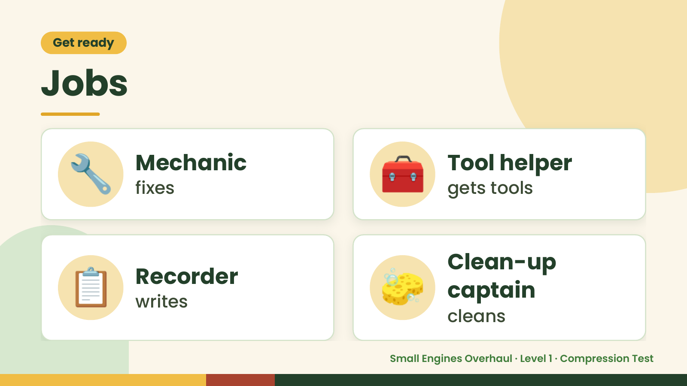
Notes:
Get ready
Jobs
🔧 Mechanic
fixes 🧰 Tool helper
gets tools
📋 Recorder
writes 🧽 Clean-up
captain
cleans
Small Engines Overhaul · Level 1 · Compression Test

Slide 3
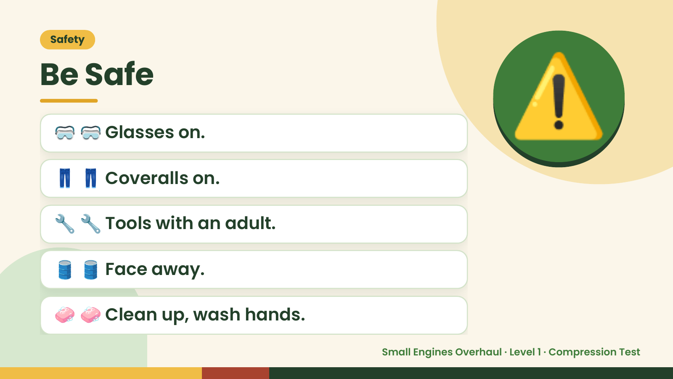
Notes:
Safety
Be Safe
🥽 🥽 Glasses on.
👖 👖 Coveralls on.
⚠️
🔧 🔧 Tools with an adult.
🛢️ 🛢️ Face away.
🧼 🧼 Clean up, wash hands.
Small Engines Overhaul · Level 1 · Compression Test

Slide 4
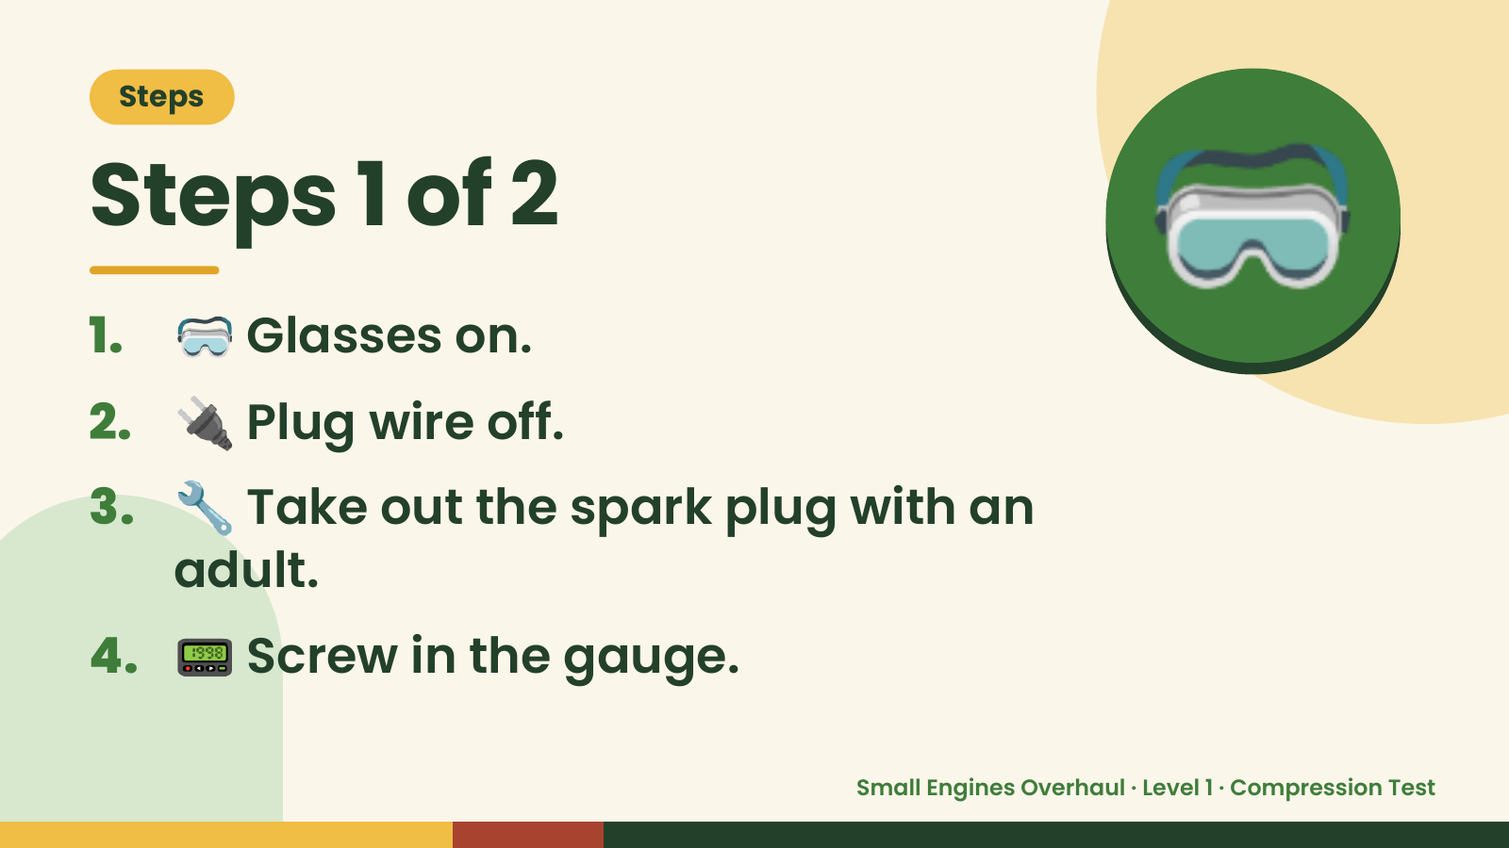
Notes:
Steps
Steps 1 of 2
1. 🥽 Glasses on.
2. 🔌 Plug wire off.
🥽
3. 🔧 Take out the spark plug with an
adult.
4. 📟 Screw in the gauge.
Small Engines Overhaul · Level 1 · Compression Test

Slide 5
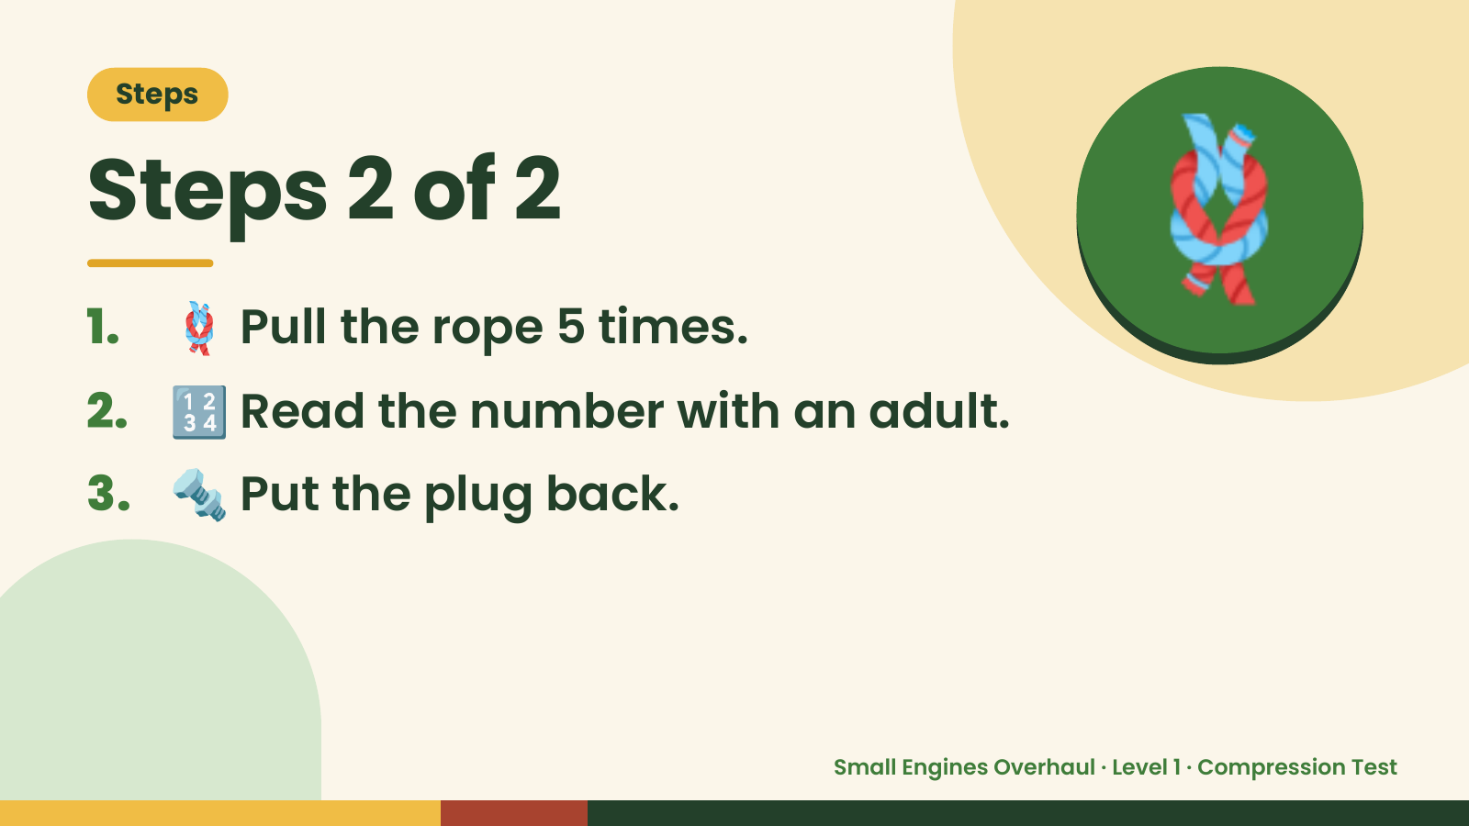
Notes:
Steps
Steps 2 of 2
1. 🪢 Pull the rope 5 times.
2. 🔢 Read the number with an adult.
🪢
3. 🔩 Put the plug back.
Small Engines Overhaul · Level 1 · Compression Test

Slide 6
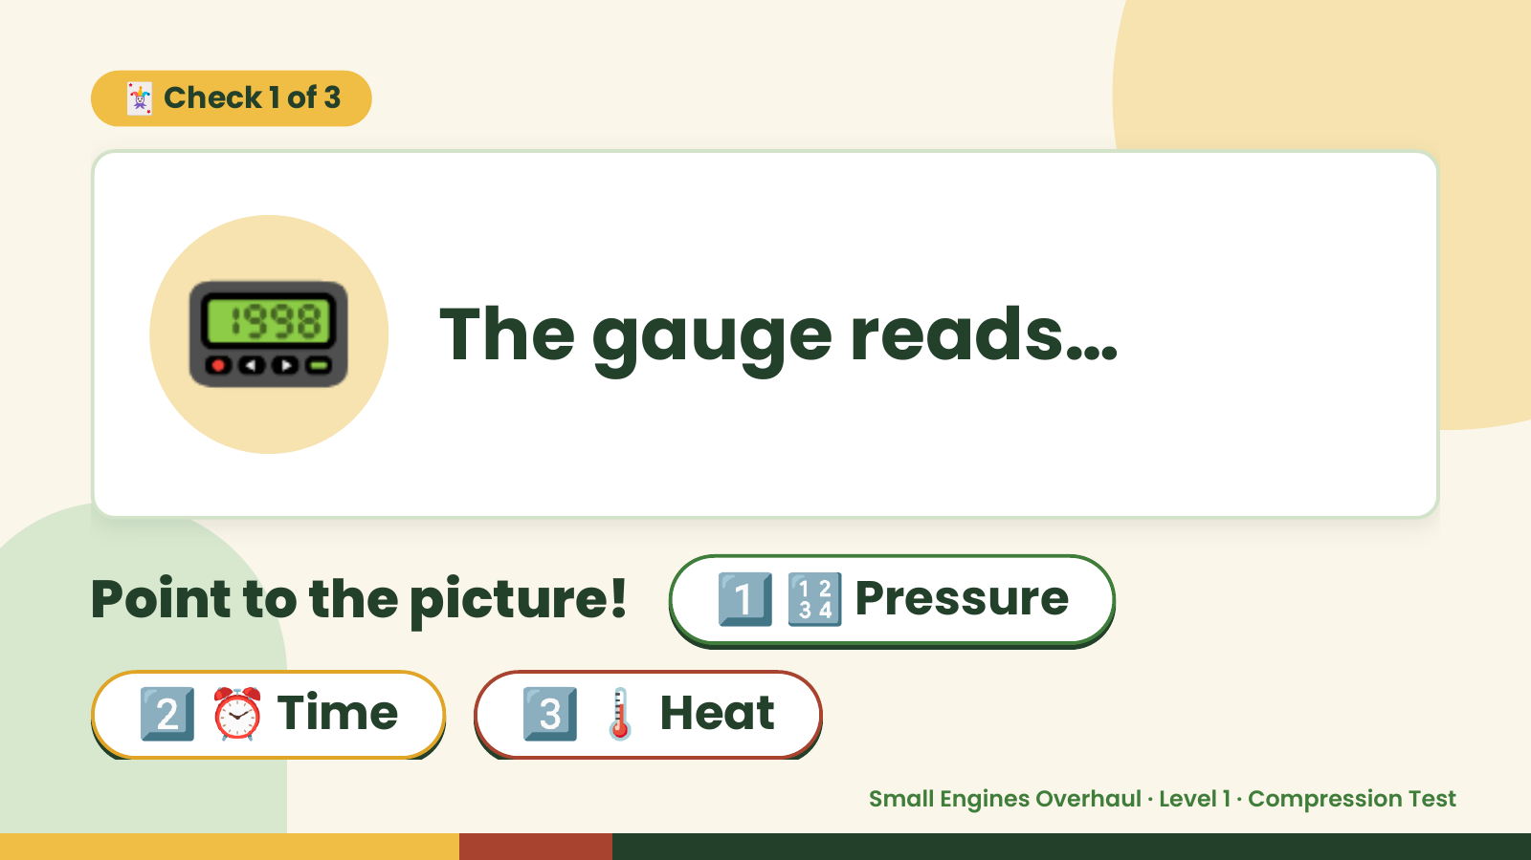
Notes:
🃏 Check 1 of 3
📟 The gauge reads…
Point to the picture! 1️⃣ 🔢 Pressure
2️⃣ ⏰ Time 3️⃣ 🌡️ Heat
Small Engines Overhaul · Level 1 · Compression Test

Slide 7
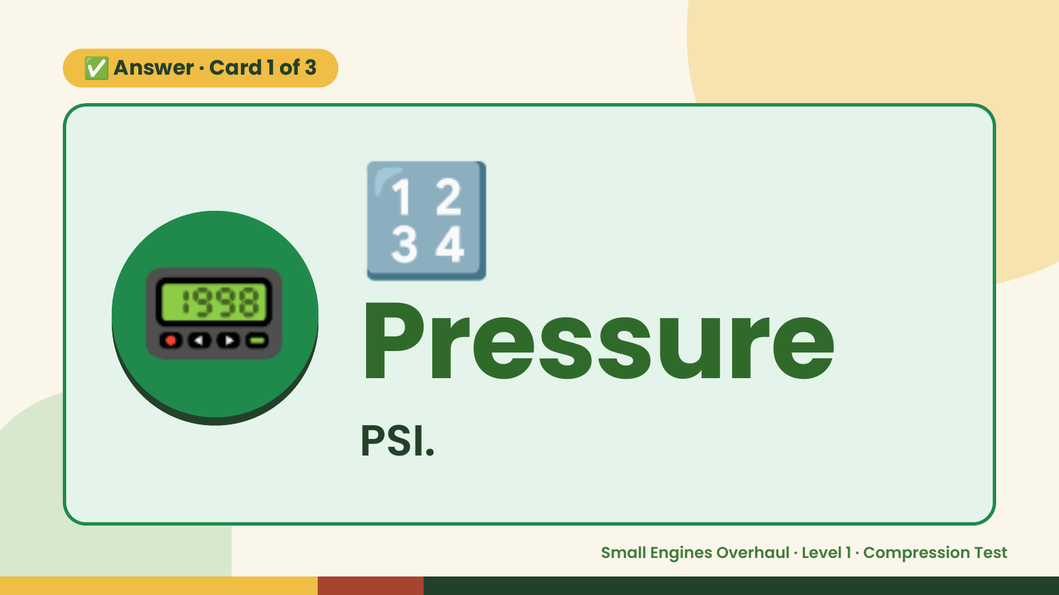
Notes:
🔢
✅ Answer · Card 1 of 3
📟 Pressure PSI.
Small Engines Overhaul · Level 1 · Compression Test

Slide 8
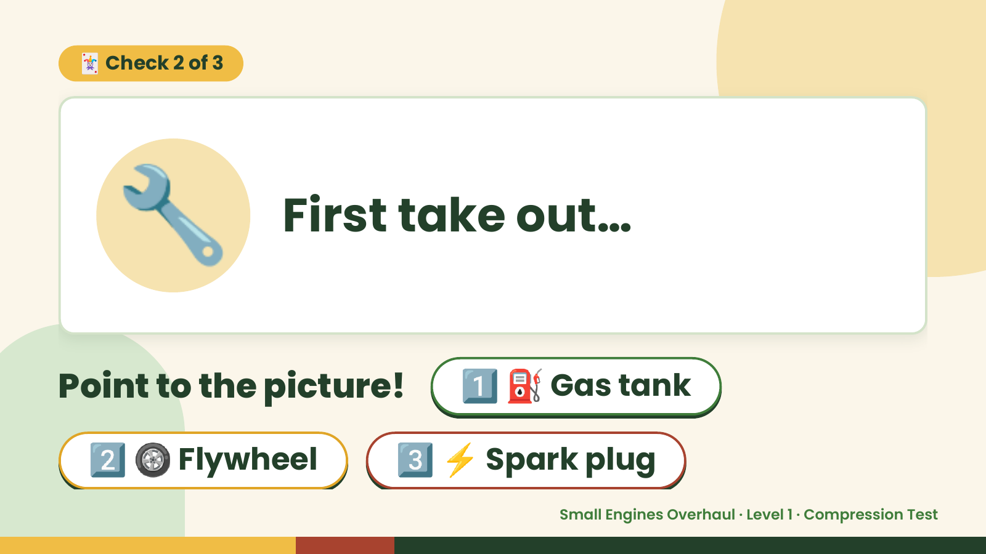
Notes:
🃏 Check 2 of 3
🔧 First take out…
Point to the picture! 1️⃣ ⛽ Gas tank
2️⃣ 🛞 Flywheel 3️⃣ ⚡ Spark plug
Small Engines Overhaul · Level 1 · Compression Test

Slide 9

Notes:
⚡
✅ Answer · Card 2 of 3
🔧 plug
Spark
Plug.
Small Engines Overhaul · Level 1 · Compression Test

Slide 10
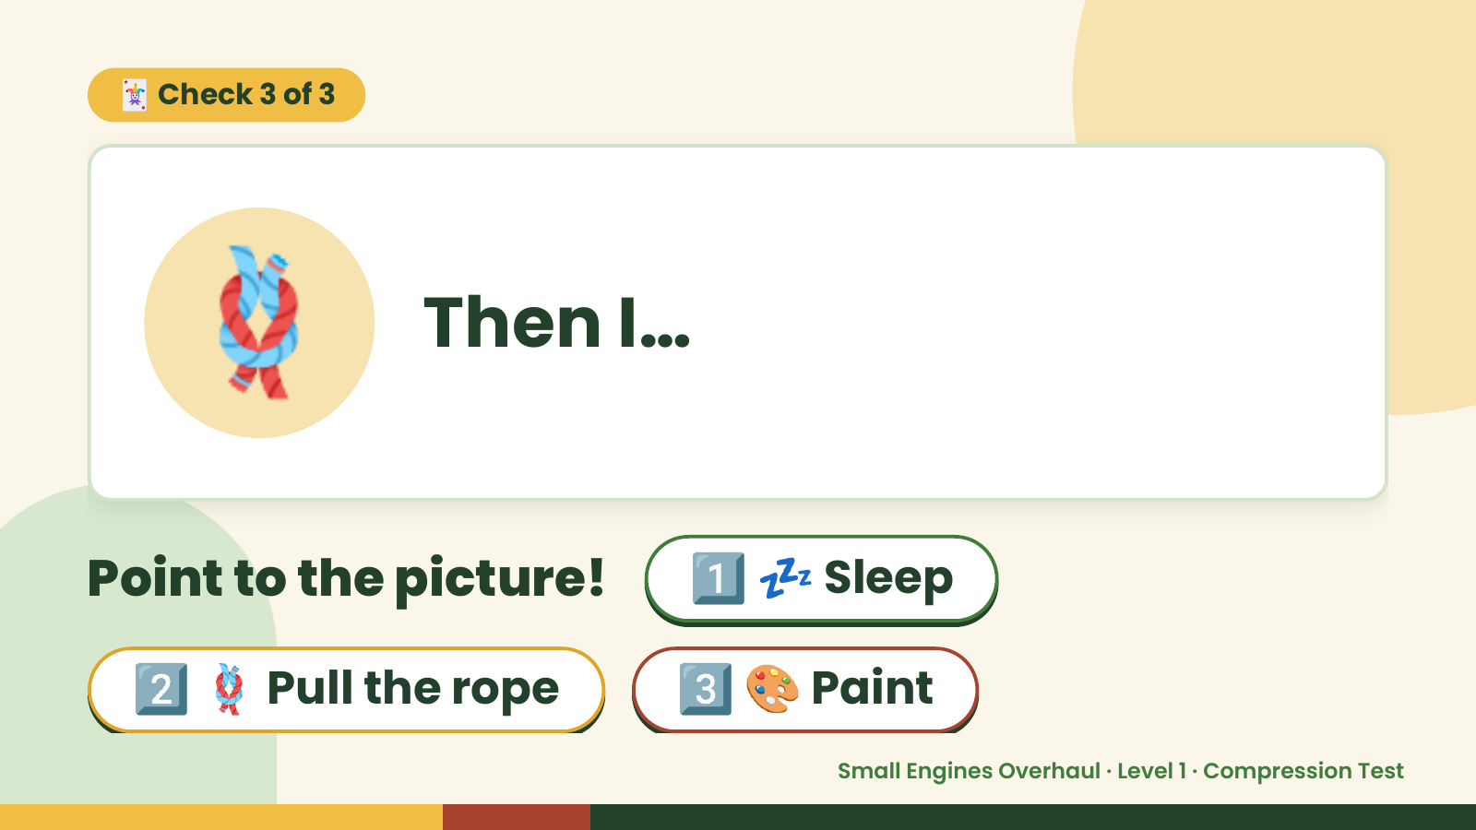
Notes:
🃏 Check 3 of 3
🪢 Then I…
Point to the picture! 1️⃣ 💤 Sleep
2️⃣ 🪢 Pull the rope 3️⃣ 🎨 Paint
Small Engines Overhaul · Level 1 · Compression Test

Slide 11
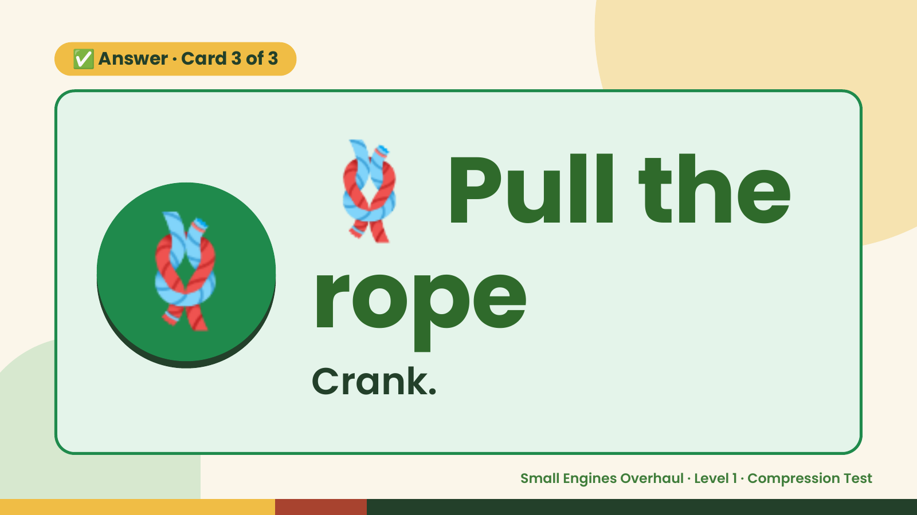
Notes:
🪢
✅ Answer · Card 3 of 3
🪢 rope
Pull the
Crank.
Small Engines Overhaul · Level 1 · Compression Test

Slide 12

Notes:
Wrap-Up
Clean Up +
Reflect
🧽
🧽 Wipe the bench.
🧰 Give tools back.
🧼 Wash hands.
Small Engines Overhaul · Level 1 · Compression Test

