Slide 1
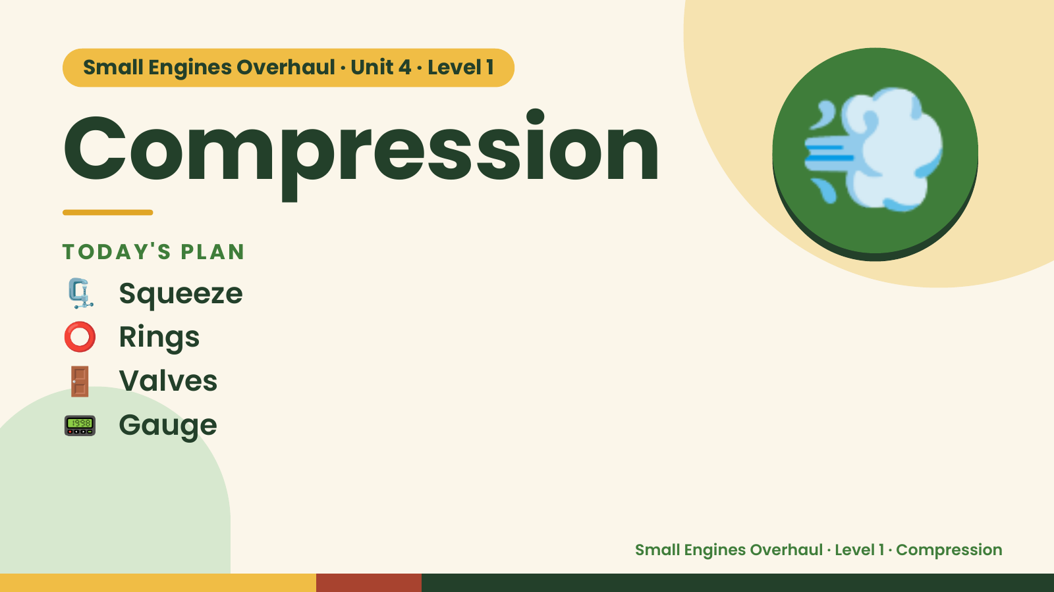
Notes:
Small Engines Overhaul · Unit 4 · Level 1
Compression
TODAY'S PLAN
🗜️ Squeeze
💨
⭕ Rings
🚪 Valves
📟 Gauge
Small Engines Overhaul · Level 1 · Compression

Slide 2
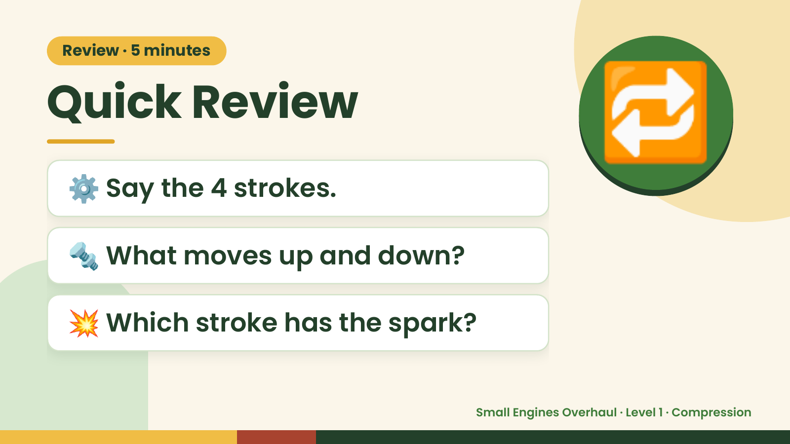
Notes:
Review · 5 minutes
Quick Review
⚙️ Say the 4 strokes.
🔁
🔩 What moves up and down?
💥 Which stroke has the spark?
Small Engines Overhaul · Level 1 · Compression

Slide 3
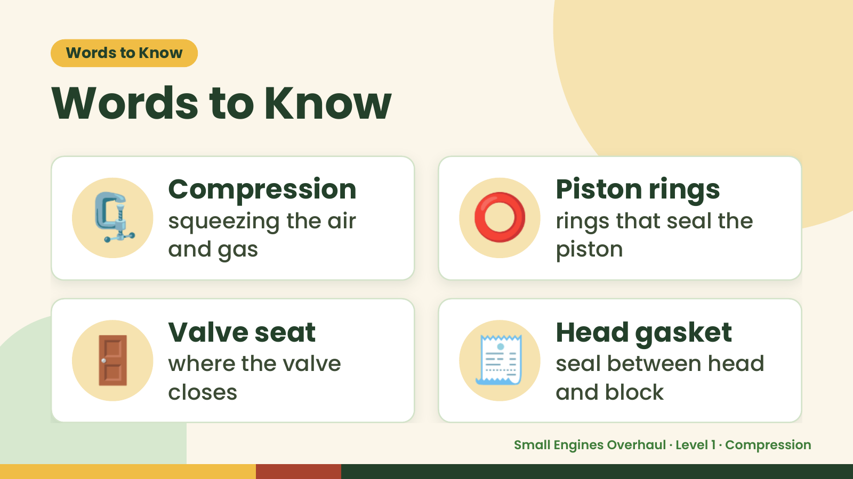
Notes:
Words to Know
Words to Know
🗜️ Compression
squeezing the air
and gas
⭕ Piston rings
rings that seal the
piston
🚪 Valve seat
where the valve
closes
🧾 Head gasket
seal between head
and block
Small Engines Overhaul · Level 1 · Compression

Slide 4
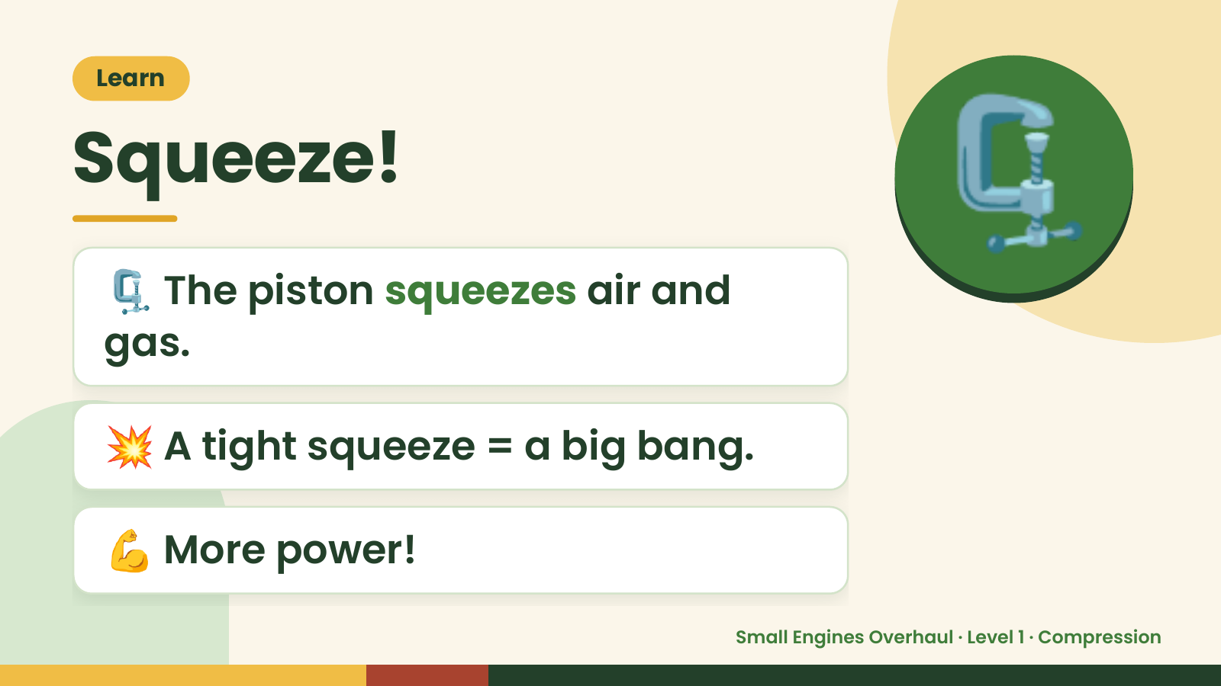
Notes:
Learn
Squeeze!
🗜️ The piston squeezes air and
gas.
🗜️
💥 A tight squeeze = a big bang.
💪 More power!
Small Engines Overhaul · Level 1 · Compression

Slide 5
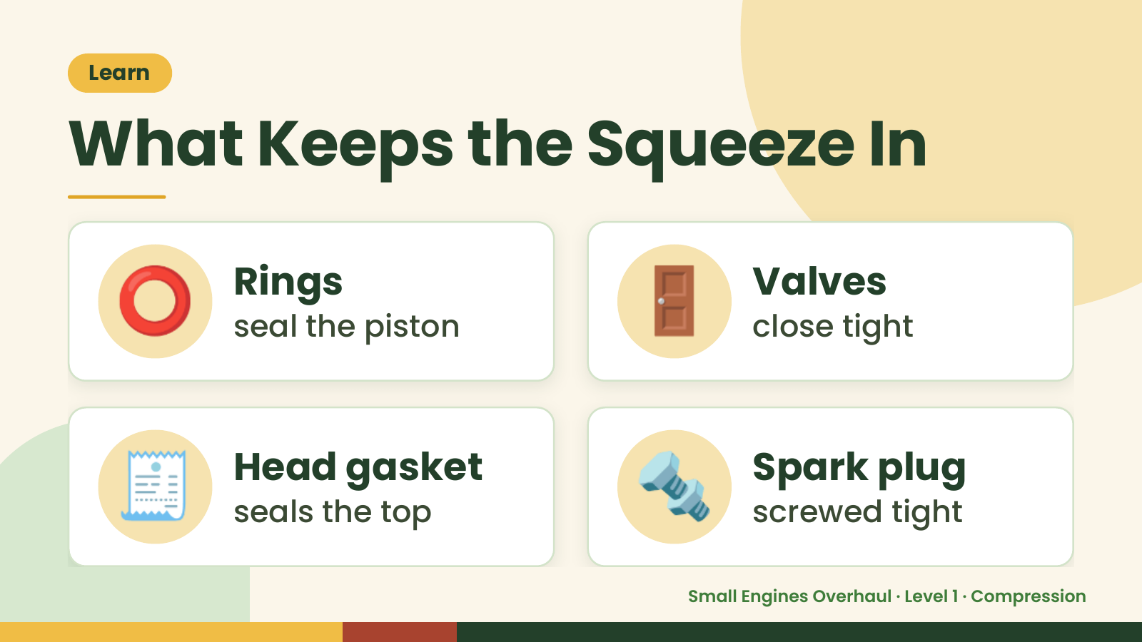
Notes:
Learn
What Keeps the Squeeze In
⭕ Rings
seal the piston 🚪 Valves
close tight
🧾 Head gasket
seals the top 🔩 Spark plug
screwed tight
Small Engines Overhaul · Level 1 · Compression

Slide 6
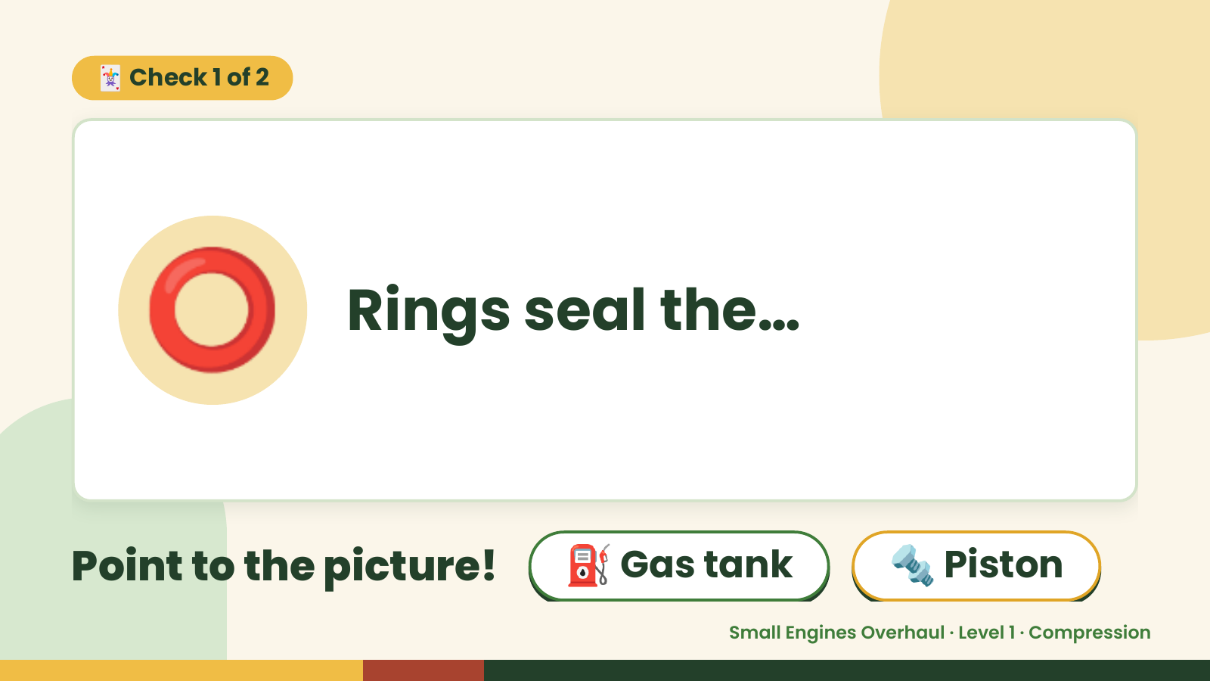
Notes:
🃏 Check 1 of 2
⭕ Rings seal the…
Point to the picture! ⛽ Gas tank 🔩 Piston
Small Engines Overhaul · Level 1 · Compression

Slide 7
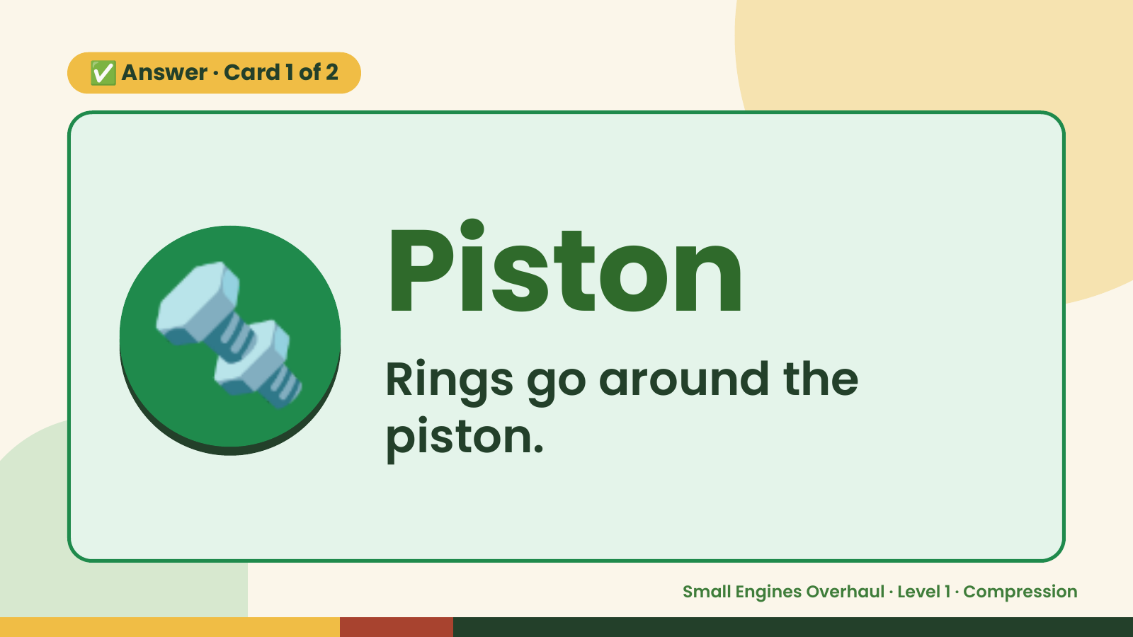
Notes:
✅ Answer · Card 1 of 2
🔩 Piston
Rings go around the
piston.
Small Engines Overhaul · Level 1 · Compression

Slide 8
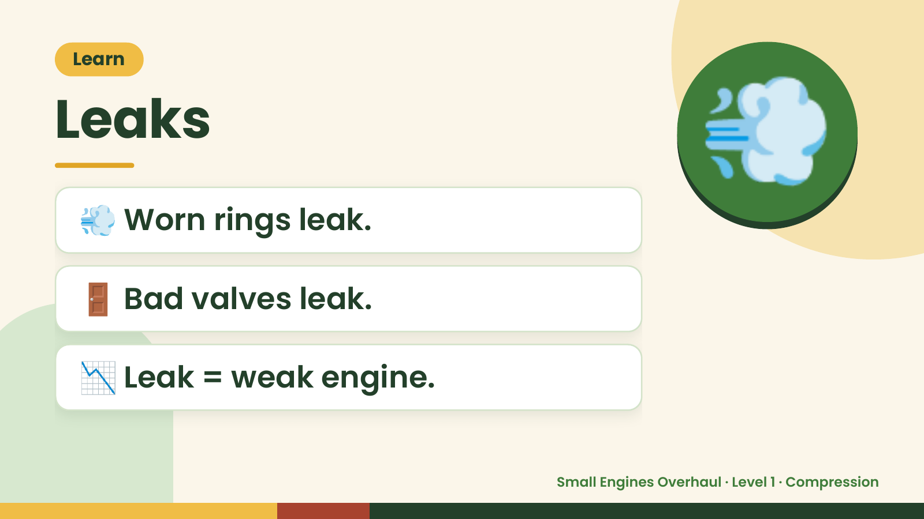
Notes:
Learn
Leaks
💨 Worn rings leak.
💨
🚪 Bad valves leak.
📉 Leak = weak engine.
Small Engines Overhaul · Level 1 · Compression

Slide 9
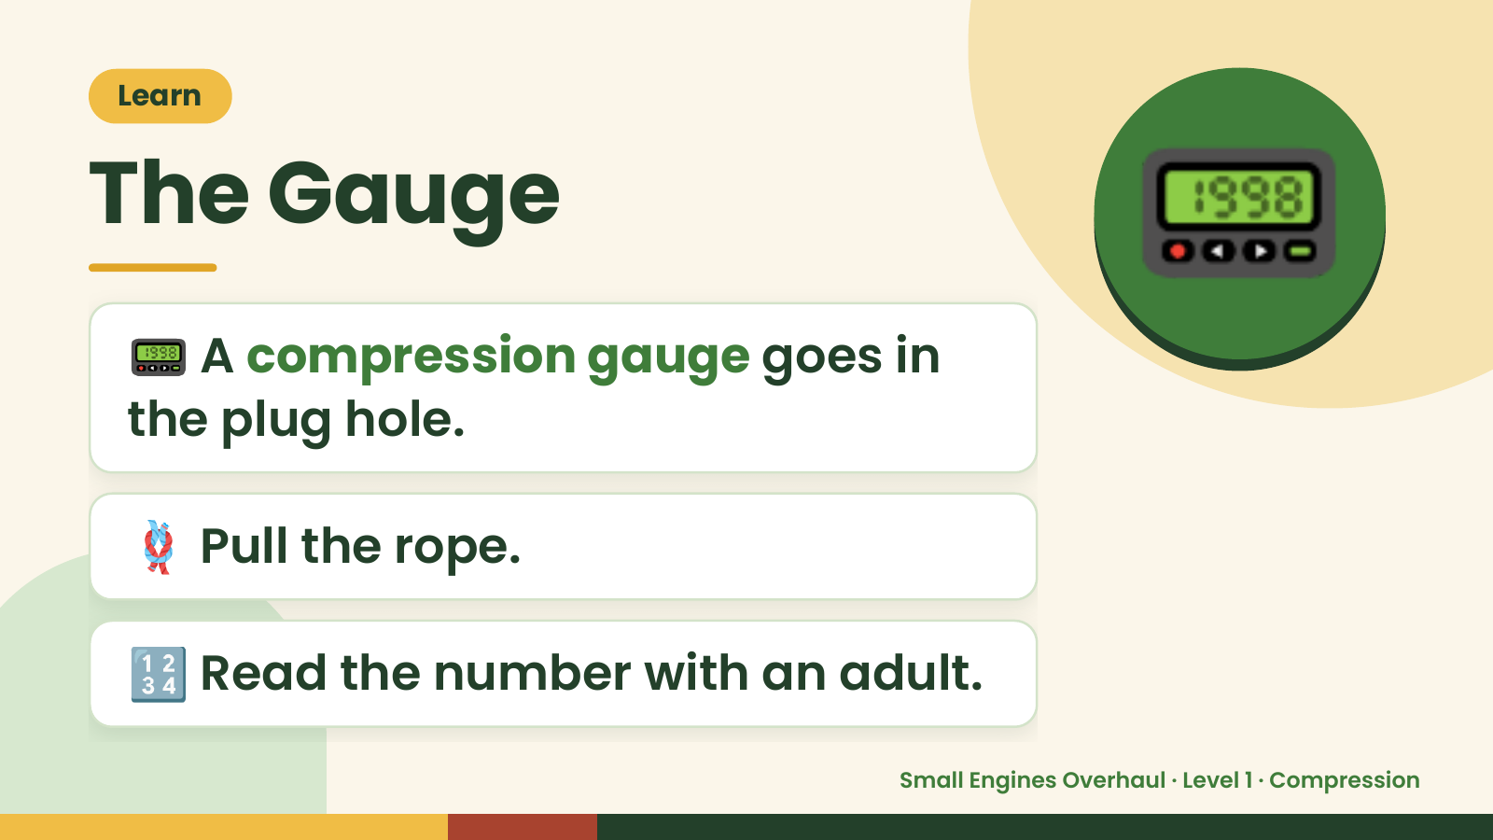
Notes:
Learn
The Gauge
📟 A compression gauge goes in
the plug hole.
📟
🪢 Pull the rope.
🔢 Read the number with an adult.
Small Engines Overhaul · Level 1 · Compression

Slide 10
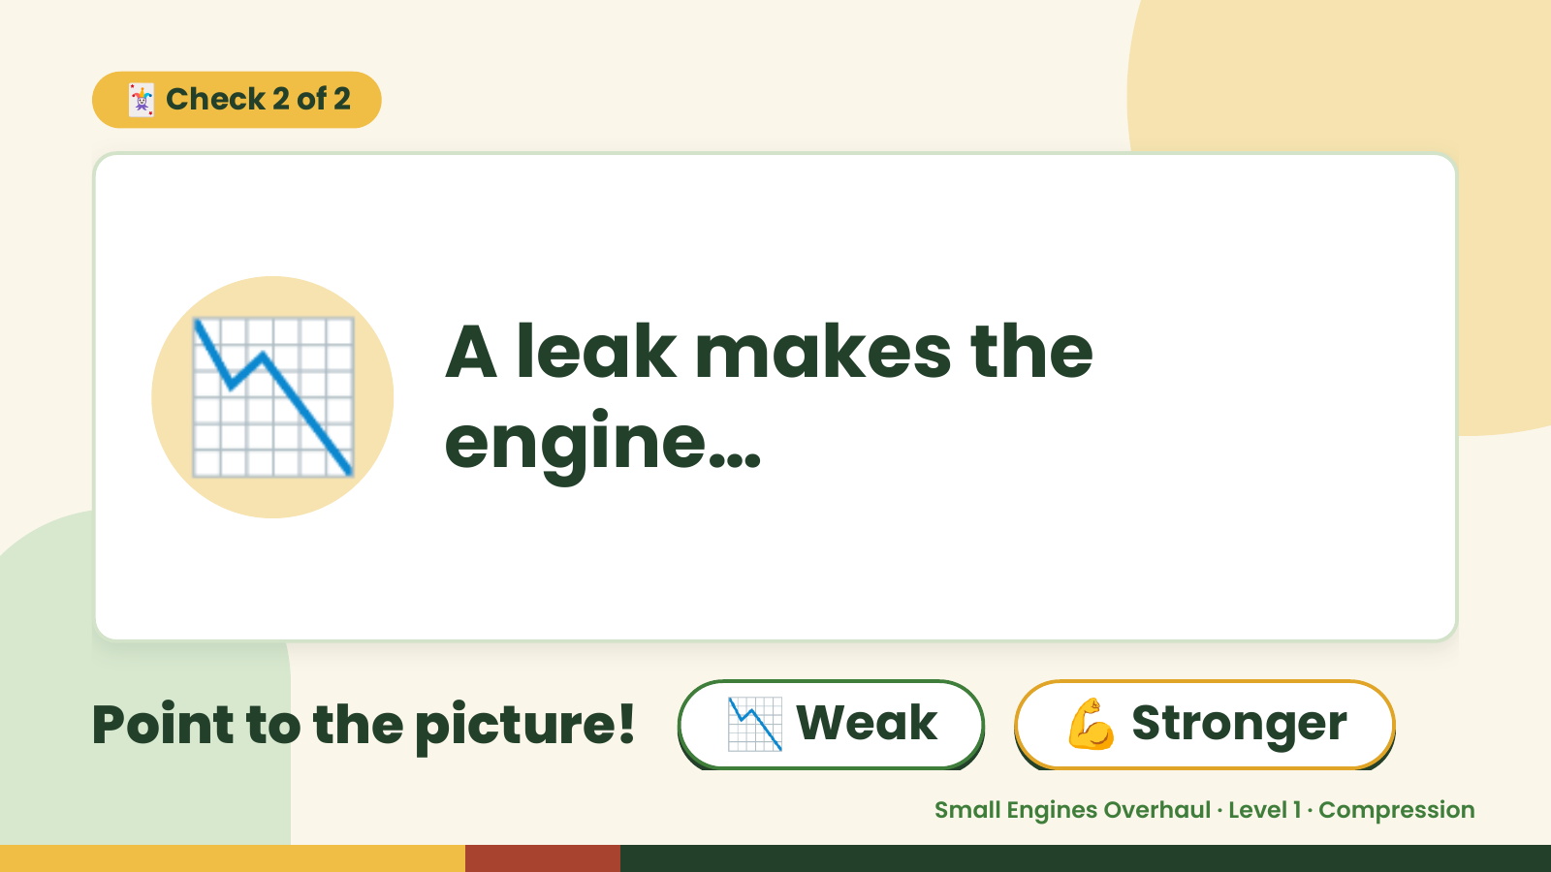
Notes:
🃏 Check 2 of 2
📉 A leak makes the
engine…
Point to the picture! 📉 Weak 💪 Stronger
Small Engines Overhaul · Level 1 · Compression

Slide 11
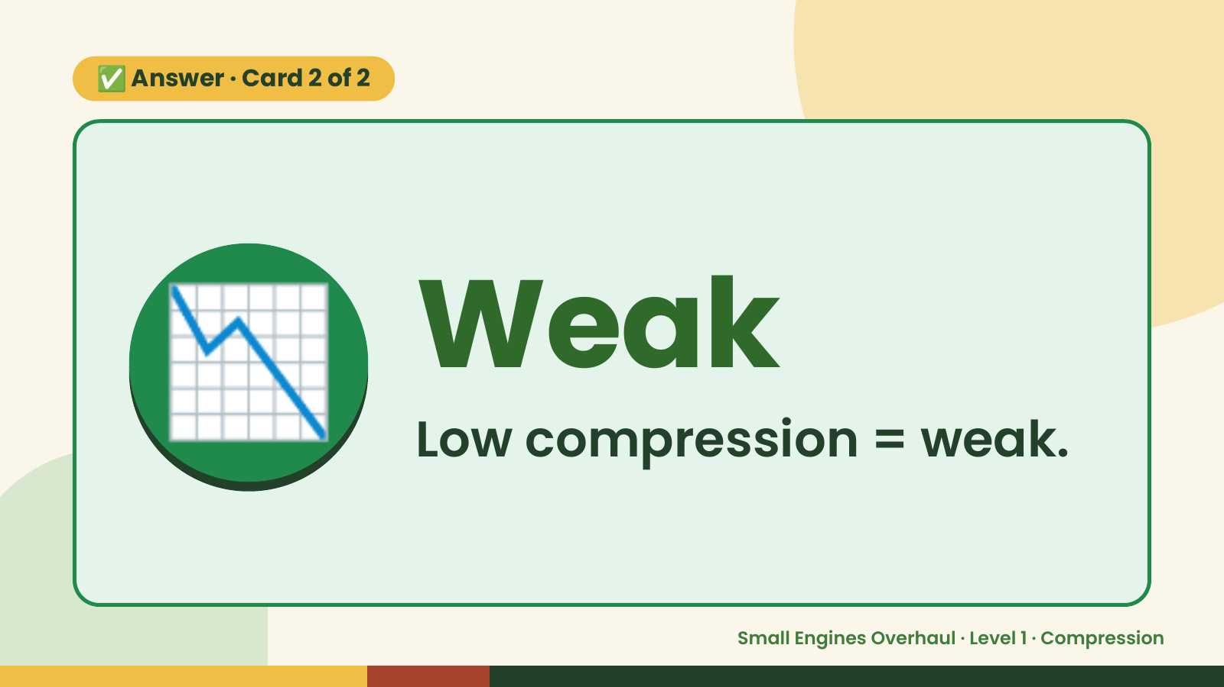
Notes:
✅ Answer · Card 2 of 2
📉 Weak
Low compression = weak.
Small Engines Overhaul · Level 1 · Compression

Slide 12
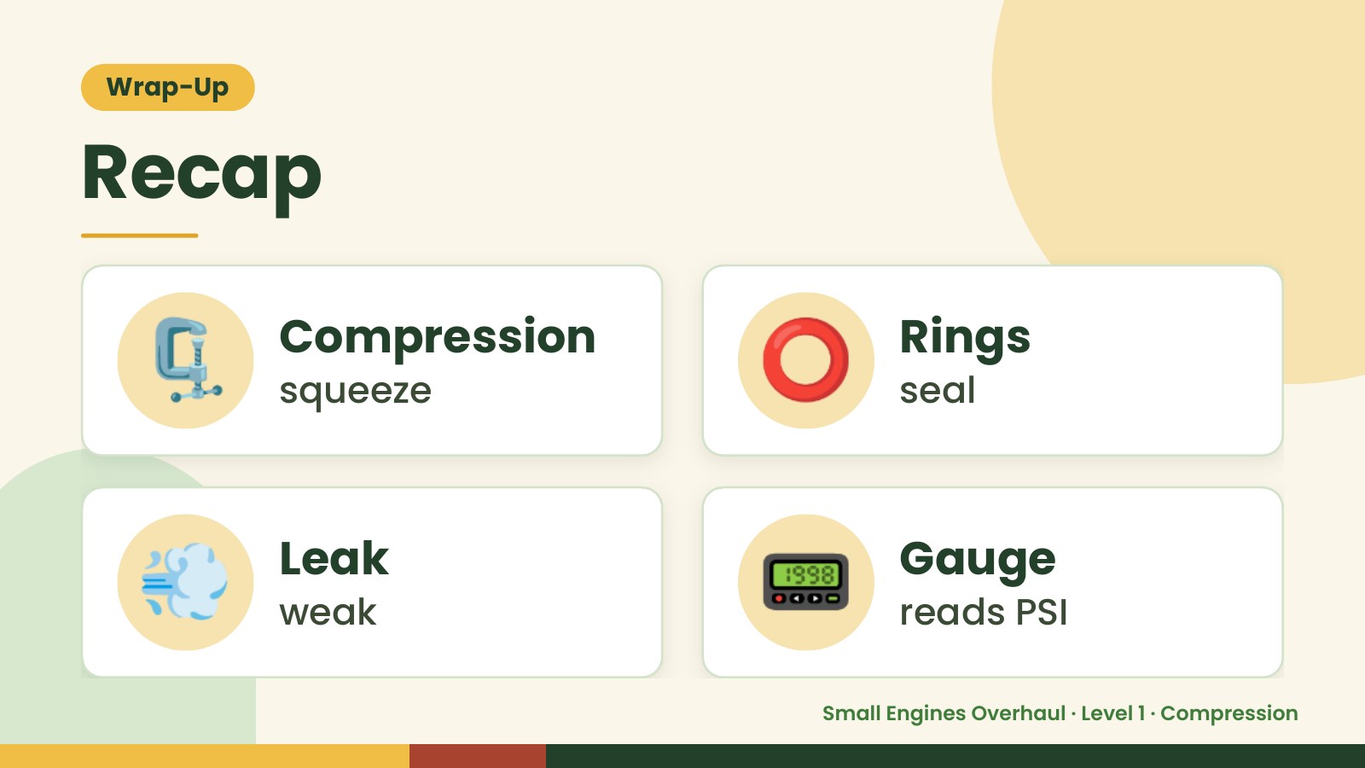
Notes:
Wrap-Up
Recap
🗜️ Compression
squeeze ⭕ Rings
seal
💨 Leak
weak 📟 Gauge
reads PSI
Small Engines Overhaul · Level 1 · Compression

Slide 13
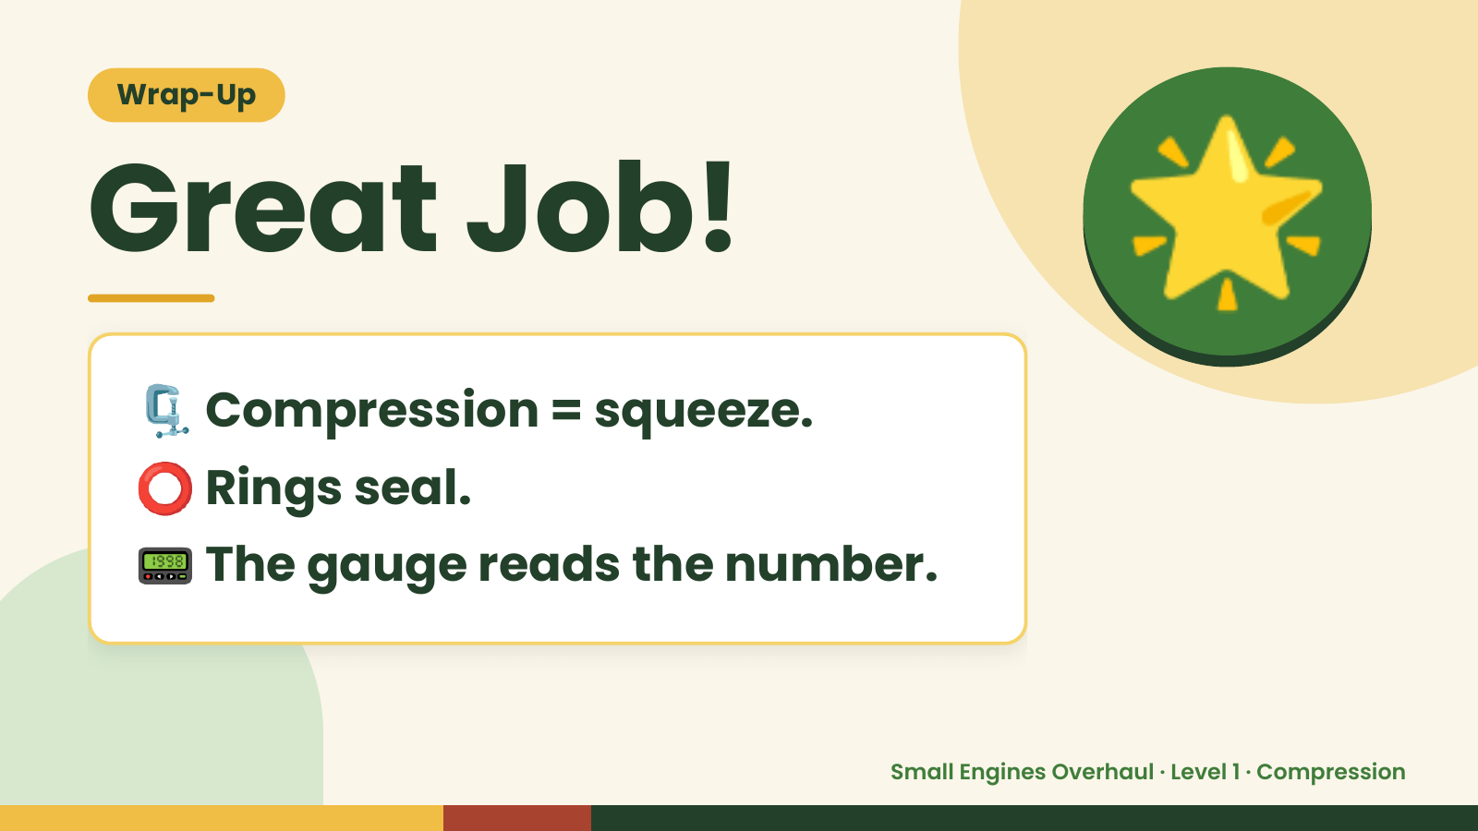
Notes:
Wrap-Up
Great Job!
🗜️ Compression = squeeze.
🌟
⭕ Rings seal.
📟 The gauge reads the number.
Small Engines Overhaul · Level 1 · Compression

