Slide 1
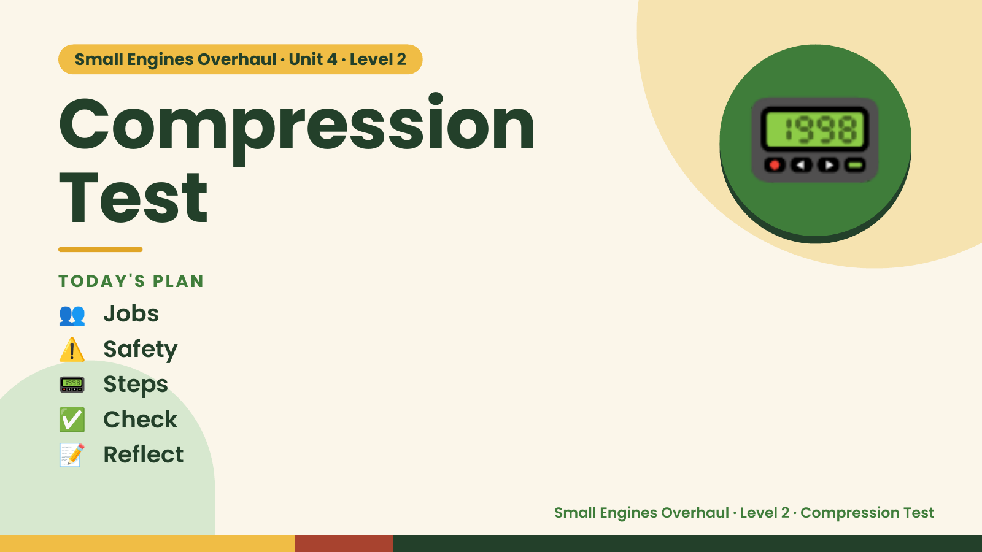
Notes:
Small Engines Overhaul · Unit 4 · Level 2
Compression
Test
👥 Jobs
TODAY'S PLAN
📟
⚠️ Safety
📟 Steps
✅ Check
📝 Reflect
Small Engines Overhaul · Level 2 · Compression Test

Slide 2

Notes:
Get ready
Jobs
🔧 Mechanic
Does the main engine job
with the tools
🧰 Tool helper
Gets tools from the board
and returns them to staff
📋 Recorder
Takes photos and fills in
the chart
🧽 Clean-up captain
Wipes the bench,
sweeps, checks tools are
back
Small Engines Overhaul · Level 2 · Compression Test

Slide 3
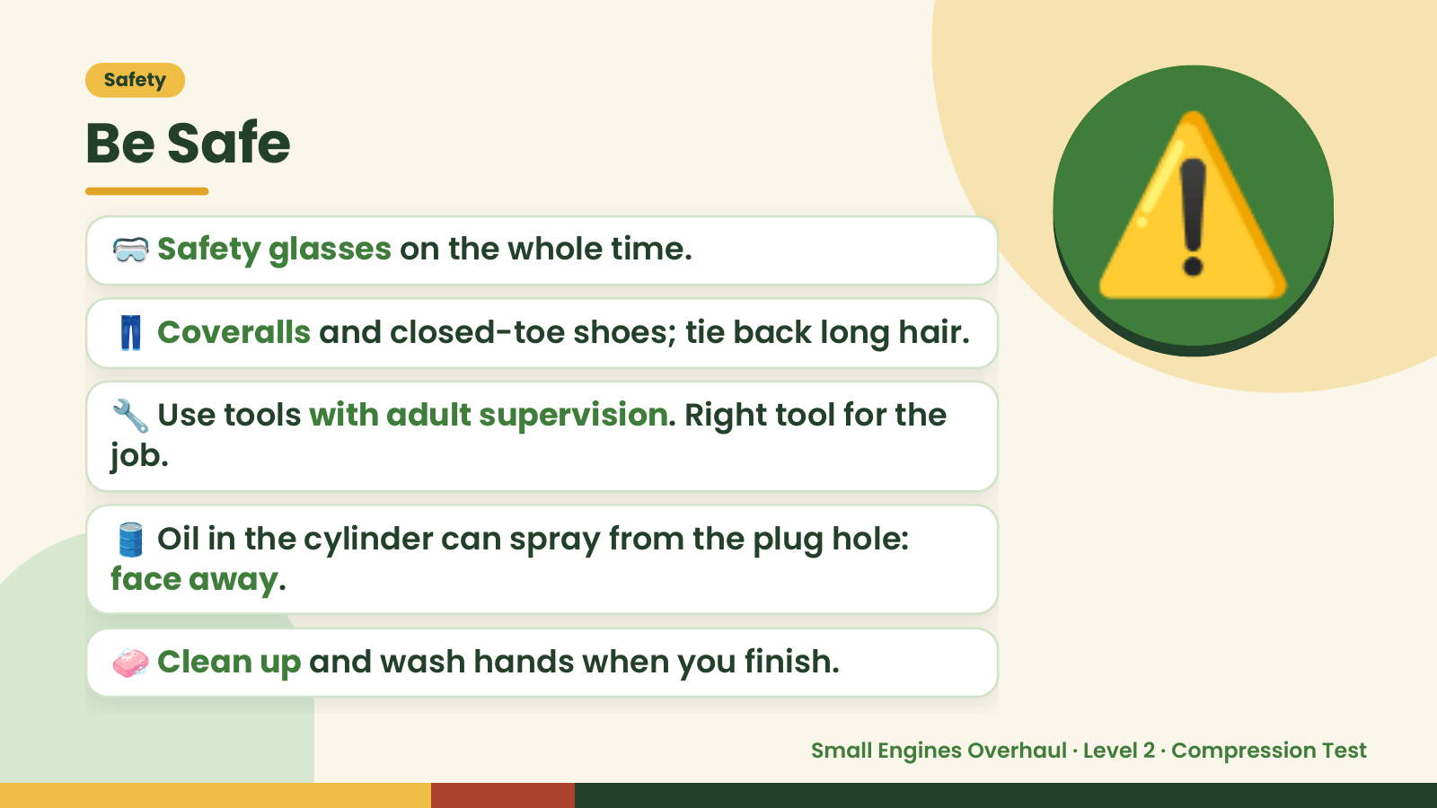
Notes:
Safety
Be Safe
🥽 Safety glasses on the whole time.
👖 Coveralls and closed-toe shoes; tie back long hair.
🔧 Use tools with adult supervision. Right tool for the
job.
⚠️
🛢️ Oil in the cylinder can spray from the plug hole:
face away.
🧼 Clean up and wash hands when you finish.
Small Engines Overhaul · Level 2 · Compression Test

Slide 4
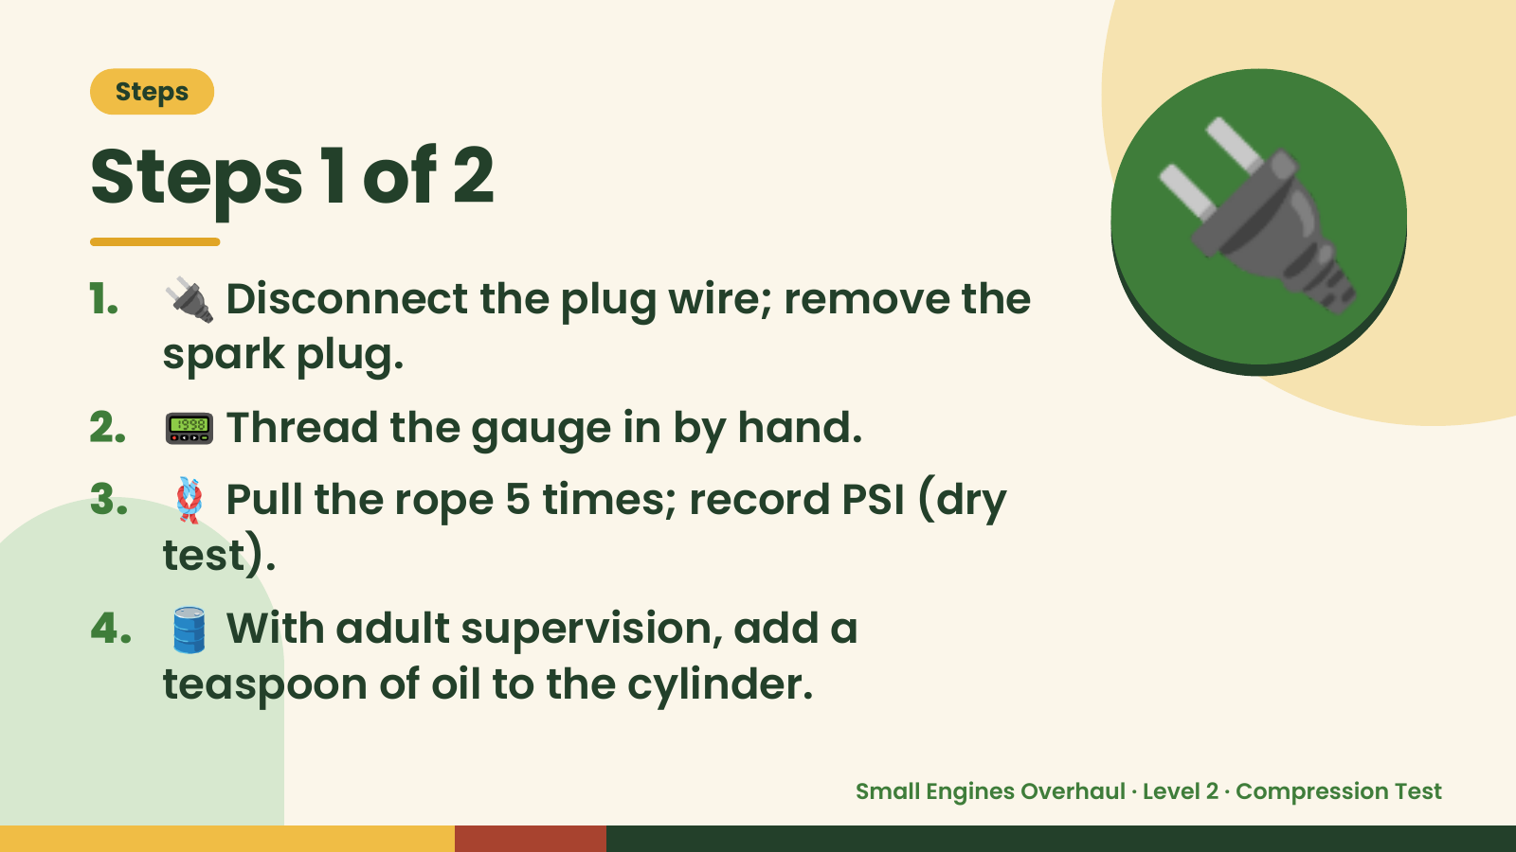
Notes:
Steps
Steps 1 of 2
1. 🔌 Disconnect the plug wire; remove the
spark plug.
2. 📟 Thread the gauge in by hand.
🔌
3. 🪢 Pull the rope 5 times; record PSI (dry
test).
4. 🛢️ With adult supervision, add a
teaspoon of oil to the cylinder.
Small Engines Overhaul · Level 2 · Compression Test

Slide 5
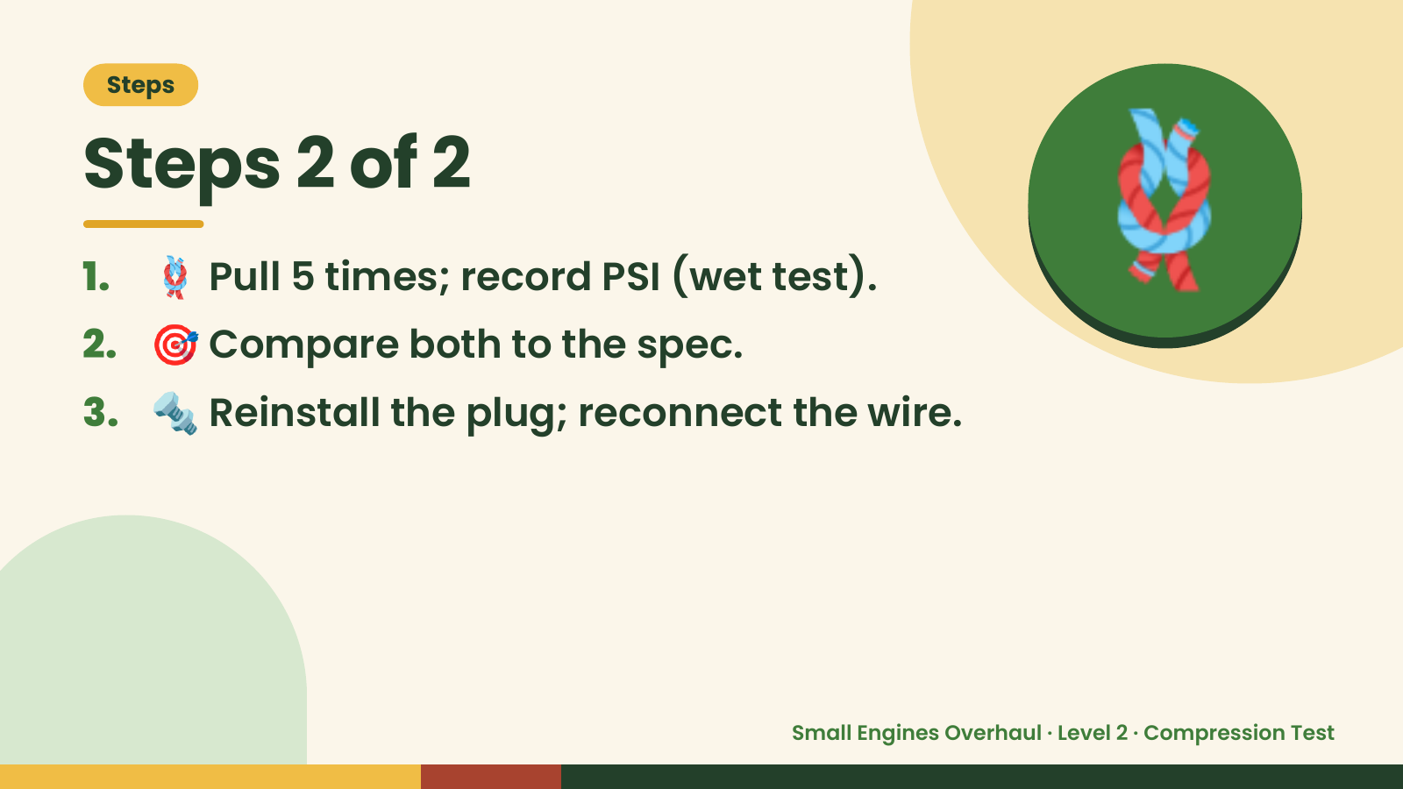
Notes:
Steps
Steps 2 of 2
1. 🪢 Pull 5 times; record PSI (wet test).
2. 🎯 Compare both to the spec.
3. 🔩 Reinstall the plug; reconnect the wire.
🪢
Small Engines Overhaul · Level 2 · Compression Test

Slide 6
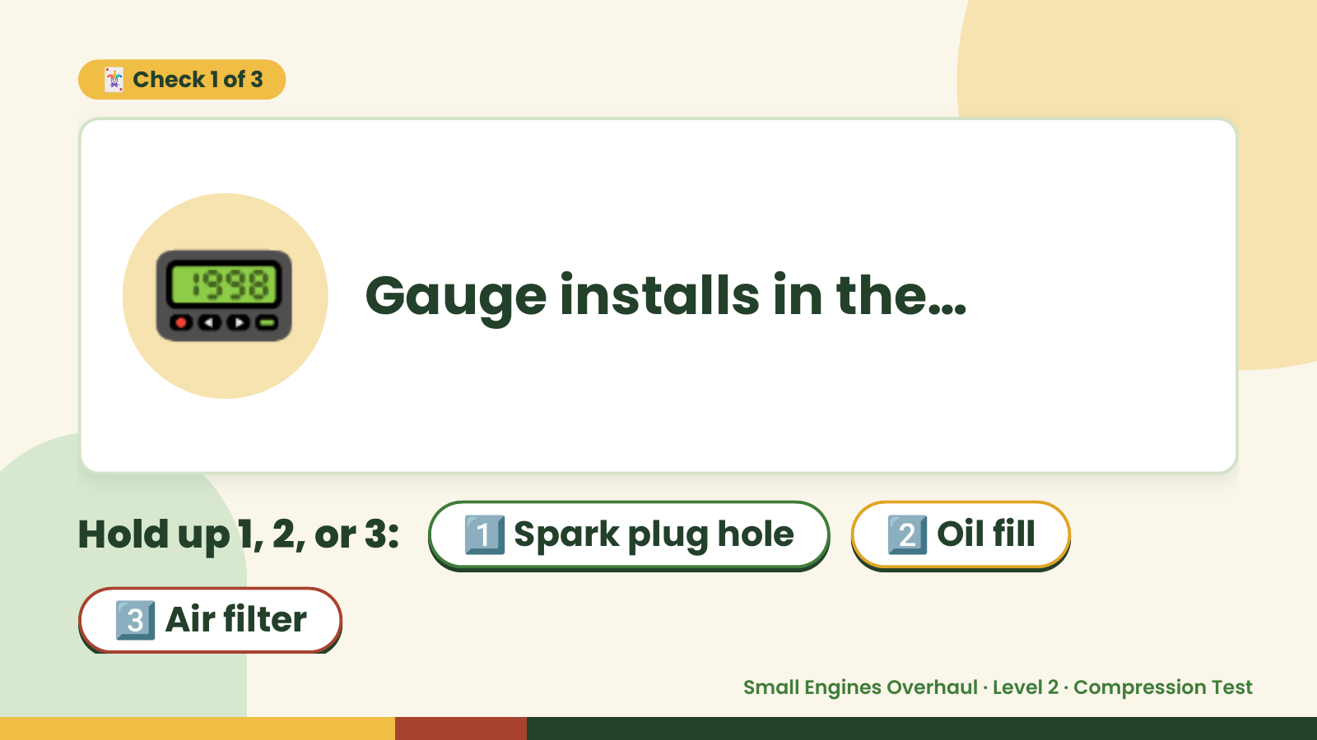
Notes:
🃏 Check 1 of 3
📟 Gauge installs in the…
Hold up 1, 2, or 3: 1️⃣ Spark plug hole 2️⃣ Oil fill
3️⃣ Air filter
Small Engines Overhaul · Level 2 · Compression Test

Slide 7

Notes:
✅ Answer · Card 1 of 3
📟 Spark plug
hole
Plug hole.
Small Engines Overhaul · Level 2 · Compression Test

Slide 8
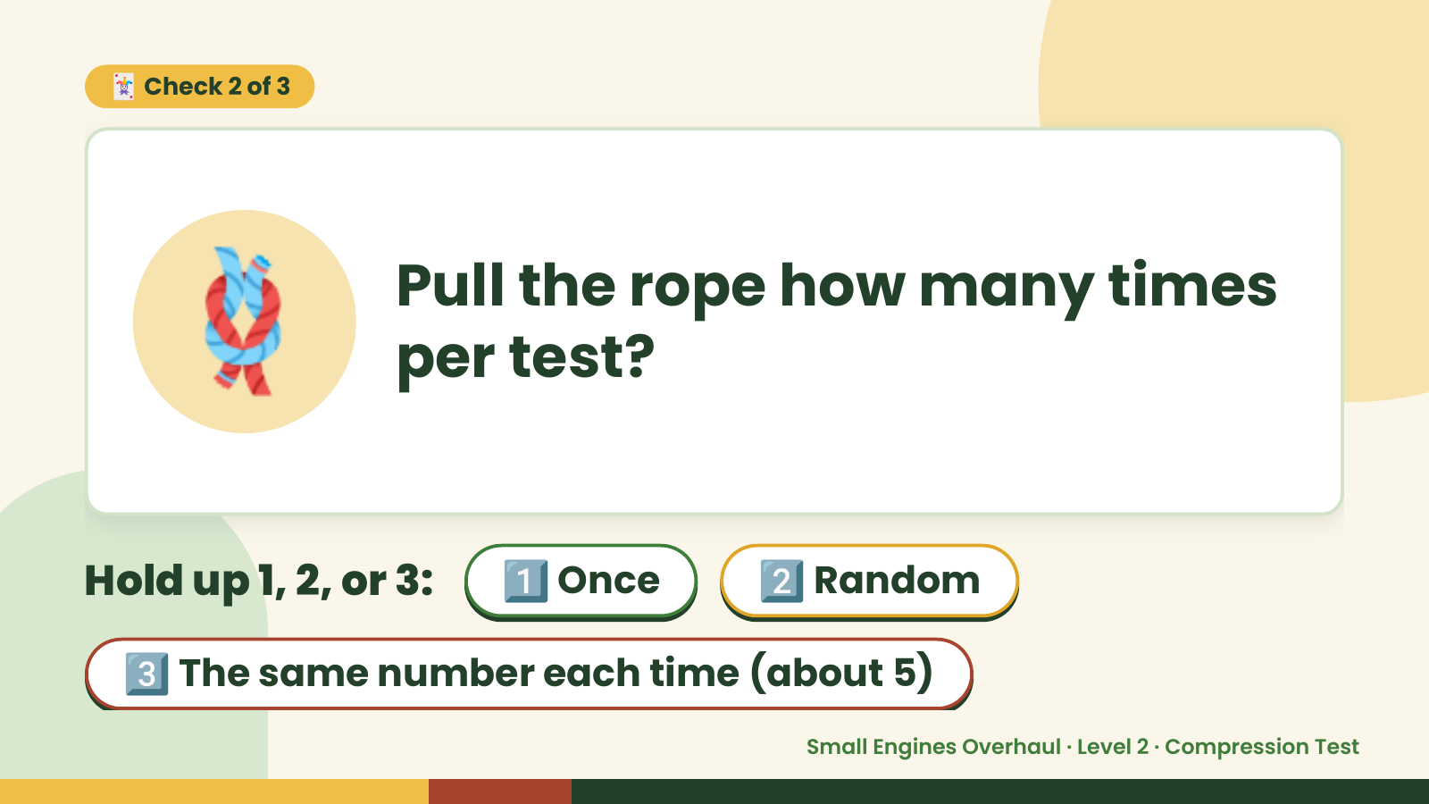
Notes:
🃏 Check 2 of 3
🪢 Pull the rope how many times
per test?
Hold up 1, 2, or 3: 1️⃣ Once 2️⃣ Random
3️⃣ The same number each time (about 5)
Small Engines Overhaul · Level 2 · Compression Test

Slide 9
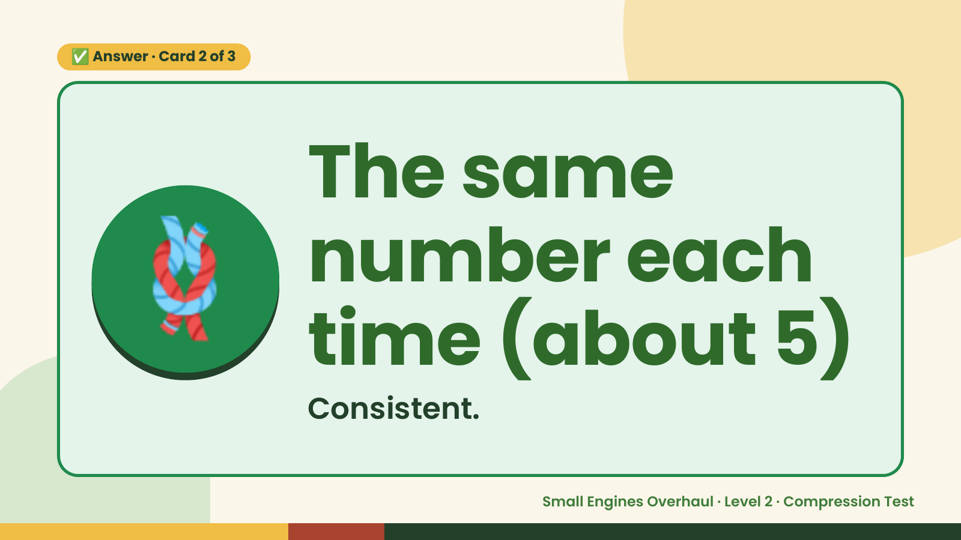
Notes:
✅ Answer · Card 2 of 3
🪢 The same
number each
time (about 5)
Consistent.
Small Engines Overhaul · Level 2 · Compression Test

Slide 10
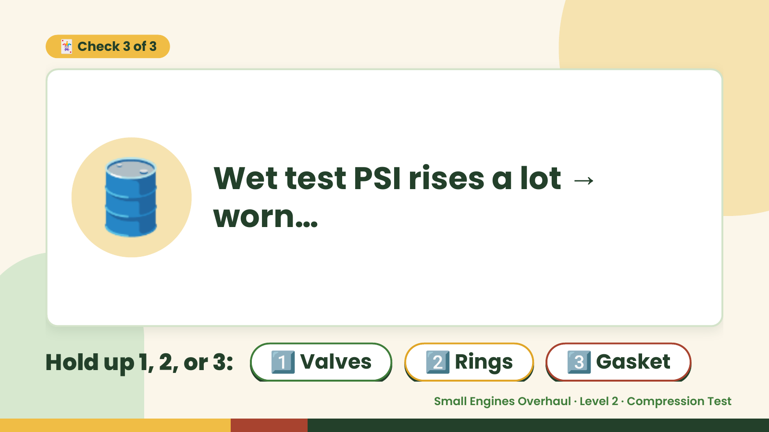
Notes:
🃏 Check 3 of 3
🛢️ Wet test PSI rises a lot →
worn…
Hold up 1, 2, or 3: 1️⃣ Valves 2️⃣ Rings 3️⃣ Gasket
Small Engines Overhaul · Level 2 · Compression Test

Slide 11
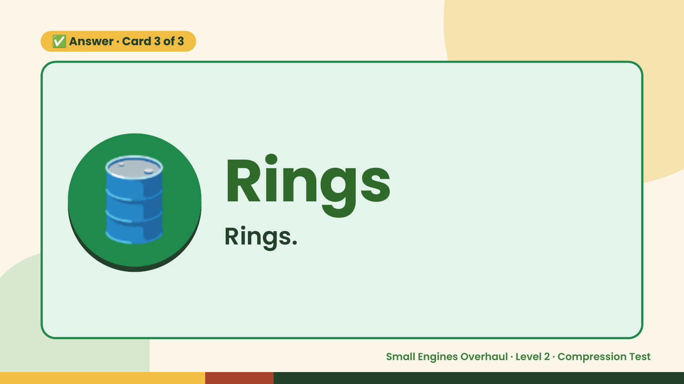
Notes:
✅ Answer · Card 3 of 3
🛢️ Rings
Rings.
Small Engines Overhaul · Level 2 · Compression Test

Slide 12

Notes:
Wrap-Up
Clean Up +
Reflect
🧽
Return and count tools.
Sweep and wipe your bench.
Wash hands, then do the reflection.
Small Engines Overhaul · Level 2 · Compression Test

