Slide 1
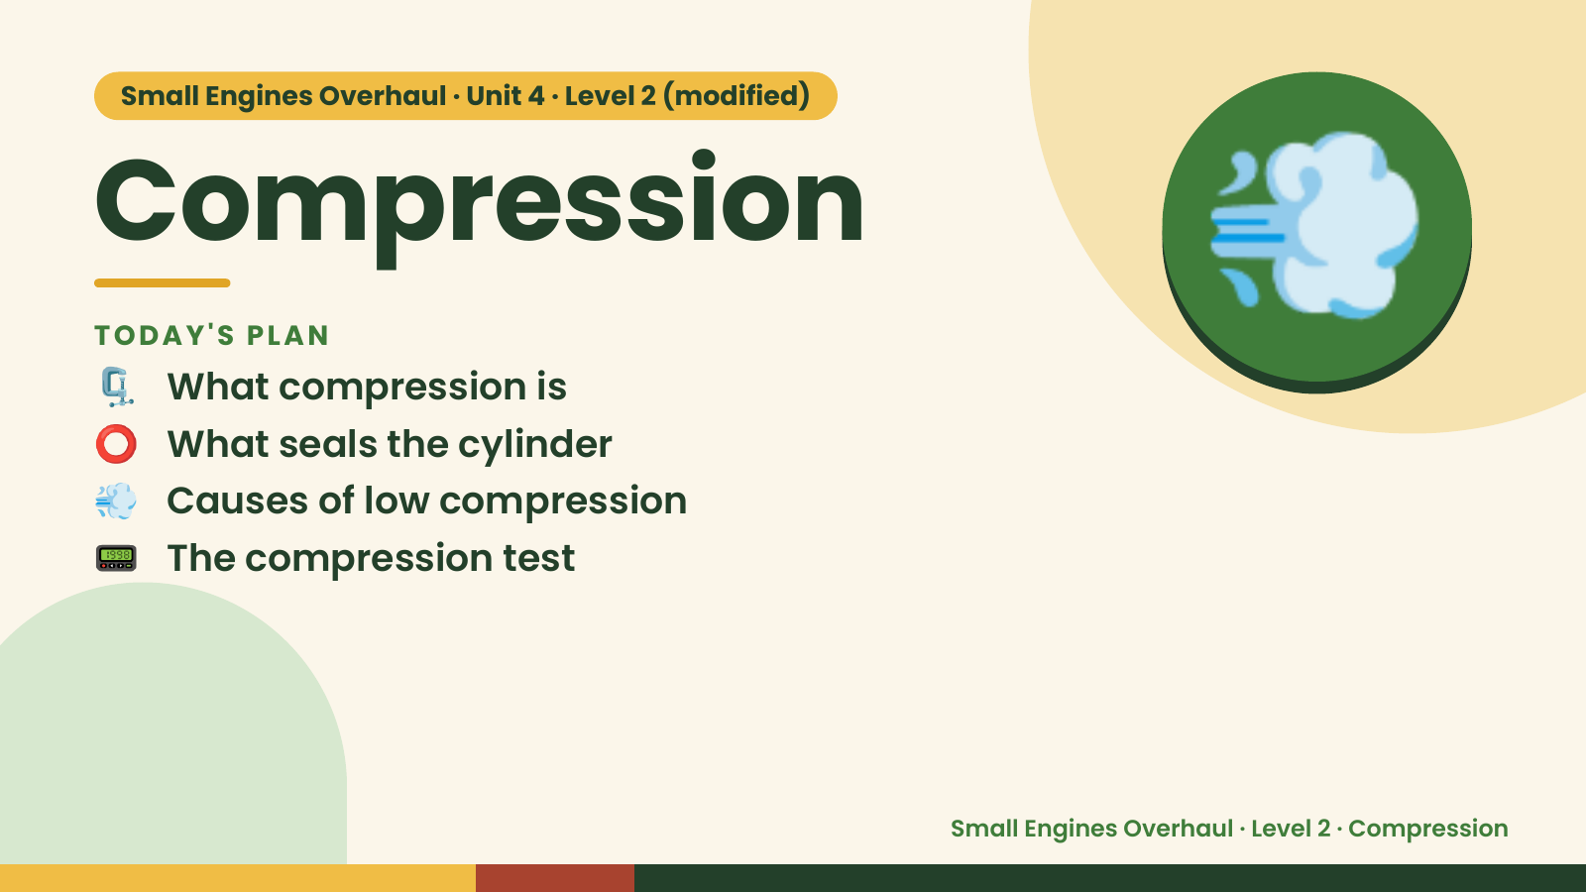
Notes:
Small Engines Overhaul · Unit 4 · Level 2 (modified)
Compression
🗜️ What compression is
TODAY'S PLAN
⭕ What seals the cylinder
💨 Causes of low compression
💨
📟 The compression test
Small Engines Overhaul · Level 2 · Compression

Slide 2
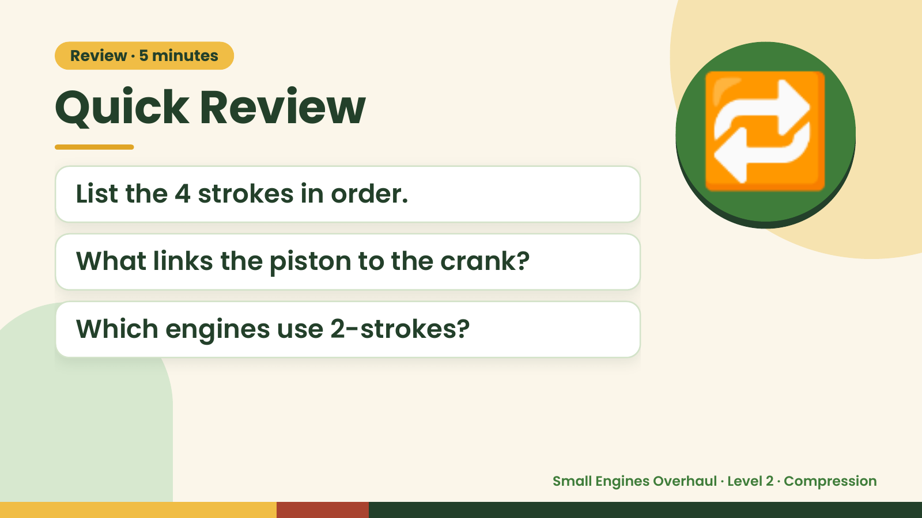
Notes:
Review · 5 minutes
Quick Review
List the 4 strokes in order.
What links the piston to the crank?
🔁
Which engines use 2-strokes?
Small Engines Overhaul · Level 2 · Compression

Slide 3
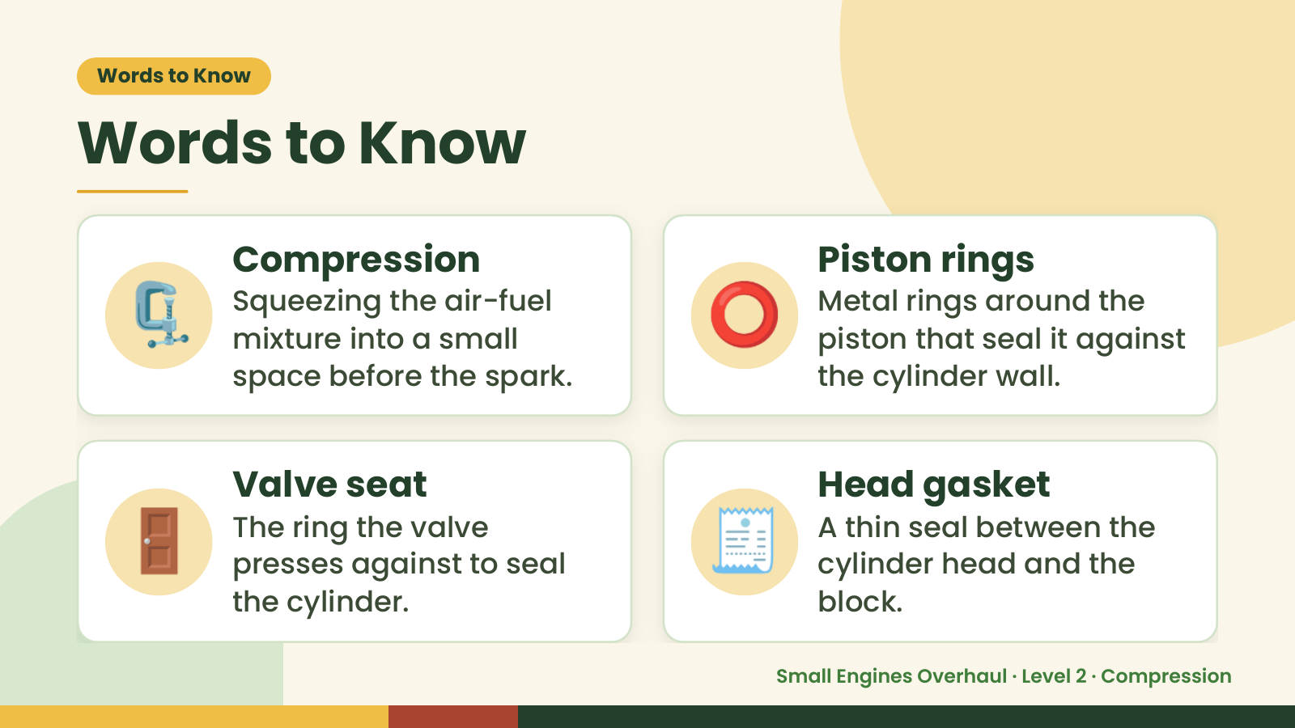
Notes:
Words to Know
Words to Know
🗜️ Compression
Squeezing the air-fuel
mixture into a small
space before the spark.
⭕ Piston rings
Metal rings around the
piston that seal it against
the cylinder wall.
🚪 Valve seat
The ring the valve
presses against to seal
the cylinder.
🧾 Head gasket
A thin seal between the
cylinder head and the
block.
Small Engines Overhaul · Level 2 · Compression

Slide 4
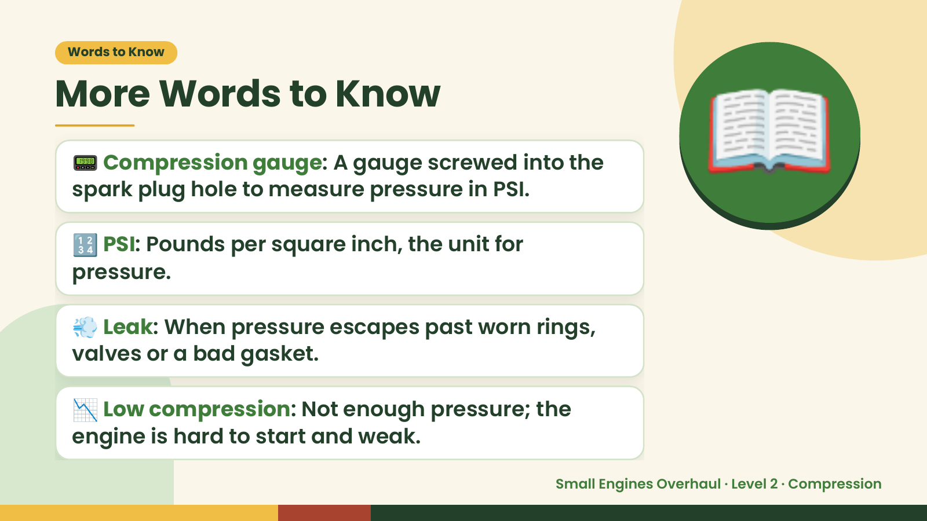
Notes:
Words to Know
More Words to Know
📟 Compression gauge: A gauge screwed into the
spark plug hole to measure pressure in PSI.
🔢 PSI: Pounds per square inch, the unit for
pressure.
📖
💨 Leak: When pressure escapes past worn rings,
valves or a bad gasket.
📉 Low compression: Not enough pressure; the
engine is hard to start and weak.
Small Engines Overhaul · Level 2 · Compression

Slide 5
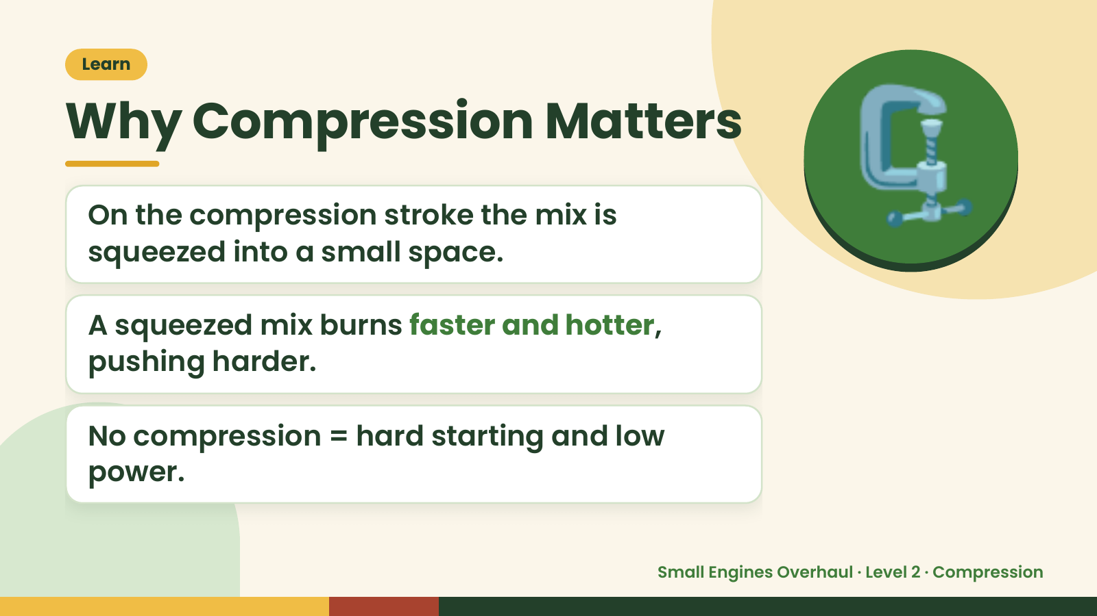
Notes:
Learn
Why Compression Matters
On the compression stroke the mix is
squeezed into a small space.
A squeezed mix burns faster and hotter,
🗜️
pushing harder.
No compression = hard starting and low
power.
Small Engines Overhaul · Level 2 · Compression

Slide 6
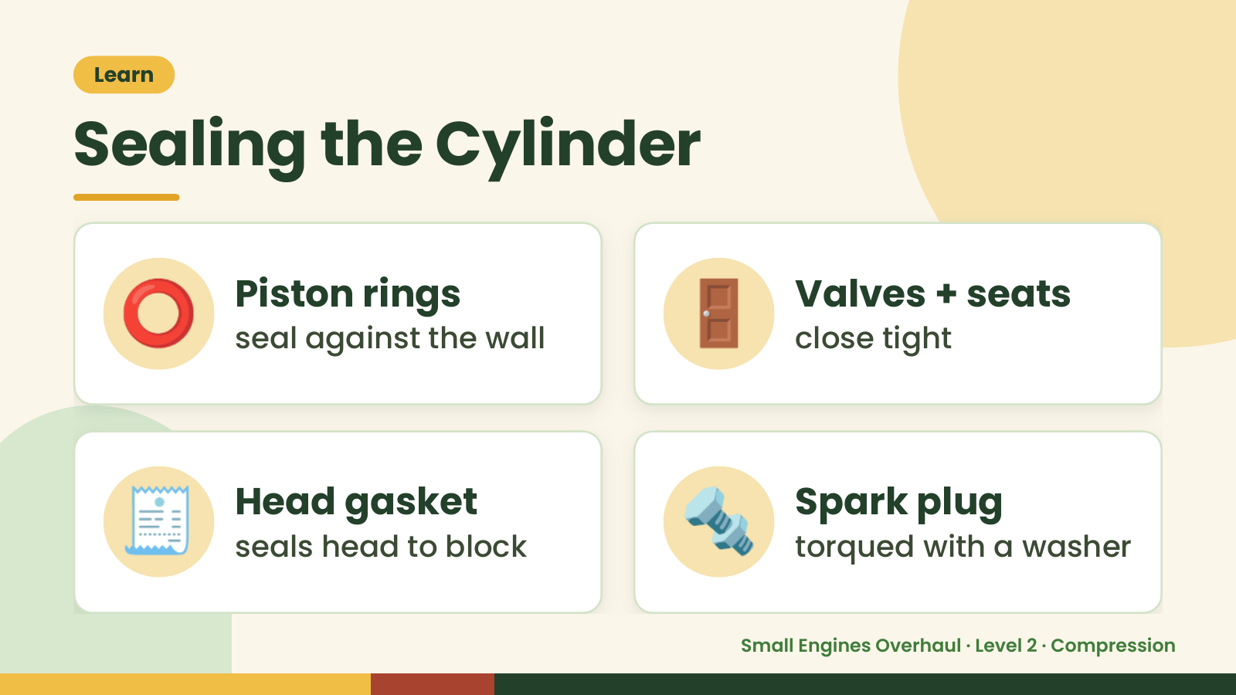
Notes:
Learn
Sealing the Cylinder
⭕ Piston rings
seal against the wall 🚪 Valves + seats
close tight
🧾 Head gasket
seals head to block 🔩 Spark plug
torqued with a washer
Small Engines Overhaul · Level 2 · Compression

Slide 7
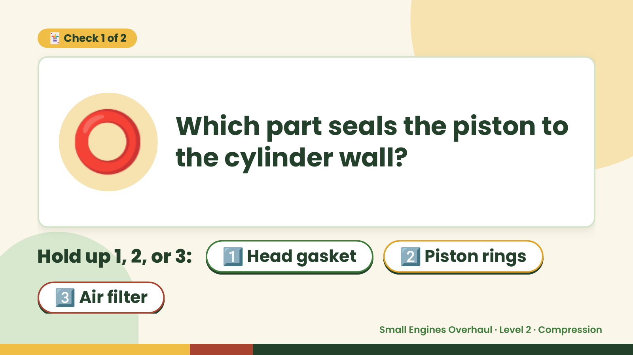
Notes:
🃏 Check 1 of 2
⭕ Which part seals the piston to
the cylinder wall?
Hold up 1, 2, or 3: 1️⃣ Head gasket 2️⃣ Piston rings
3️⃣ Air filter
Small Engines Overhaul · Level 2 · Compression

Slide 8
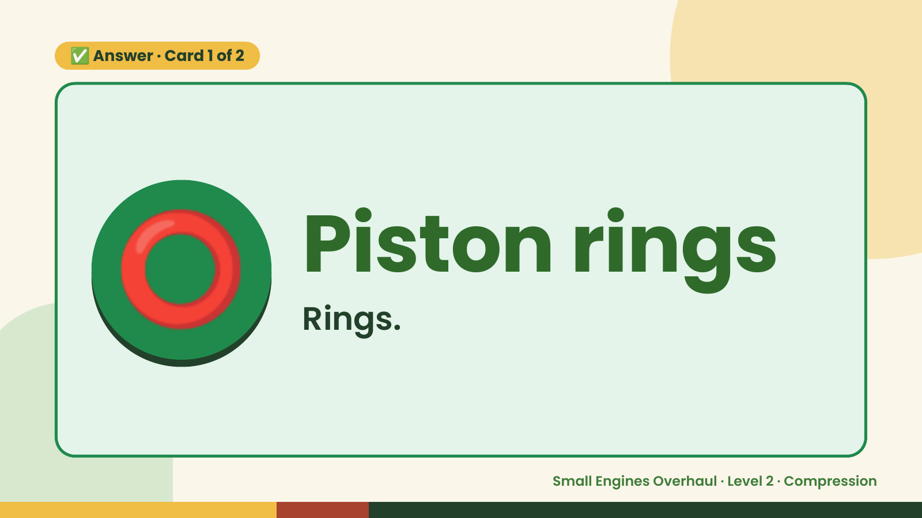
Notes:
✅ Answer · Card 1 of 2
⭕ Piston rings
Rings.
Small Engines Overhaul · Level 2 · Compression

Slide 9
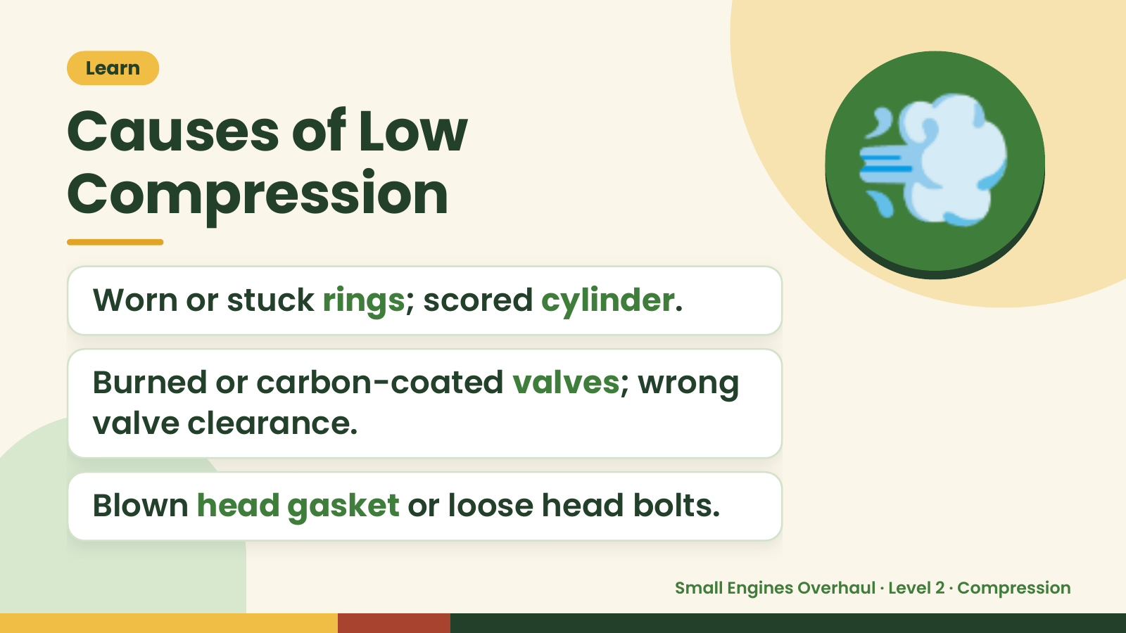
Notes:
Learn
Causes of Low
Compression
Worn or stuck rings; scored cylinder.
💨
Burned or carbon-coated valves; wrong
valve clearance.
Blown head gasket or loose head bolts.
Small Engines Overhaul · Level 2 · Compression

Slide 10
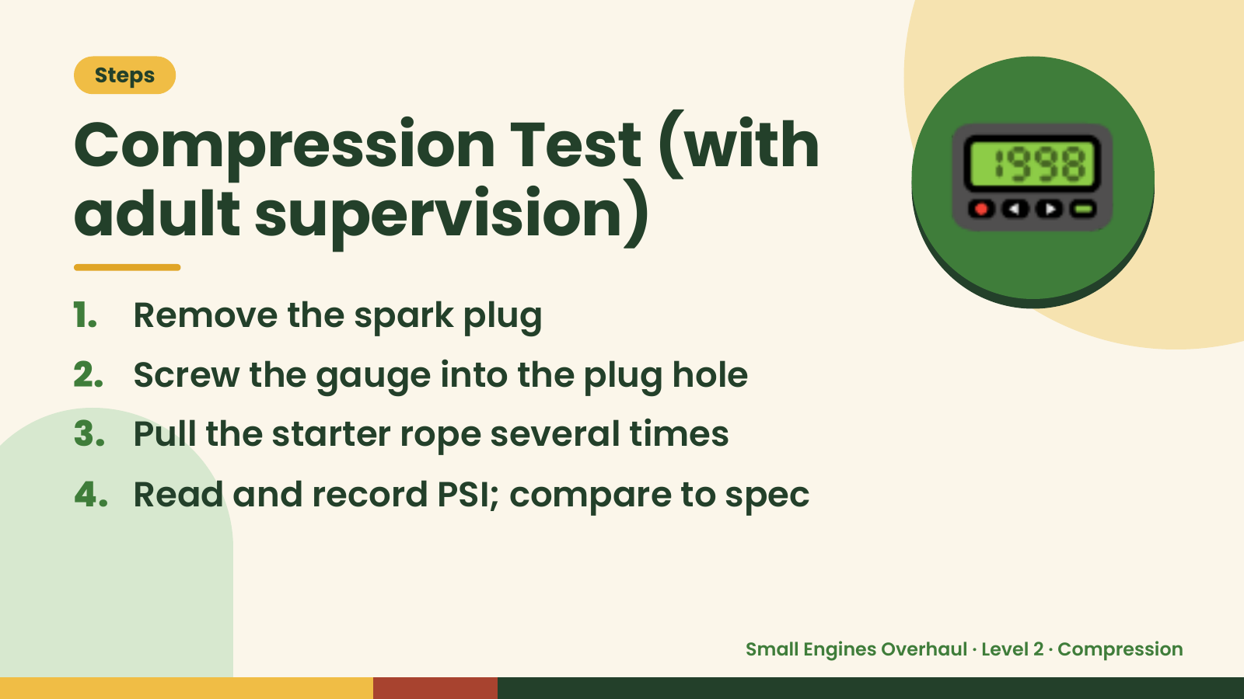
Notes:
Steps
Compression Test (with
adult supervision)
1. Remove the spark plug
2. Screw the gauge into the plug hole
📟
3. Pull the starter rope several times
4. Read and record PSI; compare to spec
Small Engines Overhaul · Level 2 · Compression

Slide 11
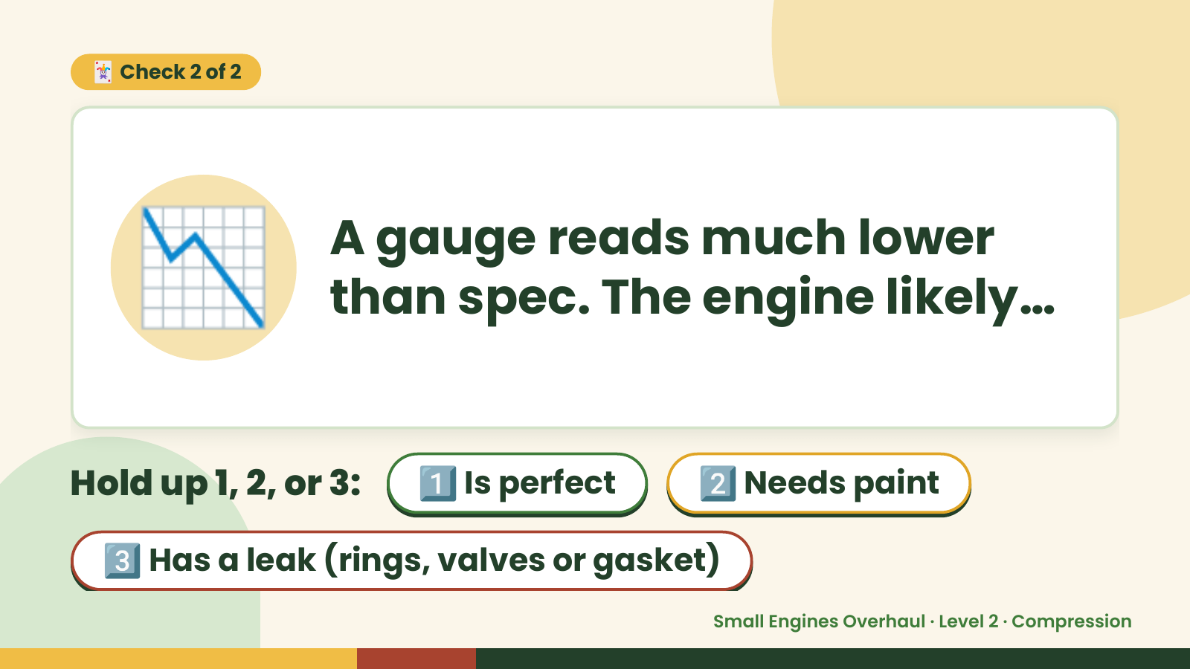
Notes:
🃏 Check 2 of 2
📉 A gauge reads much lower
than spec. The engine likely…
Hold up 1, 2, or 3: 1️⃣ Is perfect 2️⃣ Needs paint
3️⃣ Has a leak (rings, valves or gasket)
Small Engines Overhaul · Level 2 · Compression

Slide 12
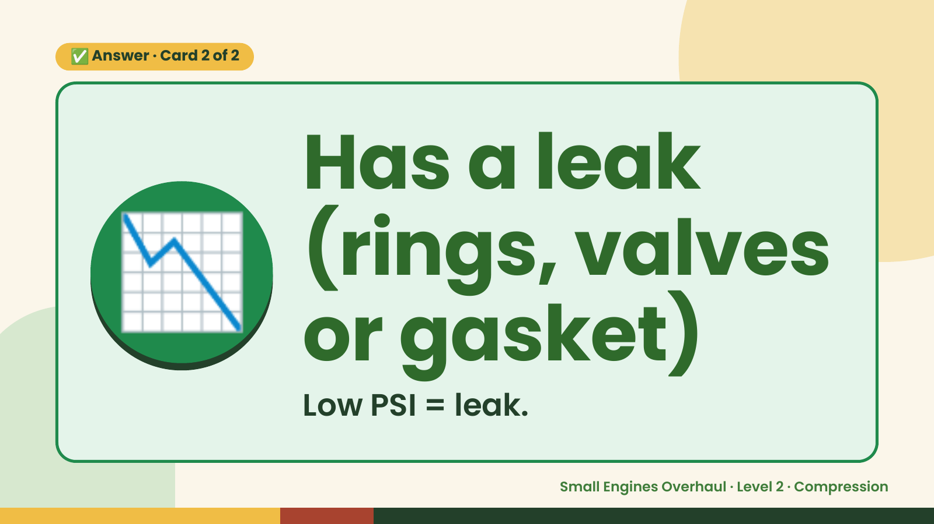
Notes:
✅ Answer · Card 2 of 2
📉 Has a leak
(rings, valves
or gasket)
Low PSI = leak.
Small Engines Overhaul · Level 2 · Compression

Slide 13
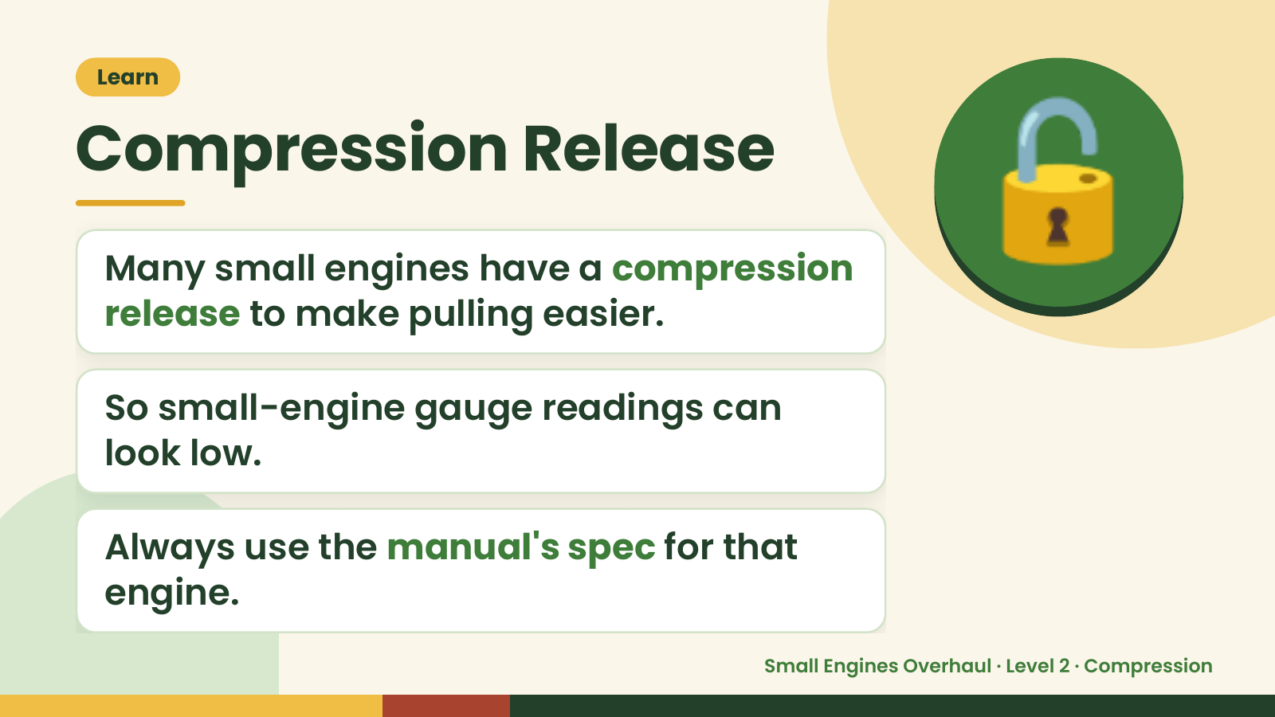
Notes:
Learn
Compression Release
Many small engines have a compression
release to make pulling easier.
🔓
So small-engine gauge readings can
look low.
Always use the manual's spec for that
engine.
Small Engines Overhaul · Level 2 · Compression

Slide 14
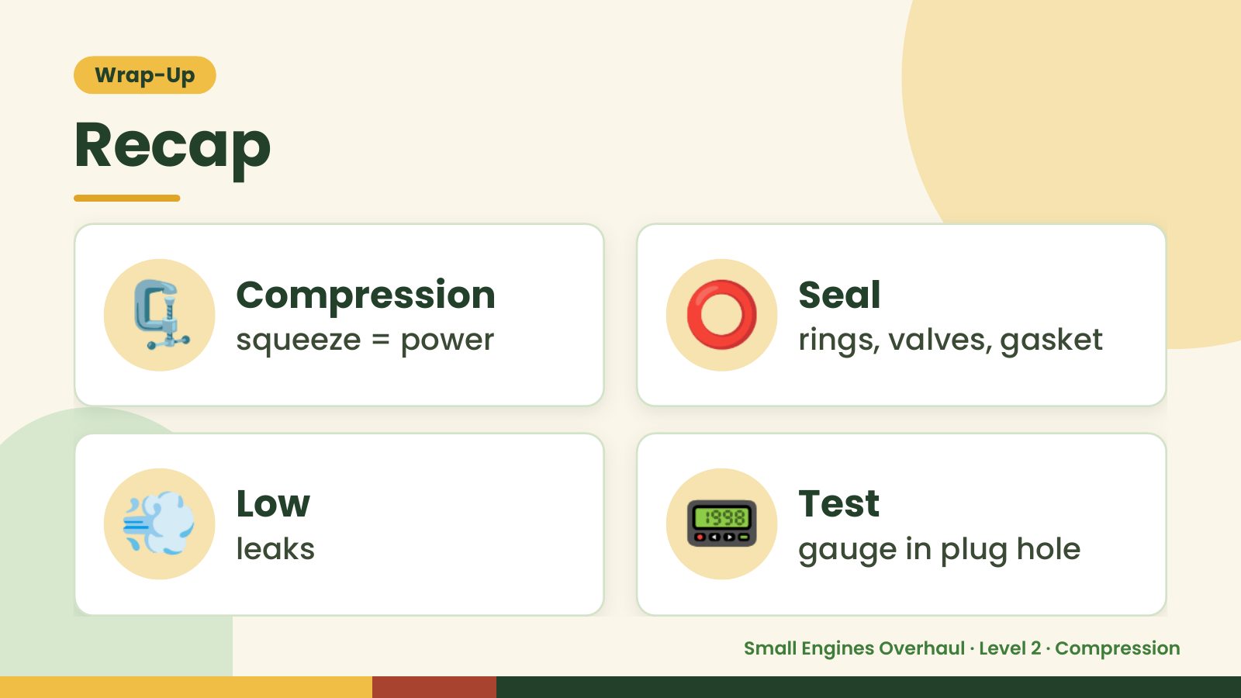
Notes:
Wrap-Up
Recap
🗜️ Compression
squeeze = power ⭕ Seal
rings, valves, gasket
💨 Low
leaks 📟 Test
gauge in plug hole
Small Engines Overhaul · Level 2 · Compression

Slide 15
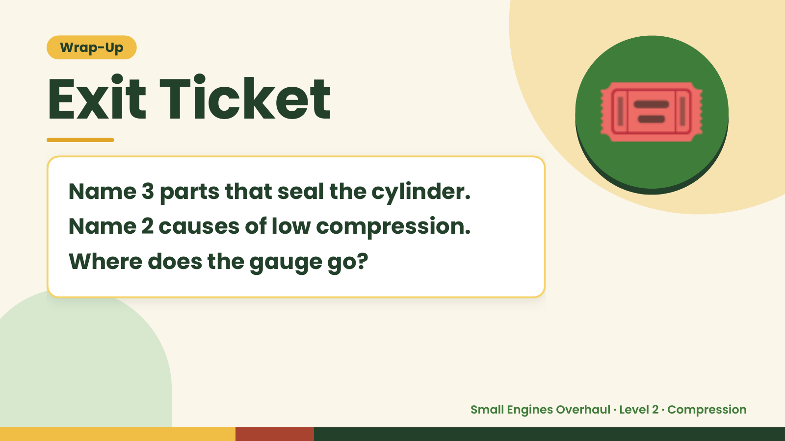
Notes:
Wrap-Up
Exit Ticket
Name 3 parts that seal the cylinder.
Name 2 causes of low compression.
🎟️
Where does the gauge go?
Small Engines Overhaul · Level 2 · Compression

