Slide 1
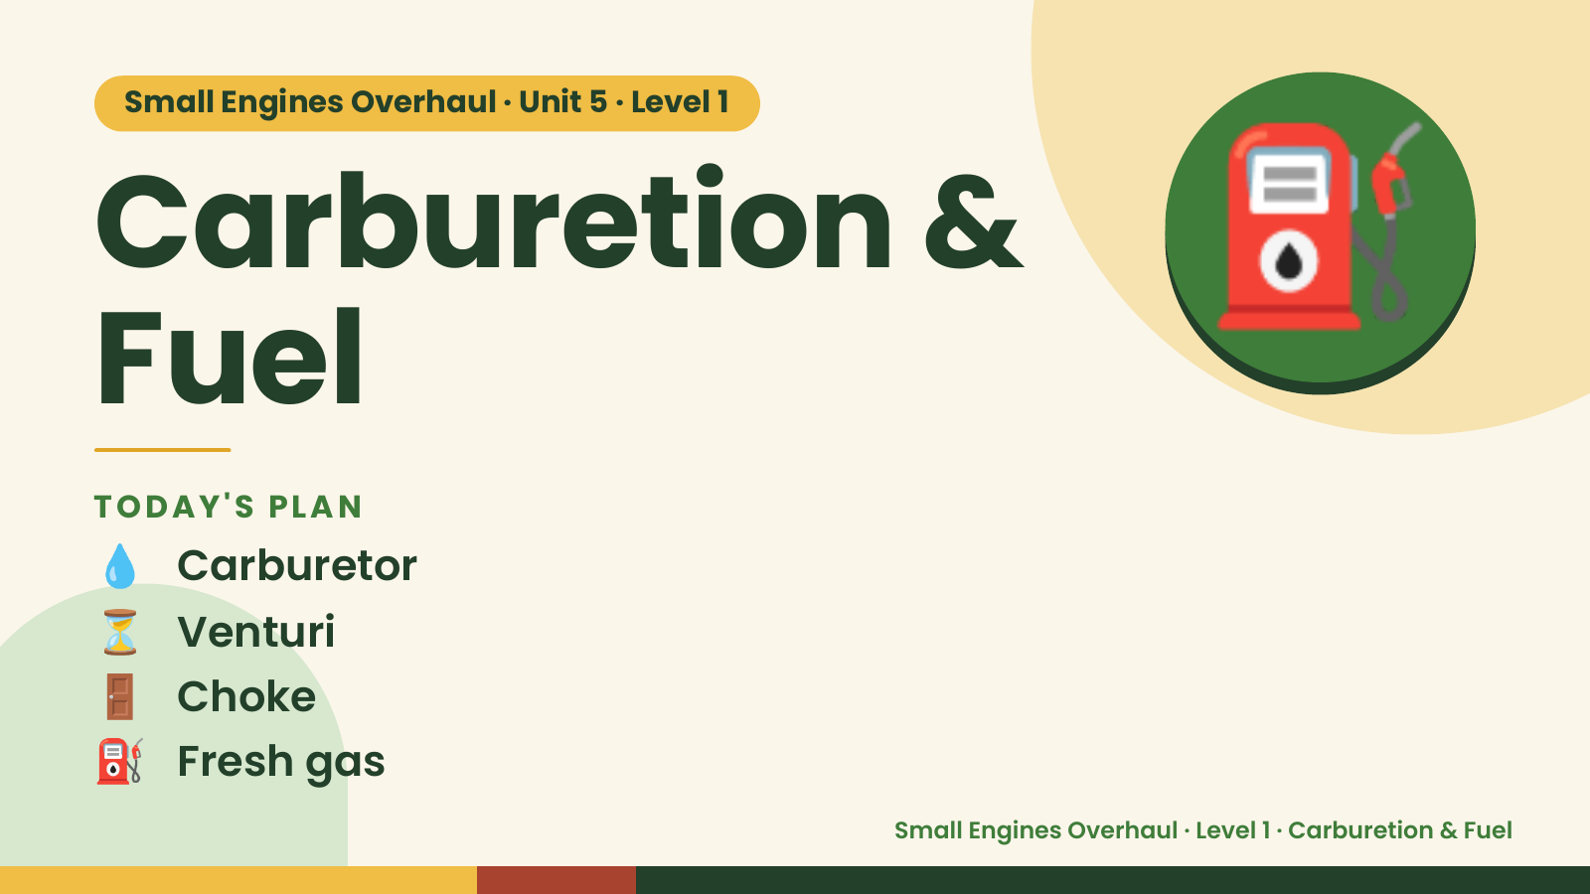
Notes:
Small Engines Overhaul · Unit 5 · Level 1
Carburetion &
Fuel
⛽
💧 Carburetor
TODAY'S PLAN
⏳ Venturi
🚪 Choke
⛽ Fresh gas
Small Engines Overhaul · Level 1 · Carburetion & Fuel

Slide 2
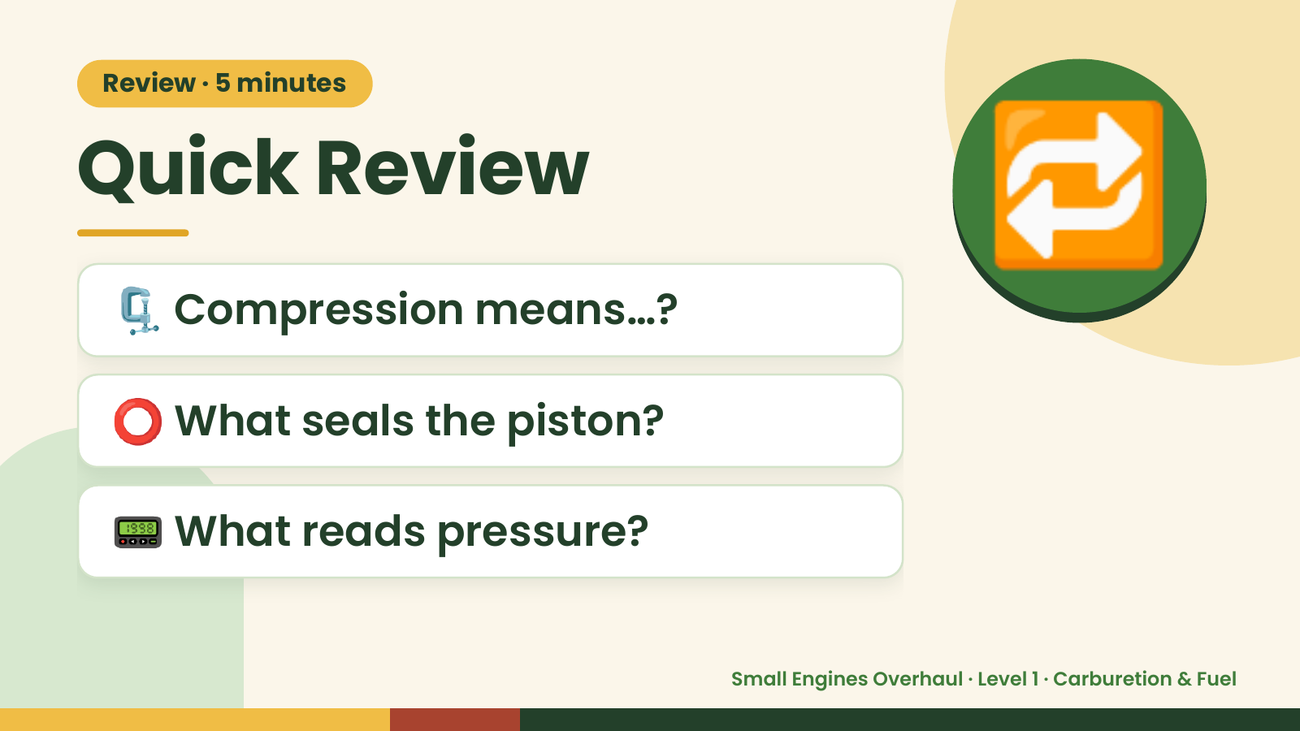
Notes:
Review · 5 minutes
Quick Review
🗜️ Compression means…?
🔁
⭕ What seals the piston?
📟 What reads pressure?
Small Engines Overhaul · Level 1 · Carburetion & Fuel

Slide 3
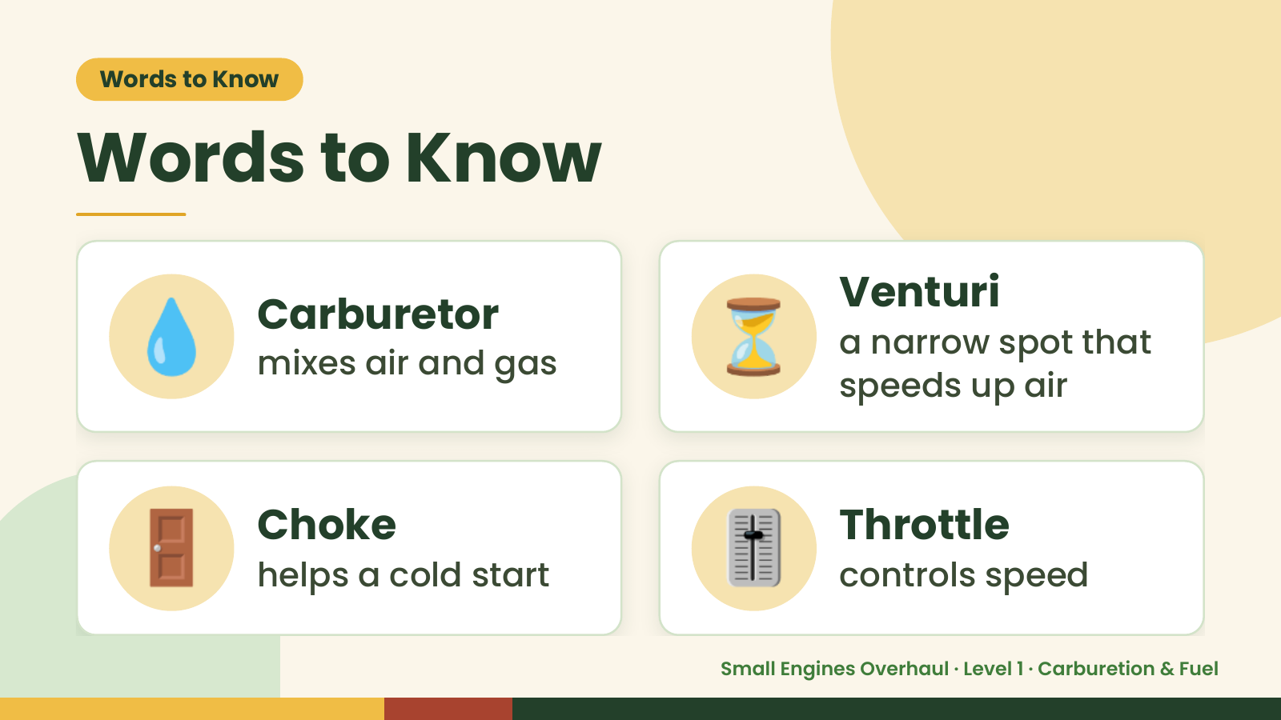
Notes:
Words to Know
Words to Know
💧 Carburetor
mixes air and gas ⏳ Venturi
a narrow spot that
speeds up air
🚪 Choke
helps a cold start 🎚️ Throttle
controls speed
Small Engines Overhaul · Level 1 · Carburetion & Fuel

Slide 4
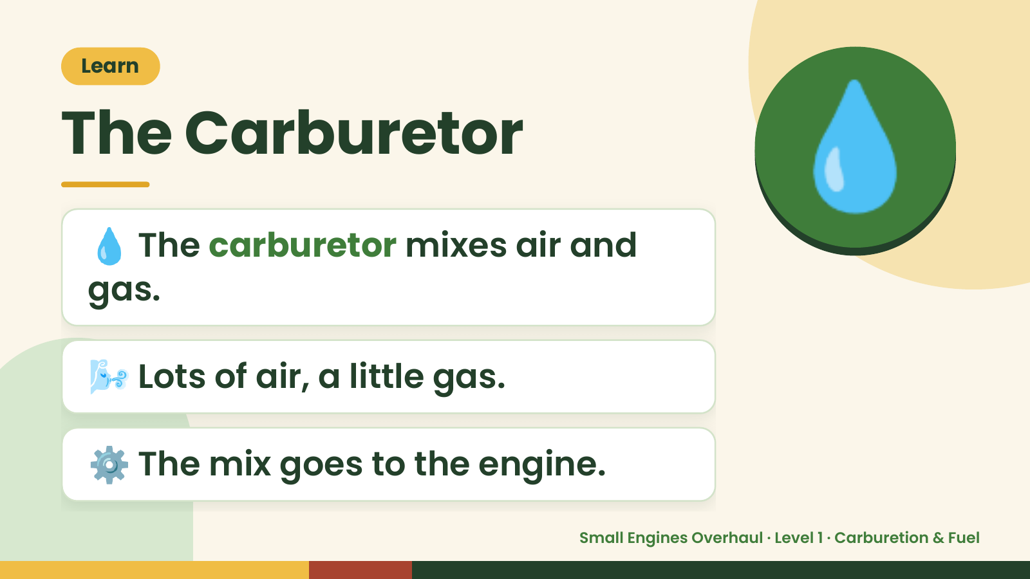
Notes:
Learn
The Carburetor
💧 The carburetor mixes air and
gas.
💧
🌬️ Lots of air, a little gas.
⚙️ The mix goes to the engine.
Small Engines Overhaul · Level 1 · Carburetion & Fuel

Slide 5
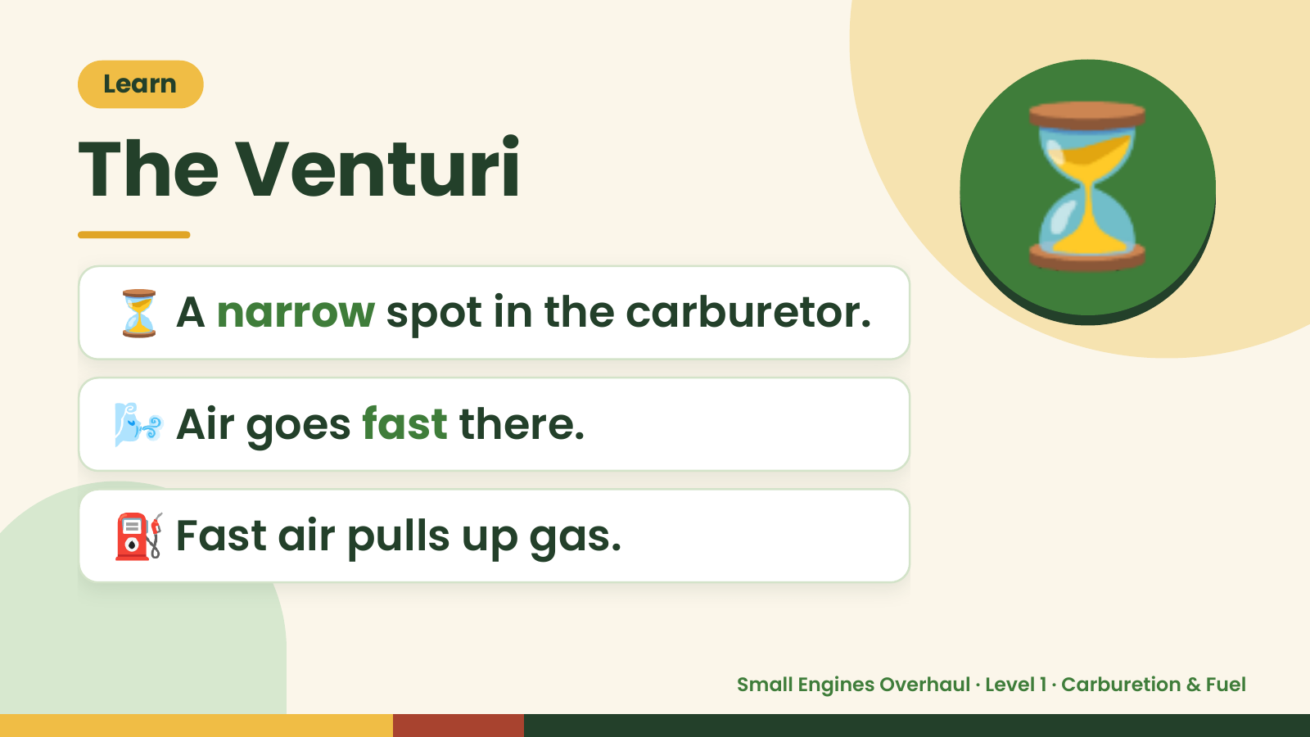
Notes:
Learn
The Venturi
⏳ A narrow spot in the carburetor.
⏳
🌬️ Air goes fast there.
⛽ Fast air pulls up gas.
Small Engines Overhaul · Level 1 · Carburetion & Fuel

Slide 6
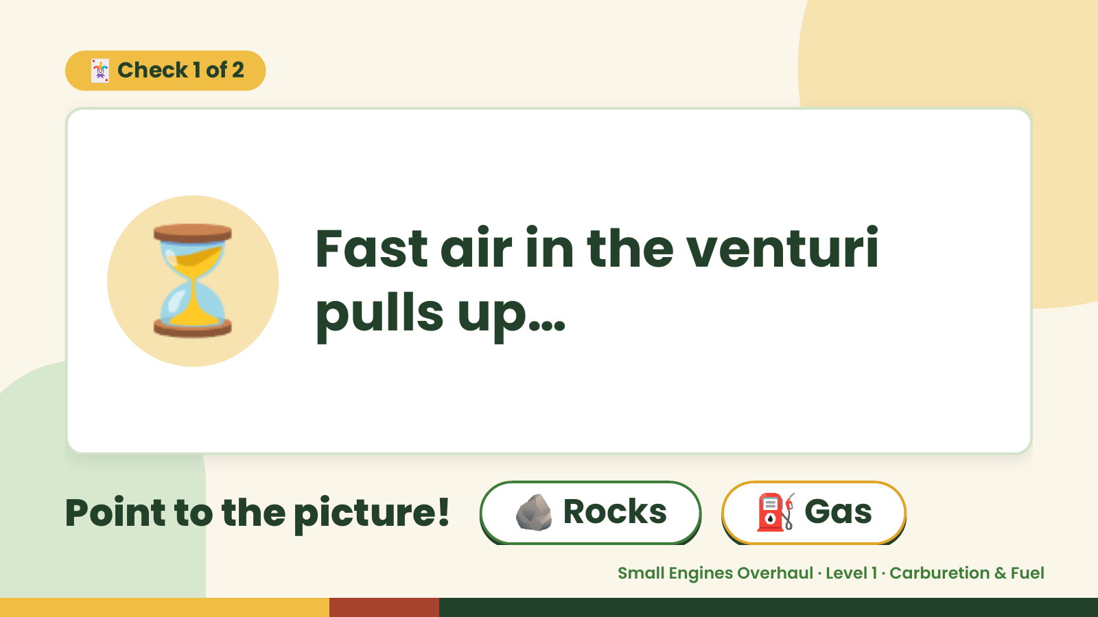
Notes:
🃏 Check 1 of 2
⏳ Fast air in the venturi
pulls up…
Point to the picture! 🪨 Rocks ⛽ Gas
Small Engines Overhaul · Level 1 · Carburetion & Fuel

Slide 7
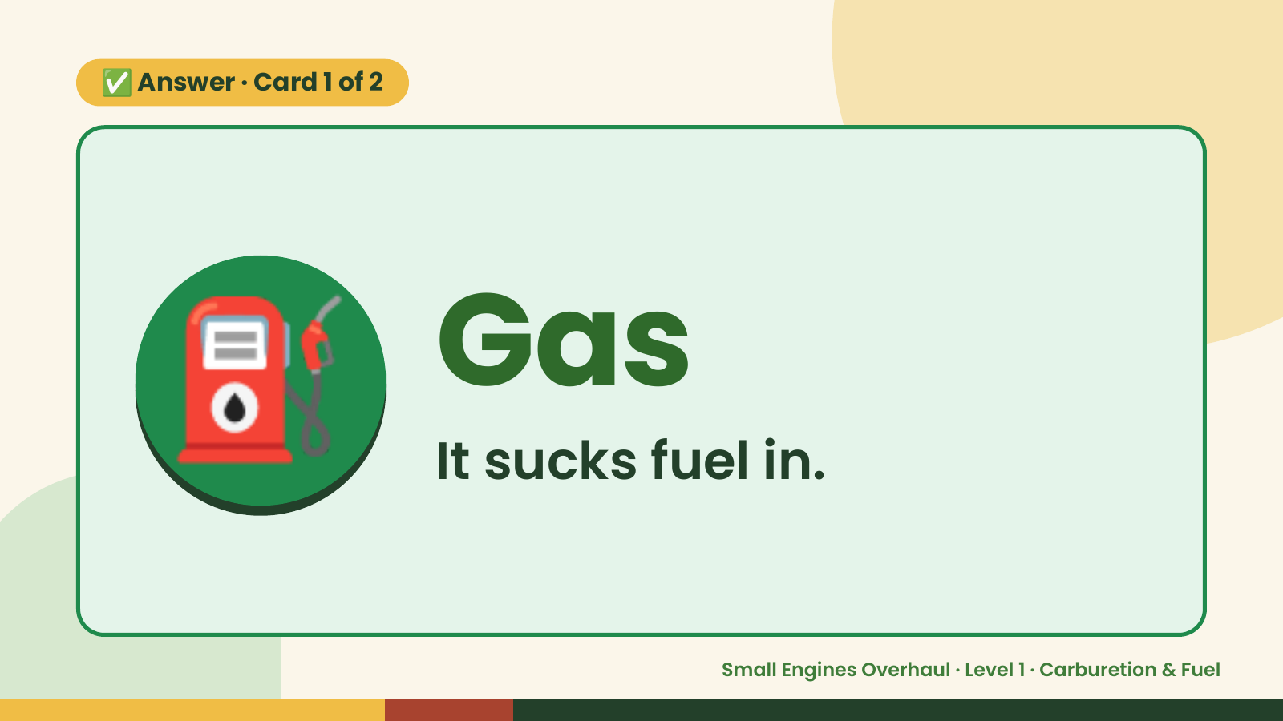
Notes:
✅ Answer · Card 1 of 2
⛽ Gas
It sucks fuel in.
Small Engines Overhaul · Level 1 · Carburetion & Fuel

Slide 8
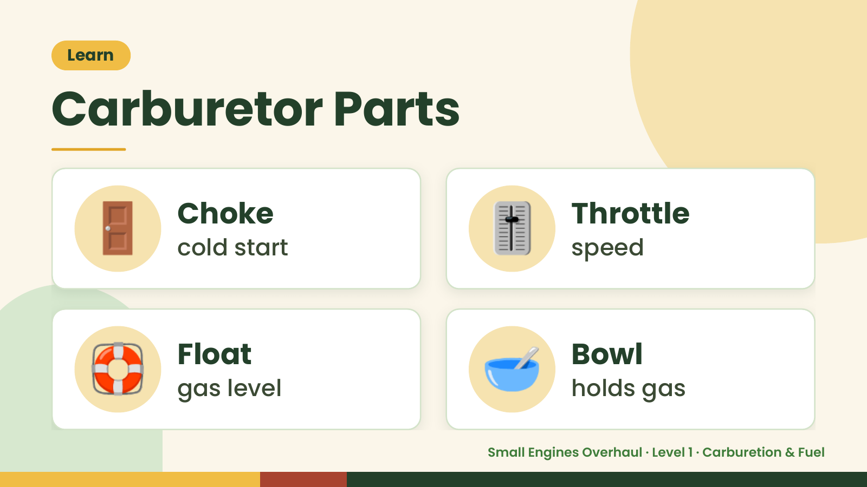
Notes:
Learn
Carburetor Parts
🚪 Choke
cold start 🎚️ Throttle
speed
🛟 Float
gas level 🥣 Bowl
holds gas
Small Engines Overhaul · Level 1 · Carburetion & Fuel

Slide 9
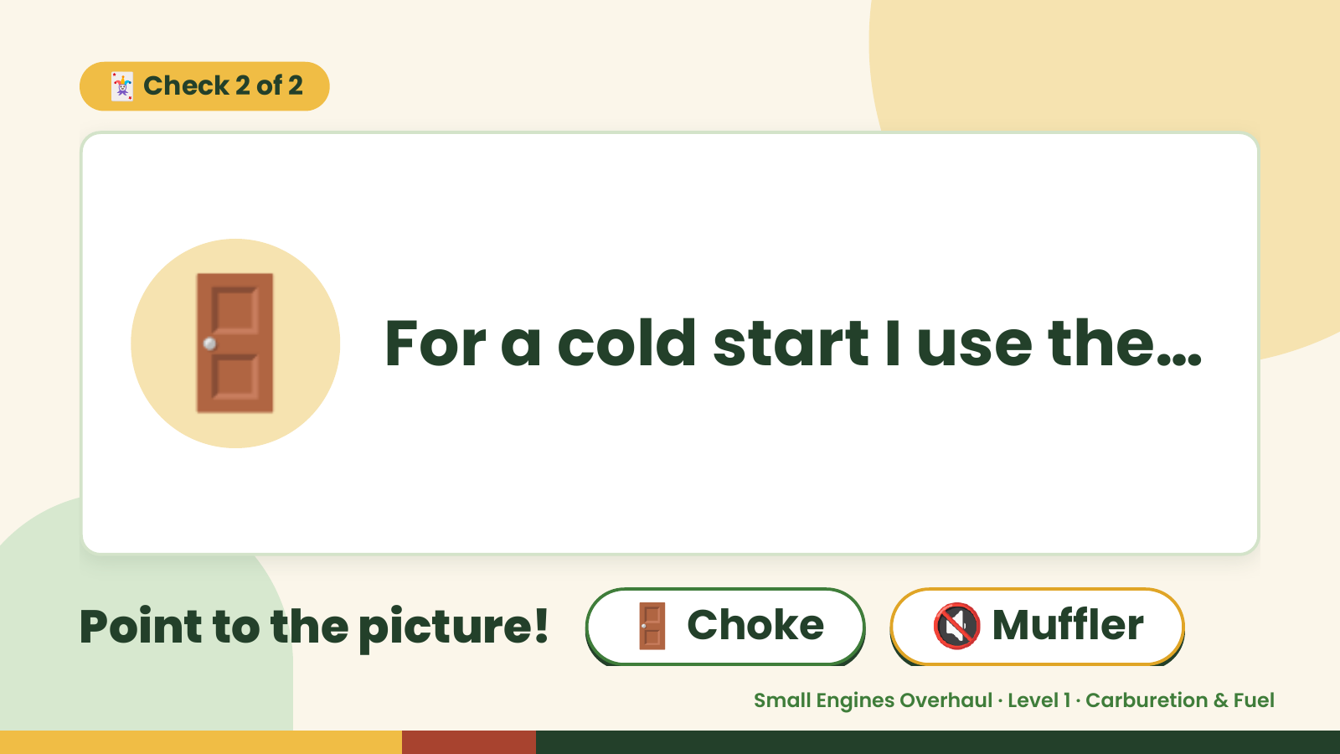
Notes:
🃏 Check 2 of 2
🚪 For a cold start I use the…
Point to the picture! 🚪 Choke 🔇 Muffler
Small Engines Overhaul · Level 1 · Carburetion & Fuel

Slide 10

Notes:
✅ Answer · Card 2 of 2
🚪 Choke
Choke for cold.
Small Engines Overhaul · Level 1 · Carburetion & Fuel

Slide 11
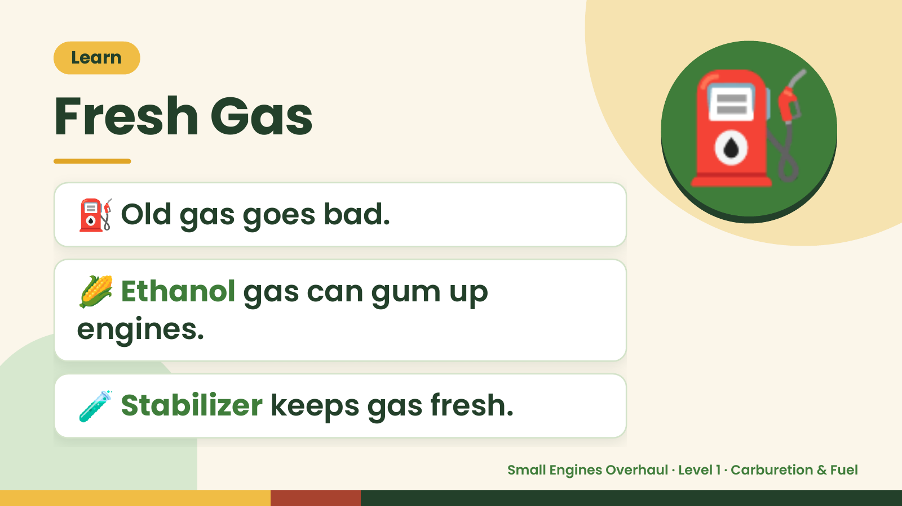
Notes:
Learn
Fresh Gas
⛽ Old gas goes bad.
⛽
🌽 Ethanol gas can gum up
engines.
🧪 Stabilizer keeps gas fresh.
Small Engines Overhaul · Level 1 · Carburetion & Fuel

Slide 12
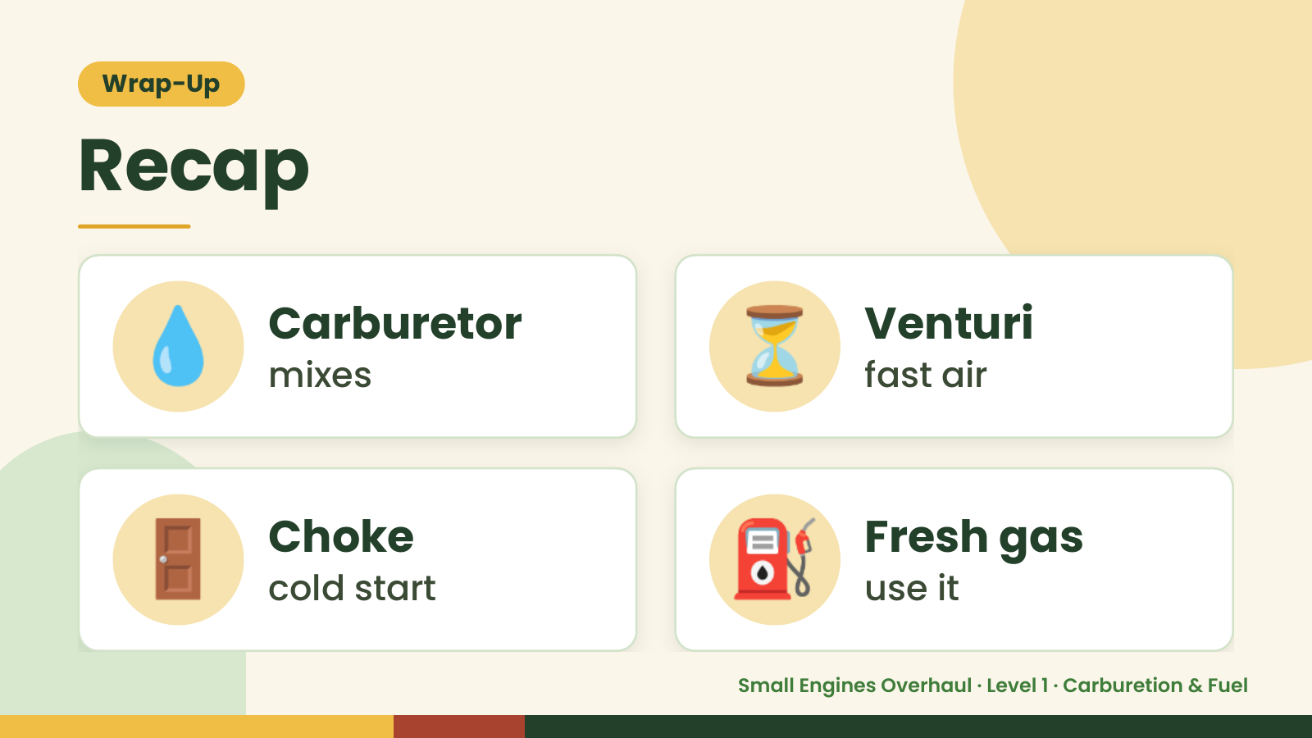
Notes:
Wrap-Up
Recap
💧 Carburetor
mixes ⏳ Venturi
fast air
🚪 Choke
cold start ⛽ Fresh gas
use it
Small Engines Overhaul · Level 1 · Carburetion & Fuel

Slide 13
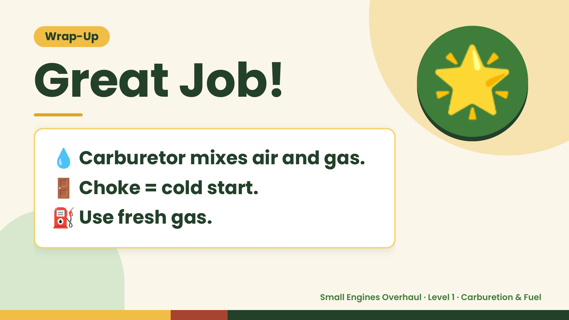
Notes:
Wrap-Up
Great Job!
💧 Carburetor mixes air and gas.
🌟
🚪 Choke = cold start.
⛽ Use fresh gas.
Small Engines Overhaul · Level 1 · Carburetion & Fuel

