Slide 1

Notes:
Small Engines Overhaul · Unit 5 · Level 1
Venturi &
Carburetor Lab
TODAY'S PLAN
⏳
👥 Jobs
⚠️ Safety
⏳ Steps
✅ Check
📝 Reflect
Small Engines Overhaul · Level 1 · Venturi & Carburetor Lab

Slide 2

Notes:
Get ready
Jobs
🔧 Mechanic
fixes 🧰 Tool helper
gets tools
📋 Recorder
writes 🧽 Clean-up
captain
cleans
Small Engines Overhaul · Level 1 · Venturi & Carburetor Lab

Slide 3
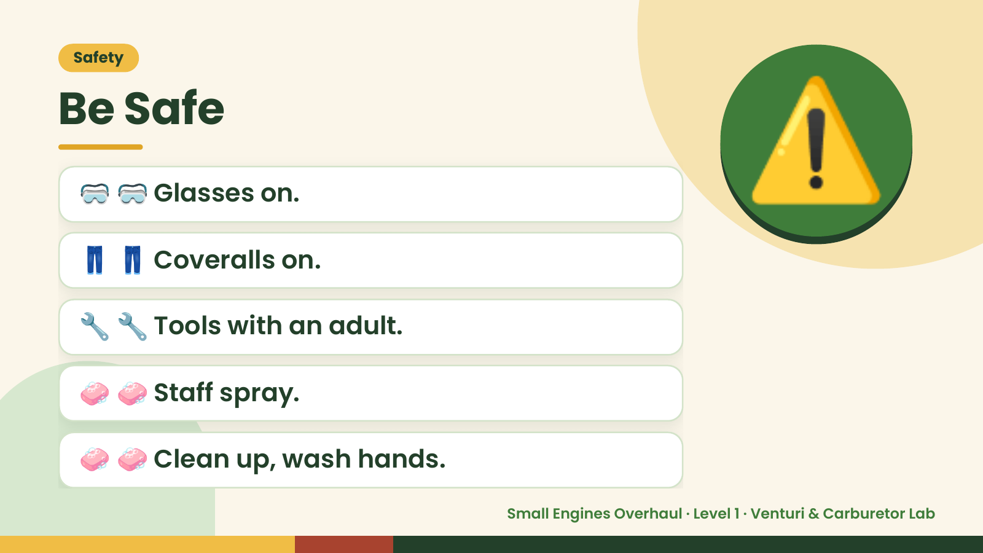
Notes:
Safety
Be Safe
🥽 🥽 Glasses on.
👖 👖 Coveralls on.
⚠️
🔧 🔧 Tools with an adult.
🧼 🧼 Staff spray.
🧼 🧼 Clean up, wash hands.
Small Engines Overhaul · Level 1 · Venturi & Carburetor Lab

Slide 4
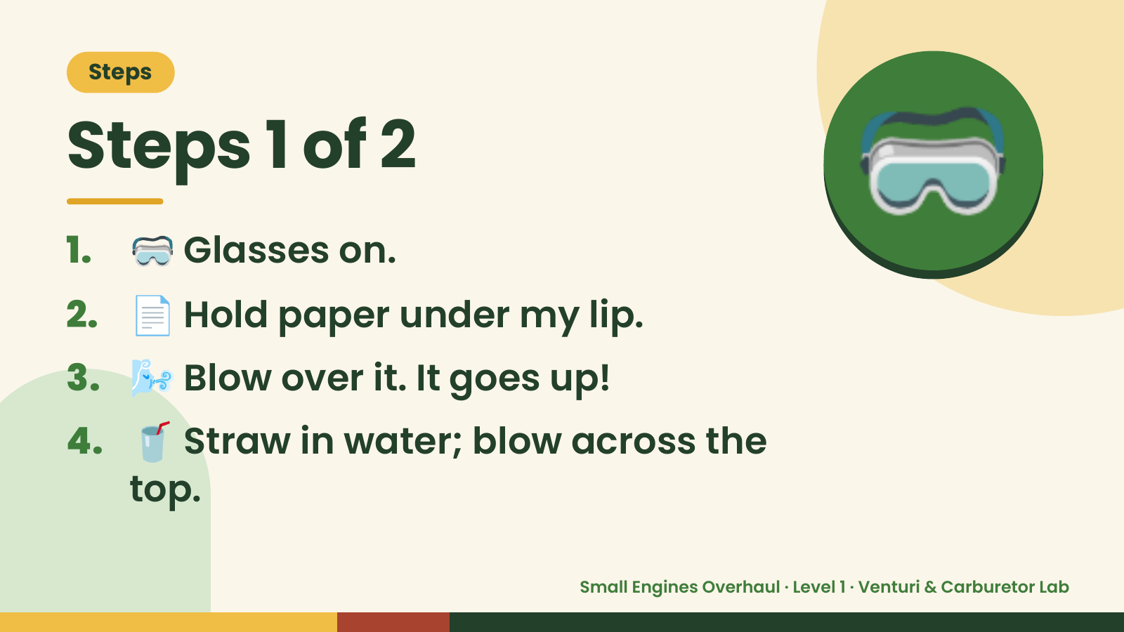
Notes:
Steps
Steps 1 of 2
1. 🥽 Glasses on.
2. 📄 Hold paper under my lip.
🥽
3. 🌬️ Blow over it. It goes up!
4. 🥤 Straw in water; blow across the
top.
Small Engines Overhaul · Level 1 · Venturi & Carburetor Lab

Slide 5
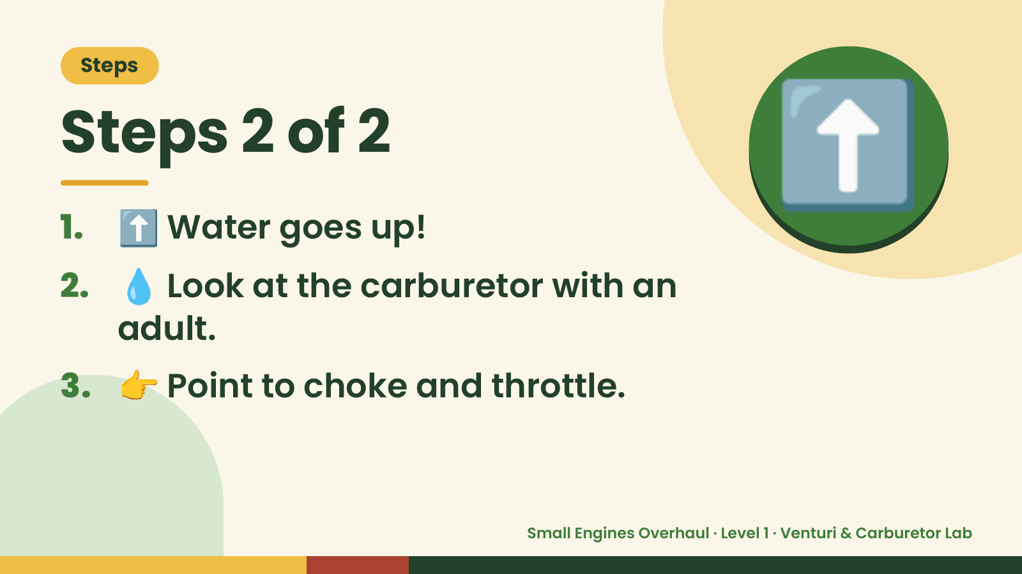
Notes:
Steps
Steps 2 of 2
1. ⬆️ Water goes up!
2. 💧 Look at the carburetor with an
⬆️
adult.
3. 👉 Point to choke and throttle.
Small Engines Overhaul · Level 1 · Venturi & Carburetor Lab

Slide 6
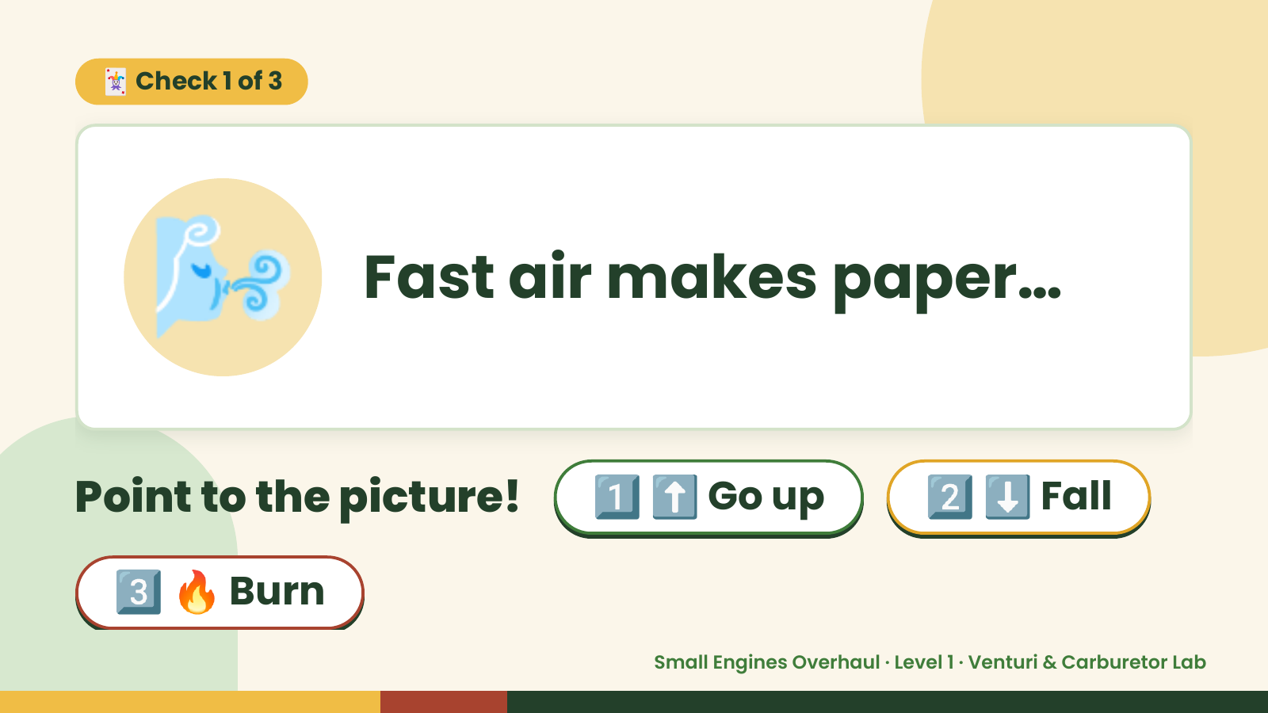
Notes:
🃏 Check 1 of 3
🌬️ Fast air makes paper…
Point to the picture! 1️⃣ ⬆️ Go up 2️⃣ ⬇️ Fall
3️⃣ 🔥 Burn
Small Engines Overhaul · Level 1 · Venturi & Carburetor Lab

Slide 7
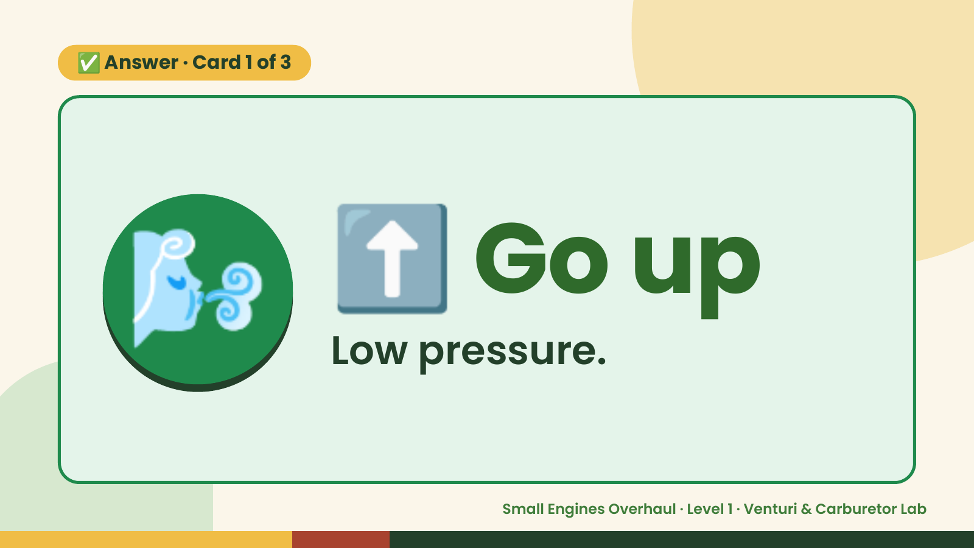
Notes:
✅ Answer · Card 1 of 3
🌬️ ⬆️ Go up
Low pressure.
Small Engines Overhaul · Level 1 · Venturi & Carburetor Lab

Slide 8
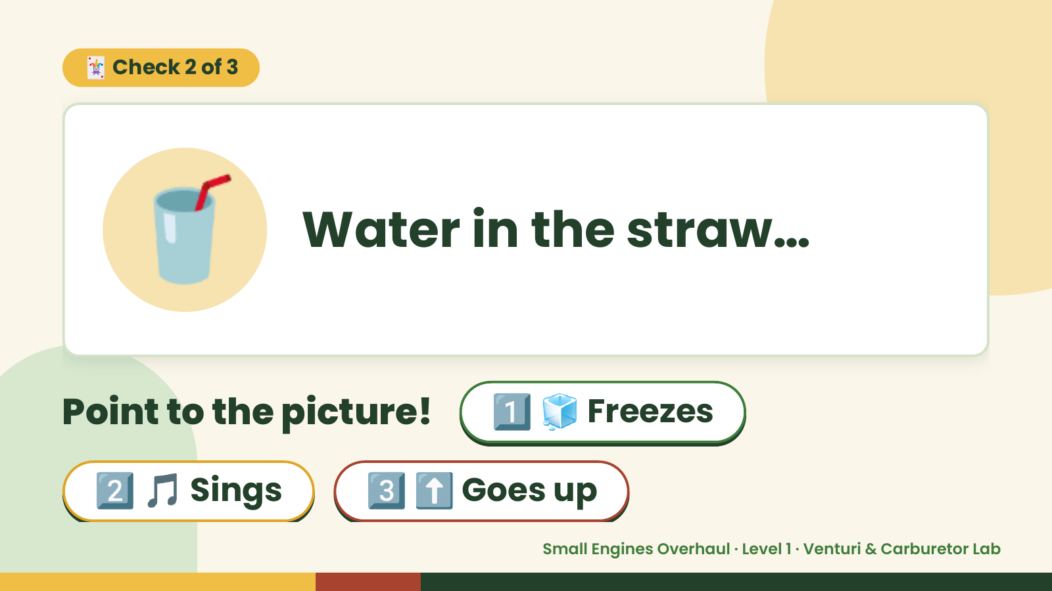
Notes:
🃏 Check 2 of 3
🥤 Water in the straw…
Point to the picture! 1️⃣ 🧊 Freezes
2️⃣ 🎵 Sings 3️⃣ ⬆️ Goes up
Small Engines Overhaul · Level 1 · Venturi & Carburetor Lab

Slide 9

Notes:
⬆️
✅ Answer · Card 2 of 3
🥤 up Goes
Lifted.
Small Engines Overhaul · Level 1 · Venturi & Carburetor Lab

Slide 10
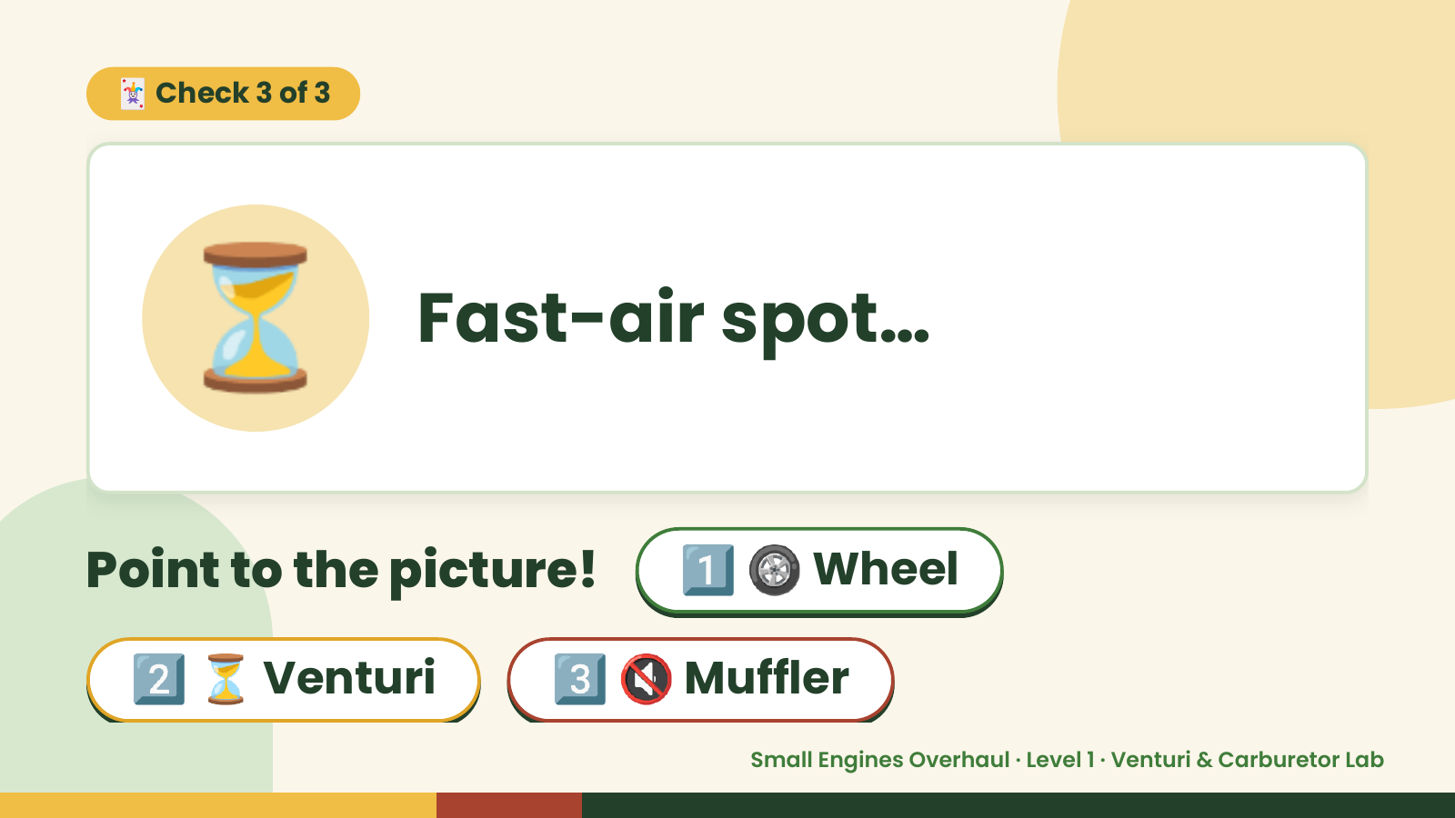
Notes:
🃏 Check 3 of 3
⏳ Fast-air spot…
Point to the picture! 1️⃣ 🛞 Wheel
2️⃣ ⏳ Venturi 3️⃣ 🔇 Muffler
Small Engines Overhaul · Level 1 · Venturi & Carburetor Lab

Slide 11
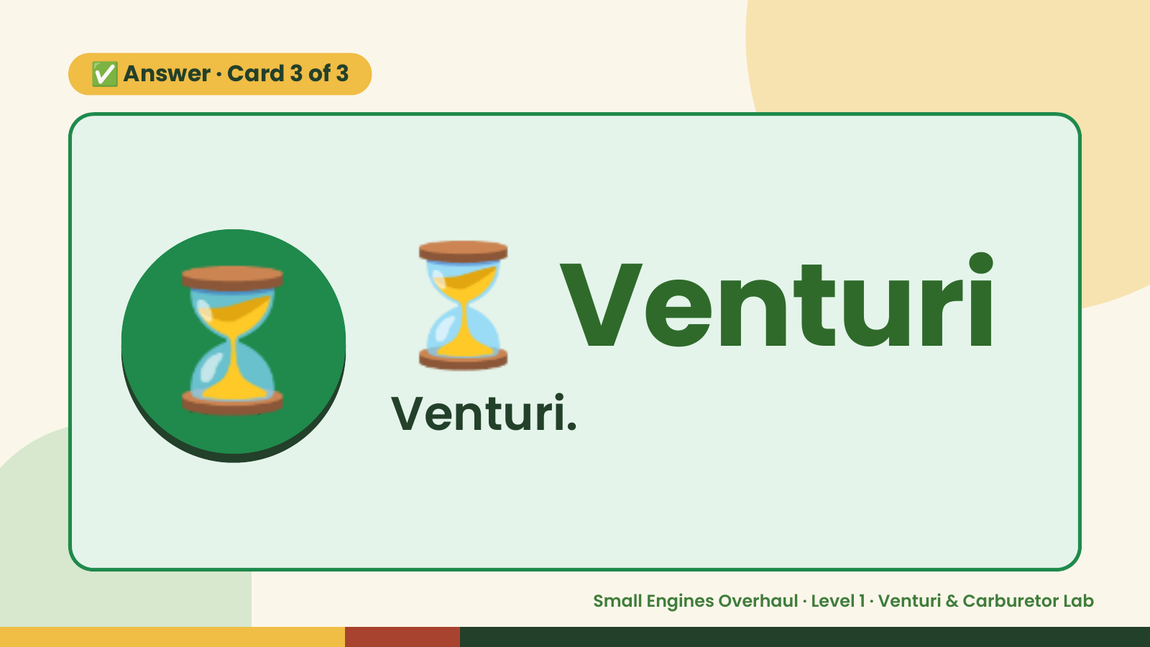
Notes:
✅ Answer · Card 3 of 3
⏳ ⏳ Venturi
Venturi.
Small Engines Overhaul · Level 1 · Venturi & Carburetor Lab

Slide 12

Notes:
Wrap-Up
Clean Up +
Reflect
🧽
🧽 Wipe the bench.
🧰 Give tools back.
🧼 Wash hands.
Small Engines Overhaul · Level 1 · Venturi & Carburetor Lab

