Slide 1
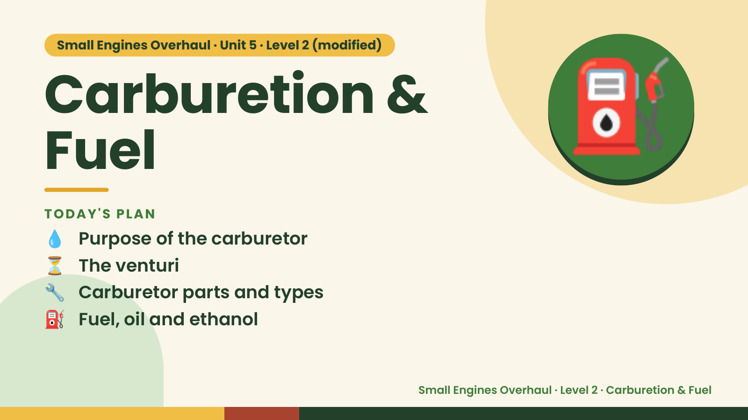
Notes:
Small Engines Overhaul · Unit 5 · Level 2 (modified)
Carburetion &
Fuel
💧 Purpose of the carburetor
TODAY'S PLAN
⛽
⏳ The venturi
🔧 Carburetor parts and types
⛽ Fuel, oil and ethanol
Small Engines Overhaul · Level 2 · Carburetion & Fuel

Slide 2
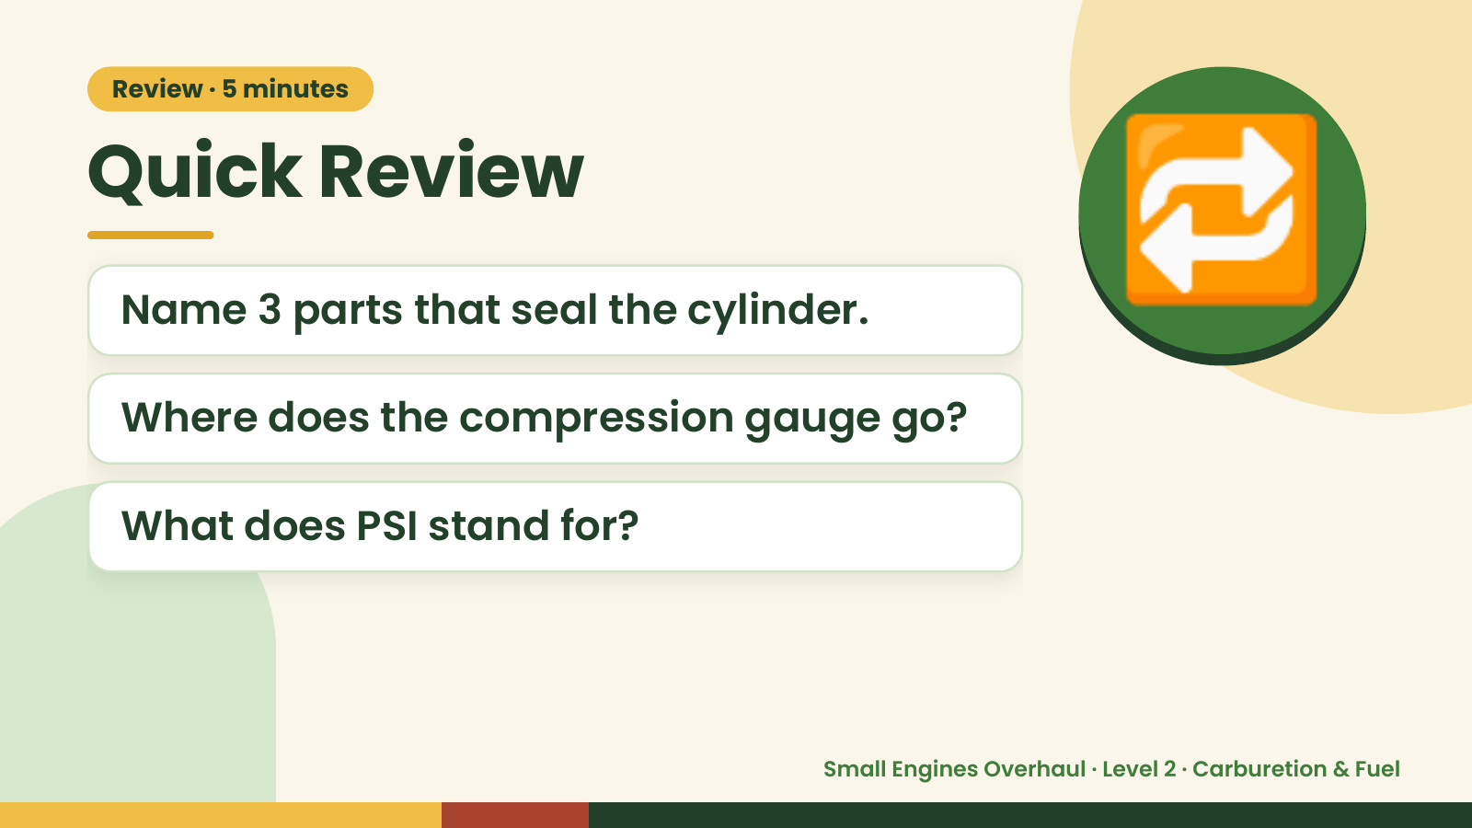
Notes:
Review · 5 minutes
Quick Review
Name 3 parts that seal the cylinder.
Where does the compression gauge go?
🔁
What does PSI stand for?
Small Engines Overhaul · Level 2 · Carburetion & Fuel

Slide 3
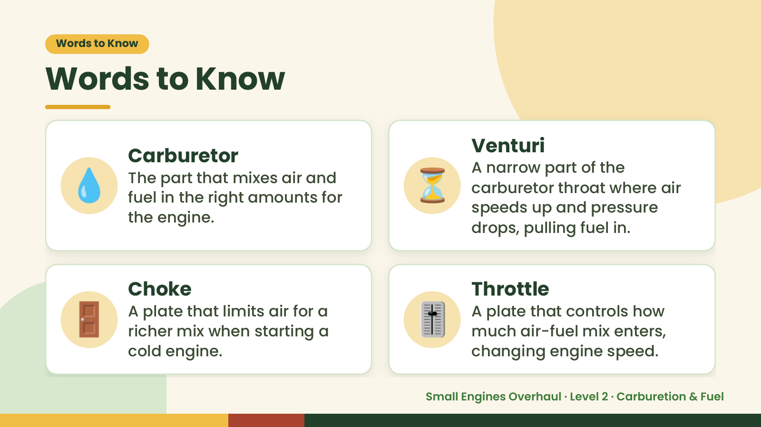
Notes:
Words to Know
Words to Know
💧 ⏳
Venturi
Carburetor
A narrow part of the
The part that mixes air and
carburetor throat where air
fuel in the right amounts for
speeds up and pressure
the engine.
drops, pulling fuel in.
🚪 Choke
A plate that limits air for a
richer mix when starting a
cold engine.
🎚️ Throttle
A plate that controls how
much air-fuel mix enters,
changing engine speed.
Small Engines Overhaul · Level 2 · Carburetion & Fuel

Slide 4
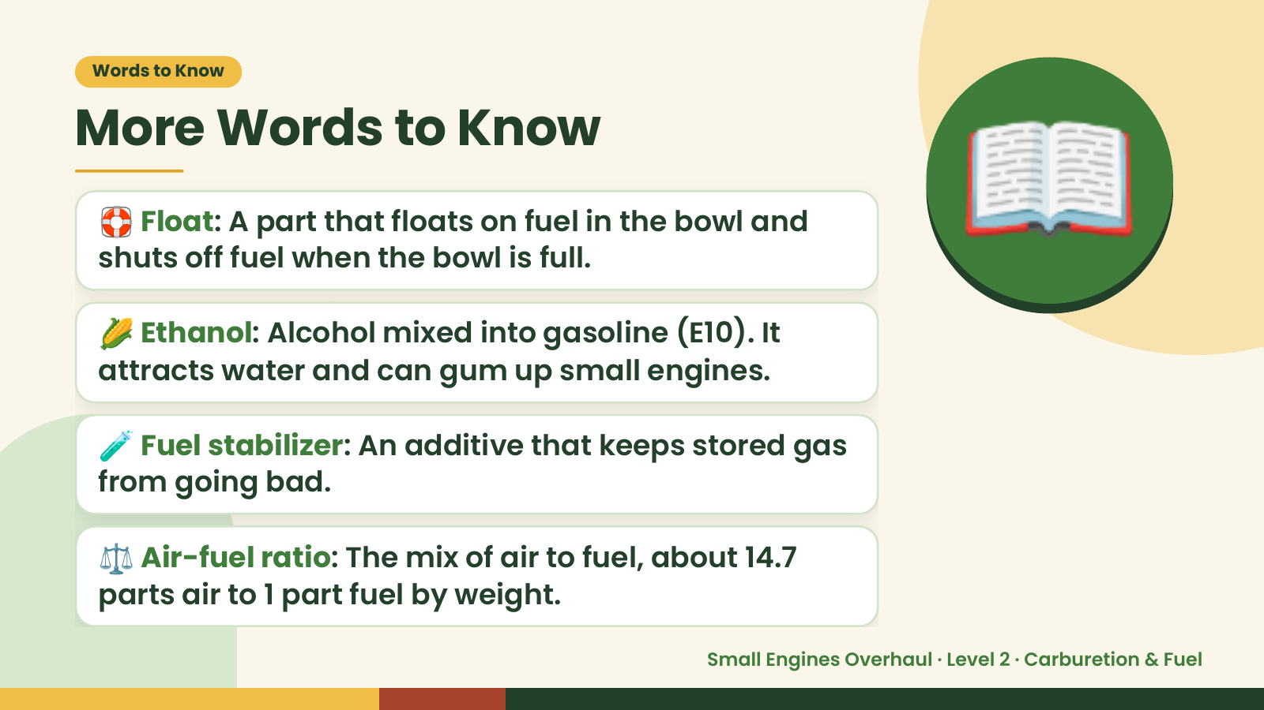
Notes:
Words to Know
More Words to Know
🛟 Float: A part that floats on fuel in the bowl and
shuts off fuel when the bowl is full.
🌽 Ethanol: Alcohol mixed into gasoline (E10). It
attracts water and can gum up small engines.
📖
🧪 Fuel stabilizer: An additive that keeps stored gas
from going bad.
⚖️ Air-fuel ratio: The mix of air to fuel, about 14.7
parts air to 1 part fuel by weight.
Small Engines Overhaul · Level 2 · Carburetion & Fuel

Slide 5
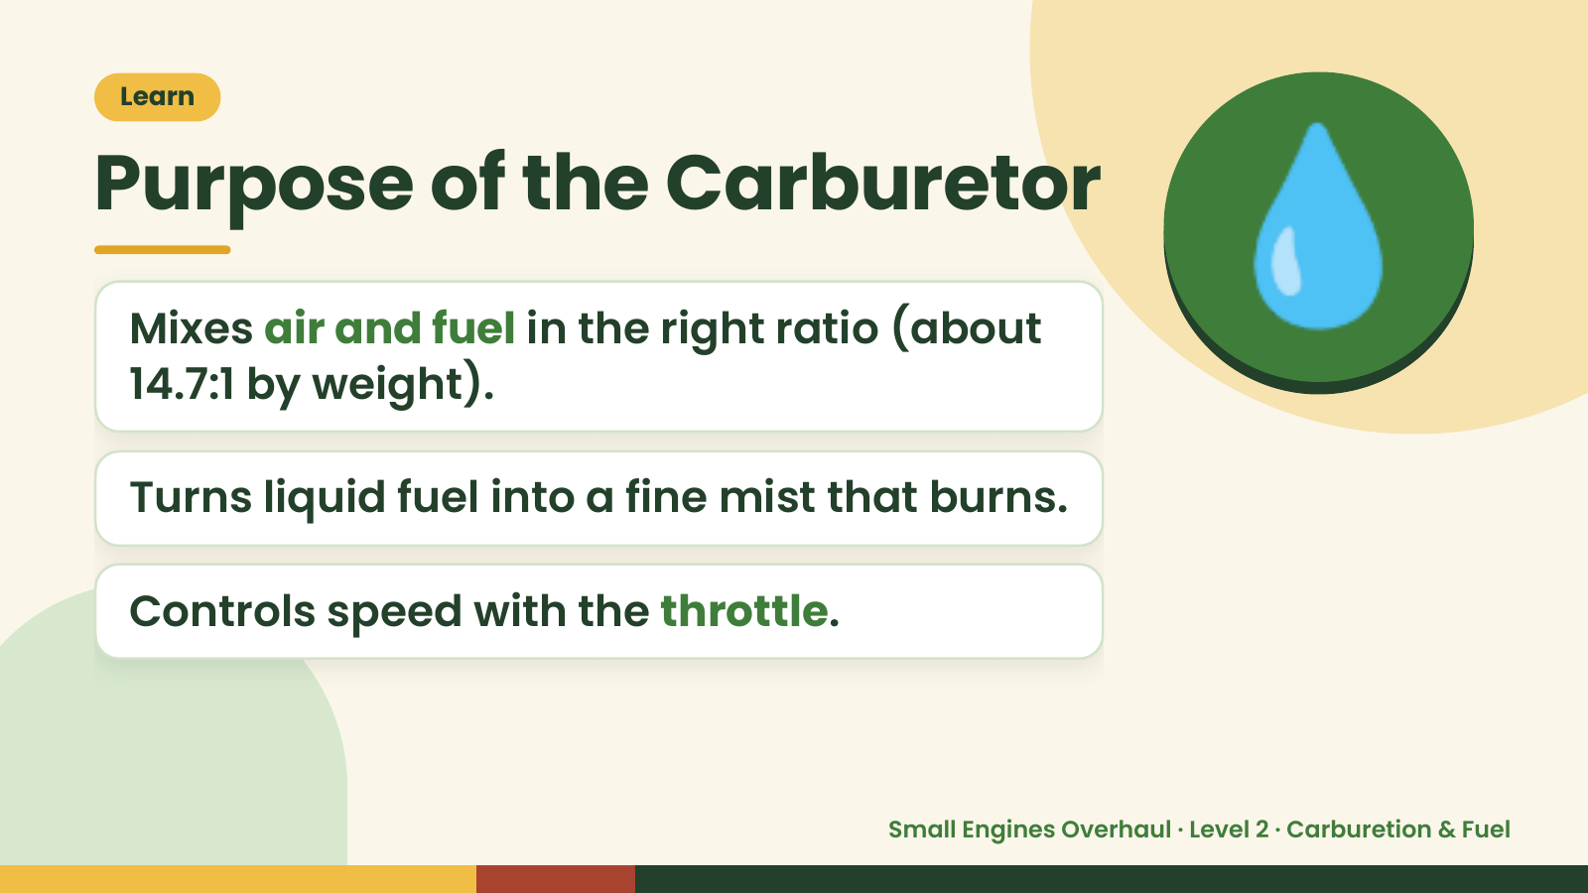
Notes:
Learn
Purpose of the Carburetor
Mixes air and fuel in the right ratio (about
14.7:1 by weight).
Turns liquid fuel into a fine mist that burns.
💧
Controls speed with the throttle.
Small Engines Overhaul · Level 2 · Carburetion & Fuel

Slide 6
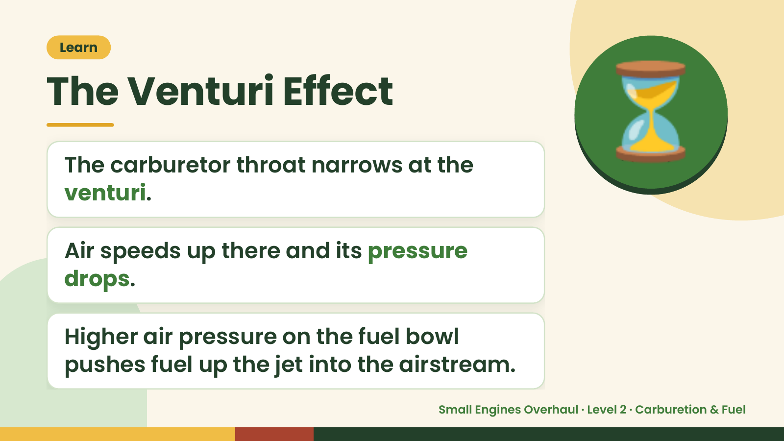
Notes:
Learn
The Venturi Effect
The carburetor throat narrows at the
venturi.
⏳
Air speeds up there and its pressure
drops.
Higher air pressure on the fuel bowl
pushes fuel up the jet into the airstream.
Small Engines Overhaul · Level 2 · Carburetion & Fuel

Slide 7
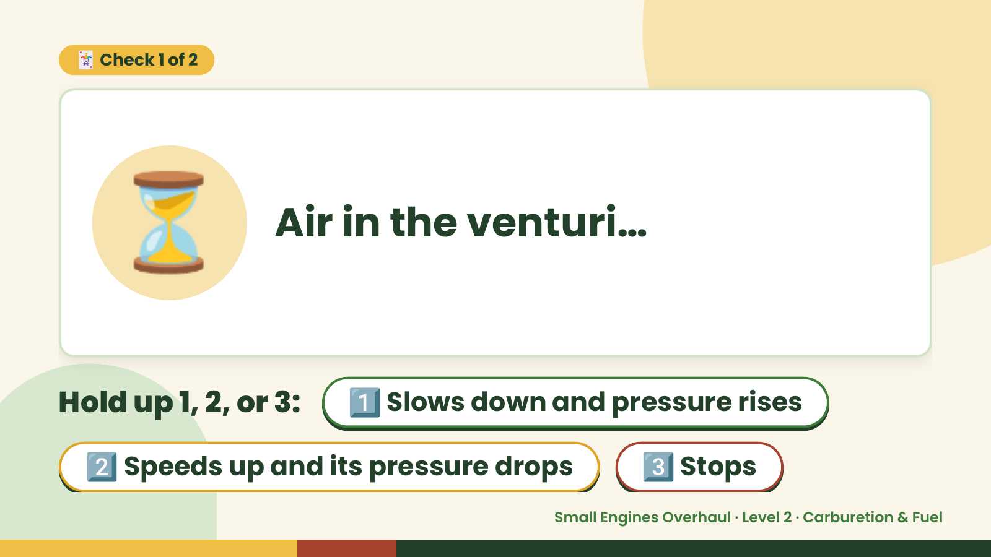
Notes:
🃏 Check 1 of 2
⏳ Air in the venturi…
Hold up 1, 2, or 3: 1️⃣ Slows down and pressure rises
2️⃣ Speeds up and its pressure drops 3️⃣ Stops
Small Engines Overhaul · Level 2 · Carburetion & Fuel

Slide 8
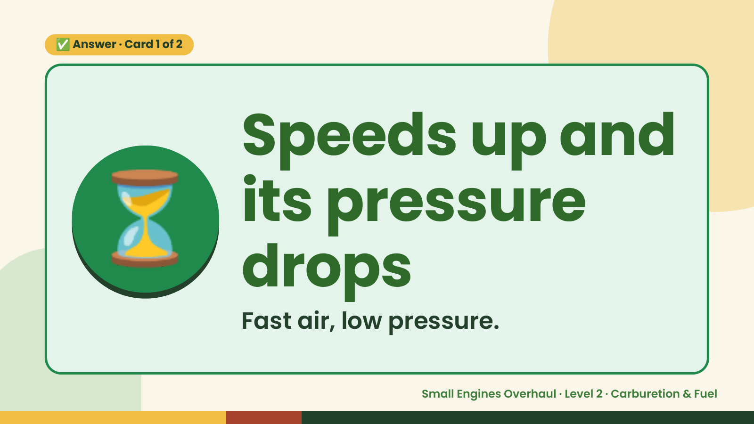
Notes:
✅ Answer · Card 1 of 2
⏳ Speeds up and
its pressure
drops
Fast air, low pressure.
Small Engines Overhaul · Level 2 · Carburetion & Fuel

Slide 9
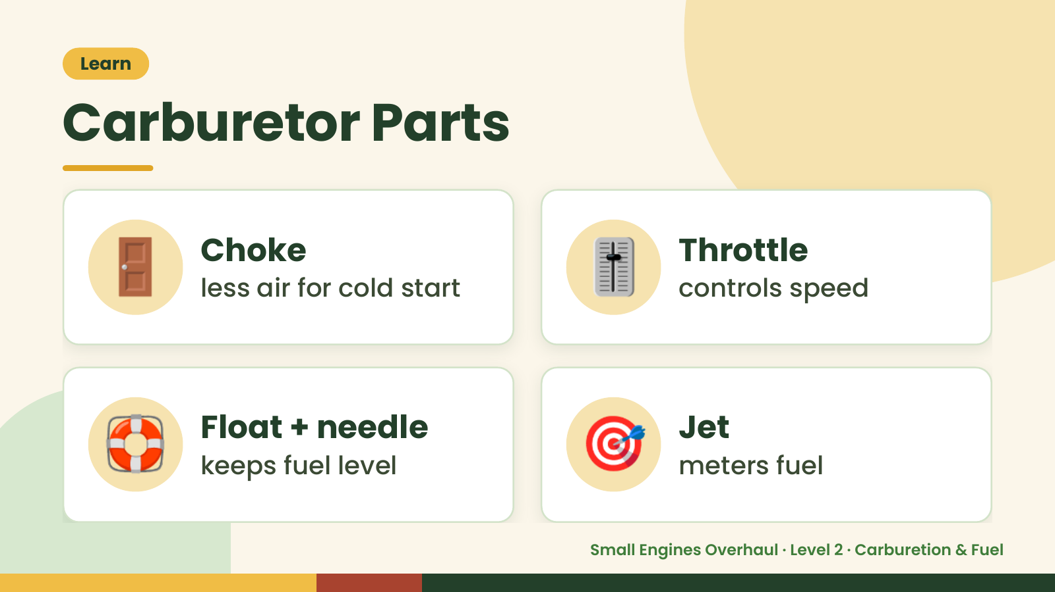
Notes:
Learn
Carburetor Parts
🚪 Choke
less air for cold start 🎚️ Throttle
controls speed
🛟 Float + needle
keeps fuel level 🎯 Jet
meters fuel
Small Engines Overhaul · Level 2 · Carburetion & Fuel

Slide 10
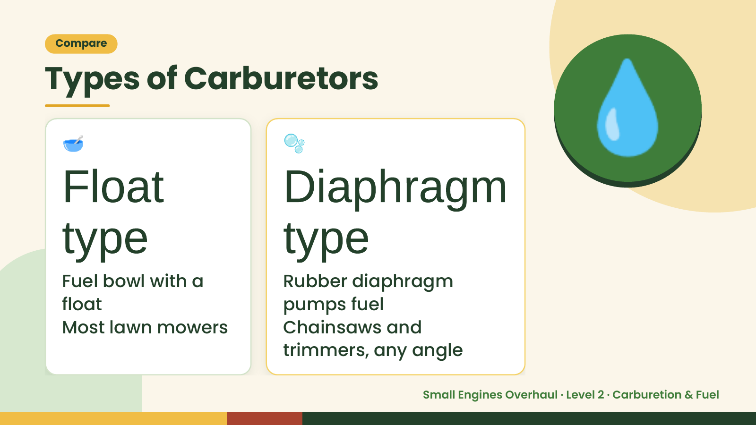
Notes:
Compare
Types of Carburetors
🥣
Float
🫧
Diaphragm
💧
type
Fuel bowl with a
type
Rubber diaphragm
float pumps fuel
Most lawn mowers Chainsaws and
trimmers, any angle
Small Engines Overhaul · Level 2 · Carburetion & Fuel

Slide 11
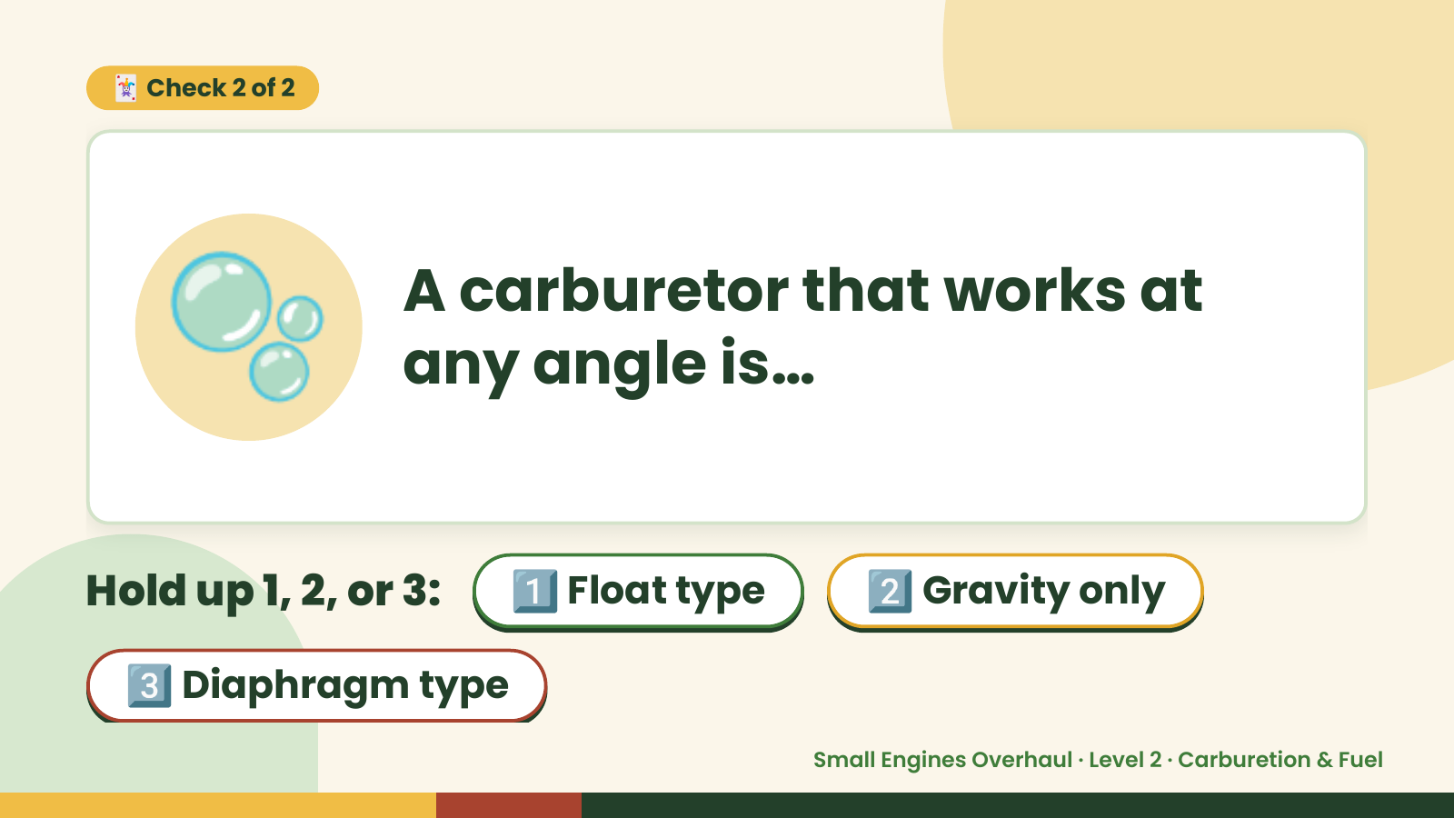
Notes:
🃏 Check 2 of 2
🫧 A carburetor that works at
any angle is…
Hold up 1, 2, or 3: 1️⃣ Float type 2️⃣ Gravity only
3️⃣ Diaphragm type
Small Engines Overhaul · Level 2 · Carburetion & Fuel

Slide 12
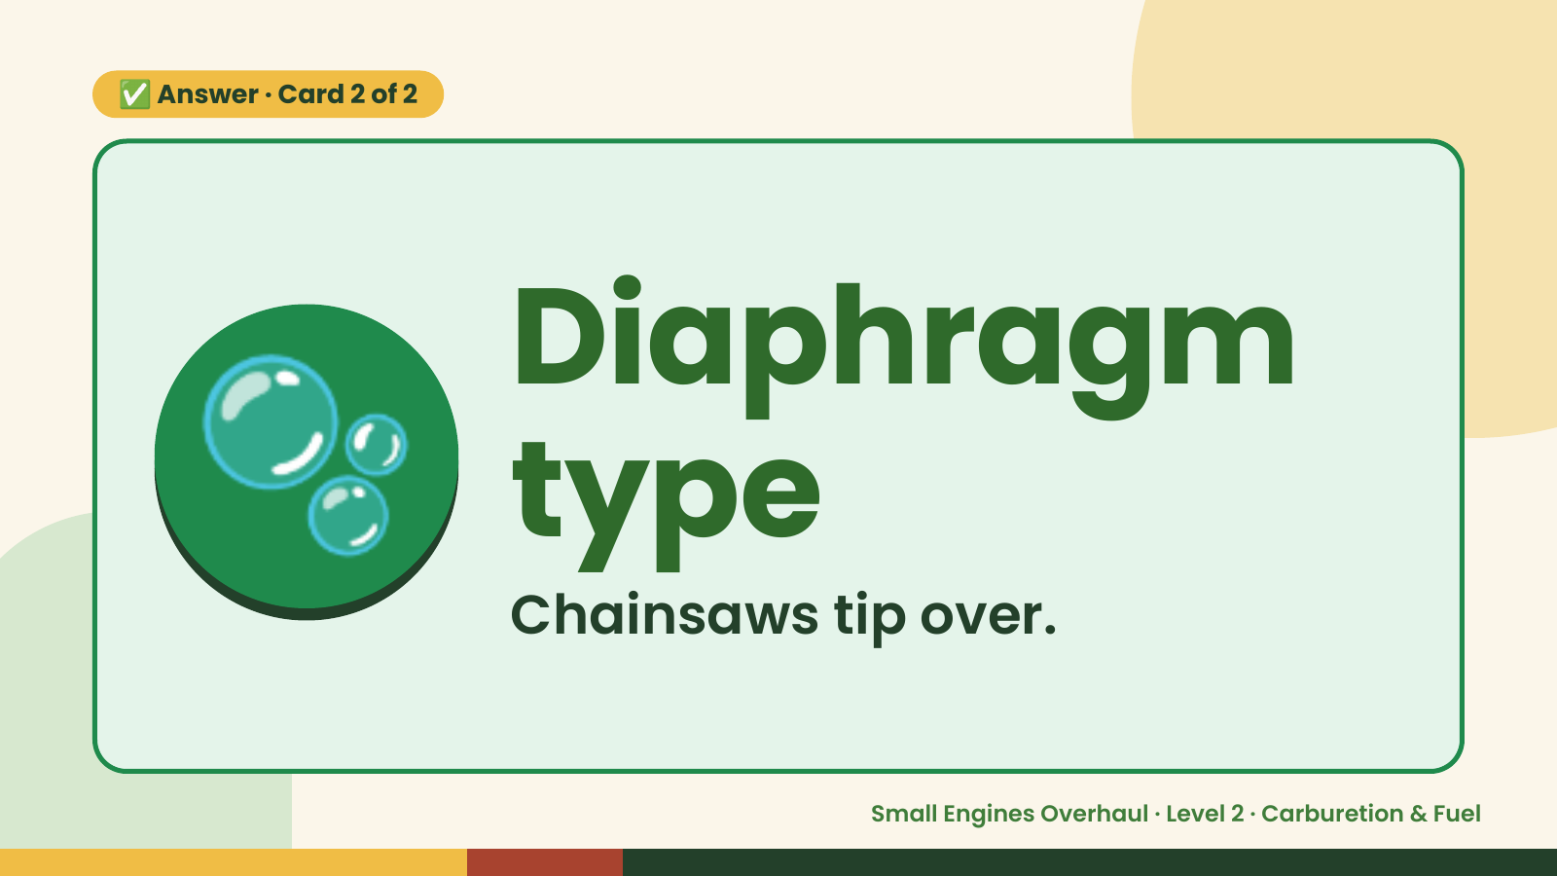
Notes:
✅ Answer · Card 2 of 2
🫧 Diaphragm
type
Chainsaws tip over.
Small Engines Overhaul · Level 2 · Carburetion & Fuel

Slide 13
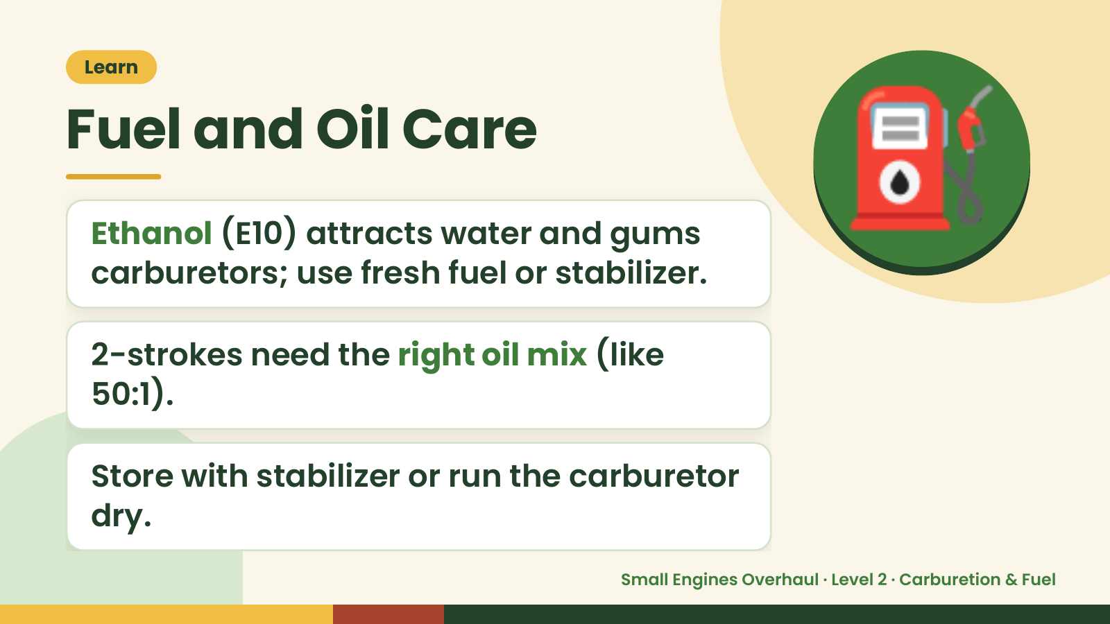
Notes:
Learn
Fuel and Oil Care
Ethanol (E10) attracts water and gums
carburetors; use fresh fuel or stabilizer.
⛽
2-strokes need the right oil mix (like
50:1).
Store with stabilizer or run the carburetor
dry.
Small Engines Overhaul · Level 2 · Carburetion & Fuel

Slide 14
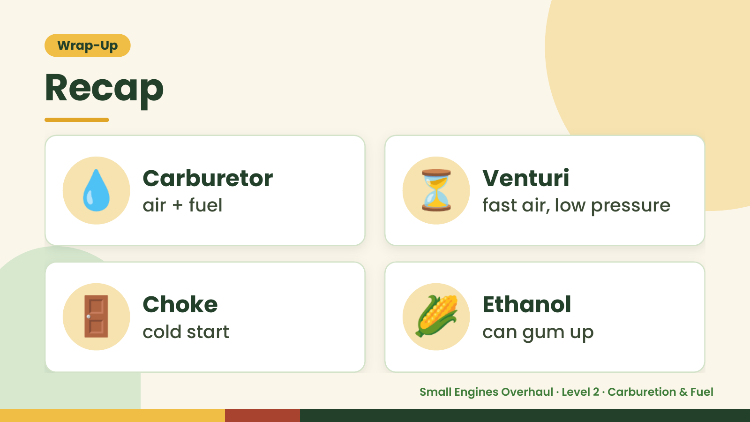
Notes:
Wrap-Up
Recap
💧 Carburetor
air + fuel ⏳ Venturi
fast air, low pressure
🚪 Choke
cold start 🌽 Ethanol
can gum up
Small Engines Overhaul · Level 2 · Carburetion & Fuel

Slide 15
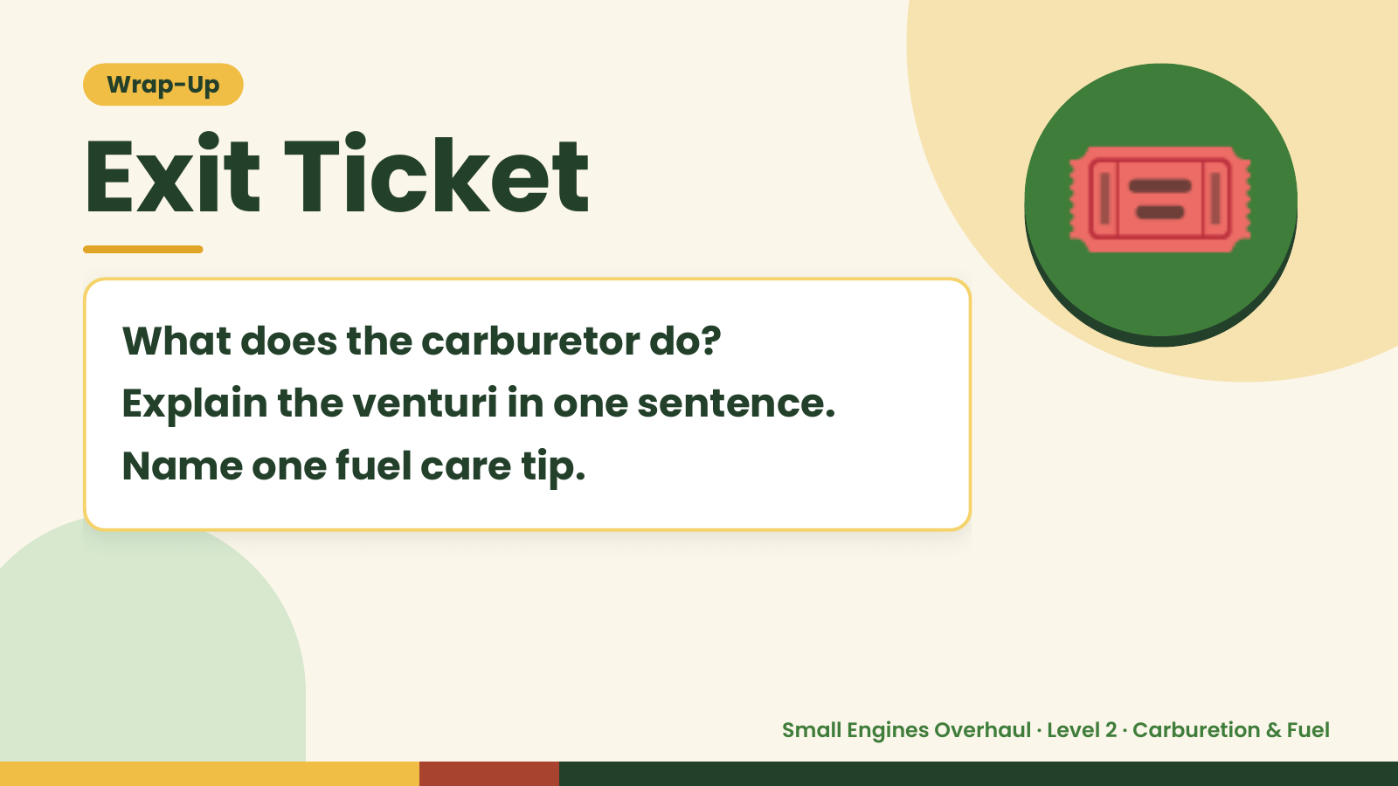
Notes:
Wrap-Up
Exit Ticket
What does the carburetor do?
Explain the venturi in one sentence.
🎟️
Name one fuel care tip.
Small Engines Overhaul · Level 2 · Carburetion & Fuel

