Slide 1
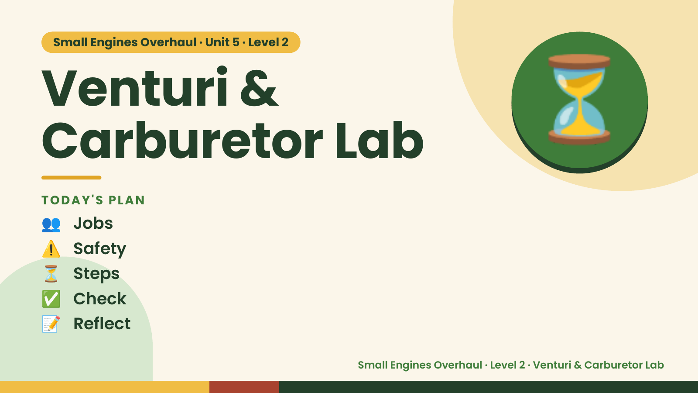
Notes:
Small Engines Overhaul · Unit 5 · Level 2
Venturi &
Carburetor Lab
👥 Jobs
TODAY'S PLAN
⏳
⚠️ Safety
⏳ Steps
✅ Check
📝 Reflect
Small Engines Overhaul · Level 2 · Venturi & Carburetor Lab

Slide 2

Notes:
Get ready
Jobs
🔧 Mechanic
Does the main engine job
with the tools
🧰 Tool helper
Gets tools from the board
and returns them to staff
📋 Recorder
Takes photos and fills in
the chart
🧽 Clean-up captain
Wipes the bench,
sweeps, checks tools are
back
Small Engines Overhaul · Level 2 · Venturi & Carburetor Lab

Slide 3
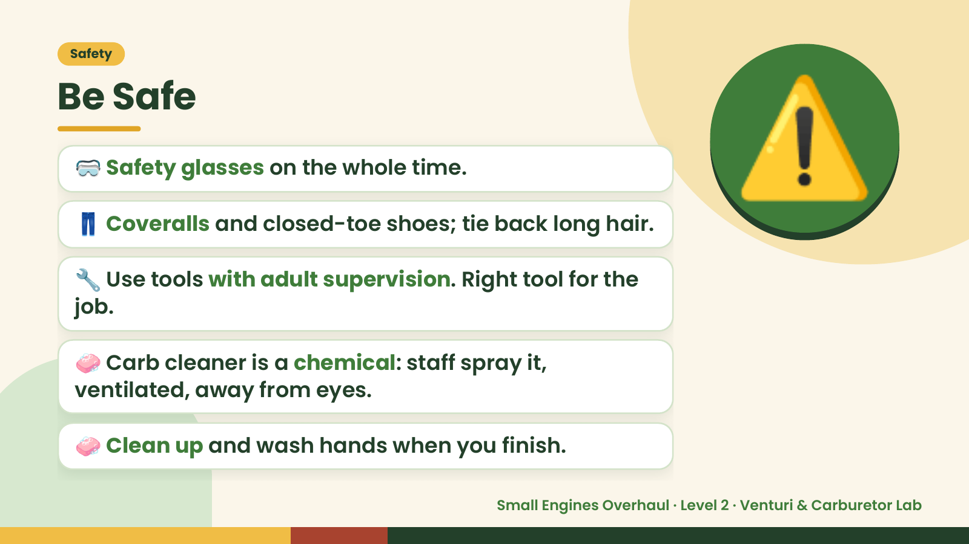
Notes:
Safety
Be Safe
🥽 Safety glasses on the whole time.
👖 Coveralls and closed-toe shoes; tie back long hair.
🔧 Use tools with adult supervision. Right tool for the
job.
⚠️
🧼 Carb cleaner is a chemical: staff spray it,
ventilated, away from eyes.
🧼 Clean up and wash hands when you finish.
Small Engines Overhaul · Level 2 · Venturi & Carburetor Lab

Slide 4
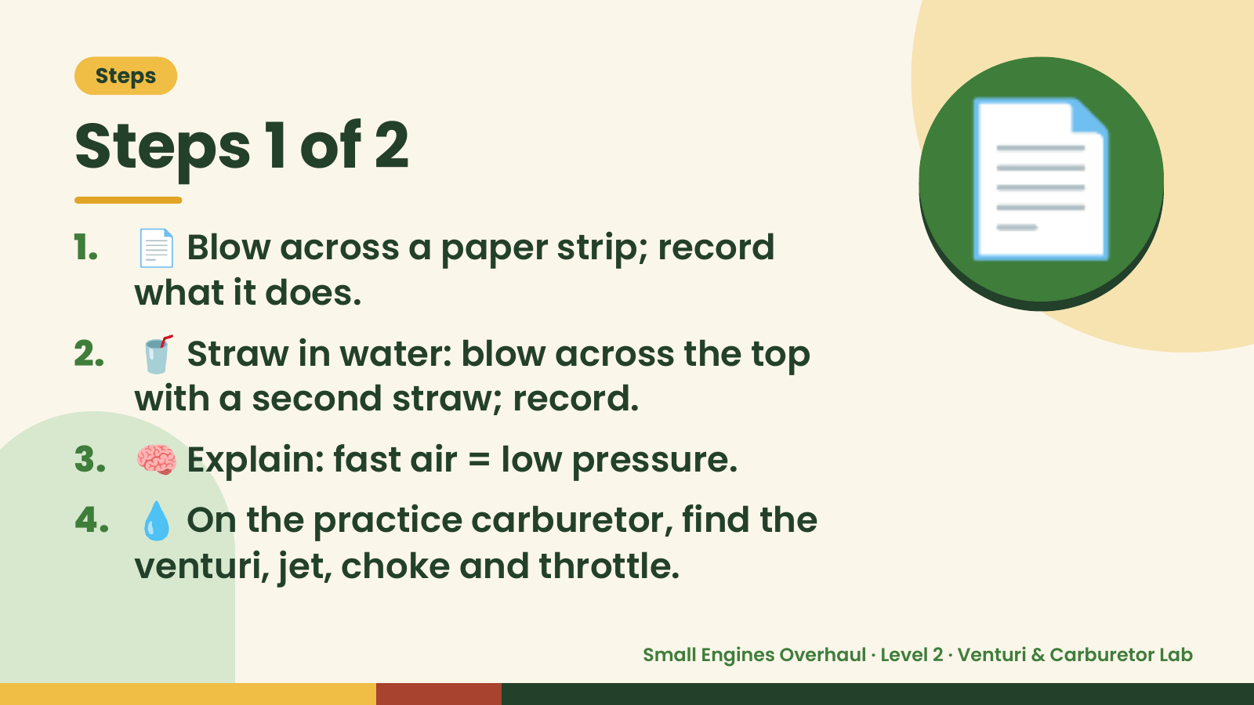
Notes:
Steps
Steps 1 of 2
1. 📄 Blow across a paper strip; record
what it does.
2. 🥤 Straw in water: blow across the top
with a second straw; record.
📄
3. 🧠 Explain: fast air = low pressure.
4. 💧 On the practice carburetor, find the
venturi, jet, choke and throttle.
Small Engines Overhaul · Level 2 · Venturi & Carburetor Lab

Slide 5
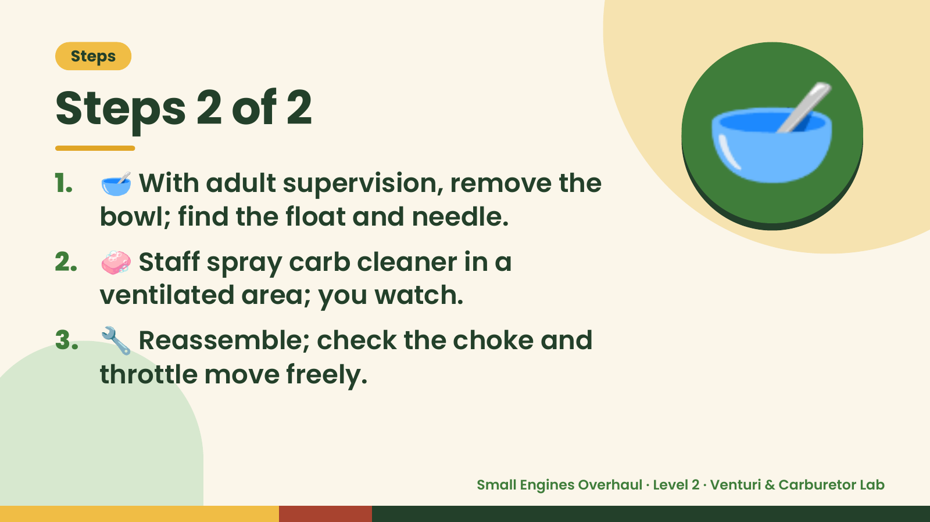
Notes:
Steps
Steps 2 of 2
1. 🥣 With adult supervision, remove the
bowl; find the float and needle.
2. 🧼 Staff spray carb cleaner in a
ventilated area; you watch.
🥣
3. 🔧 Reassemble; check the choke and
throttle move freely.
Small Engines Overhaul · Level 2 · Venturi & Carburetor Lab

Slide 6
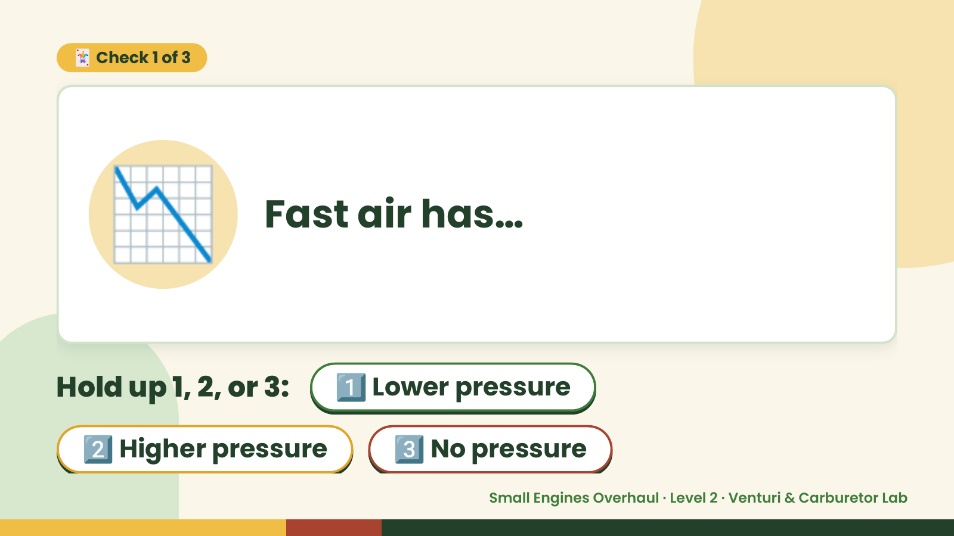
Notes:
🃏 Check 1 of 3
📉 Fast air has…
Hold up 1, 2, or 3: 1️⃣ Lower pressure
2️⃣ Higher pressure 3️⃣ No pressure
Small Engines Overhaul · Level 2 · Venturi & Carburetor Lab

Slide 7
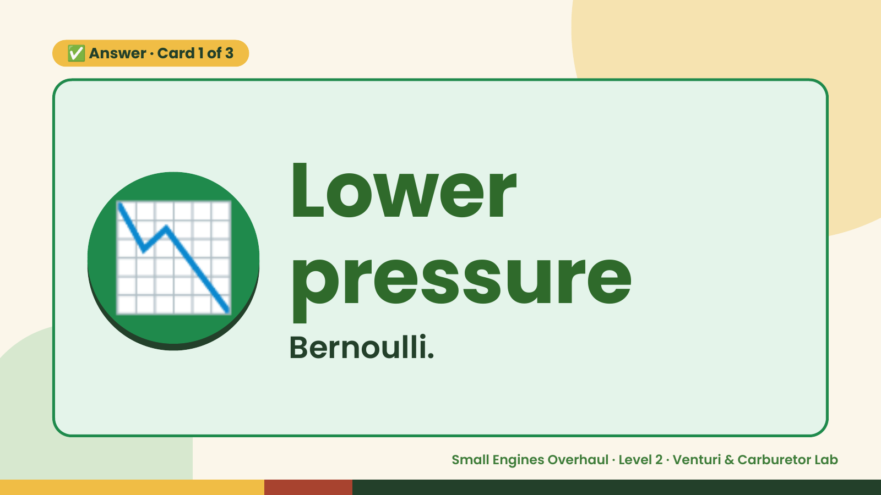
Notes:
✅ Answer · Card 1 of 3
📉 Lower
pressure
Bernoulli.
Small Engines Overhaul · Level 2 · Venturi & Carburetor Lab

Slide 8
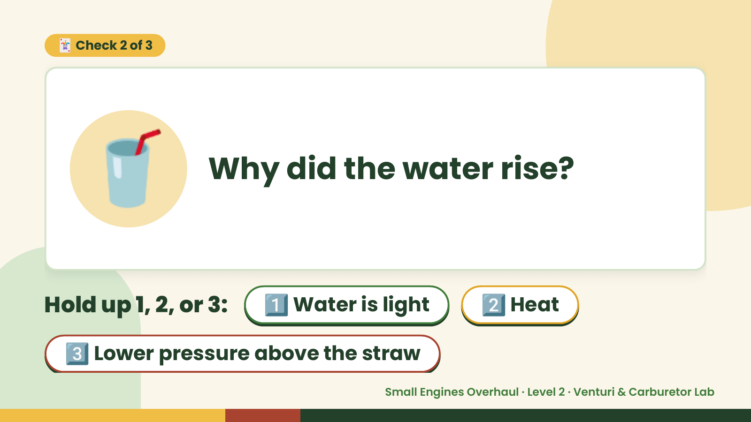
Notes:
🃏 Check 2 of 3
🥤 Why did the water rise?
Hold up 1, 2, or 3: 1️⃣ Water is light 2️⃣ Heat
3️⃣ Lower pressure above the straw
Small Engines Overhaul · Level 2 · Venturi & Carburetor Lab

Slide 9
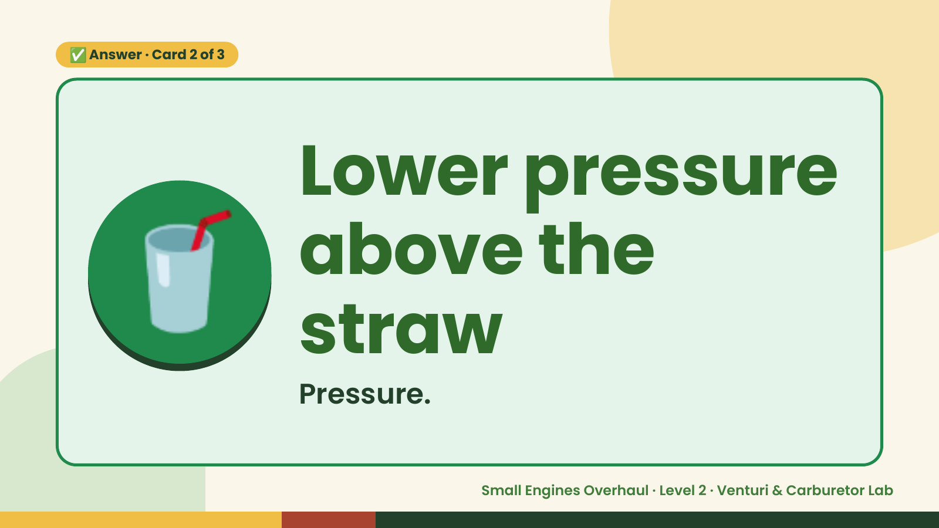
Notes:
✅ Answer · Card 2 of 3
🥤 Lower pressure
above the
straw
Pressure.
Small Engines Overhaul · Level 2 · Venturi & Carburetor Lab

Slide 10
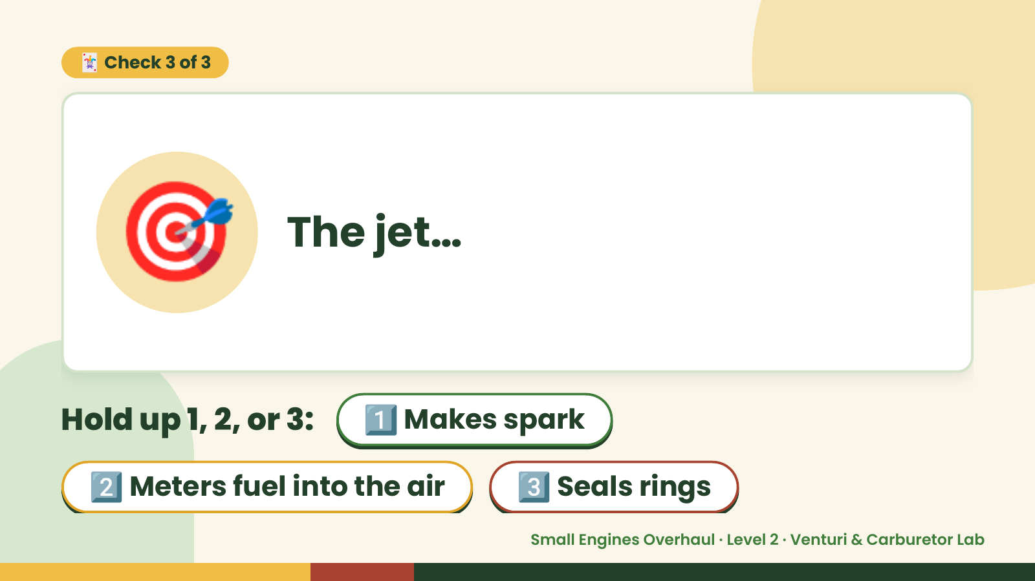
Notes:
🃏 Check 3 of 3
🎯 The jet…
Hold up 1, 2, or 3: 1️⃣ Makes spark
2️⃣ Meters fuel into the air 3️⃣ Seals rings
Small Engines Overhaul · Level 2 · Venturi & Carburetor Lab

Slide 11
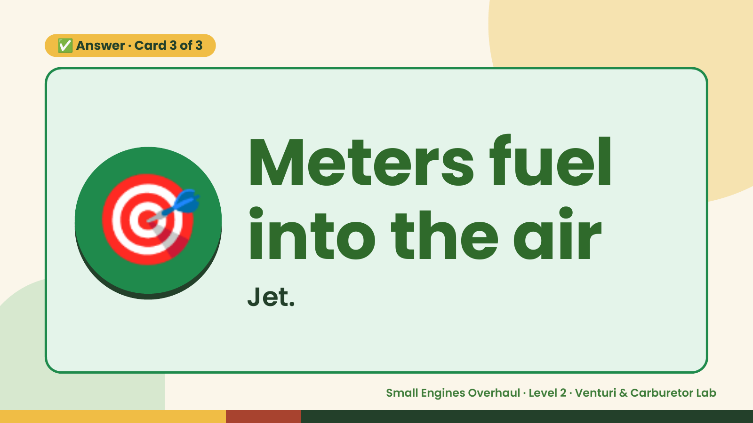
Notes:
✅ Answer · Card 3 of 3
🎯 Meters fuel
into the air
Jet.
Small Engines Overhaul · Level 2 · Venturi & Carburetor Lab

Slide 12
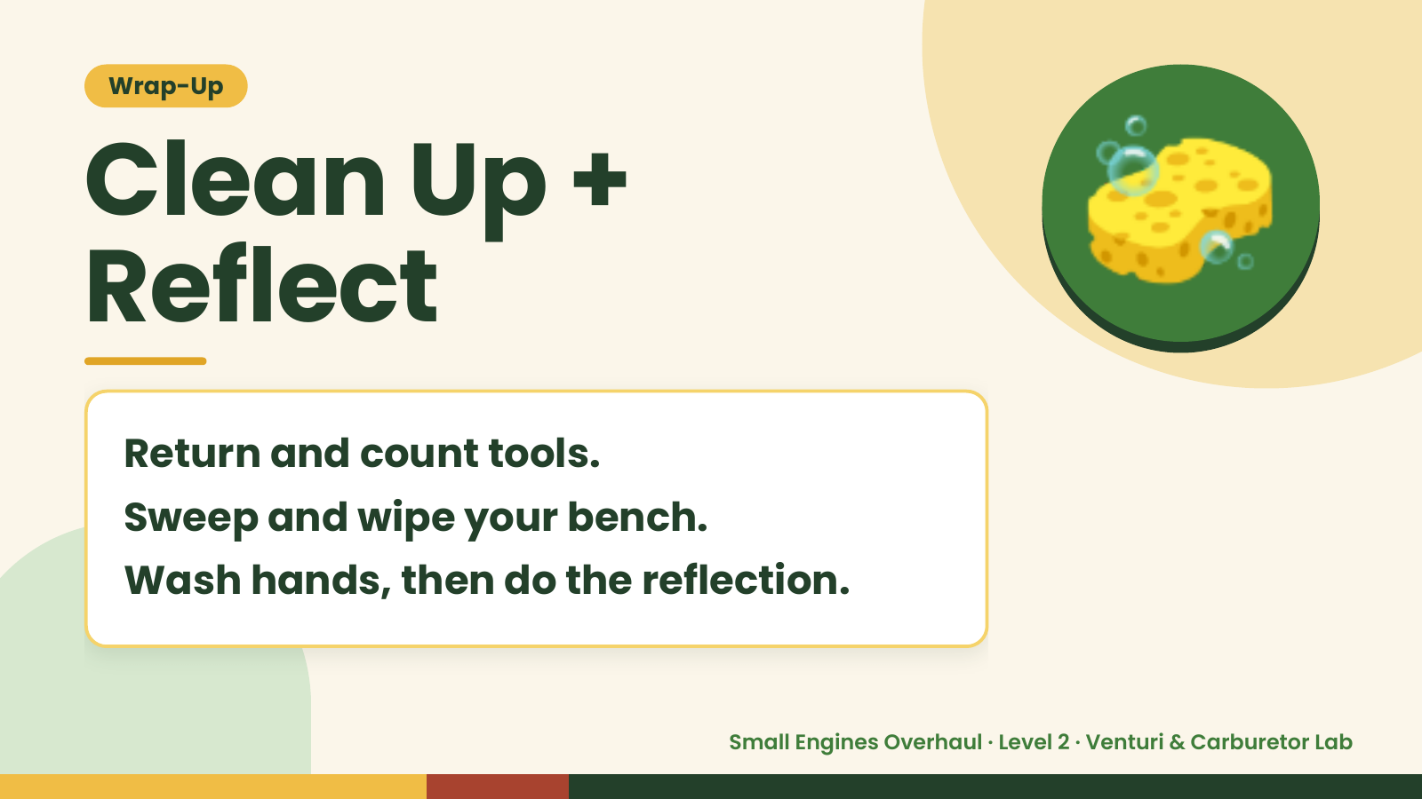
Notes:
Wrap-Up
Clean Up +
Reflect
🧽
Return and count tools.
Sweep and wipe your bench.
Wash hands, then do the reflection.
Small Engines Overhaul · Level 2 · Venturi & Carburetor Lab

