Slide 1

Notes:
Small Engines Overhaul · Unit 6 · Level 1
Spark Plug &
Spark Check
TODAY'S PLAN
⚡
👥 Jobs
⚠️ Safety
⚡ Steps
✅ Check
📝 Reflect
Small Engines Overhaul · Level 1 · Spark Plug & Spark Check

Slide 2

Notes:
Get ready
Jobs
🔧 Mechanic
fixes 🧰 Tool helper
gets tools
📋 Recorder
writes 🧽 Clean-up
captain
cleans
Small Engines Overhaul · Level 1 · Spark Plug & Spark Check

Slide 3
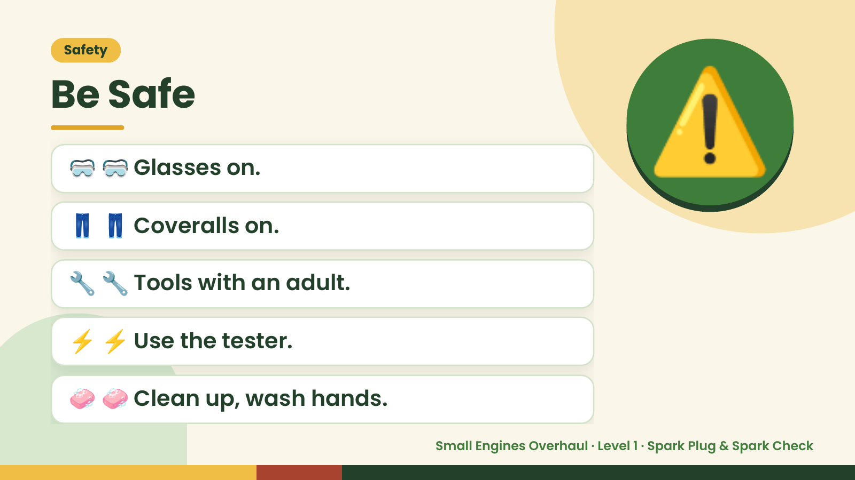
Notes:
Safety
Be Safe
🥽 🥽 Glasses on.
👖 👖 Coveralls on.
⚠️
🔧 🔧 Tools with an adult.
⚡ ⚡ Use the tester.
🧼 🧼 Clean up, wash hands.
Small Engines Overhaul · Level 1 · Spark Plug & Spark Check

Slide 4
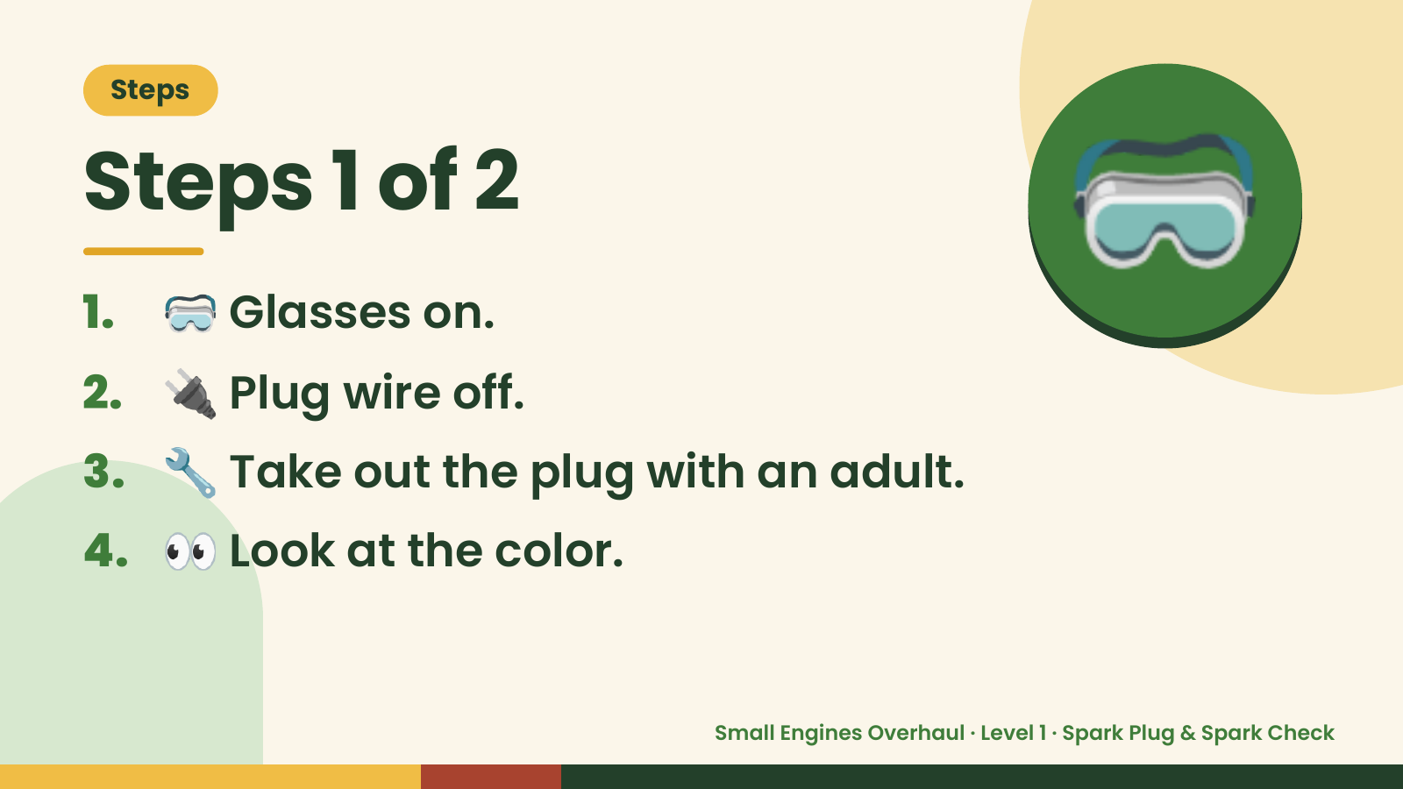
Notes:
Steps
Steps 1 of 2
1. 🥽 Glasses on.
2. 🔌 Plug wire off.
🥽
3. 🔧 Take out the plug with an adult.
4. 👀 Look at the color.
Small Engines Overhaul · Level 1 · Spark Plug & Spark Check

Slide 5
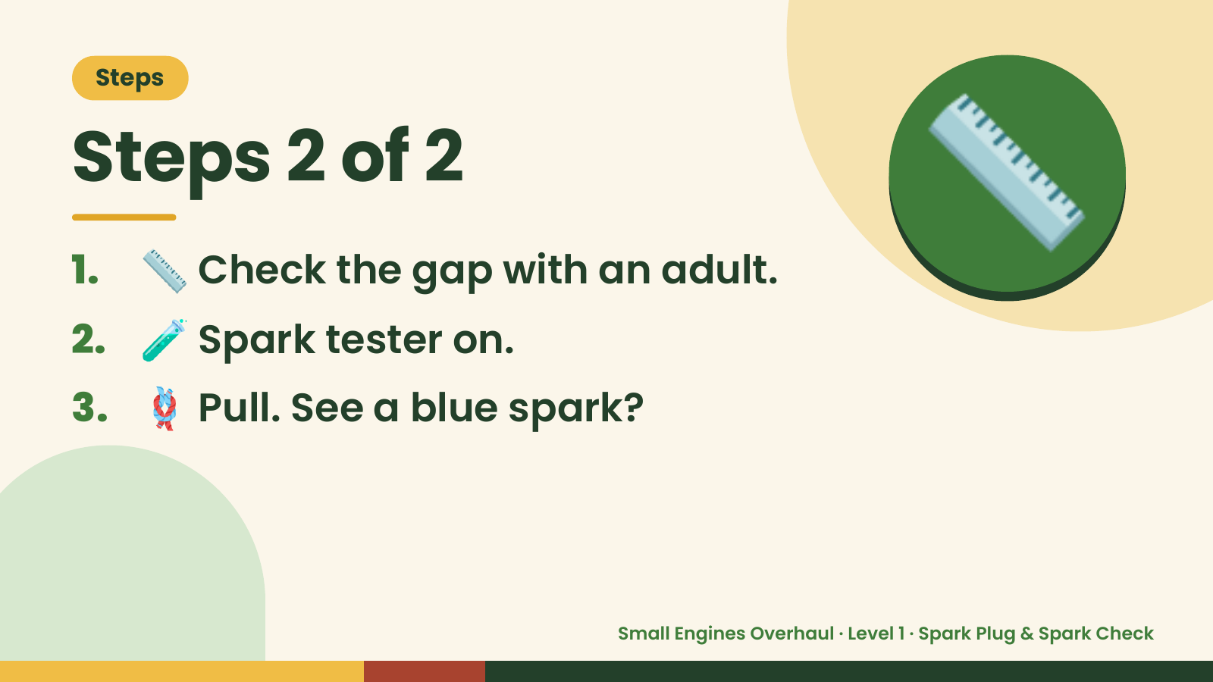
Notes:
Steps
Steps 2 of 2
1. 📏 Check the gap with an adult.
2. 🧪 Spark tester on.
📏
3. 🪢 Pull. See a blue spark?
Small Engines Overhaul · Level 1 · Spark Plug & Spark Check

Slide 6
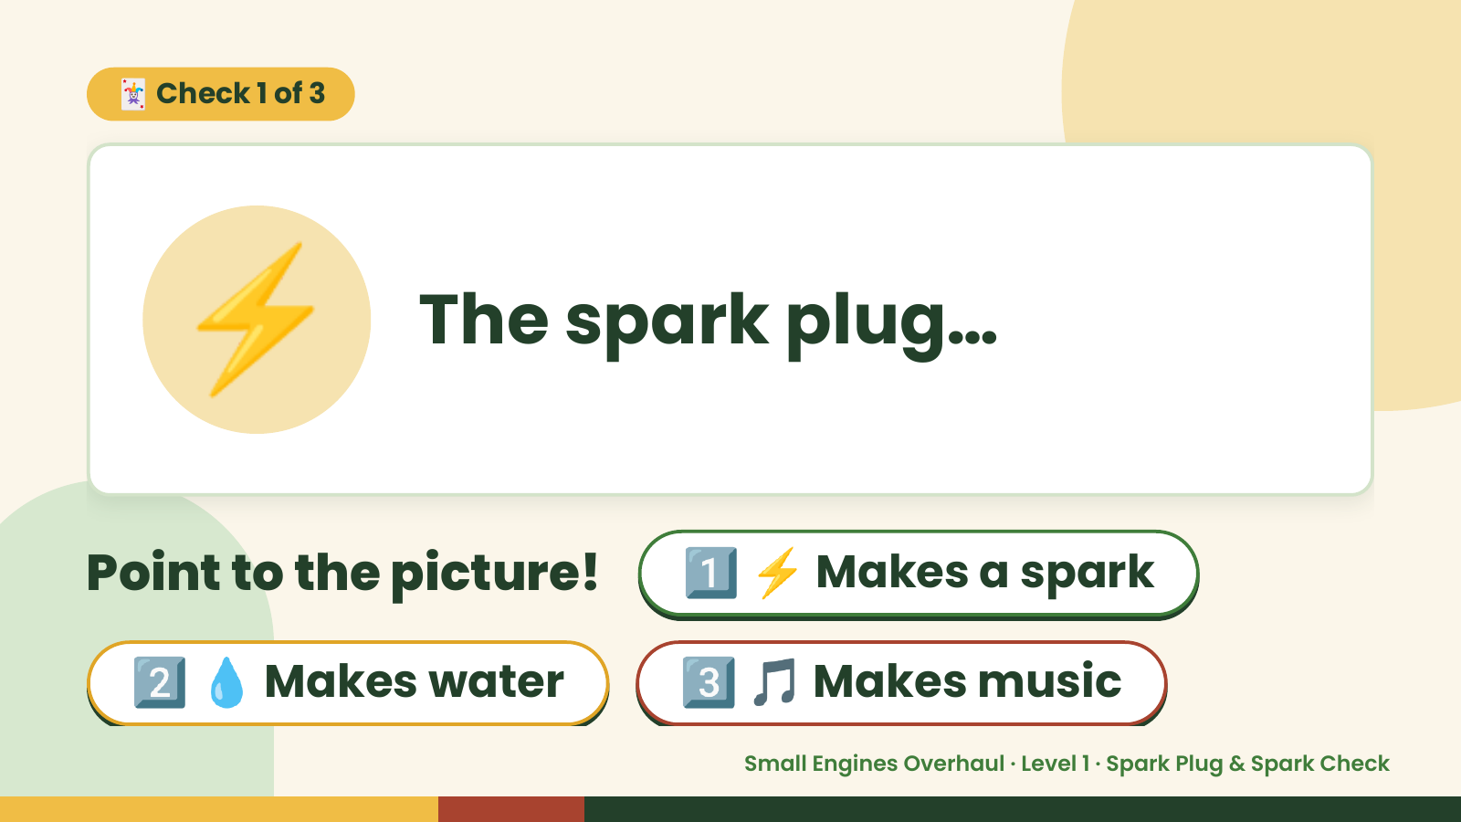
Notes:
🃏 Check 1 of 3
⚡ The spark plug…
Point to the picture! 1️⃣ ⚡ Makes a spark
2️⃣ 💧 Makes water 3️⃣ 🎵 Makes music
Small Engines Overhaul · Level 1 · Spark Plug & Spark Check

Slide 7
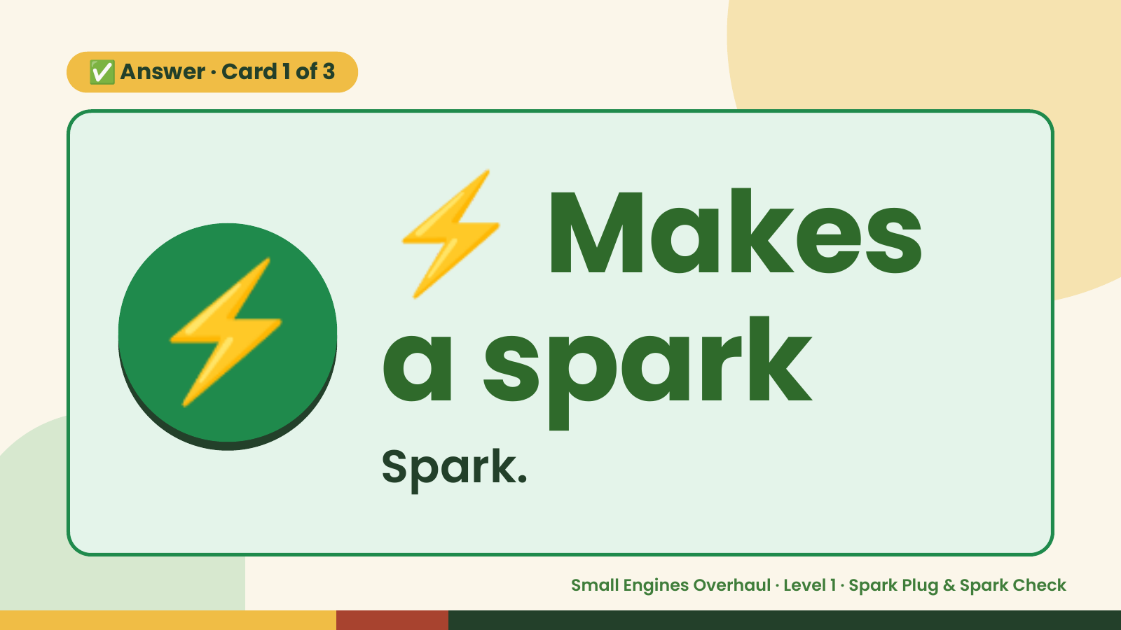
Notes:
⚡
✅ Answer · Card 1 of 3
⚡ a spark
Makes
Spark.
Small Engines Overhaul · Level 1 · Spark Plug & Spark Check

Slide 8
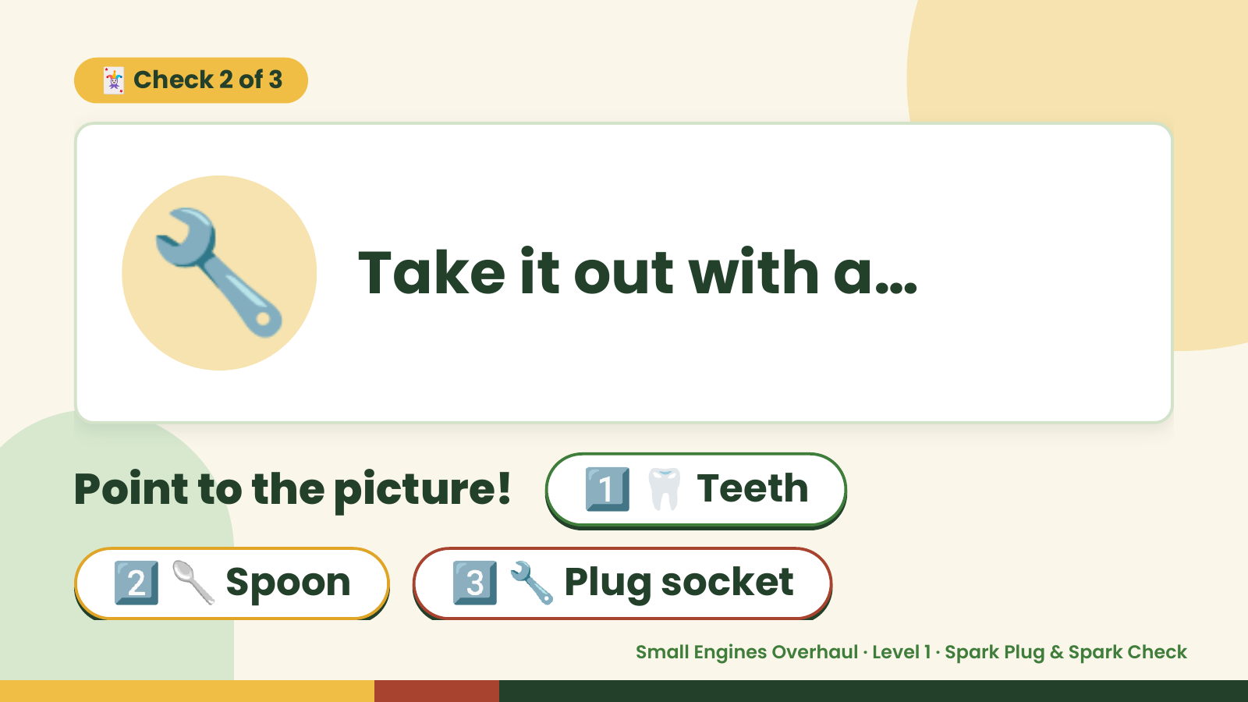
Notes:
🃏 Check 2 of 3
🔧 Take it out with a…
Point to the picture! 1️⃣ 🦷 Teeth
2️⃣ 🥄 Spoon 3️⃣ 🔧 Plug socket
Small Engines Overhaul · Level 1 · Spark Plug & Spark Check

Slide 9
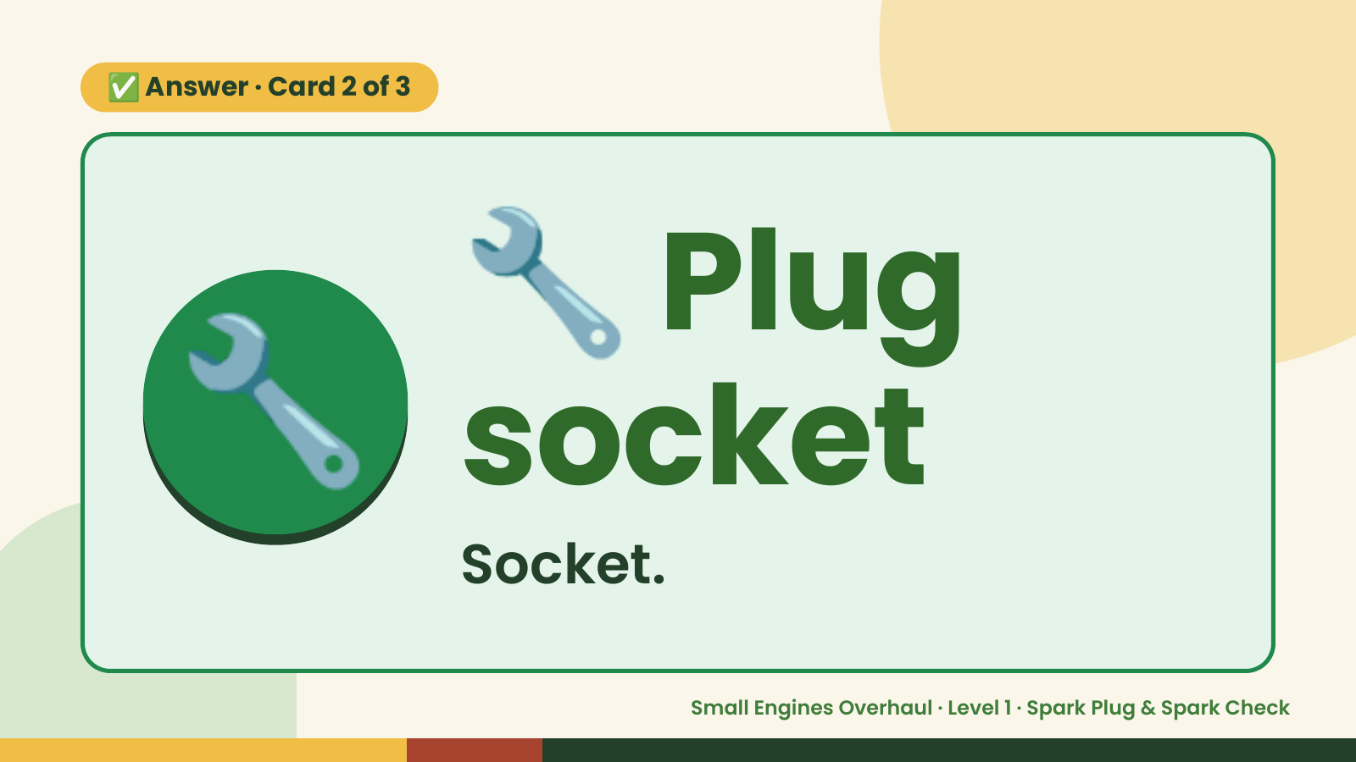
Notes:
🔧
✅ Answer · Card 2 of 3
🔧 socket
Plug
Socket.
Small Engines Overhaul · Level 1 · Spark Plug & Spark Check

Slide 10
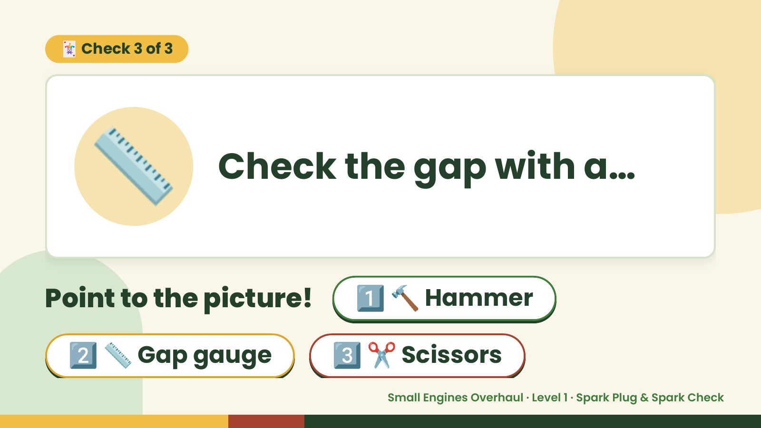
Notes:
🃏 Check 3 of 3
📏 Check the gap with a…
Point to the picture! 1️⃣ 🔨 Hammer
2️⃣ 📏 Gap gauge 3️⃣ ✂️ Scissors
Small Engines Overhaul · Level 1 · Spark Plug & Spark Check

Slide 11
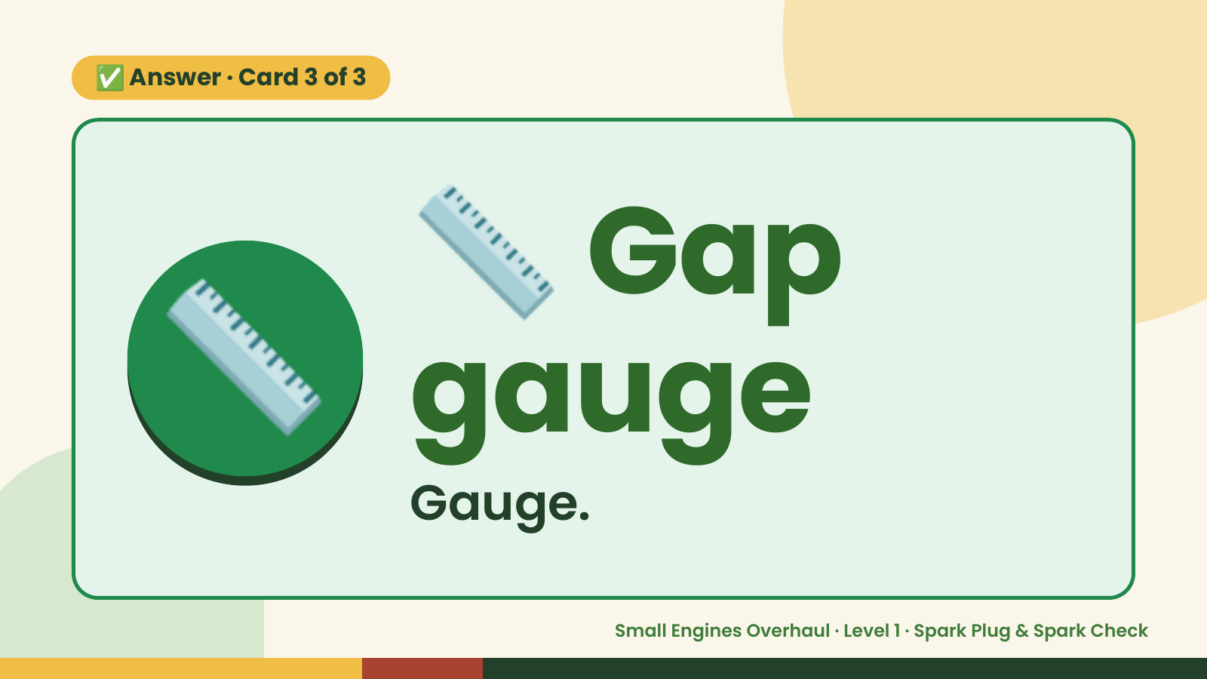
Notes:
📏
✅ Answer · Card 3 of 3
📏 gauge
Gap
Gauge.
Small Engines Overhaul · Level 1 · Spark Plug & Spark Check

Slide 12

Notes:
Wrap-Up
Clean Up +
Reflect
🧽
🧽 Wipe the bench.
🧰 Give tools back.
🧼 Wash hands.
Small Engines Overhaul · Level 1 · Spark Plug & Spark Check

