Slide 1
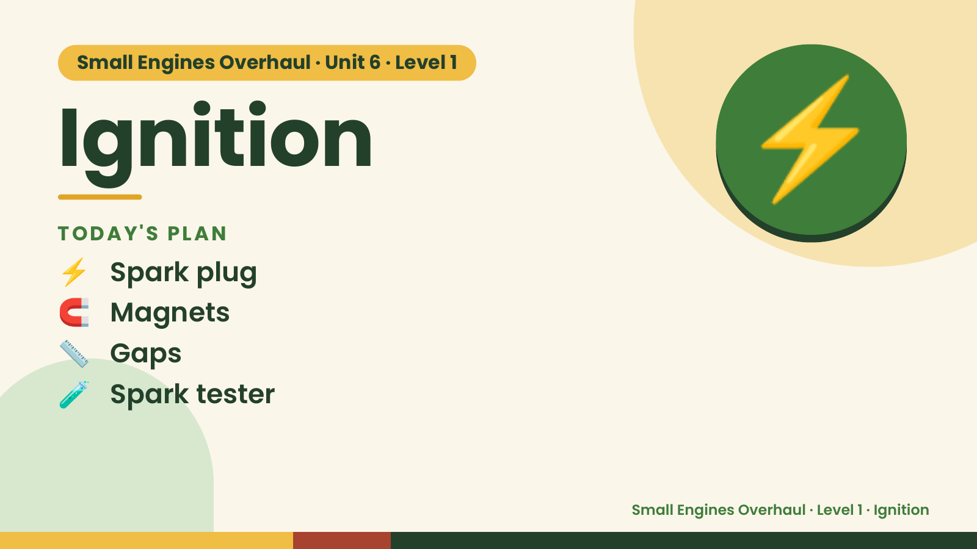
Notes:
Small Engines Overhaul · Unit 6 · Level 1
Ignition
TODAY'S PLAN
⚡ Spark plug
⚡
🧲 Magnets
📏 Gaps
🧪 Spark tester
Small Engines Overhaul · Level 1 · Ignition

Slide 2
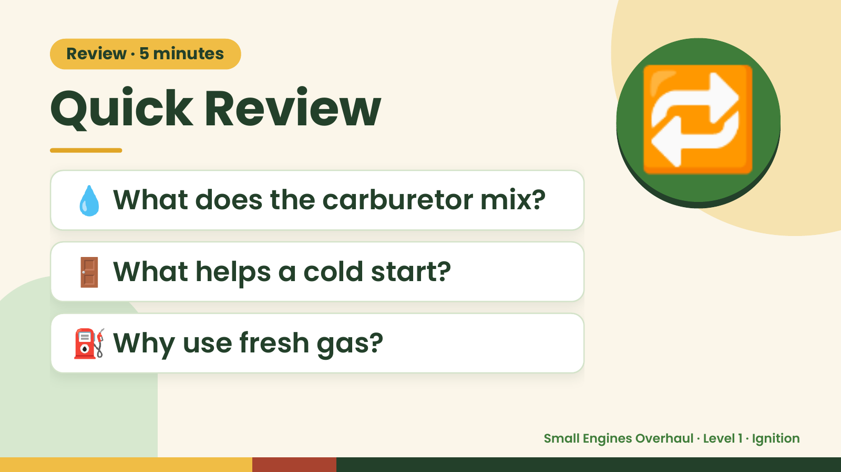
Notes:
Review · 5 minutes
Quick Review
💧 What does the carburetor mix?
🔁
🚪 What helps a cold start?
⛽ Why use fresh gas?
Small Engines Overhaul · Level 1 · Ignition

Slide 3
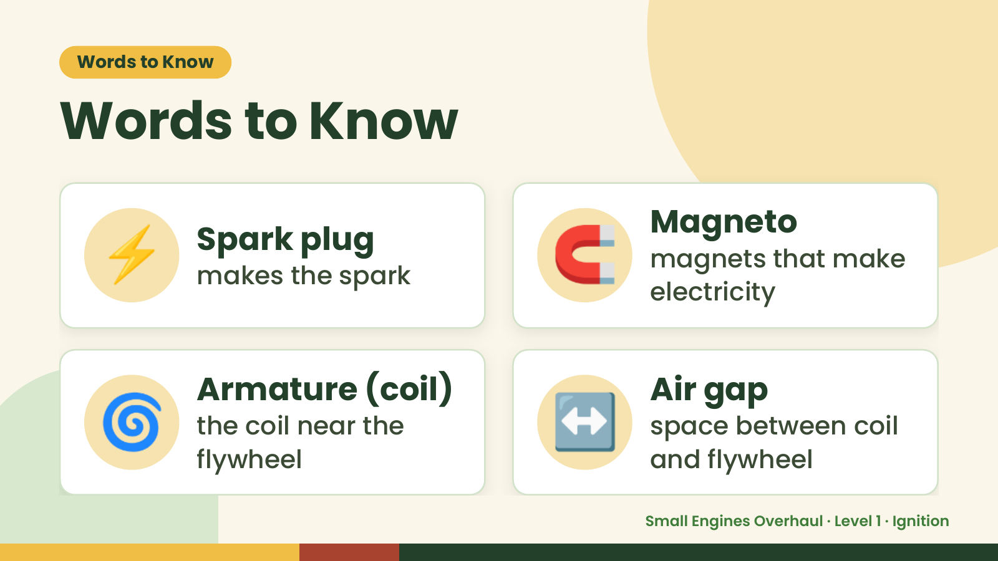
Notes:
Words to Know
Words to Know
⚡ Spark plug
makes the spark 🧲 Magneto
magnets that make
electricity
🌀 Armature (coil)
the coil near the
flywheel
↔️ Air gap
space between coil
and flywheel
Small Engines Overhaul · Level 1 · Ignition

Slide 4
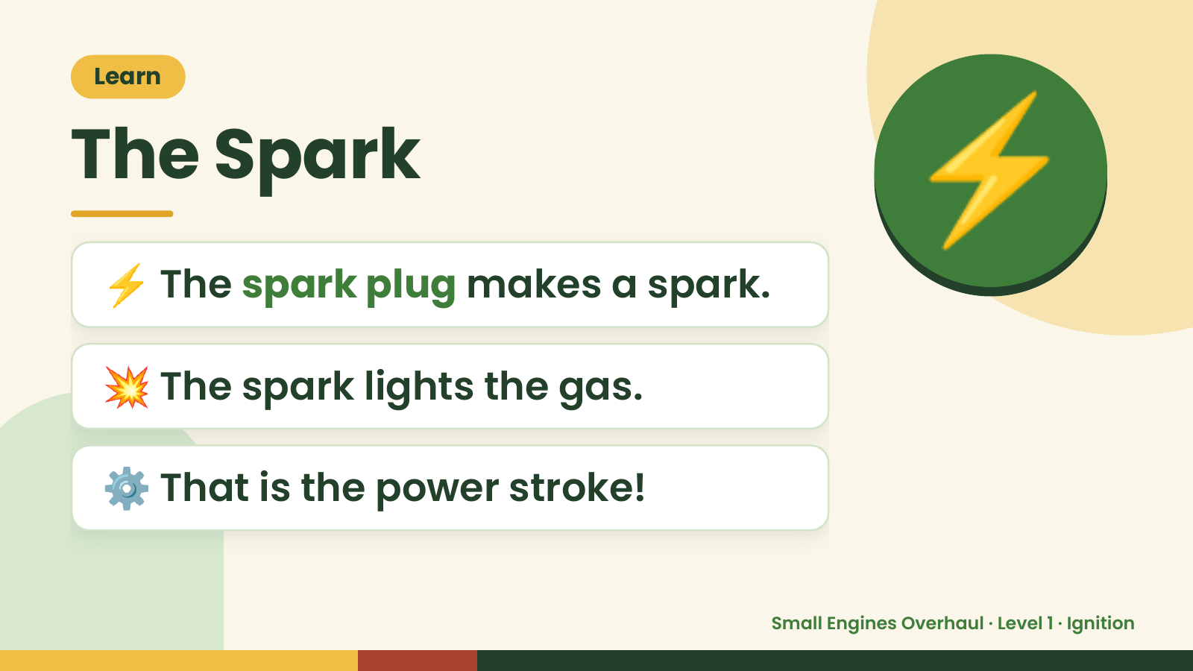
Notes:
Learn
The Spark
⚡ The spark plug makes a spark.
⚡
💥 The spark lights the gas.
⚙️ That is the power stroke!
Small Engines Overhaul · Level 1 · Ignition

Slide 5
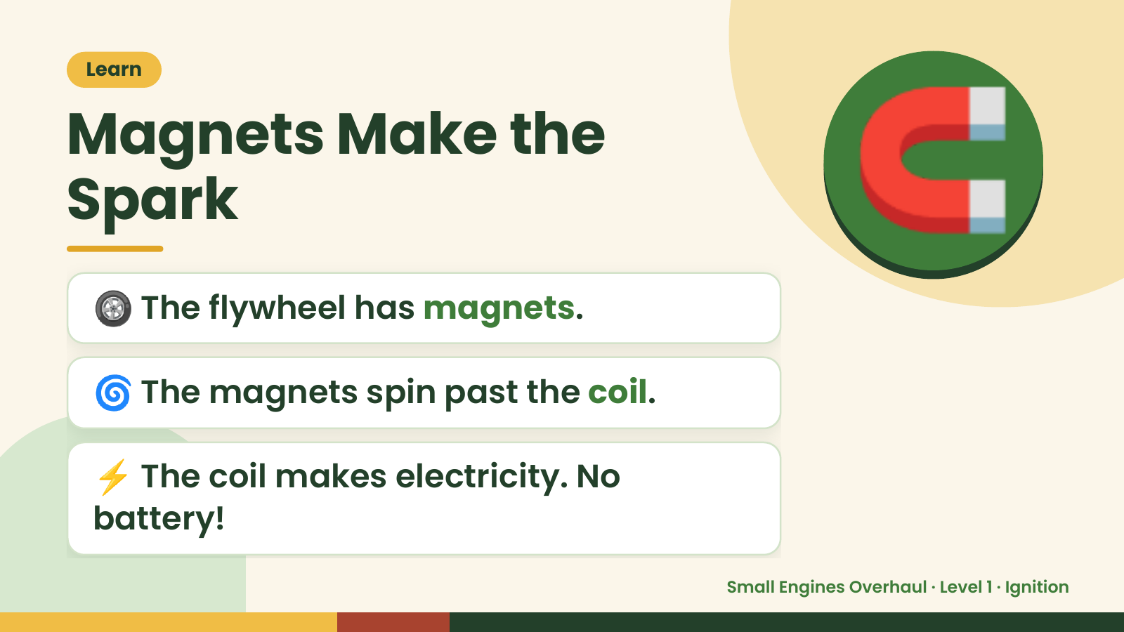
Notes:
Learn
Magnets Make the
Spark
🛞 The flywheel has magnets.
🧲
🌀 The magnets spin past the coil.
⚡ The coil makes electricity. No
battery!
Small Engines Overhaul · Level 1 · Ignition

Slide 6
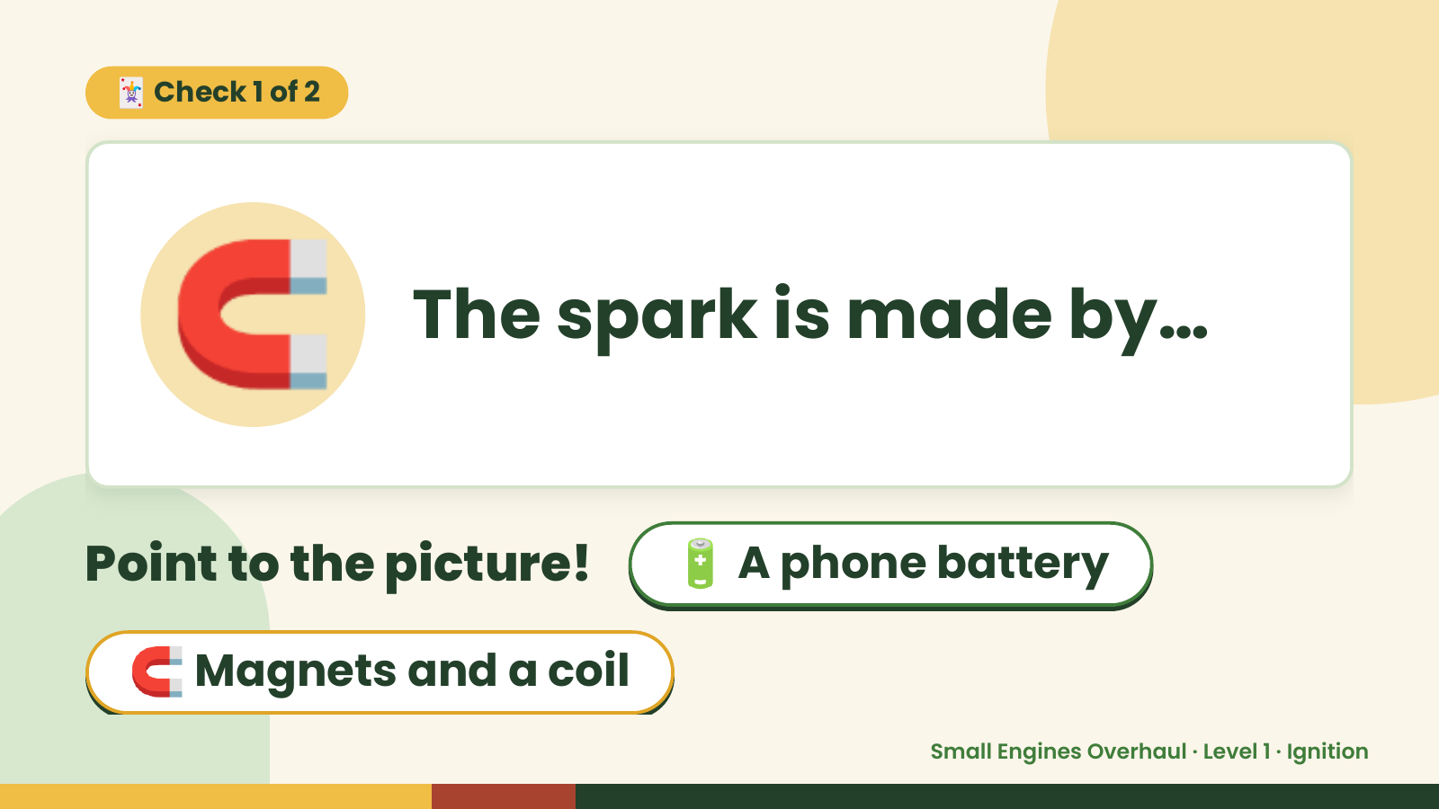
Notes:
🃏 Check 1 of 2
🧲 The spark is made by…
Point to the picture! 🔋 A phone battery
🧲 Magnets and a coil
Small Engines Overhaul · Level 1 · Ignition

Slide 7
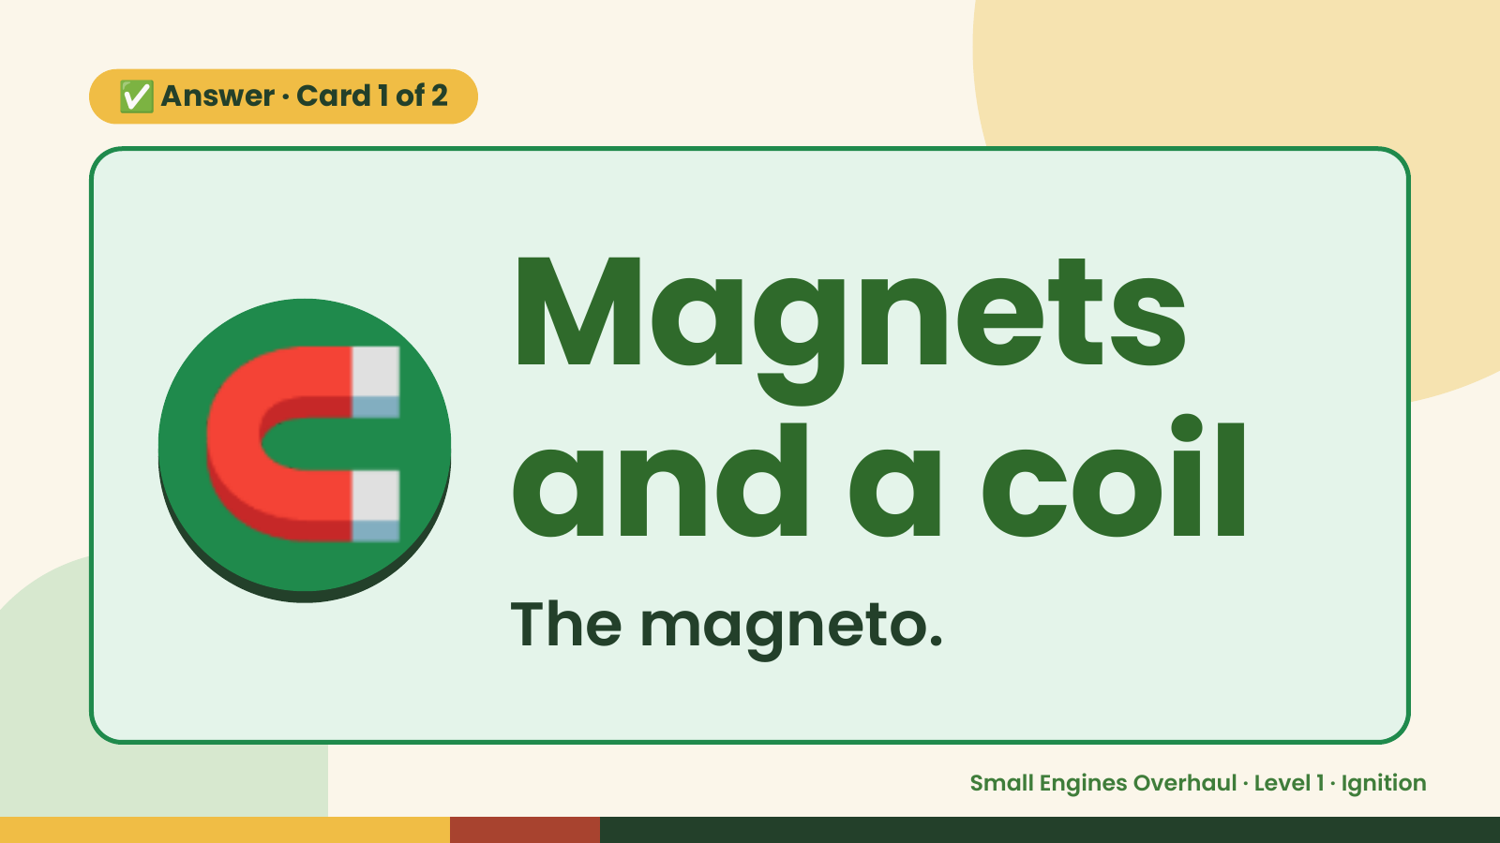
Notes:
✅ Answer · Card 1 of 2
🧲 Magnets
and a coil
The magneto.
Small Engines Overhaul · Level 1 · Ignition

Slide 8
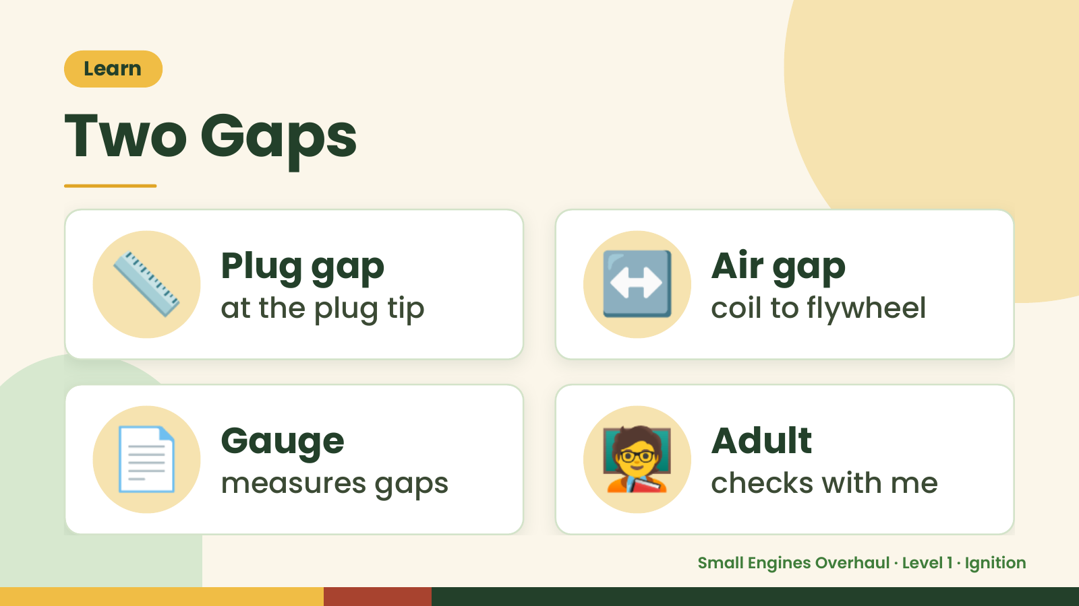
Notes:
Learn
Two Gaps
📏 Plug gap
at the plug tip ↔️ Air gap
coil to flywheel
📄 Gauge
measures gaps 🧑‍🏫 Adult
checks with me
Small Engines Overhaul · Level 1 · Ignition

Slide 9
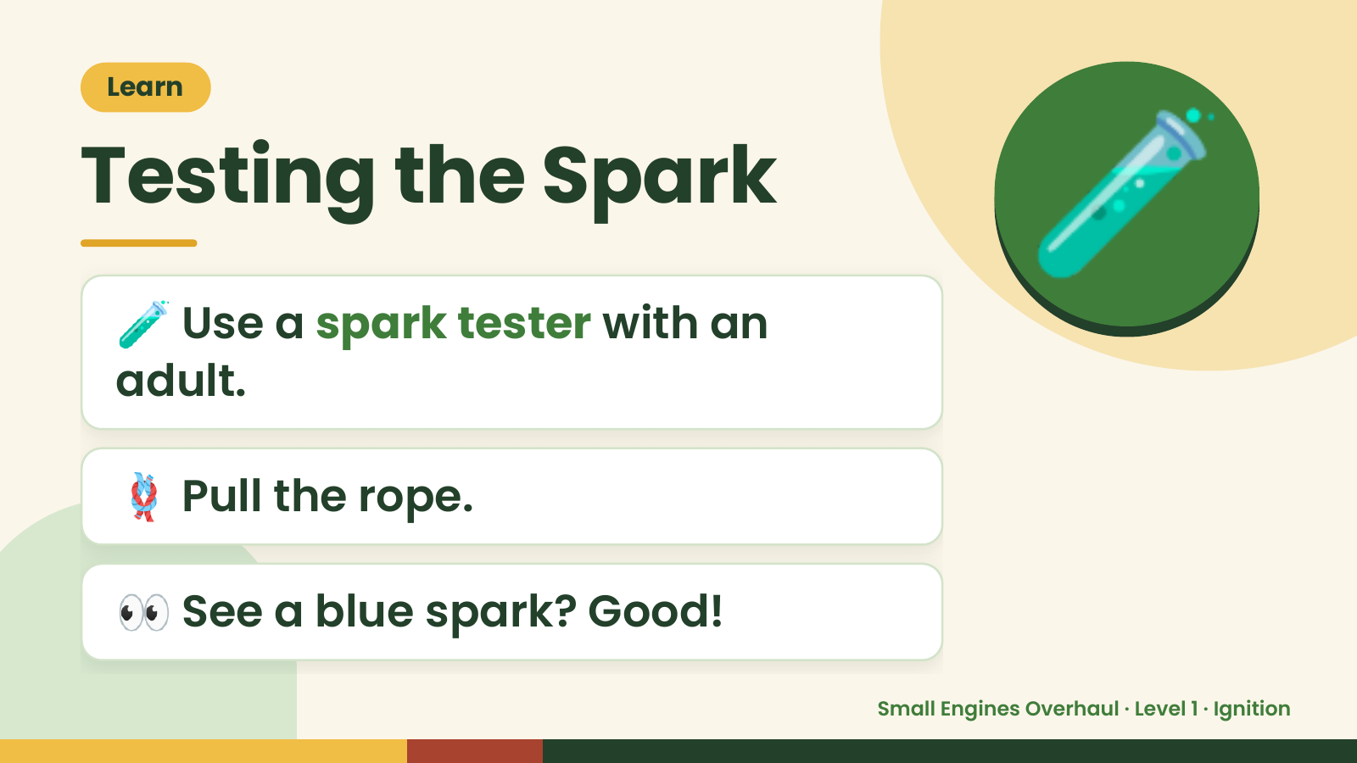
Notes:
Learn
Testing the Spark
🧪 Use a spark tester with an
adult.
🧪
🪢 Pull the rope.
👀 See a blue spark? Good!
Small Engines Overhaul · Level 1 · Ignition

Slide 10
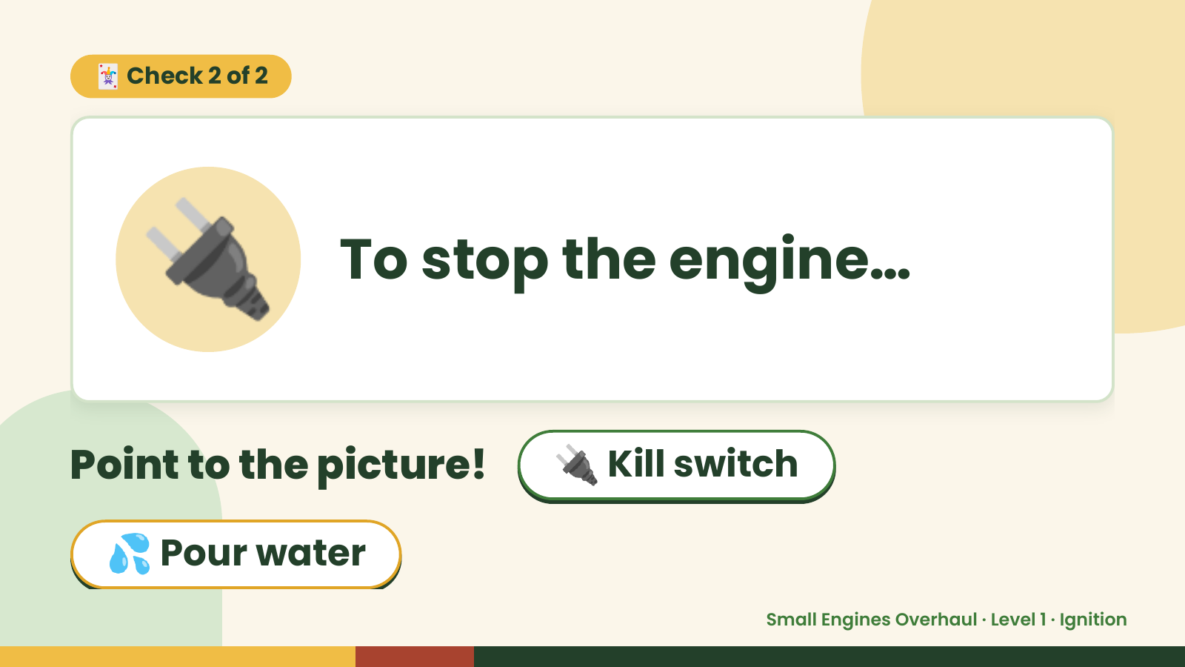
Notes:
🃏 Check 2 of 2
🔌 To stop the engine…
Point to the picture! 🔌 Kill switch
💦 Pour water
Small Engines Overhaul · Level 1 · Ignition

Slide 11
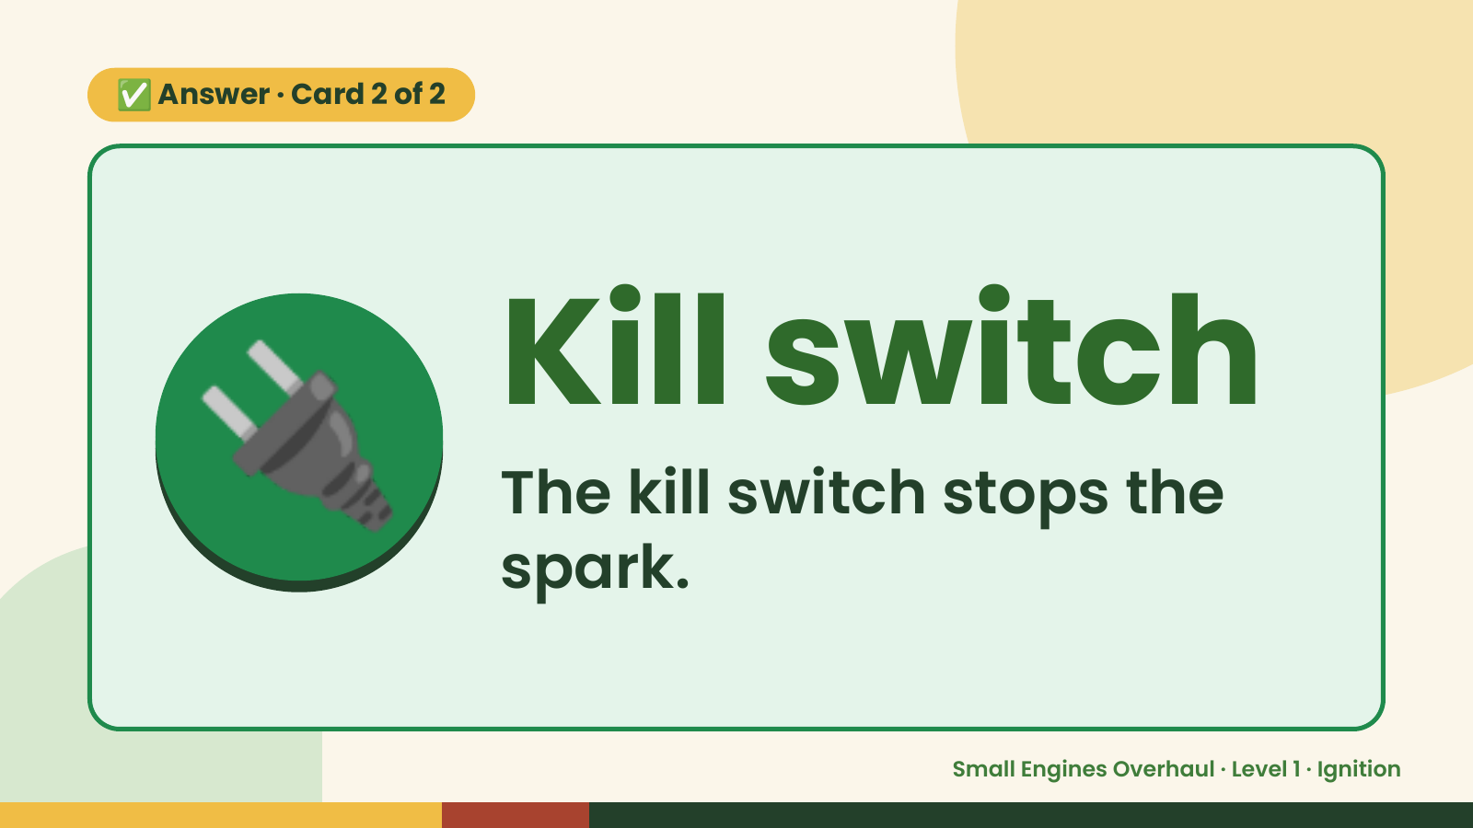
Notes:
✅ Answer · Card 2 of 2
🔌 Kill switch
The kill switch stops the
spark.
Small Engines Overhaul · Level 1 · Ignition

Slide 12
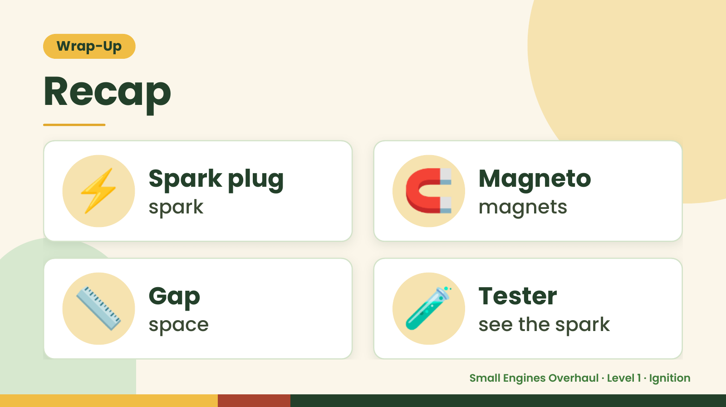
Notes:
Wrap-Up
Recap
⚡ Spark plug
spark 🧲 Magneto
magnets
📏 Gap
space 🧪 Tester
see the spark
Small Engines Overhaul · Level 1 · Ignition

Slide 13
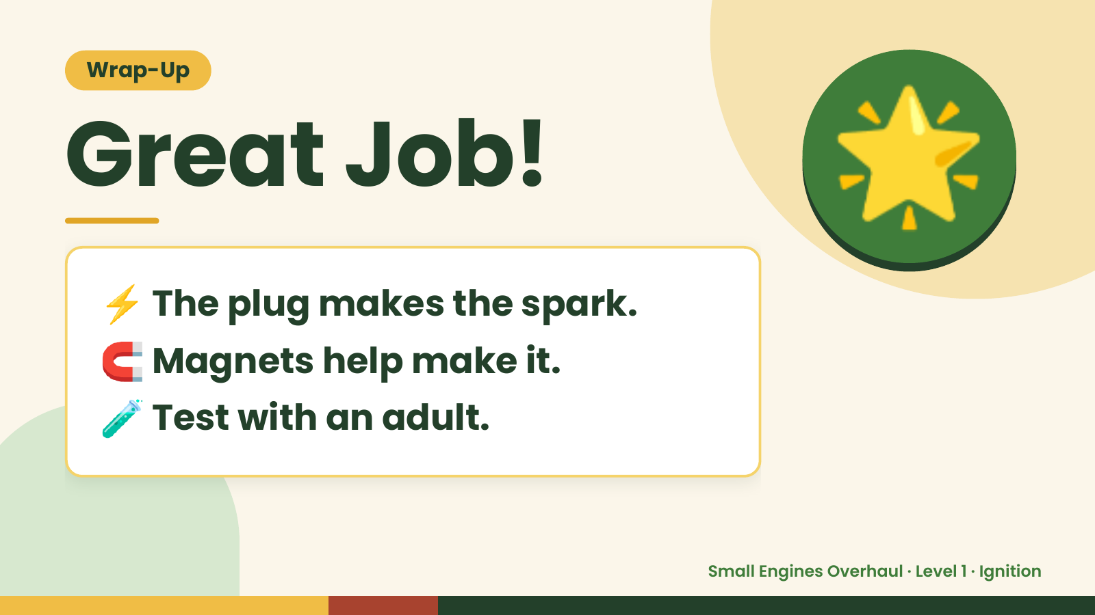
Notes:
Wrap-Up
Great Job!
⚡ The plug makes the spark.
🌟
🧲 Magnets help make it.
🧪 Test with an adult.
Small Engines Overhaul · Level 1 · Ignition

