Slide 1

Notes:
Small Engines Overhaul · Unit 6 · Level 2
Spark Plug &
Spark Check
👥 Jobs
TODAY'S PLAN
⚡
⚠️ Safety
⚡ Steps
✅ Check
📝 Reflect
Small Engines Overhaul · Level 2 · Spark Plug & Spark Check

Slide 2

Notes:
Get ready
Jobs
🔧 Mechanic
Does the main engine job
with the tools
🧰 Tool helper
Gets tools from the board
and returns them to staff
📋 Recorder
Takes photos and fills in
the chart
🧽 Clean-up captain
Wipes the bench,
sweeps, checks tools are
back
Small Engines Overhaul · Level 2 · Spark Plug & Spark Check

Slide 3
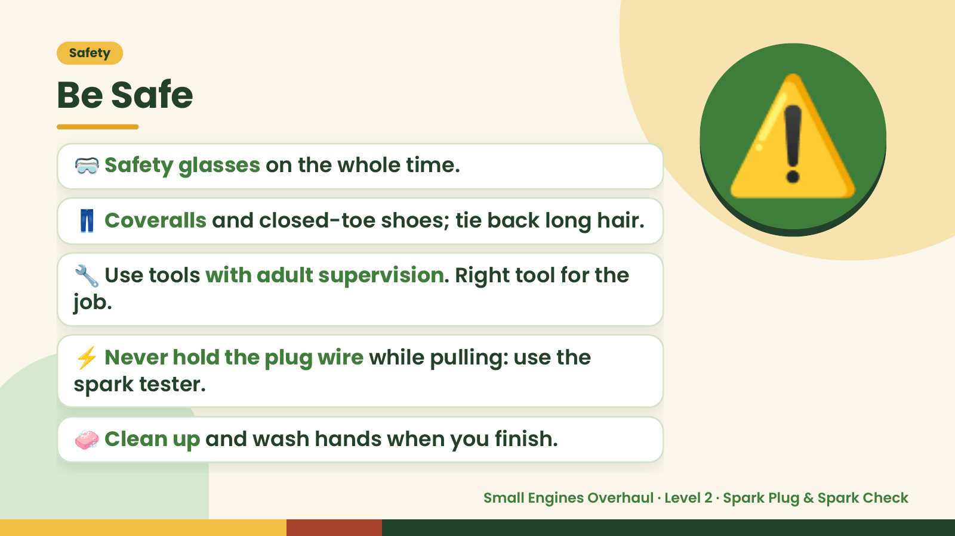
Notes:
Safety
Be Safe
🥽 Safety glasses on the whole time.
👖 Coveralls and closed-toe shoes; tie back long hair.
🔧 Use tools with adult supervision. Right tool for the
job.
⚠️
⚡ Never hold the plug wire while pulling: use the
spark tester.
🧼 Clean up and wash hands when you finish.
Small Engines Overhaul · Level 2 · Spark Plug & Spark Check

Slide 4
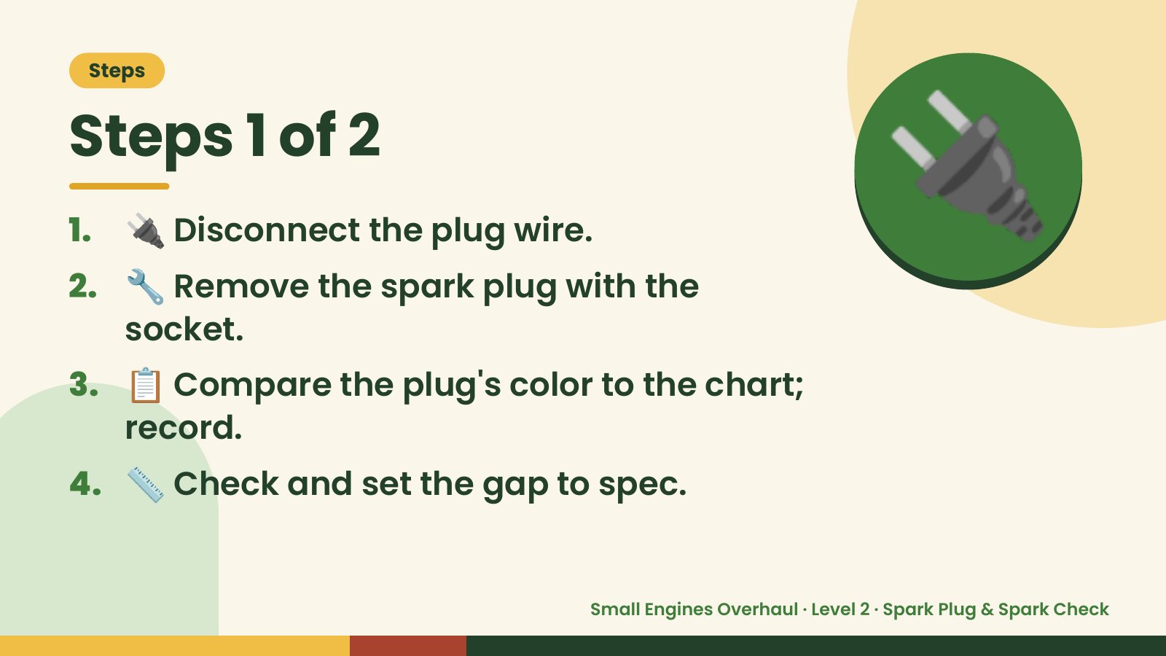
Notes:
Steps
Steps 1 of 2
1. 🔌 Disconnect the plug wire.
2. 🔧 Remove the spark plug with the
socket.
🔌
3. 📋 Compare the plug's color to the chart;
record.
4. 📏 Check and set the gap to spec.
Small Engines Overhaul · Level 2 · Spark Plug & Spark Check

Slide 5
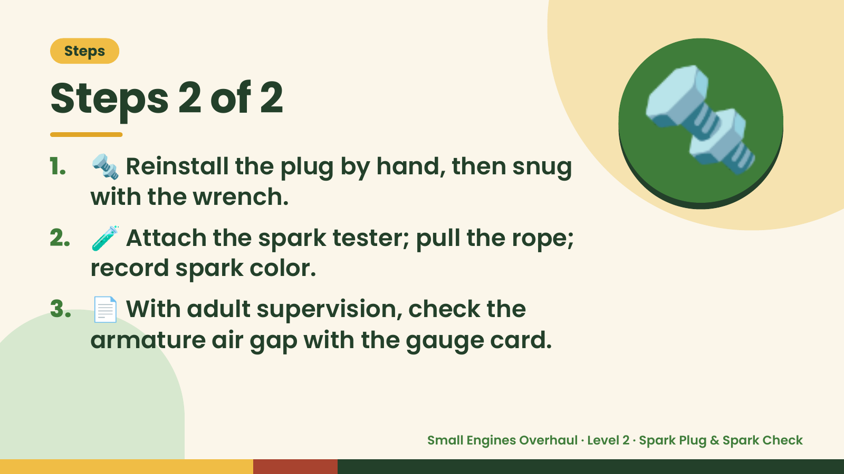
Notes:
Steps
Steps 2 of 2
1. 🔩 Reinstall the plug by hand, then snug
with the wrench.
2. 🧪 Attach the spark tester; pull the rope;
record spark color.
🔩
3. 📄 With adult supervision, check the
armature air gap with the gauge card.
Small Engines Overhaul · Level 2 · Spark Plug & Spark Check

Slide 6
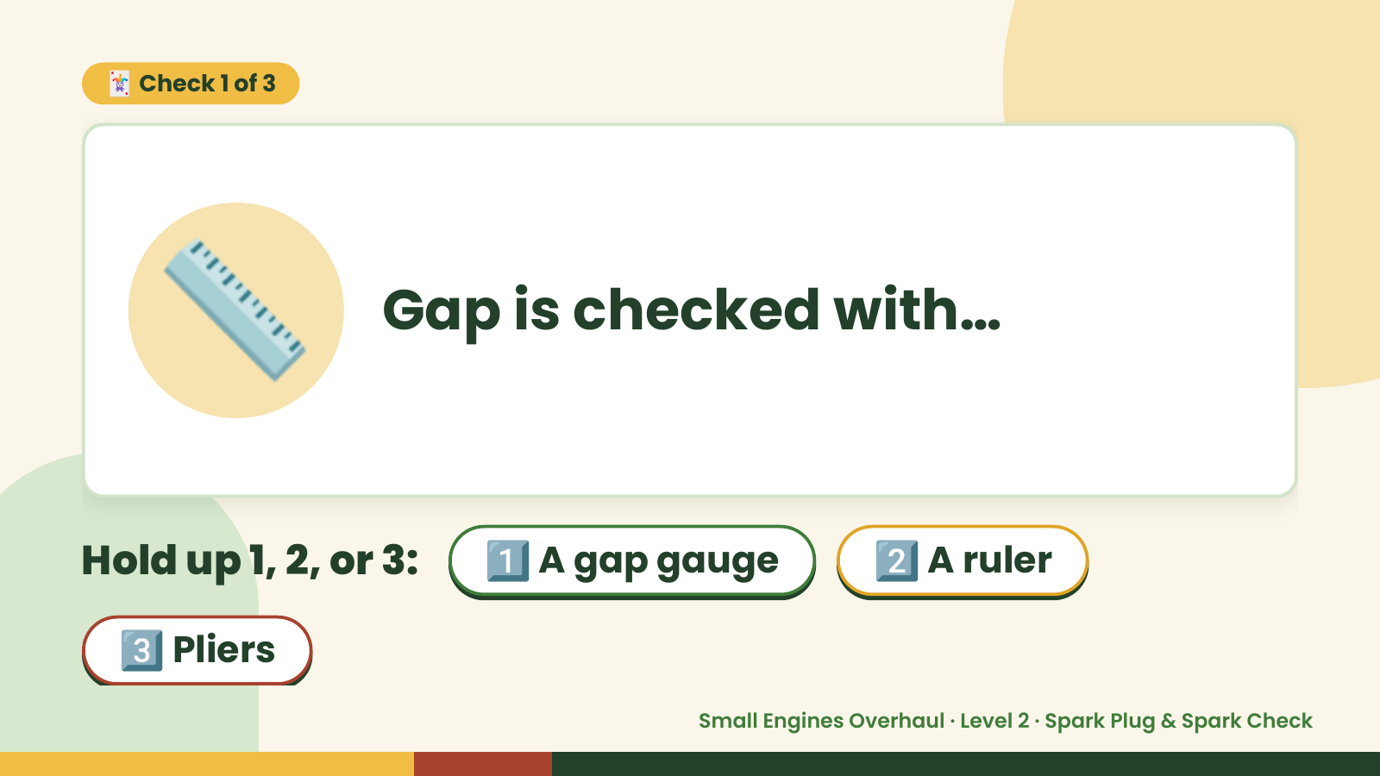
Notes:
🃏 Check 1 of 3
📏 Gap is checked with…
Hold up 1, 2, or 3: 1️⃣ A gap gauge 2️⃣ A ruler
3️⃣ Pliers
Small Engines Overhaul · Level 2 · Spark Plug & Spark Check

Slide 7

Notes:
✅ Answer · Card 1 of 3
📏 A gap gauge
Gauge.
Small Engines Overhaul · Level 2 · Spark Plug & Spark Check

Slide 8
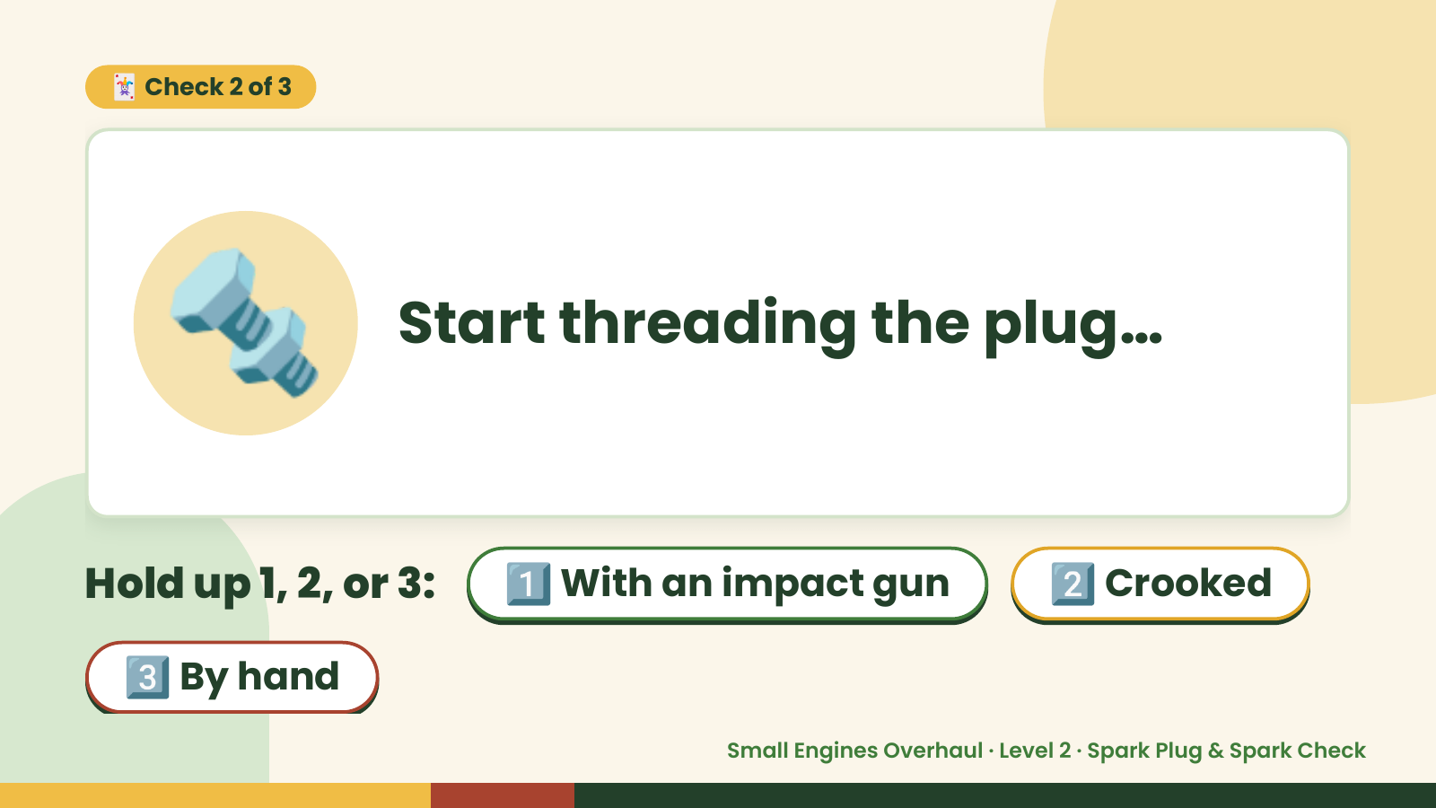
Notes:
🃏 Check 2 of 3
🔩 Start threading the plug…
Hold up 1, 2, or 3: 1️⃣ With an impact gun 2️⃣ Crooked
3️⃣ By hand
Small Engines Overhaul · Level 2 · Spark Plug & Spark Check

Slide 9
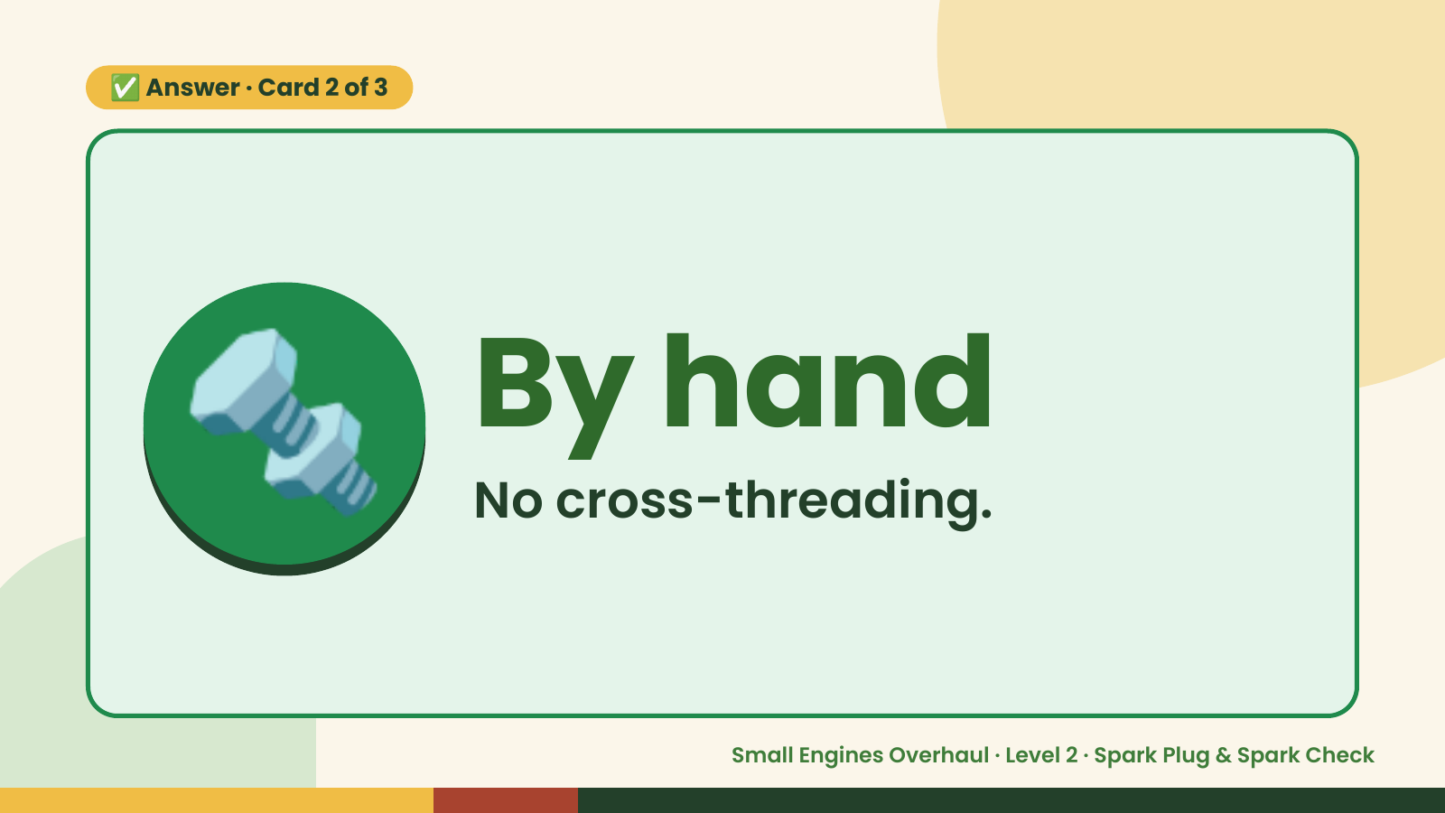
Notes:
✅ Answer · Card 2 of 3
🔩 By hand
No cross-threading.
Small Engines Overhaul · Level 2 · Spark Plug & Spark Check

Slide 10
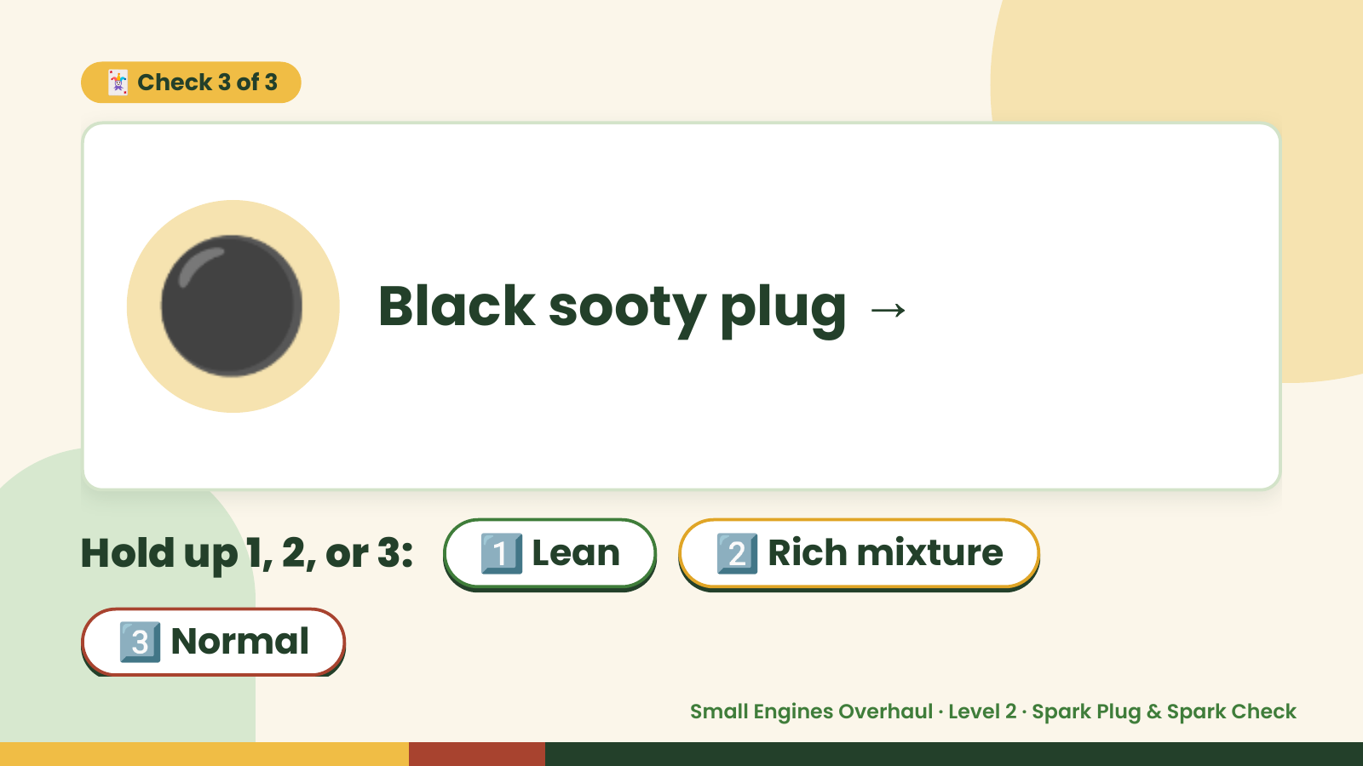
Notes:
🃏 Check 3 of 3
⚫ Black sooty plug →
Hold up 1, 2, or 3: 1️⃣ Lean 2️⃣ Rich mixture
3️⃣ Normal
Small Engines Overhaul · Level 2 · Spark Plug & Spark Check

Slide 11

Notes:
✅ Answer · Card 3 of 3
⚫ Rich mixture
Rich.
Small Engines Overhaul · Level 2 · Spark Plug & Spark Check

Slide 12

Notes:
Wrap-Up
Clean Up +
Reflect
🧽
Return and count tools.
Sweep and wipe your bench.
Wash hands, then do the reflection.
Small Engines Overhaul · Level 2 · Spark Plug & Spark Check

