Slide 1
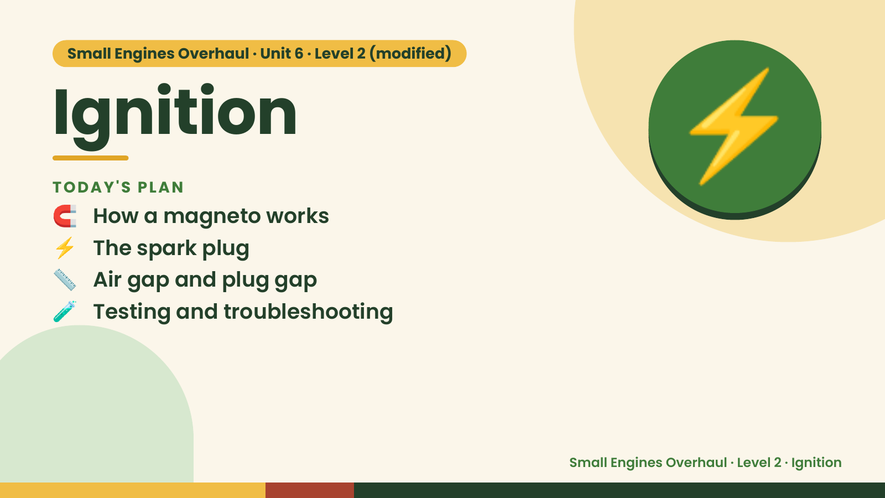
Notes:
Small Engines Overhaul · Unit 6 · Level 2 (modified)
Ignition
🧲 How a magneto works
TODAY'S PLAN
⚡ The spark plug
📏 Air gap and plug gap
⚡
🧪 Testing and troubleshooting
Small Engines Overhaul · Level 2 · Ignition

Slide 2
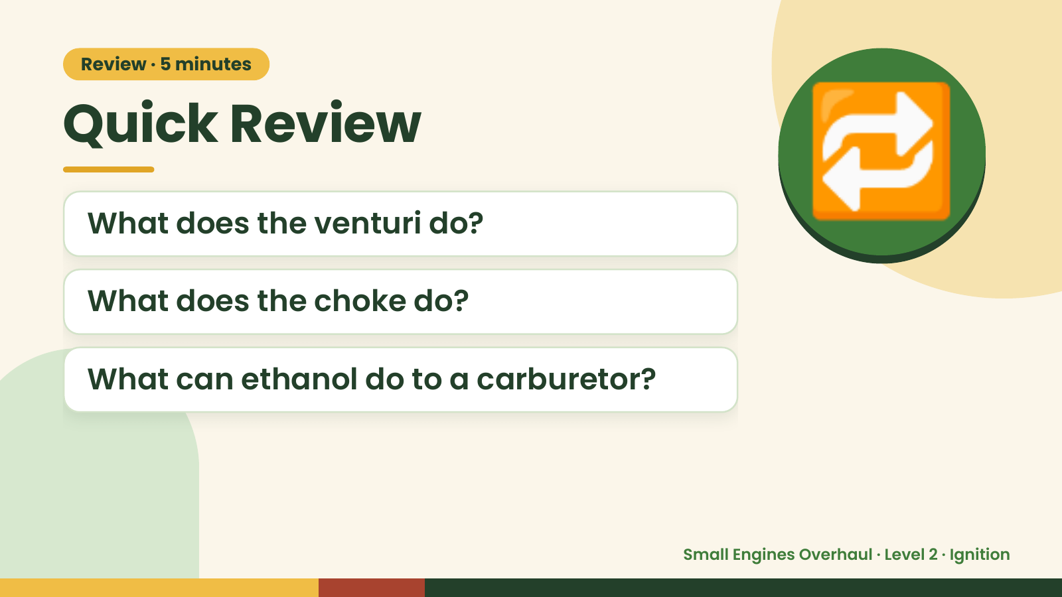
Notes:
Review · 5 minutes
Quick Review
What does the venturi do?
What does the choke do?
🔁
What can ethanol do to a carburetor?
Small Engines Overhaul · Level 2 · Ignition

Slide 3
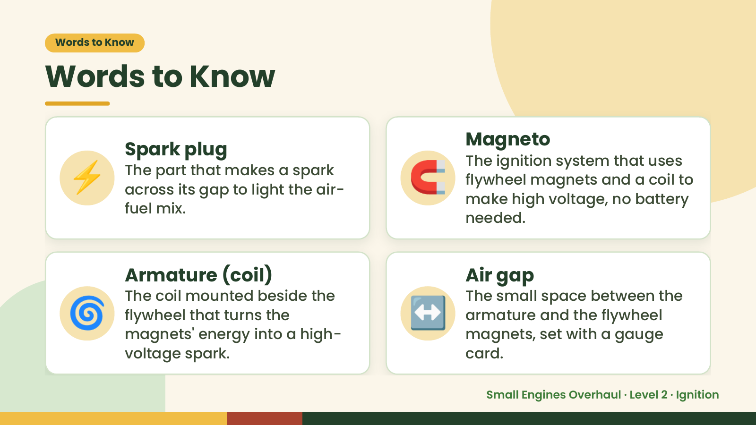
Notes:
Words to Know
Words to Know
⚡ 🧲
Magneto
Spark plug
The ignition system that uses
The part that makes a spark
flywheel magnets and a coil to
across its gap to light the air-
make high voltage, no battery
fuel mix.
needed.
🌀 ↔️
Armature (coil) Air gap
The coil mounted beside the The small space between the
flywheel that turns the armature and the flywheel
magnets' energy into a high- magnets, set with a gauge
voltage spark. card.
Small Engines Overhaul · Level 2 · Ignition

Slide 4
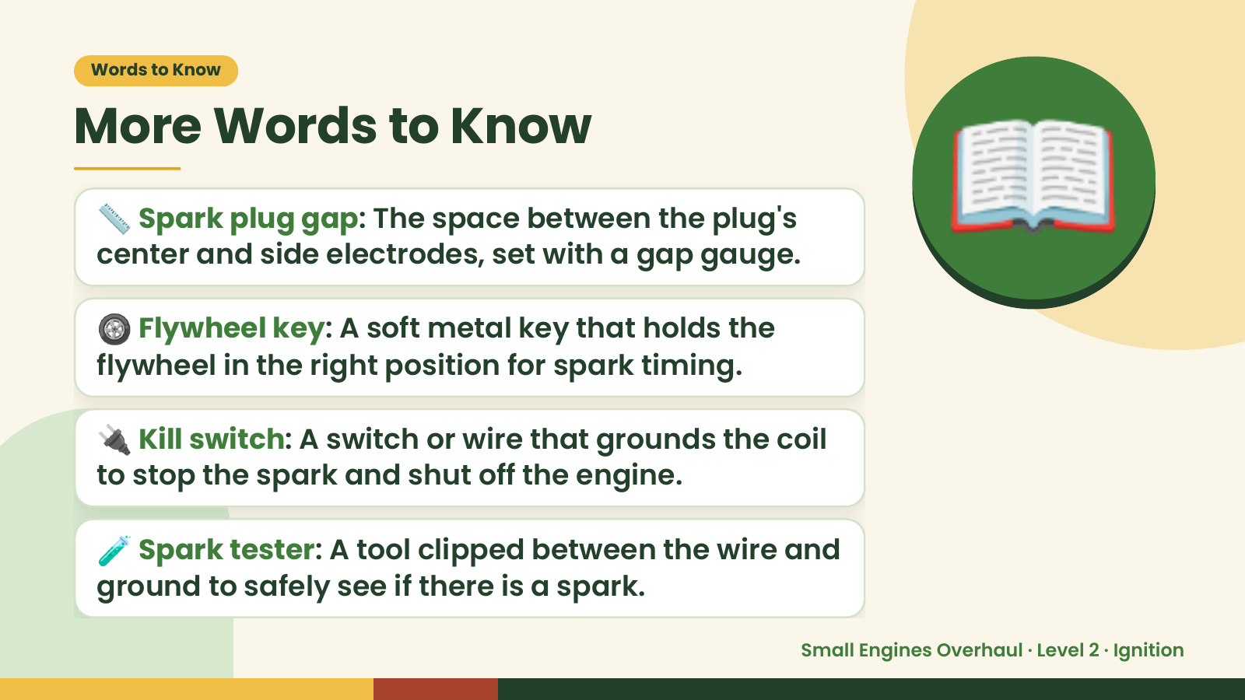
Notes:
Words to Know
More Words to Know
📏 Spark plug gap: The space between the plug's
center and side electrodes, set with a gap gauge.
🛞 Flywheel key: A soft metal key that holds the
flywheel in the right position for spark timing.
📖
🔌 Kill switch: A switch or wire that grounds the coil
to stop the spark and shut off the engine.
🧪 Spark tester: A tool clipped between the wire and
ground to safely see if there is a spark.
Small Engines Overhaul · Level 2 · Ignition

Slide 5
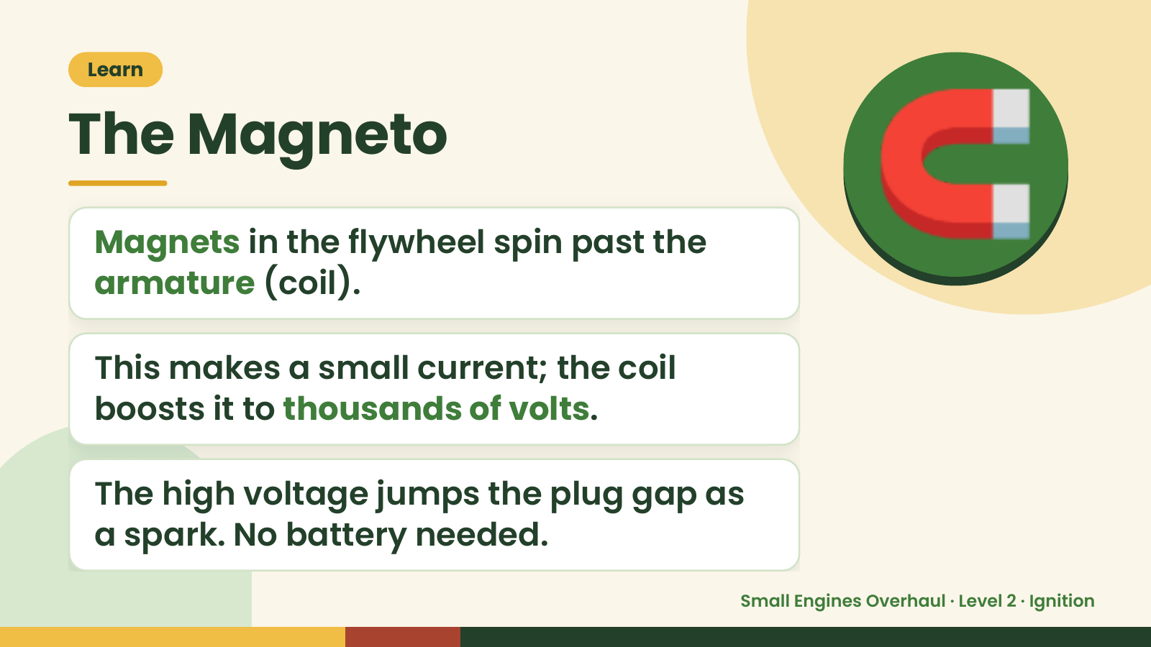
Notes:
Learn
The Magneto
Magnets in the flywheel spin past the
armature (coil).
🧲
This makes a small current; the coil
boosts it to thousands of volts.
The high voltage jumps the plug gap as
a spark. No battery needed.
Small Engines Overhaul · Level 2 · Ignition

Slide 6
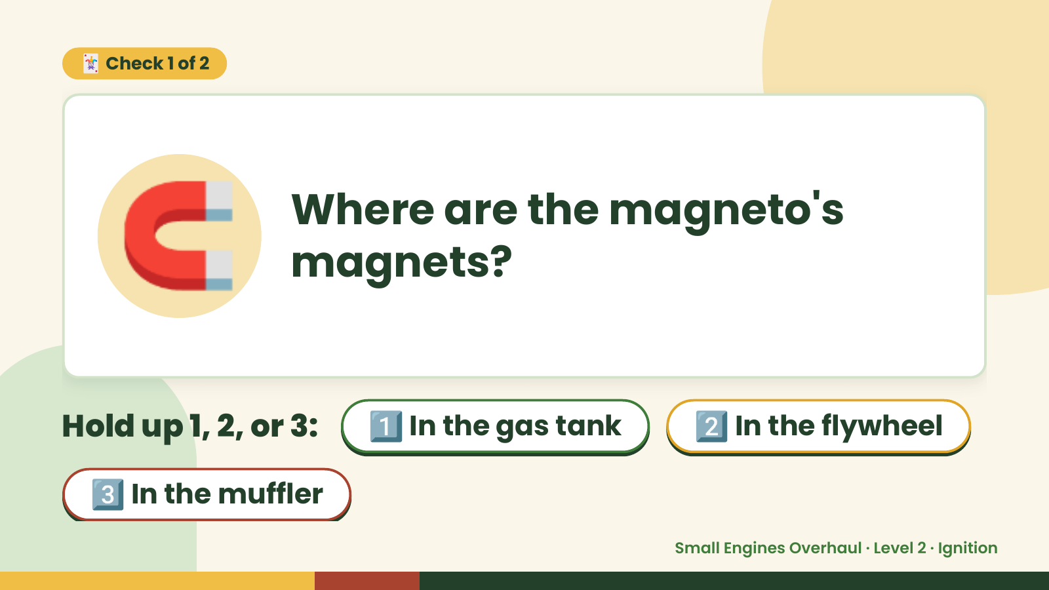
Notes:
🃏 Check 1 of 2
🧲 Where are the magneto's
magnets?
Hold up 1, 2, or 3: 1️⃣ In the gas tank 2️⃣ In the flywheel
3️⃣ In the muffler
Small Engines Overhaul · Level 2 · Ignition

Slide 7
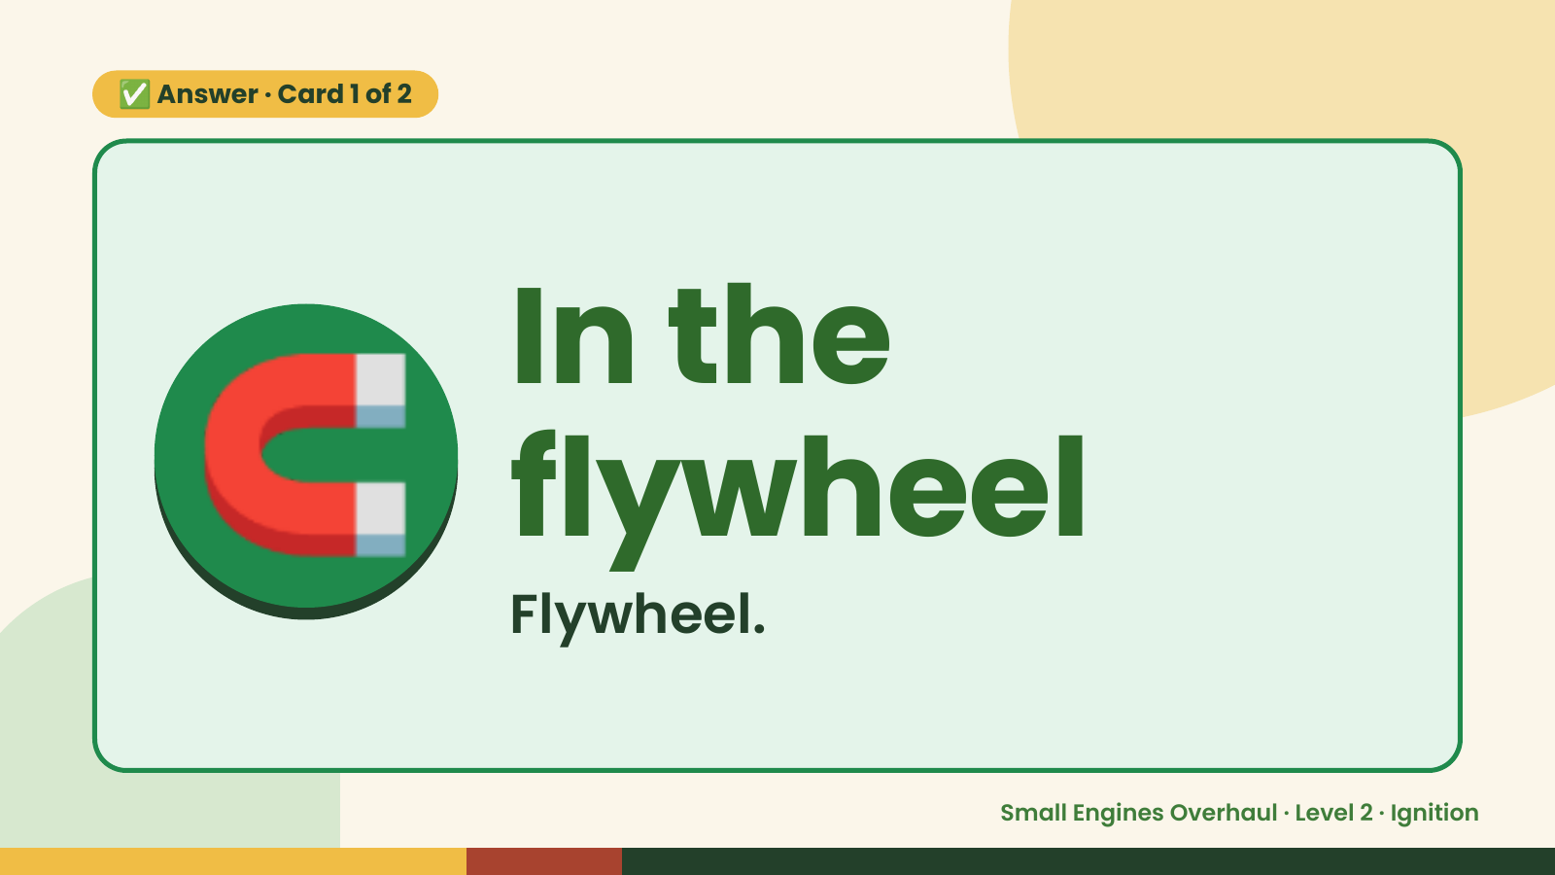
Notes:
✅ Answer · Card 1 of 2
🧲 In the
flywheel
Flywheel.
Small Engines Overhaul · Level 2 · Ignition

Slide 8
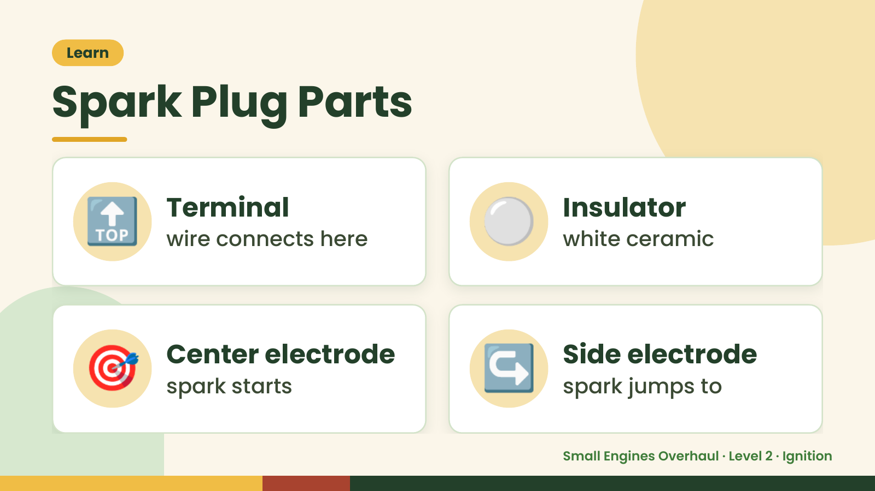
Notes:
Learn
Spark Plug Parts
🔝 Terminal
wire connects here ⚪ Insulator
white ceramic
🎯 Center electrode
spark starts ↪️ Side electrode
spark jumps to
Small Engines Overhaul · Level 2 · Ignition

Slide 9
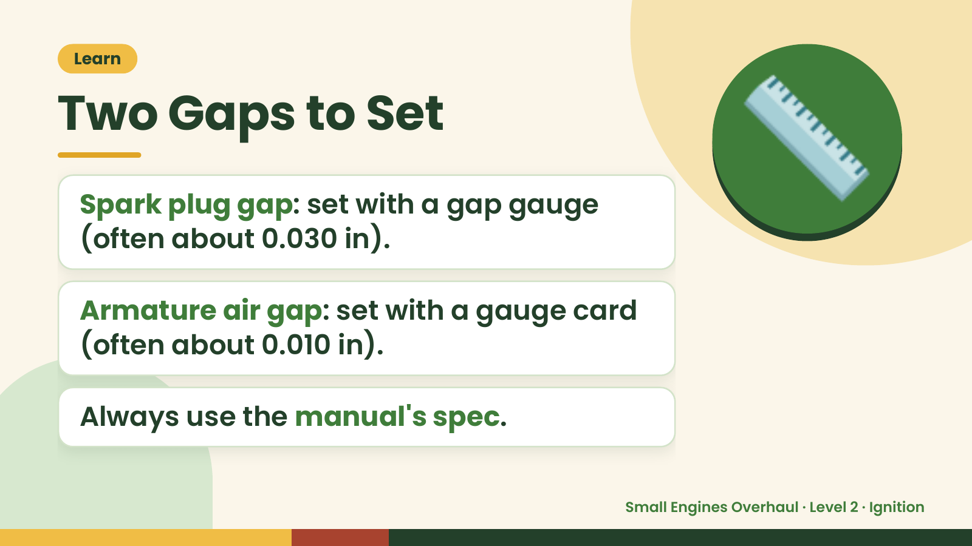
Notes:
Learn
Two Gaps to Set
Spark plug gap: set with a gap gauge
(often about 0.030 in).
📏
Armature air gap: set with a gauge card
(often about 0.010 in).
Always use the manual's spec.
Small Engines Overhaul · Level 2 · Ignition

Slide 10
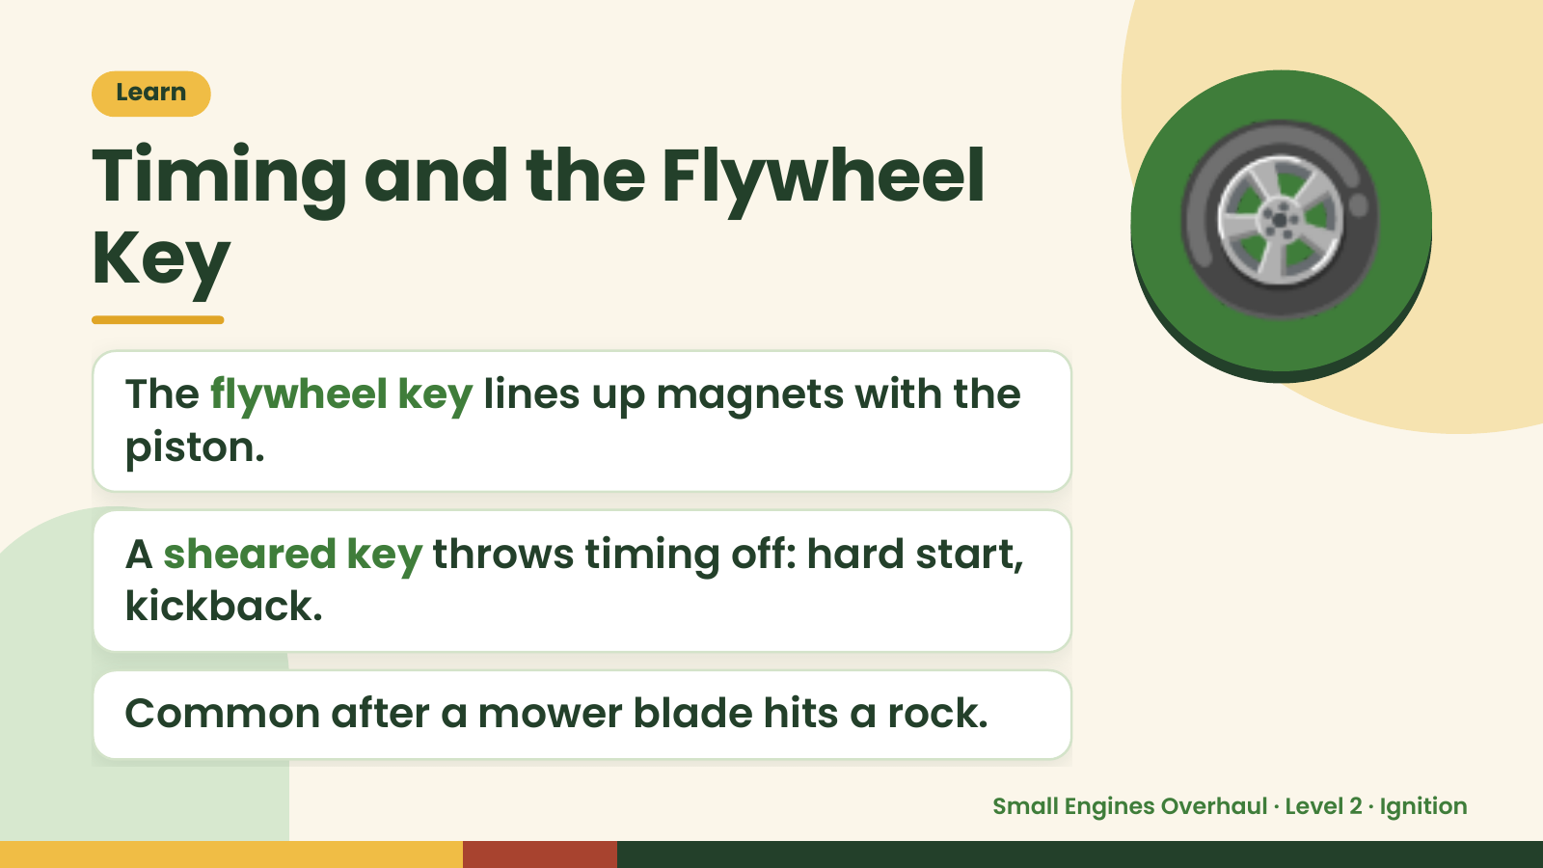
Notes:
Learn
Timing and the Flywheel
Key
The flywheel key lines up magnets with the
piston.
🛞
A sheared key throws timing off: hard start,
kickback.
Common after a mower blade hits a rock.
Small Engines Overhaul · Level 2 · Ignition

Slide 11
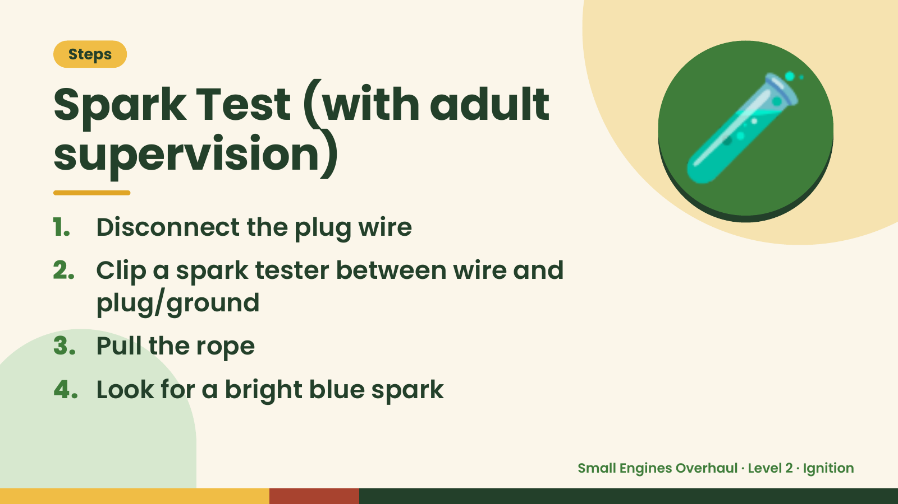
Notes:
Steps
Spark Test (with adult
supervision)
1. Disconnect the plug wire
2. Clip a spark tester between wire and
🧪
plug/ground
3. Pull the rope
4. Look for a bright blue spark
Small Engines Overhaul · Level 2 · Ignition

Slide 12
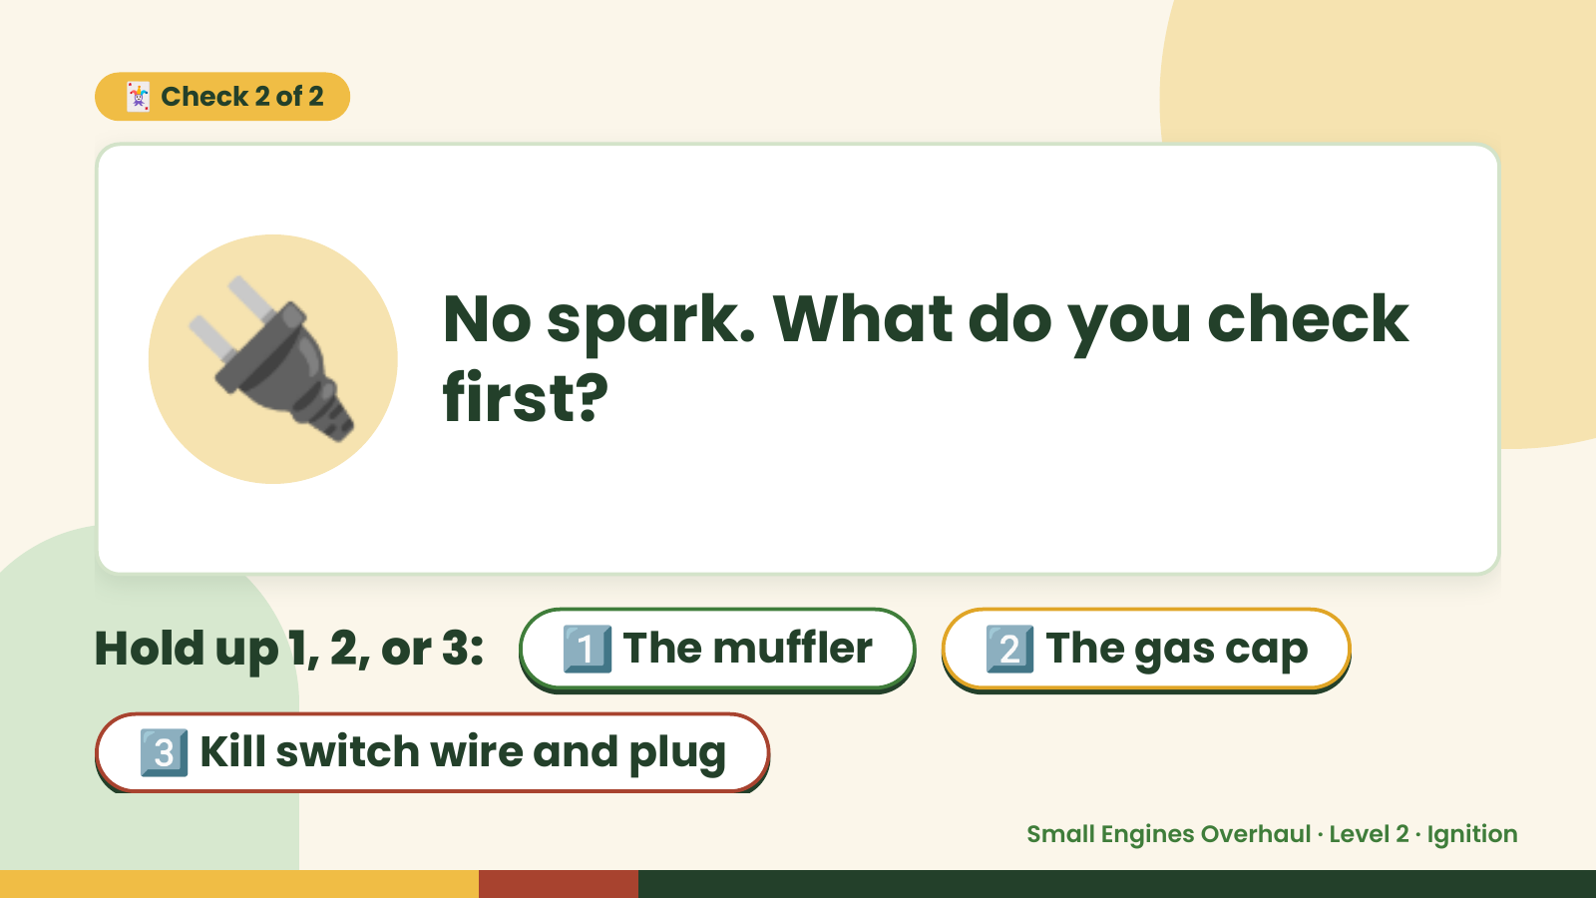
Notes:
🃏 Check 2 of 2
🔌 No spark. What do you check
first?
Hold up 1, 2, or 3: 1️⃣ The muffler 2️⃣ The gas cap
3️⃣ Kill switch wire and plug
Small Engines Overhaul · Level 2 · Ignition

Slide 13
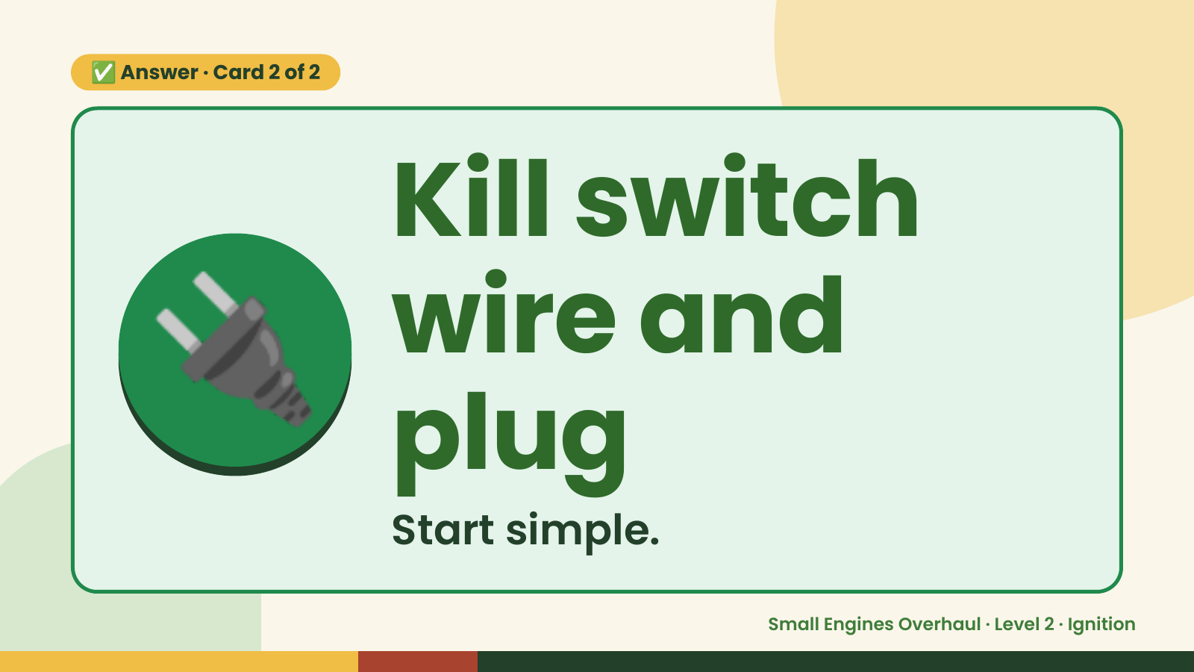
Notes:
✅ Answer · Card 2 of 2
🔌 Kill switch
wire and
plug
Start simple.
Small Engines Overhaul · Level 2 · Ignition

Slide 14
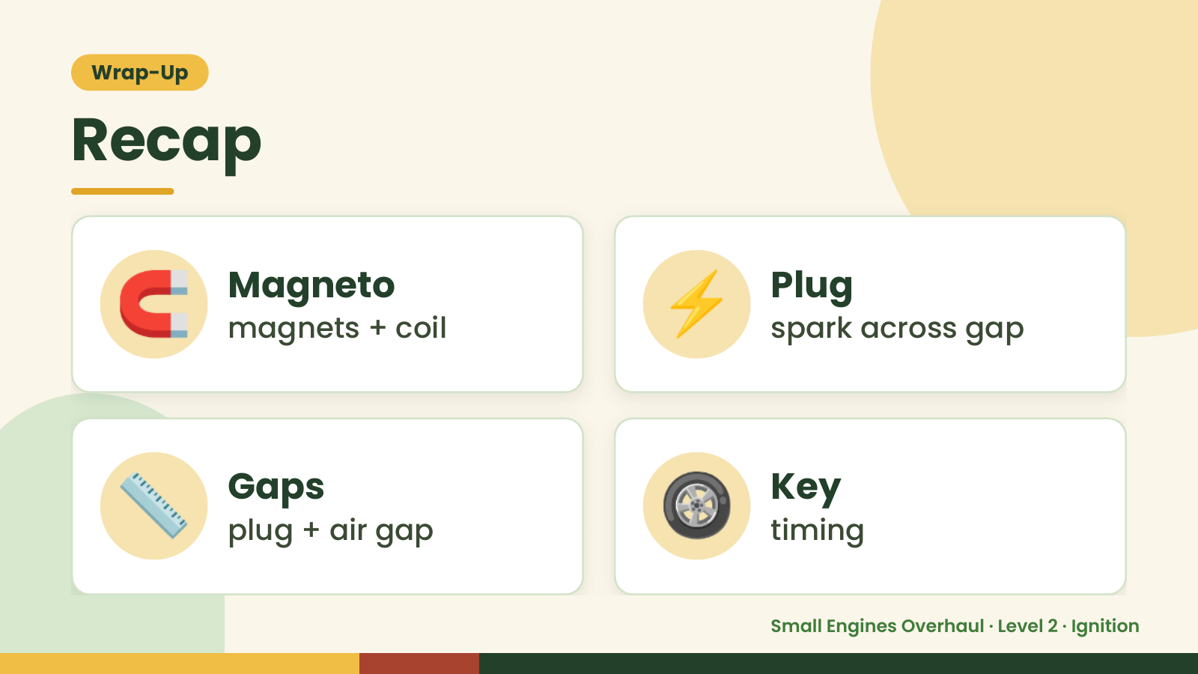
Notes:
Wrap-Up
Recap
🧲 Magneto
magnets + coil ⚡ Plug
spark across gap
📏 Gaps
plug + air gap 🛞 Key
timing
Small Engines Overhaul · Level 2 · Ignition

Slide 15
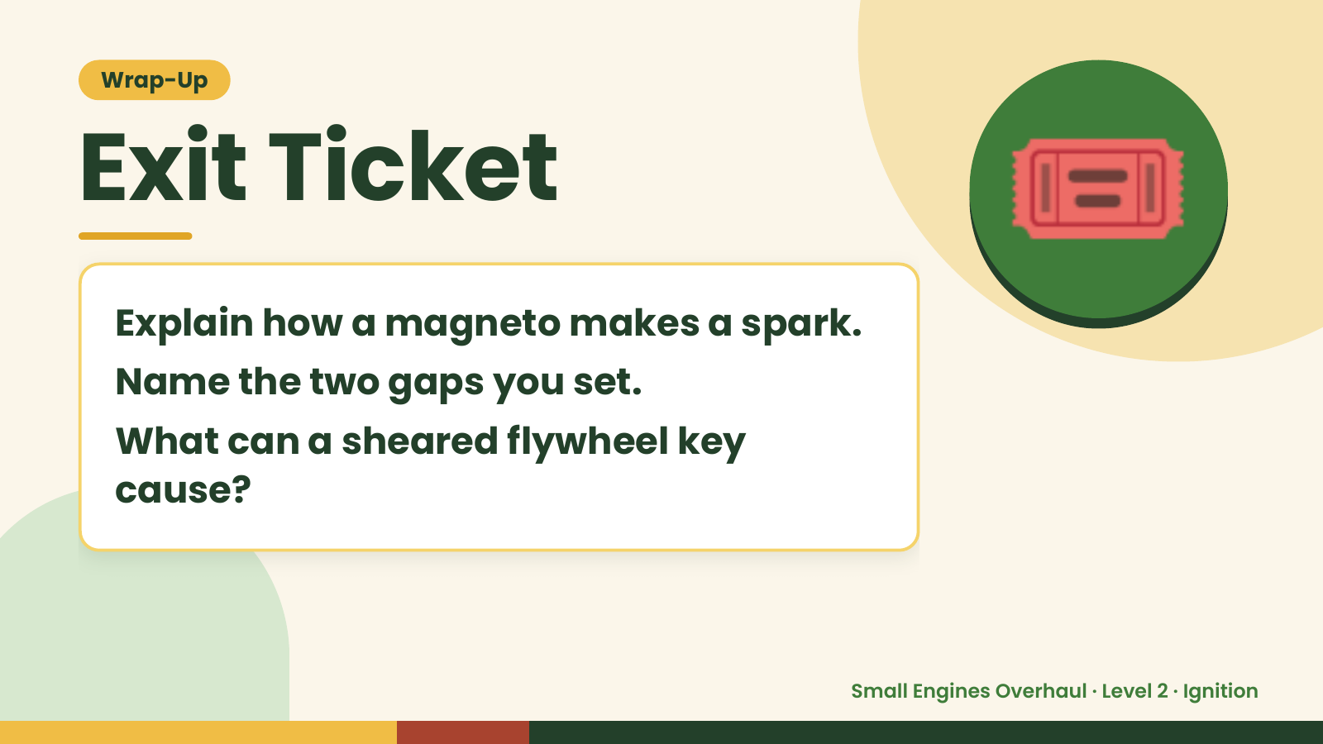
Notes:
Wrap-Up
Exit Ticket
Explain how a magneto makes a spark.
Name the two gaps you set.
🎟️
What can a sheared flywheel key
cause?
Small Engines Overhaul · Level 2 · Ignition

