Slide 1

Notes:
Small Engines Overhaul · Unit 7 · Level 1
Repair Manual
Look-Up
TODAY'S PLAN
📘
👥 Jobs
⚠️ Safety
📘 Steps
✅ Check
📝 Reflect
Small Engines Overhaul · Level 1 · Repair Manual Look-Up

Slide 2

Notes:
Get ready
Jobs
🔧 Mechanic
fixes 🧰 Tool helper
gets tools
📋 Recorder
writes 🧽 Clean-up
captain
cleans
Small Engines Overhaul · Level 1 · Repair Manual Look-Up

Slide 3
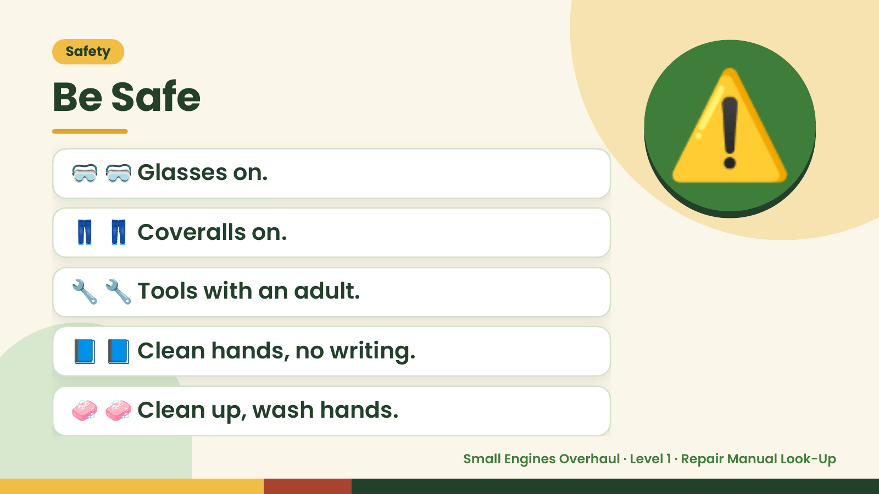
Notes:
Safety
Be Safe
🥽 🥽 Glasses on.
👖 👖 Coveralls on.
⚠️
🔧 🔧 Tools with an adult.
📘 📘 Clean hands, no writing.
🧼 🧼 Clean up, wash hands.
Small Engines Overhaul · Level 1 · Repair Manual Look-Up

Slide 4
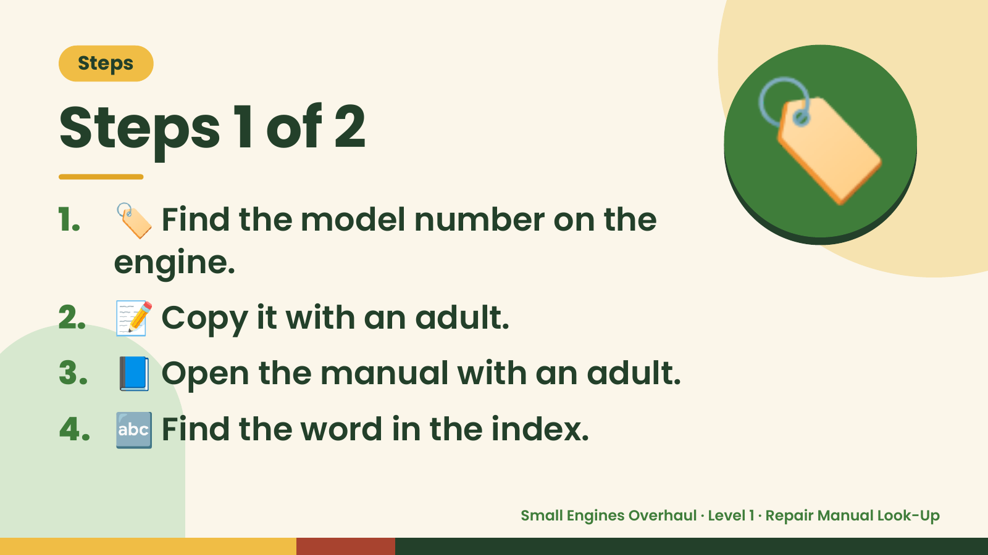
Notes:
Steps
Steps 1 of 2
1. 🏷️ Find the model number on the
engine.
🏷️
2. 📝 Copy it with an adult.
3. 📘 Open the manual with an adult.
4. 🔤 Find the word in the index.
Small Engines Overhaul · Level 1 · Repair Manual Look-Up

Slide 5
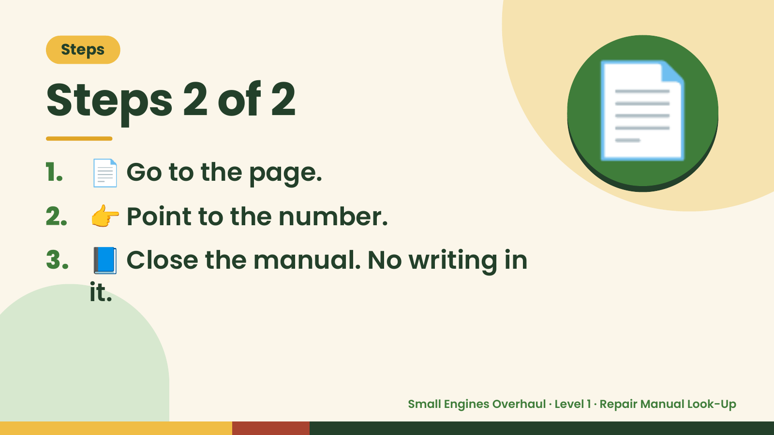
Notes:
Steps
Steps 2 of 2
1. 📄 Go to the page.
2. 👉 Point to the number.
📄
3. 📘 Close the manual. No writing in
it.
Small Engines Overhaul · Level 1 · Repair Manual Look-Up

Slide 6
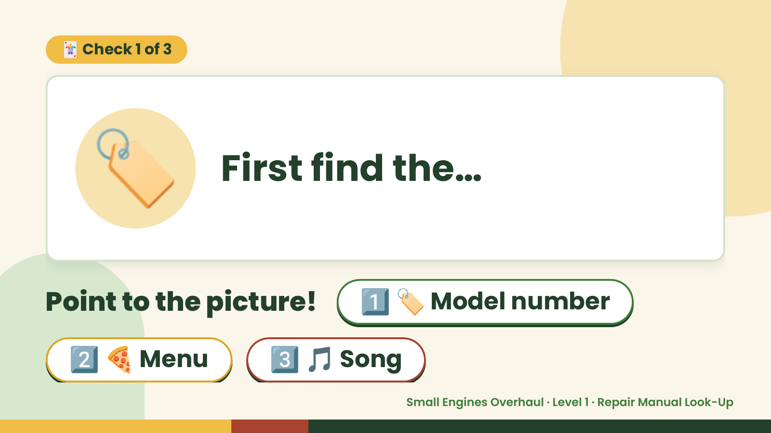
Notes:
🃏 Check 1 of 3
🏷️ First find the…
Point to the picture! 1️⃣ 🏷️ Model number
2️⃣ 🍕 Menu 3️⃣ 🎵 Song
Small Engines Overhaul · Level 1 · Repair Manual Look-Up

Slide 7
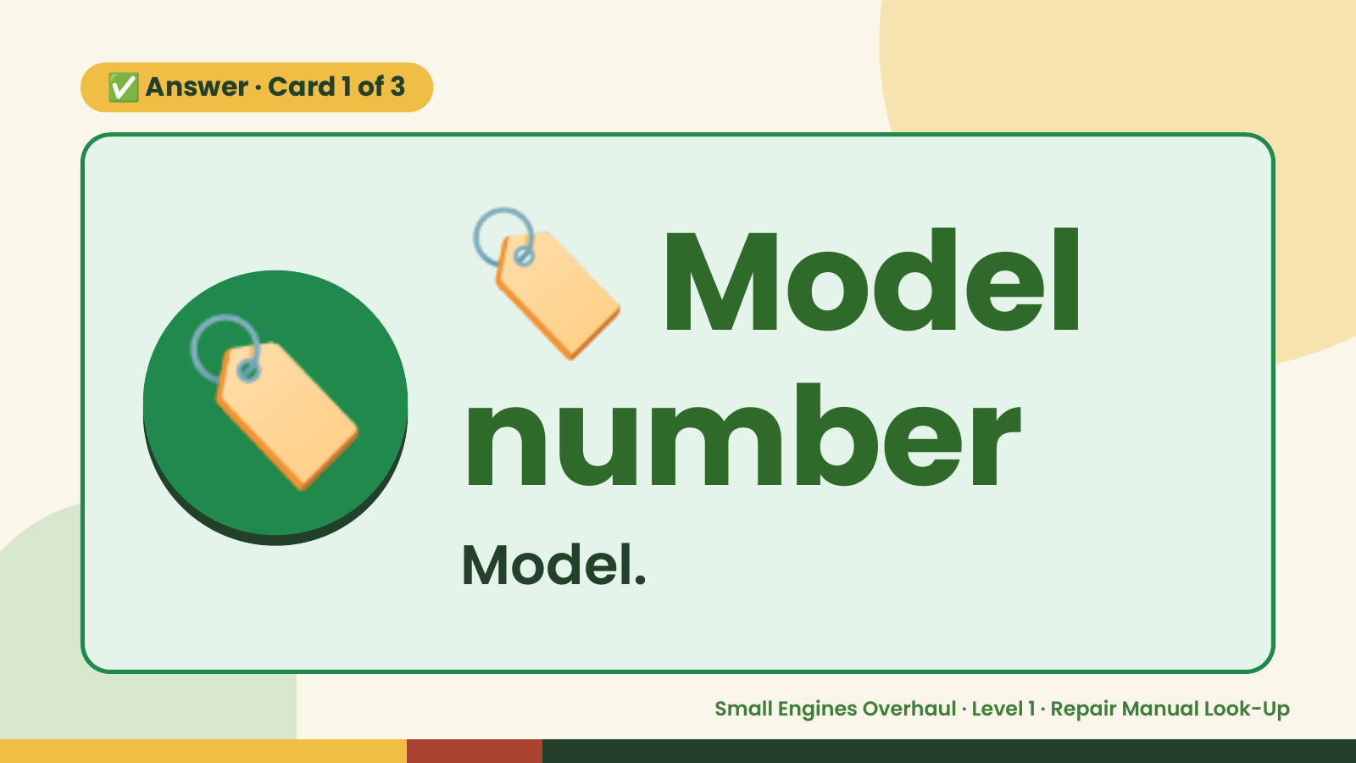
Notes:
🏷️
✅ Answer · Card 1 of 3
🏷️ number
Model
Model.
Small Engines Overhaul · Level 1 · Repair Manual Look-Up

Slide 8
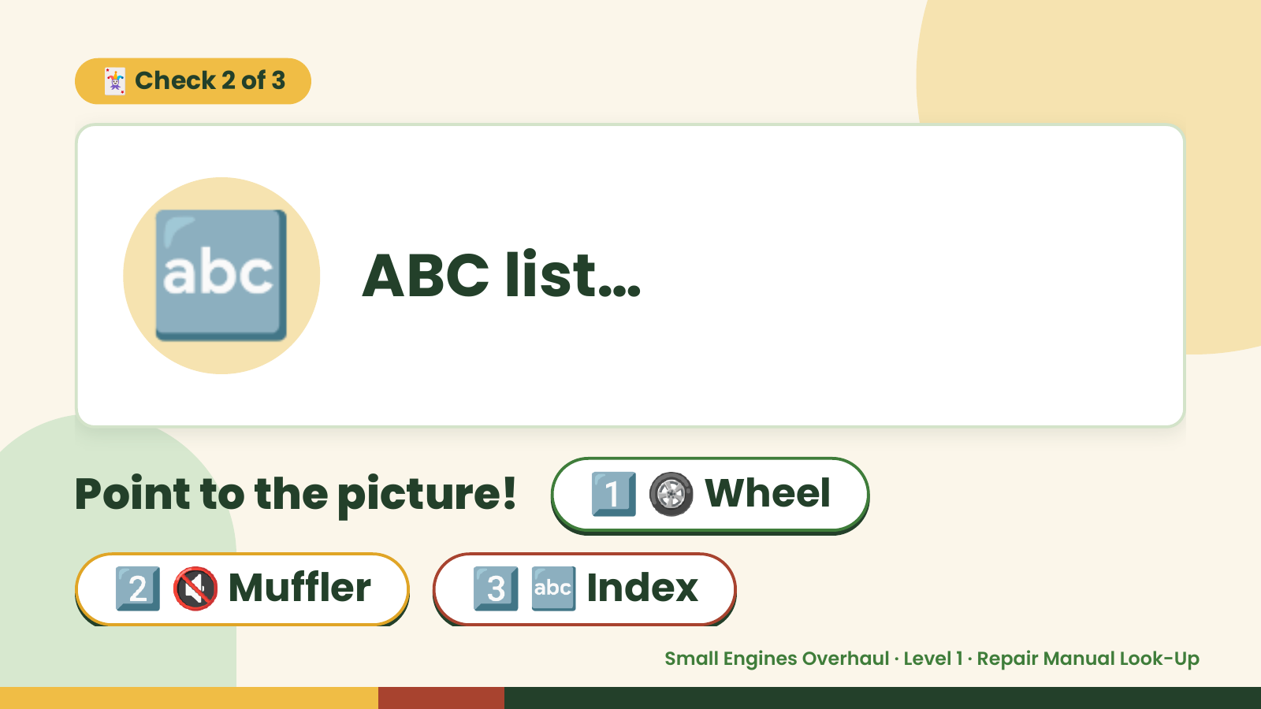
Notes:
🃏 Check 2 of 3
🔤 ABC list…
Point to the picture! 1️⃣ 🛞 Wheel
2️⃣ 🔇 Muffler 3️⃣ 🔤 Index
Small Engines Overhaul · Level 1 · Repair Manual Look-Up

Slide 9
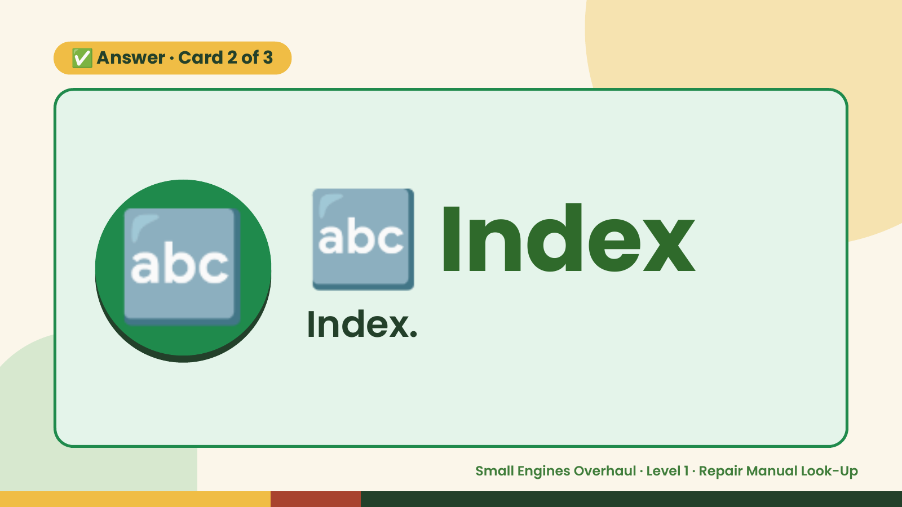
Notes:
✅ Answer · Card 2 of 3
🔤 🔤 Index
Index.
Small Engines Overhaul · Level 1 · Repair Manual Look-Up

Slide 10
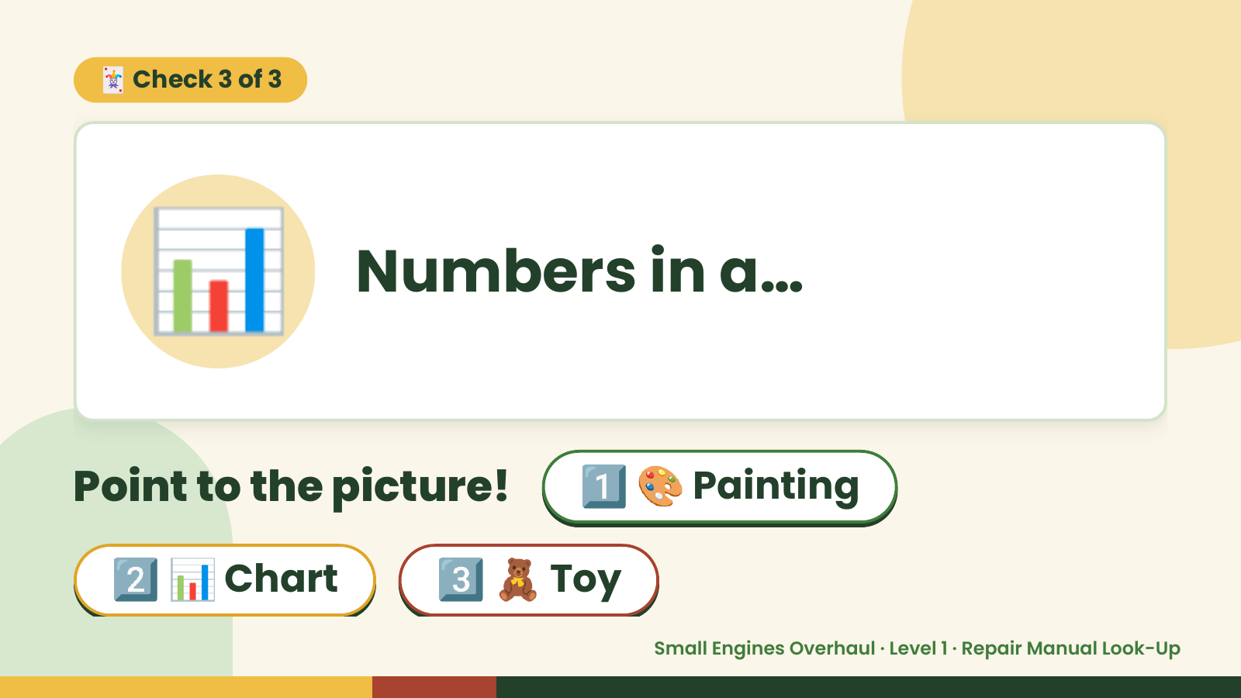
Notes:
🃏 Check 3 of 3
📊 Numbers in a…
Point to the picture! 1️⃣ 🎨 Painting
2️⃣ 📊 Chart 3️⃣ 🧸 Toy
Small Engines Overhaul · Level 1 · Repair Manual Look-Up

Slide 11
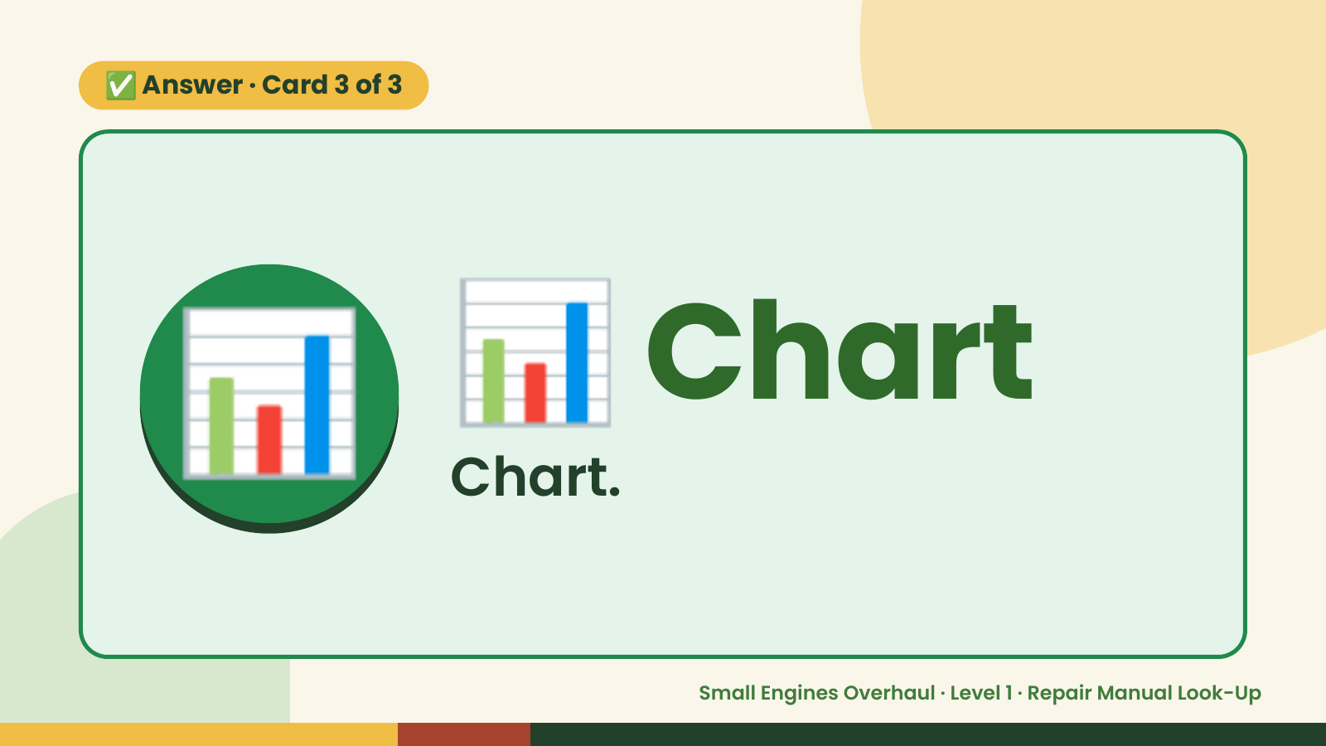
Notes:
✅ Answer · Card 3 of 3
📊 📊 Chart
Chart.
Small Engines Overhaul · Level 1 · Repair Manual Look-Up

Slide 12

Notes:
Wrap-Up
Clean Up +
Reflect
🧽
🧽 Wipe the bench.
🧰 Give tools back.
🧼 Wash hands.
Small Engines Overhaul · Level 1 · Repair Manual Look-Up

