Slide 1
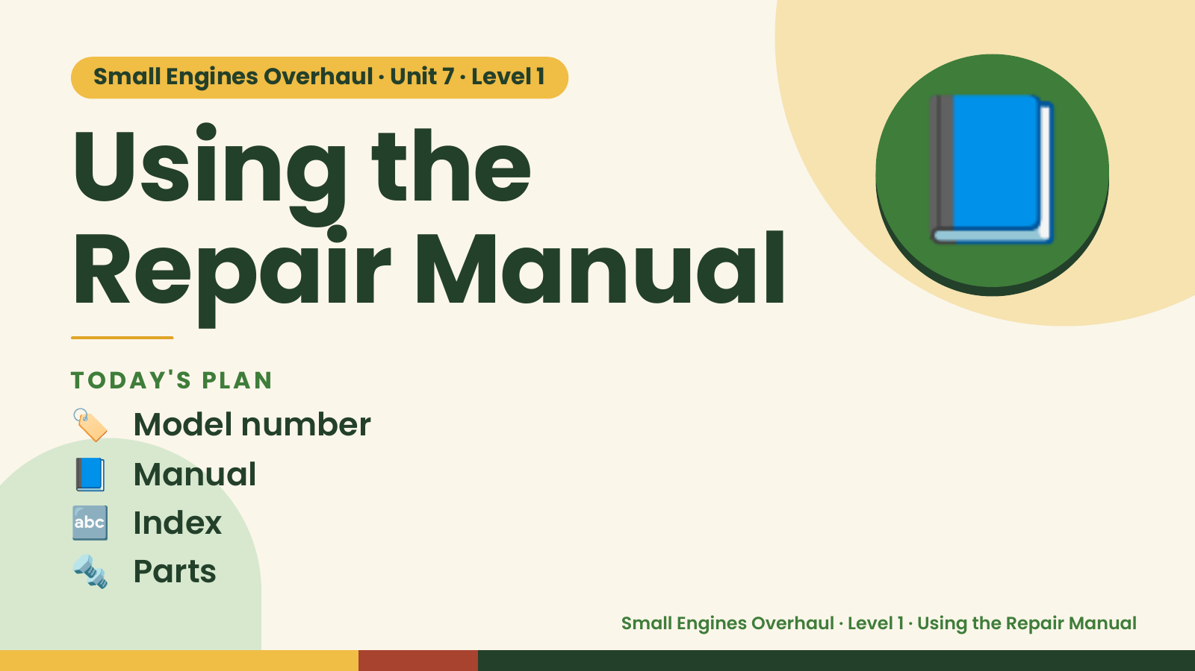
Notes:
Small Engines Overhaul · Unit 7 · Level 1
Using the
Repair Manual
📘
🏷️ Model number
TODAY'S PLAN
📘 Manual
🔤 Index
🔩 Parts
Small Engines Overhaul · Level 1 · Using the Repair Manual

Slide 2
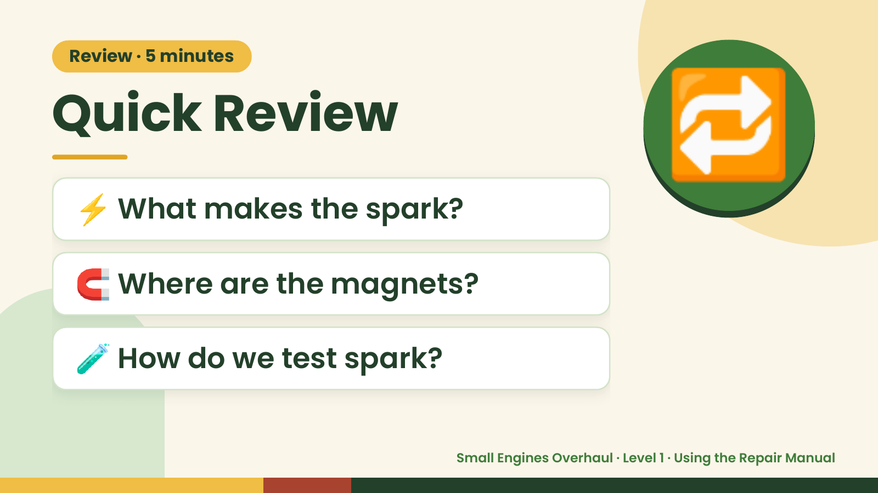
Notes:
Review · 5 minutes
Quick Review
⚡ What makes the spark?
🔁
🧲 Where are the magnets?
🧪 How do we test spark?
Small Engines Overhaul · Level 1 · Using the Repair Manual

Slide 3
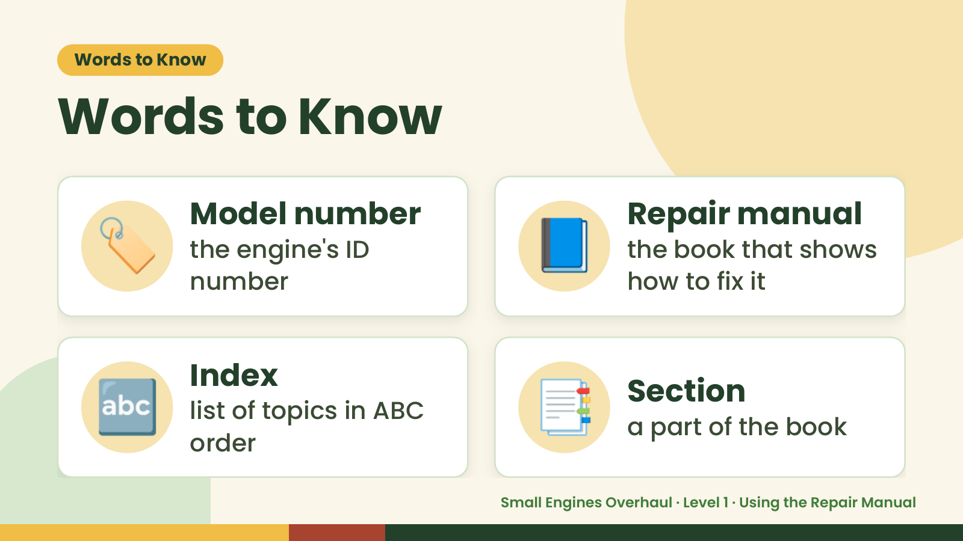
Notes:
Words to Know
Words to Know
🏷️ Model number
the engine's ID
number
📘 Repair manual
the book that shows
how to fix it
🔤 Index
list of topics in ABC
order
📑 Section
a part of the book
Small Engines Overhaul · Level 1 · Using the Repair Manual

Slide 4
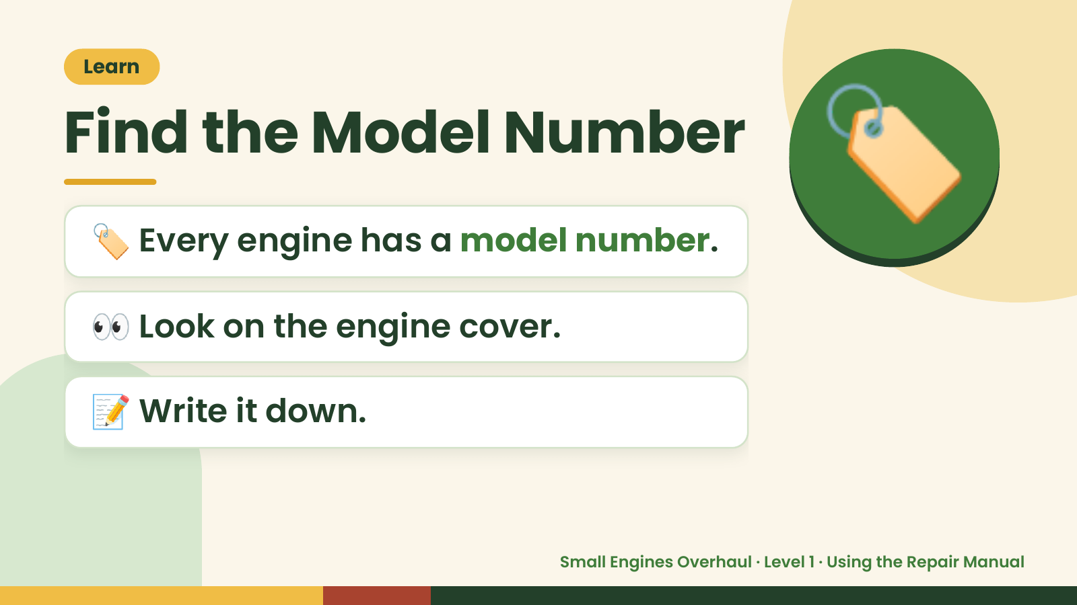
Notes:
Learn
Find the Model Number
🏷️ Every engine has a model number.
👀 Look on the engine cover.
🏷️
📝 Write it down.
Small Engines Overhaul · Level 1 · Using the Repair Manual

Slide 5
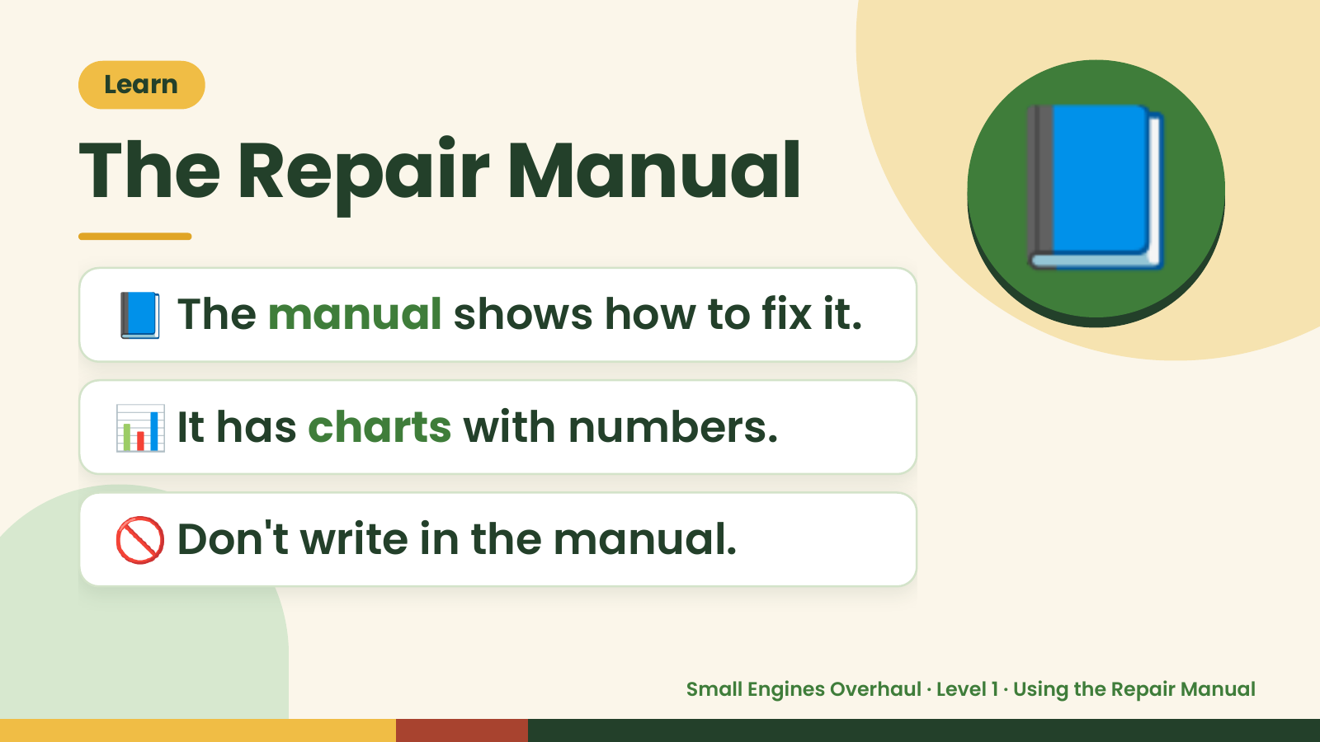
Notes:
Learn
The Repair Manual
📘 The manual shows how to fix it.
📘
📊 It has charts with numbers.
🚫 Don't write in the manual.
Small Engines Overhaul · Level 1 · Using the Repair Manual

Slide 6
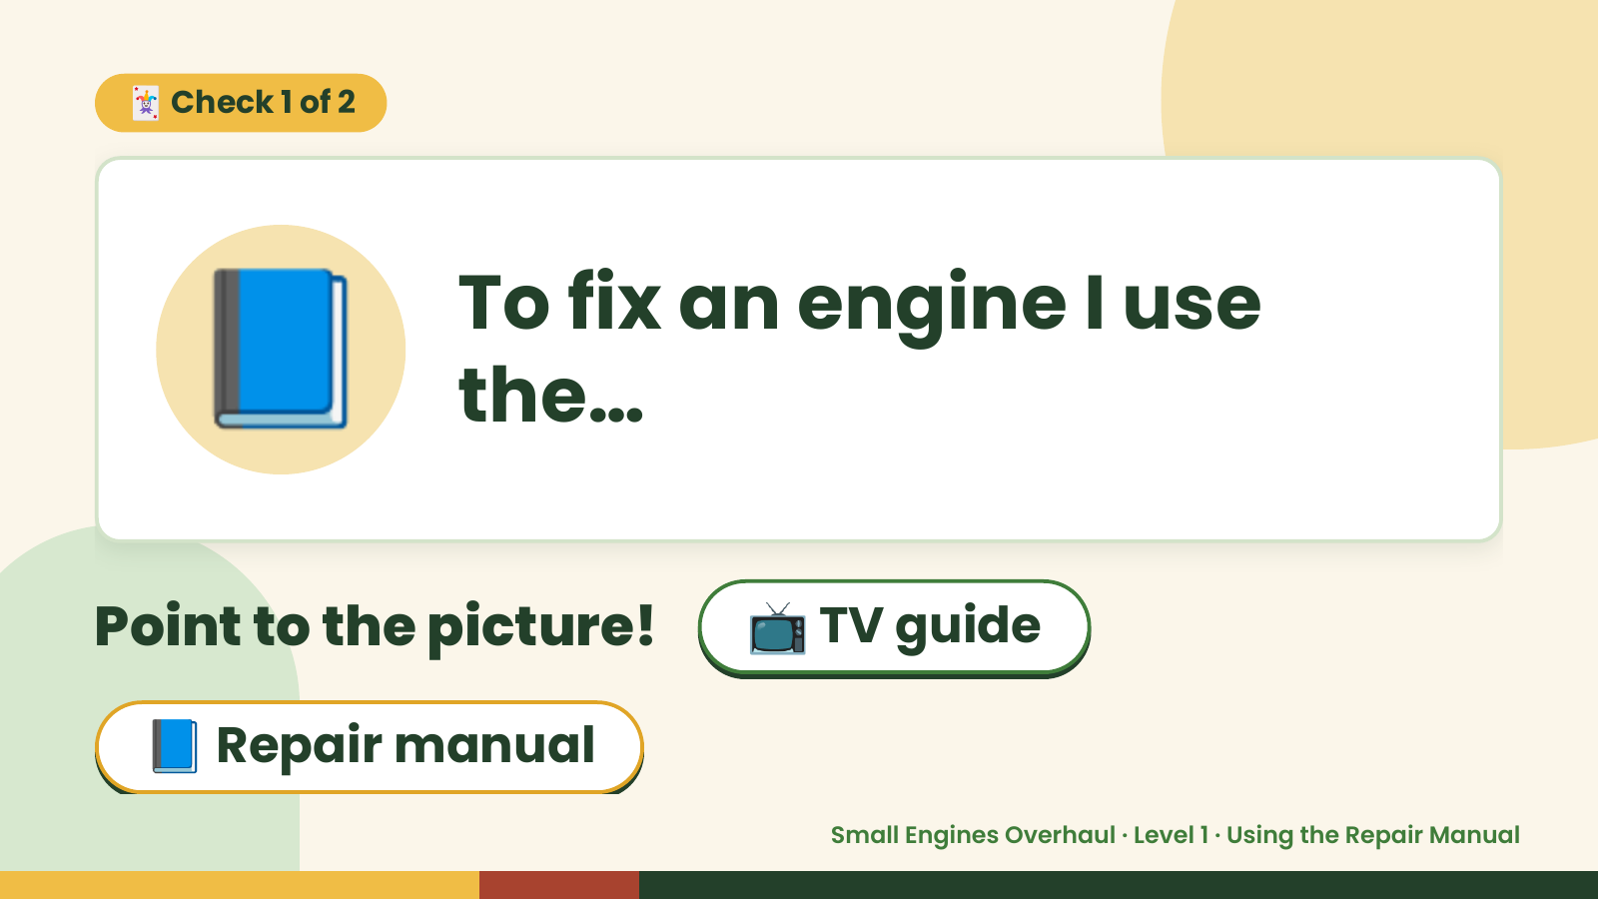
Notes:
🃏 Check 1 of 2
📘 To fix an engine I use
the…
Point to the picture! 📺 TV guide
📘 Repair manual
Small Engines Overhaul · Level 1 · Using the Repair Manual

Slide 7
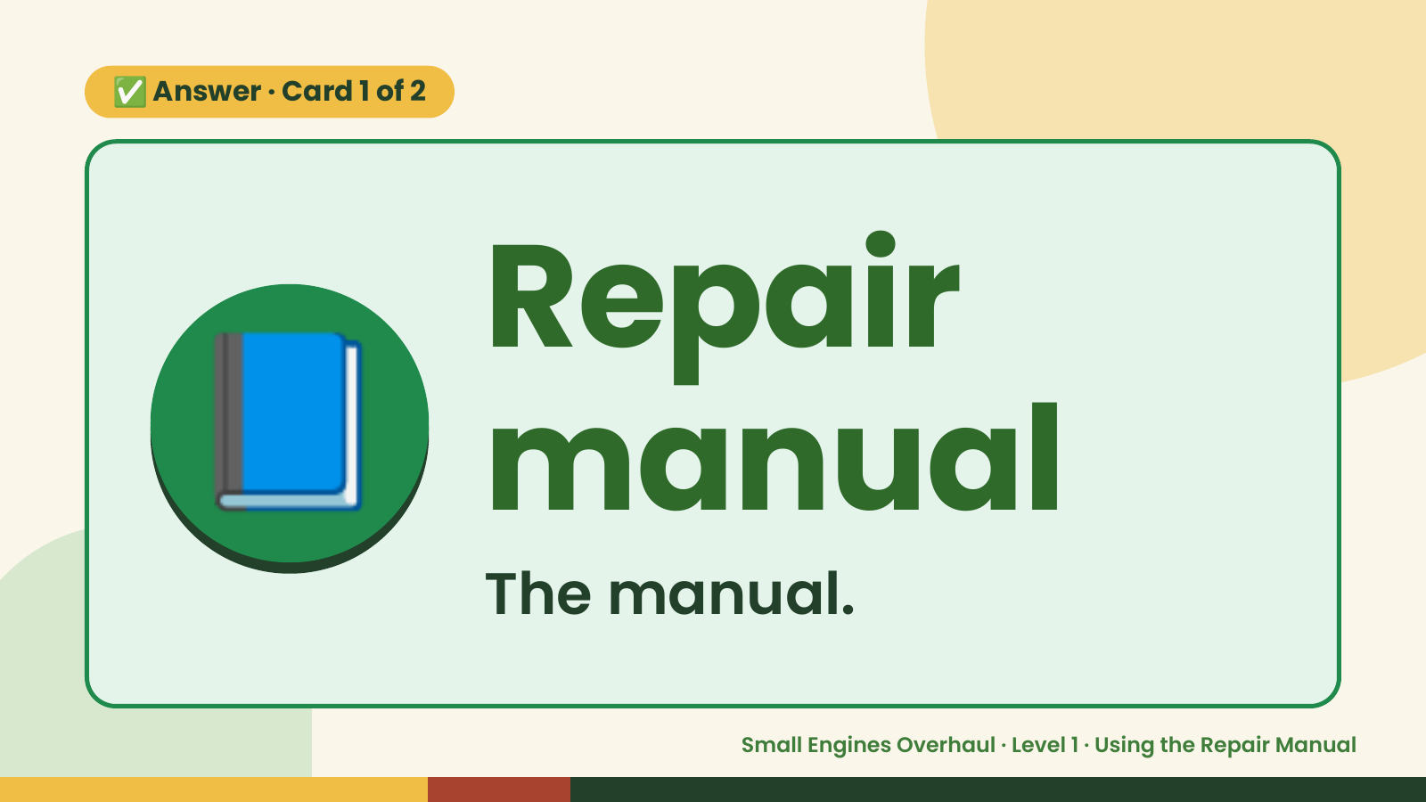
Notes:
✅ Answer · Card 1 of 2
📘 Repair
manual
The manual.
Small Engines Overhaul · Level 1 · Using the Repair Manual

Slide 8
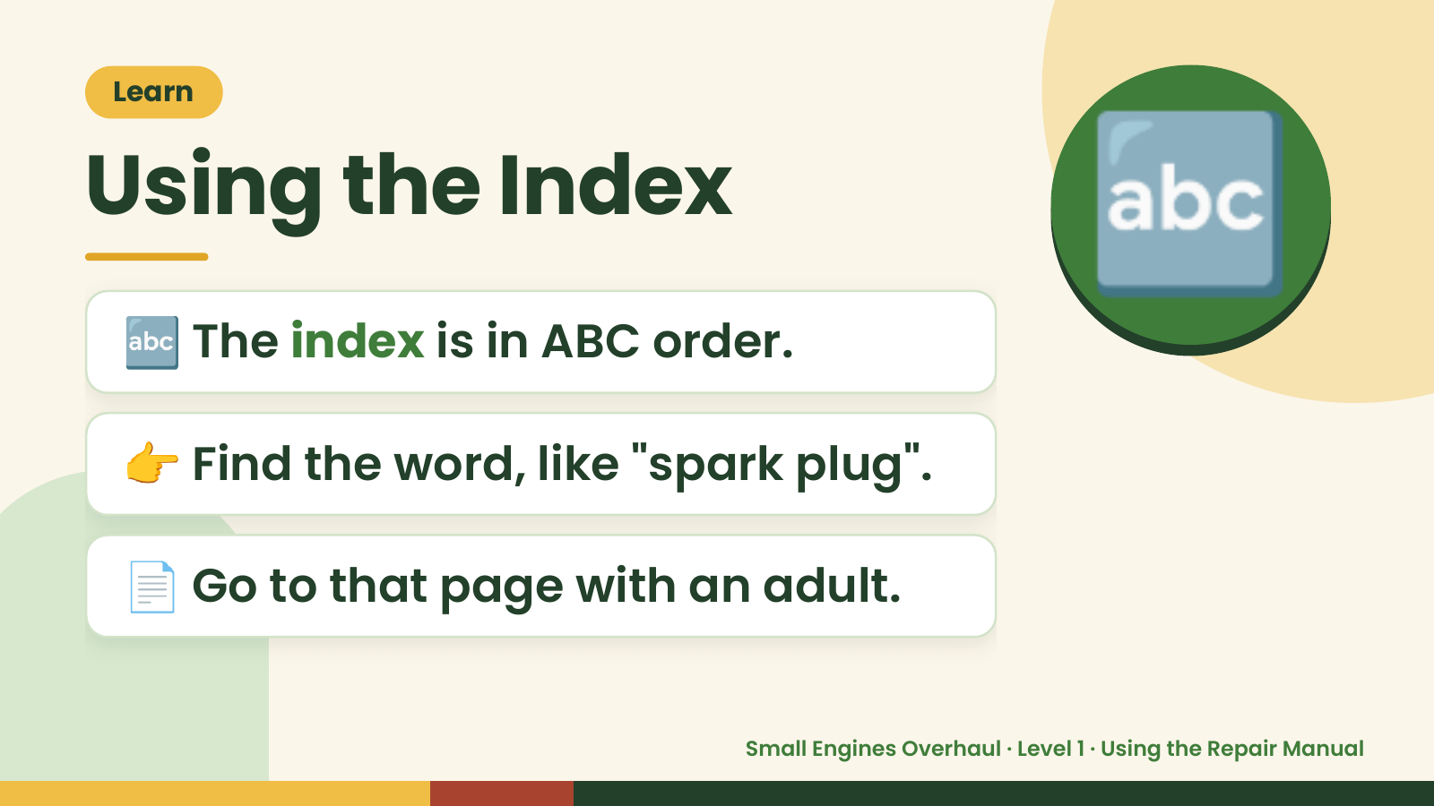
Notes:
Learn
Using the Index
🔤 The index is in ABC order.
🔤
👉 Find the word, like "spark plug".
📄 Go to that page with an adult.
Small Engines Overhaul · Level 1 · Using the Repair Manual

Slide 9
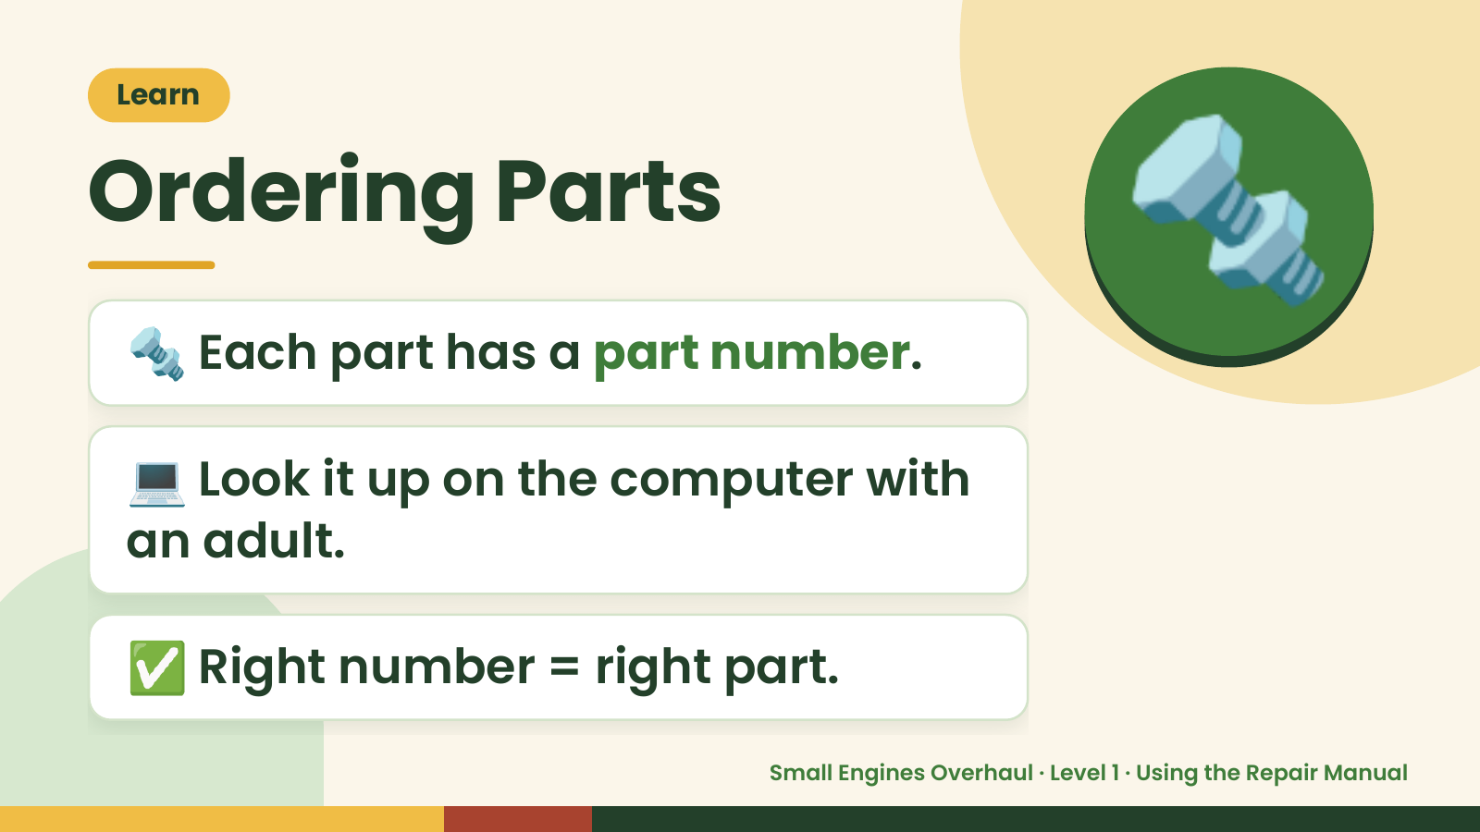
Notes:
Learn
Ordering Parts
🔩 Each part has a part number.
🔩
💻 Look it up on the computer with
an adult.
✅ Right number = right part.
Small Engines Overhaul · Level 1 · Using the Repair Manual

Slide 10
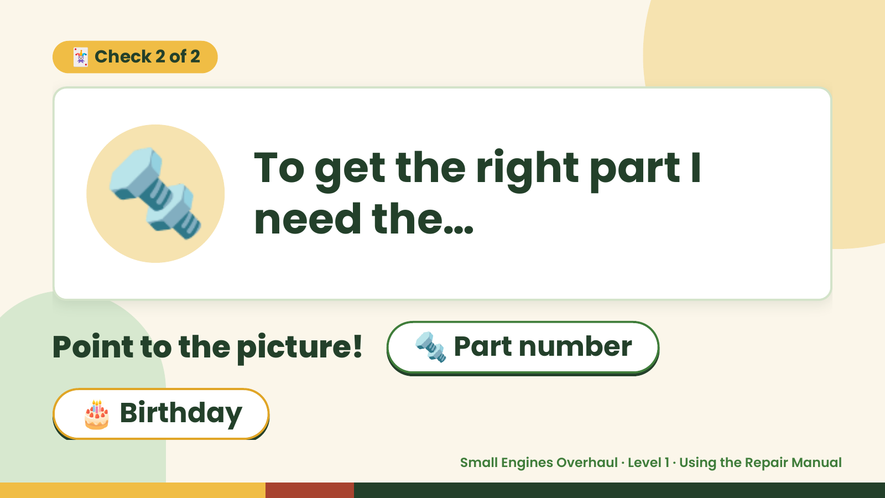
Notes:
🃏 Check 2 of 2
🔩 To get the right part I
need the…
Point to the picture! 🔩 Part number
🎂 Birthday
Small Engines Overhaul · Level 1 · Using the Repair Manual

Slide 11
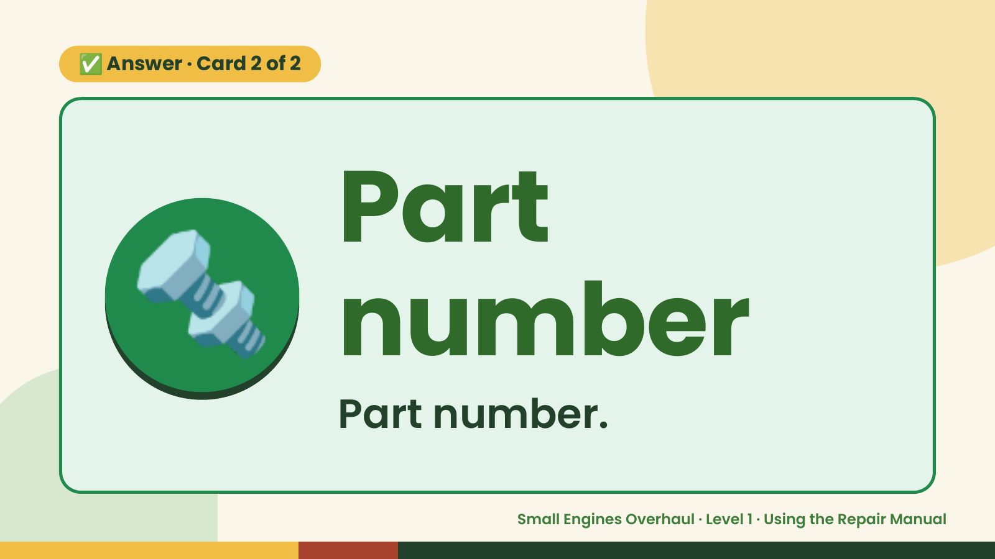
Notes:
✅ Answer · Card 2 of 2
🔩 Part
number
Part number.
Small Engines Overhaul · Level 1 · Using the Repair Manual

Slide 12
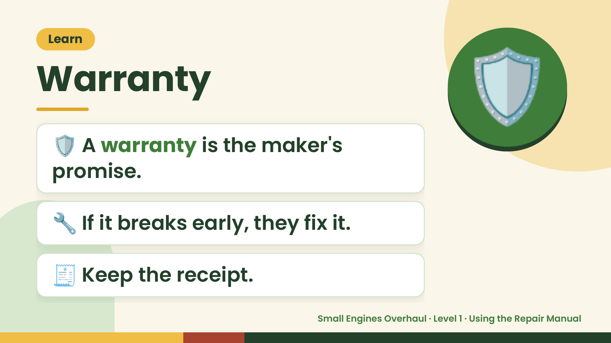
Notes:
Learn
Warranty
🛡️ A warranty is the maker's
promise.
🛡️
🔧 If it breaks early, they fix it.
🧾 Keep the receipt.
Small Engines Overhaul · Level 1 · Using the Repair Manual

Slide 13
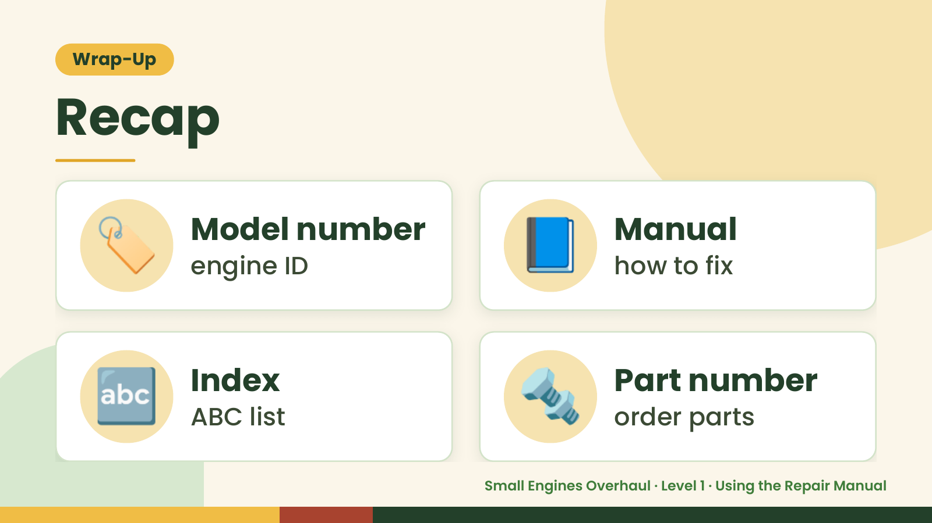
Notes:
Wrap-Up
Recap
🏷️ Model number
engine ID 📘 Manual
how to fix
🔤 Index
ABC list 🔩 Part number
order parts
Small Engines Overhaul · Level 1 · Using the Repair Manual

Slide 14
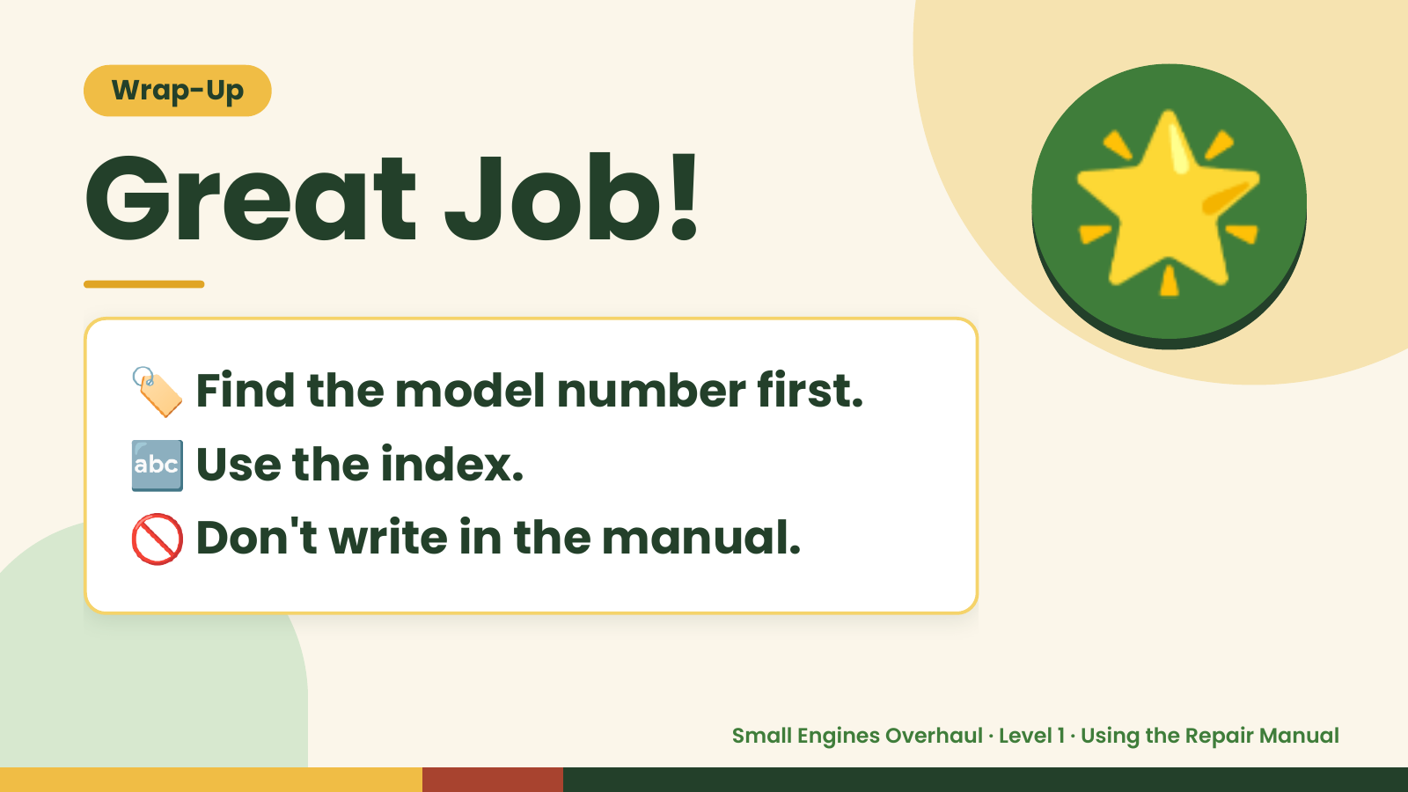
Notes:
Wrap-Up
Great Job!
🏷️ Find the model number first.
🌟
🔤 Use the index.
🚫 Don't write in the manual.
Small Engines Overhaul · Level 1 · Using the Repair Manual

