Slide 1

Notes:
Small Engines Overhaul · Unit 7 · Level 2
Repair Manual
Look-Up
👥 Jobs
TODAY'S PLAN
📘
⚠️ Safety
📘 Steps
✅ Check
📝 Reflect
Small Engines Overhaul · Level 2 · Repair Manual Look-Up

Slide 2

Notes:
Get ready
Jobs
🔧 Mechanic
Does the main engine job
with the tools
🧰 Tool helper
Gets tools from the board
and returns them to staff
📋 Recorder
Takes photos and fills in
the chart
🧽 Clean-up captain
Wipes the bench,
sweeps, checks tools are
back
Small Engines Overhaul · Level 2 · Repair Manual Look-Up

Slide 3
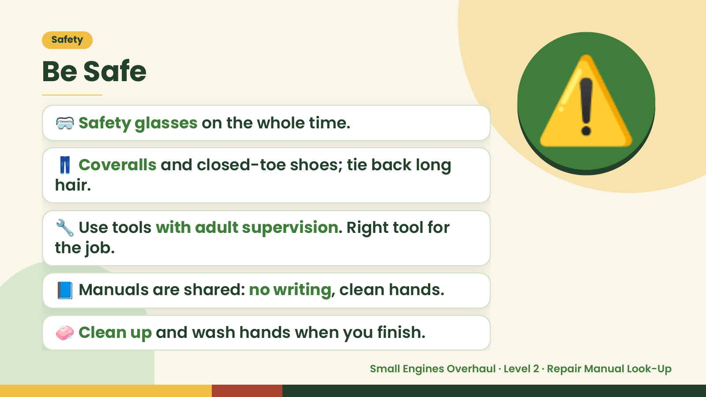
Notes:
Safety
Be Safe
🥽 Safety glasses on the whole time.
👖 Coveralls and closed-toe shoes; tie back long
hair.
⚠️
🔧 Use tools with adult supervision. Right tool for
the job.
📘 Manuals are shared: no writing, clean hands.
🧼 Clean up and wash hands when you finish.
Small Engines Overhaul · Level 2 · Repair Manual Look-Up

Slide 4
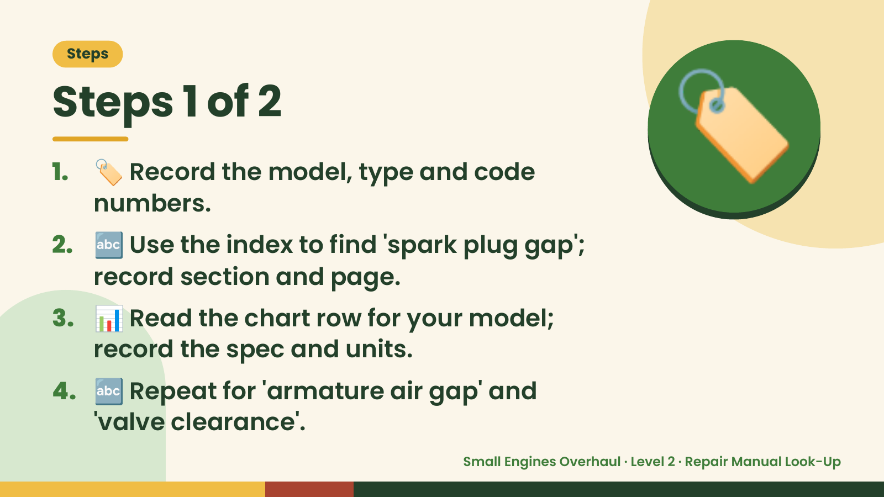
Notes:
Steps
Steps 1 of 2
1. 🏷️ Record the model, type and code
numbers.
2. 🔤 Use the index to find 'spark plug gap';
record section and page.
🏷️
3. 📊 Read the chart row for your model;
record the spec and units.
4. 🔤 Repeat for 'armature air gap' and
'valve clearance'.
Small Engines Overhaul · Level 2 · Repair Manual Look-Up

Slide 5
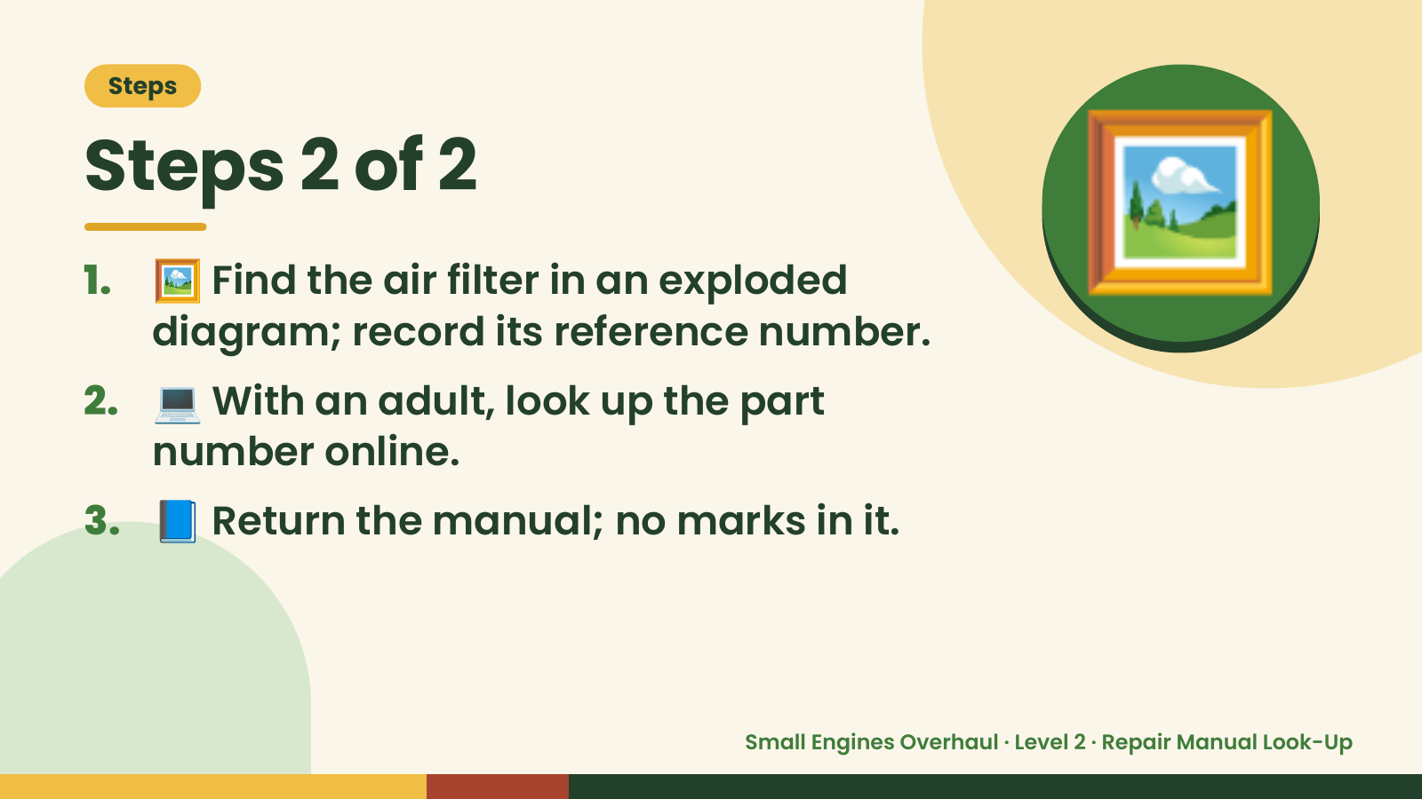
Notes:
Steps
Steps 2 of 2
1. 🖼️ Find the air filter in an exploded
diagram; record its reference number.
2. 💻 With an adult, look up the part
number online.
🖼️
3. 📘 Return the manual; no marks in it.
Small Engines Overhaul · Level 2 · Repair Manual Look-Up

Slide 6
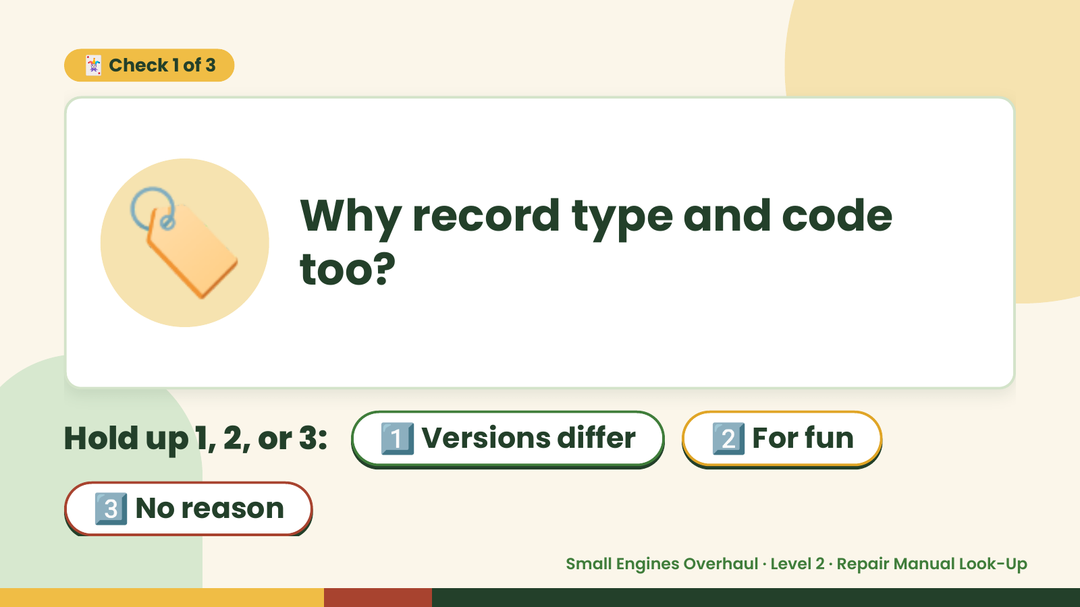
Notes:
🃏 Check 1 of 3
🏷️ Why record type and code
too?
Hold up 1, 2, or 3: 1️⃣ Versions differ 2️⃣ For fun
3️⃣ No reason
Small Engines Overhaul · Level 2 · Repair Manual Look-Up

Slide 7

Notes:
✅ Answer · Card 1 of 3
🏷️ Versions
differ
Versions.
Small Engines Overhaul · Level 2 · Repair Manual Look-Up

Slide 8
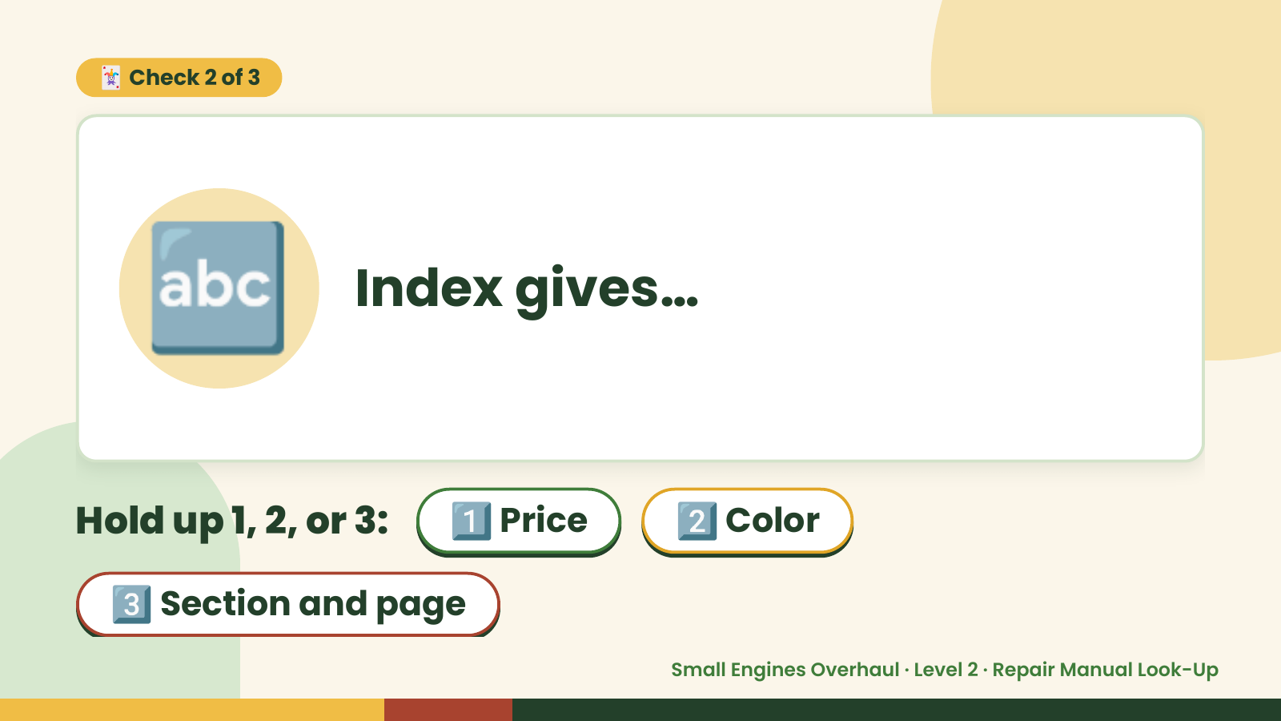
Notes:
🃏 Check 2 of 3
🔤 Index gives…
Hold up 1, 2, or 3: 1️⃣ Price 2️⃣ Color
3️⃣ Section and page
Small Engines Overhaul · Level 2 · Repair Manual Look-Up

Slide 9

Notes:
✅ Answer · Card 2 of 3
🔤 Section and
page
Location.
Small Engines Overhaul · Level 2 · Repair Manual Look-Up

Slide 10
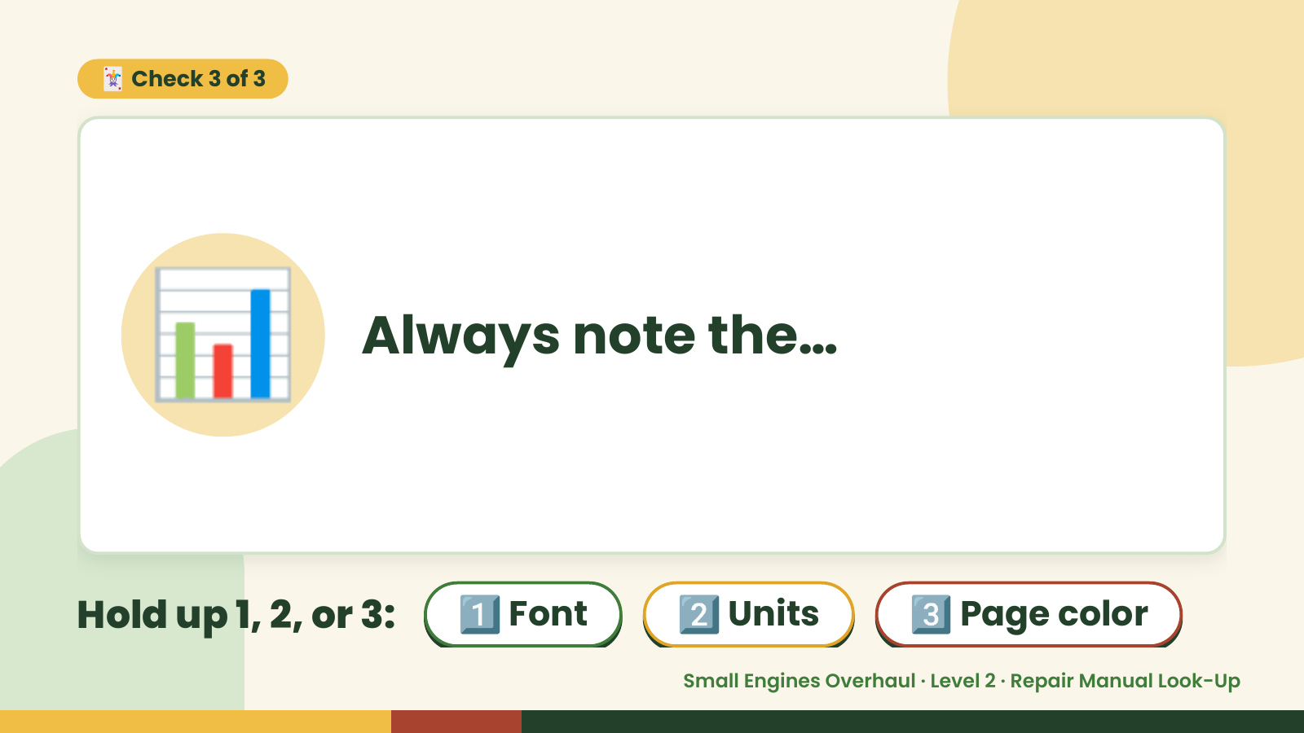
Notes:
🃏 Check 3 of 3
📊 Always note the…
Hold up 1, 2, or 3: 1️⃣ Font 2️⃣ Units 3️⃣ Page color
Small Engines Overhaul · Level 2 · Repair Manual Look-Up

Slide 11
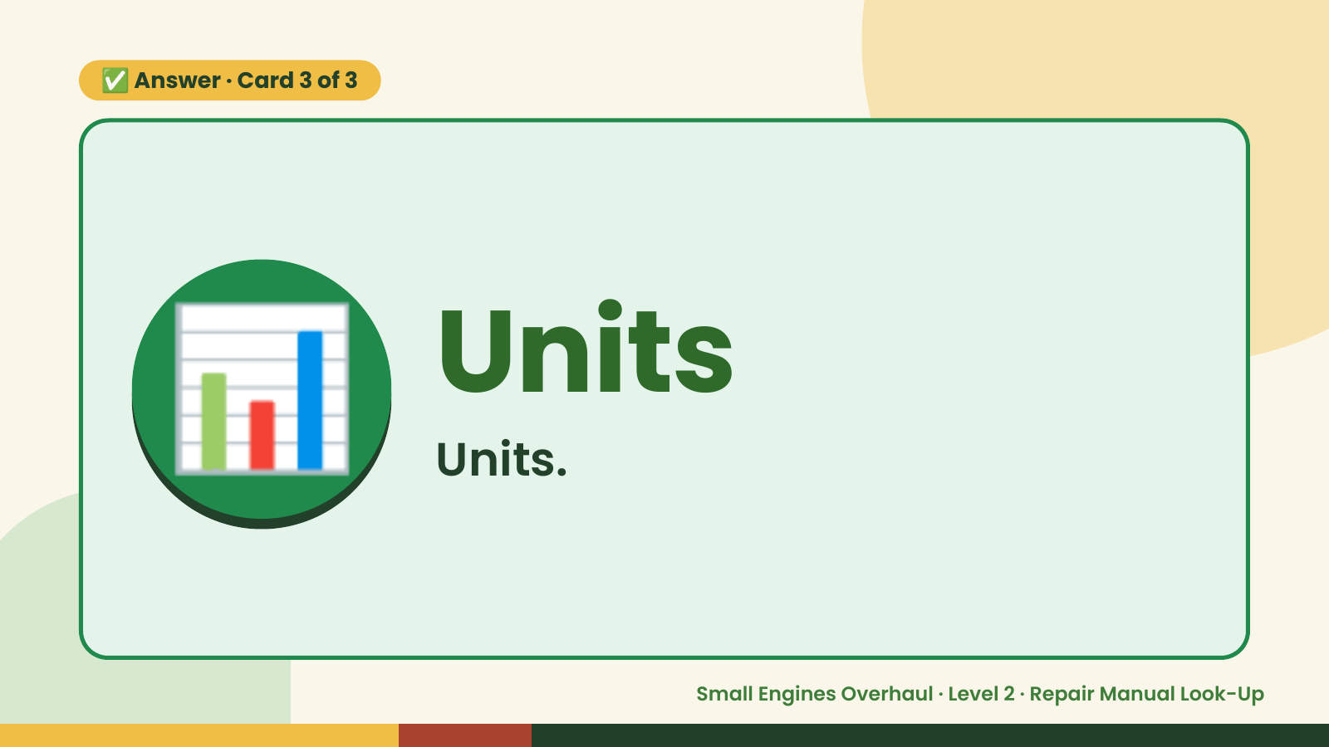
Notes:
✅ Answer · Card 3 of 3
📊 Units
Units.
Small Engines Overhaul · Level 2 · Repair Manual Look-Up

Slide 12

Notes:
Wrap-Up
Clean Up +
Reflect
🧽
Return and count tools.
Sweep and wipe your bench.
Wash hands, then do the reflection.
Small Engines Overhaul · Level 2 · Repair Manual Look-Up

