Slide 1
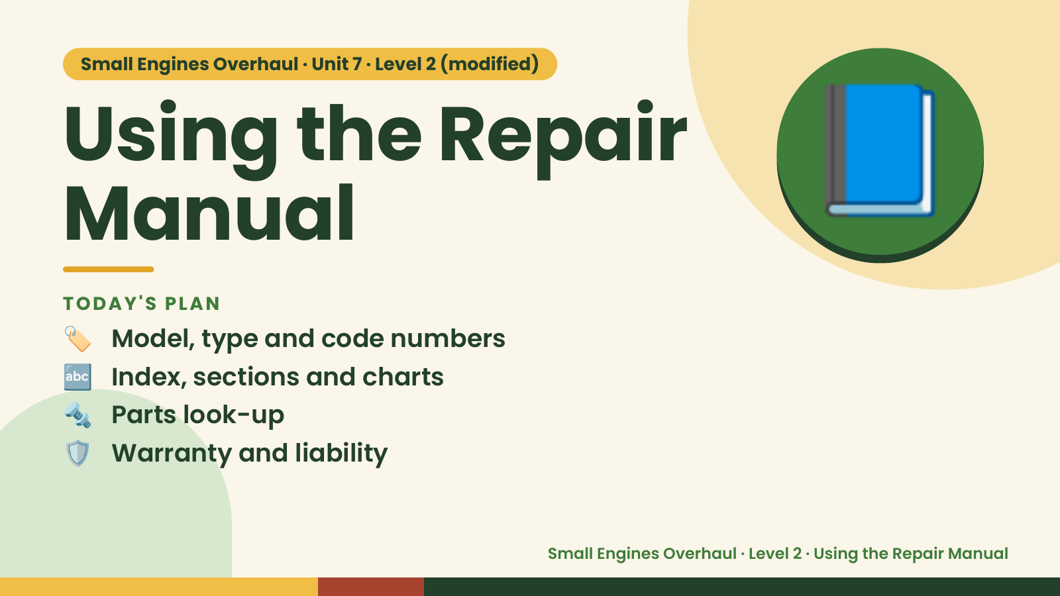
Notes:
Small Engines Overhaul · Unit 7 · Level 2 (modified)
Using the Repair
Manual
🏷️ Model, type and code numbers
TODAY'S PLAN
📘
🔤 Index, sections and charts
🔩 Parts look-up
🛡️ Warranty and liability
Small Engines Overhaul · Level 2 · Using the Repair Manual

Slide 2
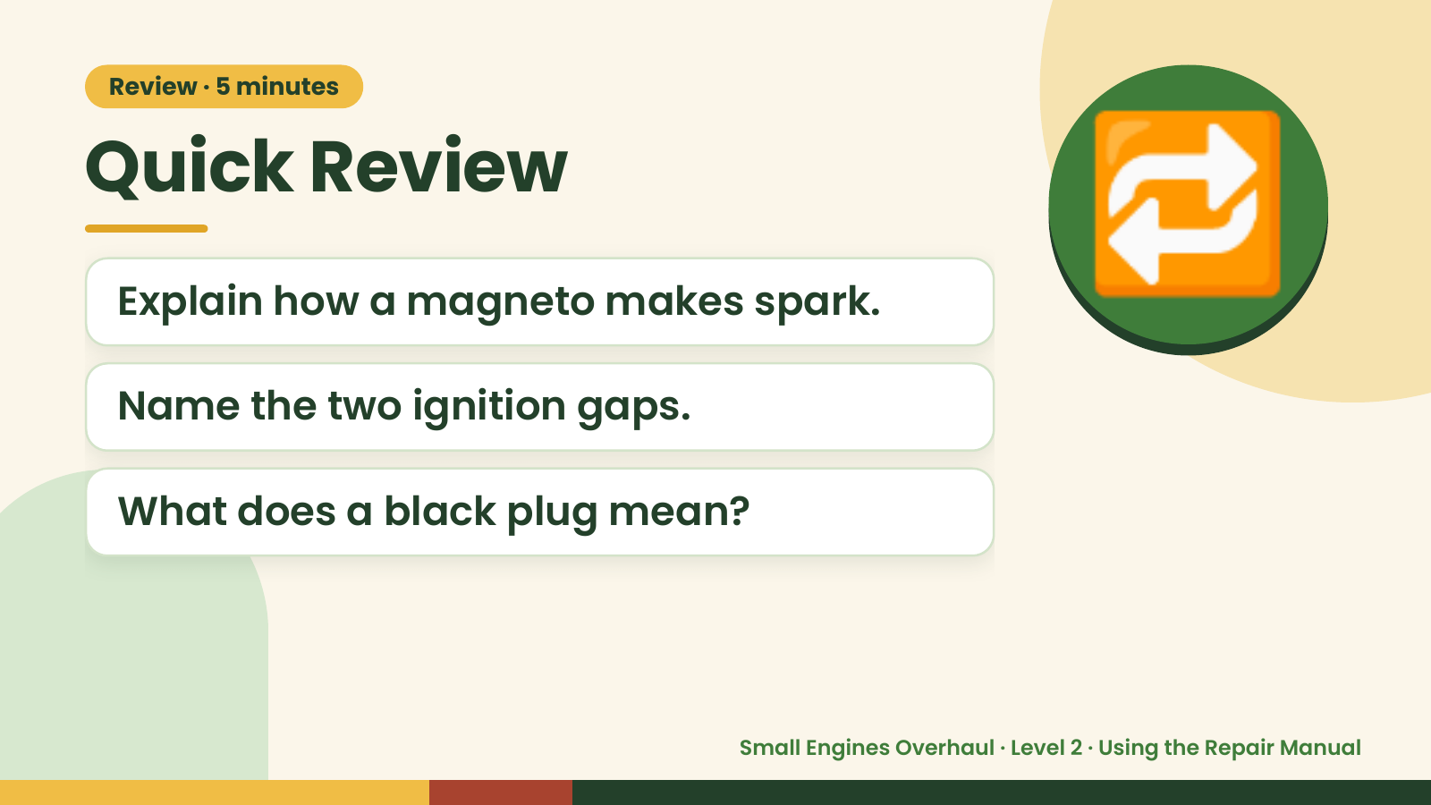
Notes:
Review · 5 minutes
Quick Review
Explain how a magneto makes spark.
Name the two ignition gaps.
🔁
What does a black plug mean?
Small Engines Overhaul · Level 2 · Using the Repair Manual

Slide 3
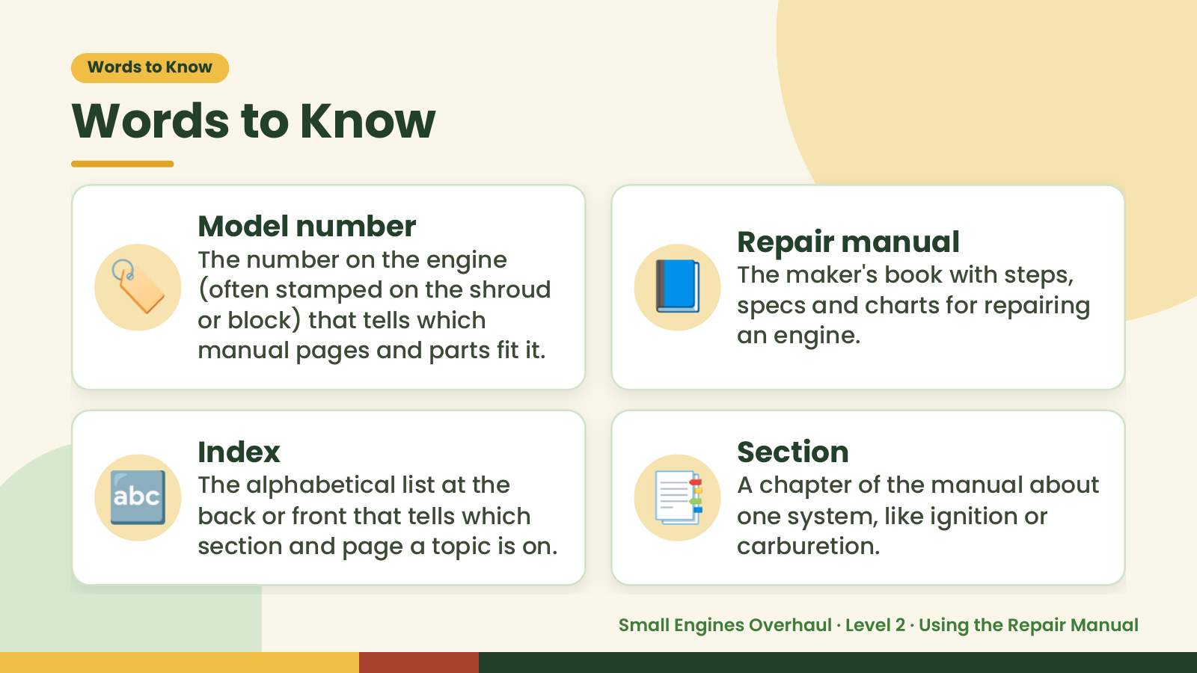
Notes:
Words to Know
Words to Know
🏷️ 📘
Model number
Repair manual
The number on the engine
The maker's book with steps,
(often stamped on the shroud
specs and charts for repairing
or block) that tells which
an engine.
manual pages and parts fit it.
🔤 Index
The alphabetical list at the
back or front that tells which
section and page a topic is on.
📑 Section
A chapter of the manual about
one system, like ignition or
carburetion.
Small Engines Overhaul · Level 2 · Using the Repair Manual

Slide 4
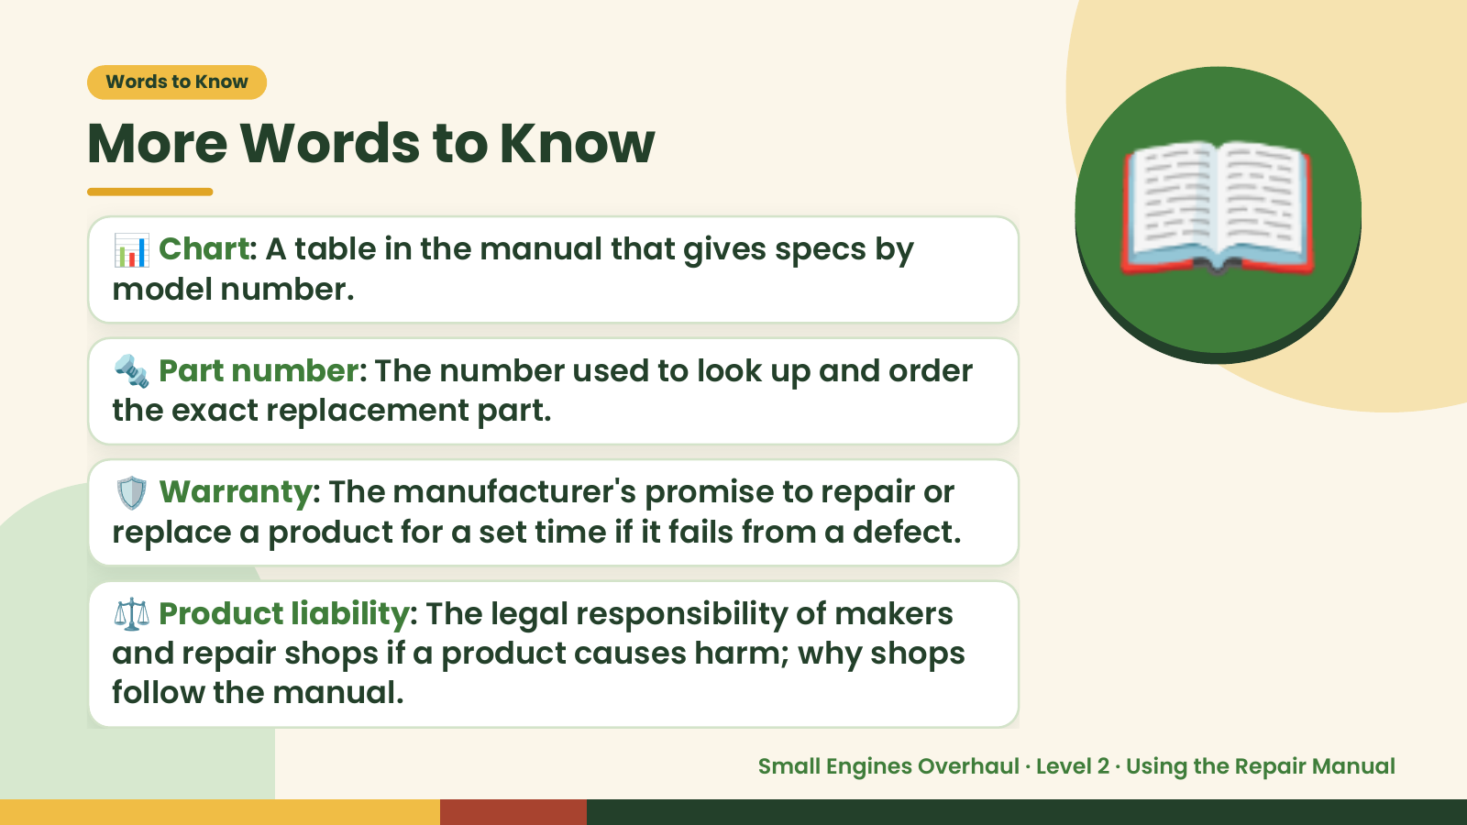
Notes:
Words to Know
More Words to Know
📊 Chart: A table in the manual that gives specs by
model number.
🔩 Part number: The number used to look up and order
the exact replacement part.
📖
🛡️ Warranty: The manufacturer's promise to repair or
replace a product for a set time if it fails from a defect.
⚖️ Product liability: The legal responsibility of makers
and repair shops if a product causes harm; why shops
follow the manual.
Small Engines Overhaul · Level 2 · Using the Repair Manual

Slide 5
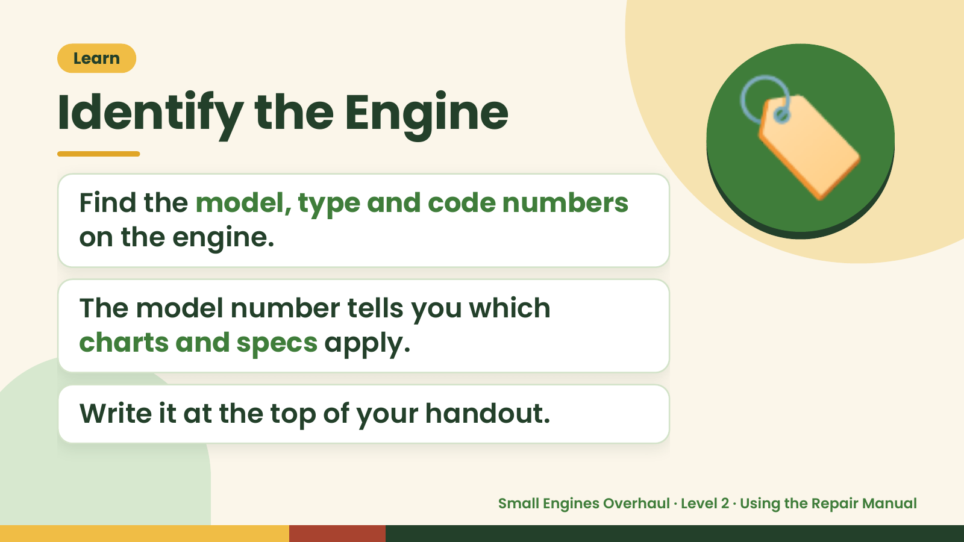
Notes:
Learn
Identify the Engine
Find the model, type and code numbers
on the engine.
🏷️
The model number tells you which
charts and specs apply.
Write it at the top of your handout.
Small Engines Overhaul · Level 2 · Using the Repair Manual

Slide 6
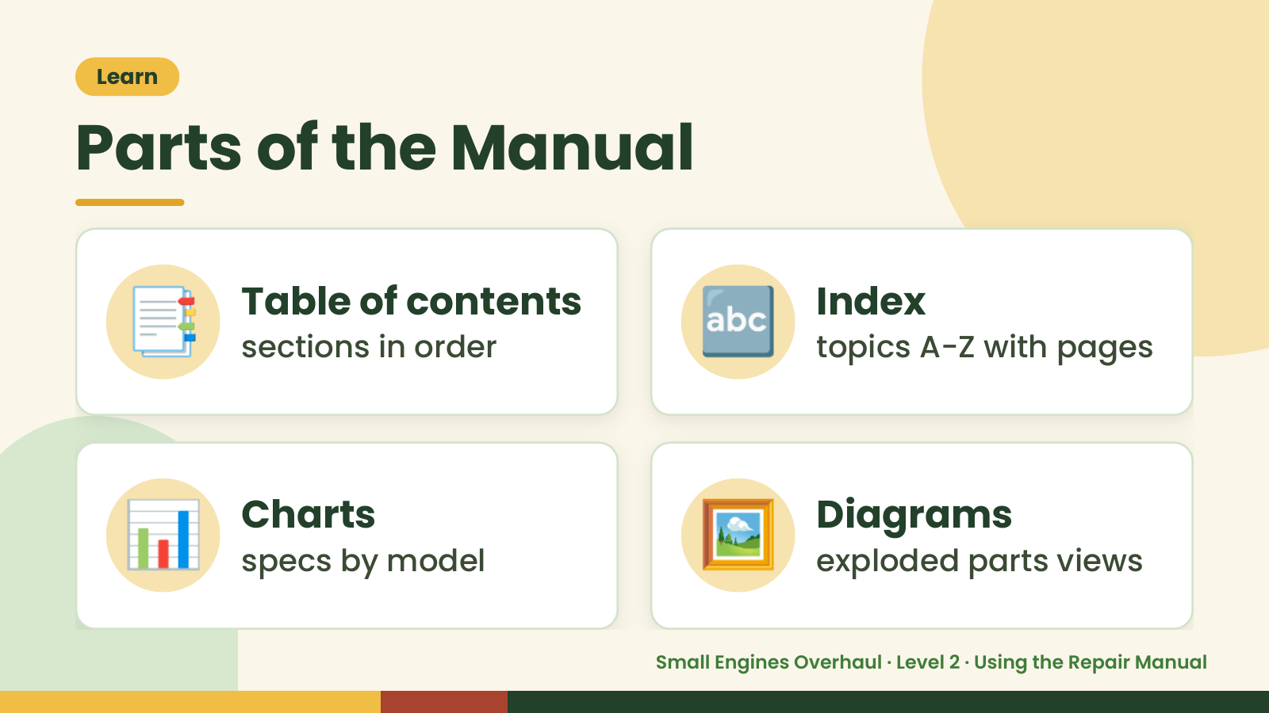
Notes:
Learn
Parts of the Manual
📑 Table of contents
sections in order 🔤 Index
topics A-Z with pages
📊 Charts
specs by model 🖼️ Diagrams
exploded parts views
Small Engines Overhaul · Level 2 · Using the Repair Manual

Slide 7
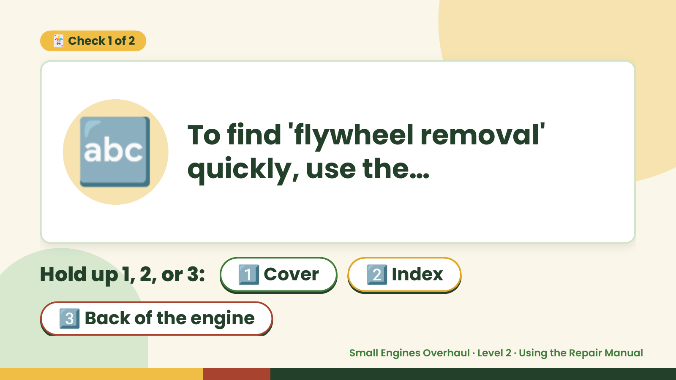
Notes:
🃏 Check 1 of 2
🔤 To find 'flywheel removal'
quickly, use the…
Hold up 1, 2, or 3: 1️⃣ Cover 2️⃣ Index
3️⃣ Back of the engine
Small Engines Overhaul · Level 2 · Using the Repair Manual

Slide 8
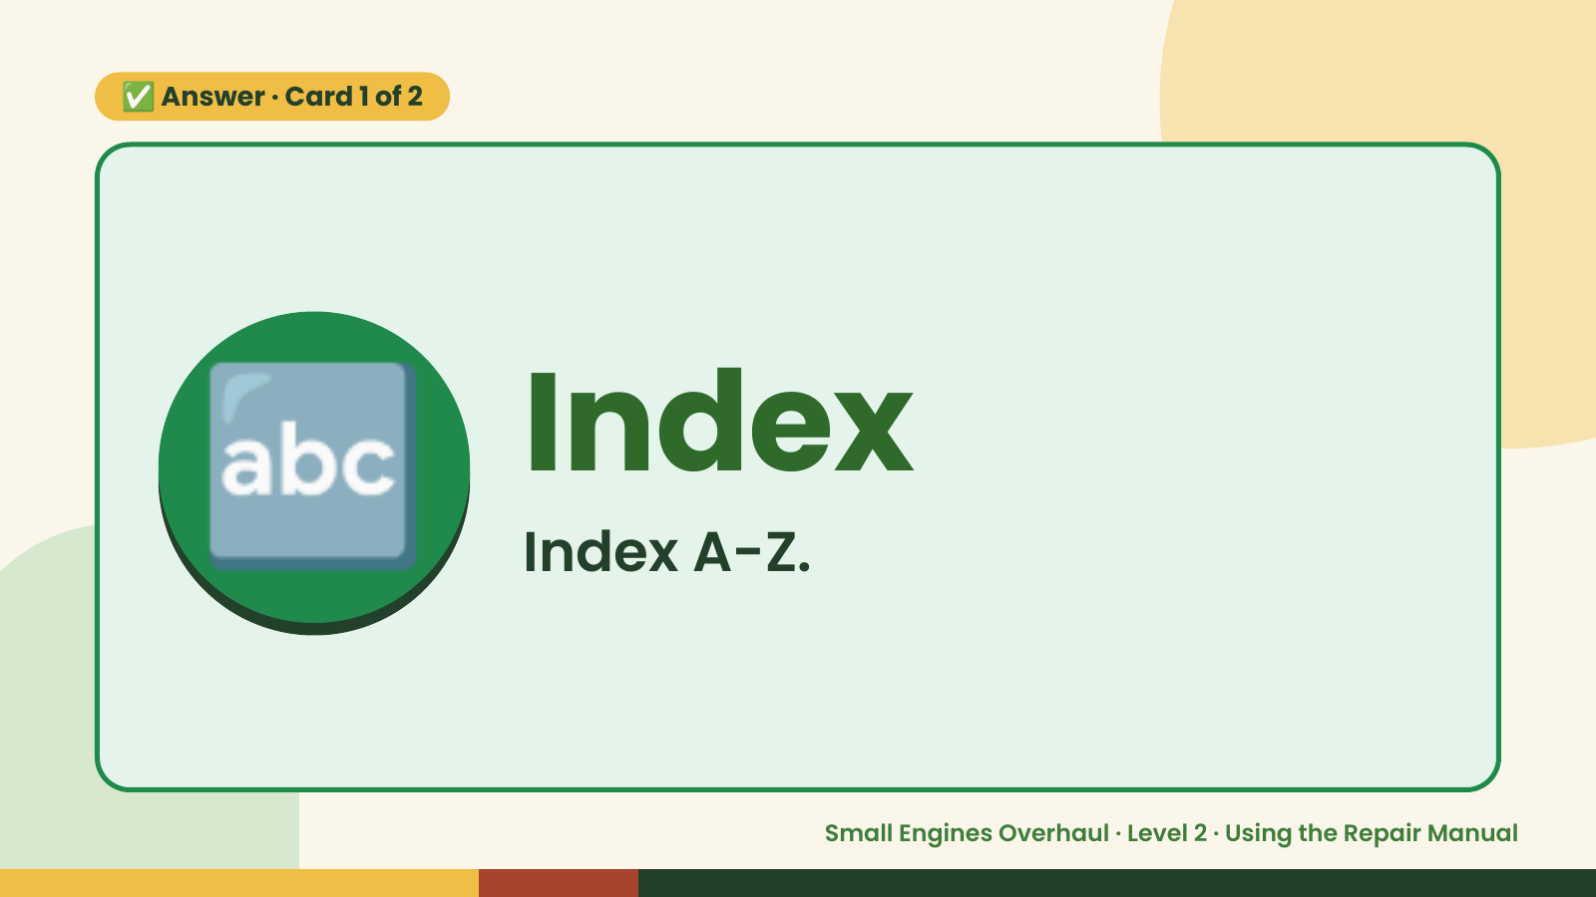
Notes:
✅ Answer · Card 1 of 2
🔤 Index
Index A-Z.
Small Engines Overhaul · Level 2 · Using the Repair Manual

Slide 9
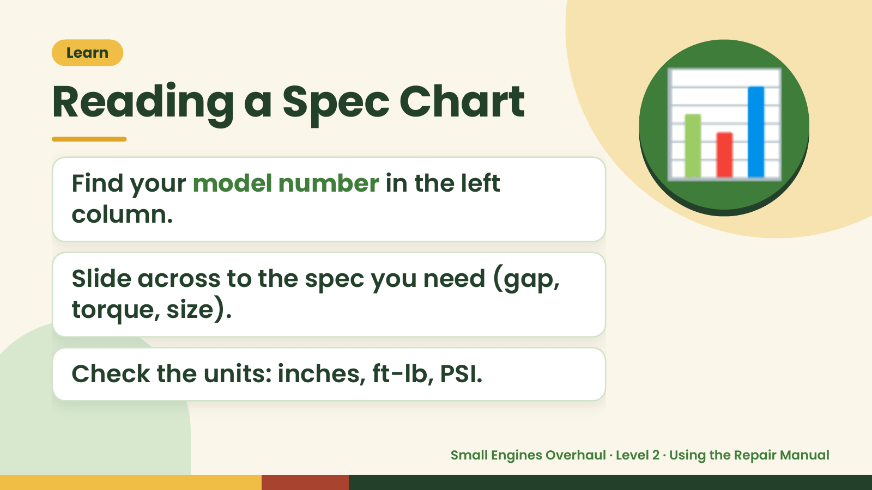
Notes:
Learn
Reading a Spec Chart
Find your model number in the left
column.
📊
Slide across to the spec you need (gap,
torque, size).
Check the units: inches, ft-lb, PSI.
Small Engines Overhaul · Level 2 · Using the Repair Manual

Slide 10
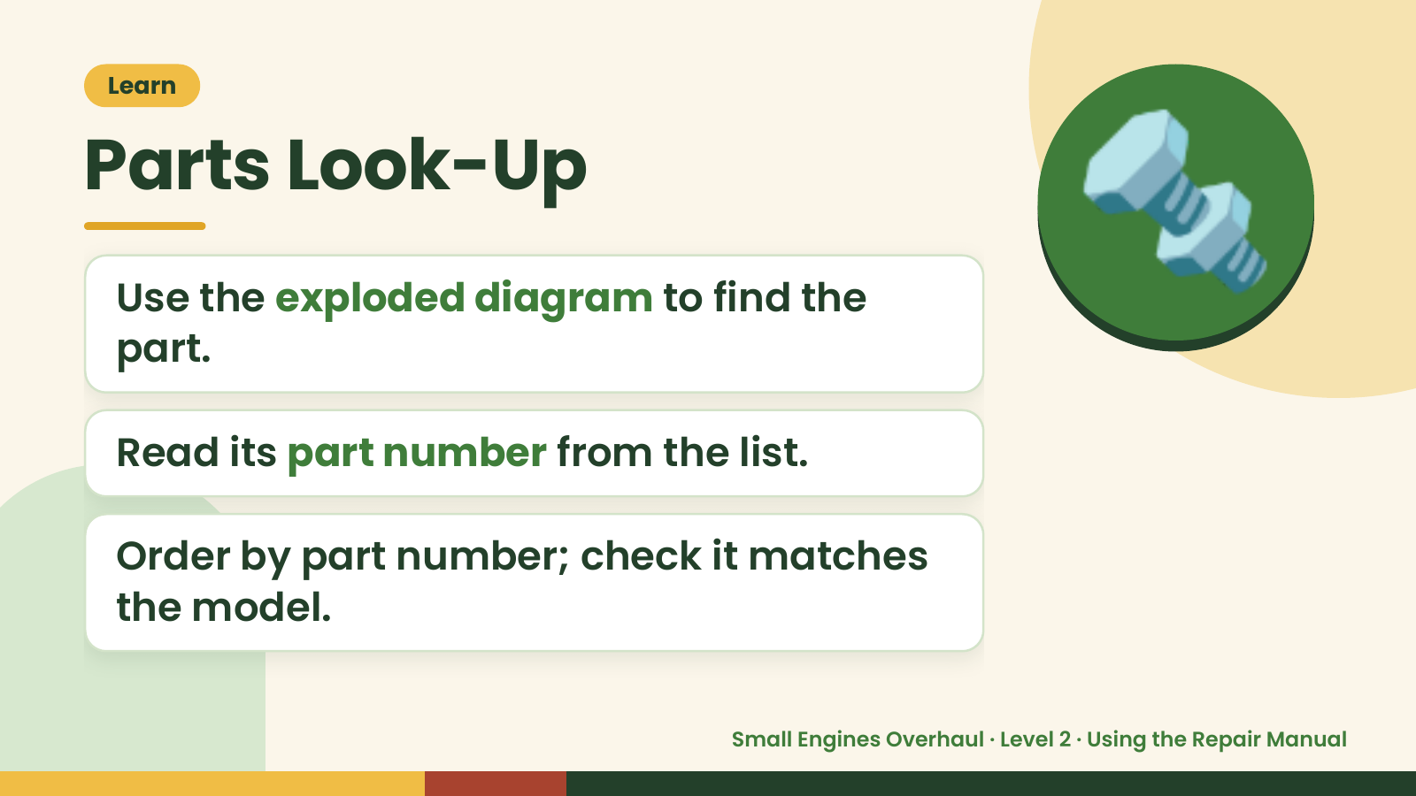
Notes:
Learn
Parts Look-Up
Use the exploded diagram to find the
part.
🔩
Read its part number from the list.
Order by part number; check it matches
the model.
Small Engines Overhaul · Level 2 · Using the Repair Manual

Slide 11
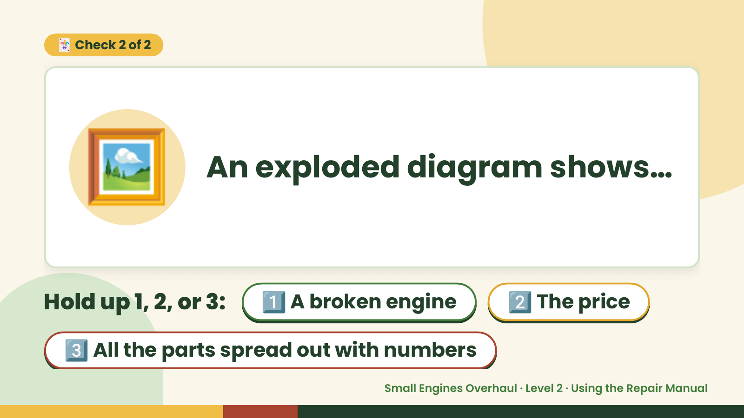
Notes:
🃏 Check 2 of 2
🖼️ An exploded diagram shows…
Hold up 1, 2, or 3: 1️⃣ A broken engine 2️⃣ The price
3️⃣ All the parts spread out with numbers
Small Engines Overhaul · Level 2 · Using the Repair Manual

Slide 12
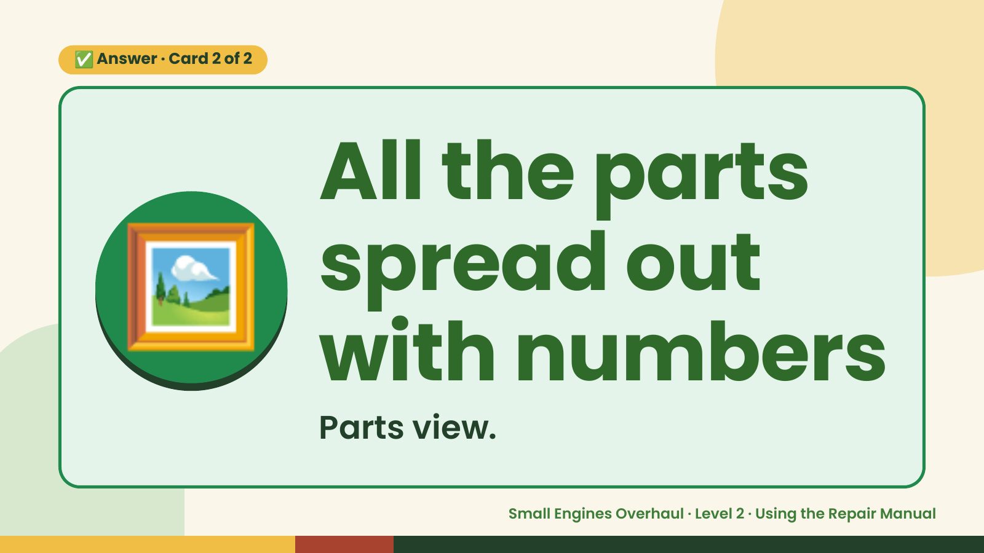
Notes:
✅ Answer · Card 2 of 2
🖼️ All the parts
spread out
with numbers
Parts view.
Small Engines Overhaul · Level 2 · Using the Repair Manual

Slide 13
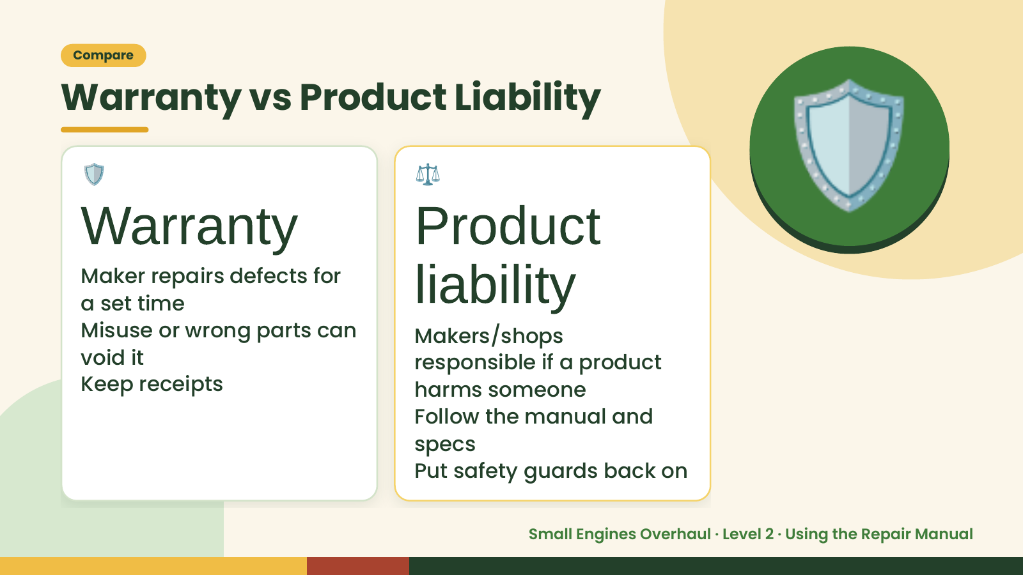
Notes:
Compare
Warranty vs Product Liability
🛡️
Warranty
Maker repairs defects for
a set time
⚖️
Product
liability
🛡️
Misuse or wrong parts can Makers/shops
void it responsible if a product
Keep receipts harms someone
Follow the manual and
specs
Put safety guards back on
Small Engines Overhaul · Level 2 · Using the Repair Manual

Slide 14
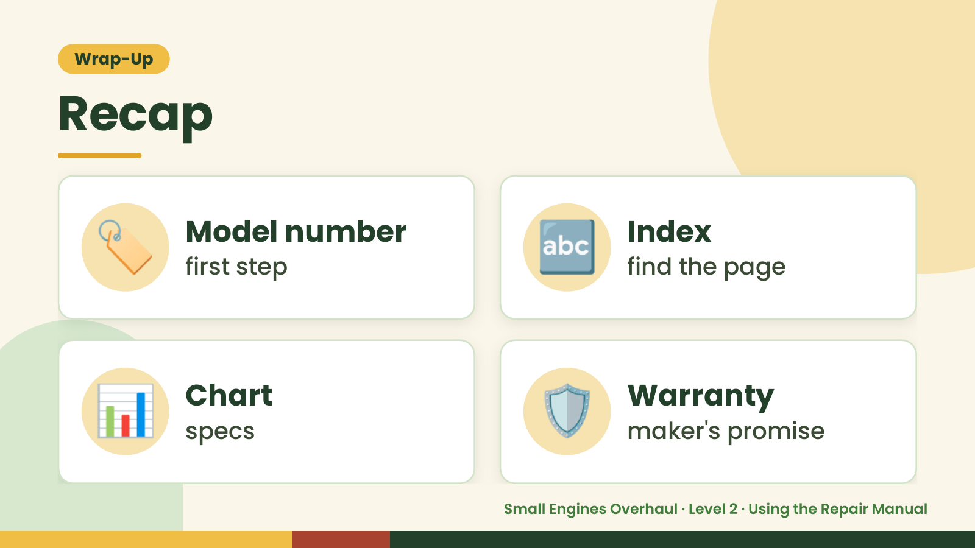
Notes:
Wrap-Up
Recap
🏷️ Model number
first step 🔤 Index
find the page
📊 Chart
specs 🛡️ Warranty
maker's promise
Small Engines Overhaul · Level 2 · Using the Repair Manual

Slide 15

Notes:
Wrap-Up
Exit Ticket
What do you find first?
Where do you look up a page fast?
🎟️
Name one thing that can void a
warranty.
Small Engines Overhaul · Level 2 · Using the Repair Manual

