Slide 1

Notes:
Small Engines Overhaul · Unit 8 · Level 1
Engine Teardown
& Rebuild
👥 Jobs
TODAY'S PLAN
🔧
⚠️ Safety
🔧 Steps
✅ Check
📝 Reflect
Small Engines Overhaul · Level 1 · Engine Teardown & Rebuild

Slide 2

Notes:
Get ready
Jobs
🔧 Mechanic
fixes 🧰 Tool helper
gets tools
📋 Recorder
writes 🧽 Clean-up
captain
cleans
Small Engines Overhaul · Level 1 · Engine Teardown & Rebuild

Slide 3
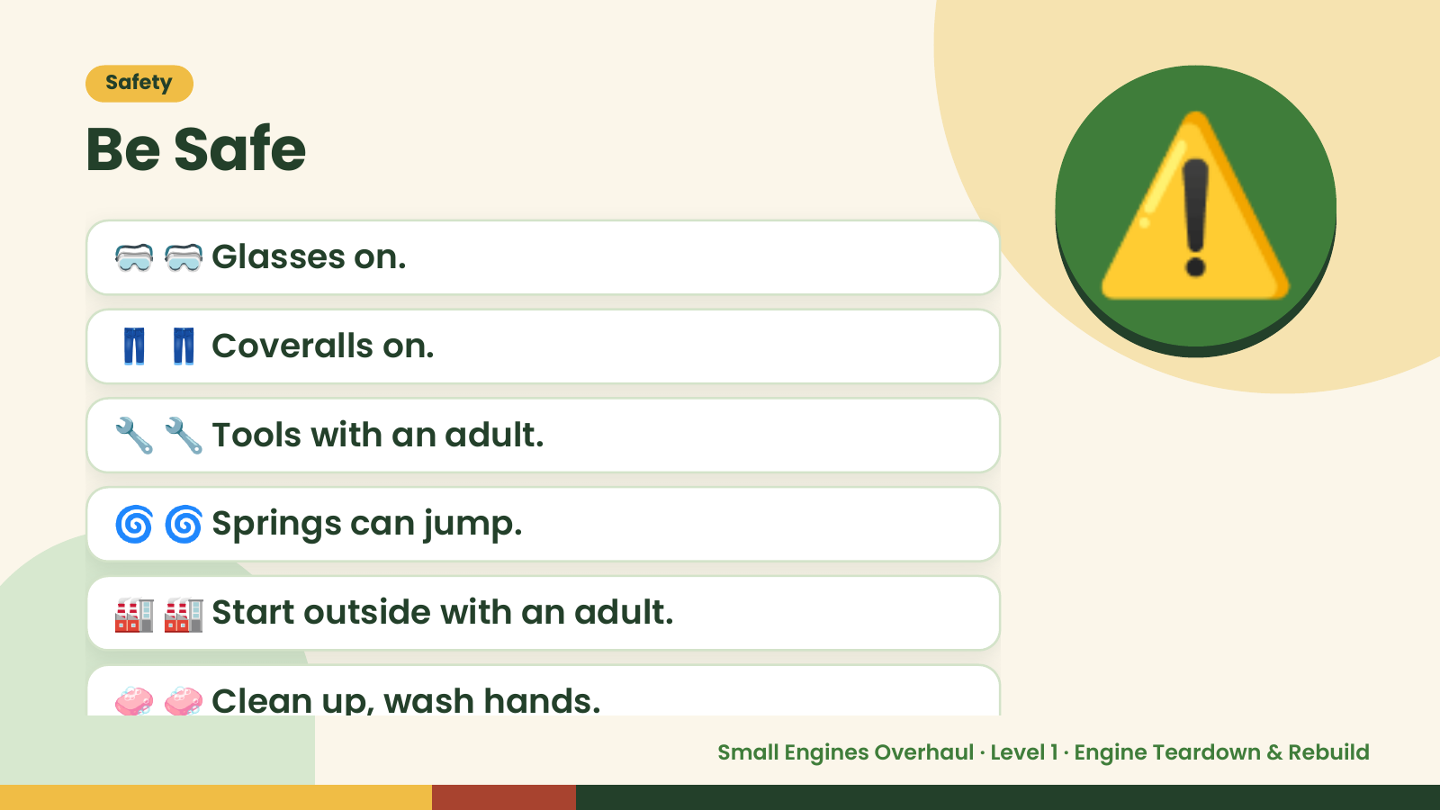
Notes:
Safety
Be Safe
🥽 🥽 Glasses on.
👖 👖 Coveralls on.
🔧 🔧 Tools with an adult.
⚠️
🌀 🌀 Springs can jump.
🏭 🏭 Start outside with an adult.
🧼 🧼 Clean up, wash hands.
Small Engines Overhaul · Level 1 · Engine Teardown & Rebuild

Slide 4
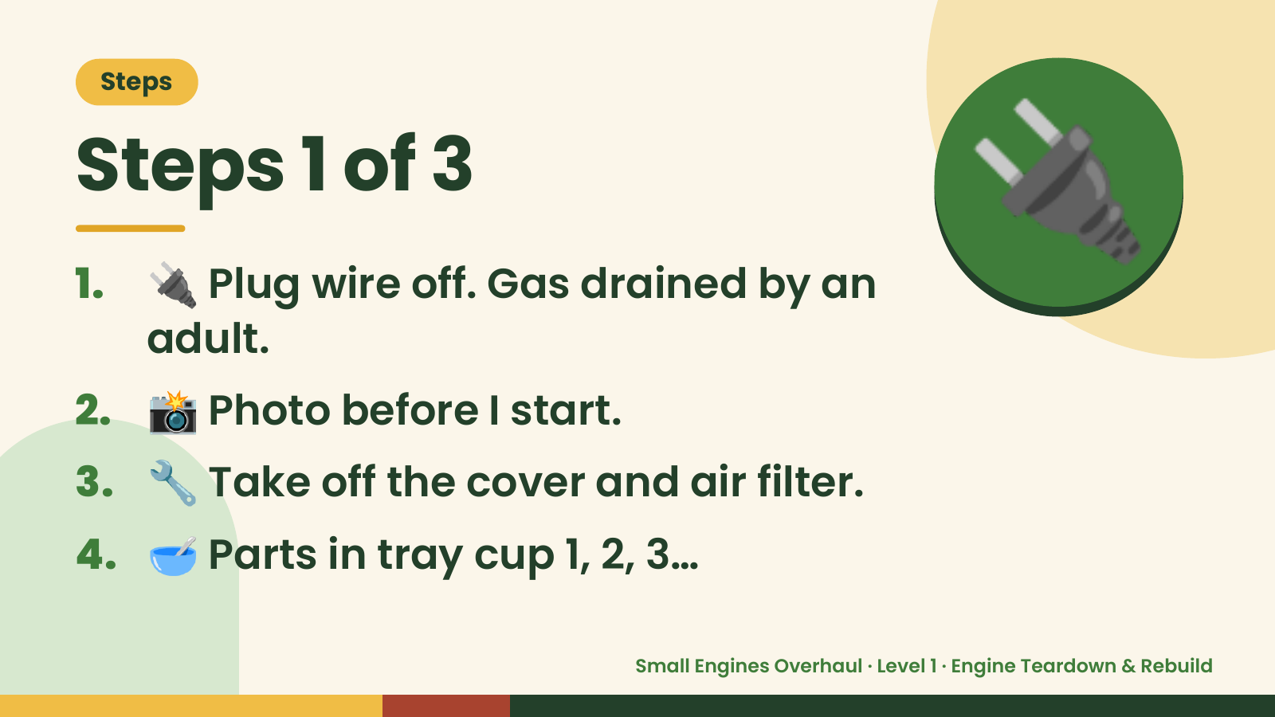
Notes:
Steps
Steps 1 of 3
1. 🔌 Plug wire off. Gas drained by an
adult.
🔌
2. 📸 Photo before I start.
3. 🔧 Take off the cover and air filter.
4. 🥣 Parts in tray cup 1, 2, 3…
Small Engines Overhaul · Level 1 · Engine Teardown & Rebuild

Slide 5
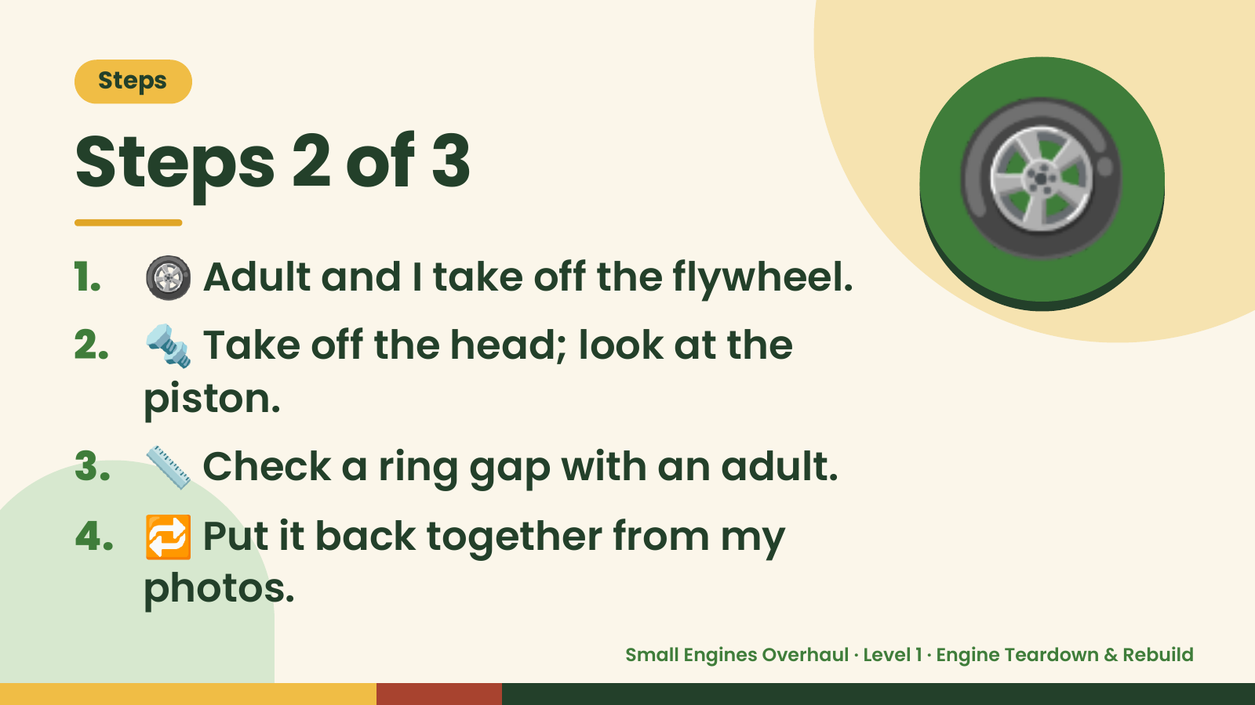
Notes:
Steps
Steps 2 of 3
1. 🛞 Adult and I take off the flywheel.
2. 🔩 Take off the head; look at the
🛞
piston.
3. 📏 Check a ring gap with an adult.
4. 🔁 Put it back together from my
photos.
Small Engines Overhaul · Level 1 · Engine Teardown & Rebuild

Slide 6
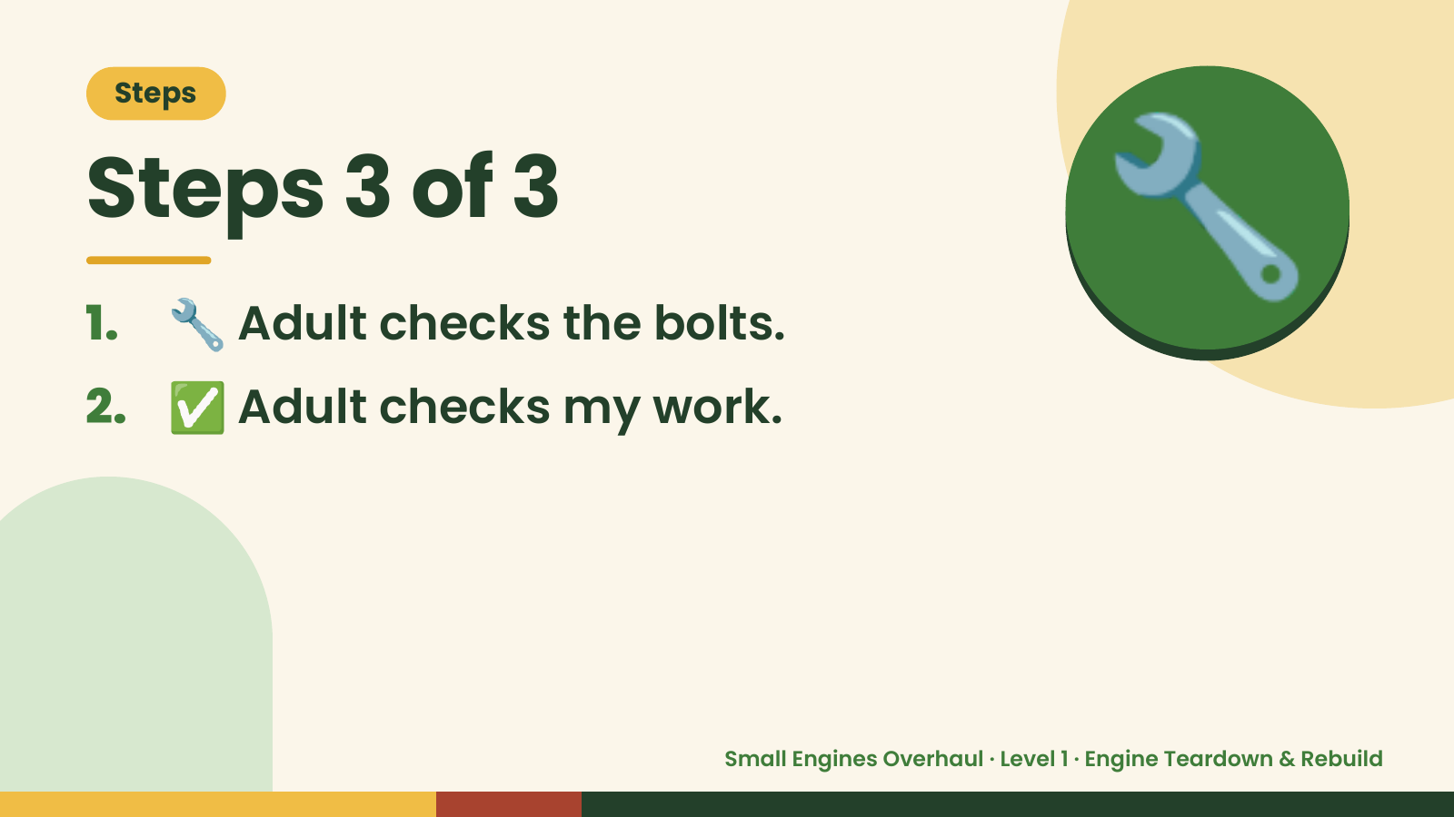
Notes:
Steps
Steps 3 of 3
1. 🔧 Adult checks the bolts.
2. ✅ Adult checks my work.
🔧
Small Engines Overhaul · Level 1 · Engine Teardown & Rebuild

Slide 7
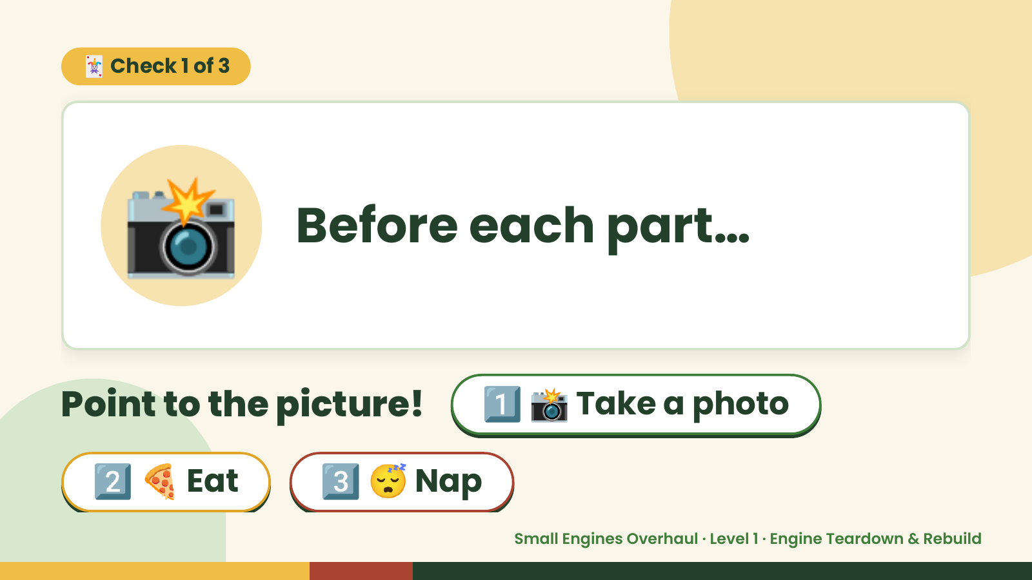
Notes:
🃏 Check 1 of 3
📸 Before each part…
Point to the picture! 1️⃣ 📸 Take a photo
2️⃣ 🍕 Eat 3️⃣ 😴 Nap
Small Engines Overhaul · Level 1 · Engine Teardown & Rebuild

Slide 8

Notes:
📸
✅ Answer · Card 1 of 3
📸 photo
Take a
Photo.
Small Engines Overhaul · Level 1 · Engine Teardown & Rebuild

Slide 9
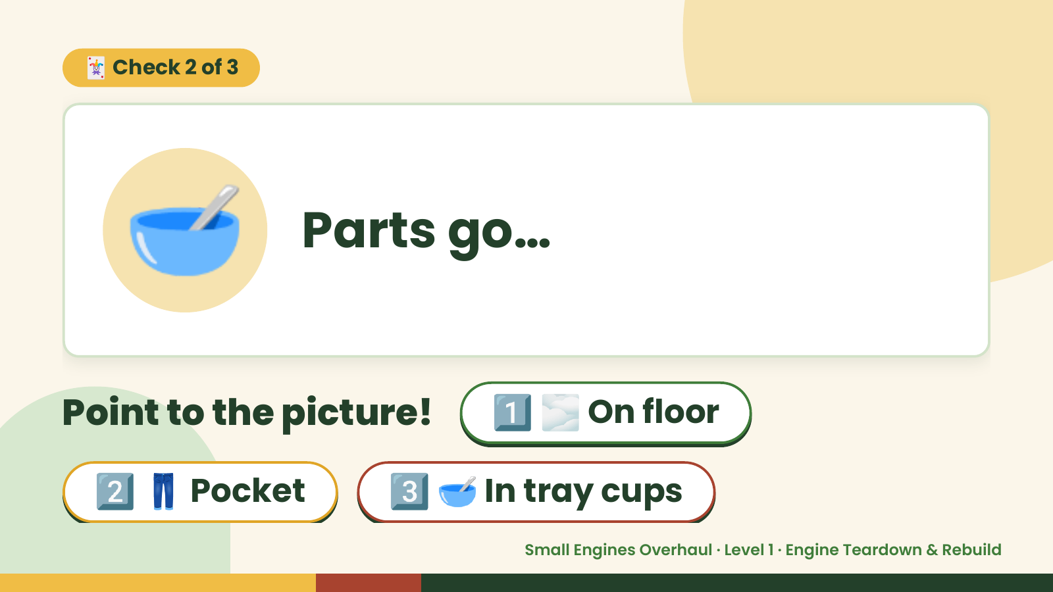
Notes:
🃏 Check 2 of 3
🥣 Parts go…
Point to the picture! 1️⃣ 🌫️ On floor
2️⃣ 👖 Pocket 3️⃣ 🥣 In tray cups
Small Engines Overhaul · Level 1 · Engine Teardown & Rebuild

Slide 10
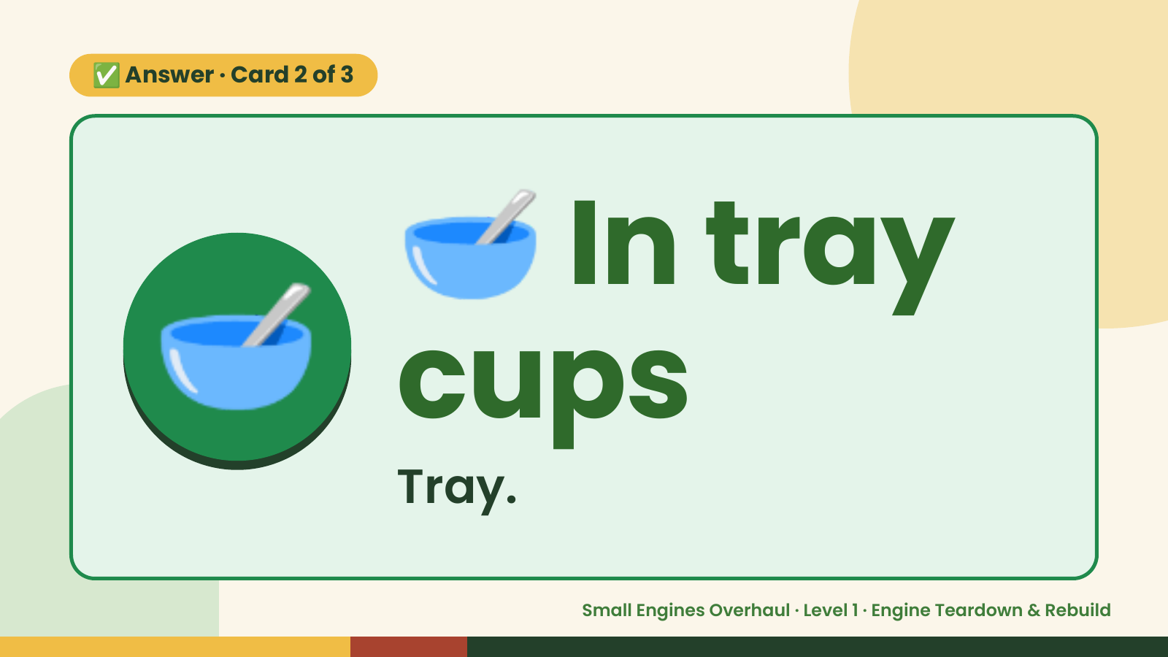
Notes:
🥣
✅ Answer · Card 2 of 3
🥣 cups
In tray
Tray.
Small Engines Overhaul · Level 1 · Engine Teardown & Rebuild

Slide 11
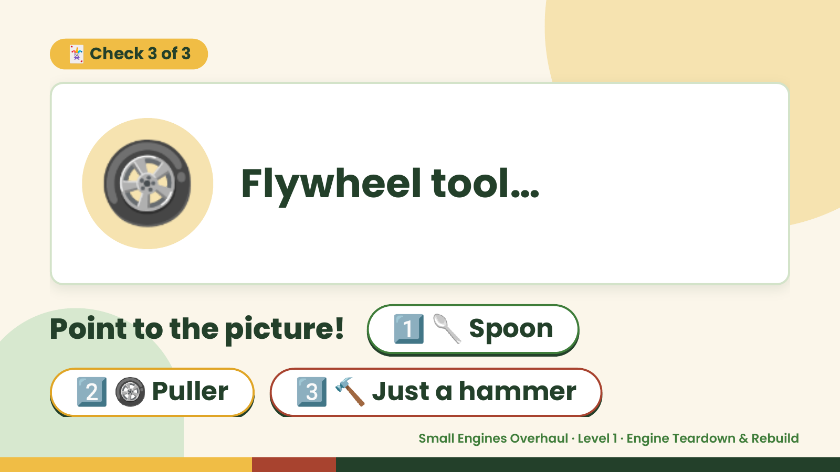
Notes:
🃏 Check 3 of 3
🛞 Flywheel tool…
Point to the picture! 1️⃣ 🥄 Spoon
2️⃣ 🛞 Puller 3️⃣ 🔨 Just a hammer
Small Engines Overhaul · Level 1 · Engine Teardown & Rebuild

Slide 12
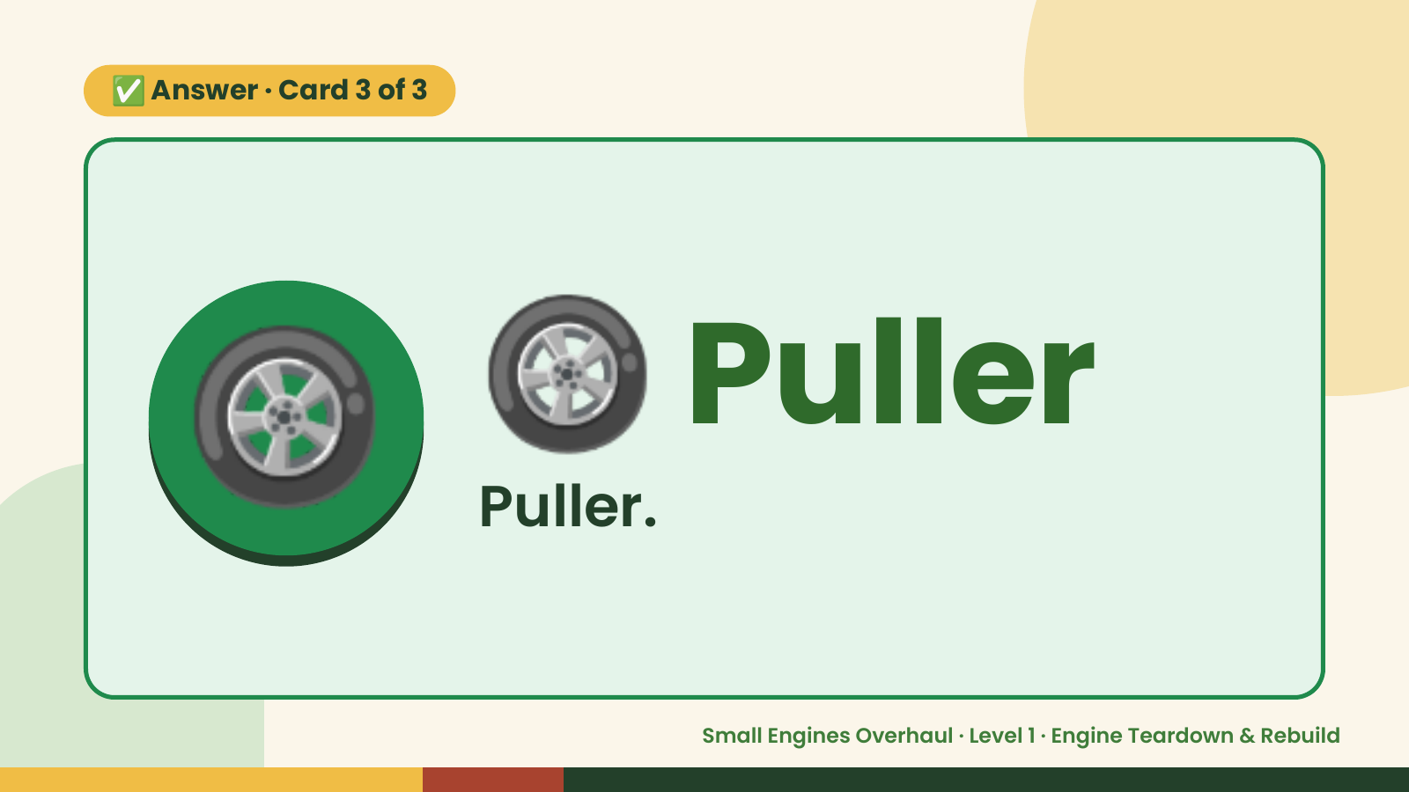
Notes:
✅ Answer · Card 3 of 3
🛞 🛞 Puller
Puller.
Small Engines Overhaul · Level 1 · Engine Teardown & Rebuild

Slide 13

Notes:
Wrap-Up
Clean Up +
Reflect
🧽
🧽 Wipe the bench.
🧰 Give tools back.
🧼 Wash hands.
Small Engines Overhaul · Level 1 · Engine Teardown & Rebuild

