Slide 1
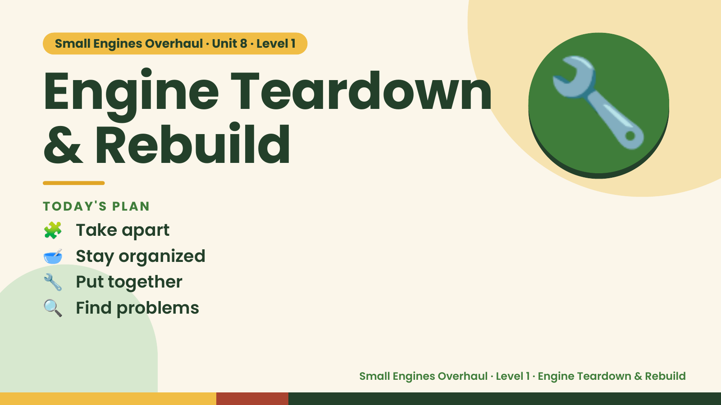
Notes:
Small Engines Overhaul · Unit 8 · Level 1
Engine Teardown
& Rebuild
🧩 Take apart
TODAY'S PLAN
🔧
🥣 Stay organized
🔧 Put together
🔍 Find problems
Small Engines Overhaul · Level 1 · Engine Teardown & Rebuild

Slide 2
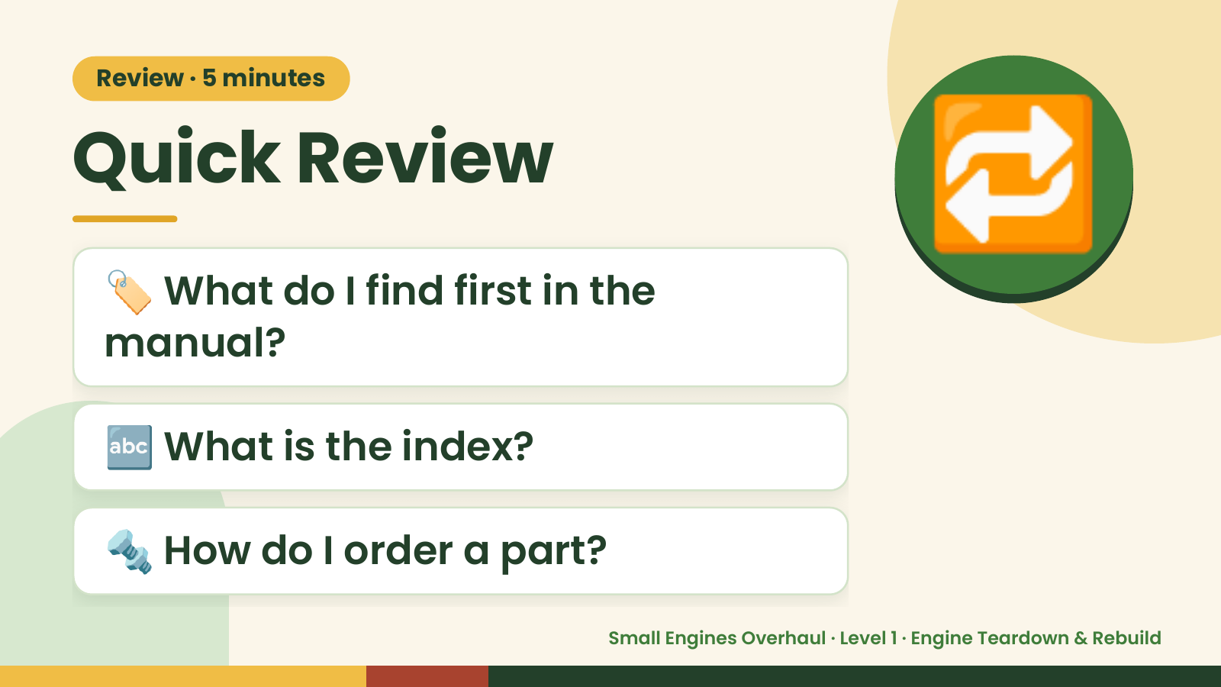
Notes:
Review · 5 minutes
Quick Review
🏷️ What do I find first in the
manual?
🔁
🔤 What is the index?
🔩 How do I order a part?
Small Engines Overhaul · Level 1 · Engine Teardown & Rebuild

Slide 3
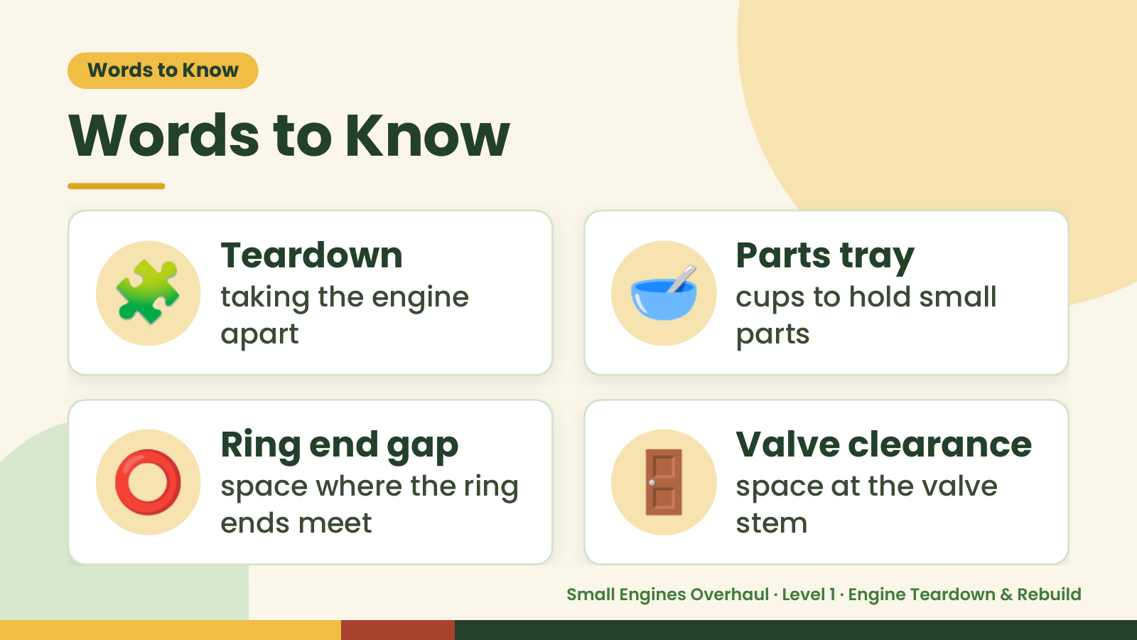
Notes:
Words to Know
Words to Know
🧩 Teardown
taking the engine
apart
🥣 Parts tray
cups to hold small
parts
⭕ Ring end gap
space where the ring
ends meet
🚪 Valve clearance
space at the valve
stem
Small Engines Overhaul · Level 1 · Engine Teardown & Rebuild

Slide 4
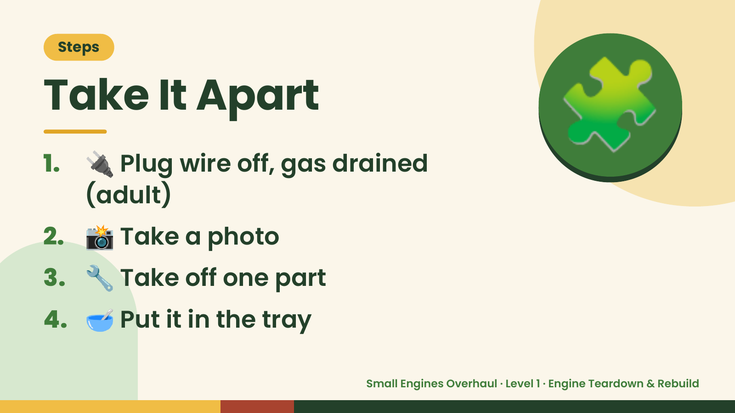
Notes:
Steps
Take It Apart
1. 🔌 Plug wire off, gas drained
(adult)
🧩
2. 📸 Take a photo
3. 🔧 Take off one part
4. 🥣 Put it in the tray
Small Engines Overhaul · Level 1 · Engine Teardown & Rebuild

Slide 5
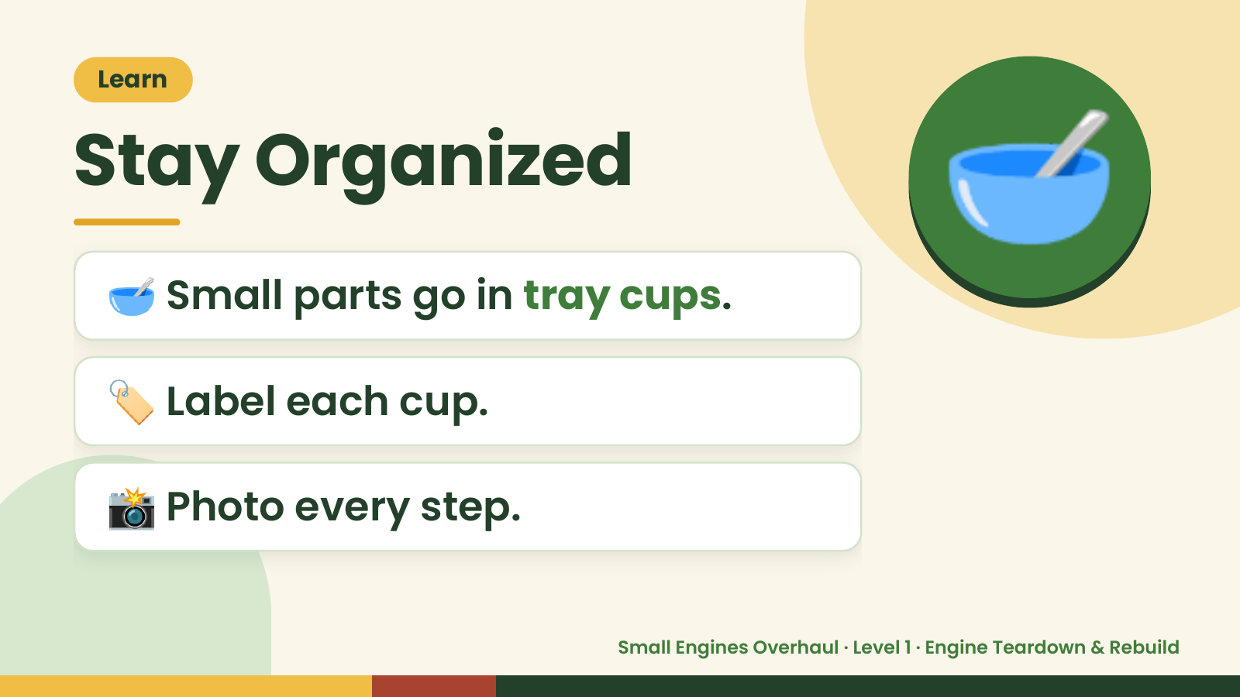
Notes:
Learn
Stay Organized
🥣 Small parts go in tray cups.
🥣
🏷️ Label each cup.
📸 Photo every step.
Small Engines Overhaul · Level 1 · Engine Teardown & Rebuild

Slide 6
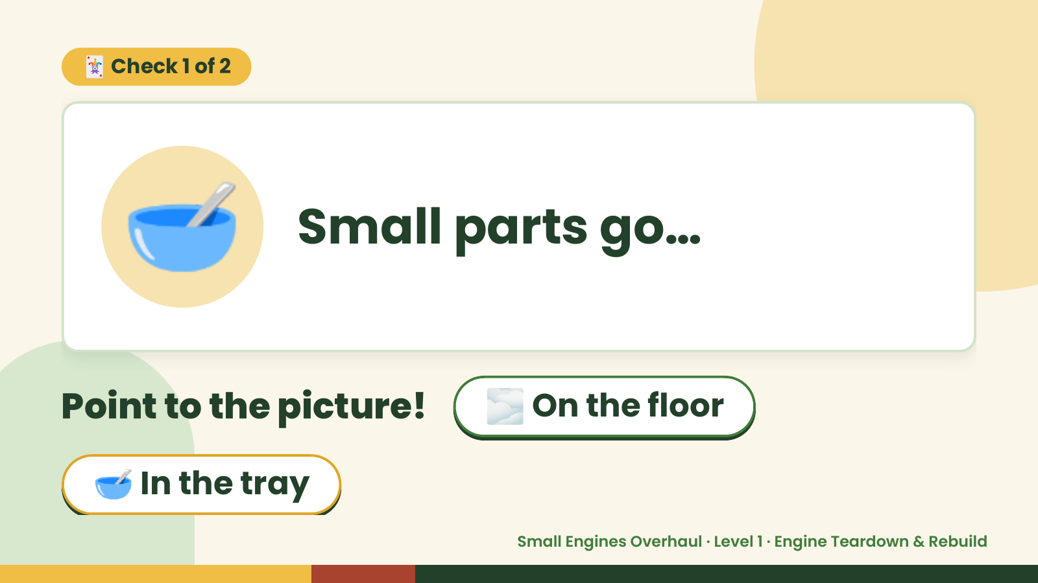
Notes:
🃏 Check 1 of 2
🥣 Small parts go…
Point to the picture! 🌫️ On the floor
🥣 In the tray
Small Engines Overhaul · Level 1 · Engine Teardown & Rebuild

Slide 7
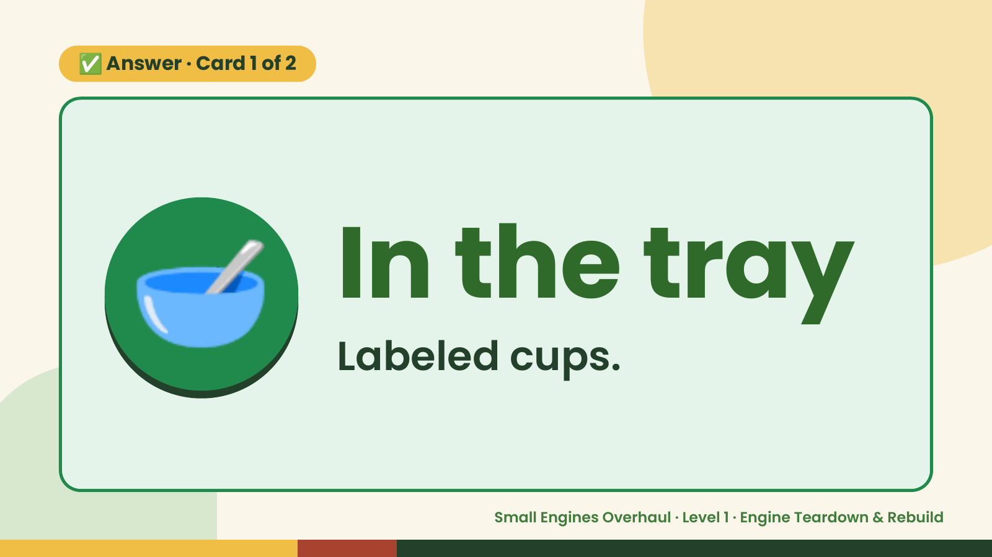
Notes:
✅ Answer · Card 1 of 2
🥣 In the tray
Labeled cups.
Small Engines Overhaul · Level 1 · Engine Teardown & Rebuild

Slide 8
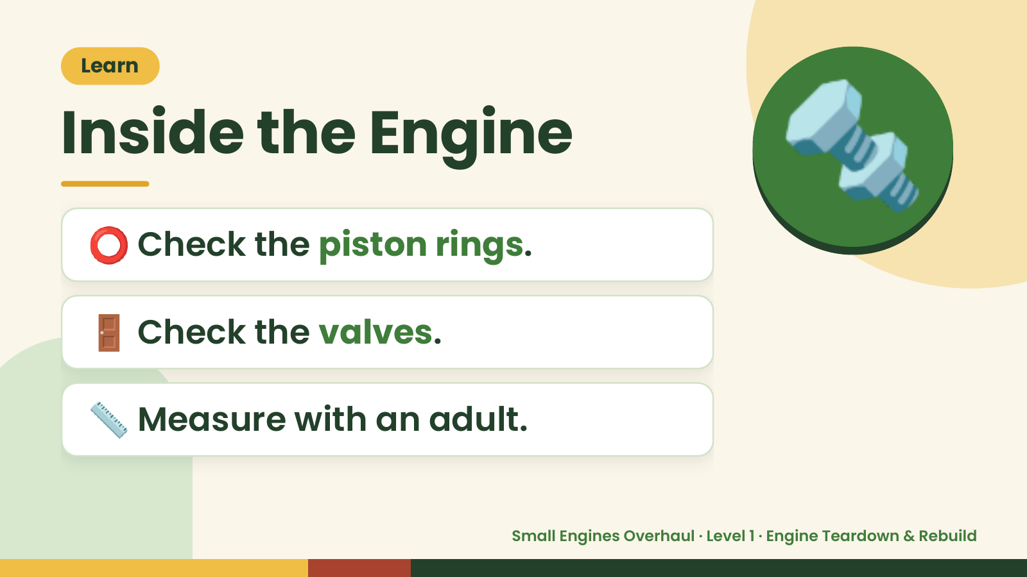
Notes:
Learn
Inside the Engine
⭕ Check the piston rings.
🔩
🚪 Check the valves.
📏 Measure with an adult.
Small Engines Overhaul · Level 1 · Engine Teardown & Rebuild

Slide 9
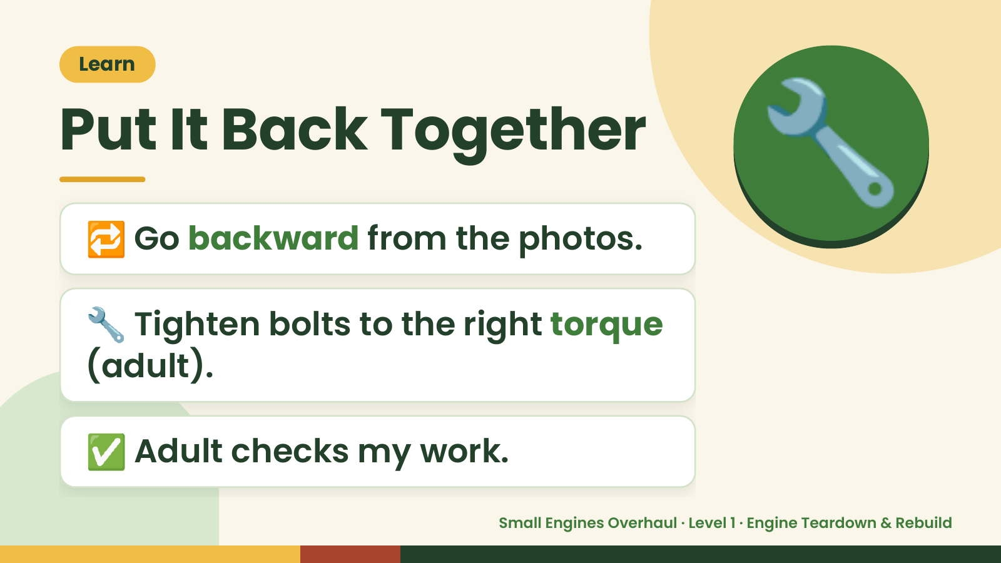
Notes:
Learn
Put It Back Together
🔁 Go backward from the photos.
🔧
🔧 Tighten bolts to the right torque
(adult).
✅ Adult checks my work.
Small Engines Overhaul · Level 1 · Engine Teardown & Rebuild

Slide 10
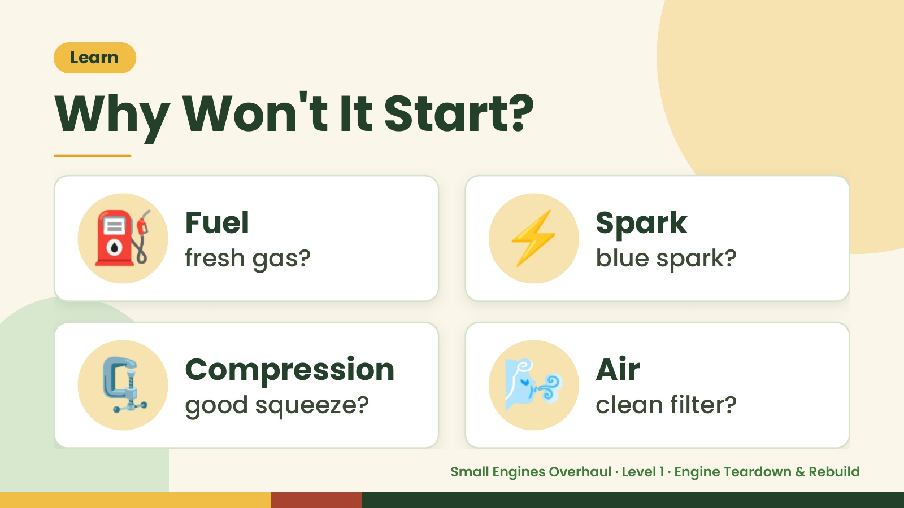
Notes:
Learn
Why Won't It Start?
⛽ Fuel
fresh gas? ⚡ Spark
blue spark?
🗜️ Compression
good squeeze? 🌬️ Air
clean filter?
Small Engines Overhaul · Level 1 · Engine Teardown & Rebuild

Slide 11
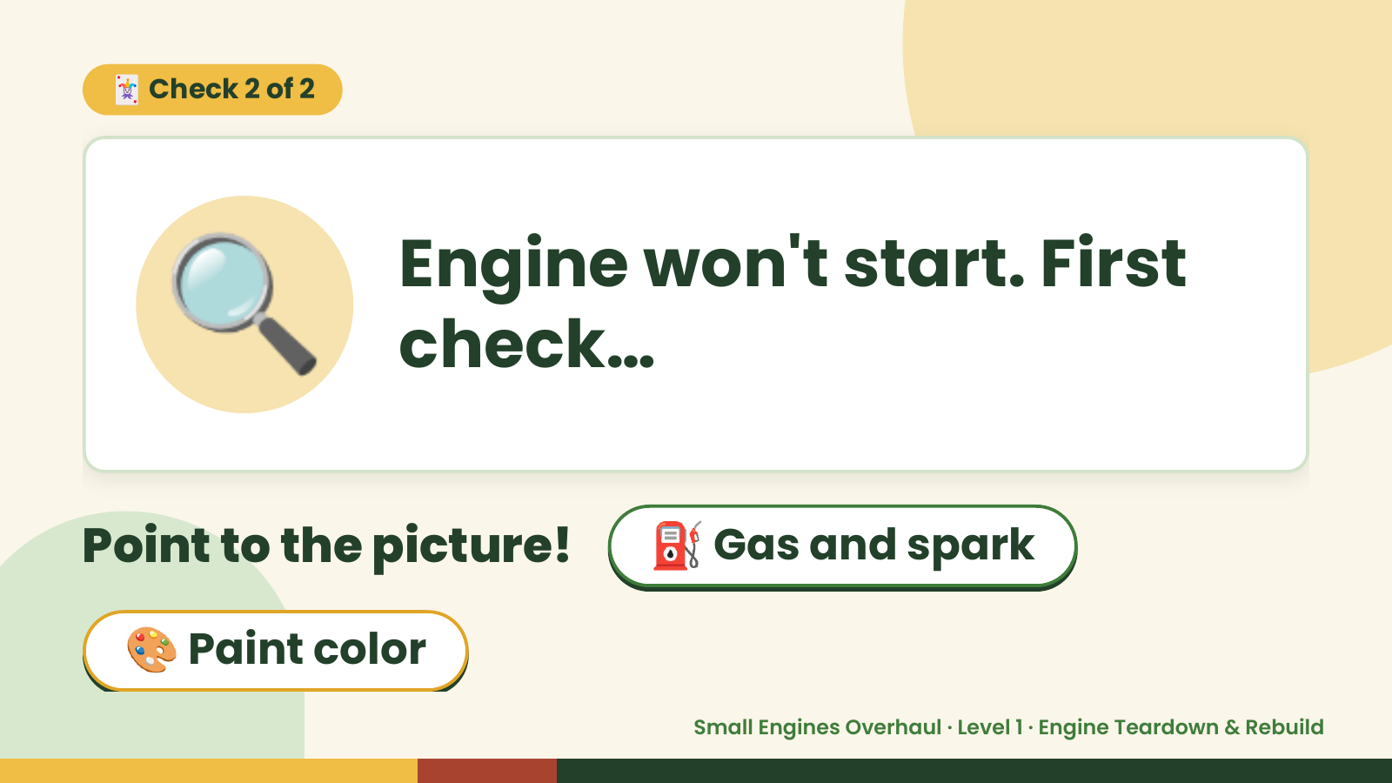
Notes:
🃏 Check 2 of 2
🔍 Engine won't start. First
check…
Point to the picture! ⛽ Gas and spark
🎨 Paint color
Small Engines Overhaul · Level 1 · Engine Teardown & Rebuild

Slide 12
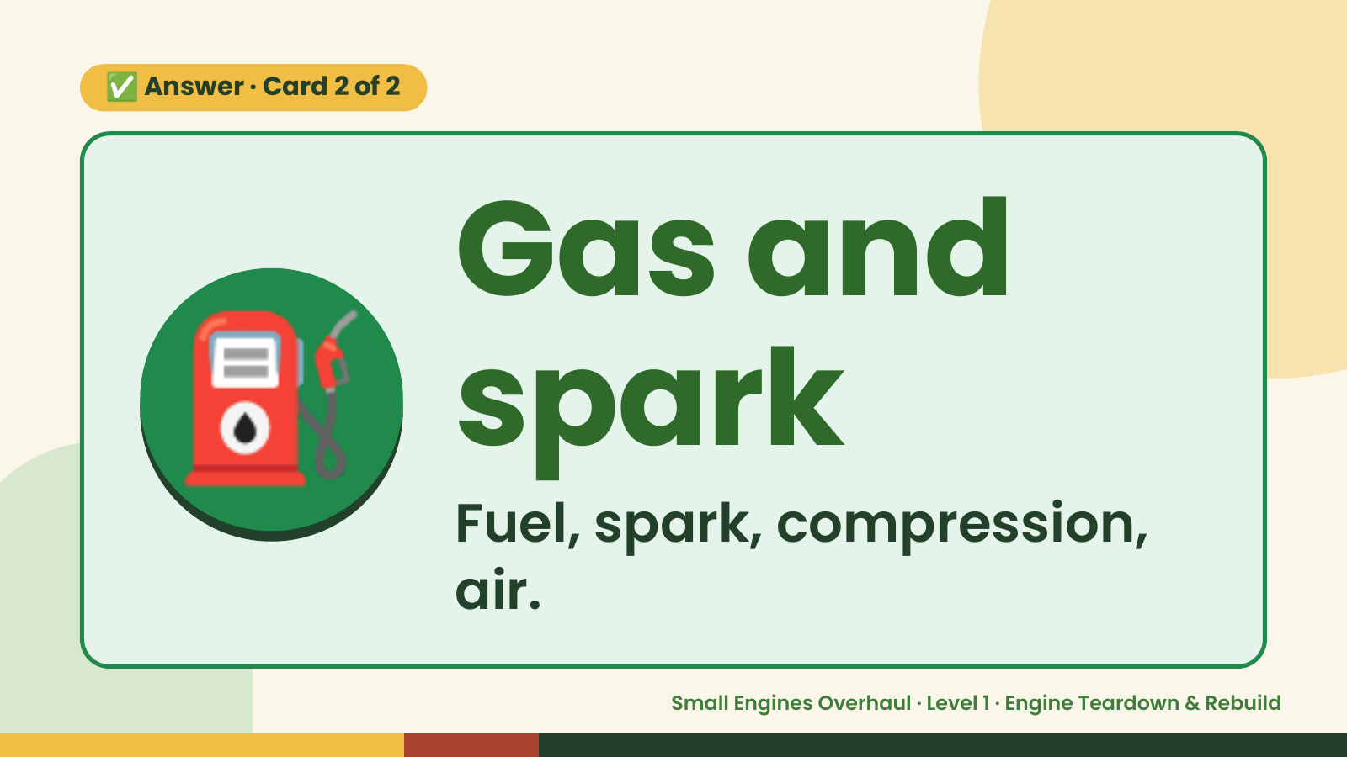
Notes:
✅ Answer · Card 2 of 2
⛽ Gas and
spark
Fuel, spark, compression,
air.
Small Engines Overhaul · Level 1 · Engine Teardown & Rebuild

Slide 13
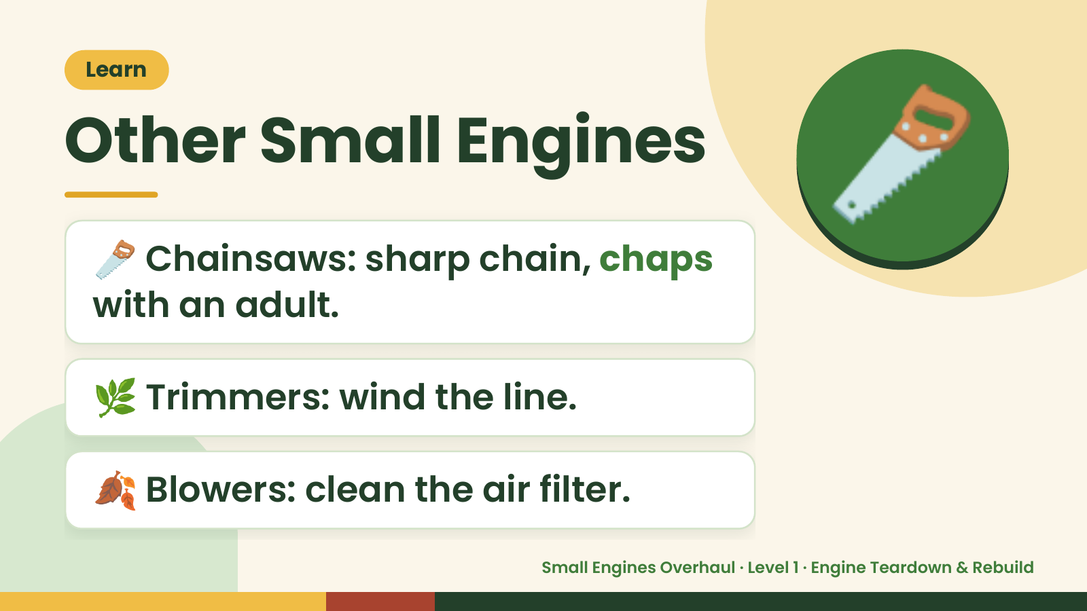
Notes:
Learn
Other Small Engines
🪚 Chainsaws: sharp chain, chaps
with an adult.
🪚
🌿 Trimmers: wind the line.
🍂 Blowers: clean the air filter.
Small Engines Overhaul · Level 1 · Engine Teardown & Rebuild

Slide 14
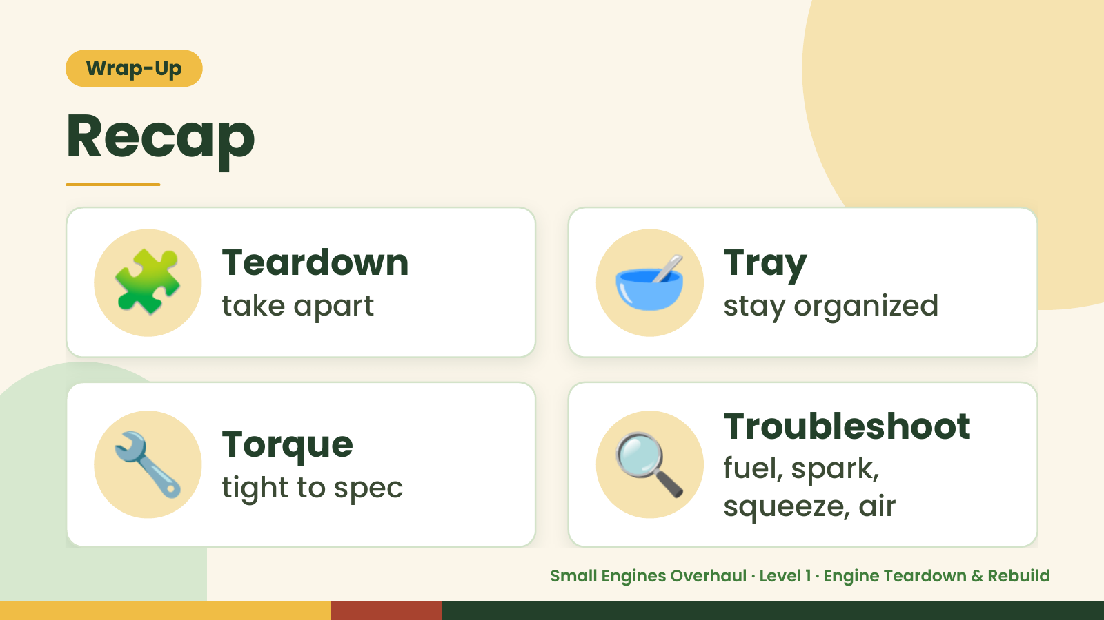
Notes:
Wrap-Up
Recap
🧩 Teardown
take apart 🥣 Tray
stay organized
🔧 Torque
tight to spec 🔍 Troubleshoot
fuel, spark,
squeeze, air
Small Engines Overhaul · Level 1 · Engine Teardown & Rebuild

Slide 15

Notes:
Wrap-Up
Great Job!
📸 Photo every step.
🌟
🥣 Parts in the tray.
🔍 Fuel, spark, squeeze, air.
Small Engines Overhaul · Level 1 · Engine Teardown & Rebuild

