Slide 1

Notes:
Small Engines Overhaul · Unit 8 · Level 2
Engine Teardown
& Rebuild
👥 Jobs
TODAY'S PLAN
🔧
⚠️ Safety
🔧 Steps
✅ Check
📝 Reflect
Small Engines Overhaul · Level 2 · Engine Teardown & Rebuild

Slide 2
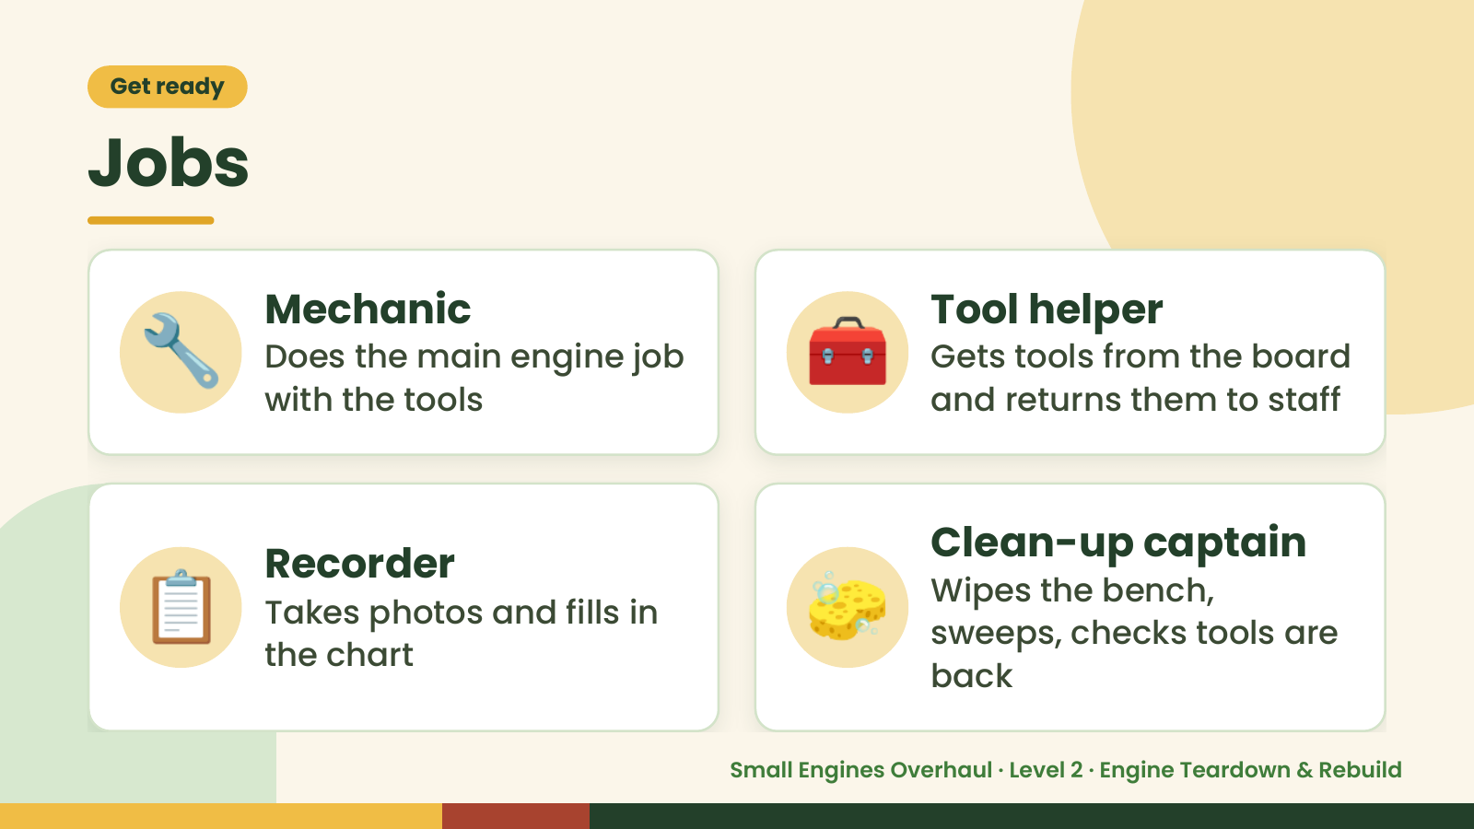
Notes:
Get ready
Jobs
🔧 Mechanic
Does the main engine job
with the tools
🧰 Tool helper
Gets tools from the board
and returns them to staff
📋 Recorder
Takes photos and fills in
the chart
🧽 Clean-up captain
Wipes the bench,
sweeps, checks tools are
back
Small Engines Overhaul · Level 2 · Engine Teardown & Rebuild

Slide 3
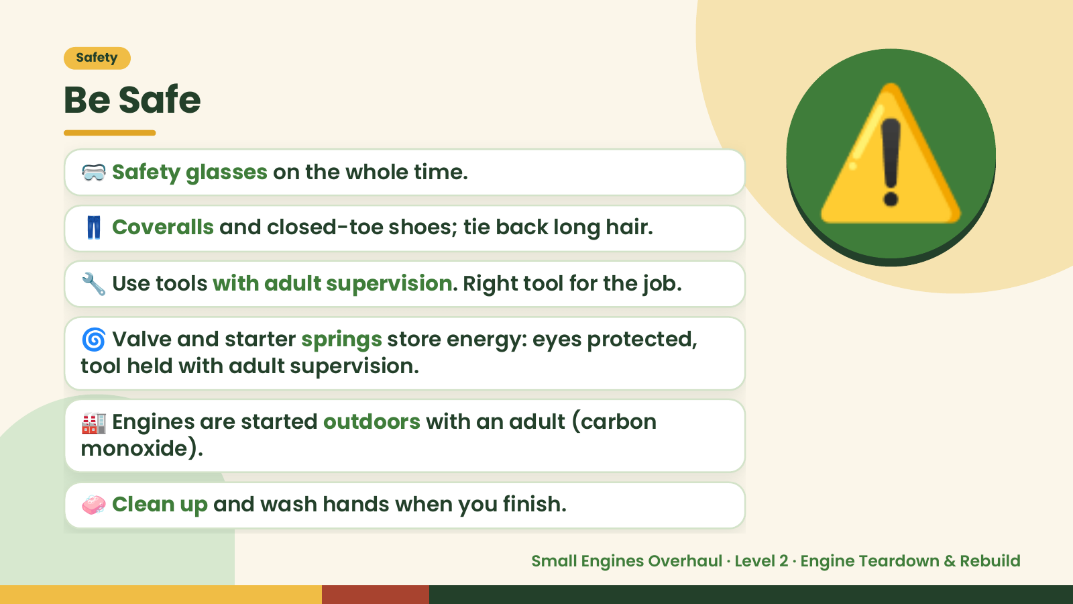
Notes:
Safety
Be Safe
🥽 Safety glasses on the whole time.
👖 Coveralls and closed-toe shoes; tie back long hair.
🔧 Use tools with adult supervision. Right tool for the job.
🌀 Valve and starter springs store energy: eyes protected,
⚠️
tool held with adult supervision.
🏭 Engines are started outdoors with an adult (carbon
monoxide).
🧼 Clean up and wash hands when you finish.
Small Engines Overhaul · Level 2 · Engine Teardown & Rebuild

Slide 4
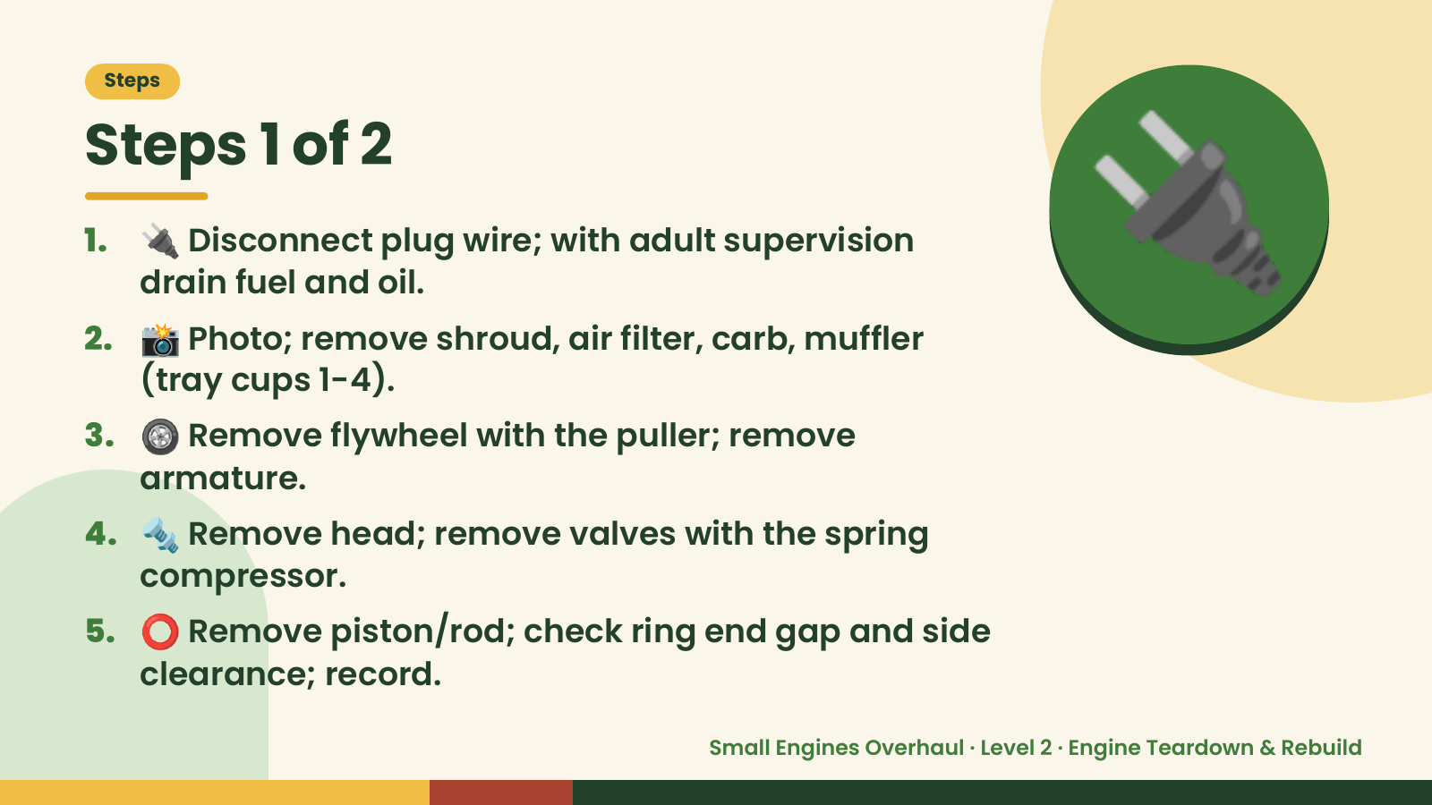
Notes:
Steps
Steps 1 of 2
1. 🔌 Disconnect plug wire; with adult supervision
drain fuel and oil.
2. 📸 Photo; remove shroud, air filter, carb, muffler
(tray cups 1-4).
3. 🛞 Remove flywheel with the puller; remove
🔌
armature.
4. 🔩 Remove head; remove valves with the spring
compressor.
5. ⭕ Remove piston/rod; check ring end gap and side
clearance; record.
Small Engines Overhaul · Level 2 · Engine Teardown & Rebuild

Slide 5
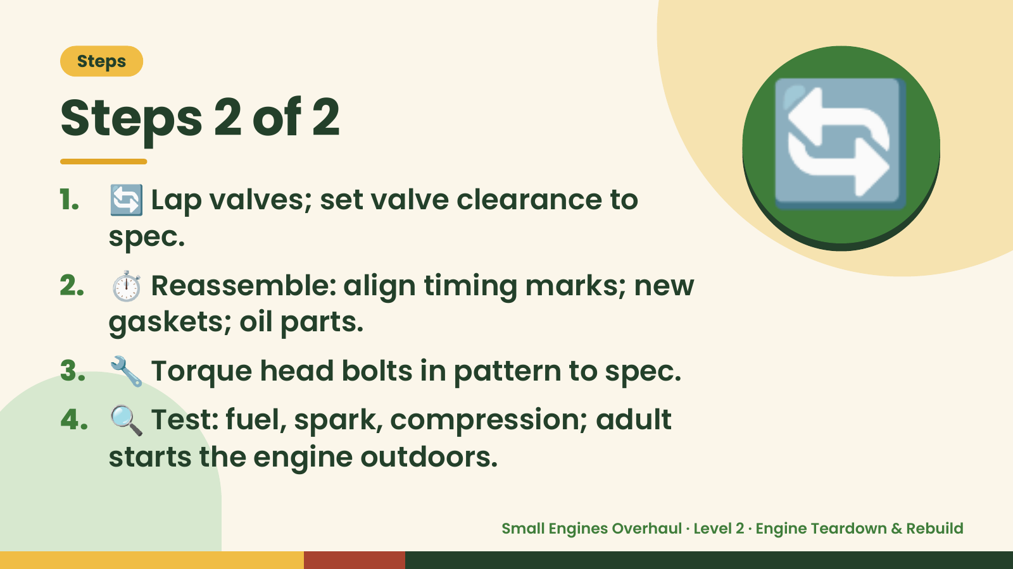
Notes:
Steps
Steps 2 of 2
1. 🔄 Lap valves; set valve clearance to
spec.
2. ⏱️ Reassemble: align timing marks; new
gaskets; oil parts.
🔄
3. 🔧 Torque head bolts in pattern to spec.
4. 🔍 Test: fuel, spark, compression; adult
starts the engine outdoors.
Small Engines Overhaul · Level 2 · Engine Teardown & Rebuild

Slide 6
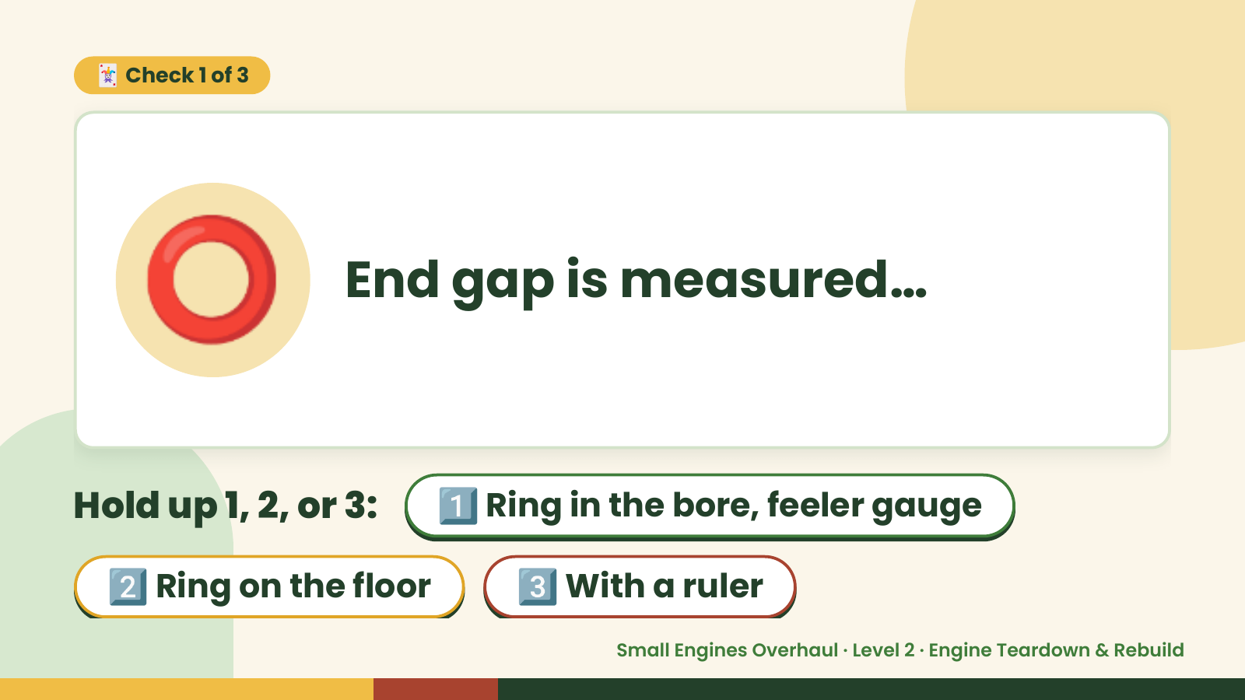
Notes:
🃏 Check 1 of 3
⭕ End gap is measured…
Hold up 1, 2, or 3: 1️⃣ Ring in the bore, feeler gauge
2️⃣ Ring on the floor 3️⃣ With a ruler
Small Engines Overhaul · Level 2 · Engine Teardown & Rebuild

Slide 7
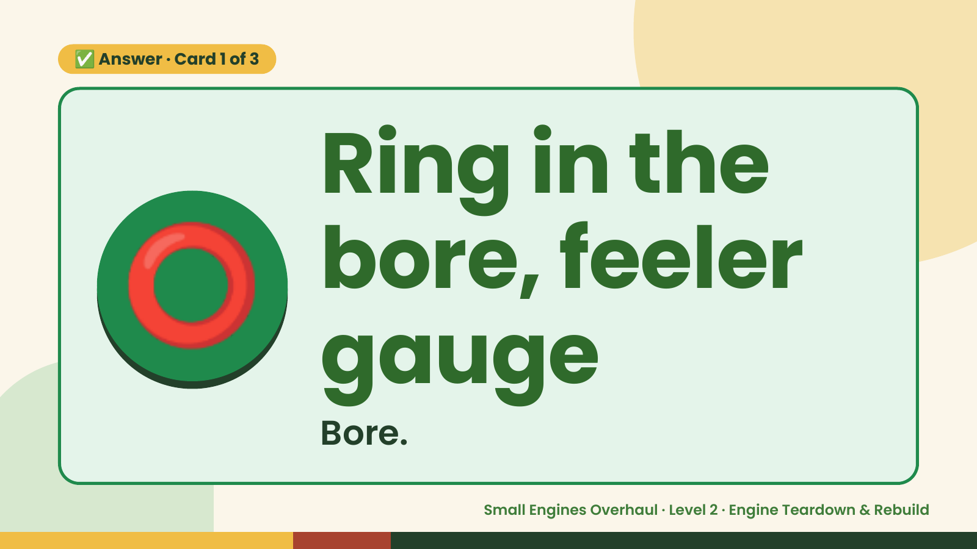
Notes:
✅ Answer · Card 1 of 3
⭕ Ring in the
bore, feeler
gauge
Bore.
Small Engines Overhaul · Level 2 · Engine Teardown & Rebuild

Slide 8
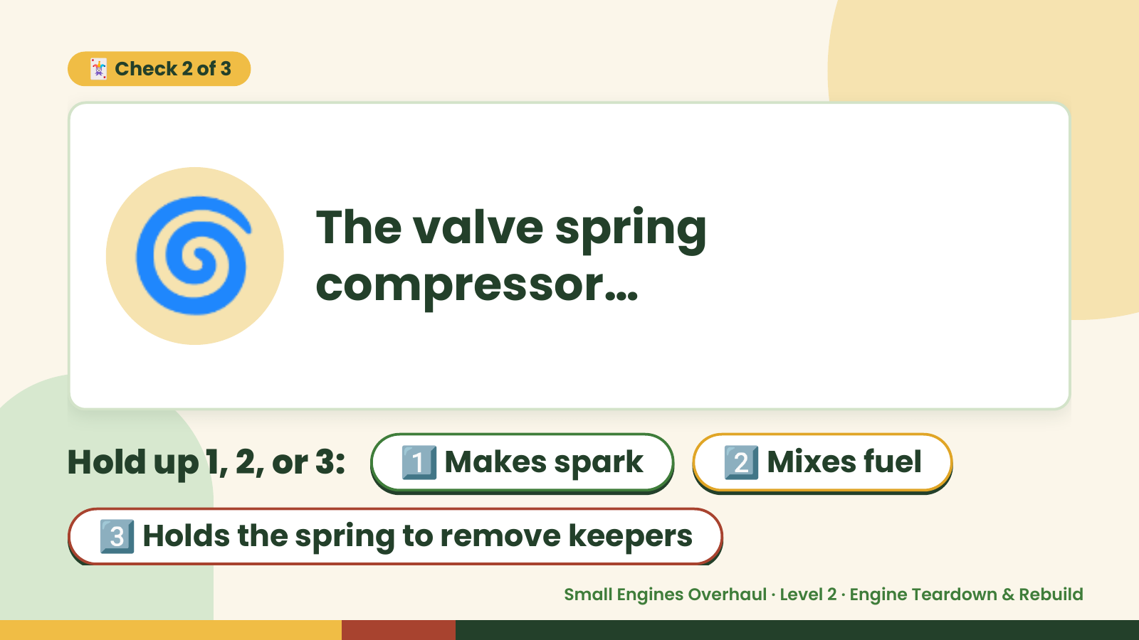
Notes:
🃏 Check 2 of 3
🌀 The valve spring
compressor…
Hold up 1, 2, or 3: 1️⃣ Makes spark 2️⃣ Mixes fuel
3️⃣ Holds the spring to remove keepers
Small Engines Overhaul · Level 2 · Engine Teardown & Rebuild

Slide 9

Notes:
✅ Answer · Card 2 of 3
🌀
Holds the
spring to
remove
keepers
Springs.
Small Engines Overhaul · Level 2 · Engine Teardown & Rebuild

Slide 10
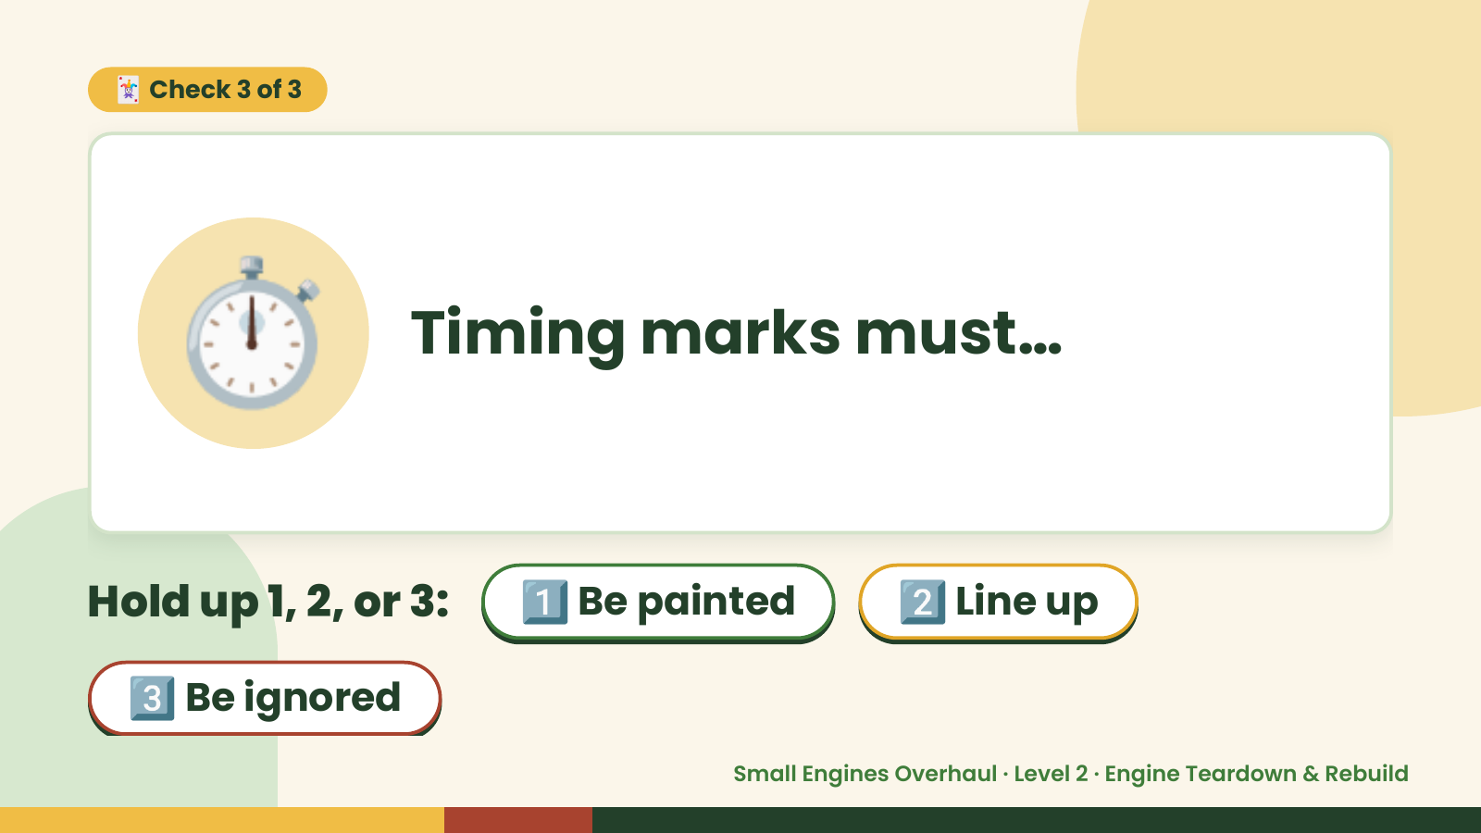
Notes:
🃏 Check 3 of 3
⏱️ Timing marks must…
Hold up 1, 2, or 3: 1️⃣ Be painted 2️⃣ Line up
3️⃣ Be ignored
Small Engines Overhaul · Level 2 · Engine Teardown & Rebuild

Slide 11
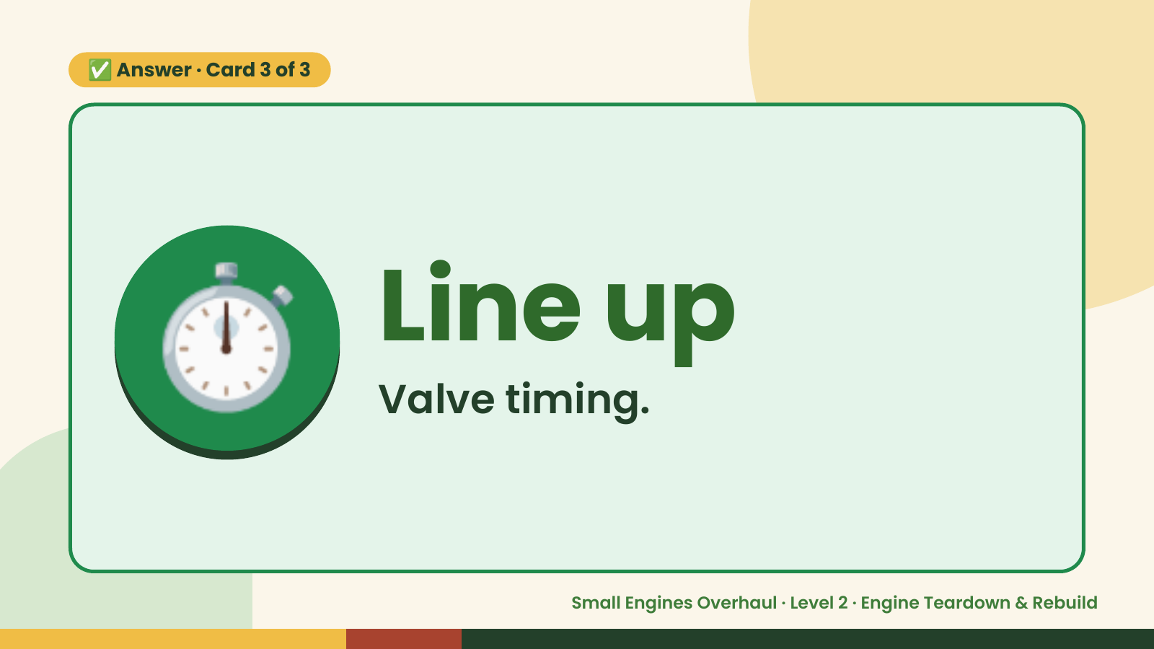
Notes:
✅ Answer · Card 3 of 3
⏱️ Line up
Valve timing.
Small Engines Overhaul · Level 2 · Engine Teardown & Rebuild

Slide 12

Notes:
Wrap-Up
Clean Up +
Reflect
🧽
Return and count tools.
Sweep and wipe your bench.
Wash hands, then do the reflection.
Small Engines Overhaul · Level 2 · Engine Teardown & Rebuild

