Slide 1
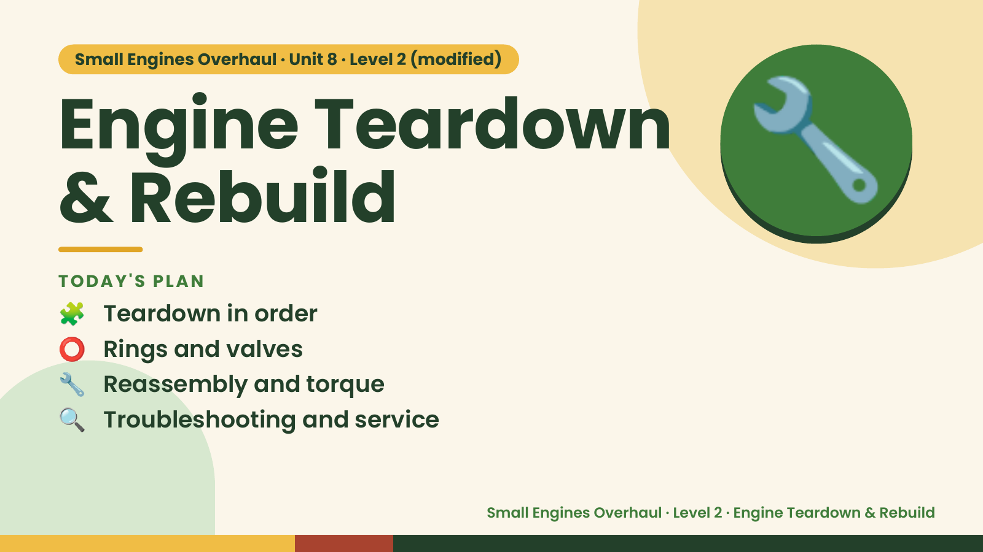
Notes:
Small Engines Overhaul · Unit 8 · Level 2 (modified)
Engine Teardown
& Rebuild
🧩 Teardown in order
TODAY'S PLAN
🔧
⭕ Rings and valves
🔧 Reassembly and torque
🔍 Troubleshooting and service
Small Engines Overhaul · Level 2 · Engine Teardown & Rebuild

Slide 2
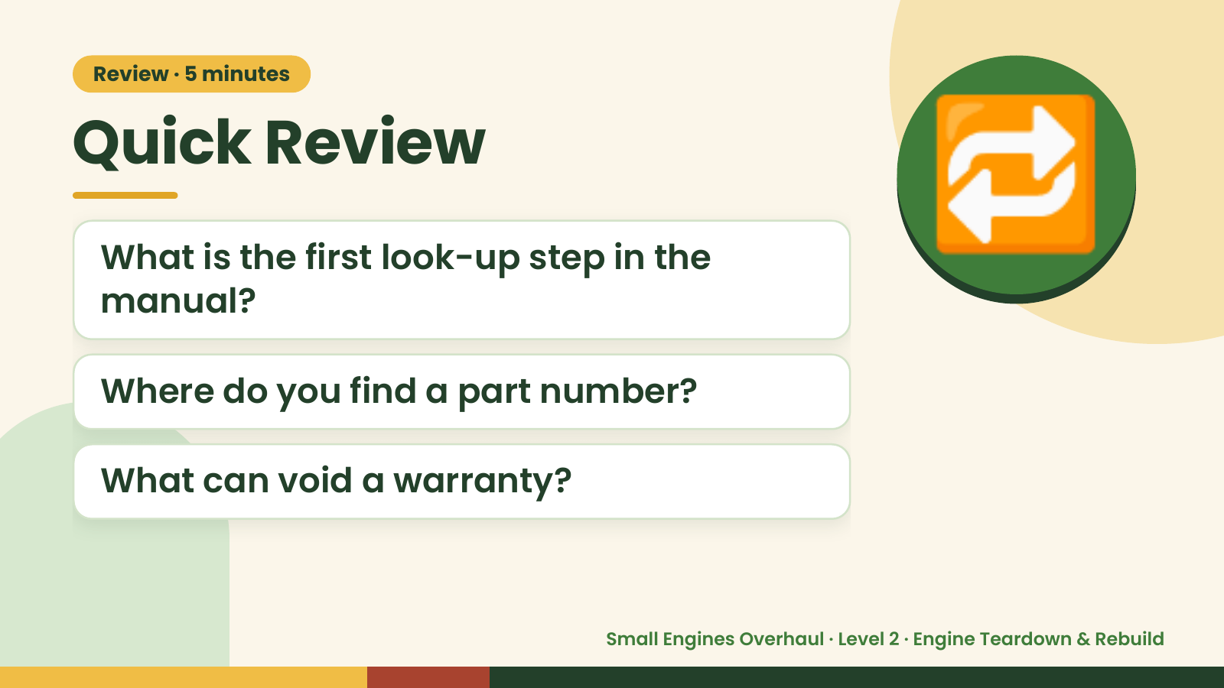
Notes:
Review · 5 minutes
Quick Review
What is the first look-up step in the
manual?
🔁
Where do you find a part number?
What can void a warranty?
Small Engines Overhaul · Level 2 · Engine Teardown & Rebuild

Slide 3
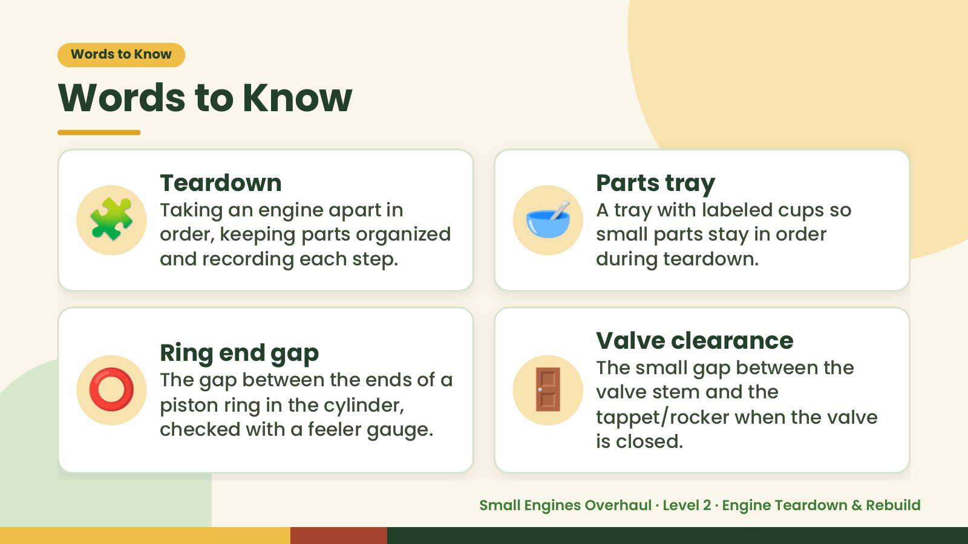
Notes:
Words to Know
Words to Know
🧩 Teardown
Taking an engine apart in
order, keeping parts organized
and recording each step.
🥣 Parts tray
A tray with labeled cups so
small parts stay in order
during teardown.
⭕ 🚪
Valve clearance
Ring end gap
The small gap between the
The gap between the ends of a
valve stem and the
piston ring in the cylinder,
tappet/rocker when the valve
checked with a feeler gauge.
is closed.
Small Engines Overhaul · Level 2 · Engine Teardown & Rebuild

Slide 4
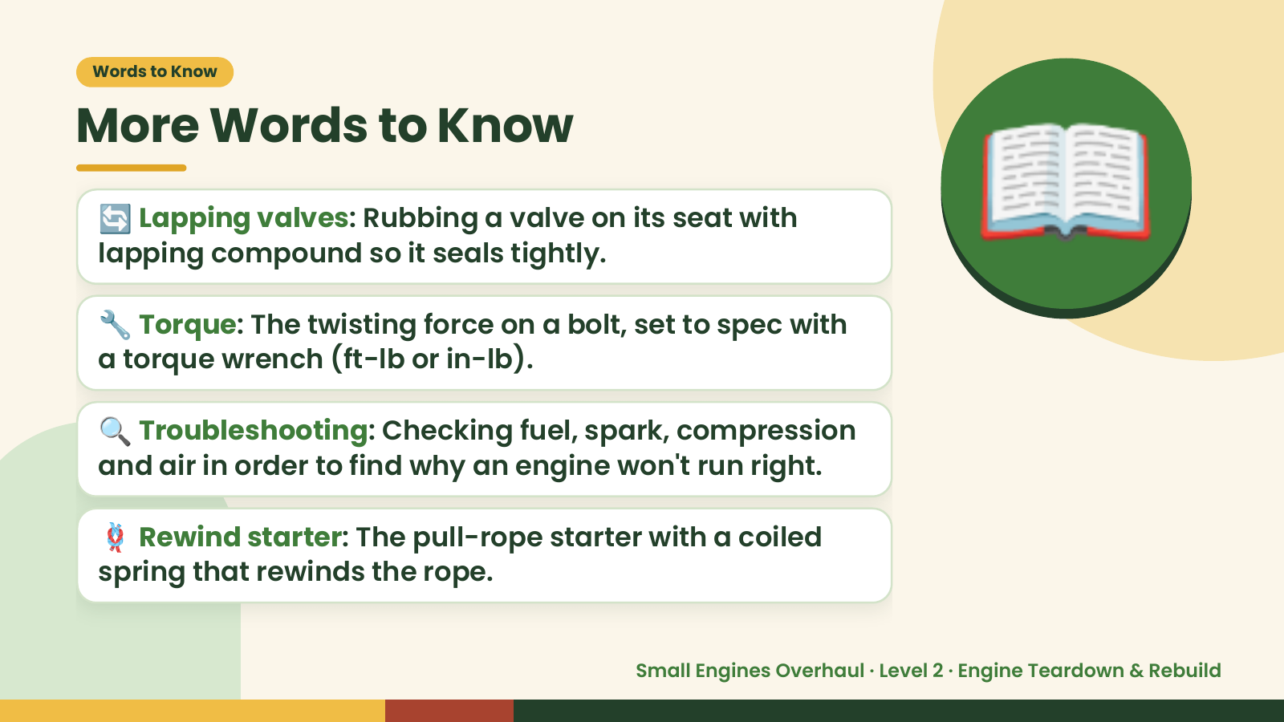
Notes:
Words to Know
More Words to Know
🔄 Lapping valves: Rubbing a valve on its seat with
lapping compound so it seals tightly.
🔧 Torque: The twisting force on a bolt, set to spec with
a torque wrench (ft-lb or in-lb).
📖
🔍 Troubleshooting: Checking fuel, spark, compression
and air in order to find why an engine won't run right.
🪢 Rewind starter: The pull-rope starter with a coiled
spring that rewinds the rope.
Small Engines Overhaul · Level 2 · Engine Teardown & Rebuild

Slide 5
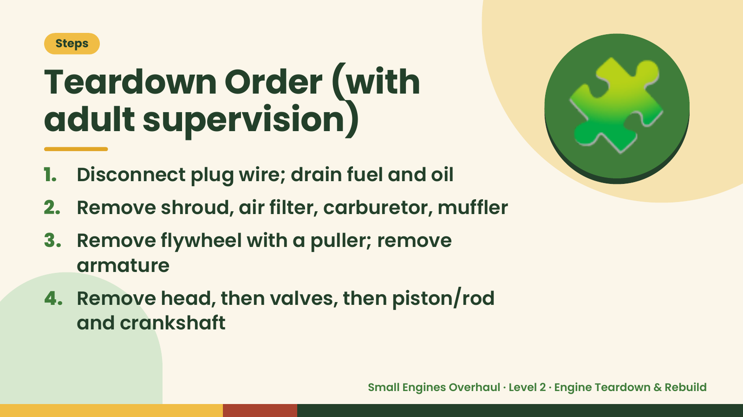
Notes:
Steps
Teardown Order (with
adult supervision)
1. Disconnect plug wire; drain fuel and oil
2. Remove shroud, air filter, carburetor, muffler
🧩
3. Remove flywheel with a puller; remove
armature
4. Remove head, then valves, then piston/rod
and crankshaft
Small Engines Overhaul · Level 2 · Engine Teardown & Rebuild

Slide 6
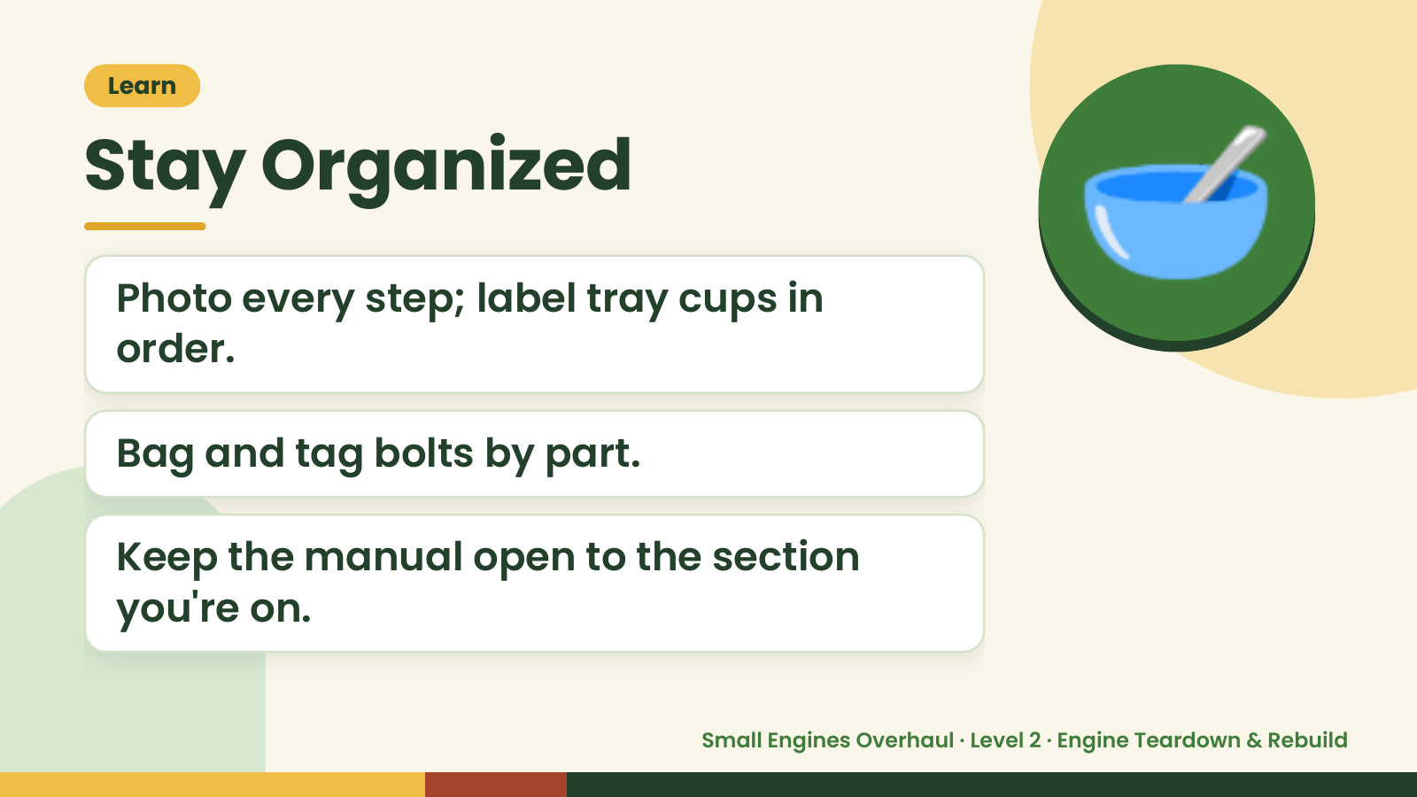
Notes:
Learn
Stay Organized
Photo every step; label tray cups in
order.
🥣
Bag and tag bolts by part.
Keep the manual open to the section
you're on.
Small Engines Overhaul · Level 2 · Engine Teardown & Rebuild

Slide 7
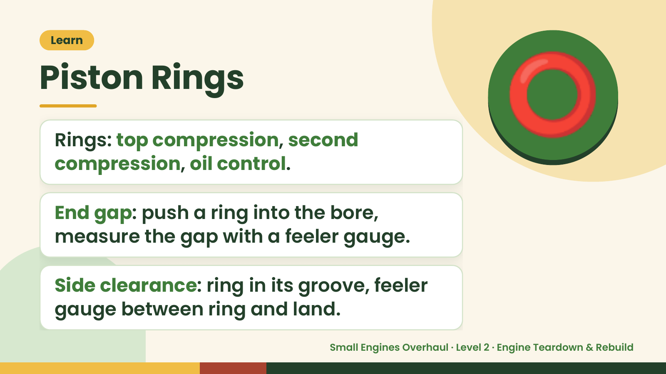
Notes:
Learn
Piston Rings
Rings: top compression, second
compression, oil control.
⭕
End gap: push a ring into the bore,
measure the gap with a feeler gauge.
Side clearance: ring in its groove, feeler
gauge between ring and land.
Small Engines Overhaul · Level 2 · Engine Teardown & Rebuild

Slide 8
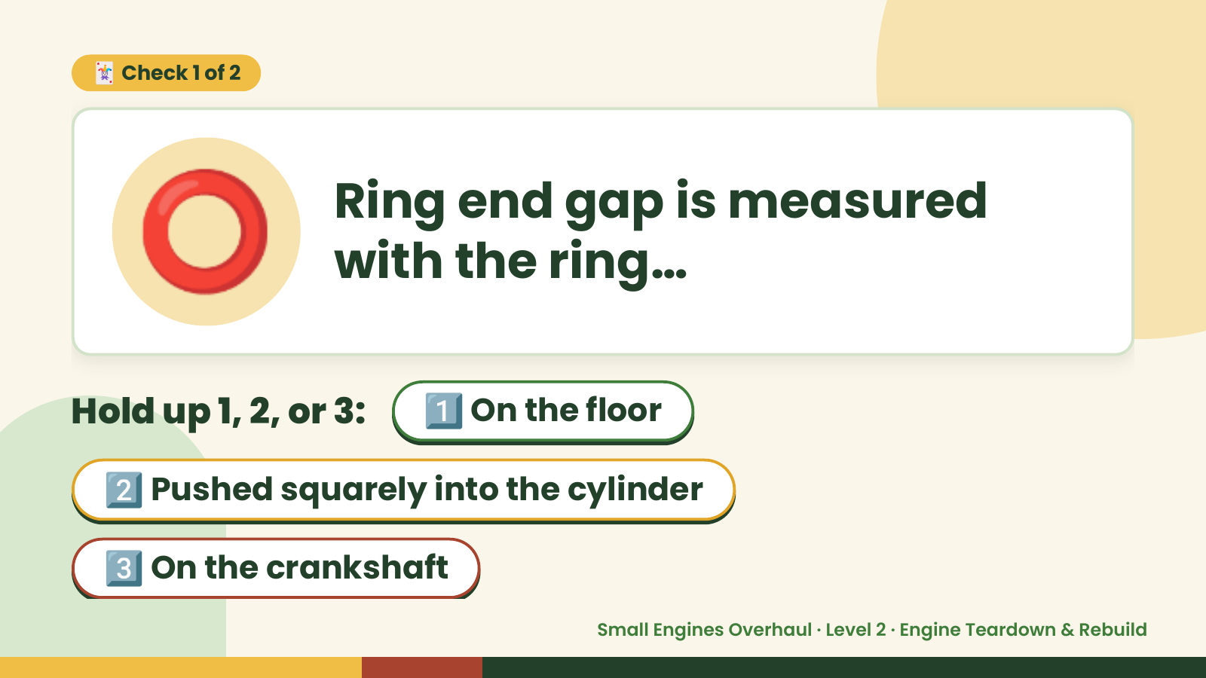
Notes:
⭕
🃏 Check 1 of 2
Ring end gap is measured
with the ring…
Hold up 1, 2, or 3: 1️⃣ On the floor
2️⃣ Pushed squarely into the cylinder
3️⃣ On the crankshaft
Small Engines Overhaul · Level 2 · Engine Teardown & Rebuild

Slide 9
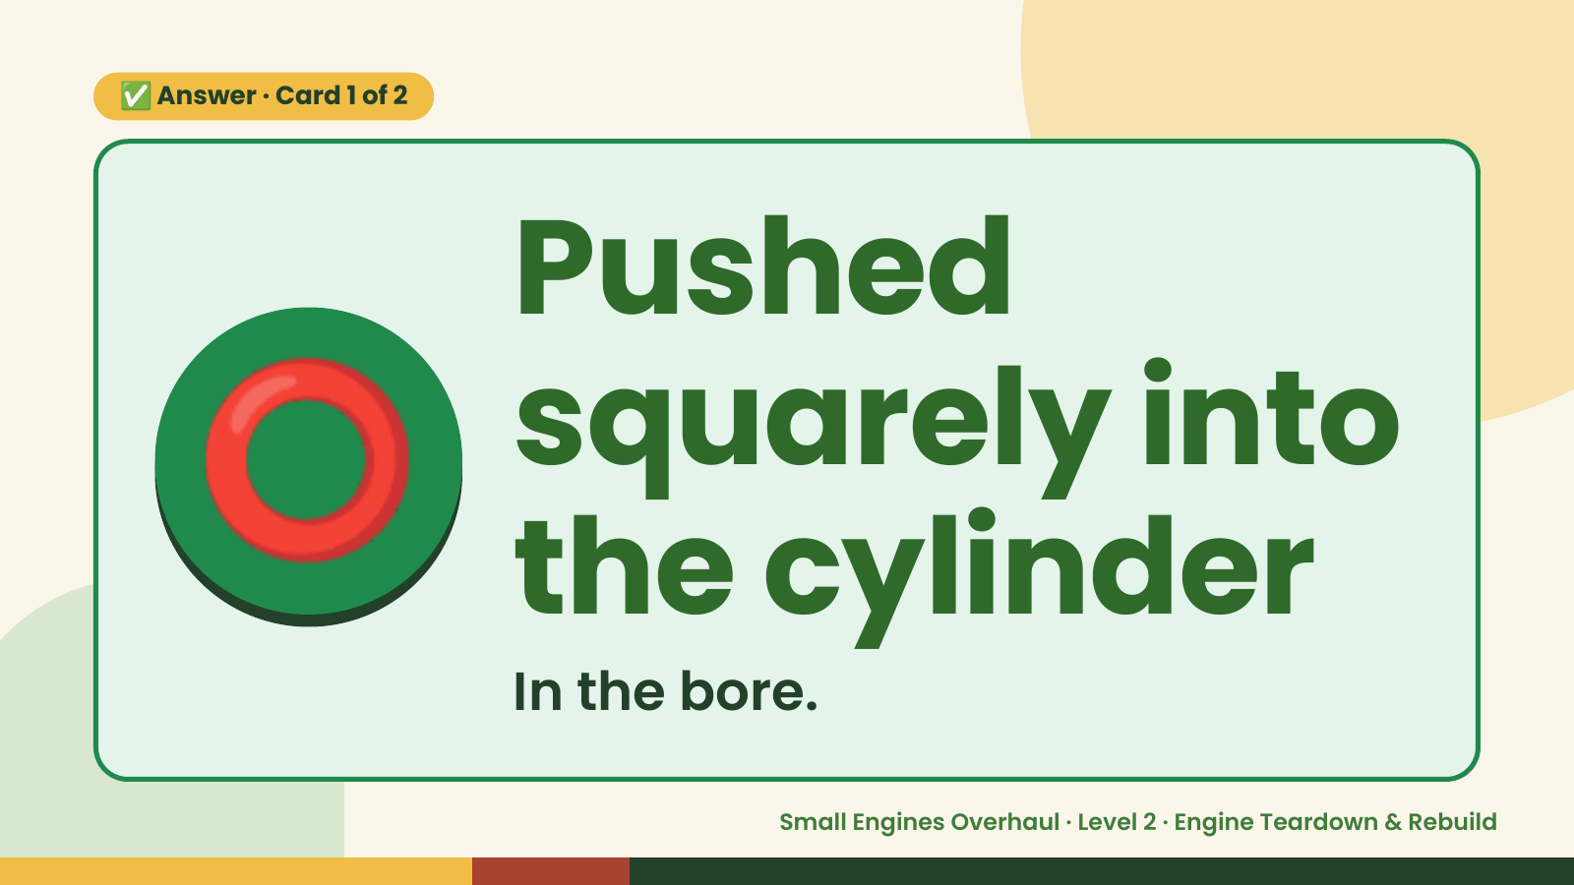
Notes:
✅ Answer · Card 1 of 2
⭕ Pushed
squarely into
the cylinder
In the bore.
Small Engines Overhaul · Level 2 · Engine Teardown & Rebuild

Slide 10
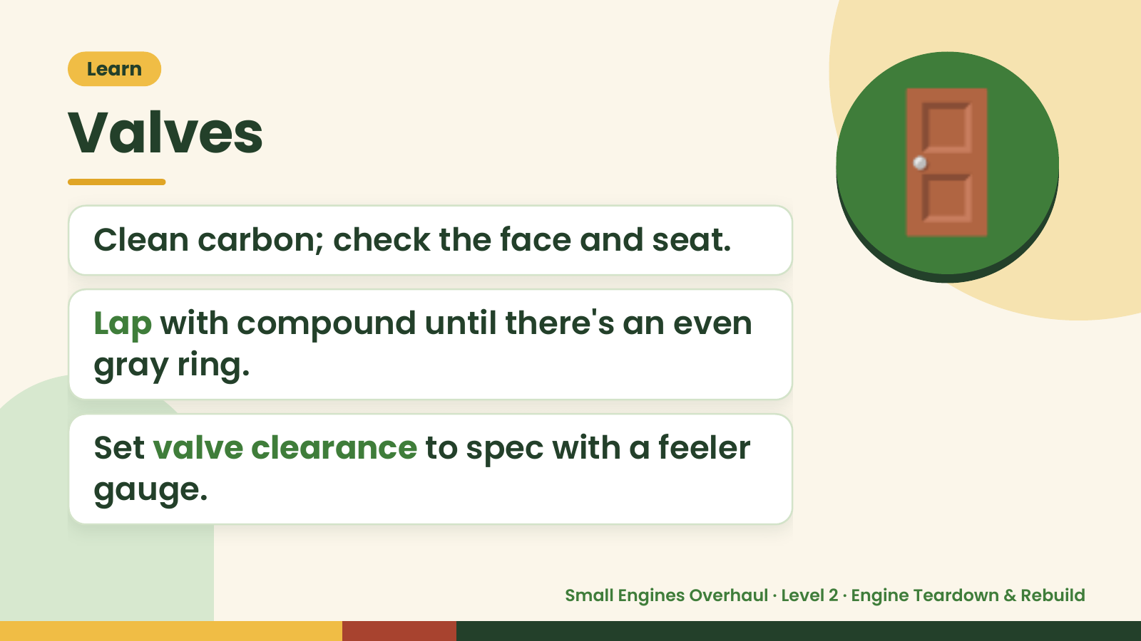
Notes:
Learn
Valves
Clean carbon; check the face and seat.
Lap with compound until there's an even
🚪
gray ring.
Set valve clearance to spec with a feeler
gauge.
Small Engines Overhaul · Level 2 · Engine Teardown & Rebuild

Slide 11
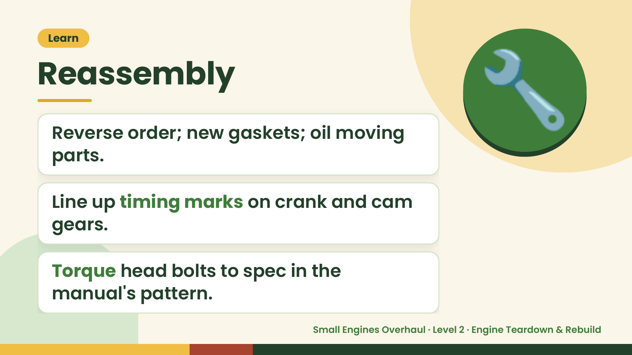
Notes:
Learn
Reassembly
Reverse order; new gaskets; oil moving
parts.
🔧
Line up timing marks on crank and cam
gears.
Torque head bolts to spec in the
manual's pattern.
Small Engines Overhaul · Level 2 · Engine Teardown & Rebuild

Slide 12
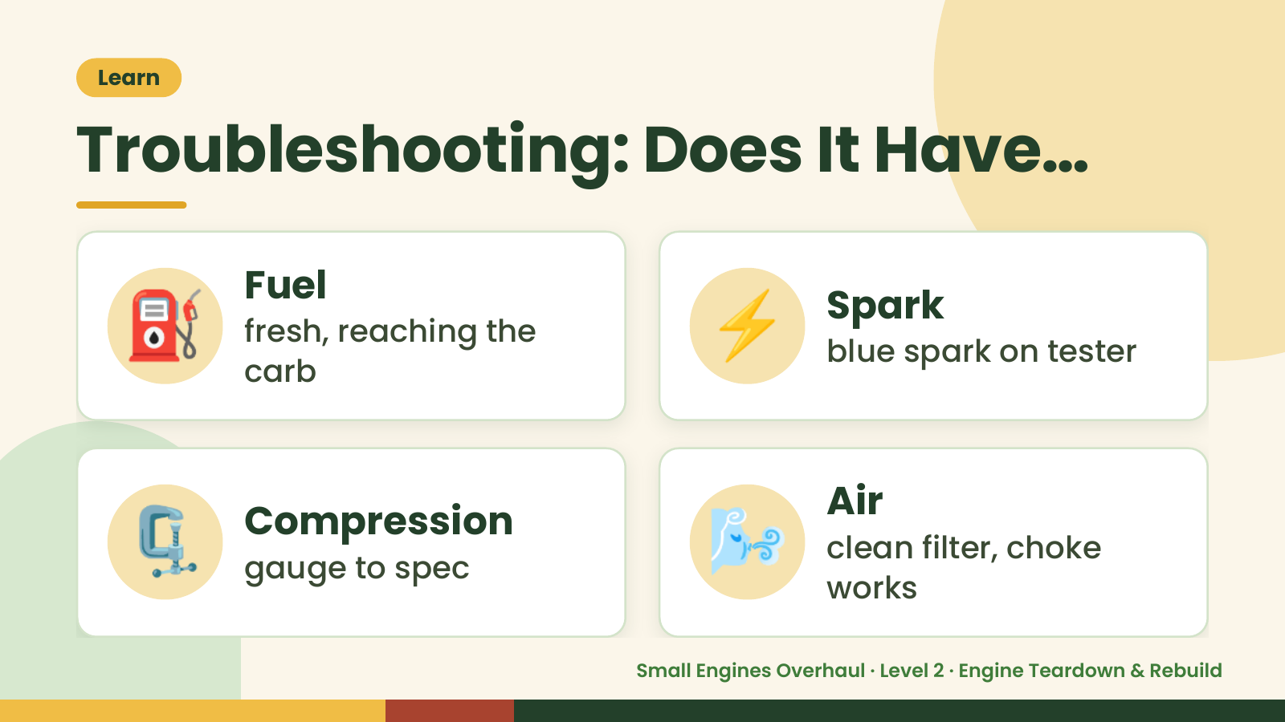
Notes:
Learn
Troubleshooting: Does It Have…
⛽ Fuel
fresh, reaching the
carb
⚡ Spark
blue spark on tester
🗜️ Compression
gauge to spec 🌬️ Air
clean filter, choke
works
Small Engines Overhaul · Level 2 · Engine Teardown & Rebuild

Slide 13
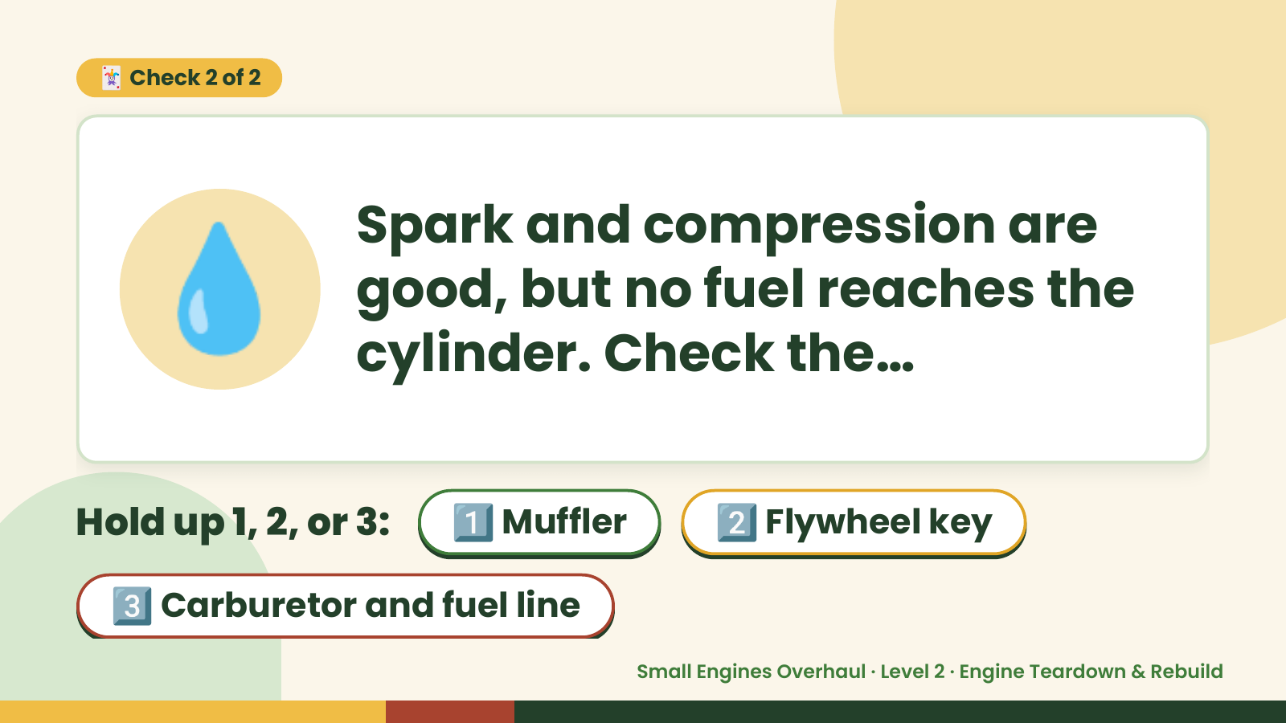
Notes:
🃏 Check 2 of 2
💧 Spark and compression are
good, but no fuel reaches the
cylinder. Check the…
Hold up 1, 2, or 3: 1️⃣ Muffler 2️⃣ Flywheel key
3️⃣ Carburetor and fuel line
Small Engines Overhaul · Level 2 · Engine Teardown & Rebuild

Slide 14
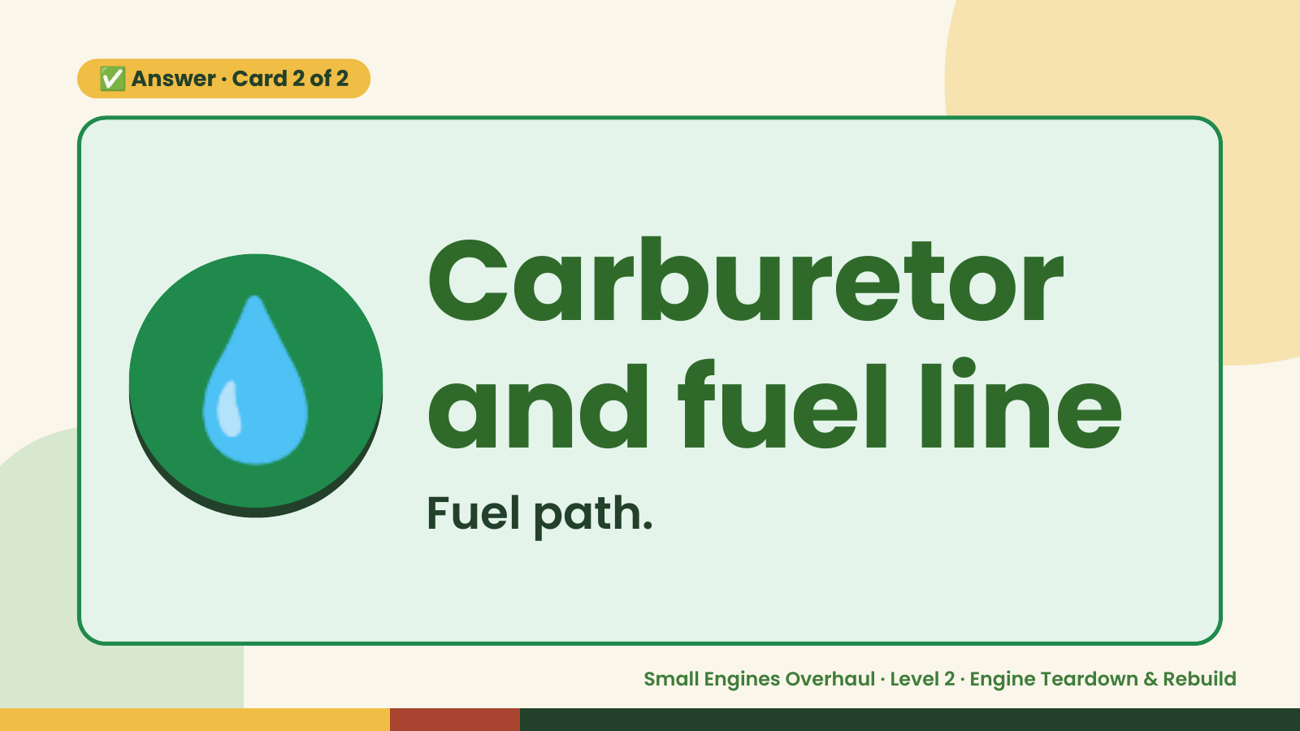
Notes:
✅ Answer · Card 2 of 2
💧 Carburetor
and fuel line
Fuel path.
Small Engines Overhaul · Level 2 · Engine Teardown & Rebuild

Slide 15
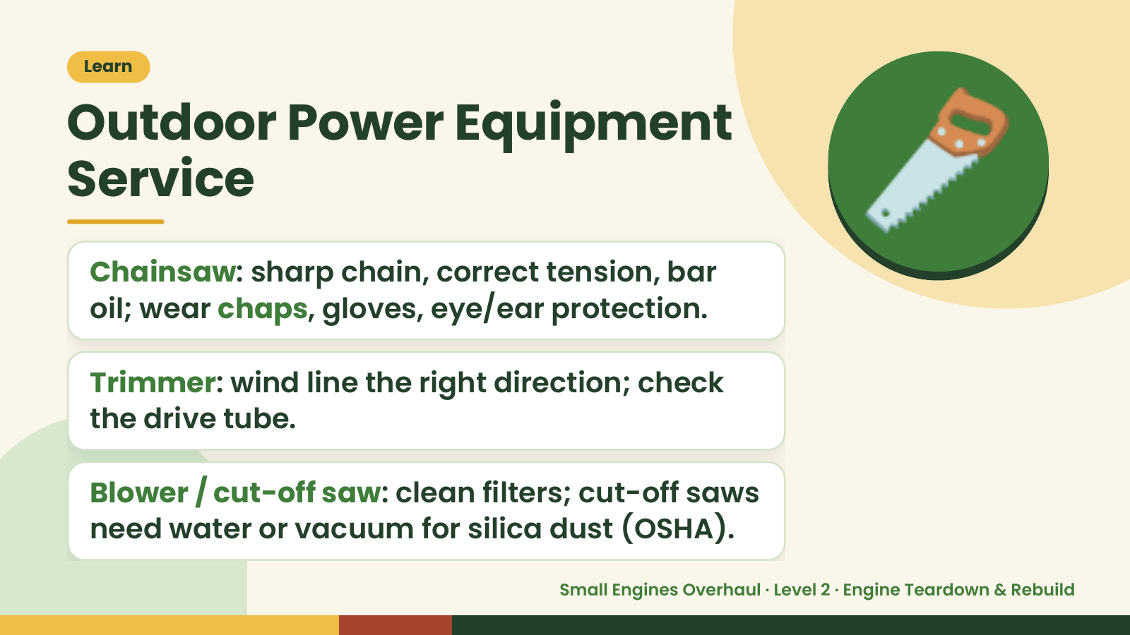
Notes:
Learn
Outdoor Power Equipment
Service
Chainsaw: sharp chain, correct tension, bar
oil; wear chaps, gloves, eye/ear protection.
🪚
Trimmer: wind line the right direction; check
the drive tube.
Blower / cut-off saw: clean filters; cut-off saws
need water or vacuum for silica dust (OSHA).
Small Engines Overhaul · Level 2 · Engine Teardown & Rebuild

Slide 16
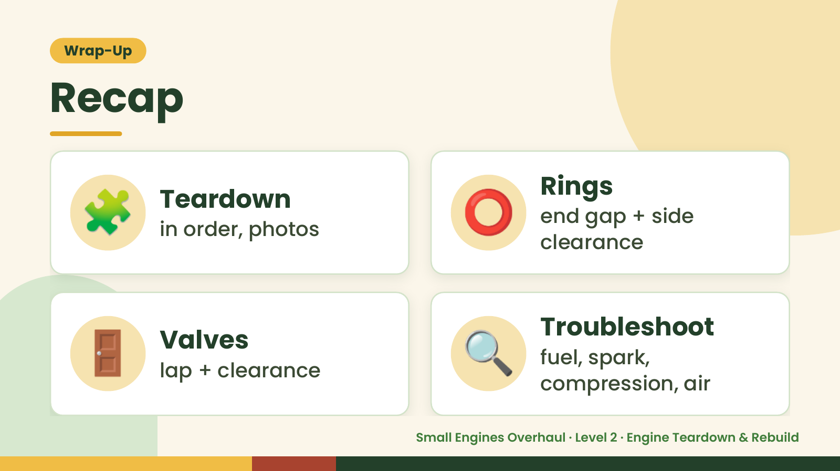
Notes:
Wrap-Up
Recap
🧩 Teardown
in order, photos ⭕ Rings
end gap + side
clearance
🚪 Valves
lap + clearance 🔍 Troubleshoot
fuel, spark,
compression, air
Small Engines Overhaul · Level 2 · Engine Teardown & Rebuild

Slide 17
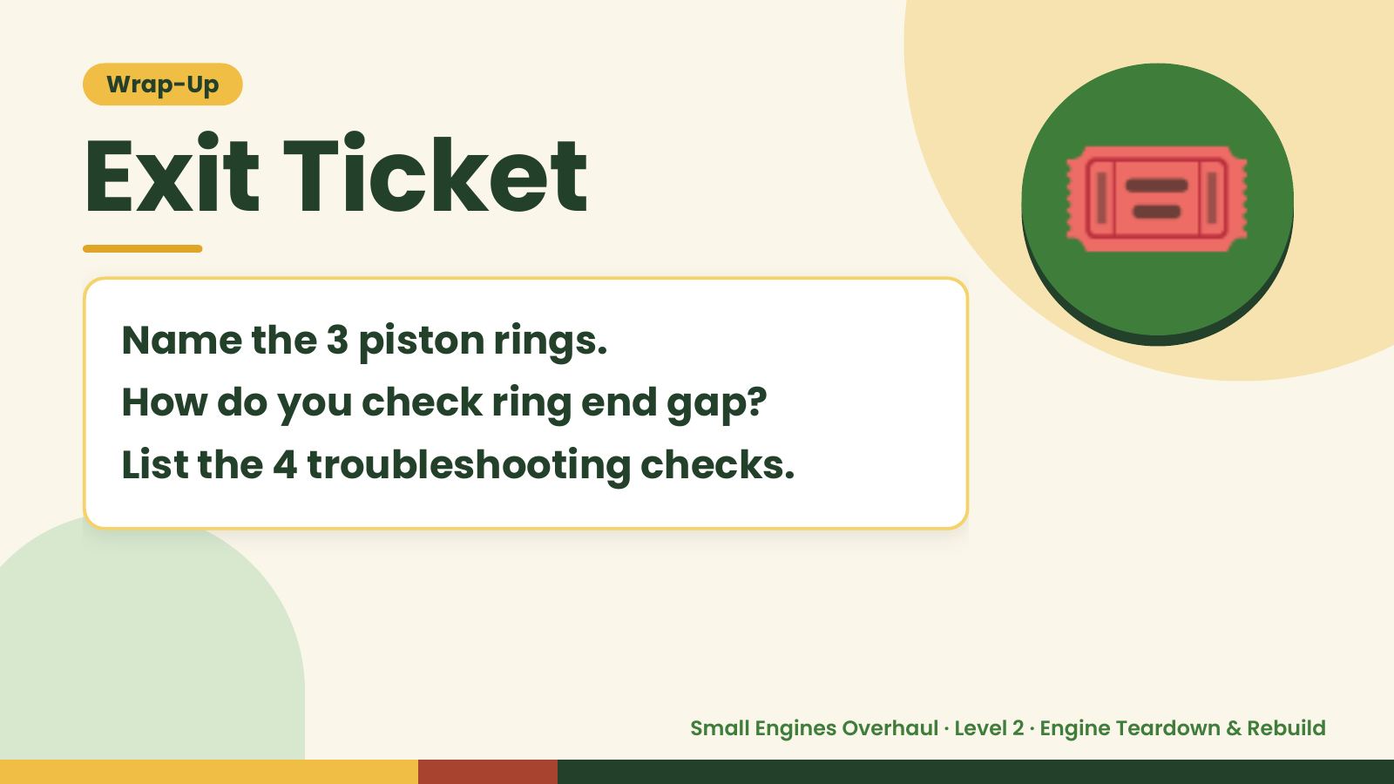
Notes:
Wrap-Up
Exit Ticket
Name the 3 piston rings.
How do you check ring end gap?
🎟️
List the 4 troubleshooting checks.
Small Engines Overhaul · Level 2 · Engine Teardown & Rebuild

