Slide 1
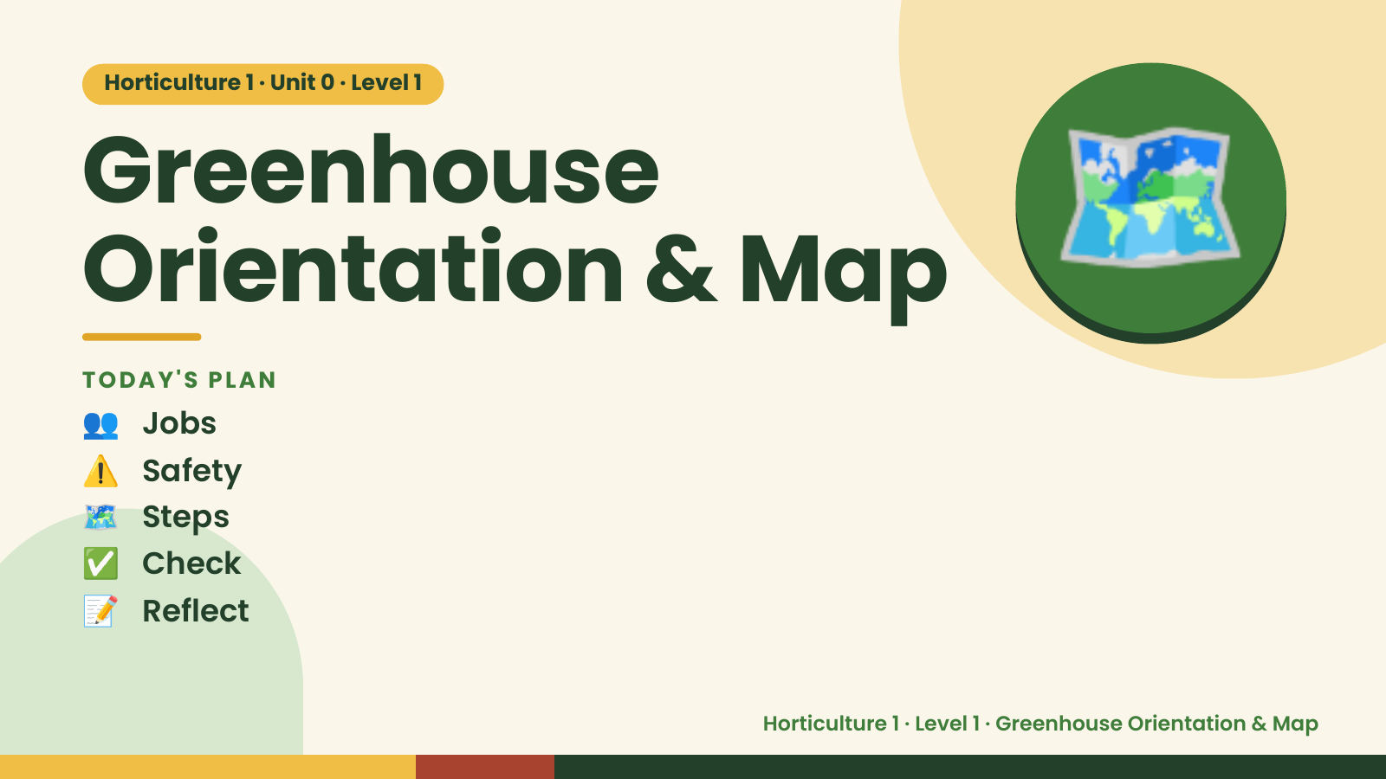
Notes:
Horticulture 1 · Unit 0 · Level 1
Greenhouse
Orientation & Map
👥 Jobs
TODAY'S PLAN
🗺️
⚠️ Safety
🗺️ Steps
✅ Check
📝 Reflect
Horticulture 1 · Level 1 · Greenhouse Orientation & Map

Slide 2

Notes:
Get ready
Jobs
🧑‍🌾 Grower
plants 🧺 Supply helper
gets tools
📸 Recorder
photos 🧽 Clean-up
captain
cleans
Horticulture 1 · Level 1 · Greenhouse Orientation & Map

Slide 3
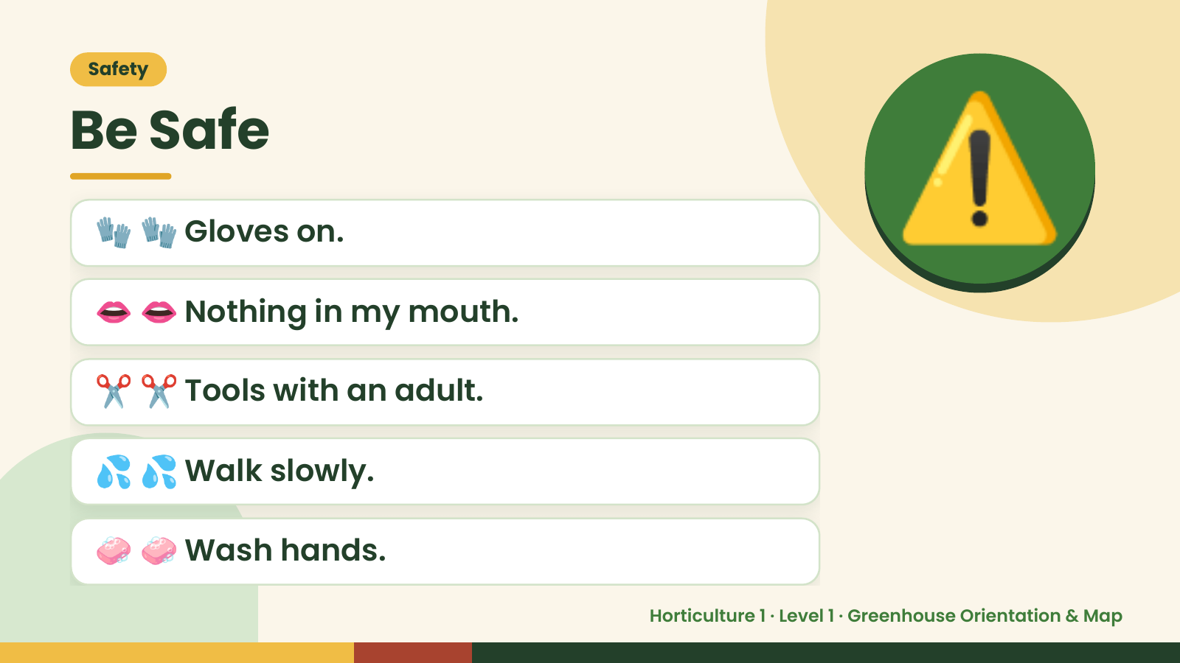
Notes:
Safety
Be Safe
🧤 🧤 Gloves on.
👄 👄 Nothing in my mouth.
⚠️
✂️ ✂️ Tools with an adult.
💦 💦 Walk slowly.
🧼 🧼 Wash hands.
Horticulture 1 · Level 1 · Greenhouse Orientation & Map

Slide 4
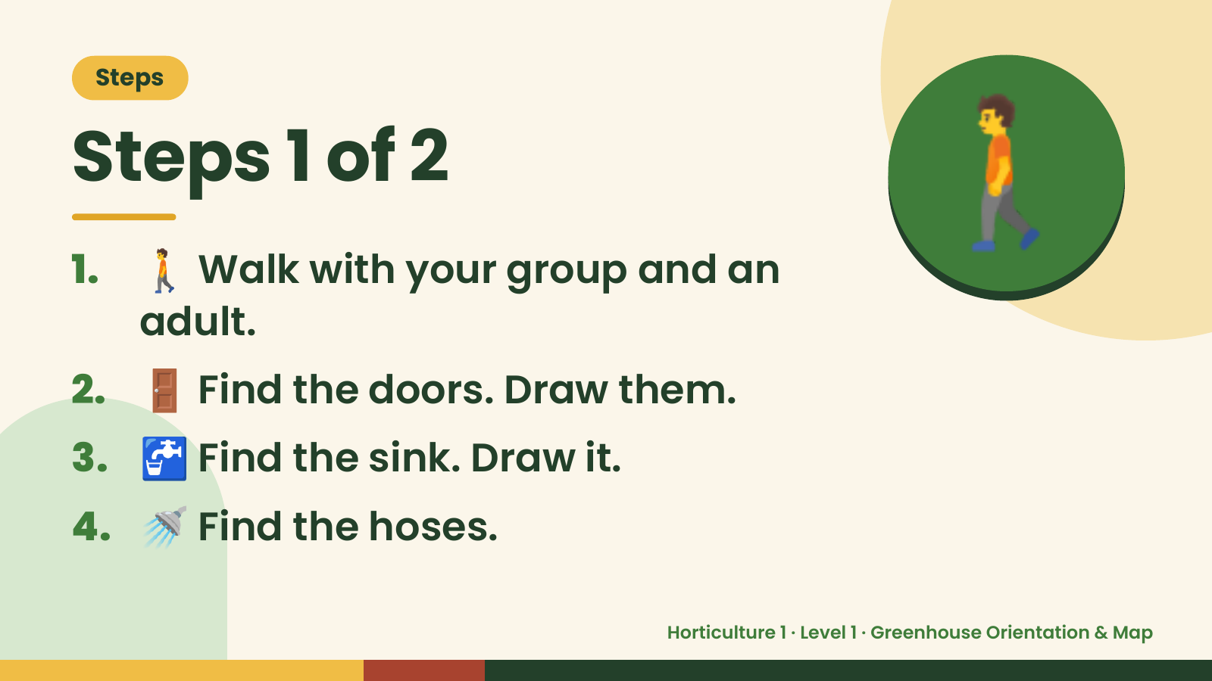
Notes:
Steps
Steps 1 of 2
1. 🚶 Walk with your group and an
adult.
🚶
2. 🚪 Find the doors. Draw them.
3. 🚰 Find the sink. Draw it.
4. 🚿 Find the hoses.
Horticulture 1 · Level 1 · Greenhouse Orientation & Map

Slide 5
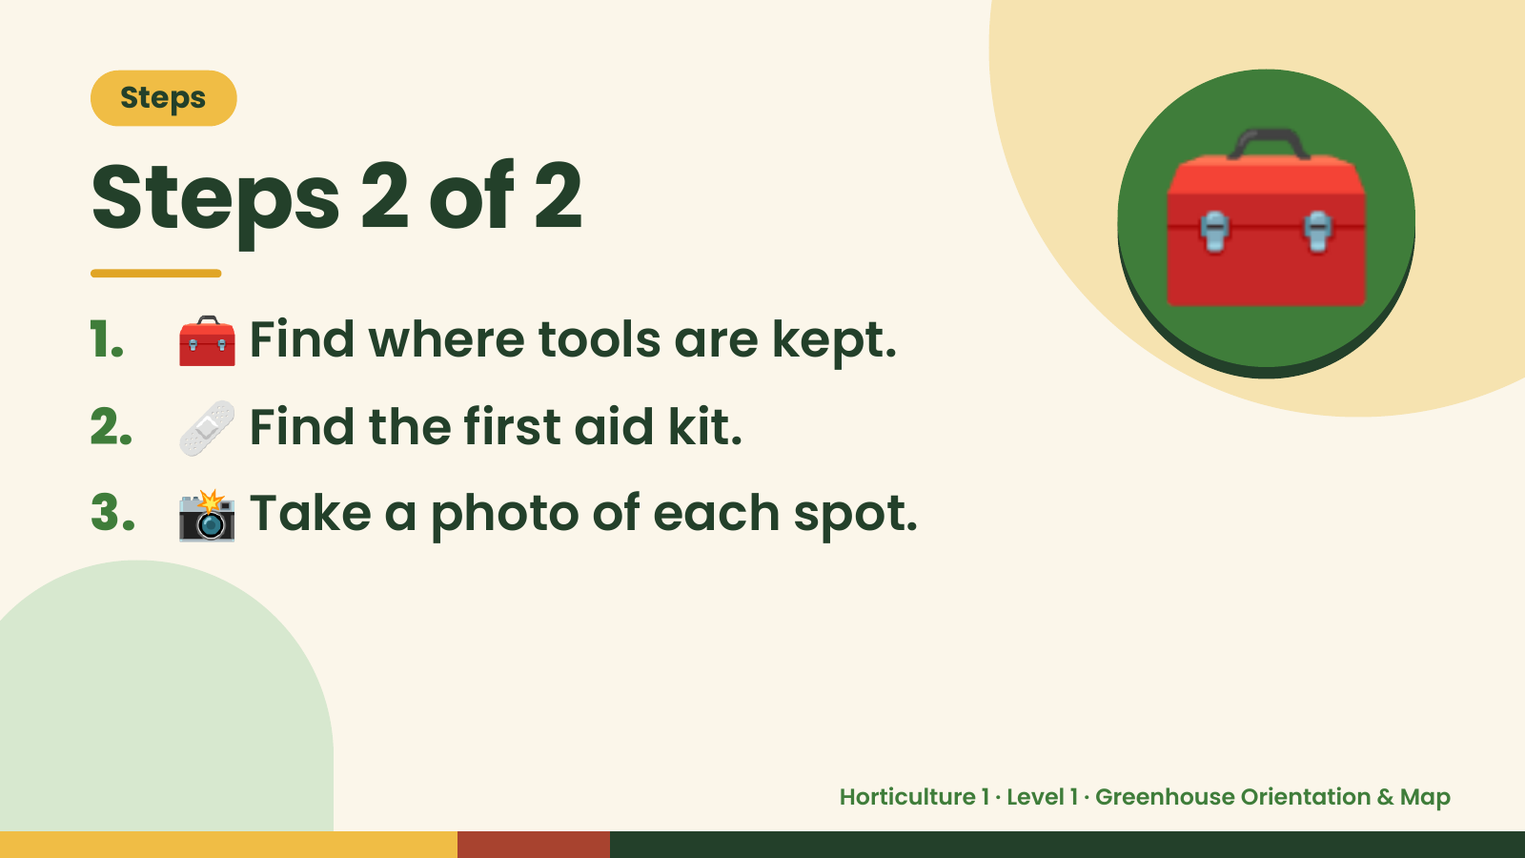
Notes:
Steps
Steps 2 of 2
1. 🧰 Find where tools are kept.
2. 🩹 Find the first aid kit.
🧰
3. 📸 Take a photo of each spot.
Horticulture 1 · Level 1 · Greenhouse Orientation & Map

Slide 6
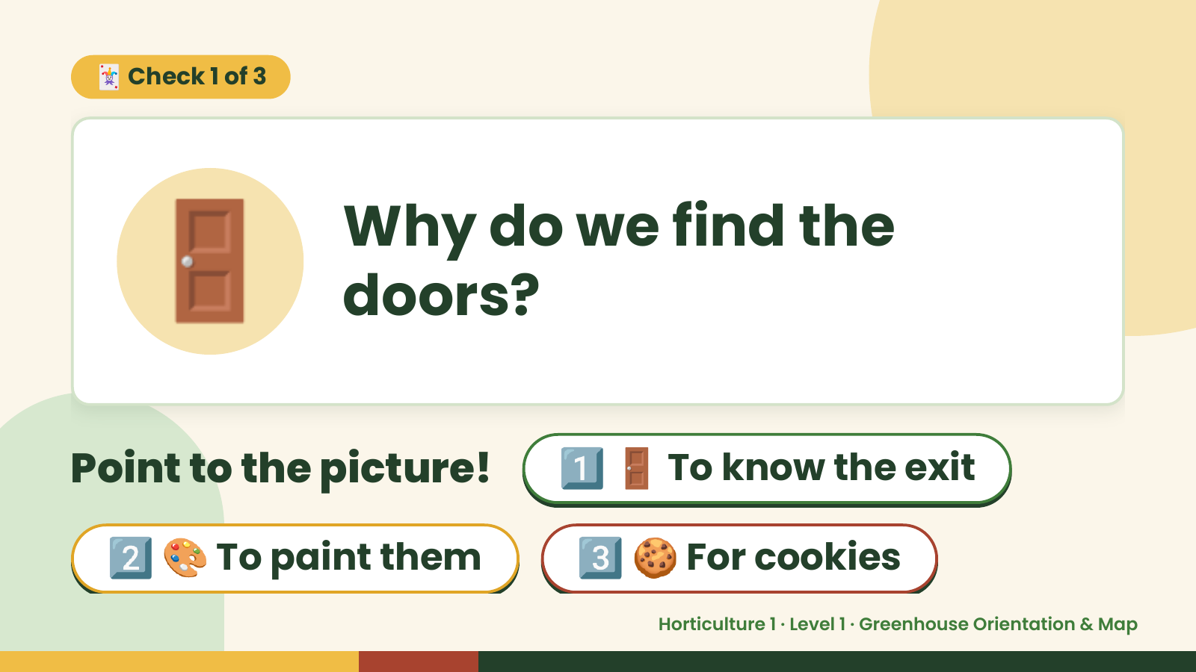
Notes:
🃏 Check 1 of 3
🚪 Why do we find the
doors?
Point to the picture! 1️⃣ 🚪 To know the exit
2️⃣ 🎨 To paint them 3️⃣ 🍪 For cookies
Horticulture 1 · Level 1 · Greenhouse Orientation & Map

Slide 7
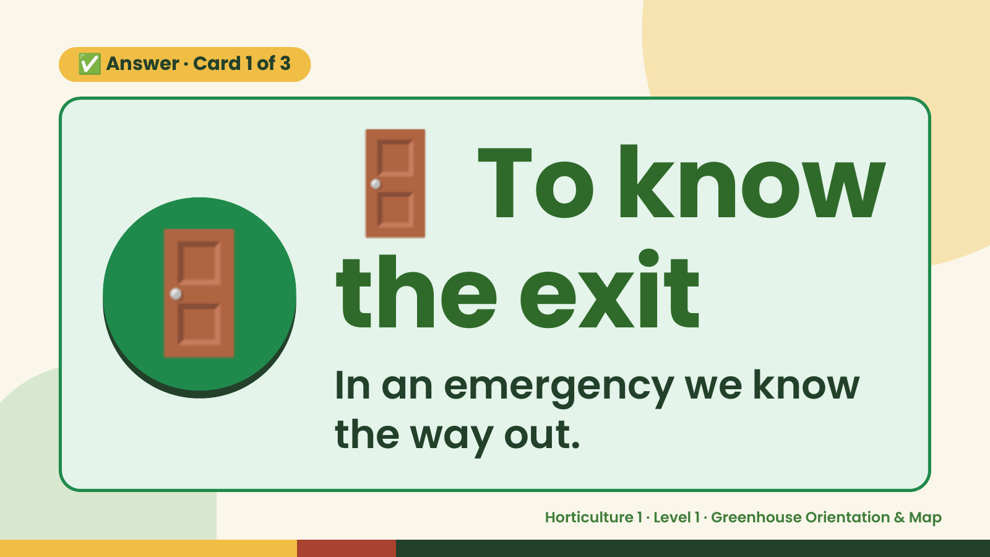
Notes:
🚪
✅ Answer · Card 1 of 3
🚪 the exit
To know
In an emergency we know
the way out.
Horticulture 1 · Level 1 · Greenhouse Orientation & Map

Slide 8
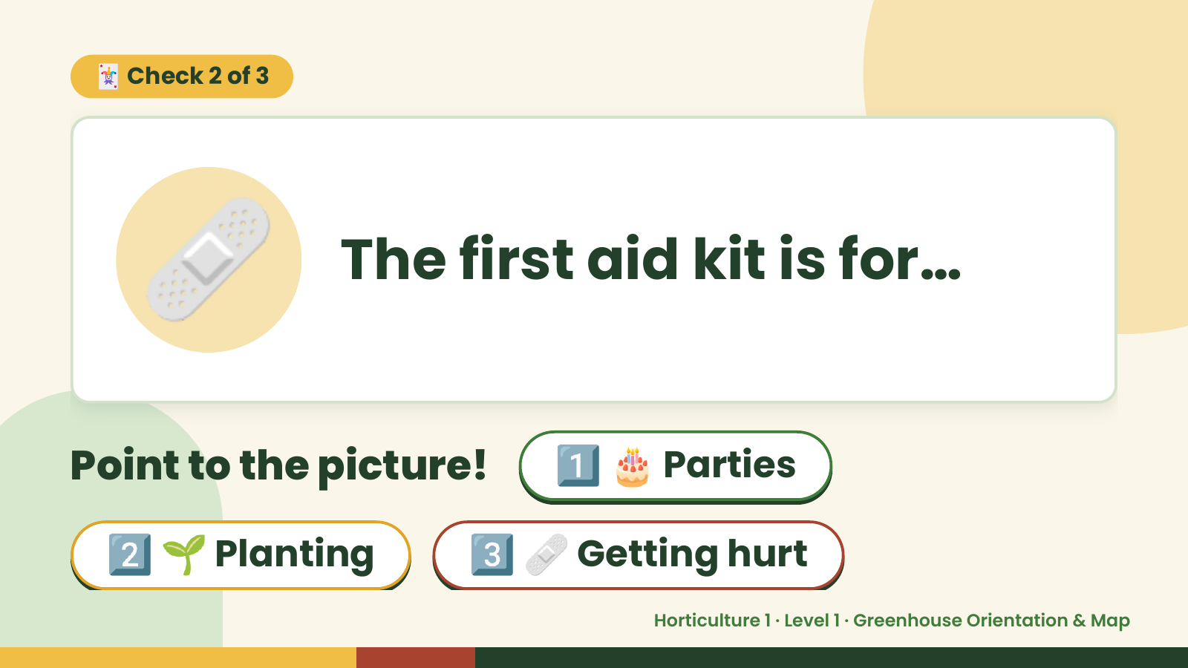
Notes:
🃏 Check 2 of 3
🩹 The first aid kit is for…
Point to the picture! 1️⃣ 🎂 Parties
2️⃣ 🌱 Planting 3️⃣ 🩹 Getting hurt
Horticulture 1 · Level 1 · Greenhouse Orientation & Map

Slide 9
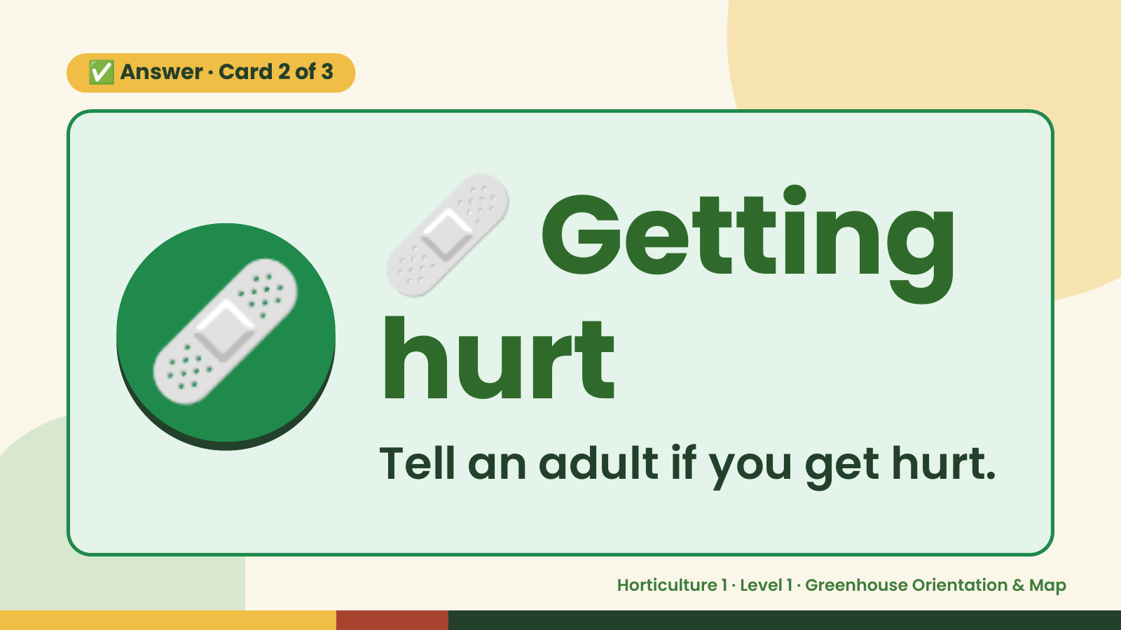
Notes:
🩹
✅ Answer · Card 2 of 3
🩹 hurt
Getting
Tell an adult if you get hurt.
Horticulture 1 · Level 1 · Greenhouse Orientation & Map

Slide 10
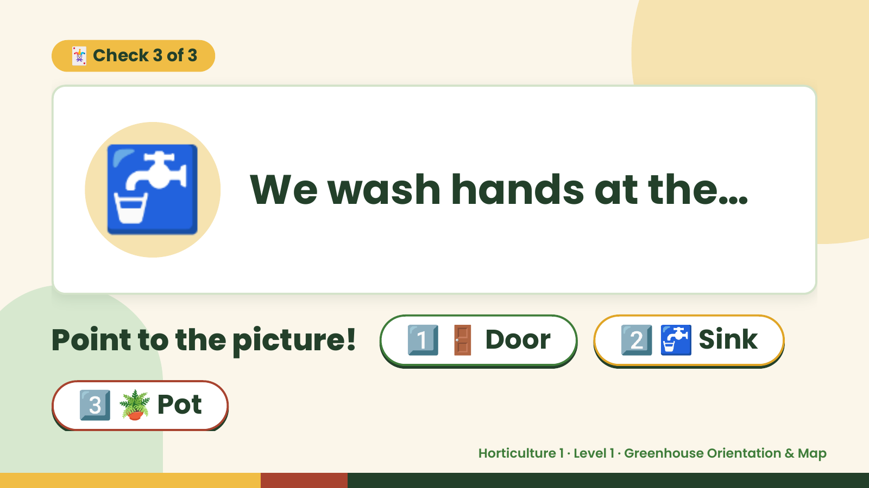
Notes:
🃏 Check 3 of 3
🚰 We wash hands at the…
Point to the picture! 1️⃣ 🚪 Door 2️⃣ 🚰 Sink
3️⃣ 🪴 Pot
Horticulture 1 · Level 1 · Greenhouse Orientation & Map

Slide 11
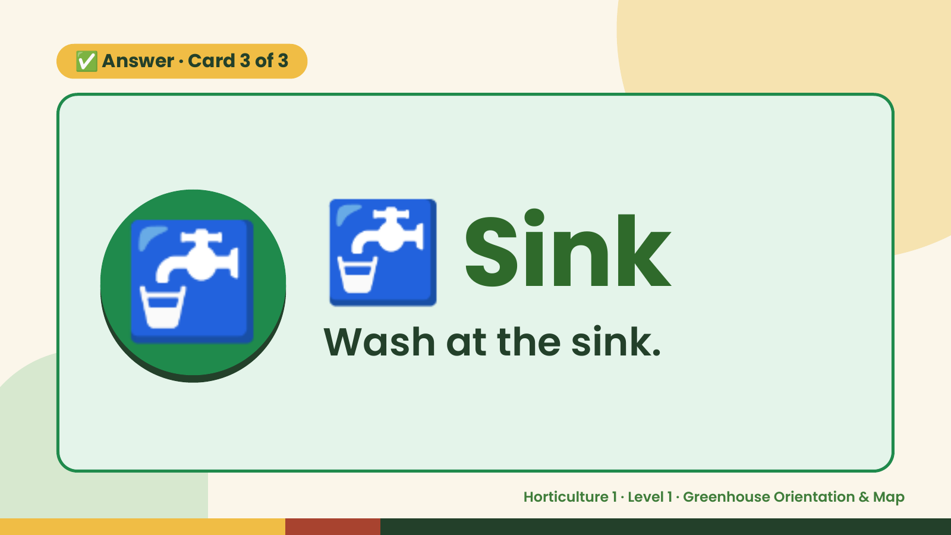
Notes:
✅ Answer · Card 3 of 3
🚰 🚰 Sink
Wash at the sink.
Horticulture 1 · Level 1 · Greenhouse Orientation & Map

Slide 12

Notes:
Wrap-Up
Clean Up +
Reflect
🧽
🧽 Clean the table.
🧰 Give tools back.
🧼 Wash hands.
Horticulture 1 · Level 1 · Greenhouse Orientation & Map

