Slide 1
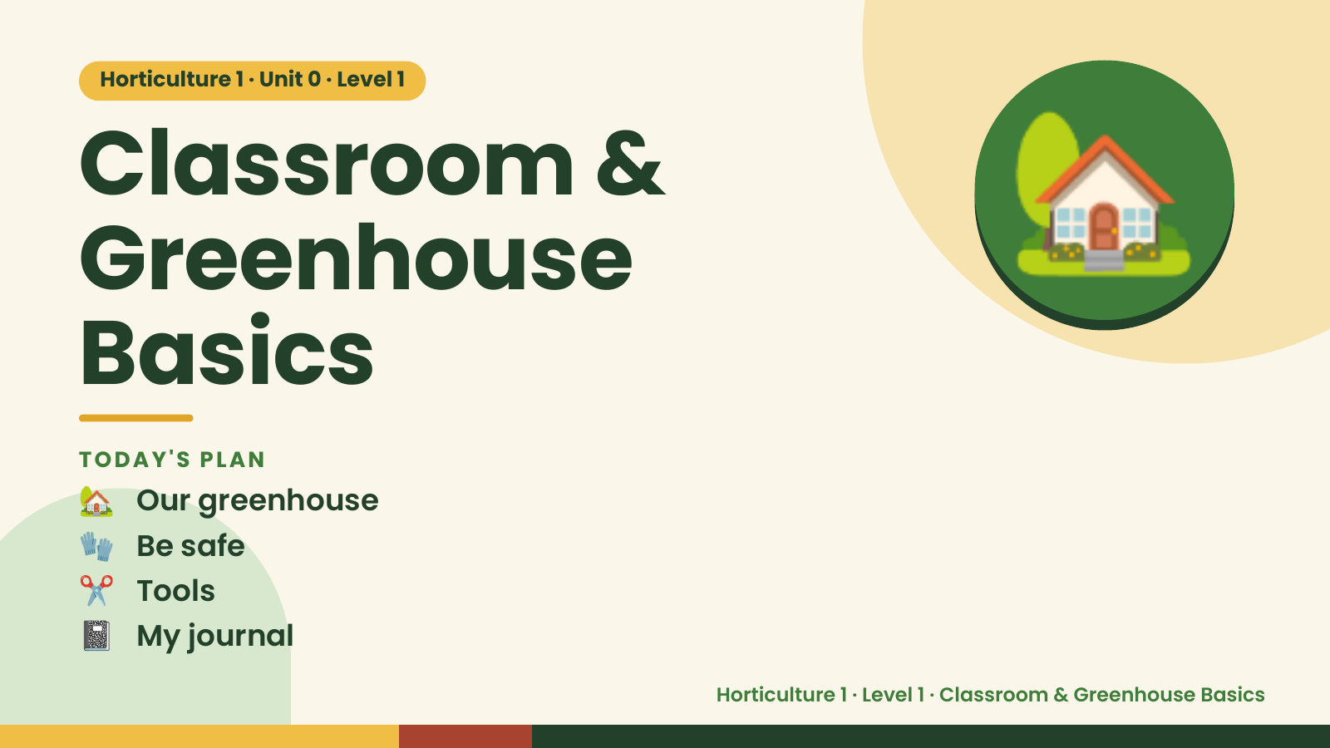
Notes:
Horticulture 1 · Unit 0 · Level 1
Classroom &
Greenhouse
Basics
🏡
🏡 Our greenhouse
TODAY'S PLAN
🧤 Be safe
✂️ Tools
📓 My journal
Horticulture 1 · Level 1 · Classroom & Greenhouse Basics

Slide 2
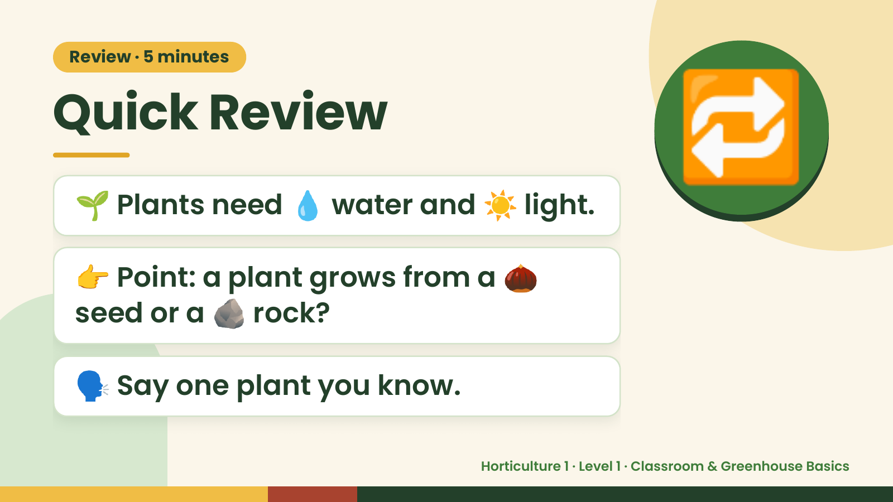
Notes:
Review · 5 minutes
Quick Review
🌱 Plants need 💧 water and ☀️ light.
👉 Point: a plant grows from a 🌰
🔁
seed or a 🪨 rock?
🗣️ Say one plant you know.
Horticulture 1 · Level 1 · Classroom & Greenhouse Basics

Slide 3
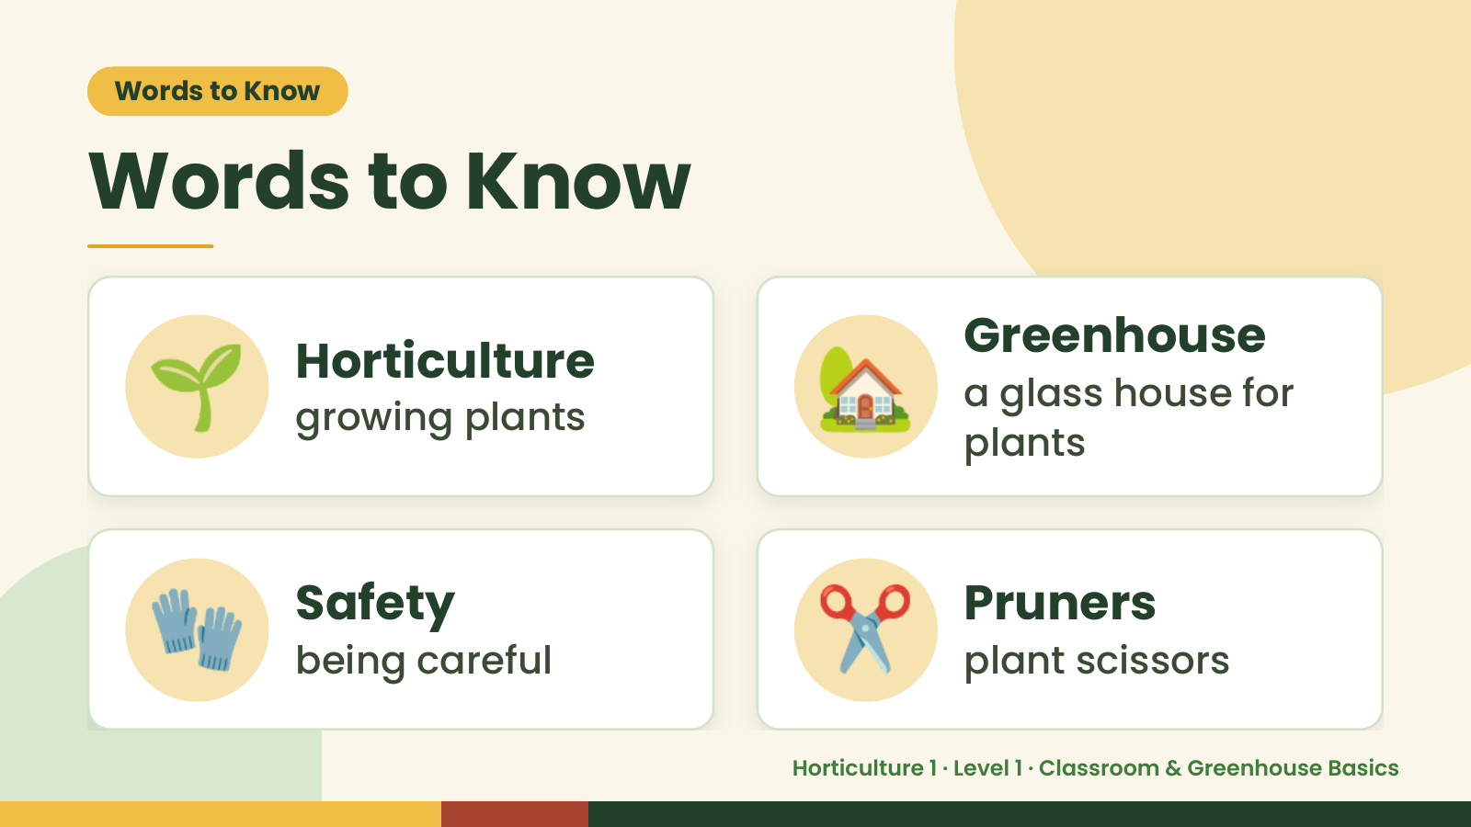
Notes:
Words to Know
Words to Know
🌱 Horticulture
growing plants 🏡 Greenhouse
a glass house for
plants
🧤 Safety
being careful ✂️ Pruners
plant scissors
Horticulture 1 · Level 1 · Classroom & Greenhouse Basics

Slide 4
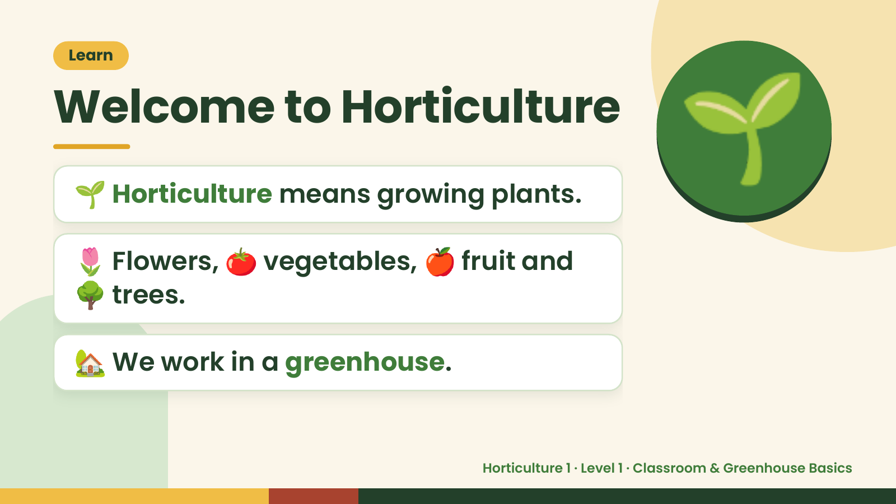
Notes:
Learn
Welcome to Horticulture
🌱 Horticulture means growing plants.
🌷 Flowers, 🍅 vegetables, 🍎 fruit and
🌱
🌳 trees.
🏡 We work in a greenhouse.
Horticulture 1 · Level 1 · Classroom & Greenhouse Basics

Slide 5
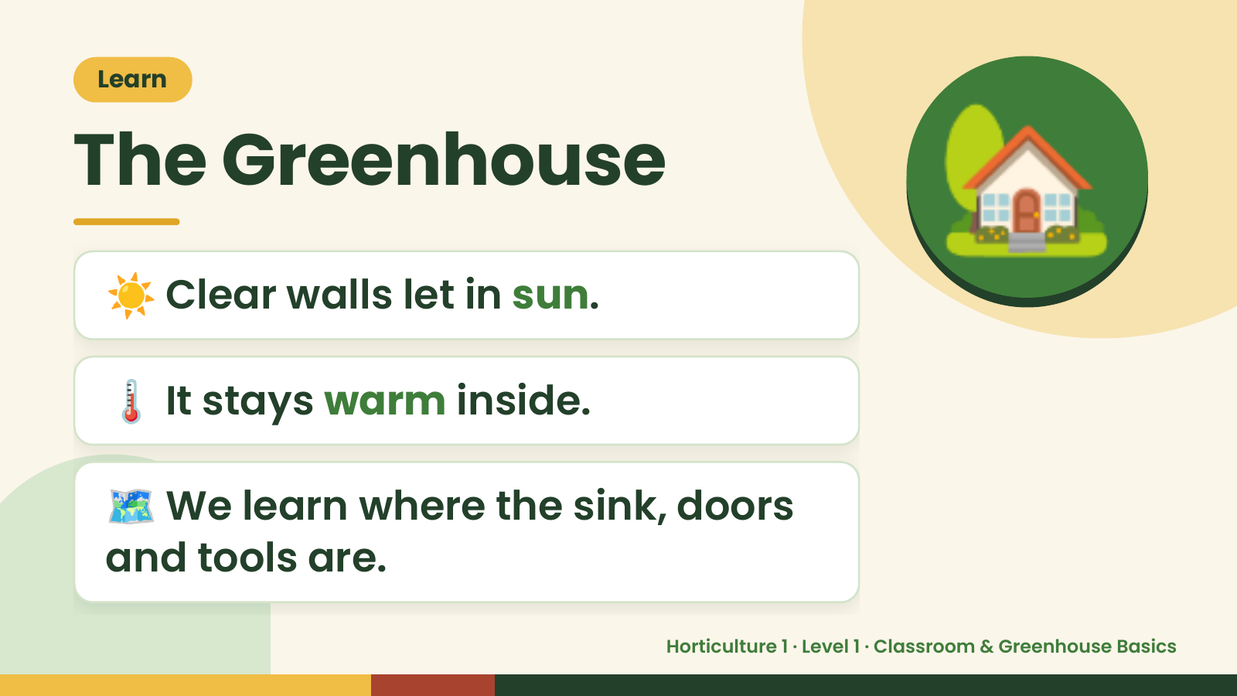
Notes:
Learn
The Greenhouse
☀️ Clear walls let in sun.
🏡
🌡️ It stays warm inside.
🗺️ We learn where the sink, doors
and tools are.
Horticulture 1 · Level 1 · Classroom & Greenhouse Basics

Slide 6
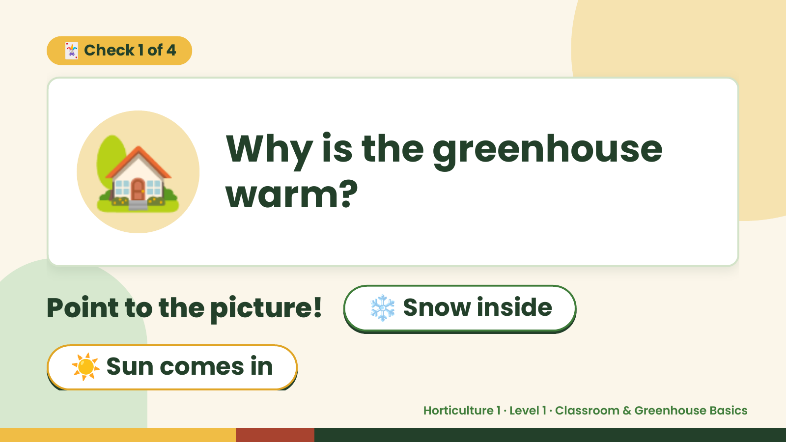
Notes:
🃏 Check 1 of 4
🏡 Why is the greenhouse
warm?
Point to the picture! ❄️ Snow inside
☀️ Sun comes in
Horticulture 1 · Level 1 · Classroom & Greenhouse Basics

Slide 7
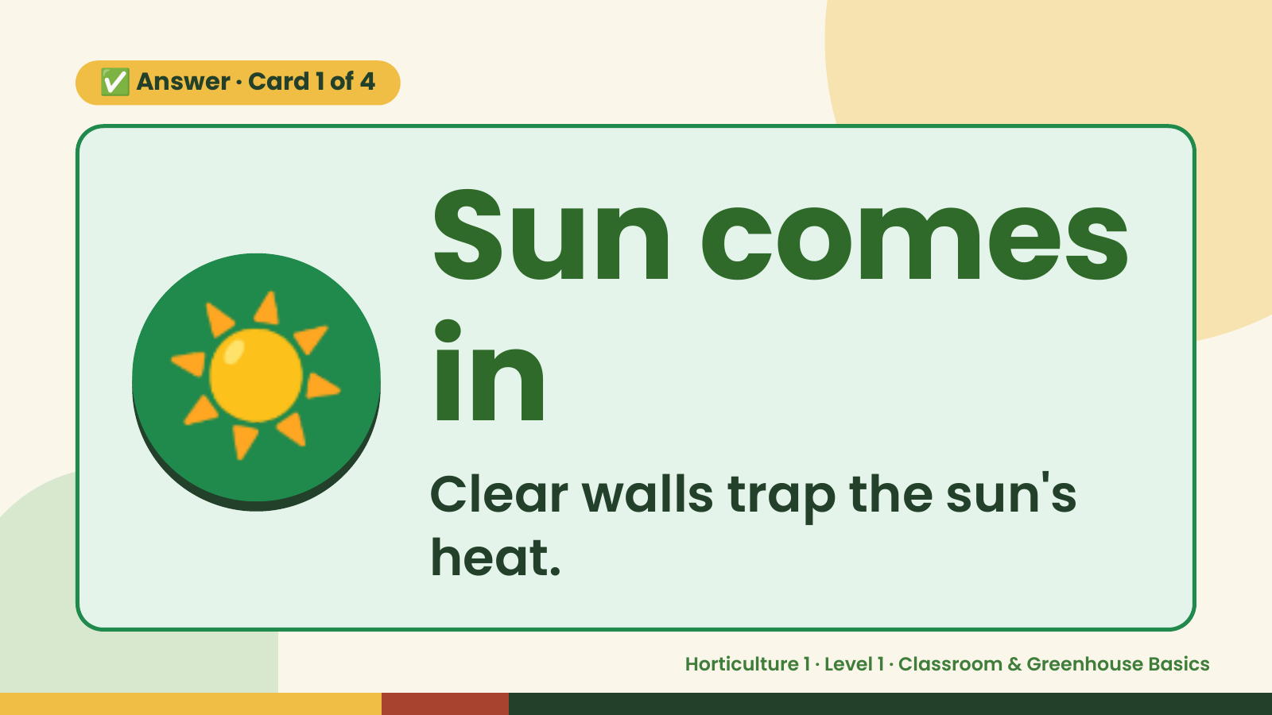
Notes:
✅ Answer · Card 1 of 4
☀️ Sun comes
in
Clear walls trap the sun's
heat.
Horticulture 1 · Level 1 · Classroom & Greenhouse Basics

Slide 8
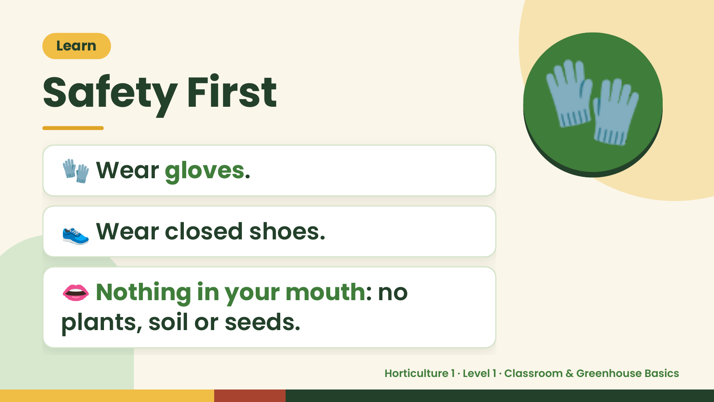
Notes:
Learn
Safety First
🧤 Wear gloves.
🧤
👟 Wear closed shoes.
👄 Nothing in your mouth: no
plants, soil or seeds.
Horticulture 1 · Level 1 · Classroom & Greenhouse Basics

Slide 9
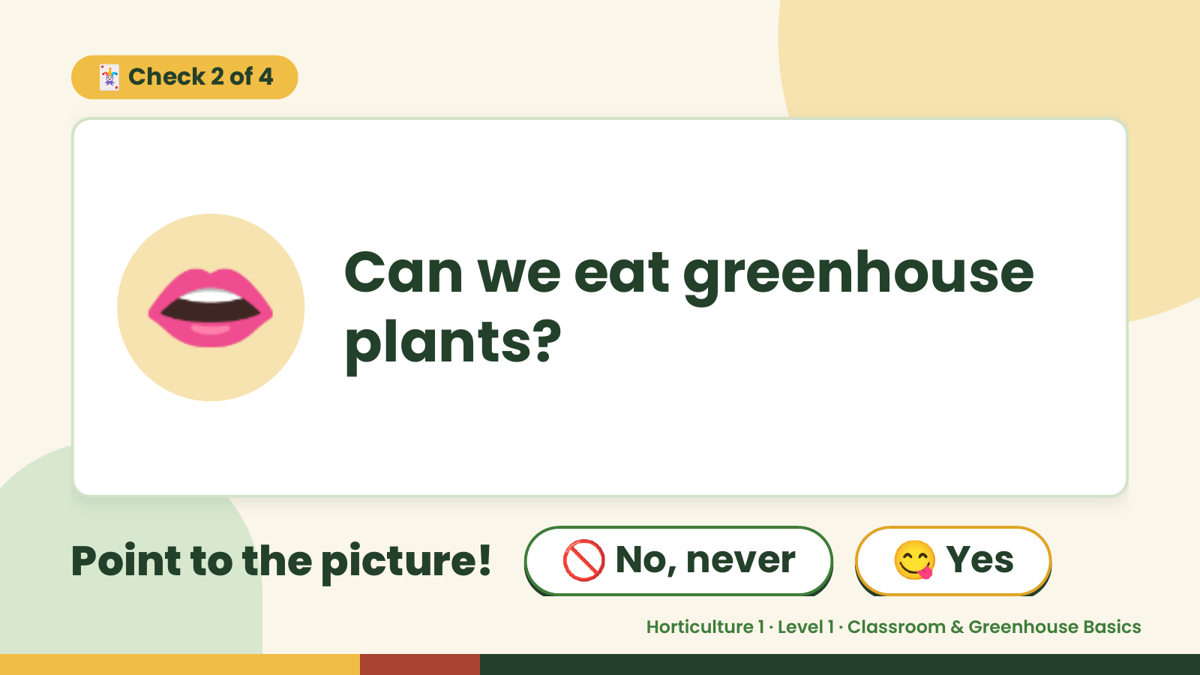
Notes:
🃏 Check 2 of 4
👄 Can we eat greenhouse
plants?
Point to the picture! 🚫 No, never 😋 Yes
Horticulture 1 · Level 1 · Classroom & Greenhouse Basics

Slide 10
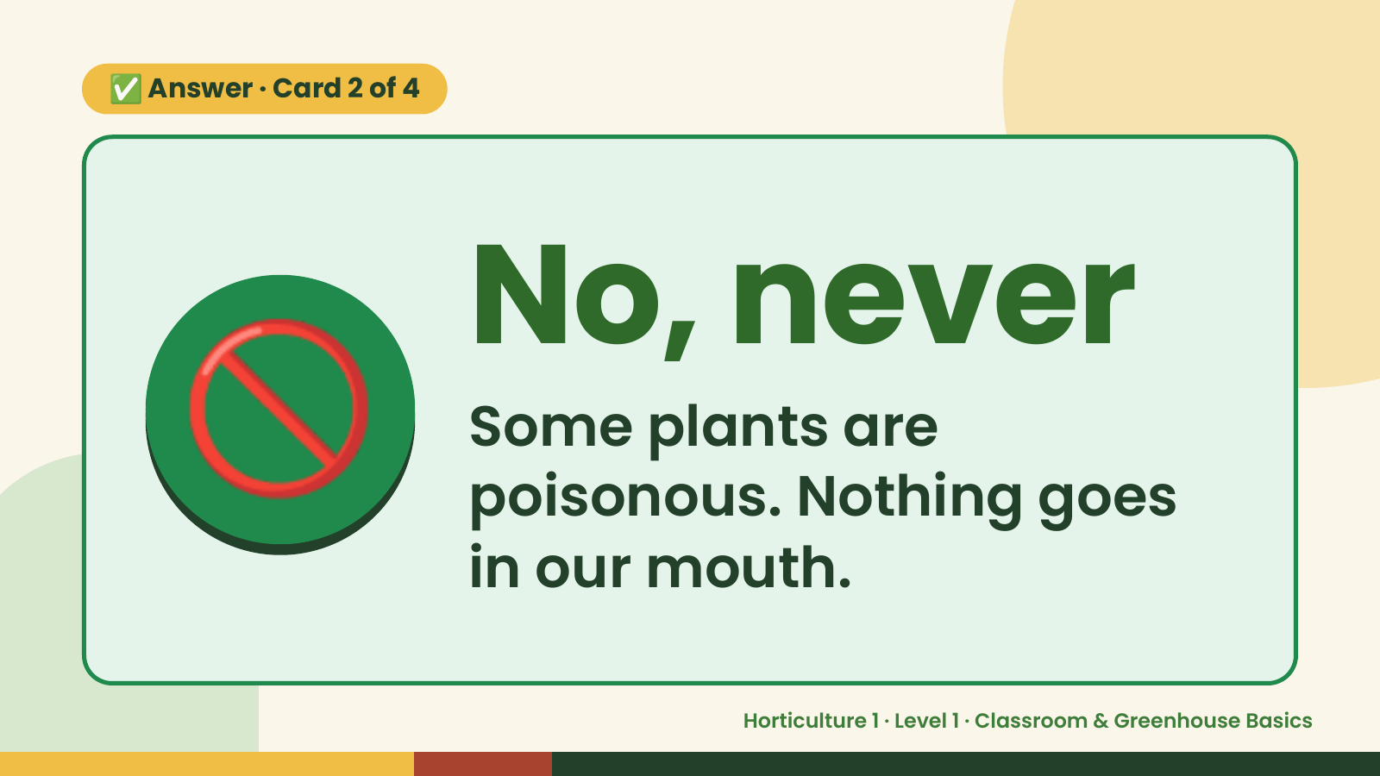
Notes:
✅ Answer · Card 2 of 4
🚫 No, never
Some plants are
poisonous. Nothing goes
in our mouth.
Horticulture 1 · Level 1 · Classroom & Greenhouse Basics

Slide 11
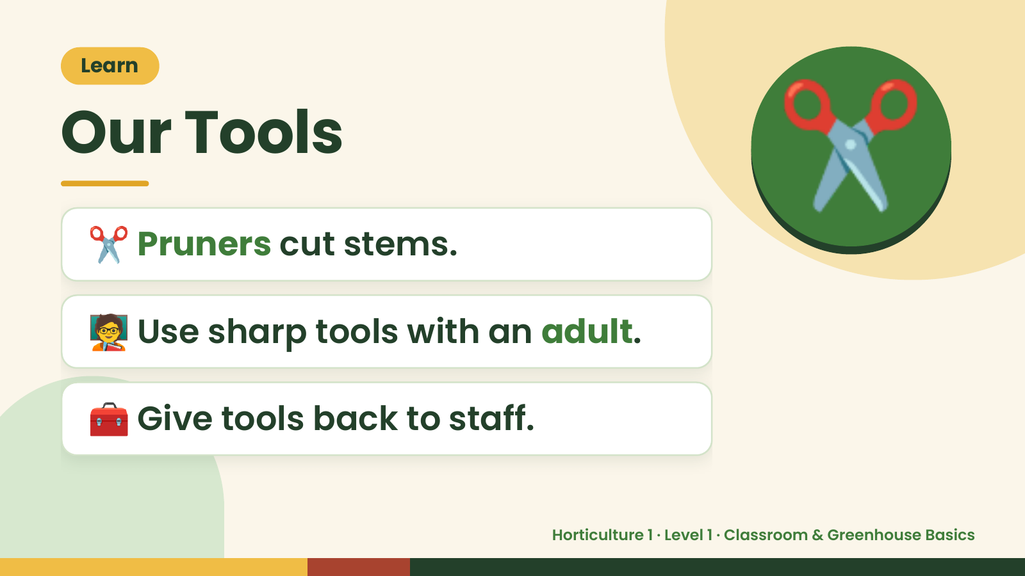
Notes:
Learn
Our Tools
✂️ Pruners cut stems.
✂️
🧑‍🏫 Use sharp tools with an adult.
🧰 Give tools back to staff.
Horticulture 1 · Level 1 · Classroom & Greenhouse Basics

Slide 12
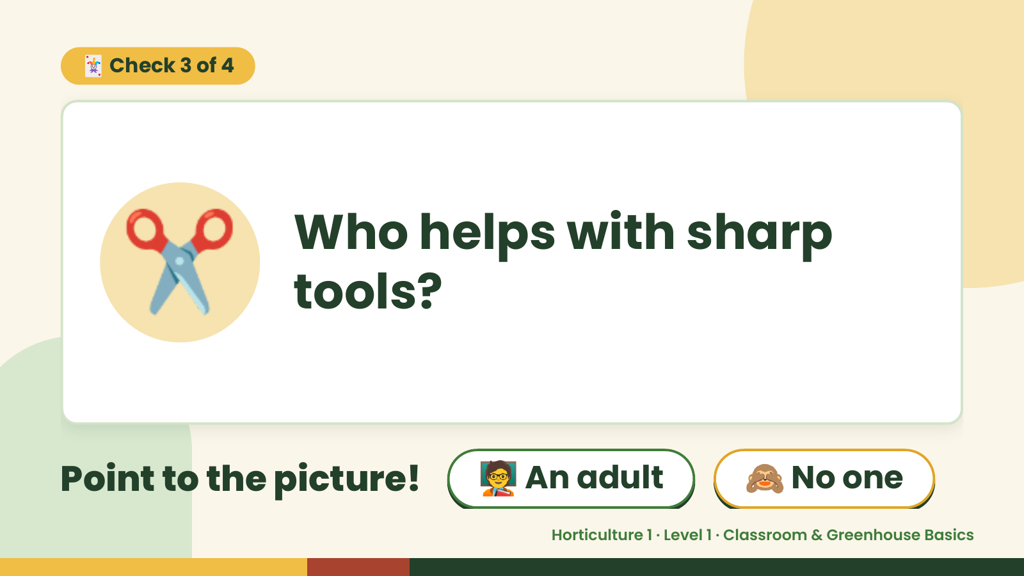
Notes:
🃏 Check 3 of 4
✂️ Who helps with sharp
tools?
Point to the picture! 🧑‍🏫 An adult 🙈 No one
Horticulture 1 · Level 1 · Classroom & Greenhouse Basics

Slide 13
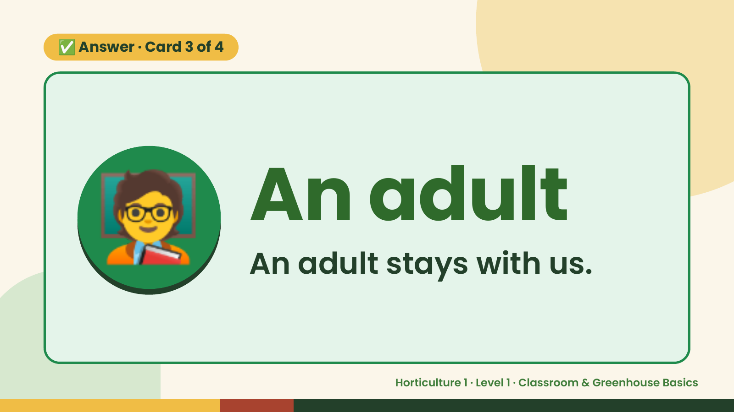
Notes:
✅ Answer · Card 3 of 4
🧑‍🏫 An adult
An adult stays with us.
Horticulture 1 · Level 1 · Classroom & Greenhouse Basics

Slide 14
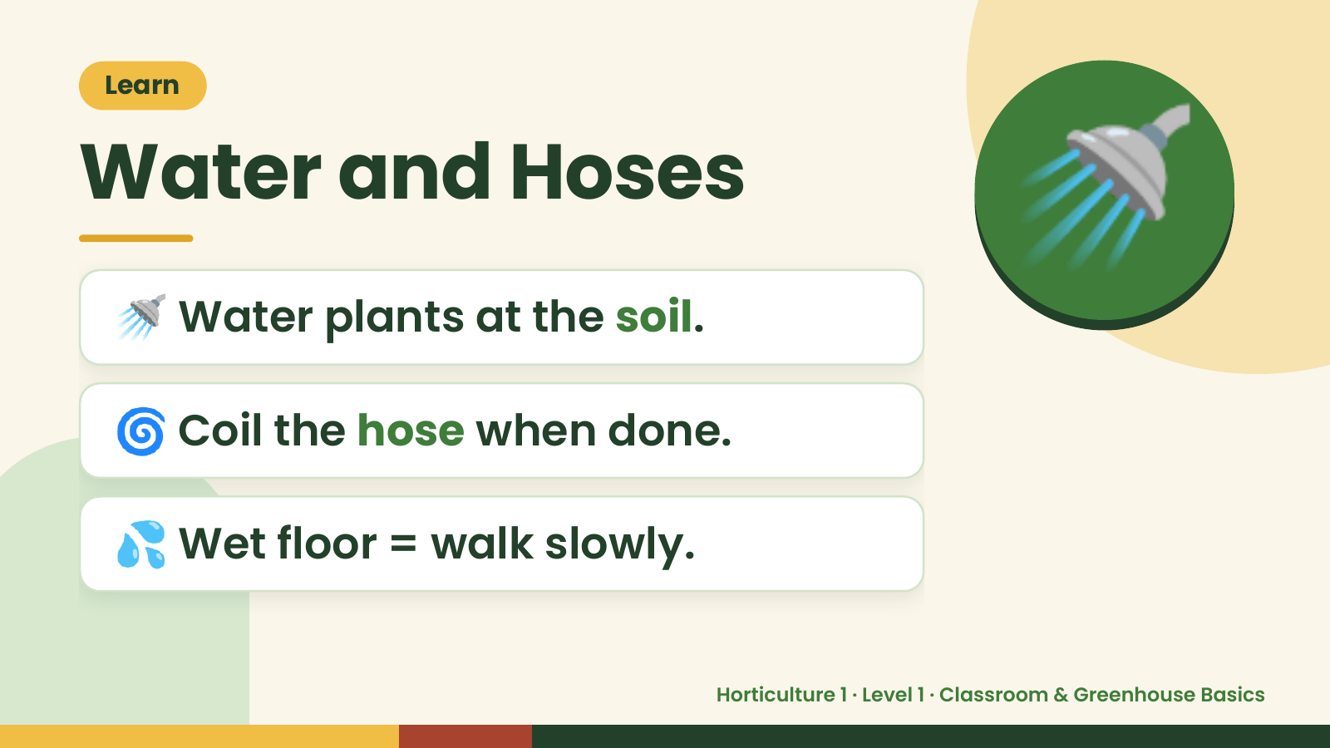
Notes:
Learn
Water and Hoses
🚿 Water plants at the soil.
🚿
🌀 Coil the hose when done.
💦 Wet floor = walk slowly.
Horticulture 1 · Level 1 · Classroom & Greenhouse Basics

Slide 15
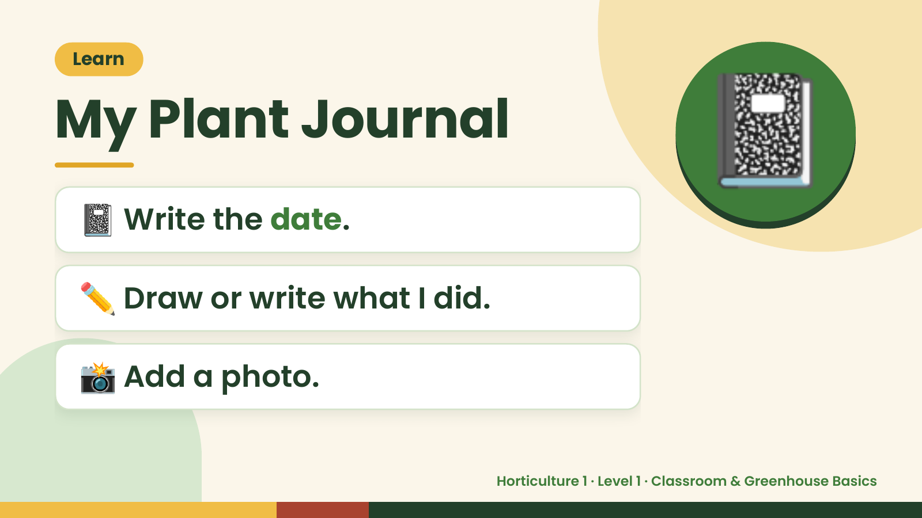
Notes:
Learn
My Plant Journal
📓 Write the date.
📓
✏️ Draw or write what I did.
📸 Add a photo.
Horticulture 1 · Level 1 · Classroom & Greenhouse Basics

Slide 16
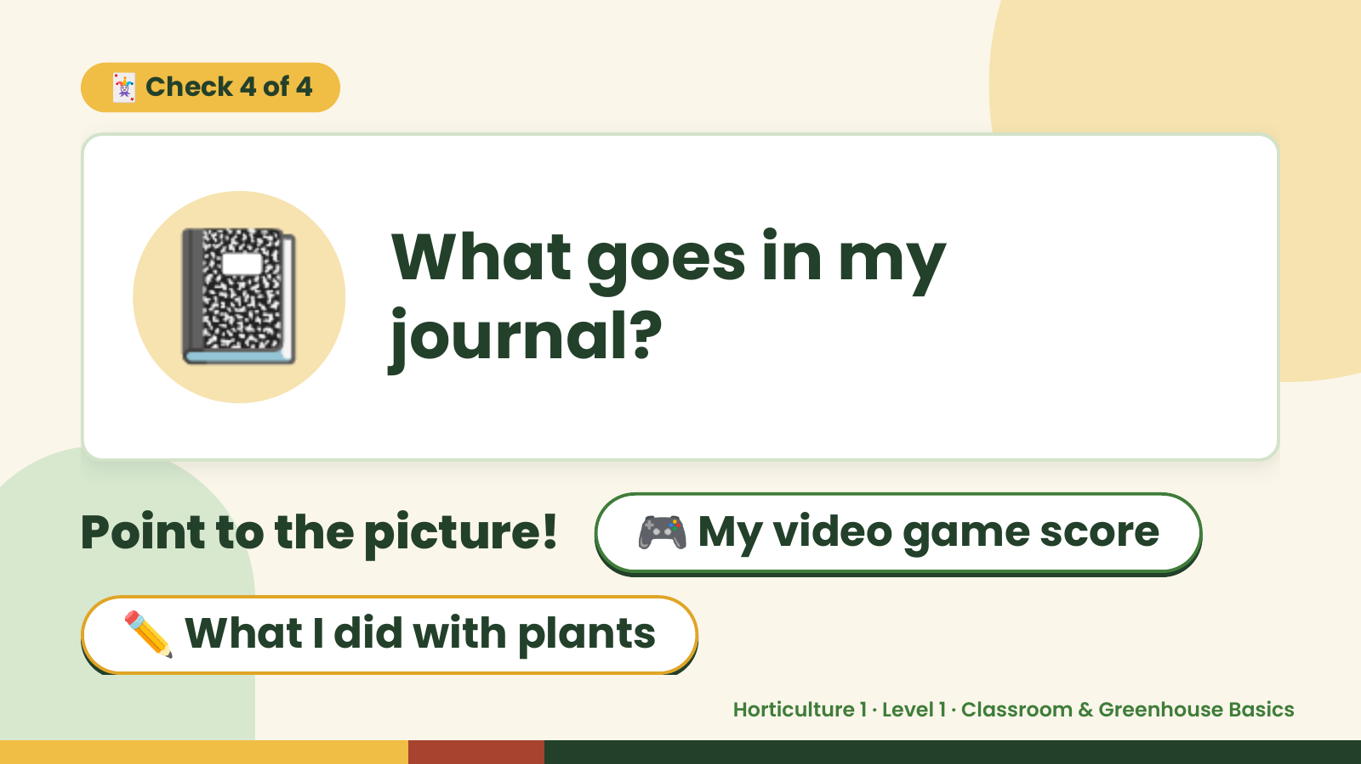
Notes:
🃏 Check 4 of 4
📓 What goes in my
journal?
Point to the picture! 🎮 My video game score
✏️ What I did with plants
Horticulture 1 · Level 1 · Classroom & Greenhouse Basics

Slide 17
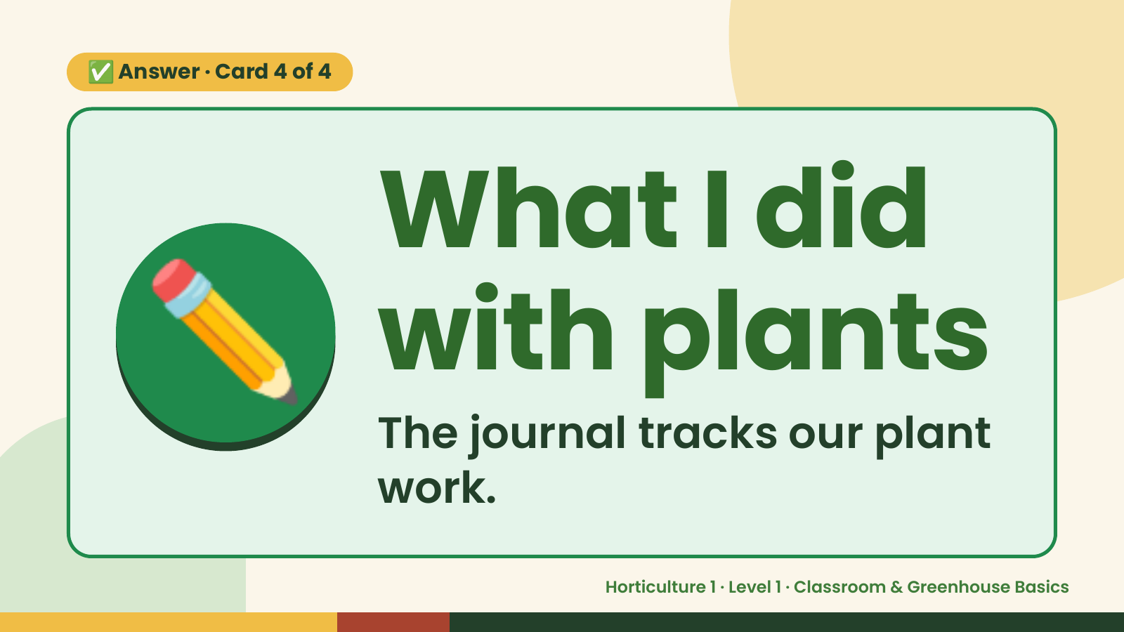
Notes:
✅ Answer · Card 4 of 4
✏️ What I did
with plants
The journal tracks our plant
work.
Horticulture 1 · Level 1 · Classroom & Greenhouse Basics

Slide 18
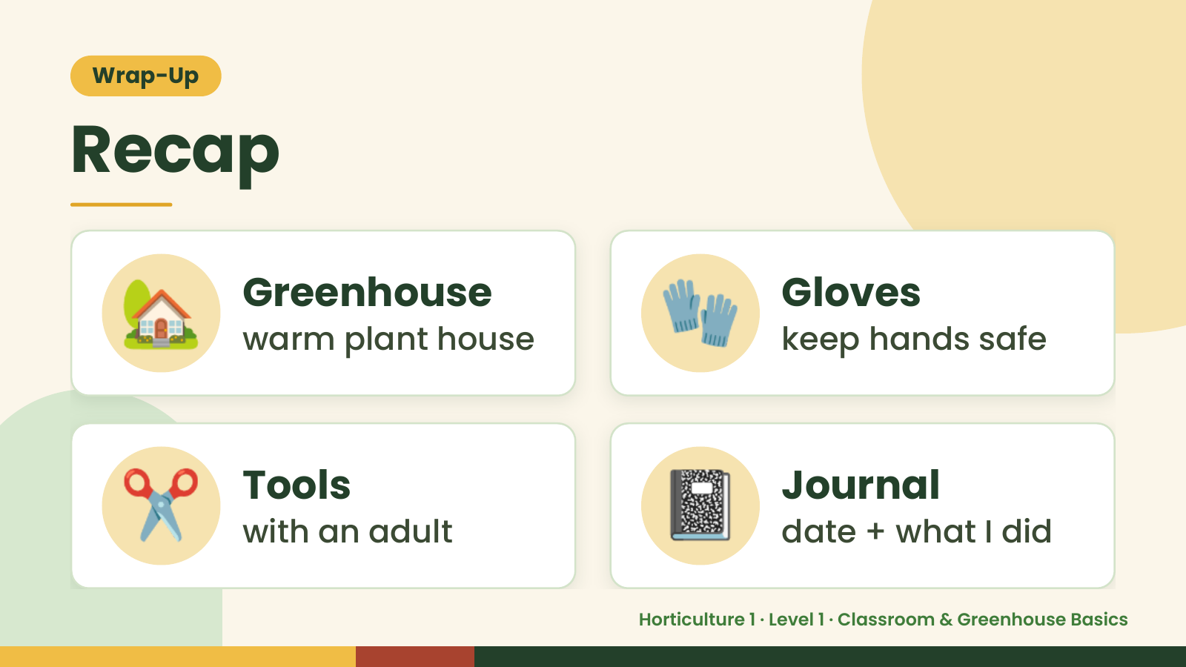
Notes:
Wrap-Up
Recap
🏡 Greenhouse
warm plant house 🧤 Gloves
keep hands safe
✂️ Tools
with an adult 📓 Journal
date + what I did
Horticulture 1 · Level 1 · Classroom & Greenhouse Basics

Slide 19
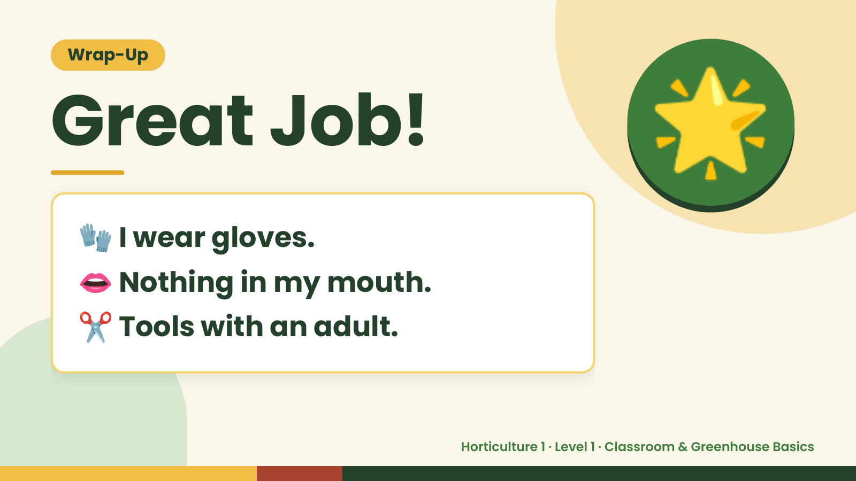
Notes:
Wrap-Up
Great Job!
🧤 I wear gloves.
🌟
👄 Nothing in my mouth.
✂️ Tools with an adult.
Horticulture 1 · Level 1 · Classroom & Greenhouse Basics

