Slide 1
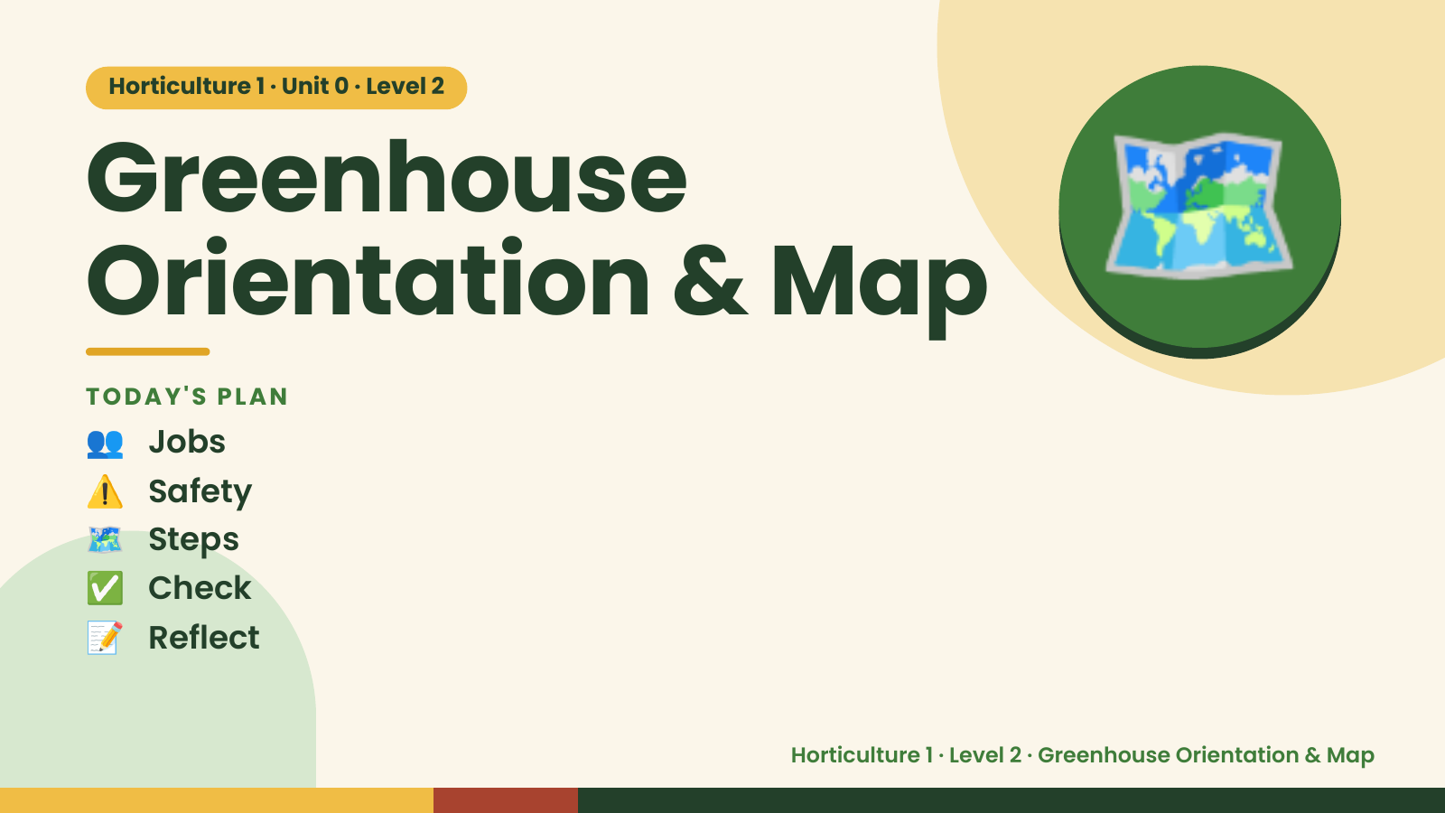
Notes:
Horticulture 1 · Unit 0 · Level 2
Greenhouse
Orientation & Map
👥 Jobs
TODAY'S PLAN
🗺️
⚠️ Safety
🗺️ Steps
✅ Check
📝 Reflect
Horticulture 1 · Level 2 · Greenhouse Orientation & Map

Slide 2

Notes:
Get ready
Jobs
🧑‍🌾 Grower
Does the main plant job
with the tools
🧺 Supply helper
Gets and returns supplies
and tools to staff
📸 Recorder
Takes photos and fills in
the chart
🧽 Clean-up captain
Sweeps, wipes tables,
checks hands are
washed
Horticulture 1 · Level 2 · Greenhouse Orientation & Map

Slide 3
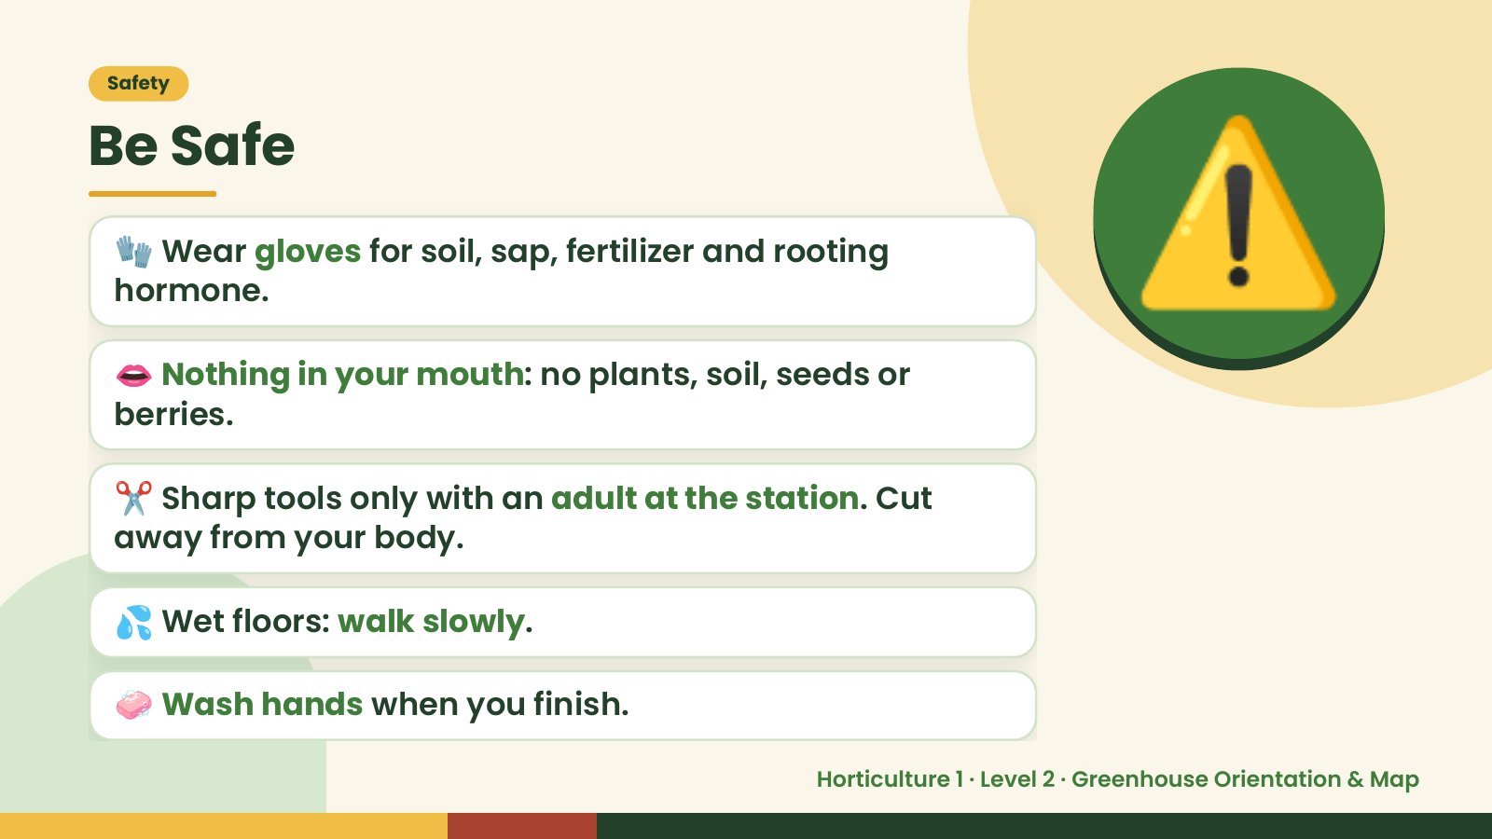
Notes:
Safety
Be Safe
🧤 Wear gloves for soil, sap, fertilizer and rooting
hormone.
👄 Nothing in your mouth: no plants, soil, seeds or
berries.
⚠️
✂️ Sharp tools only with an adult at the station. Cut
away from your body.
💦 Wet floors: walk slowly.
🧼 Wash hands when you finish.
Horticulture 1 · Level 2 · Greenhouse Orientation & Map

Slide 4
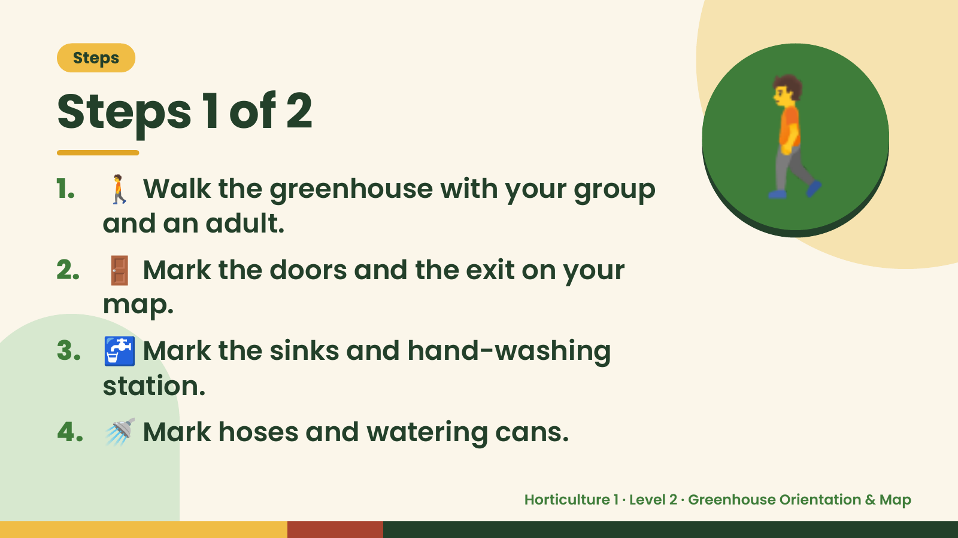
Notes:
Steps
Steps 1 of 2
1. 🚶 Walk the greenhouse with your group
and an adult.
2. 🚪 Mark the doors and the exit on your
map.
🚶
3. 🚰 Mark the sinks and hand-washing
station.
4. 🚿 Mark hoses and watering cans.
Horticulture 1 · Level 2 · Greenhouse Orientation & Map

Slide 5
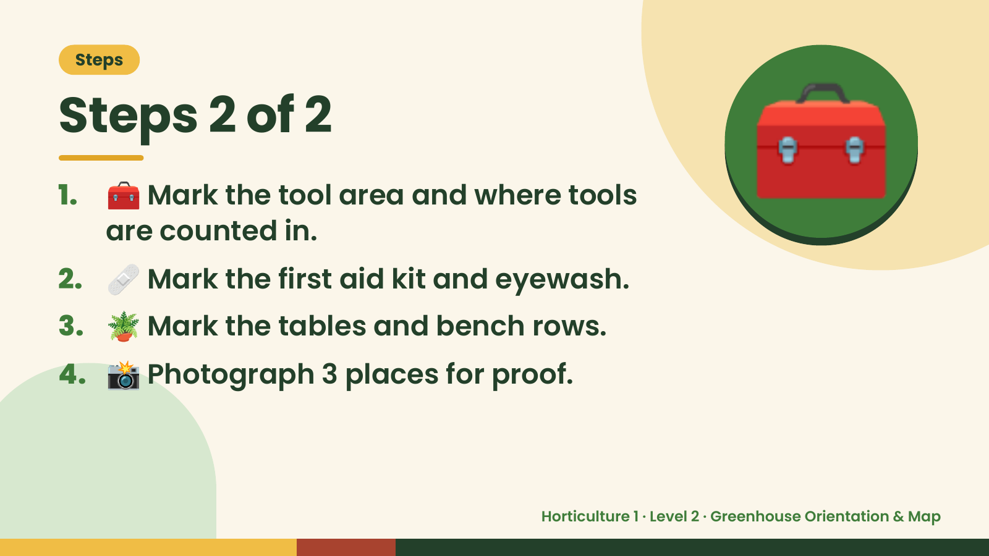
Notes:
Steps
Steps 2 of 2
1. 🧰 Mark the tool area and where tools
are counted in.
2. 🩹 Mark the first aid kit and eyewash.
🧰
3. 🪴 Mark the tables and bench rows.
4. 📸 Photograph 3 places for proof.
Horticulture 1 · Level 2 · Greenhouse Orientation & Map

Slide 6
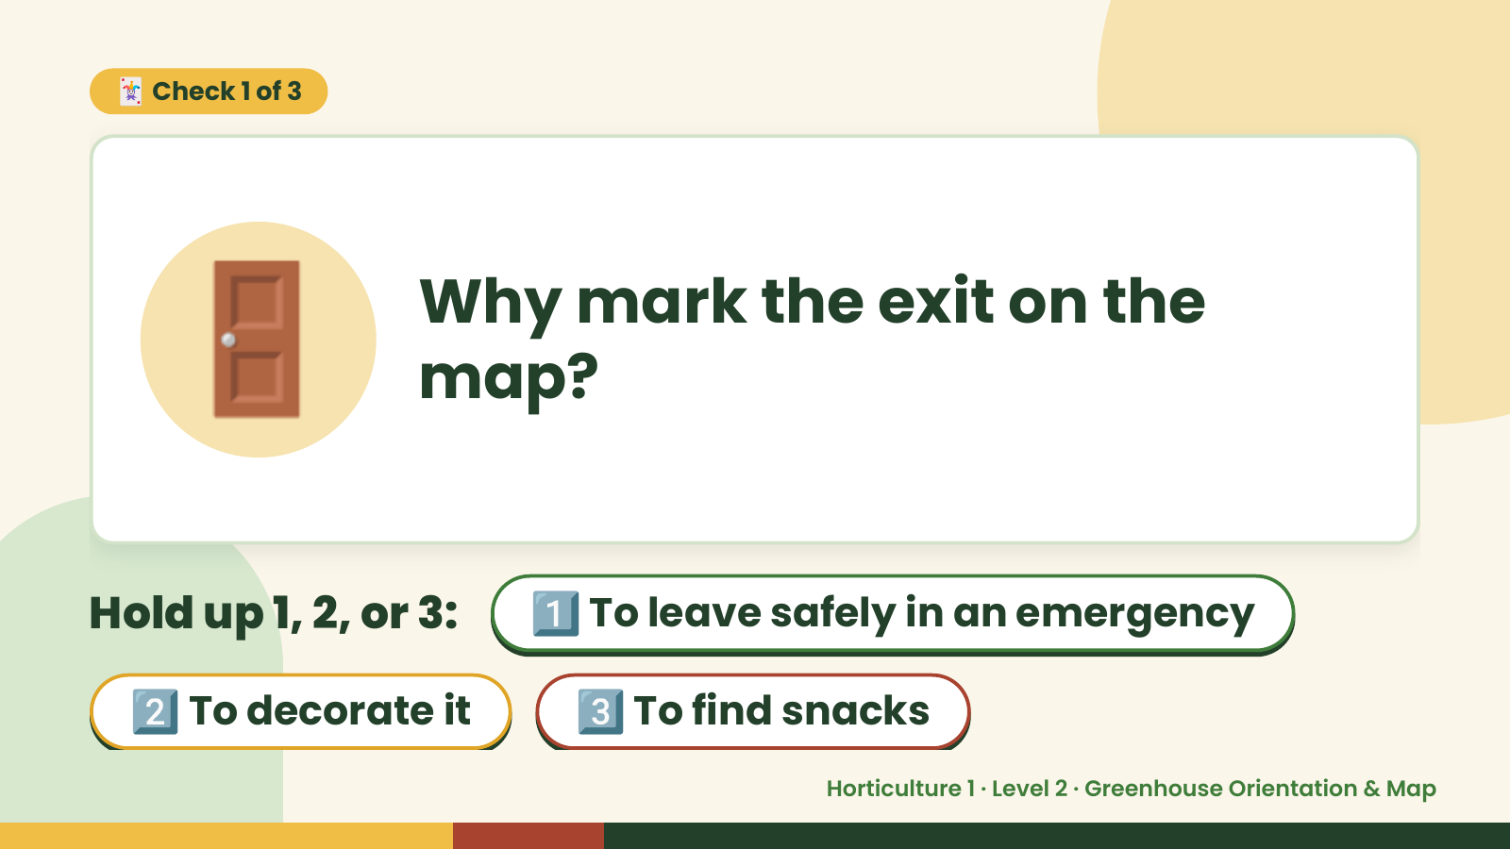
Notes:
🃏 Check 1 of 3
🚪 Why mark the exit on the
map?
Hold up 1, 2, or 3: 1️⃣ To leave safely in an emergency
2️⃣ To decorate it 3️⃣ To find snacks
Horticulture 1 · Level 2 · Greenhouse Orientation & Map

Slide 7
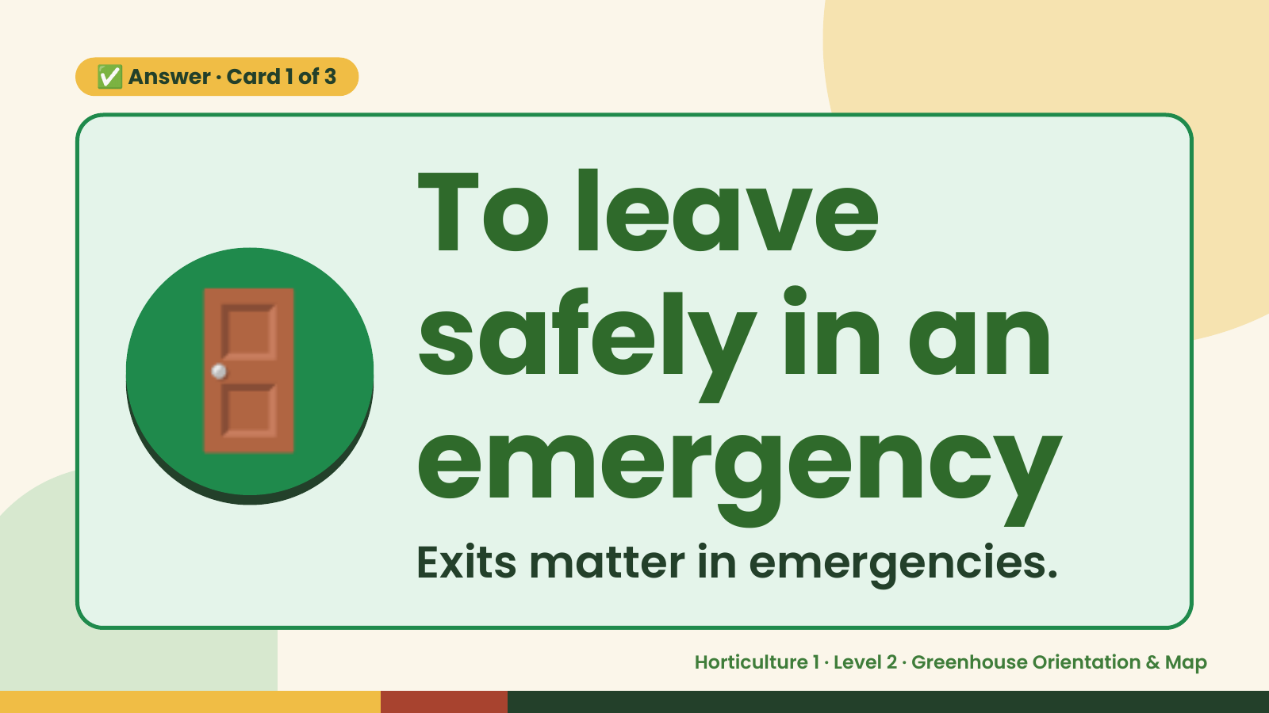
Notes:
✅ Answer · Card 1 of 3
🚪 To leave
safely in an
emergency
Exits matter in emergencies.
Horticulture 1 · Level 2 · Greenhouse Orientation & Map

Slide 8
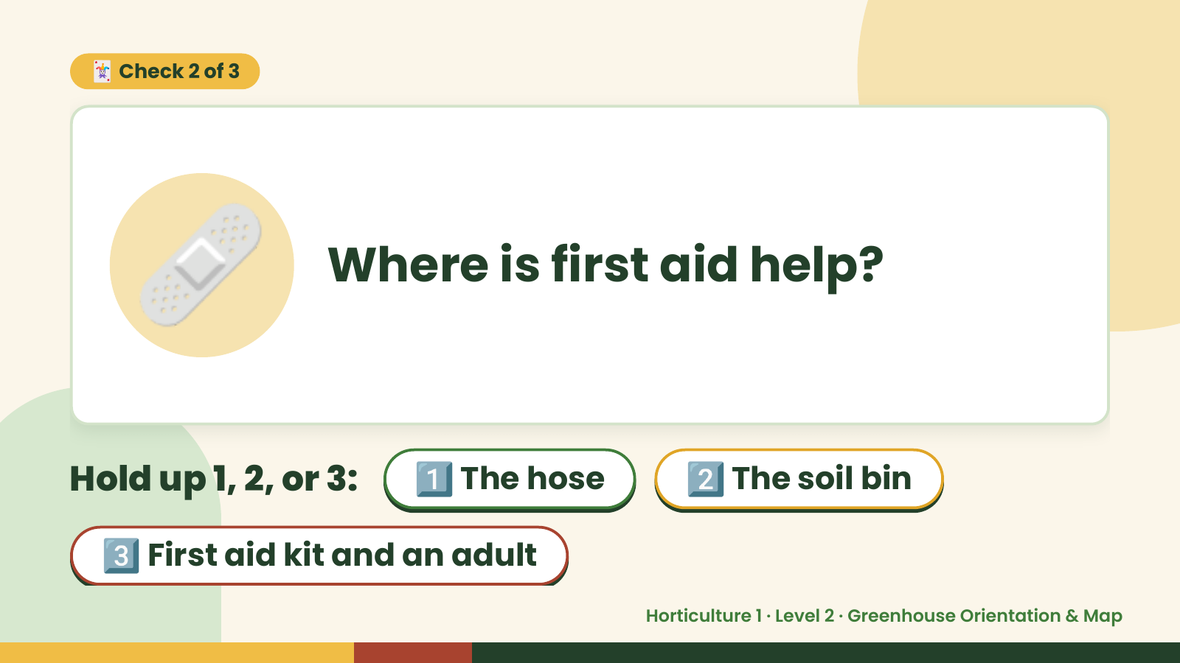
Notes:
🃏 Check 2 of 3
🩹 Where is first aid help?
Hold up 1, 2, or 3: 1️⃣ The hose 2️⃣ The soil bin
3️⃣ First aid kit and an adult
Horticulture 1 · Level 2 · Greenhouse Orientation & Map

Slide 9
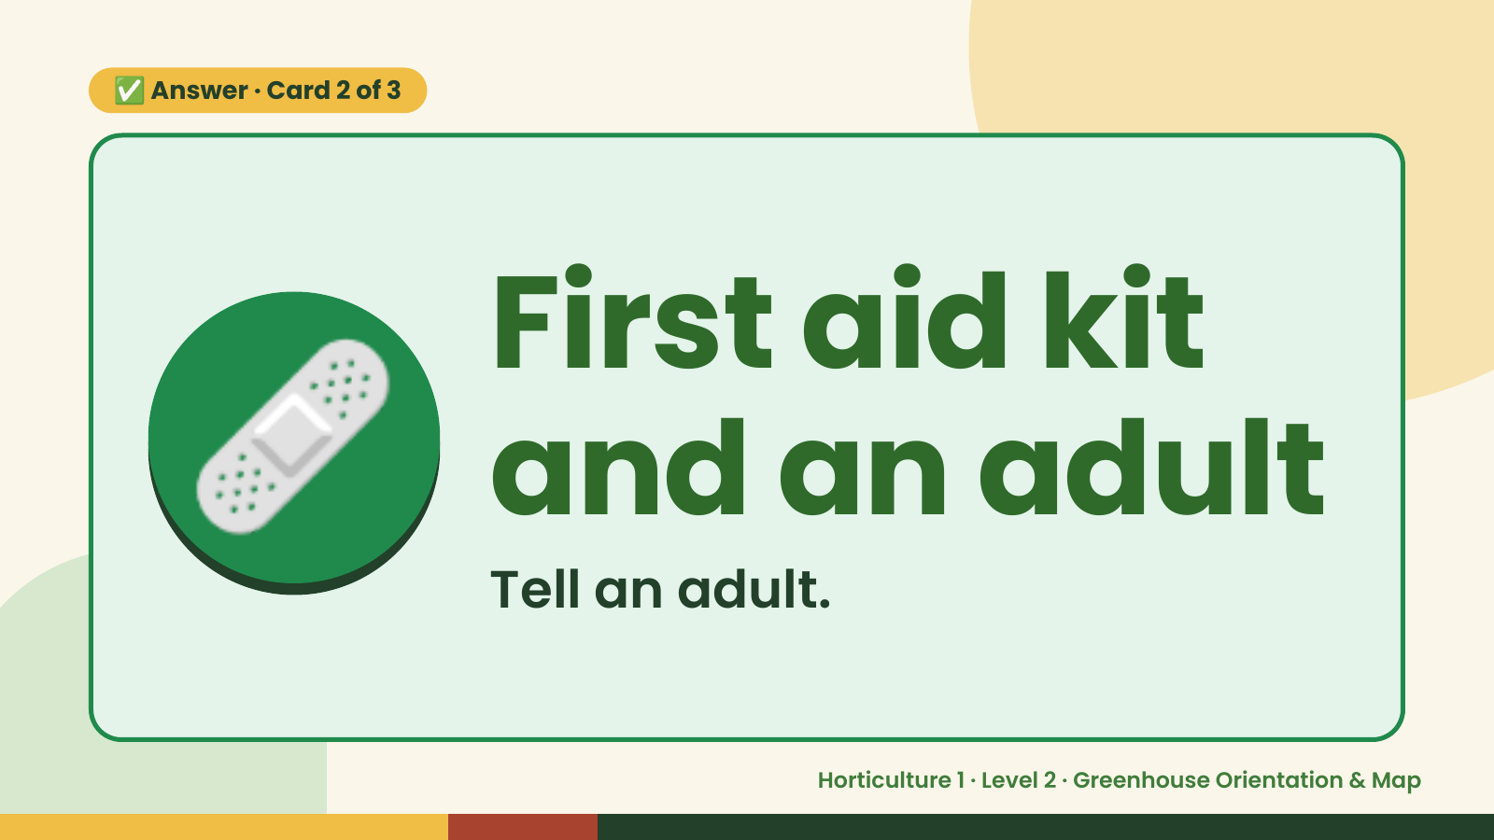
Notes:
✅ Answer · Card 2 of 3
🩹 First aid kit
and an adult
Tell an adult.
Horticulture 1 · Level 2 · Greenhouse Orientation & Map

Slide 10
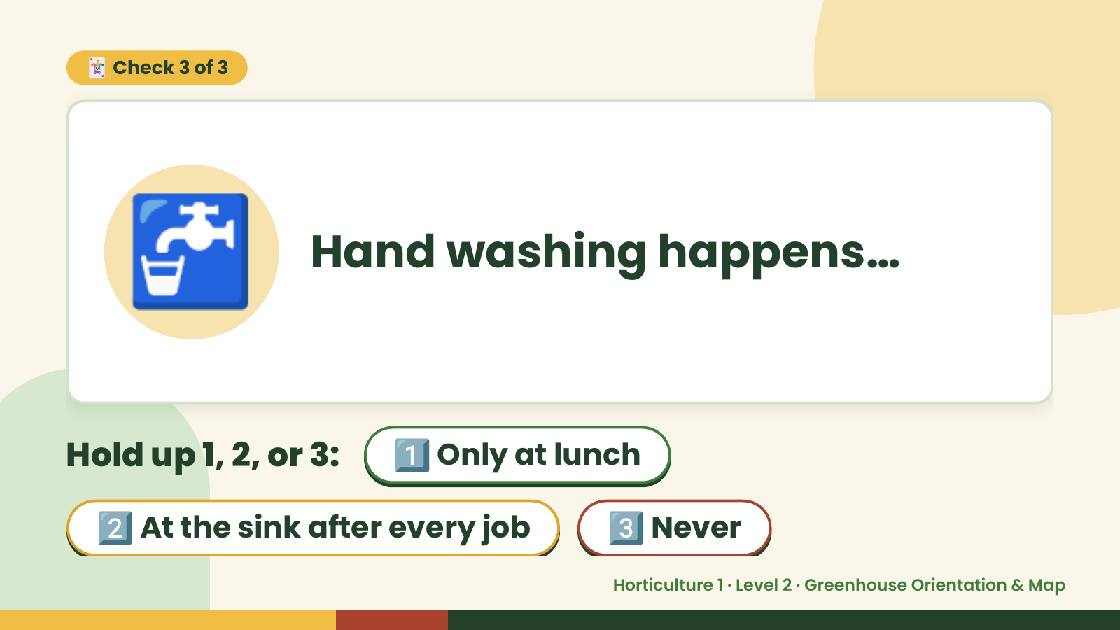
Notes:
🃏 Check 3 of 3
🚰 Hand washing happens…
Hold up 1, 2, or 3: 1️⃣ Only at lunch
2️⃣ At the sink after every job 3️⃣ Never
Horticulture 1 · Level 2 · Greenhouse Orientation & Map

Slide 11
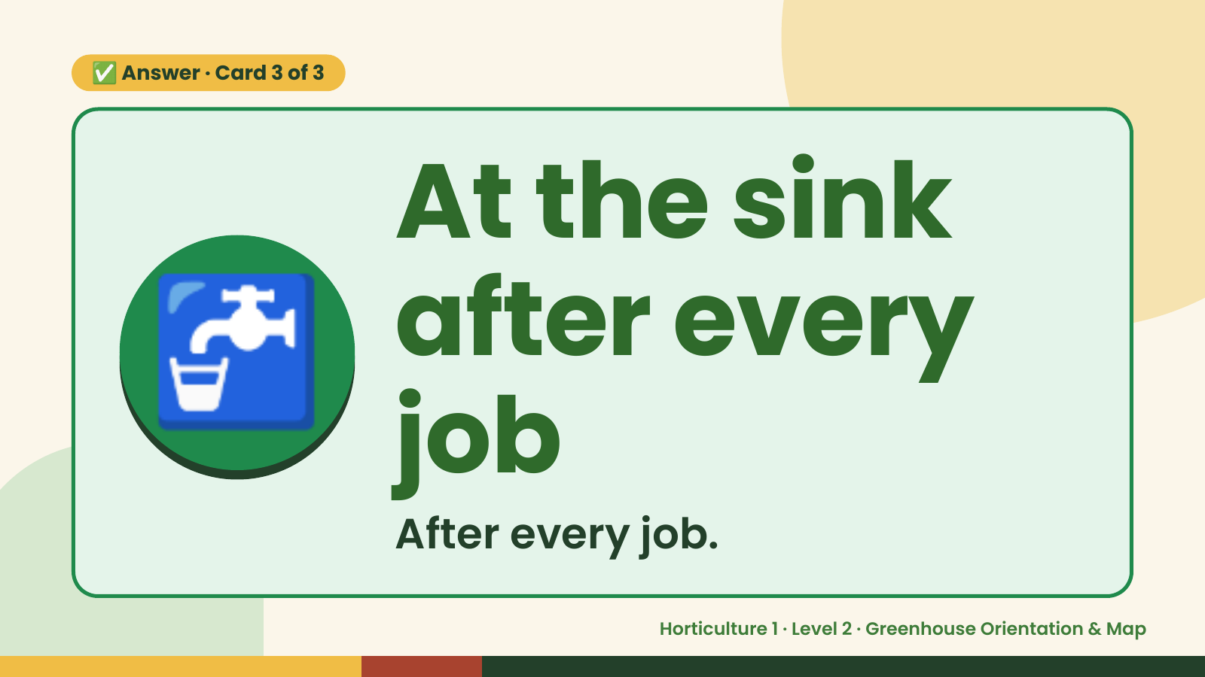
Notes:
✅ Answer · Card 3 of 3
🚰 At the sink
after every
job
After every job.
Horticulture 1 · Level 2 · Greenhouse Orientation & Map

Slide 12

Notes:
Wrap-Up
Clean Up +
Reflect
🧽
Return and count tools.
Sweep and wipe your area.
Wash hands, then do the reflection.
Horticulture 1 · Level 2 · Greenhouse Orientation & Map

