Slide 1

Notes:
Horticulture 1 · Unit 0 · Level 2 (modified)
Classroom &
Greenhouse
Basics
🏡
🌱 What is horticulture?
TODAY'S PLAN
🗺️ Greenhouse map
🧤 Safety contract
📓 Journal and leadership points
Horticulture 1 · Level 2 · Classroom & Greenhouse Basics

Slide 2
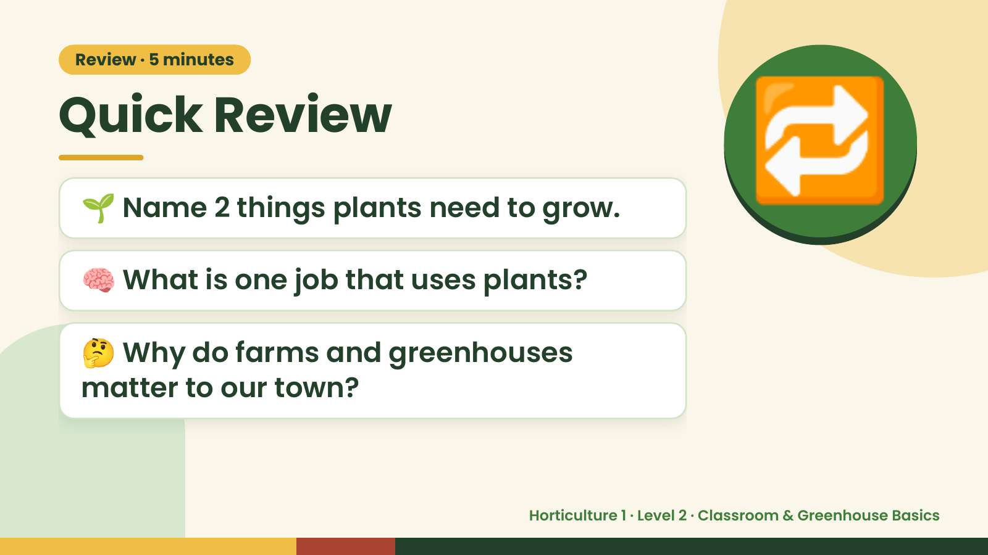
Notes:
Review · 5 minutes
Quick Review
🌱 Name 2 things plants need to grow.
🧠 What is one job that uses plants?
🔁
🤔 Why do farms and greenhouses
matter to our town?
Horticulture 1 · Level 2 · Classroom & Greenhouse Basics

Slide 3
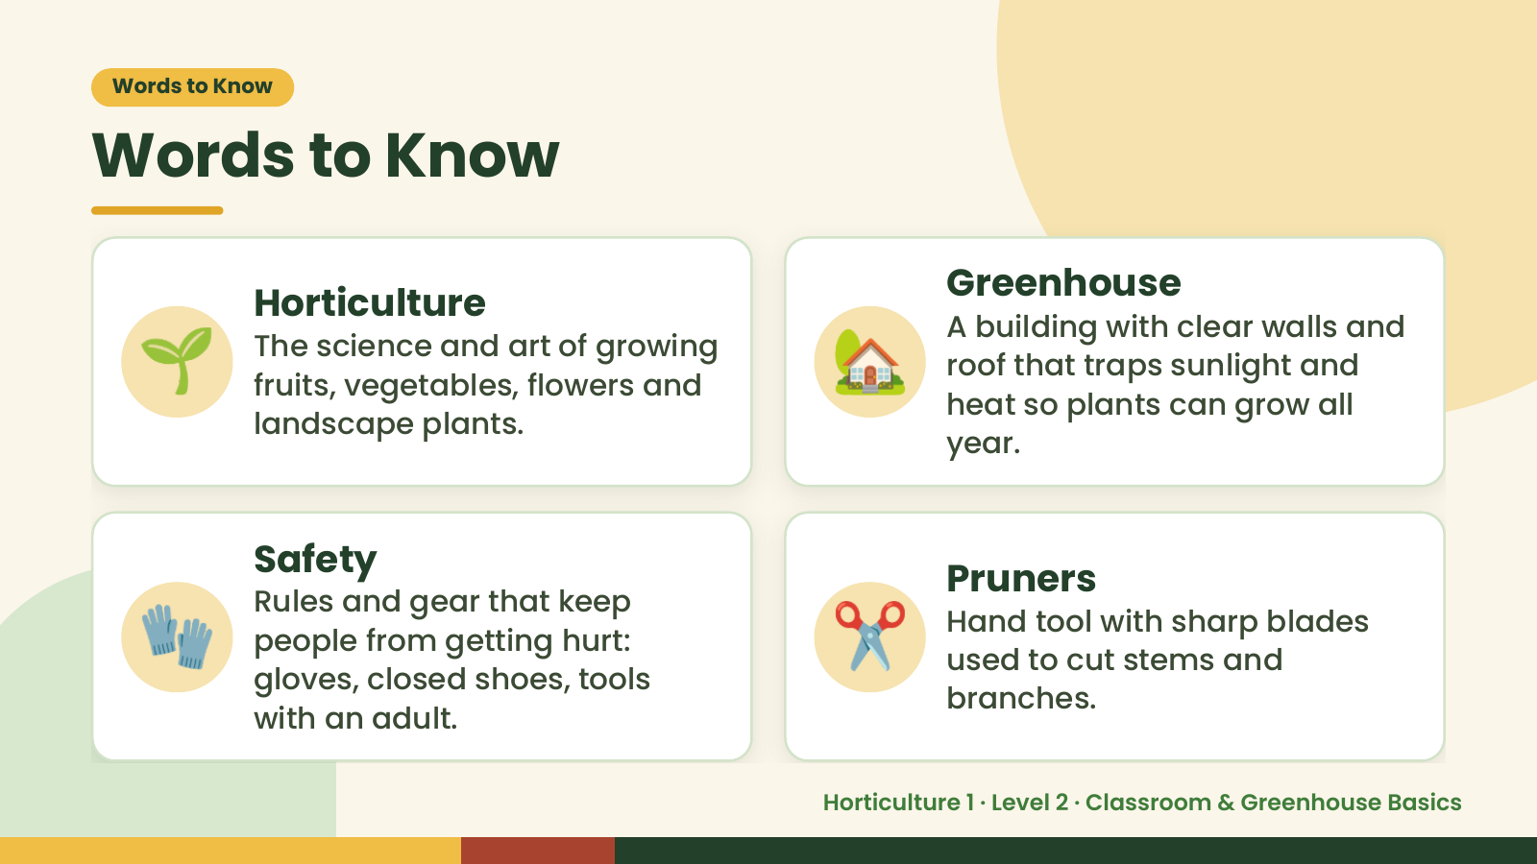
Notes:
Words to Know
Words to Know
🌱 🏡
Greenhouse
Horticulture
A building with clear walls and
The science and art of growing
roof that traps sunlight and
fruits, vegetables, flowers and
heat so plants can grow all
landscape plants.
year.
🧤 ✂️
Safety
Pruners
Rules and gear that keep
Hand tool with sharp blades
people from getting hurt:
used to cut stems and
gloves, closed shoes, tools
branches.
with an adult.
Horticulture 1 · Level 2 · Classroom & Greenhouse Basics

Slide 4
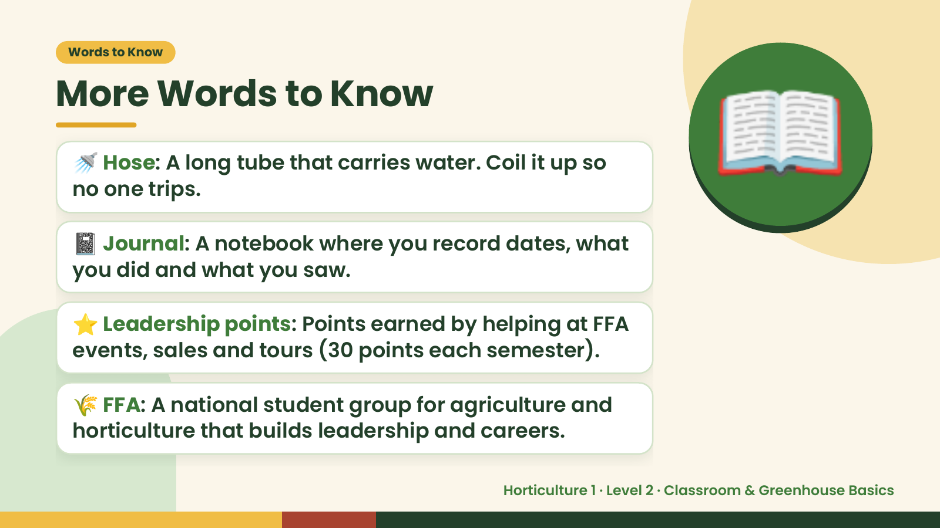
Notes:
Words to Know
More Words to Know
🚿 Hose: A long tube that carries water. Coil it up so
no one trips.
📓 Journal: A notebook where you record dates, what
you did and what you saw.
📖
⭐ Leadership points: Points earned by helping at FFA
events, sales and tours (30 points each semester).
🌾 FFA: A national student group for agriculture and
horticulture that builds leadership and careers.
Horticulture 1 · Level 2 · Classroom & Greenhouse Basics

Slide 5
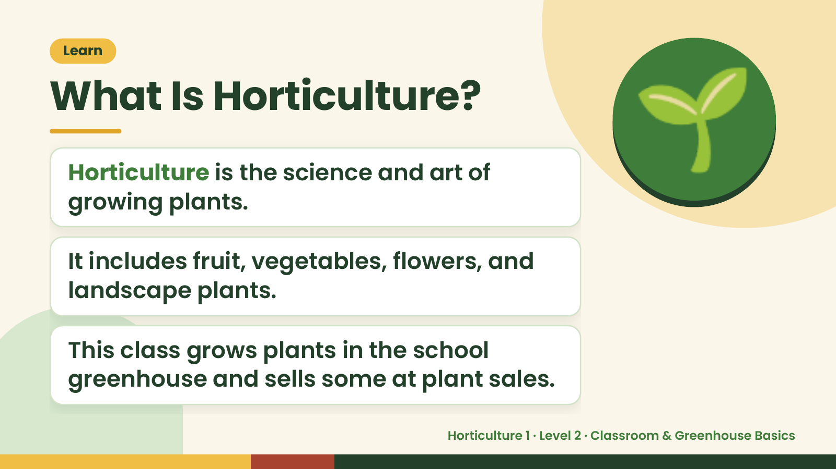
Notes:
Learn
What Is Horticulture?
Horticulture is the science and art of
growing plants.
It includes fruit, vegetables, flowers, and
🌱
landscape plants.
This class grows plants in the school
greenhouse and sells some at plant sales.
Horticulture 1 · Level 2 · Classroom & Greenhouse Basics

Slide 6
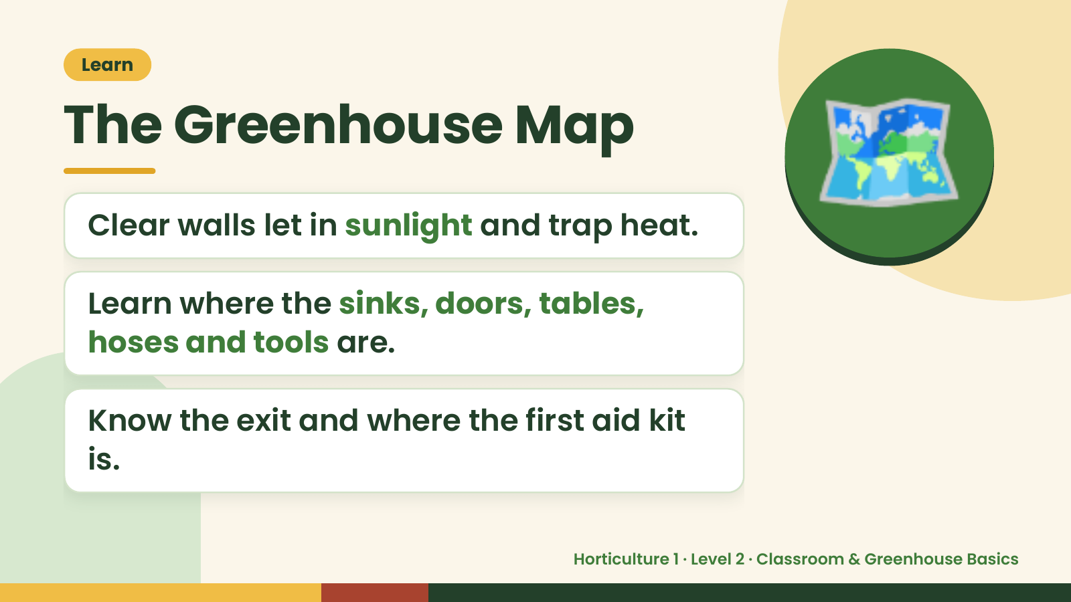
Notes:
Learn
The Greenhouse Map
Clear walls let in sunlight and trap heat.
Learn where the sinks, doors, tables,
🗺️
hoses and tools are.
Know the exit and where the first aid kit
is.
Horticulture 1 · Level 2 · Classroom & Greenhouse Basics

Slide 7
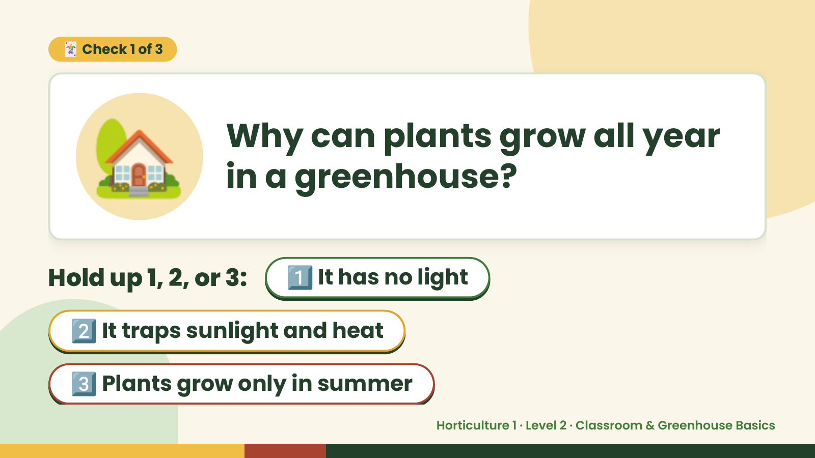
Notes:
🏡
🃏 Check 1 of 3
Why can plants grow all year
in a greenhouse?
Hold up 1, 2, or 3: 1️⃣ It has no light
2️⃣ It traps sunlight and heat
3️⃣ Plants grow only in summer
Horticulture 1 · Level 2 · Classroom & Greenhouse Basics

Slide 8
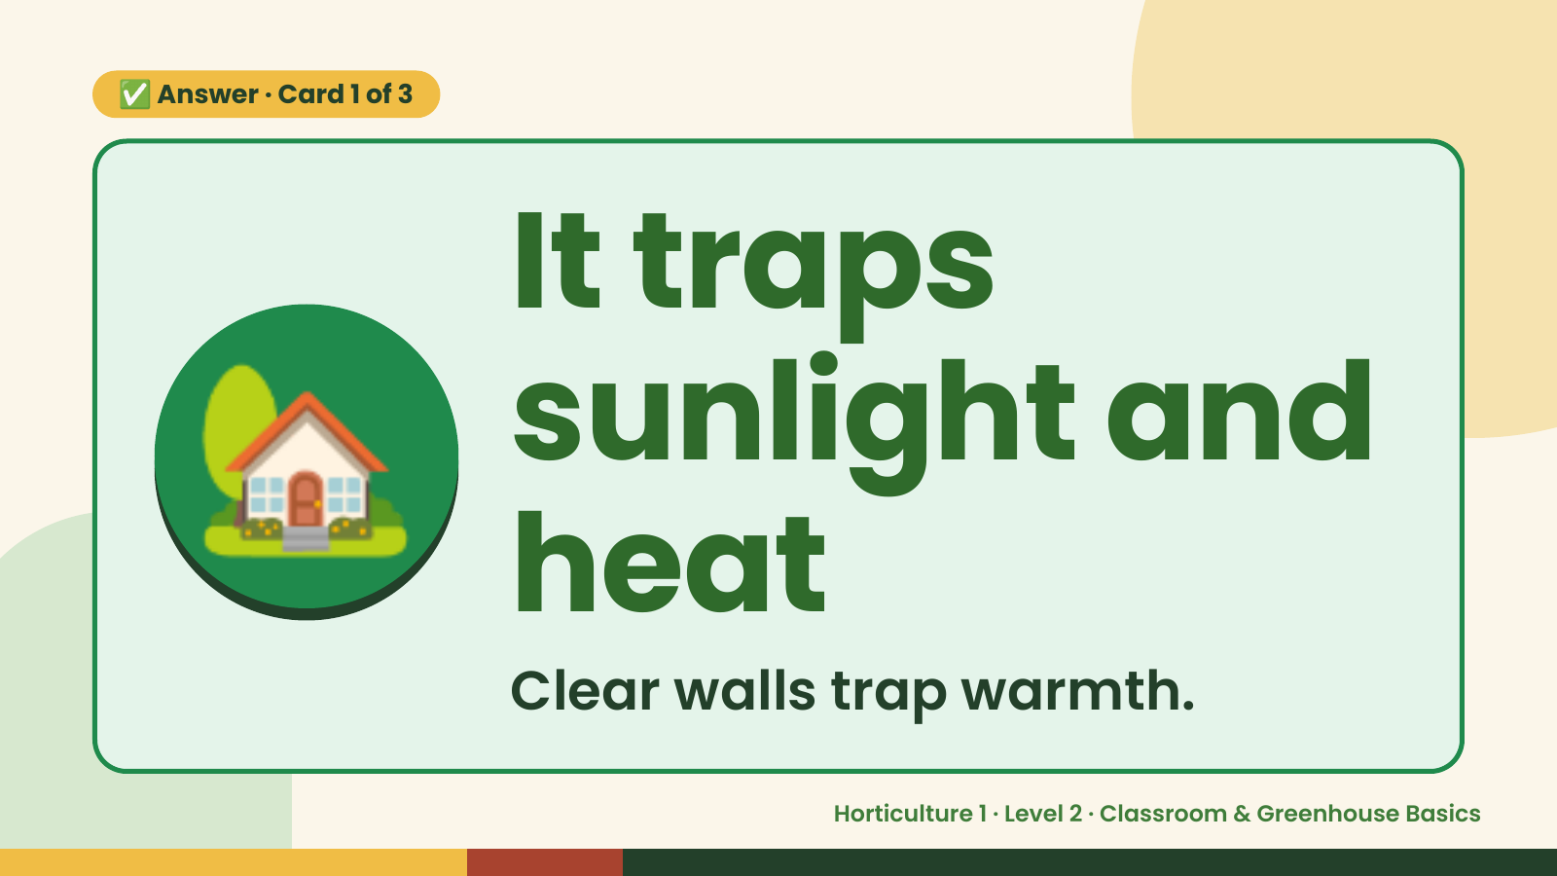
Notes:
✅ Answer · Card 1 of 3
🏡 It traps
sunlight and
heat
Clear walls trap warmth.
Horticulture 1 · Level 2 · Classroom & Greenhouse Basics

Slide 9
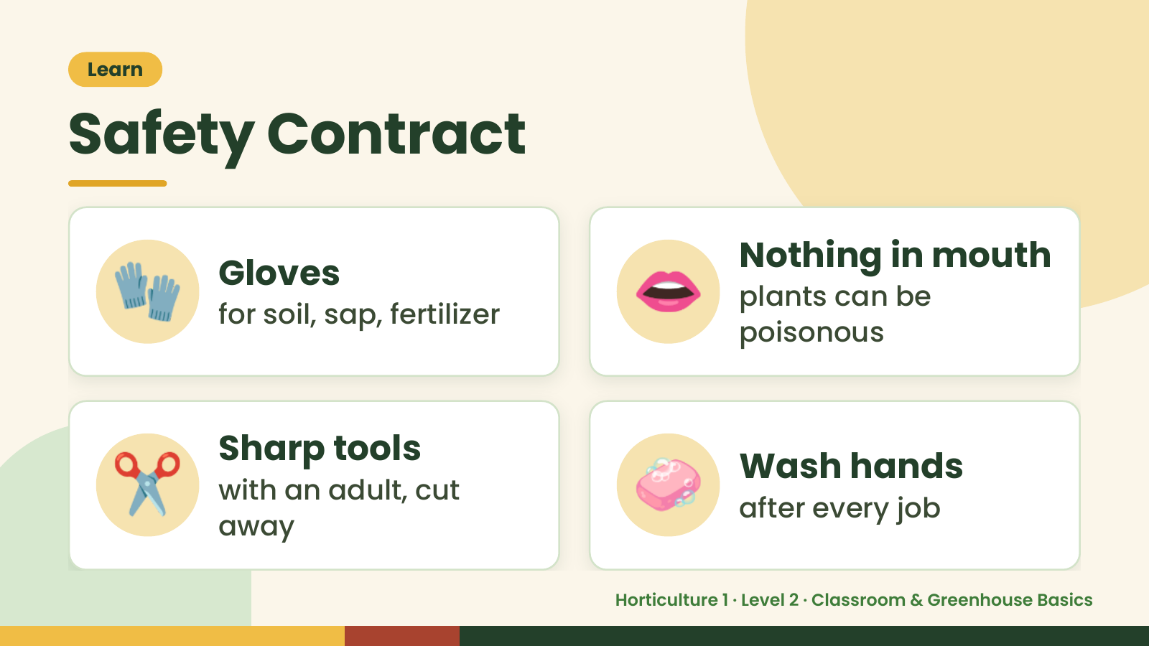
Notes:
Learn
Safety Contract
🧤 Gloves
for soil, sap, fertilizer 👄 Nothing in mouth
plants can be
poisonous
✂️ Sharp tools
with an adult, cut
away
🧼 Wash hands
after every job
Horticulture 1 · Level 2 · Classroom & Greenhouse Basics

Slide 10
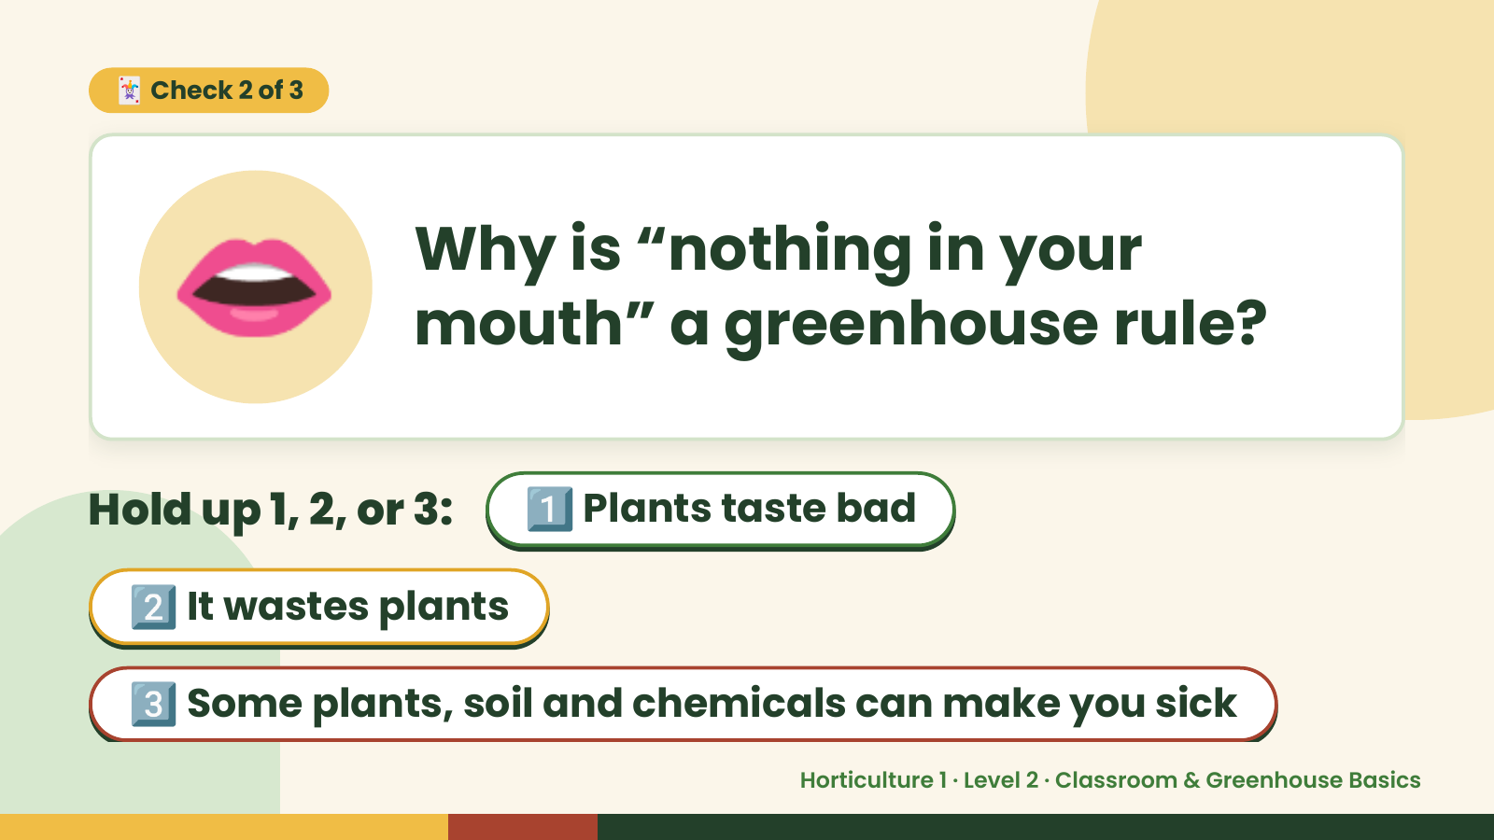
Notes:
👄
🃏 Check 2 of 3
Why is “nothing in your
mouth” a greenhouse rule?
Hold up 1, 2, or 3: 1️⃣ Plants taste bad
2️⃣ It wastes plants
3️⃣ Some plants, soil and chemicals can make you sick
Horticulture 1 · Level 2 · Classroom & Greenhouse Basics

Slide 11
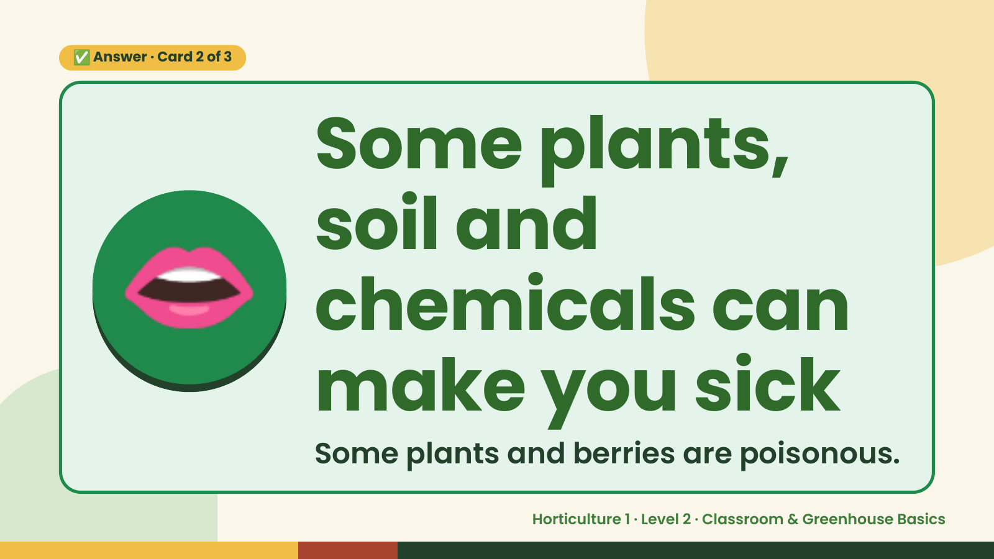
Notes:
✅ Answer · Card 2 of 3
👄
Some plants,
soil and
chemicals can
make you sick
Some plants and berries are poisonous.
Horticulture 1 · Level 2 · Classroom & Greenhouse Basics

Slide 12
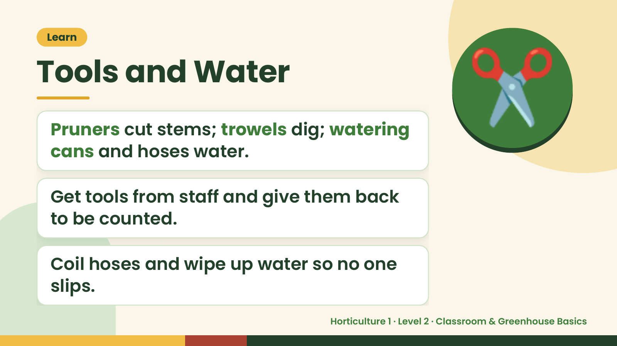
Notes:
Learn
Tools and Water
Pruners cut stems; trowels dig; watering
cans and hoses water.
✂️
Get tools from staff and give them back
to be counted.
Coil hoses and wipe up water so no one
slips.
Horticulture 1 · Level 2 · Classroom & Greenhouse Basics

Slide 13
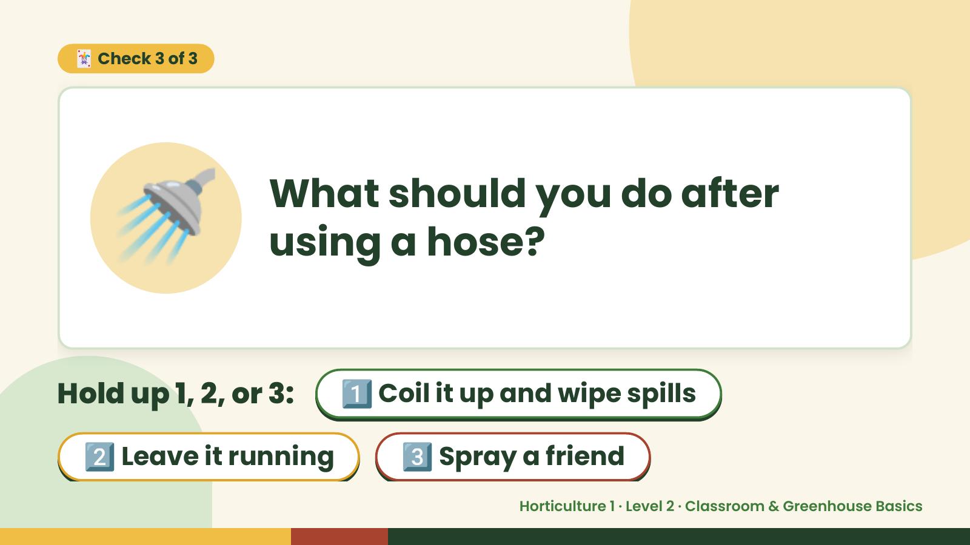
Notes:
🃏 Check 3 of 3
🚿 What should you do after
using a hose?
Hold up 1, 2, or 3: 1️⃣ Coil it up and wipe spills
2️⃣ Leave it running 3️⃣ Spray a friend
Horticulture 1 · Level 2 · Classroom & Greenhouse Basics

Slide 14
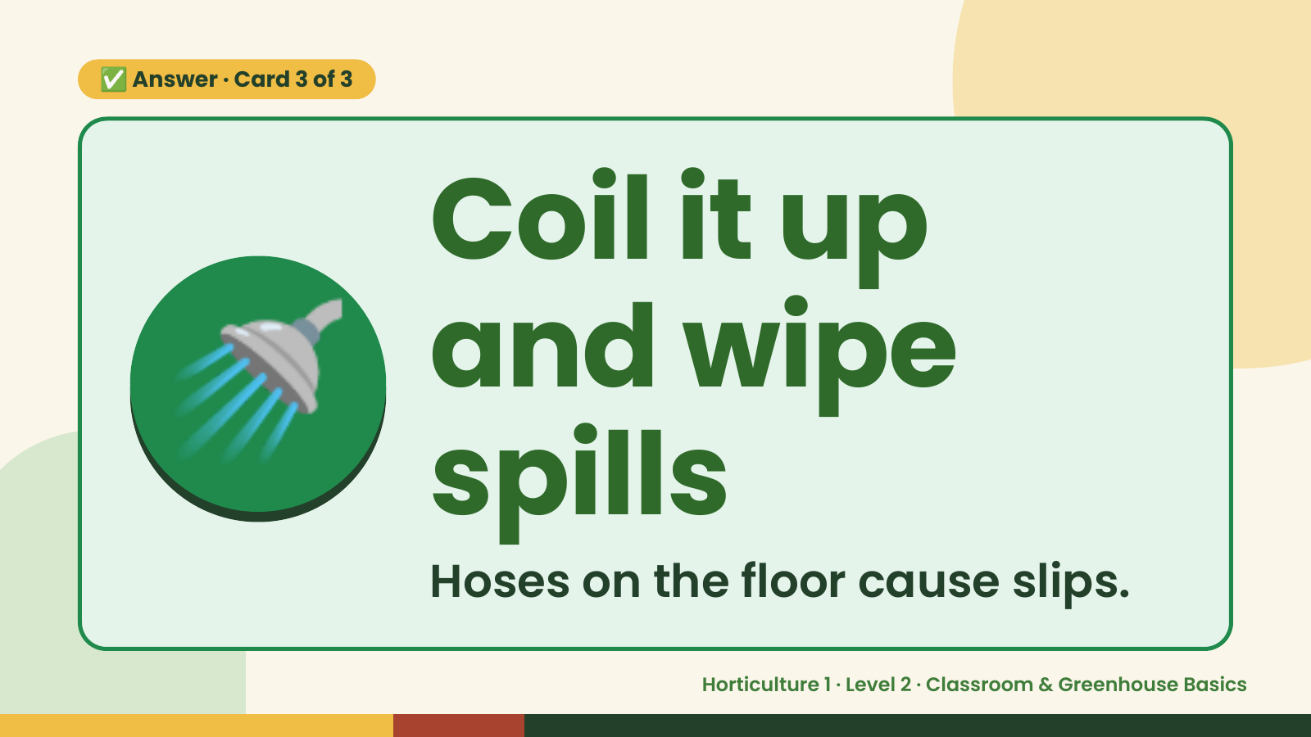
Notes:
✅ Answer · Card 3 of 3
🚿 Coil it up
and wipe
spills
Hoses on the floor cause slips.
Horticulture 1 · Level 2 · Classroom & Greenhouse Basics

Slide 15
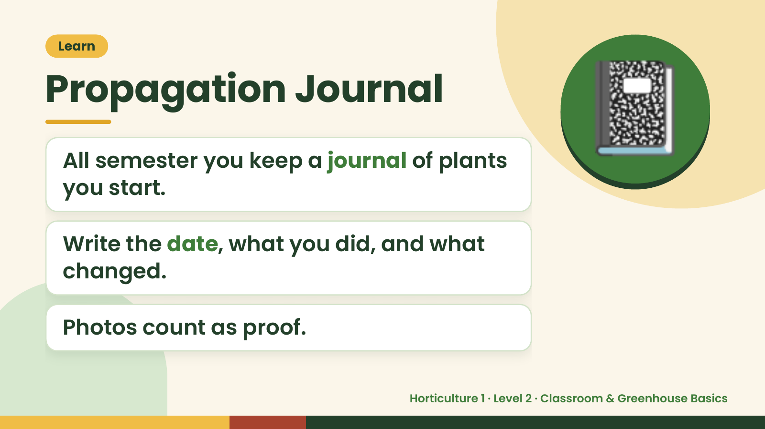
Notes:
Learn
Propagation Journal
All semester you keep a journal of plants
you start.
📓
Write the date, what you did, and what
changed.
Photos count as proof.
Horticulture 1 · Level 2 · Classroom & Greenhouse Basics

Slide 16
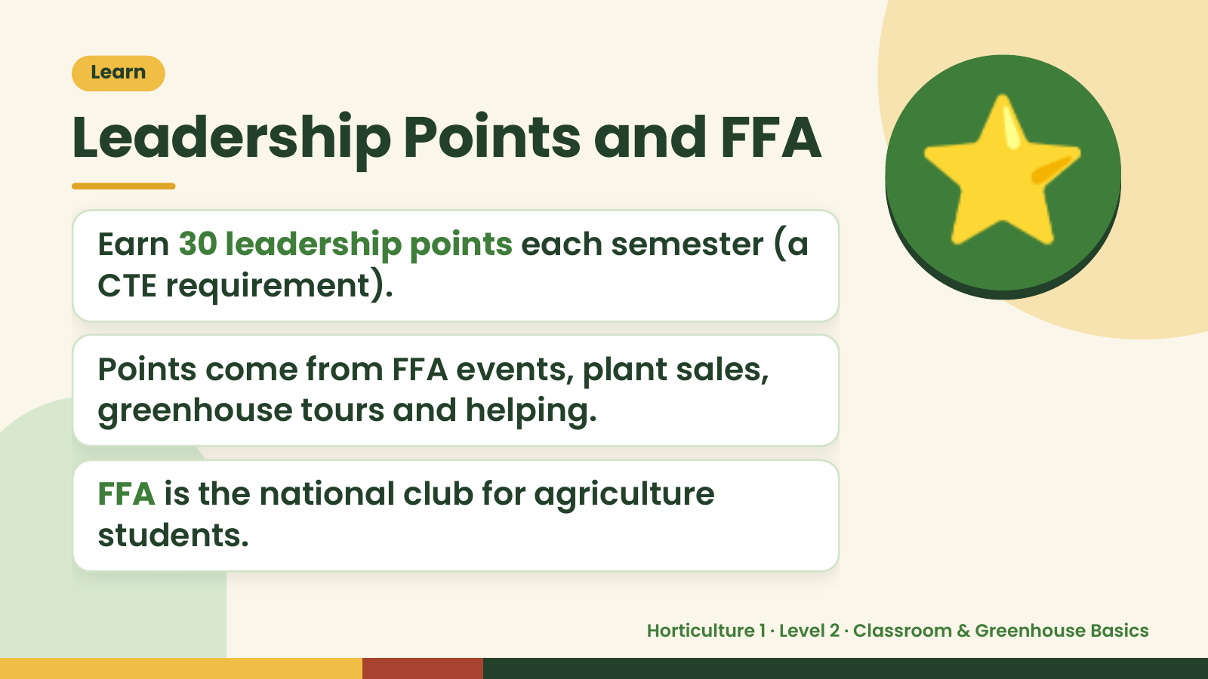
Notes:
Learn
Leadership Points and FFA
Earn 30 leadership points each semester (a
CTE requirement).
Points come from FFA events, plant sales,
⭐
greenhouse tours and helping.
FFA is the national club for agriculture
students.
Horticulture 1 · Level 2 · Classroom & Greenhouse Basics

Slide 17
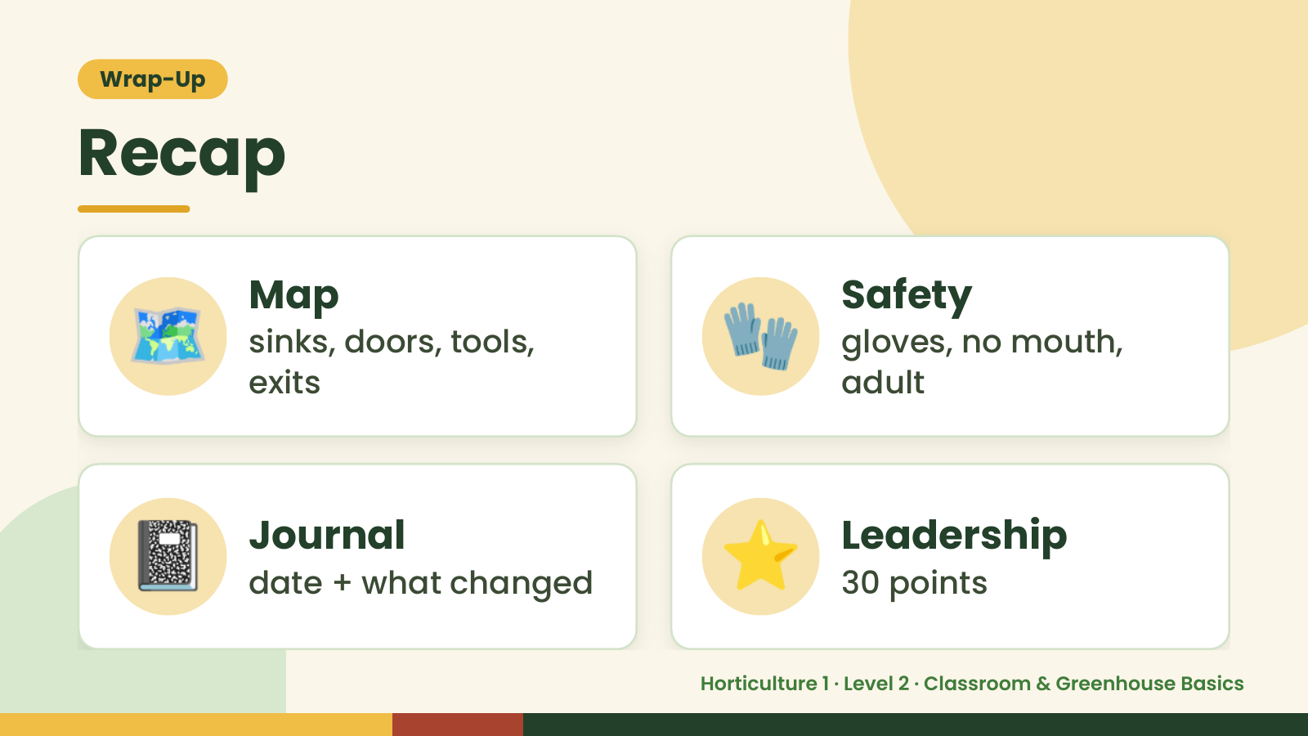
Notes:
Wrap-Up
Recap
🗺️ Map
sinks, doors, tools,
exits
🧤 Safety
gloves, no mouth,
adult
📓 Journal
date + what changed ⭐ Leadership
30 points
Horticulture 1 · Level 2 · Classroom & Greenhouse Basics

Slide 18

Notes:
Wrap-Up
Exit Ticket
Name 3 safety rules for the greenhouse.
Where do tools go when you finish?
🎟️
What goes in your Propagation Journal?
Horticulture 1 · Level 2 · Classroom & Greenhouse Basics

