Slide 1

Notes:
🧑‍🌾
Horticulture 1 · Unit 1 · Level 1
Jobs in
Horticulture
🍎 Kinds of plants
TODAY'S PLAN
🧑‍🌾 Plant jobs
📄 Resume
🤝 Interview
Horticulture 1 · Level 1 · Jobs in Horticulture

Slide 2
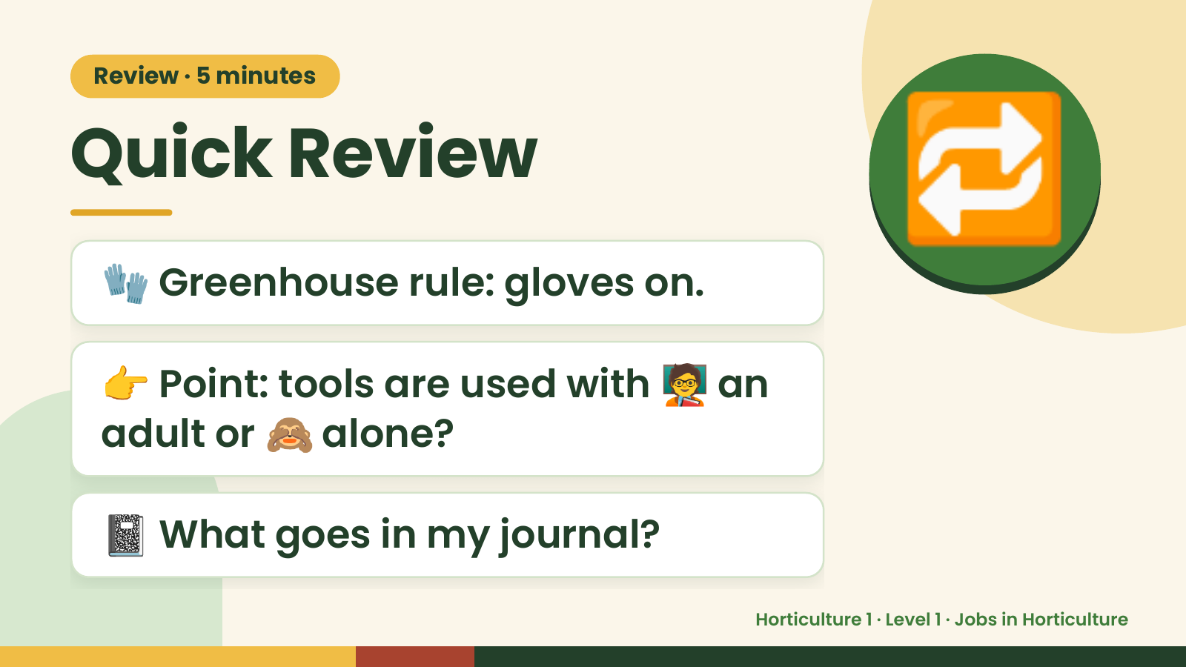
Notes:
Review · 5 minutes
Quick Review
🧤 Greenhouse rule: gloves on.
🔁
👉 Point: tools are used with 🧑‍🏫 an
adult or 🙈 alone?
📓 What goes in my journal?
Horticulture 1 · Level 1 · Jobs in Horticulture

Slide 3
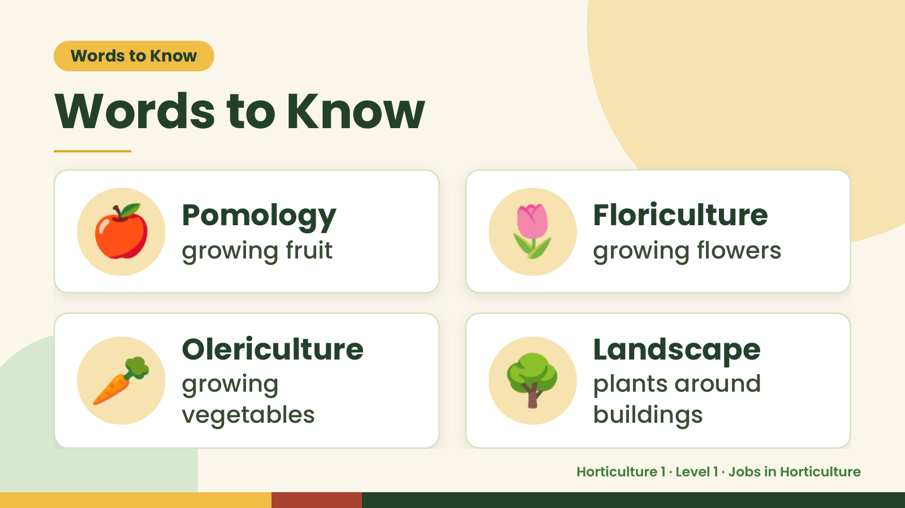
Notes:
Words to Know
Words to Know
🍎 Pomology
growing fruit 🌷 Floriculture
growing flowers
🥕 Olericulture
growing
vegetables
🌳 Landscape
plants around
buildings
Horticulture 1 · Level 1 · Jobs in Horticulture

Slide 4
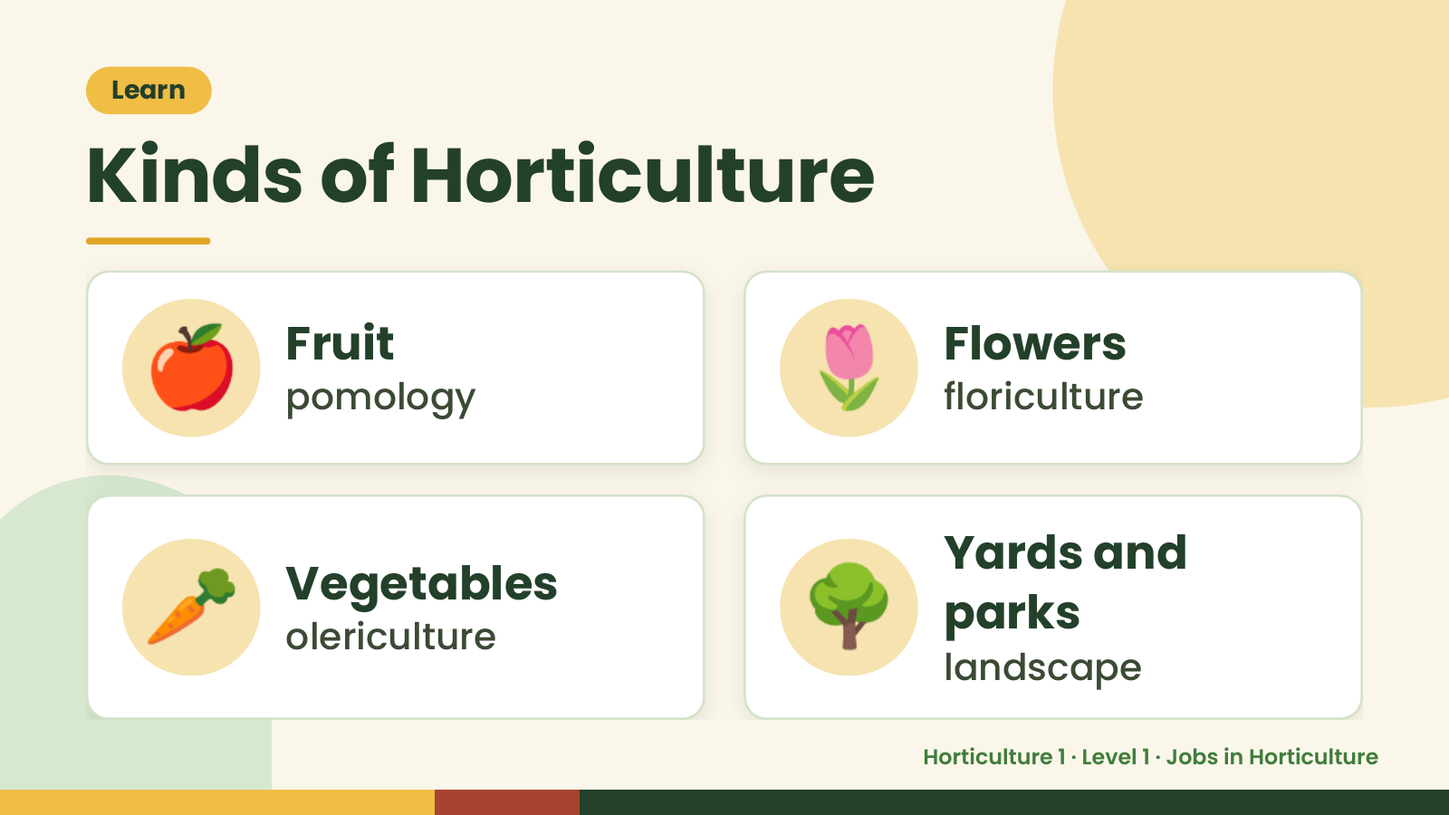
Notes:
Learn
Kinds of Horticulture
🍎 Fruit
pomology 🌷 Flowers
floriculture
🥕 Vegetables
olericulture 🌳 Yards and
parks
landscape
Horticulture 1 · Level 1 · Jobs in Horticulture

Slide 5
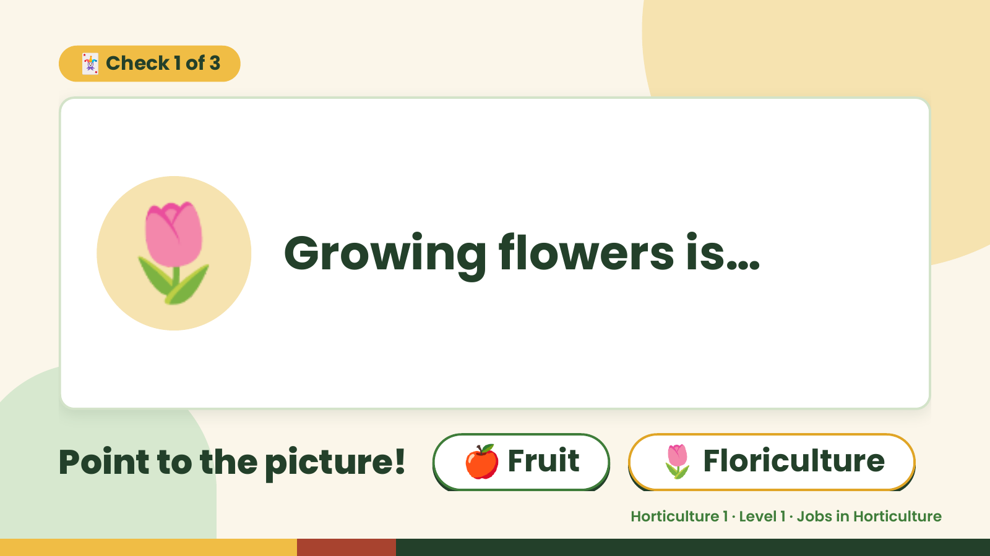
Notes:
🃏 Check 1 of 3
🌷 Growing flowers is…
Point to the picture! 🍎 Fruit 🌷 Floriculture
Horticulture 1 · Level 1 · Jobs in Horticulture

Slide 6
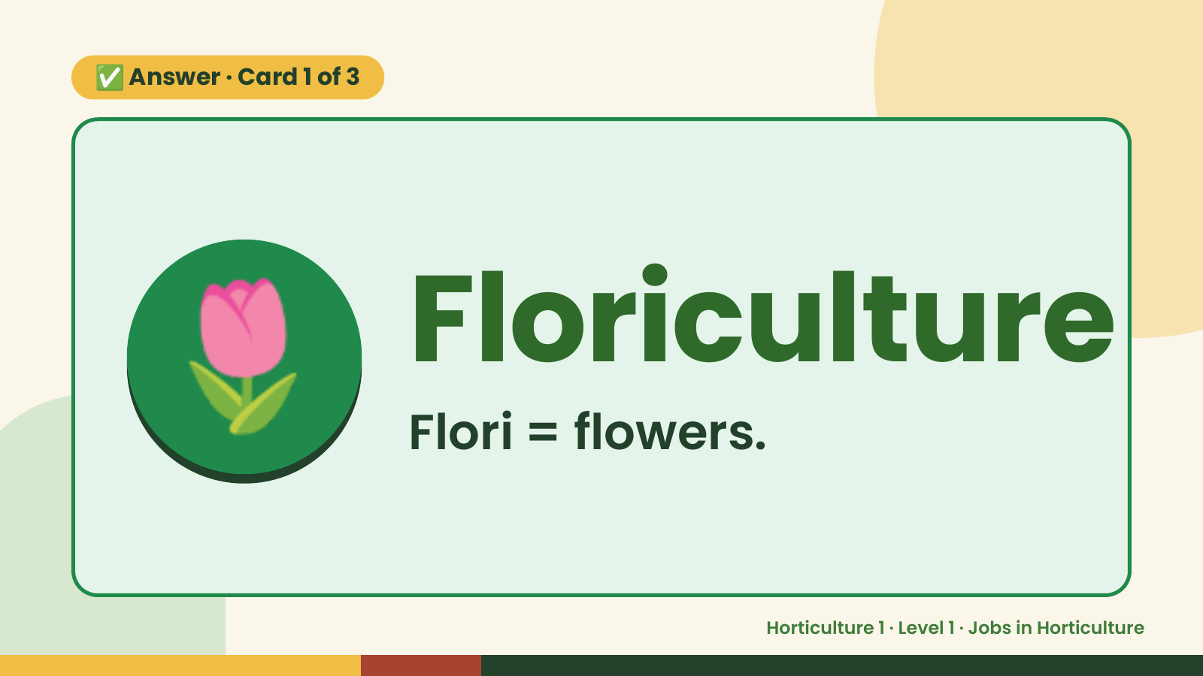
Notes:
✅ Answer · Card 1 of 3
🌷 Floriculture
Flori = flowers.
Horticulture 1 · Level 1 · Jobs in Horticulture

Slide 7
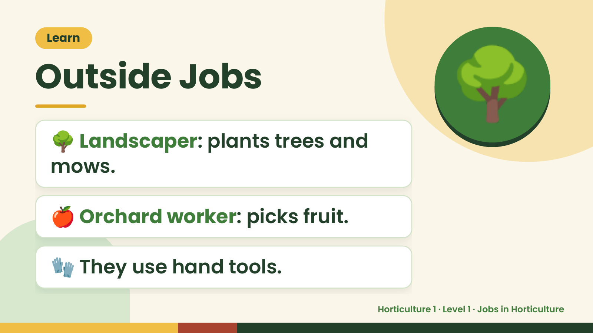
Notes:
Learn
Outside Jobs
🌳 Landscaper: plants trees and
mows.
🌳
🍎 Orchard worker: picks fruit.
🧤 They use hand tools.
Horticulture 1 · Level 1 · Jobs in Horticulture

Slide 8
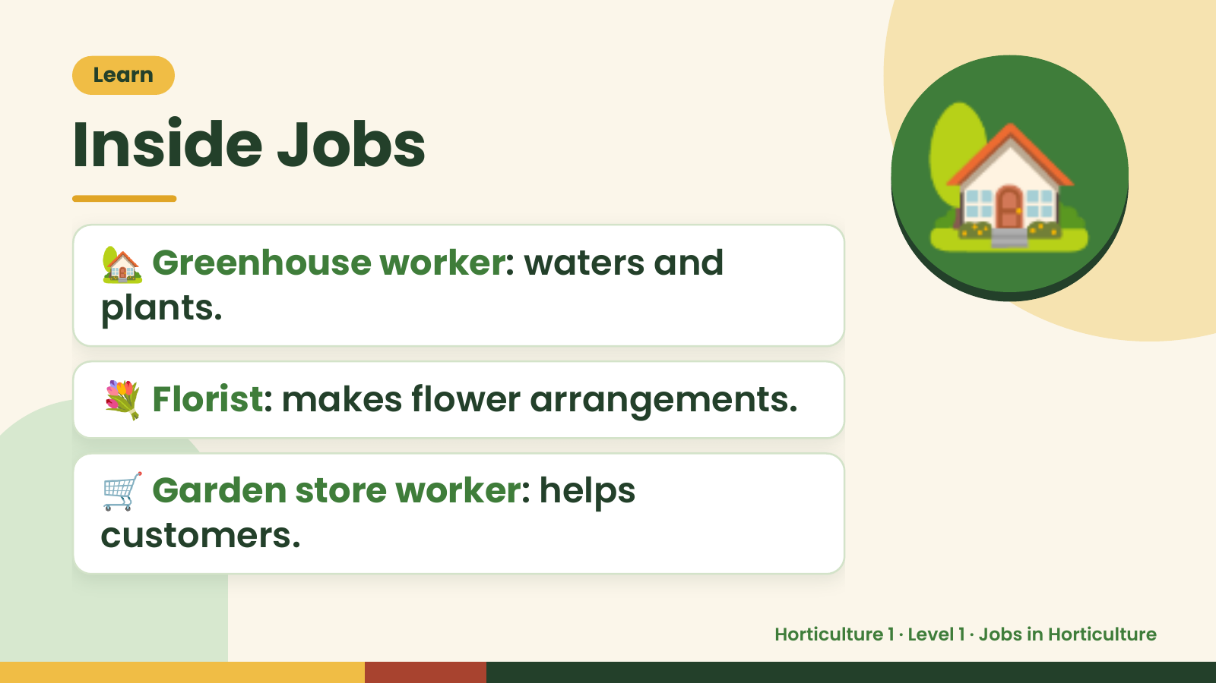
Notes:
Learn
Inside Jobs
🏡 Greenhouse worker: waters and
plants.
🏡
💐 Florist: makes flower arrangements.
🛒 Garden store worker: helps
customers.
Horticulture 1 · Level 1 · Jobs in Horticulture

Slide 9
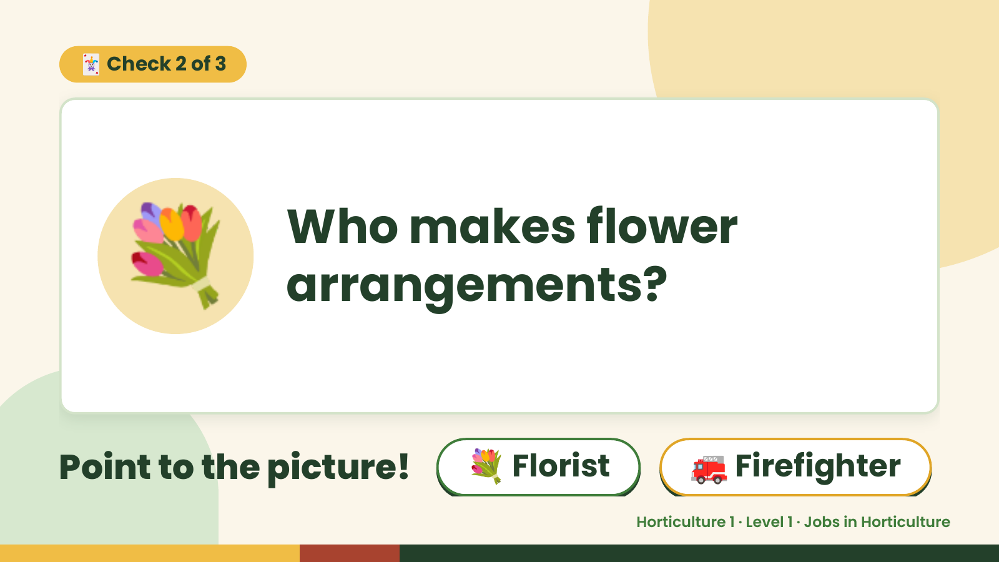
Notes:
🃏 Check 2 of 3
💐 Who makes flower
arrangements?
Point to the picture! 💐 Florist 🚒 Firefighter
Horticulture 1 · Level 1 · Jobs in Horticulture

Slide 10
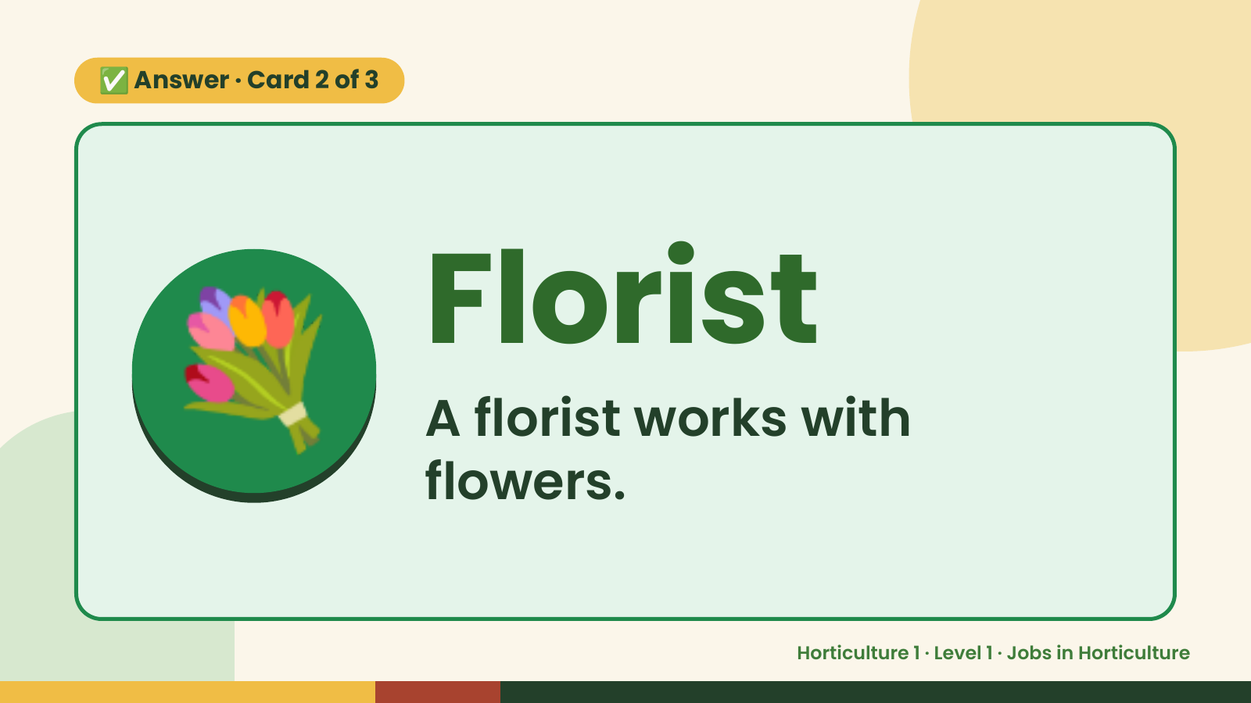
Notes:
✅ Answer · Card 2 of 3
💐 Florist
A florist works with
flowers.
Horticulture 1 · Level 1 · Jobs in Horticulture

Slide 11
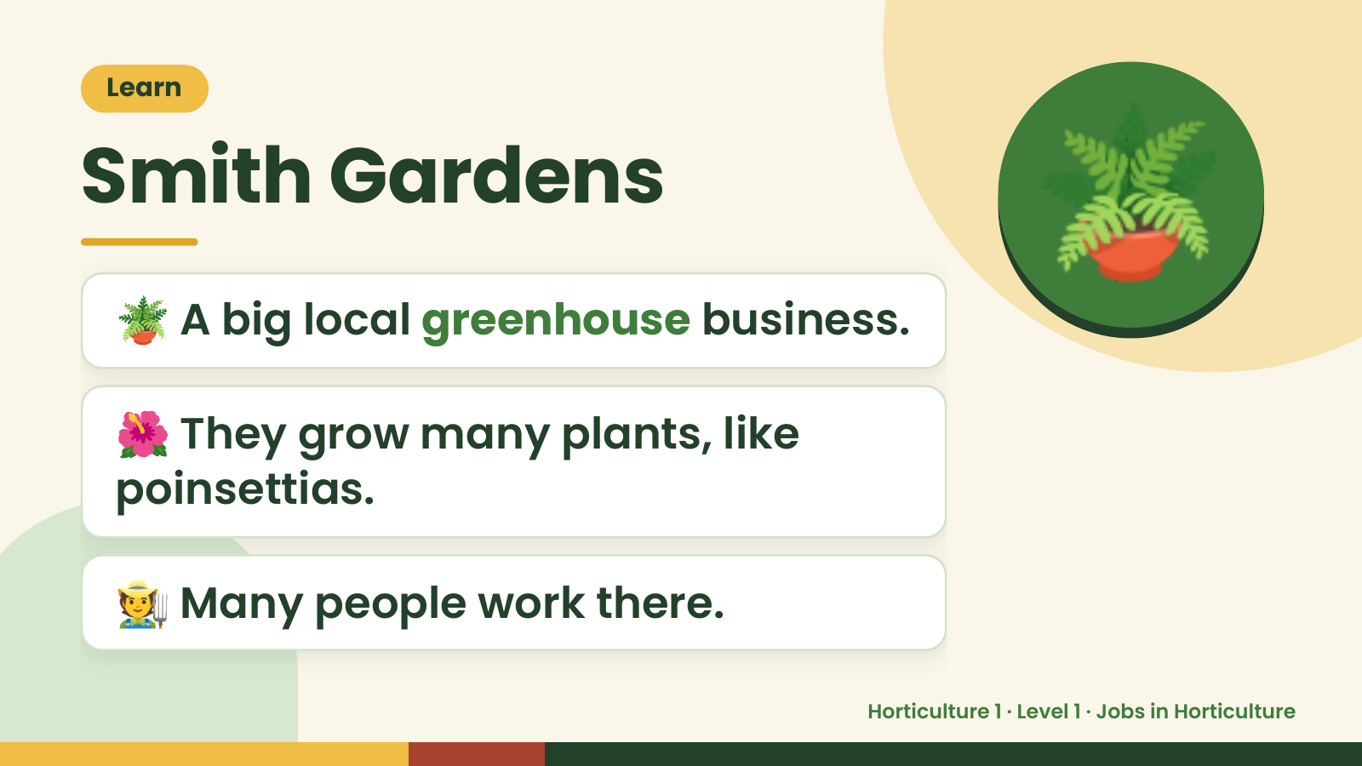
Notes:
Learn
Smith Gardens
🪴 A big local greenhouse business.
🪴
🌺 They grow many plants, like
poinsettias.
🧑‍🌾 Many people work there.
Horticulture 1 · Level 1 · Jobs in Horticulture

Slide 12
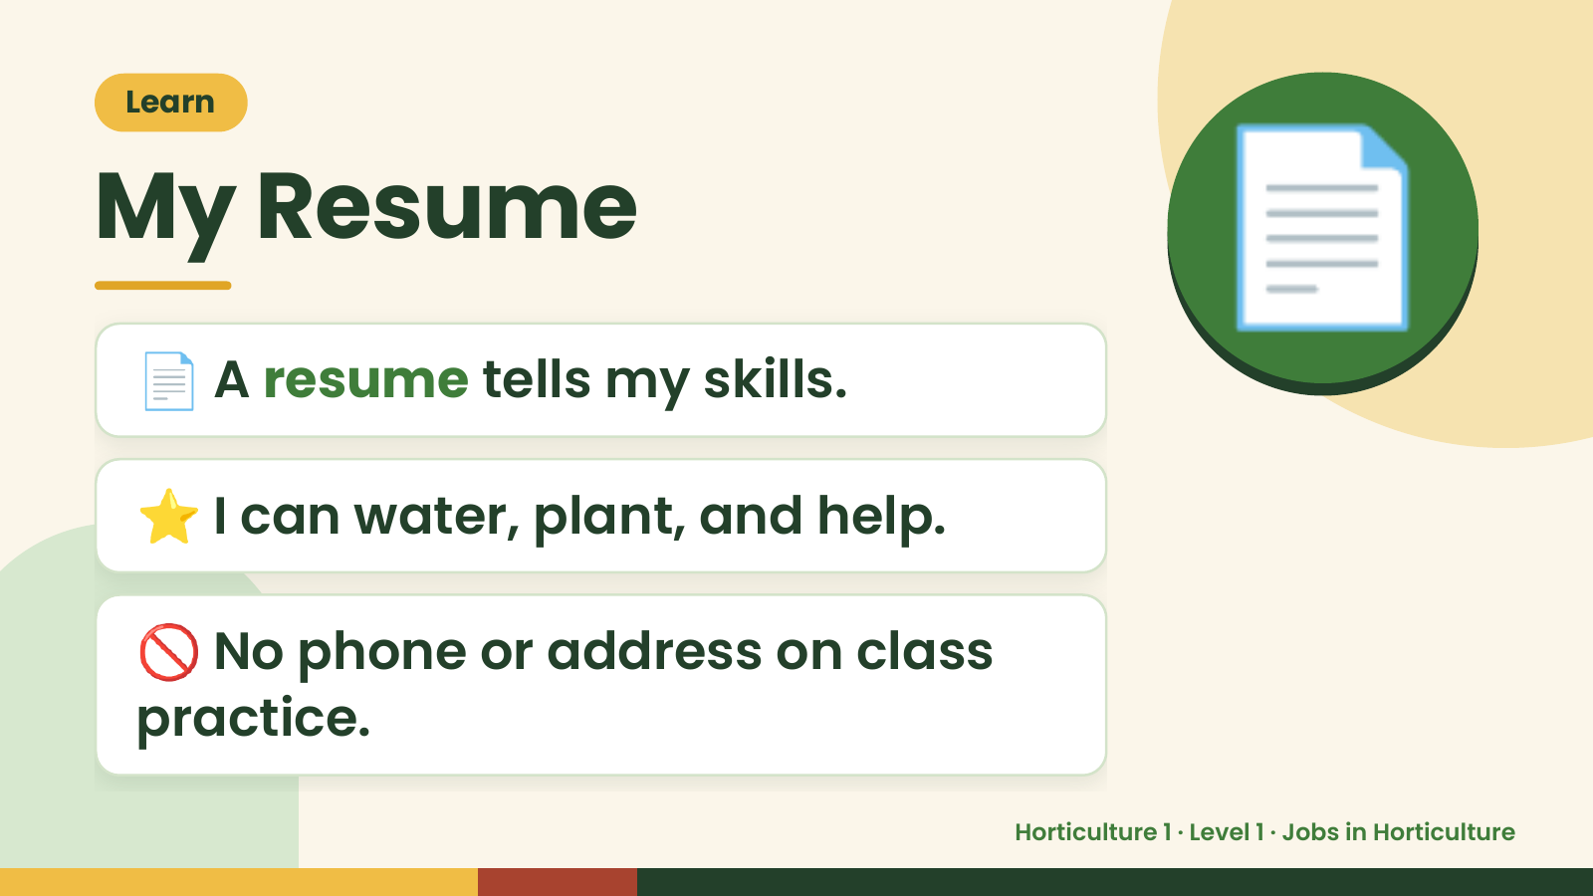
Notes:
Learn
My Resume
📄 A resume tells my skills.
📄
⭐ I can water, plant, and help.
🚫 No phone or address on class
practice.
Horticulture 1 · Level 1 · Jobs in Horticulture

Slide 13
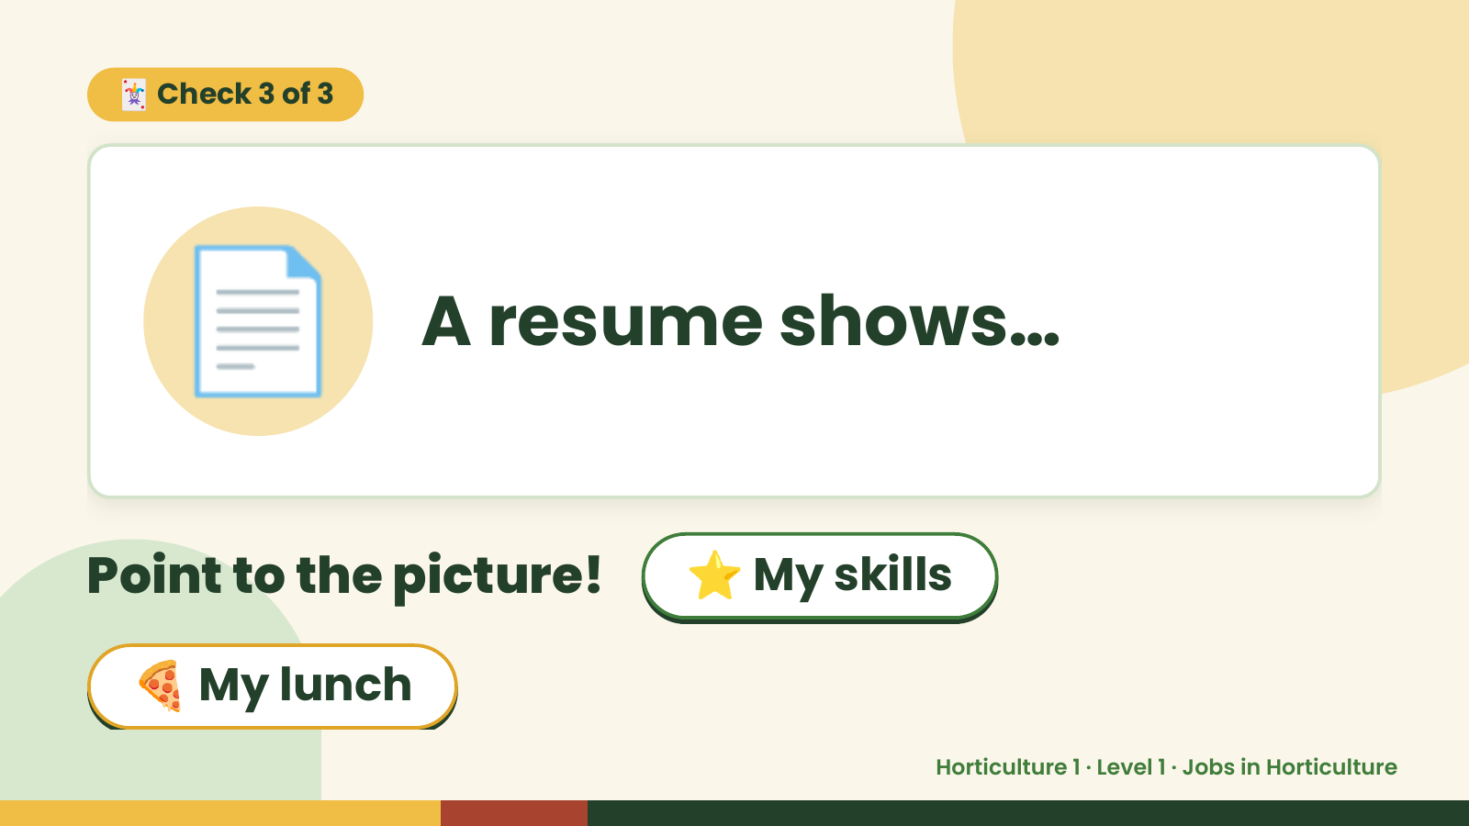
Notes:
🃏 Check 3 of 3
📄 A resume shows…
Point to the picture! ⭐ My skills
🍕 My lunch
Horticulture 1 · Level 1 · Jobs in Horticulture

Slide 14
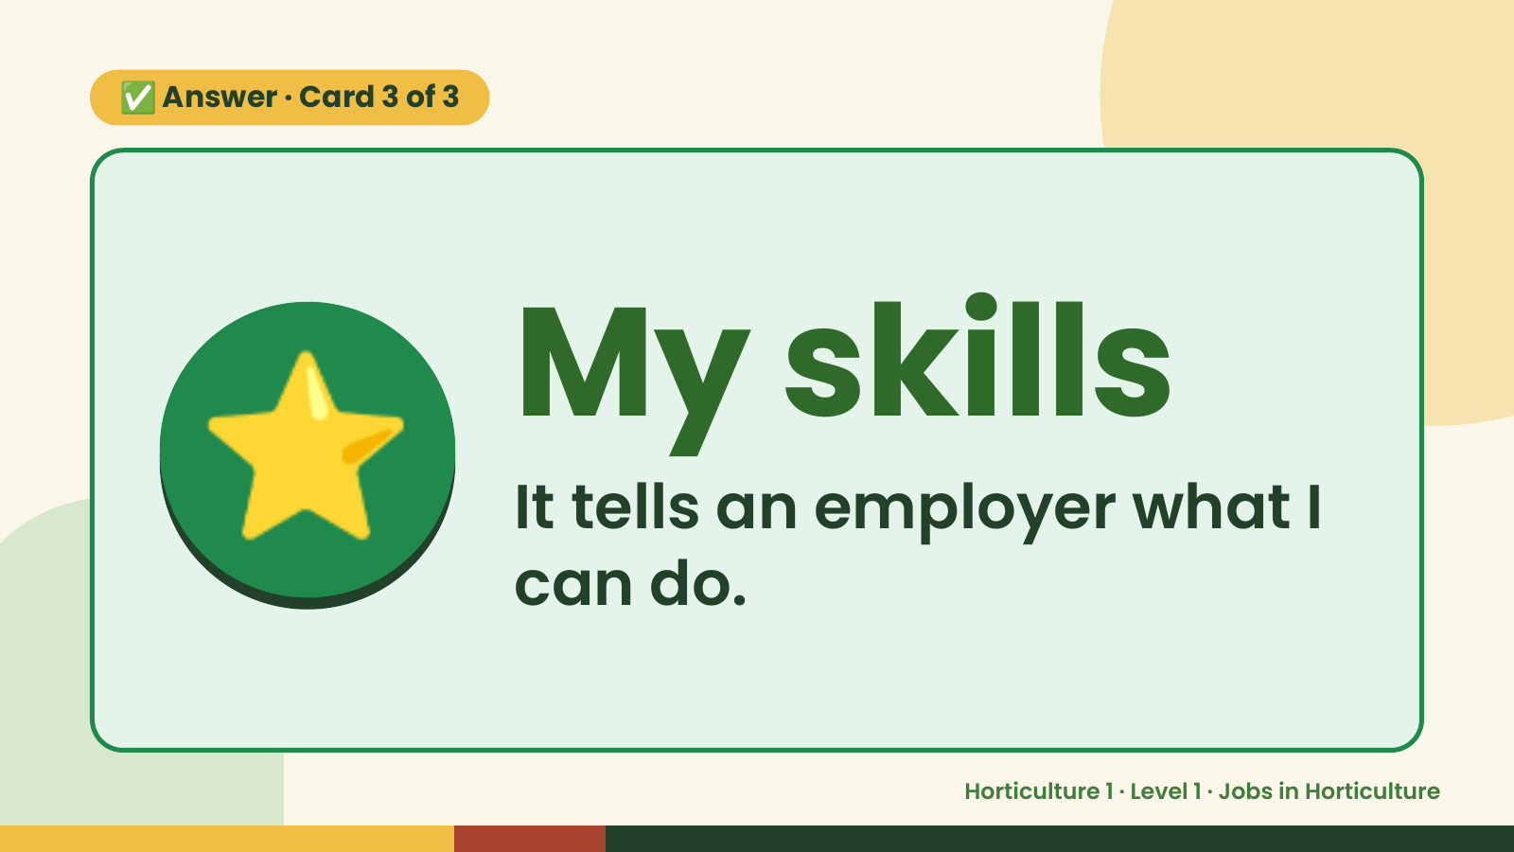
Notes:
✅ Answer · Card 3 of 3
⭐ My skills
It tells an employer what I
can do.
Horticulture 1 · Level 1 · Jobs in Horticulture

Slide 15
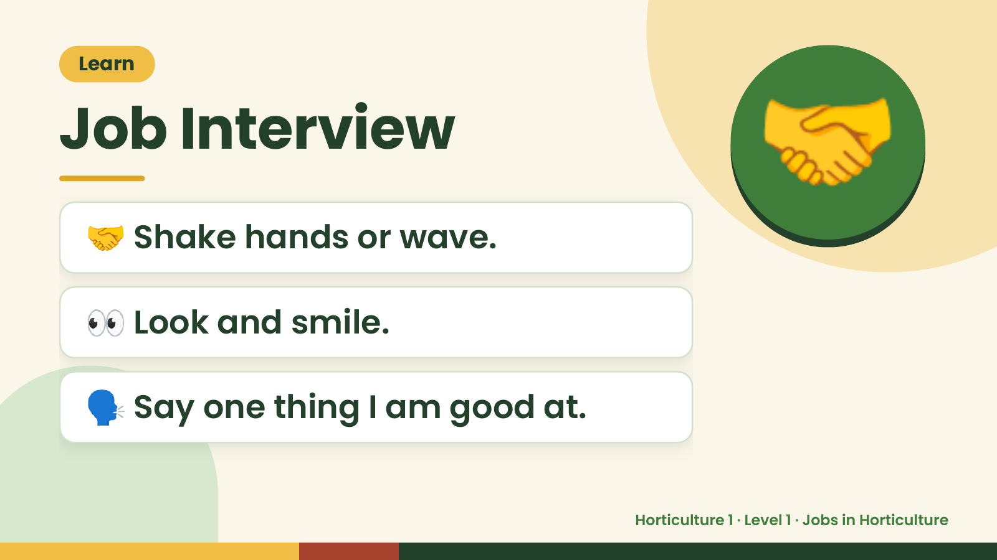
Notes:
Learn
Job Interview
🤝 Shake hands or wave.
🤝
👀 Look and smile.
🗣️ Say one thing I am good at.
Horticulture 1 · Level 1 · Jobs in Horticulture

Slide 16
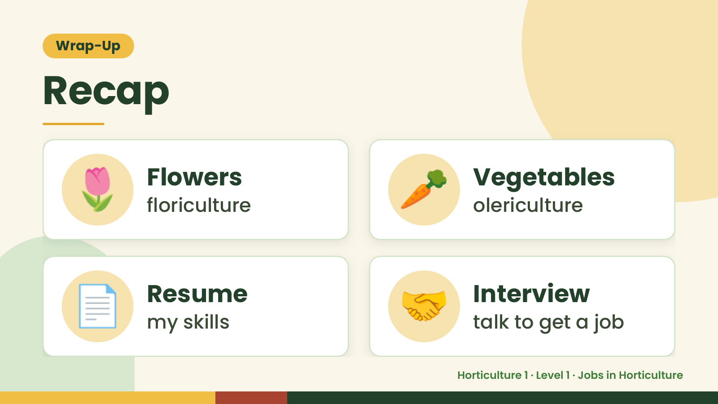
Notes:
Wrap-Up
Recap
🌷 Flowers
floriculture 🥕 Vegetables
olericulture
📄 Resume
my skills 🤝 Interview
talk to get a job
Horticulture 1 · Level 1 · Jobs in Horticulture

Slide 17
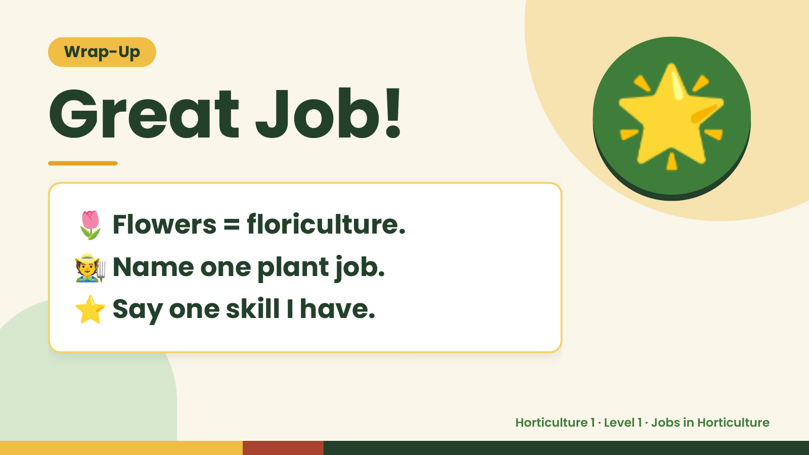
Notes:
Wrap-Up
Great Job!
🌷 Flowers = floriculture.
🌟
🧑‍🌾Name one plant job.
⭐ Say one skill I have.
Horticulture 1 · Level 1 · Jobs in Horticulture

