Slide 1

Notes:
🧑‍🌾
Horticulture 1 · Unit 1 · Level 2 (modified)
Jobs in
Horticulture
🌱 Branches of horticulture
TODAY'S PLAN
🧑‍🌾 Jobs inside and outside
🪴 Local businesses
📄 Resume and interview
Horticulture 1 · Level 2 · Jobs in Horticulture

Slide 2
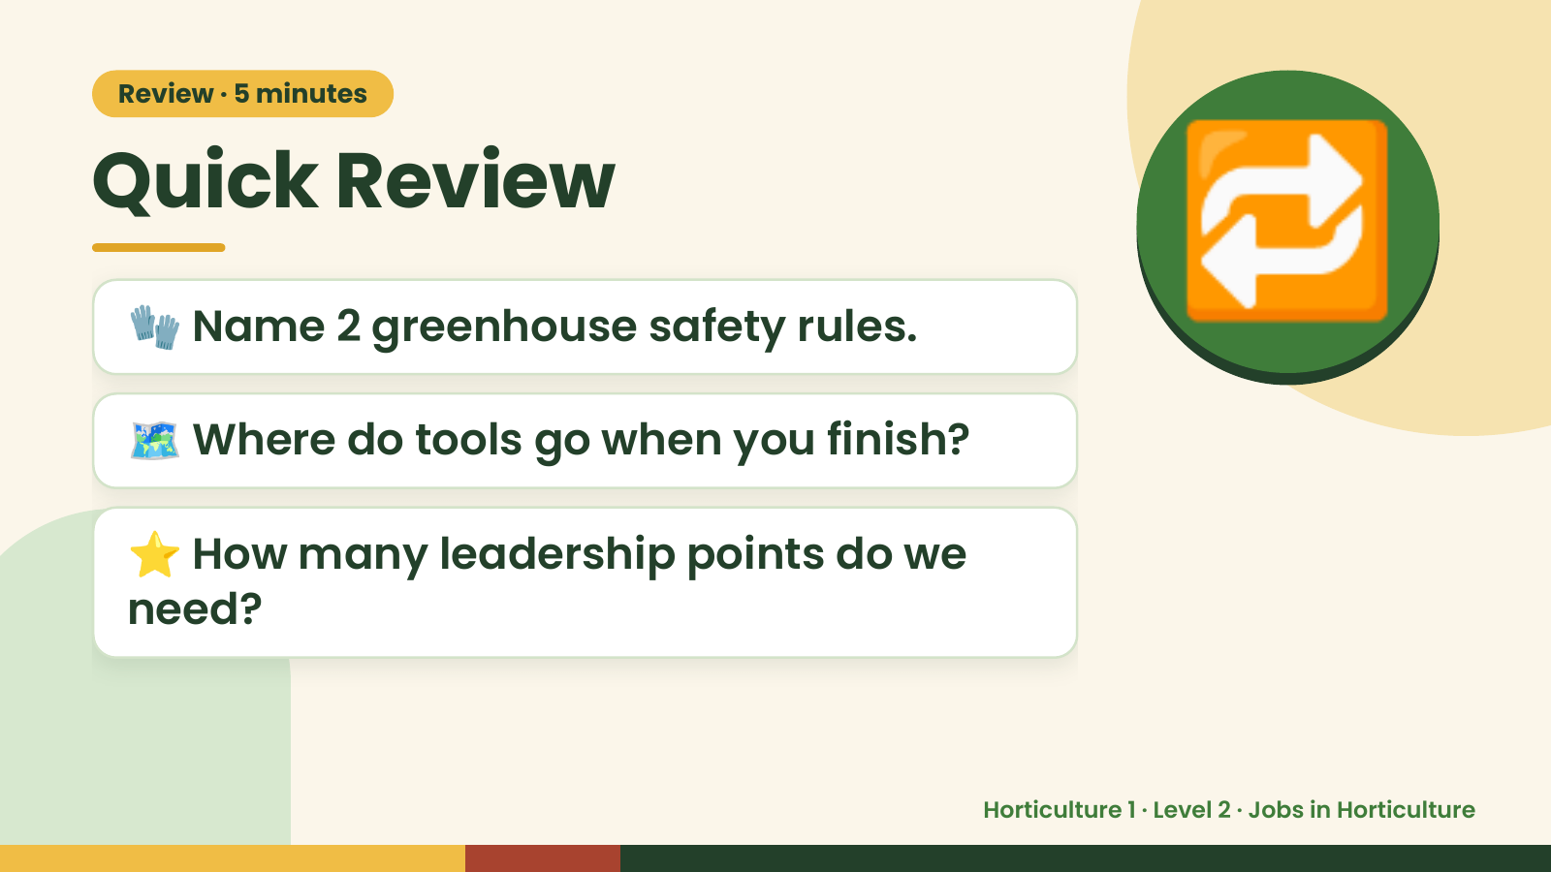
Notes:
Review · 5 minutes
Quick Review
🧤 Name 2 greenhouse safety rules.
🗺️ Where do tools go when you finish?
🔁
⭐ How many leadership points do we
need?
Horticulture 1 · Level 2 · Jobs in Horticulture

Slide 3
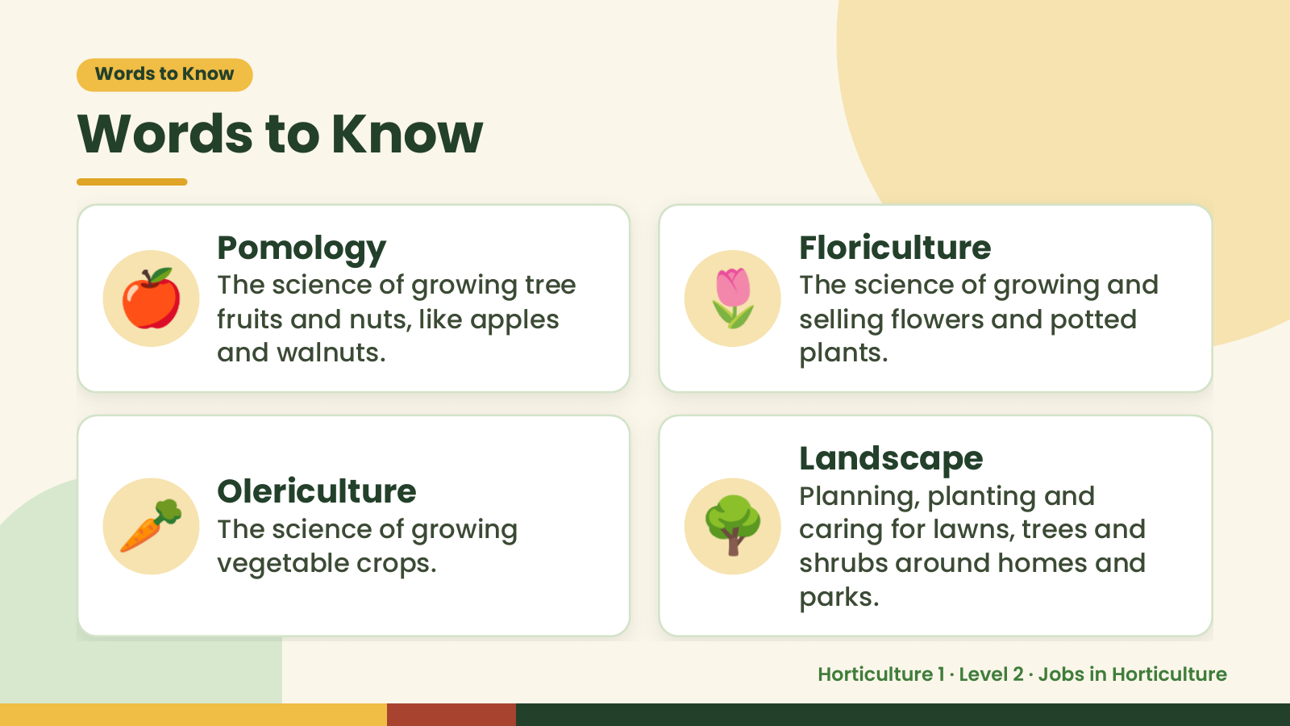
Notes:
Words to Know
Words to Know
🍎 Pomology
The science of growing tree
fruits and nuts, like apples
and walnuts.
🌷 Floriculture
The science of growing and
selling flowers and potted
plants.
🥕 🌳
Landscape
Olericulture Planning, planting and
The science of growing caring for lawns, trees and
vegetable crops. shrubs around homes and
parks.
Horticulture 1 · Level 2 · Jobs in Horticulture

Slide 4
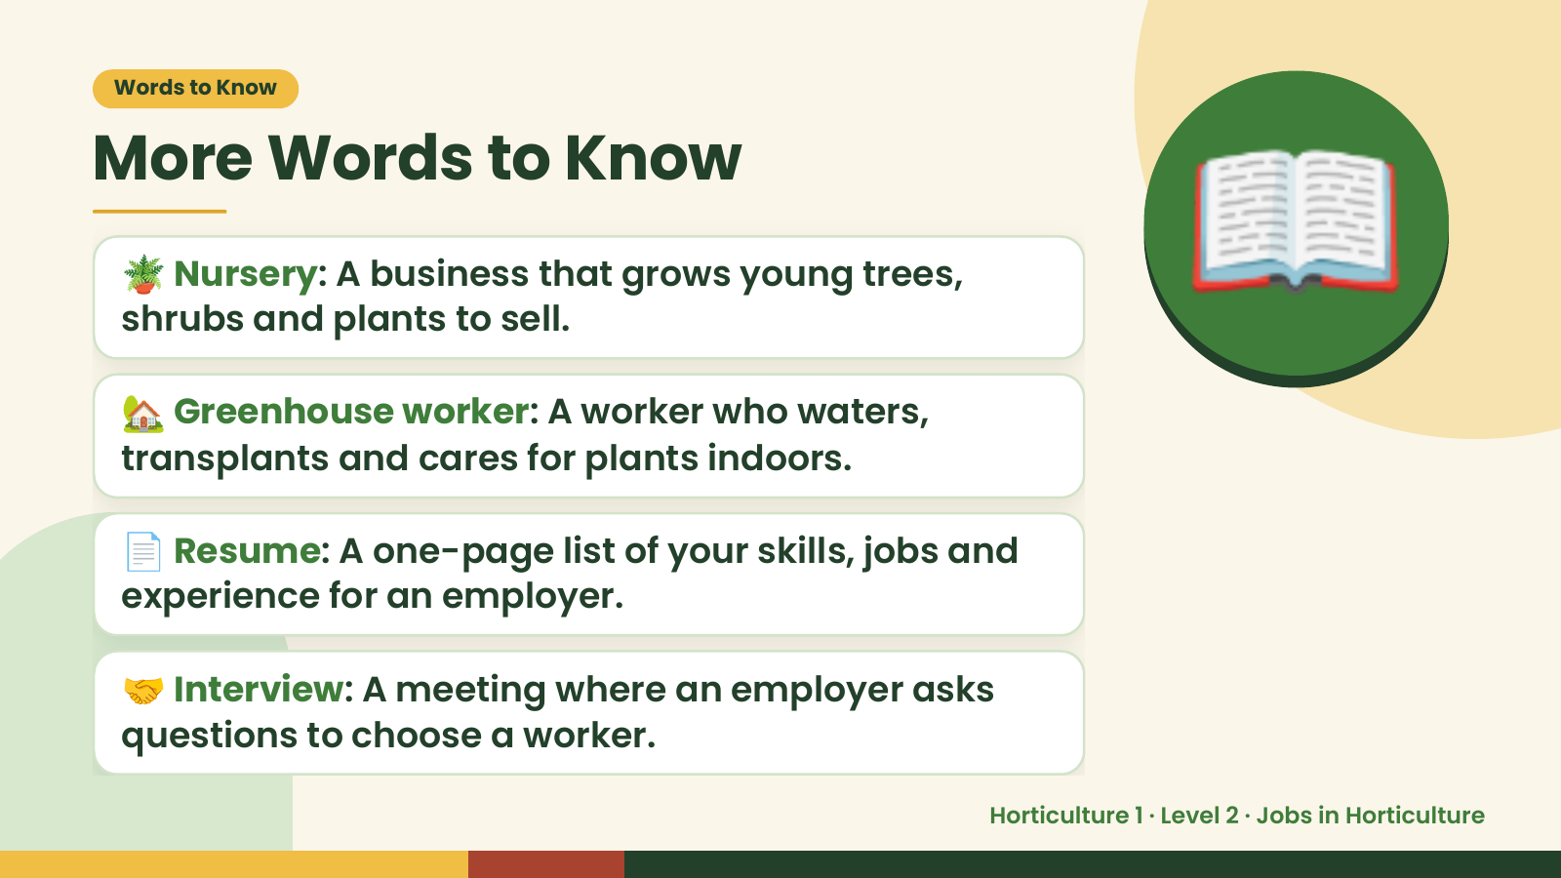
Notes:
Words to Know
More Words to Know
🪴 Nursery: A business that grows young trees,
shrubs and plants to sell.
🏡 Greenhouse worker: A worker who waters,
transplants and cares for plants indoors.
📖
📄 Resume: A one-page list of your skills, jobs and
experience for an employer.
🤝 Interview: A meeting where an employer asks
questions to choose a worker.
Horticulture 1 · Level 2 · Jobs in Horticulture

Slide 5
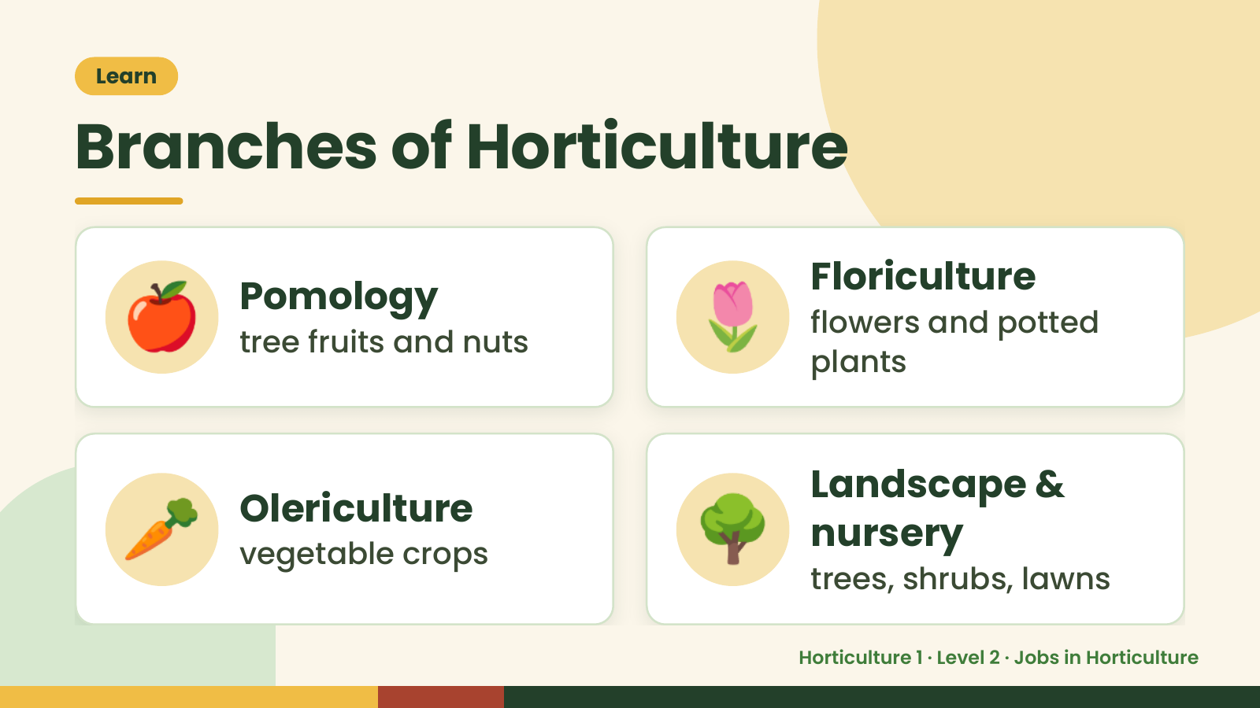
Notes:
Learn
Branches of Horticulture
🍎 Pomology
tree fruits and nuts 🌷 Floriculture
flowers and potted
plants
🥕 Olericulture
vegetable crops 🌳 Landscape &
nursery
trees, shrubs, lawns
Horticulture 1 · Level 2 · Jobs in Horticulture

Slide 6
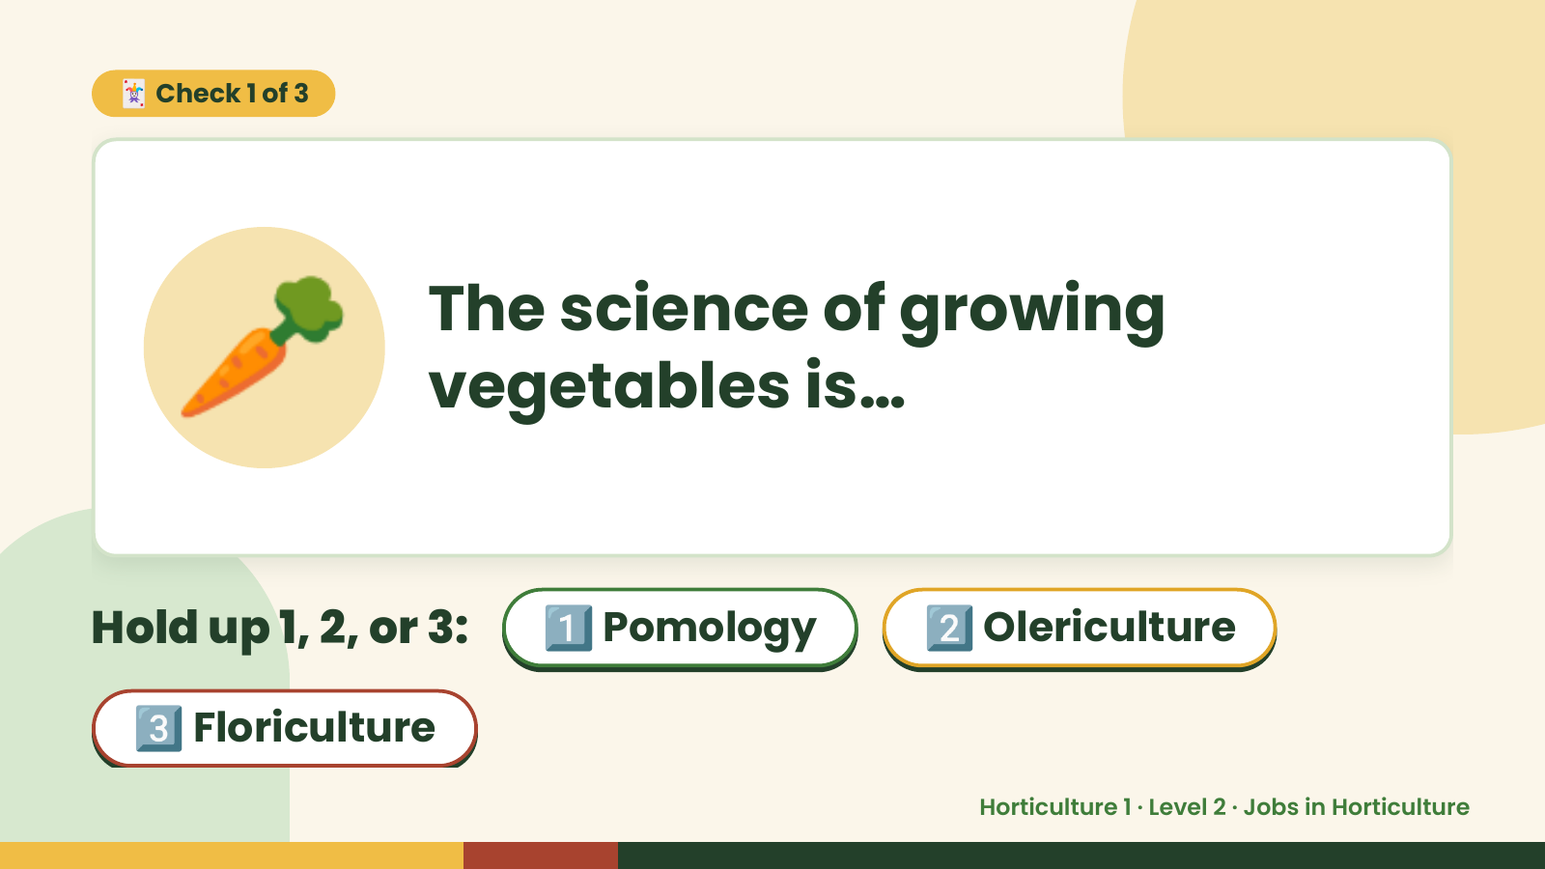
Notes:
🃏 Check 1 of 3
🥕 The science of growing
vegetables is…
Hold up 1, 2, or 3: 1️⃣ Pomology 2️⃣ Olericulture
3️⃣ Floriculture
Horticulture 1 · Level 2 · Jobs in Horticulture

Slide 7
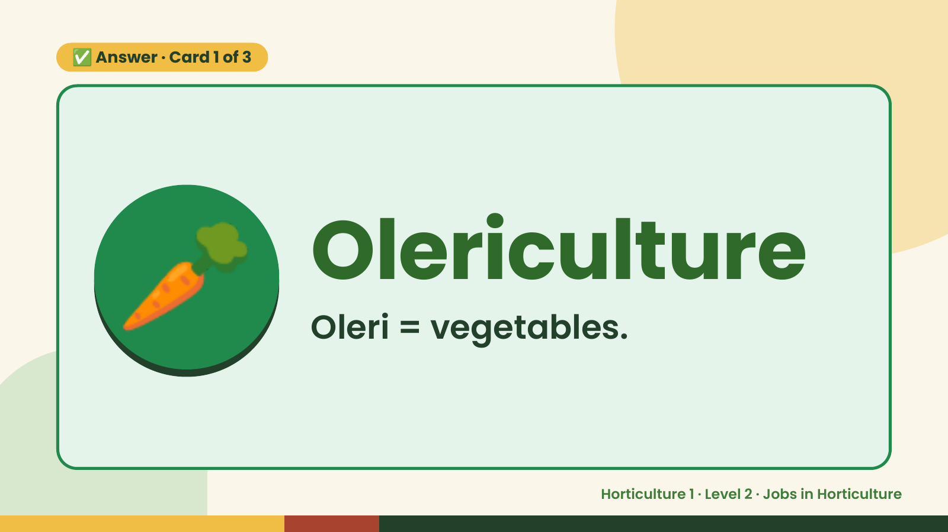
Notes:
✅ Answer · Card 1 of 3
🥕 Olericulture
Oleri = vegetables.
Horticulture 1 · Level 2 · Jobs in Horticulture

Slide 8
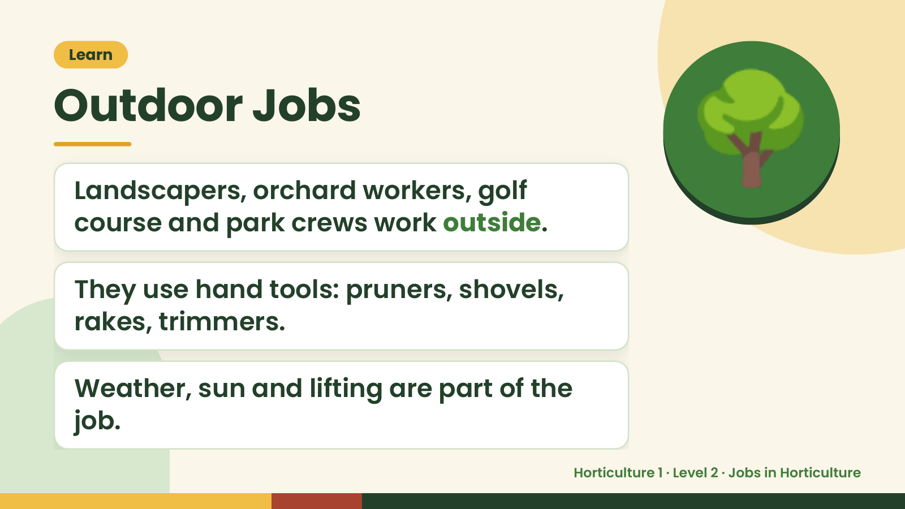
Notes:
Learn
Outdoor Jobs
Landscapers, orchard workers, golf
course and park crews work outside.
🌳
They use hand tools: pruners, shovels,
rakes, trimmers.
Weather, sun and lifting are part of the
job.
Horticulture 1 · Level 2 · Jobs in Horticulture

Slide 9
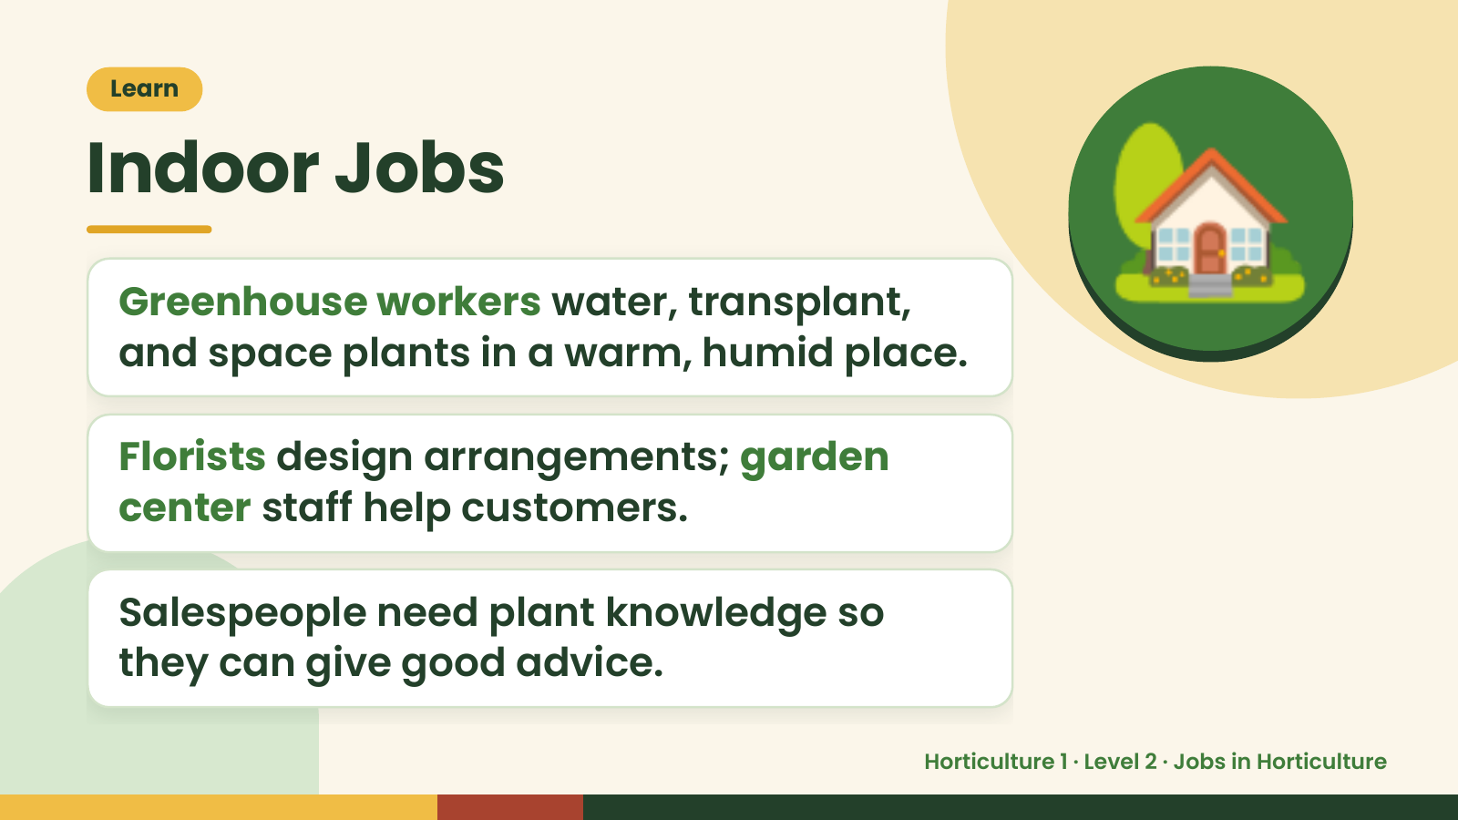
Notes:
Learn
Indoor Jobs
Greenhouse workers water, transplant,
and space plants in a warm, humid place.
Florists design arrangements; garden
🏡
center staff help customers.
Salespeople need plant knowledge so
they can give good advice.
Horticulture 1 · Level 2 · Jobs in Horticulture

Slide 10
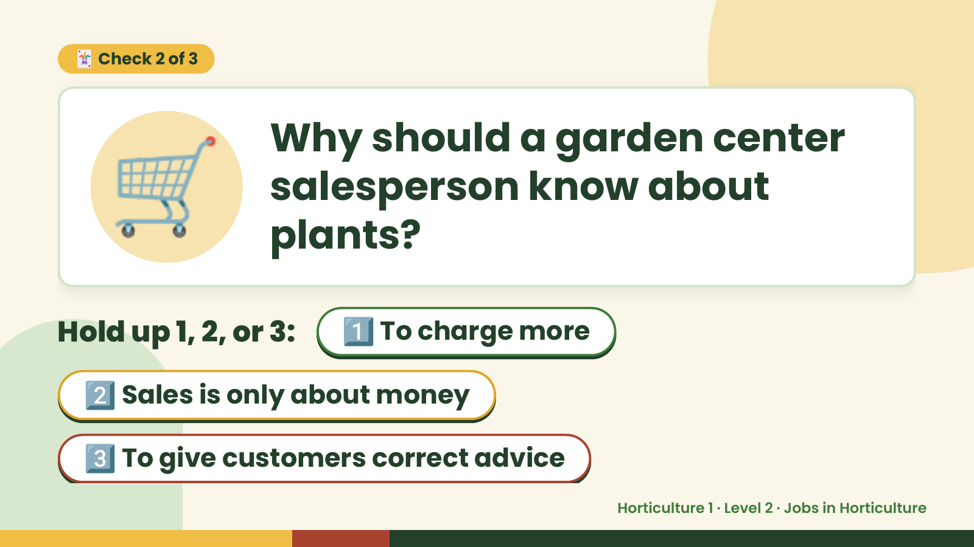
Notes:
🛒
🃏 Check 2 of 3
Why should a garden center
salesperson know about
plants?
Hold up 1, 2, or 3: 1️⃣ To charge more
2️⃣ Sales is only about money
3️⃣ To give customers correct advice
Horticulture 1 · Level 2 · Jobs in Horticulture

Slide 11
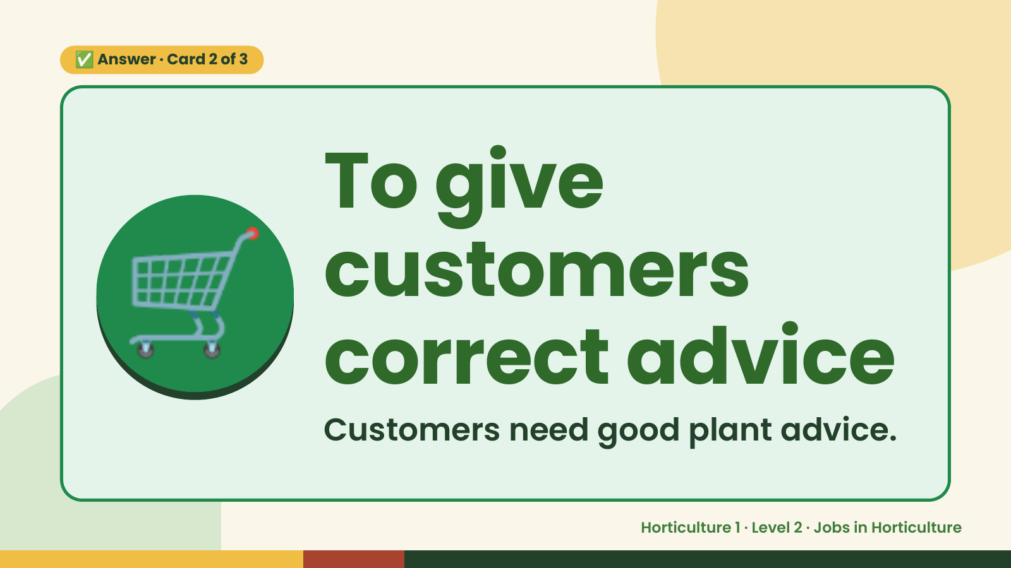
Notes:
✅ Answer · Card 2 of 3
🛒 To give
customers
correct advice
Customers need good plant advice.
Horticulture 1 · Level 2 · Jobs in Horticulture

Slide 12
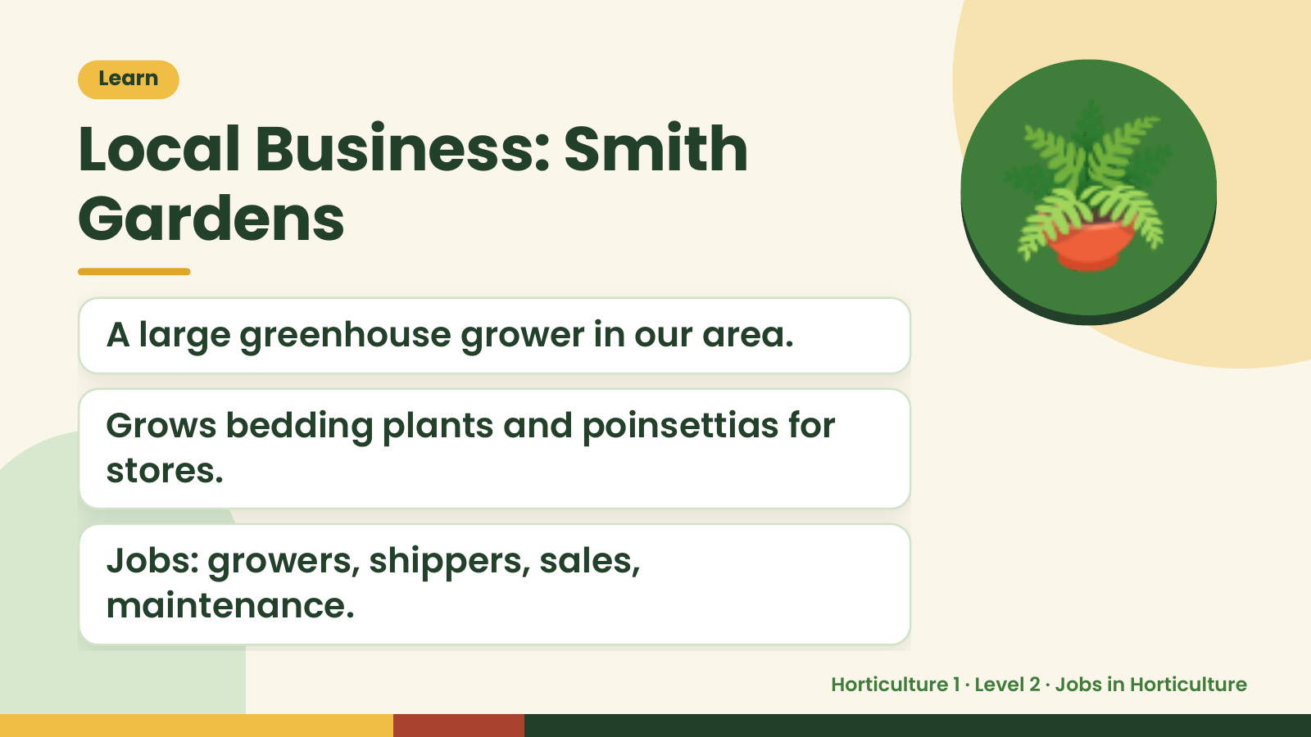
Notes:
Learn
Local Business: Smith
Gardens
A large greenhouse grower in our area.
🪴
Grows bedding plants and poinsettias for
stores.
Jobs: growers, shippers, sales,
maintenance.
Horticulture 1 · Level 2 · Jobs in Horticulture

Slide 13
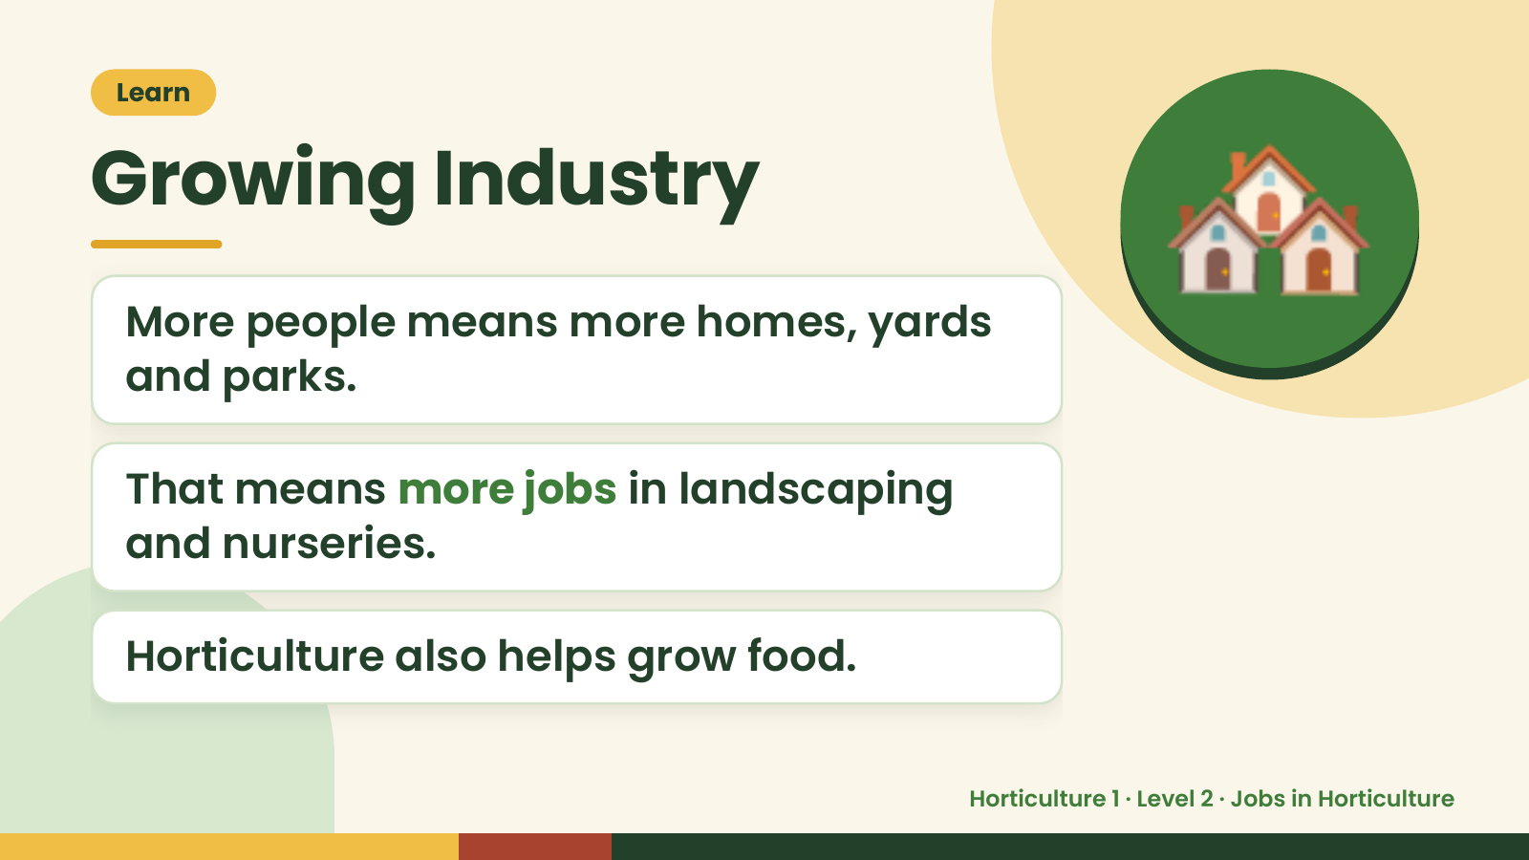
Notes:
Learn
Growing Industry
More people means more homes, yards
and parks.
🏘️
That means more jobs in landscaping
and nurseries.
Horticulture also helps grow food.
Horticulture 1 · Level 2 · Jobs in Horticulture

Slide 14
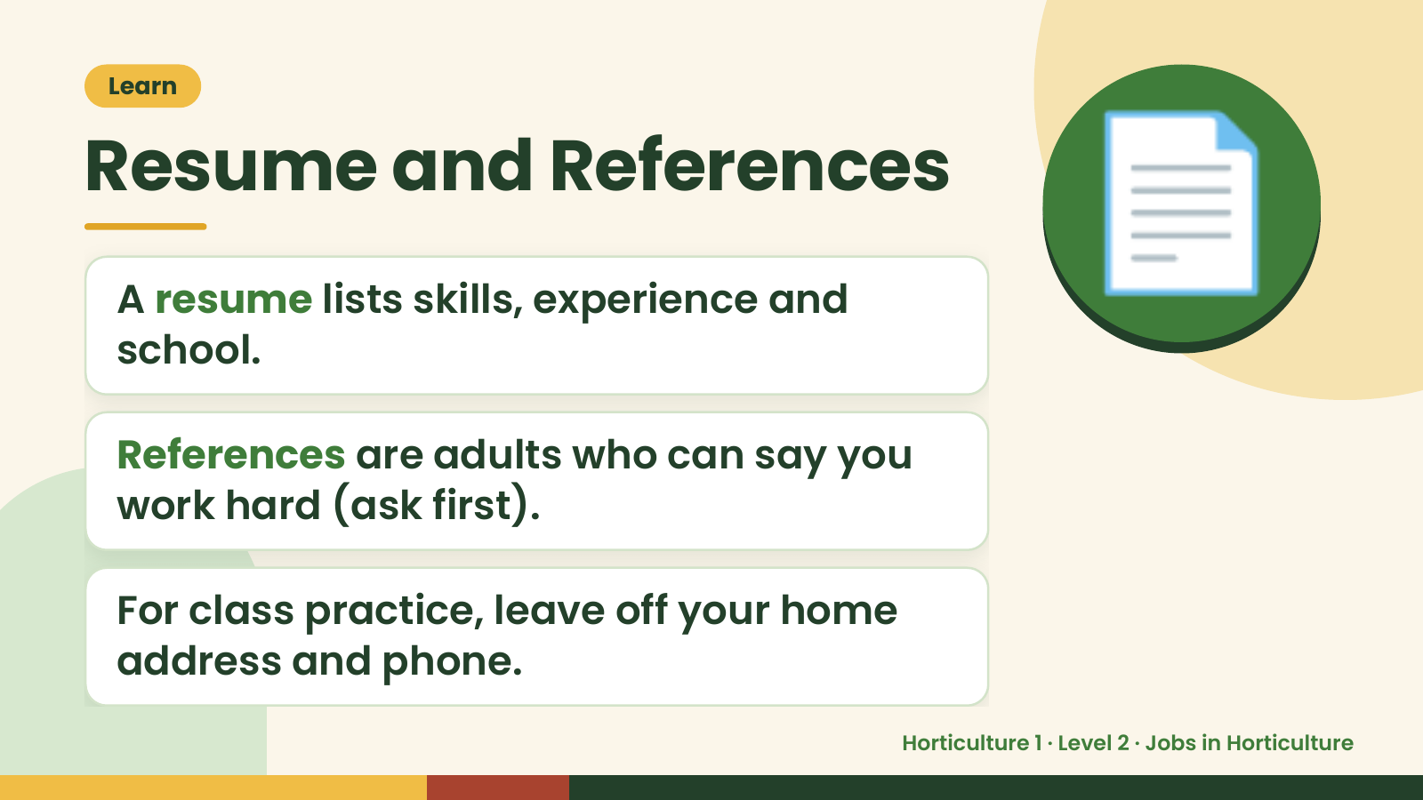
Notes:
Learn
Resume and References
A resume lists skills, experience and
school.
📄
References are adults who can say you
work hard (ask first).
For class practice, leave off your home
address and phone.
Horticulture 1 · Level 2 · Jobs in Horticulture

Slide 15
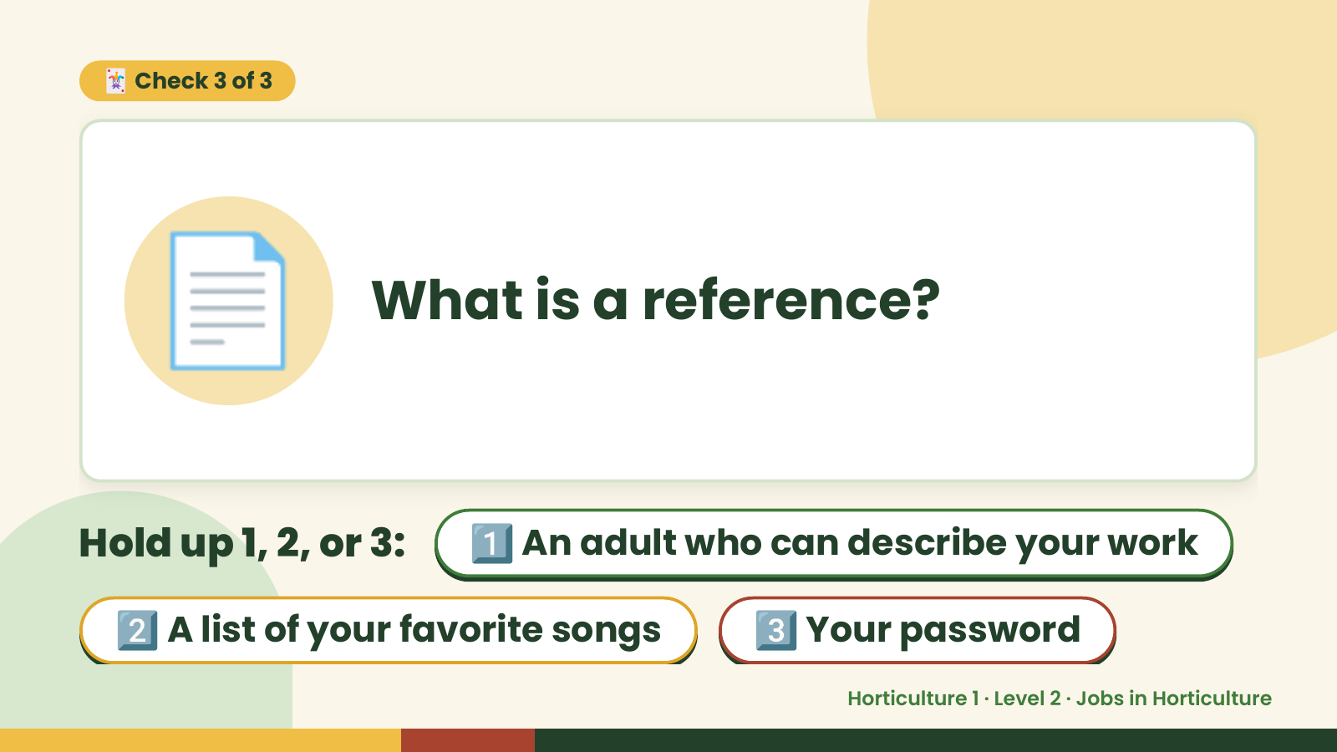
Notes:
🃏 Check 3 of 3
📄 What is a reference?
Hold up 1, 2, or 3: 1️⃣ An adult who can describe your work
2️⃣ A list of your favorite songs 3️⃣ Your password
Horticulture 1 · Level 2 · Jobs in Horticulture

Slide 16
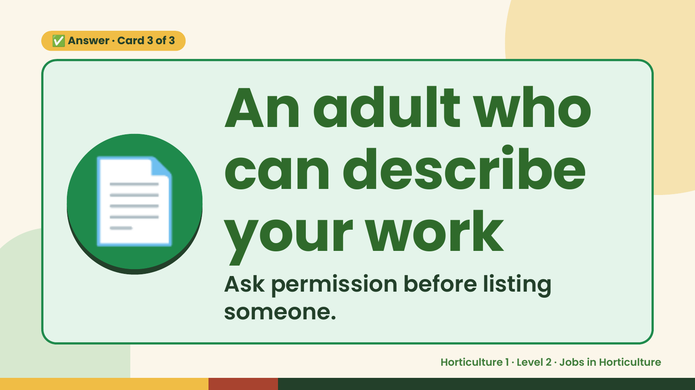
Notes:
✅ Answer · Card 3 of 3
📄
An adult who
can describe
your work
Ask permission before listing
someone.
Horticulture 1 · Level 2 · Jobs in Horticulture

Slide 17
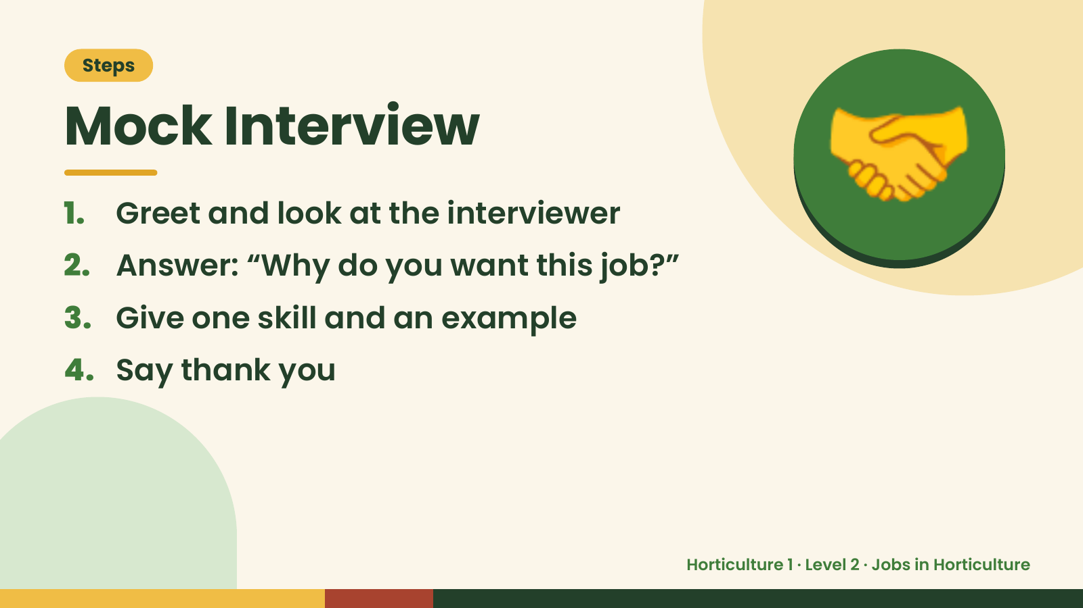
Notes:
Steps
Mock Interview
1. Greet and look at the interviewer
2. Answer: “Why do you want this job?”
3. Give one skill and an example
🤝
4. Say thank you
Horticulture 1 · Level 2 · Jobs in Horticulture

Slide 18
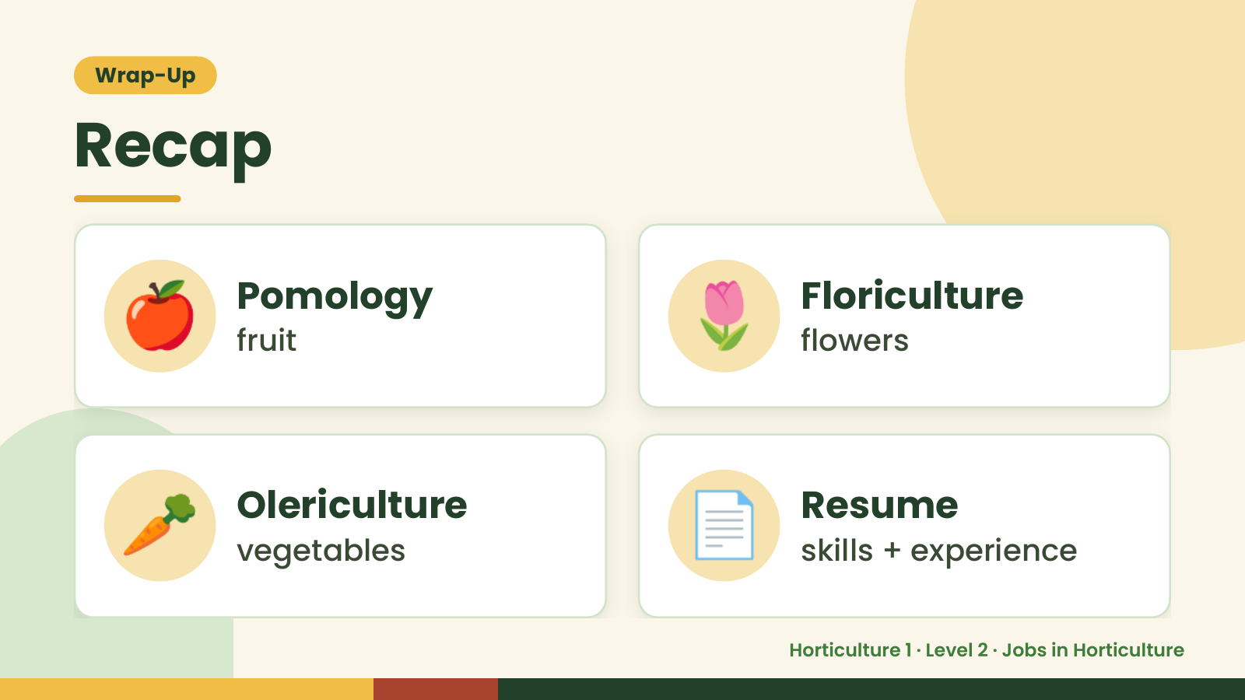
Notes:
Wrap-Up
Recap
🍎 Pomology
fruit 🌷 Floriculture
flowers
🥕 Olericulture
vegetables 📄 Resume
skills + experience
Horticulture 1 · Level 2 · Jobs in Horticulture

Slide 19
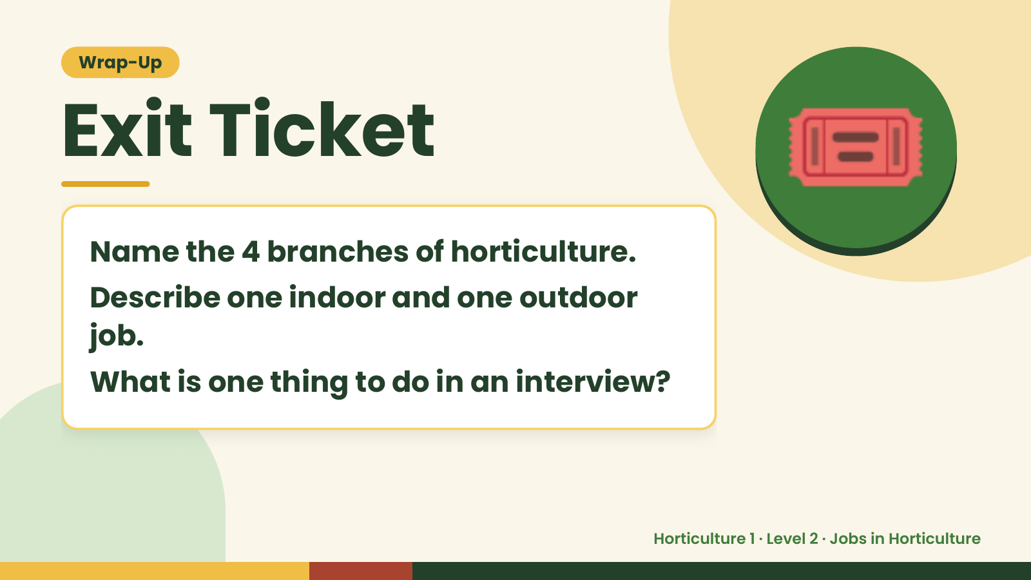
Notes:
Wrap-Up
Exit Ticket
Name the 4 branches of horticulture.
Describe one indoor and one outdoor
🎟️
job.
What is one thing to do in an interview?
Horticulture 1 · Level 2 · Jobs in Horticulture

