Slide 1
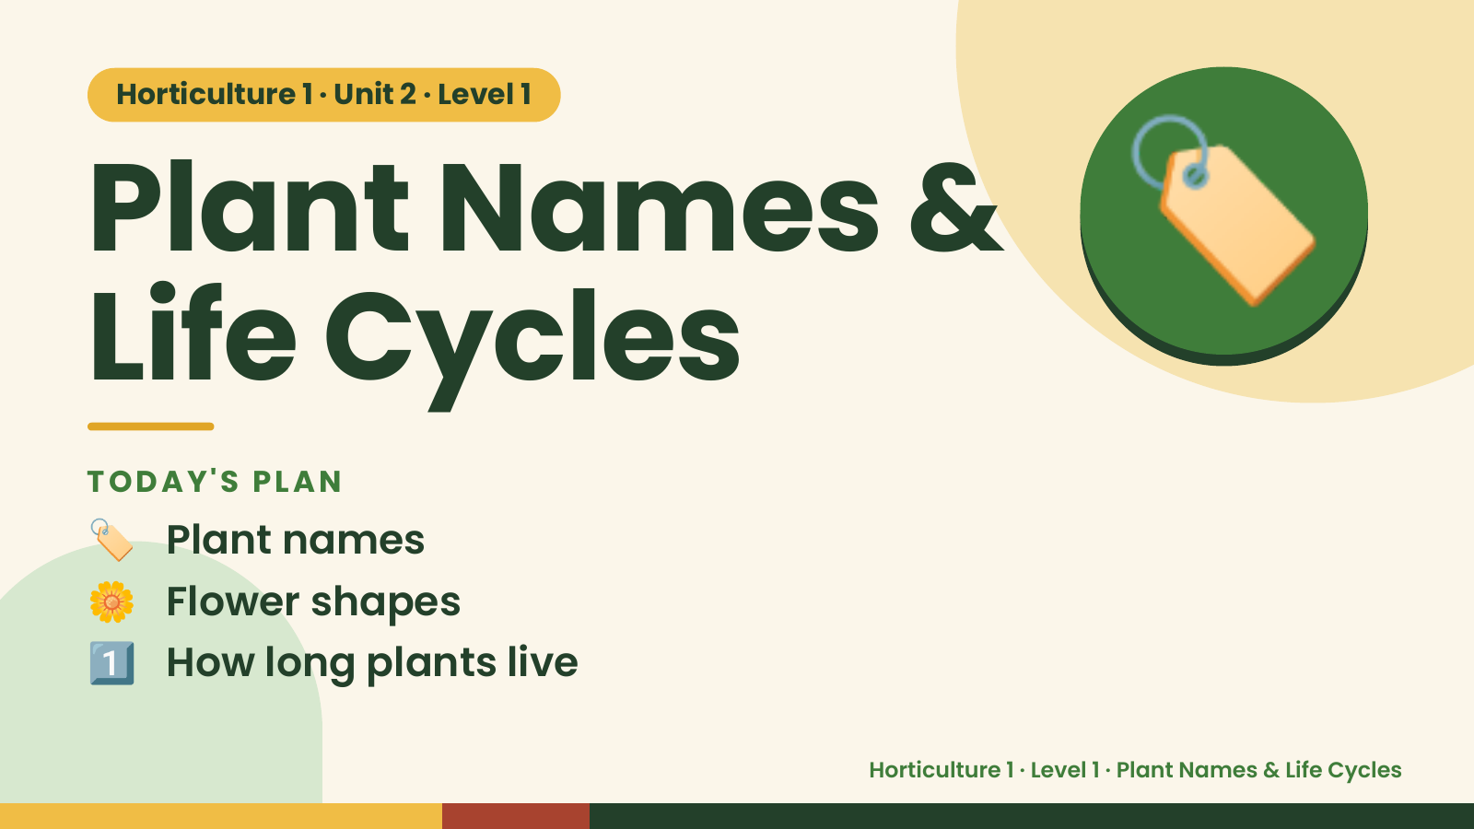
Notes:
Horticulture 1 · Unit 2 · Level 1
Plant Names &
Life Cycles
🏷️
TODAY'S PLAN
🏷️ Plant names
🌼 Flower shapes
1️⃣ How long plants live
Horticulture 1 · Level 1 · Plant Names & Life Cycles

Slide 2
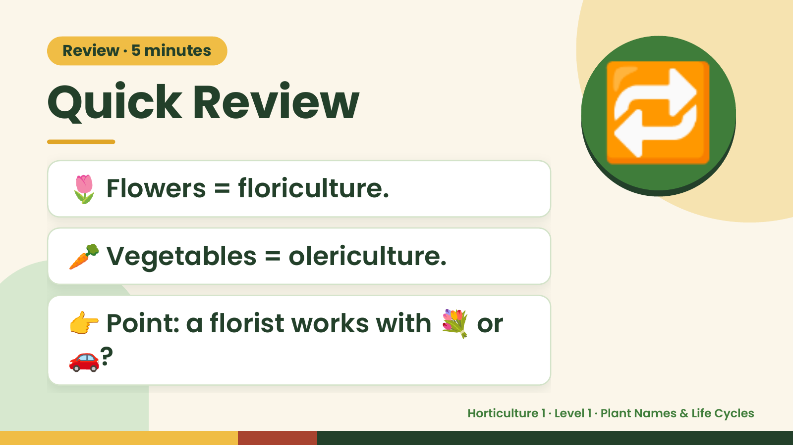
Notes:
Review · 5 minutes
Quick Review
🌷 Flowers = floriculture.
🔁
🥕 Vegetables = olericulture.
👉 Point: a florist works with 💐 or
🚗?
Horticulture 1 · Level 1 · Plant Names & Life Cycles

Slide 3
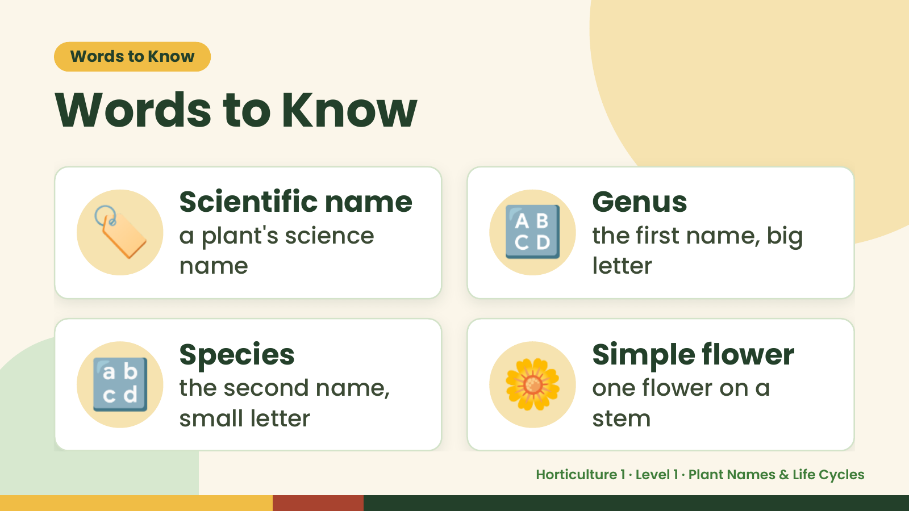
Notes:
Words to Know
Words to Know
🏷️ Scientific name
a plant's science
name
🔠 Genus
the first name, big
letter
🔡 Species
the second name,
small letter
🌼 Simple flower
one flower on a
stem
Horticulture 1 · Level 1 · Plant Names & Life Cycles

Slide 4
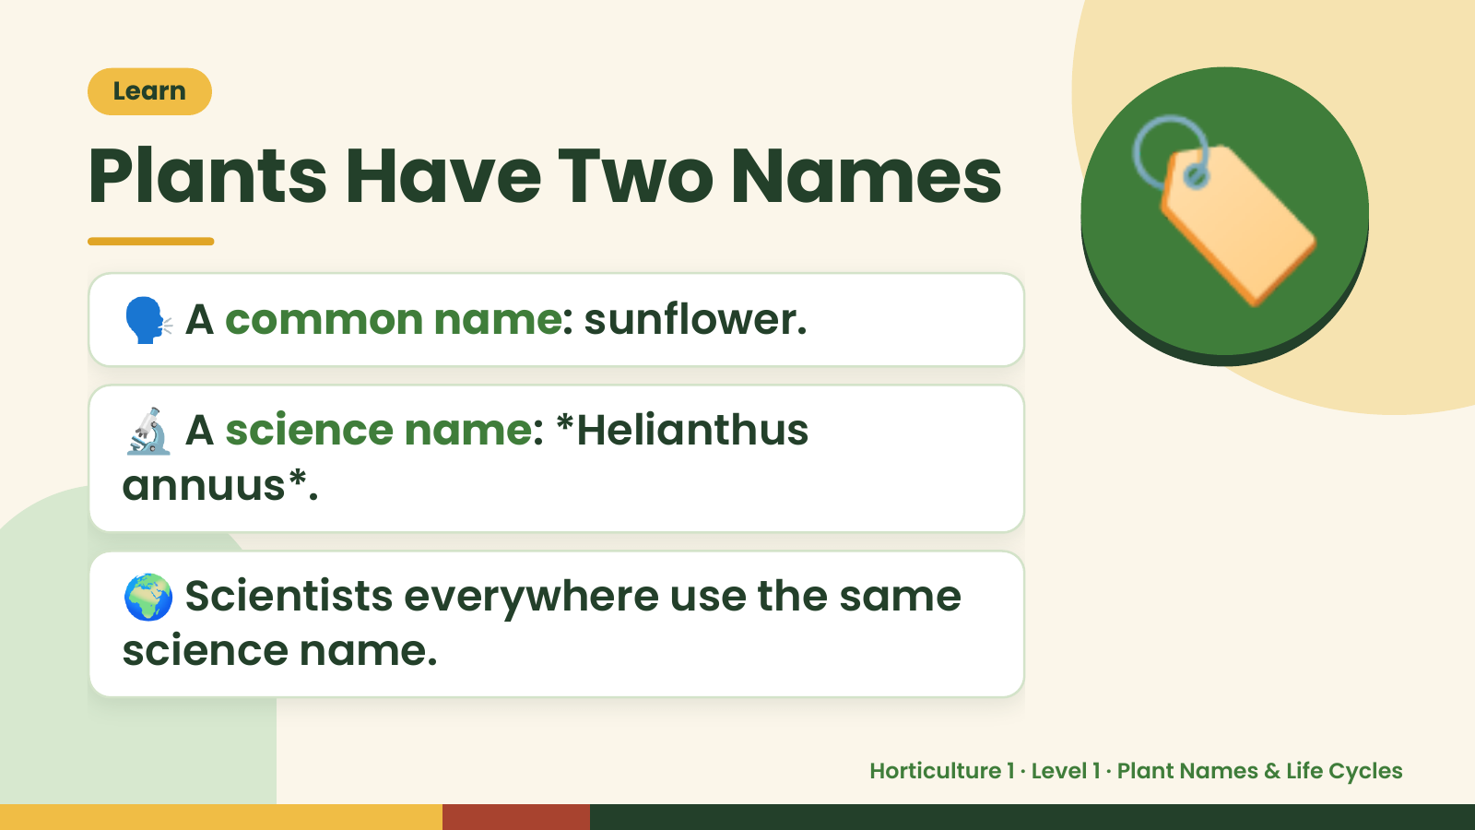
Notes:
Learn
Plants Have Two Names
🗣️ A common name: sunflower.
🔬 A science name: *Helianthus
🏷️
annuus*.
🌍 Scientists everywhere use the same
science name.
Horticulture 1 · Level 1 · Plant Names & Life Cycles

Slide 5
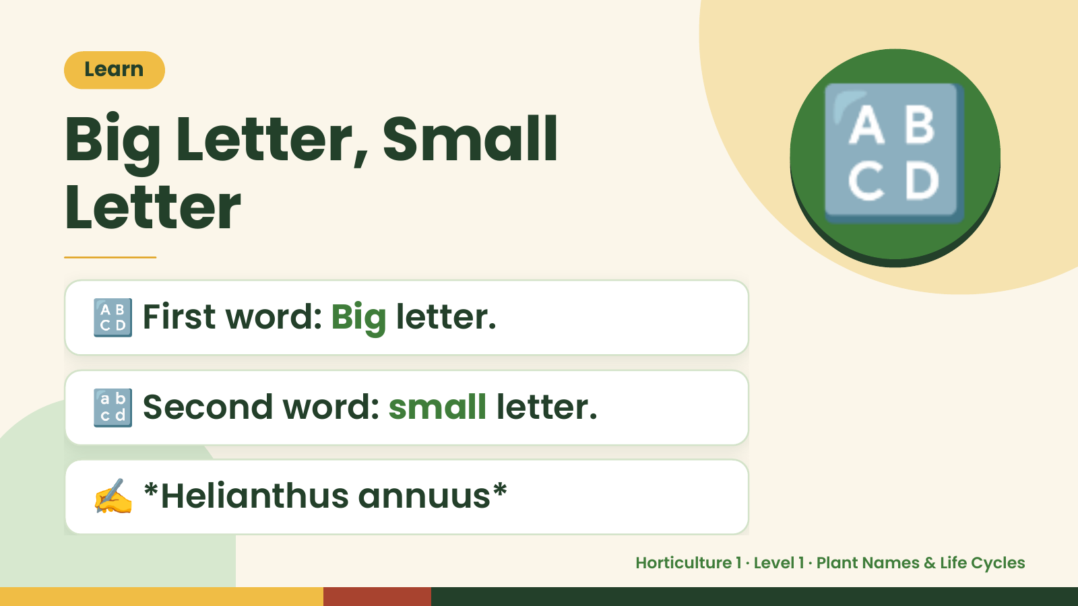
Notes:
Learn
Big Letter, Small
Letter
🔠 First word: Big letter.
🔠
🔡 Second word: small letter.
✍️ *Helianthus annuus*
Horticulture 1 · Level 1 · Plant Names & Life Cycles

Slide 6
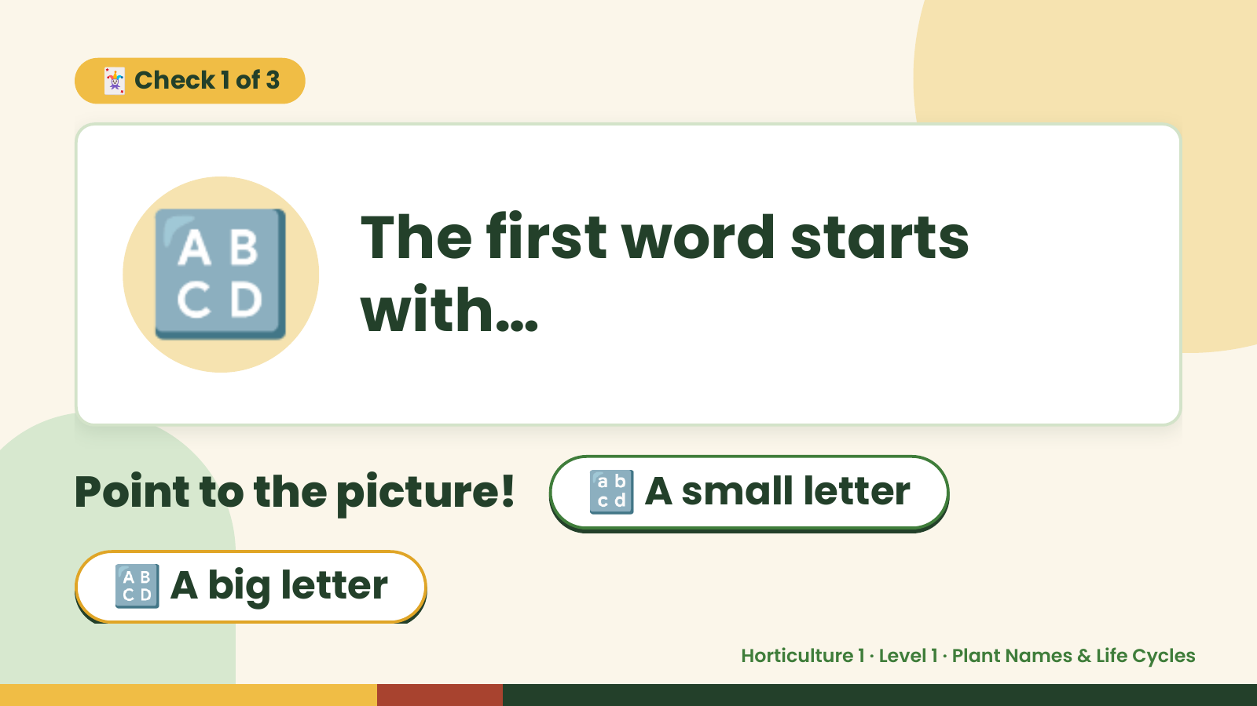
Notes:
🃏 Check 1 of 3
🔠 The first word starts
with…
Point to the picture! 🔡 A small letter
🔠 A big letter
Horticulture 1 · Level 1 · Plant Names & Life Cycles

Slide 7
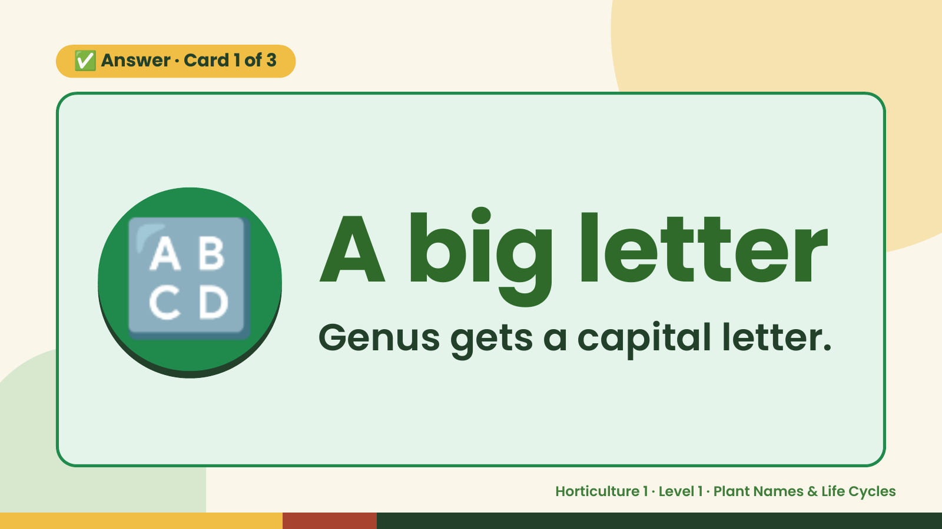
Notes:
✅ Answer · Card 1 of 3
🔠 A big letter
Genus gets a capital letter.
Horticulture 1 · Level 1 · Plant Names & Life Cycles

Slide 8
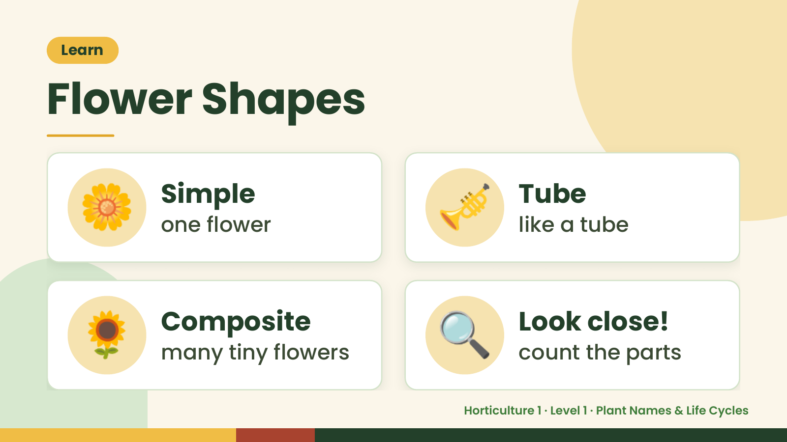
Notes:
Learn
Flower Shapes
🌼 Simple
one flower 🎺 Tube
like a tube
🌻 Composite
many tiny flowers 🔍 Look close!
count the parts
Horticulture 1 · Level 1 · Plant Names & Life Cycles

Slide 9
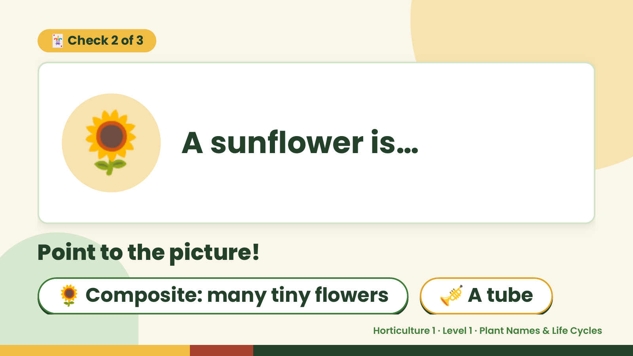
Notes:
🃏 Check 2 of 3
🌻 A sunflower is…
Point to the picture!
🌻 Composite: many tiny flowers 🎺 A tube
Horticulture 1 · Level 1 · Plant Names & Life Cycles

Slide 10
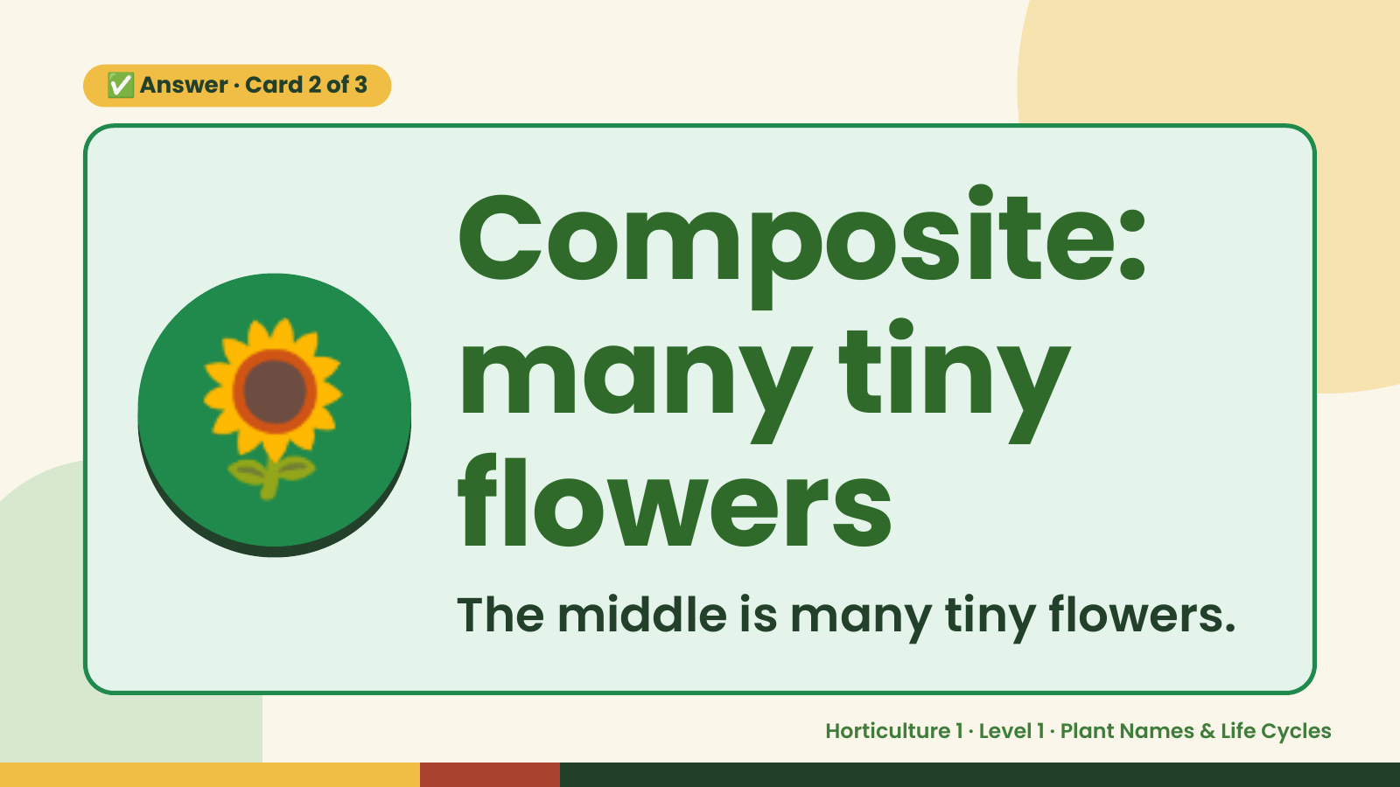
Notes:
✅ Answer · Card 2 of 3
🌻 Composite:
many tiny
flowers
The middle is many tiny flowers.
Horticulture 1 · Level 1 · Plant Names & Life Cycles

Slide 11
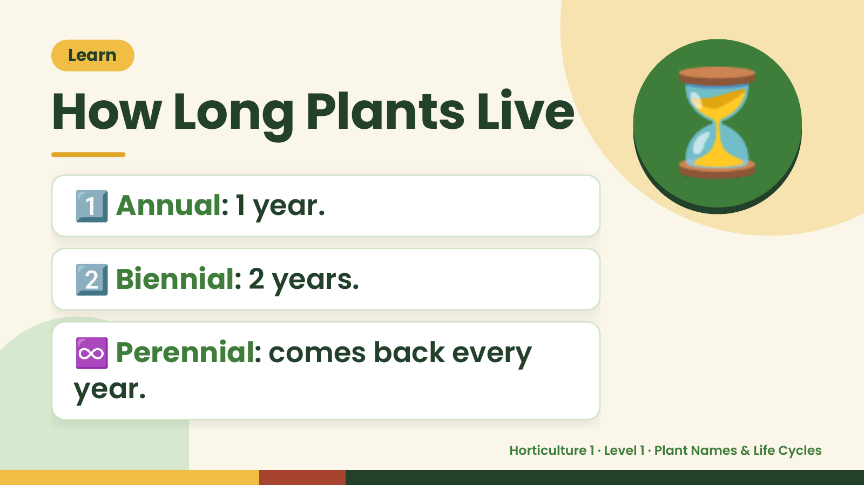
Notes:
Learn
How Long Plants Live
1️⃣ Annual: 1 year.
⏳
2️⃣ Biennial: 2 years.
♾️ Perennial: comes back every
year.
Horticulture 1 · Level 1 · Plant Names & Life Cycles

Slide 12
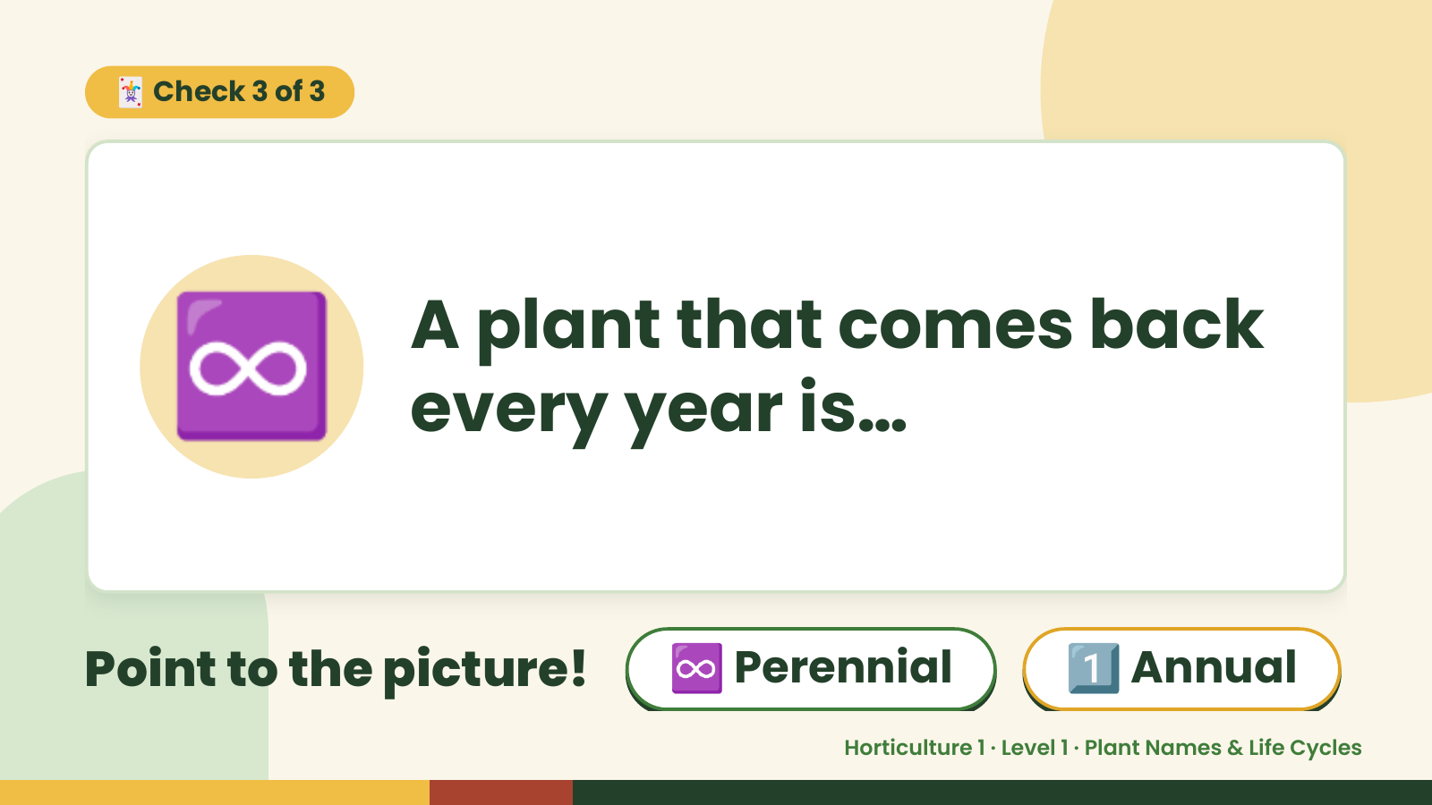
Notes:
🃏 Check 3 of 3
♾️ A plant that comes back
every year is…
Point to the picture! ♾️ Perennial 1️⃣ Annual
Horticulture 1 · Level 1 · Plant Names & Life Cycles

Slide 13
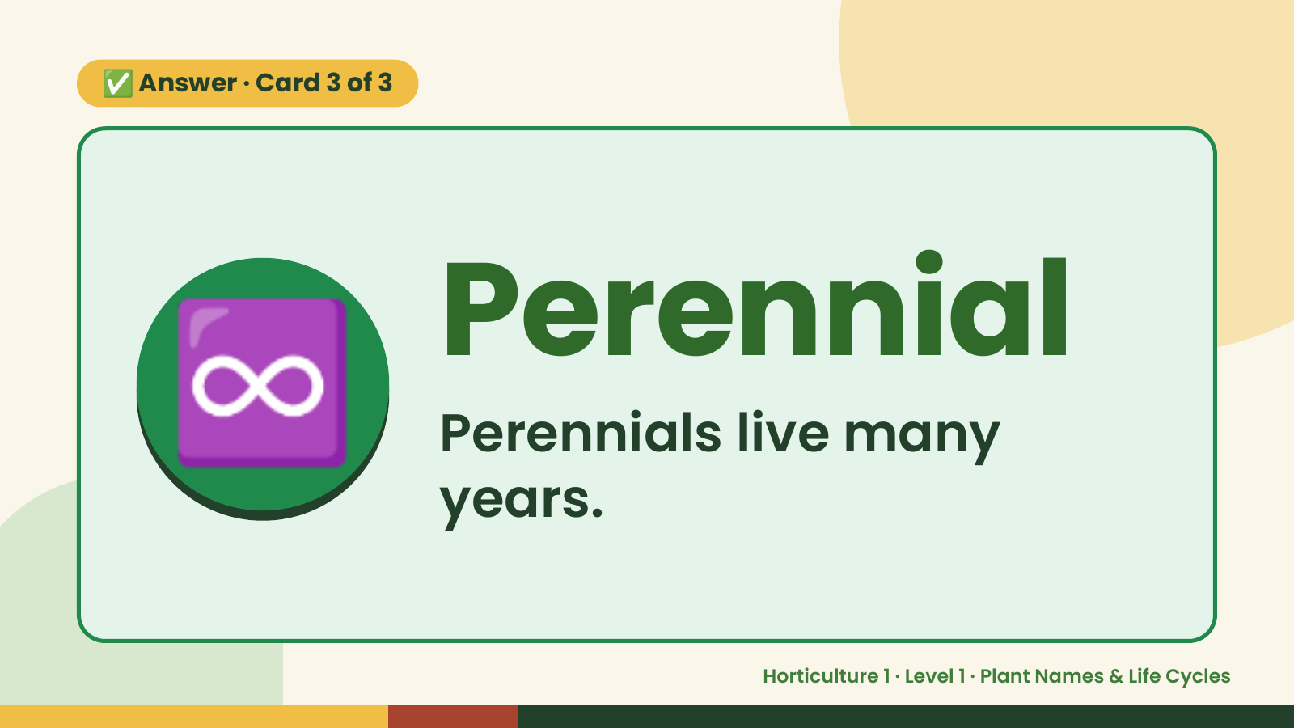
Notes:
✅ Answer · Card 3 of 3
♾️ Perennial
Perennials live many
years.
Horticulture 1 · Level 1 · Plant Names & Life Cycles

Slide 14
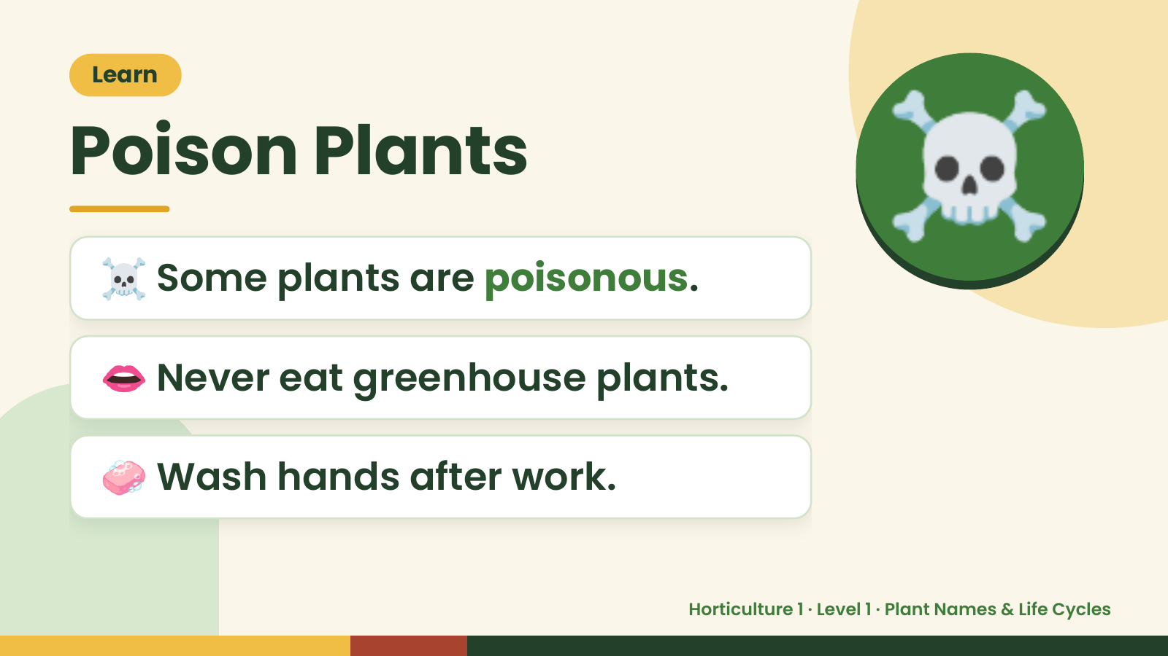
Notes:
Learn
Poison Plants
☠️ Some plants are poisonous.
☠️
👄 Never eat greenhouse plants.
🧼 Wash hands after work.
Horticulture 1 · Level 1 · Plant Names & Life Cycles

Slide 15
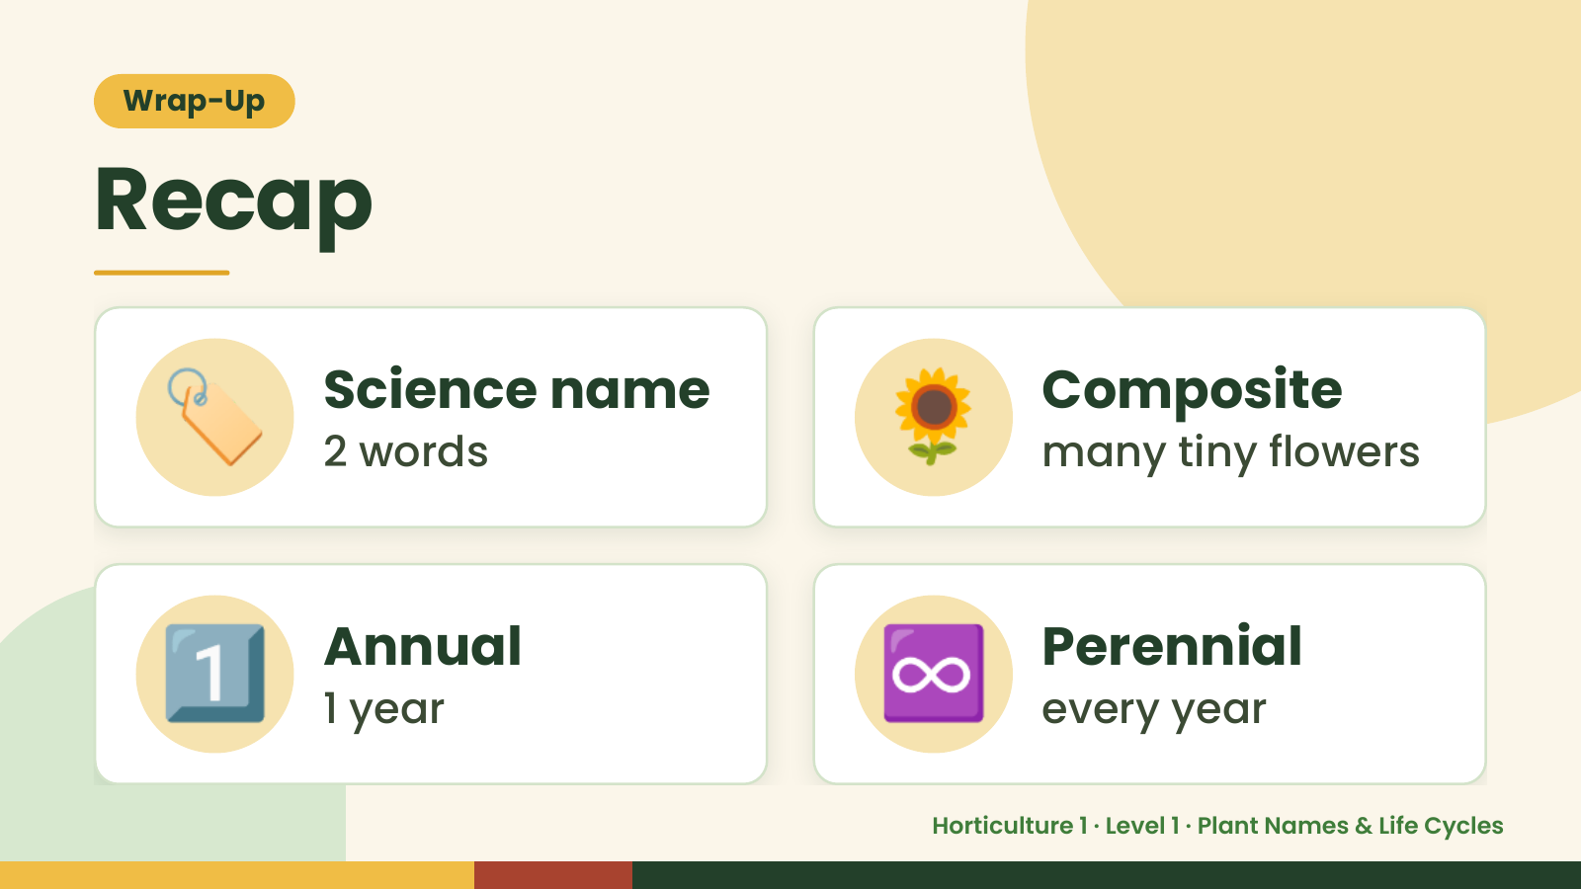
Notes:
Wrap-Up
Recap
🏷️ Science name
2 words 🌻 Composite
many tiny flowers
1️⃣ Annual
1 year ♾️ Perennial
every year
Horticulture 1 · Level 1 · Plant Names & Life Cycles

Slide 16
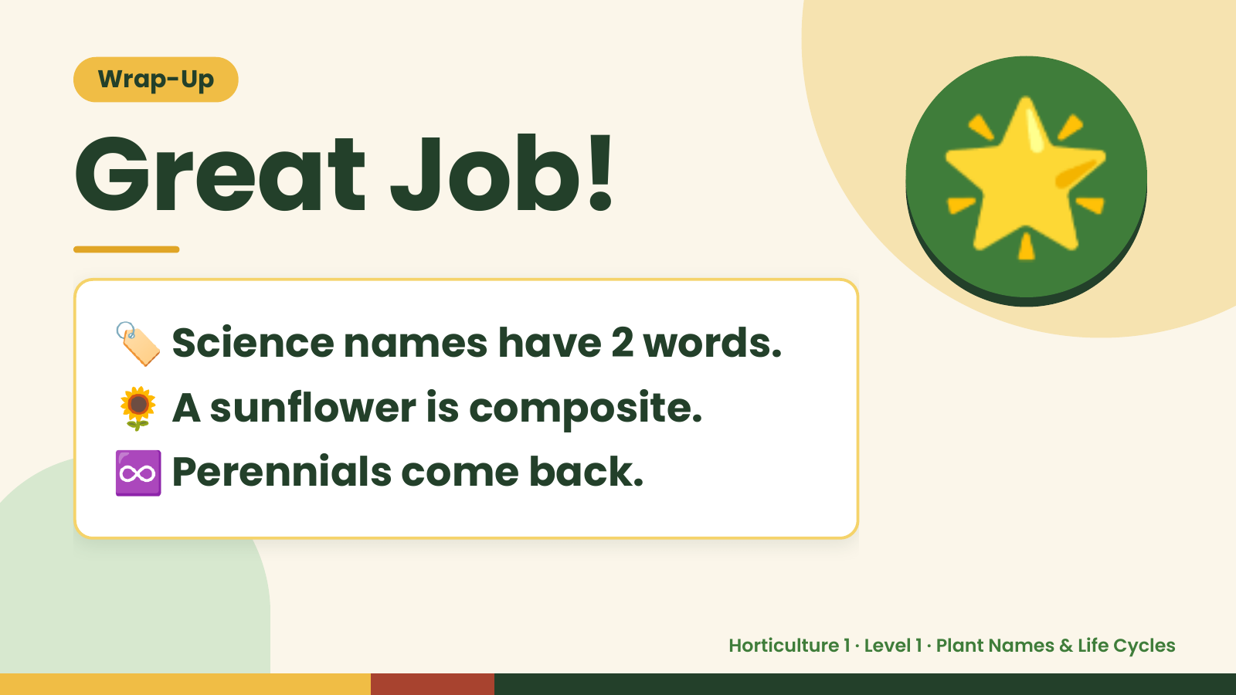
Notes:
Wrap-Up
Great Job!
🏷️ Science names have 2 words.
🌟
🌻 A sunflower is composite.
♾️ Perennials come back.
Horticulture 1 · Level 1 · Plant Names & Life Cycles

