Slide 1
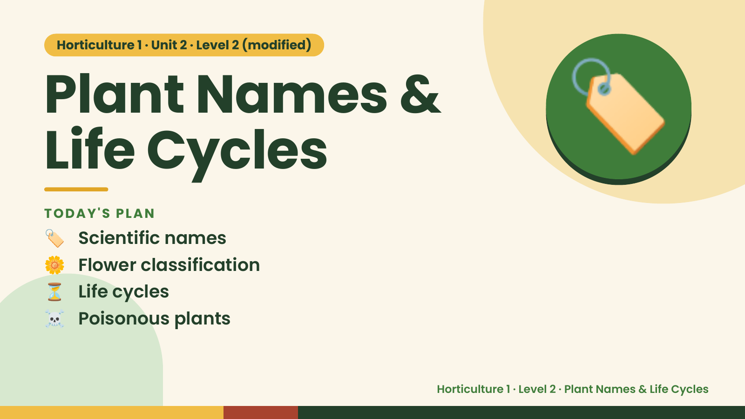
Notes:
Horticulture 1 · Unit 2 · Level 2 (modified)
Plant Names &
Life Cycles
🏷️ Scientific names
TODAY'S PLAN
🏷️
🌼 Flower classification
⏳ Life cycles
☠️ Poisonous plants
Horticulture 1 · Level 2 · Plant Names & Life Cycles

Slide 2
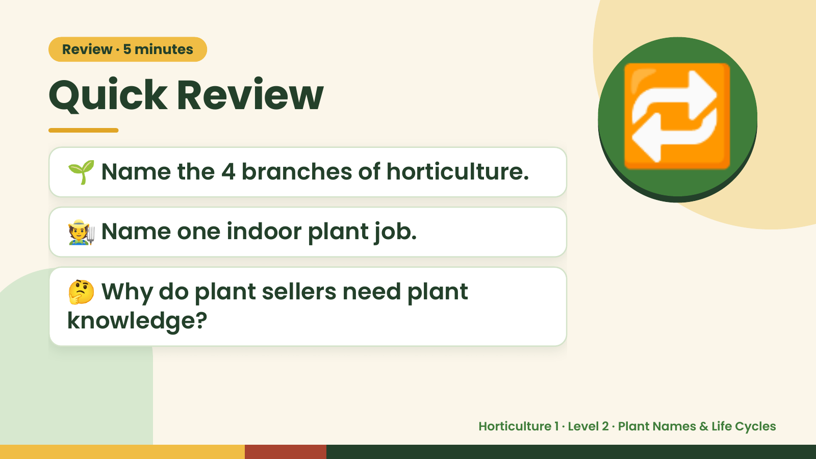
Notes:
Review · 5 minutes
Quick Review
🌱 Name the 4 branches of horticulture.
🧑‍🌾 Name one indoor plant job.
🔁
🤔 Why do plant sellers need plant
knowledge?
Horticulture 1 · Level 2 · Plant Names & Life Cycles

Slide 3
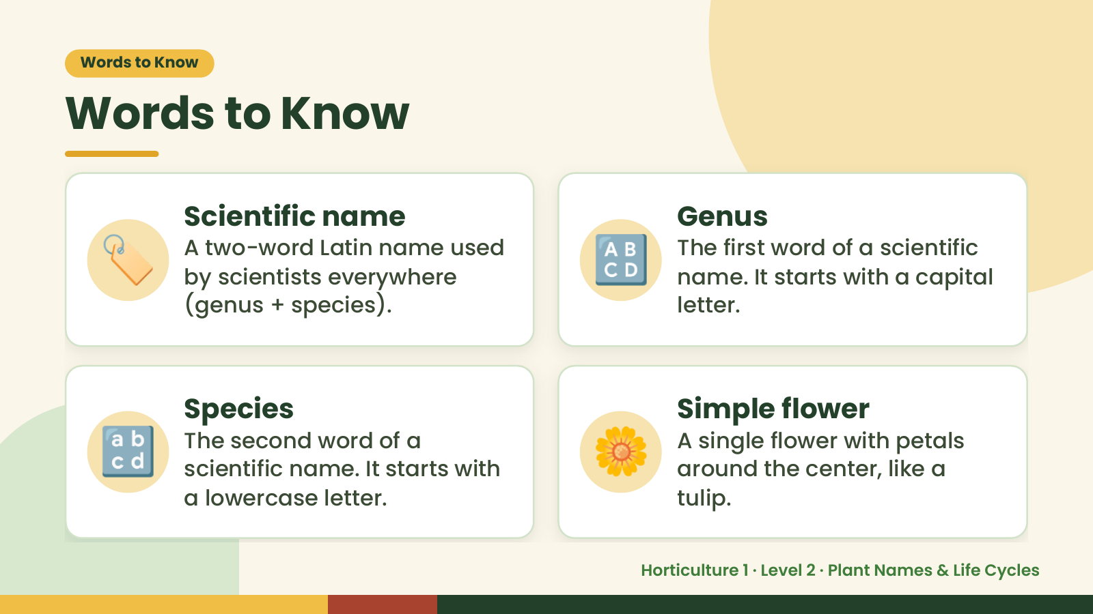
Notes:
Words to Know
Words to Know
🏷️ Scientific name
A two-word Latin name used
by scientists everywhere
(genus + species).
🔠 Genus
The first word of a scientific
name. It starts with a capital
letter.
🔡 Species
The second word of a
scientific name. It starts with
a lowercase letter.
🌼 Simple flower
A single flower with petals
around the center, like a
tulip.
Horticulture 1 · Level 2 · Plant Names & Life Cycles

Slide 4
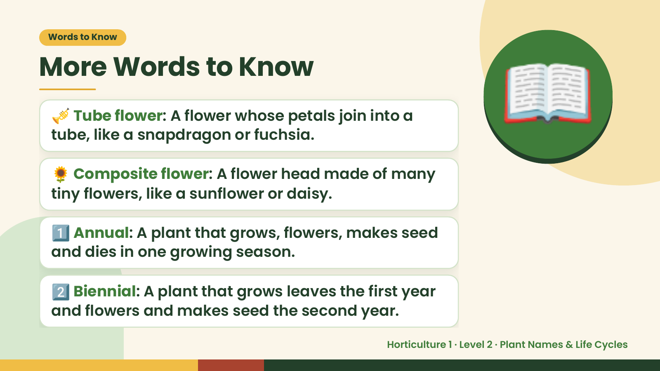
Notes:
Words to Know
More Words to Know
🎺 Tube flower: A flower whose petals join into a
tube, like a snapdragon or fuchsia.
🌻 Composite flower: A flower head made of many
tiny flowers, like a sunflower or daisy.
📖
1️⃣ Annual: A plant that grows, flowers, makes seed
and dies in one growing season.
2️⃣ Biennial: A plant that grows leaves the first year
and flowers and makes seed the second year.
Horticulture 1 · Level 2 · Plant Names & Life Cycles

Slide 5
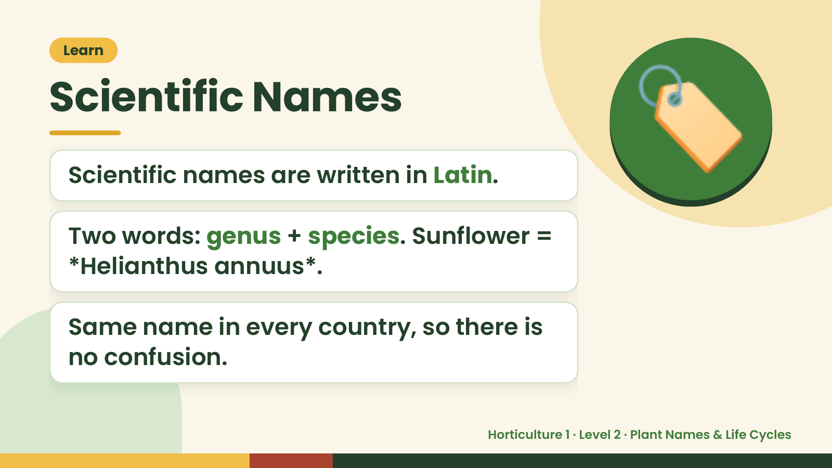
Notes:
Learn
Scientific Names
Scientific names are written in Latin.
Two words: genus + species. Sunflower =
🏷️
*Helianthus annuus*.
Same name in every country, so there is
no confusion.
Horticulture 1 · Level 2 · Plant Names & Life Cycles

Slide 6
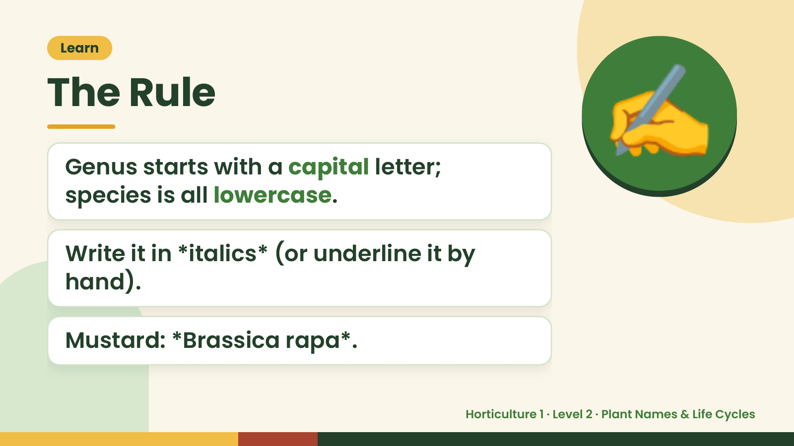
Notes:
Learn
The Rule
Genus starts with a capital letter;
species is all lowercase.
✍️
Write it in *italics* (or underline it by
hand).
Mustard: *Brassica rapa*.
Horticulture 1 · Level 2 · Plant Names & Life Cycles

Slide 7
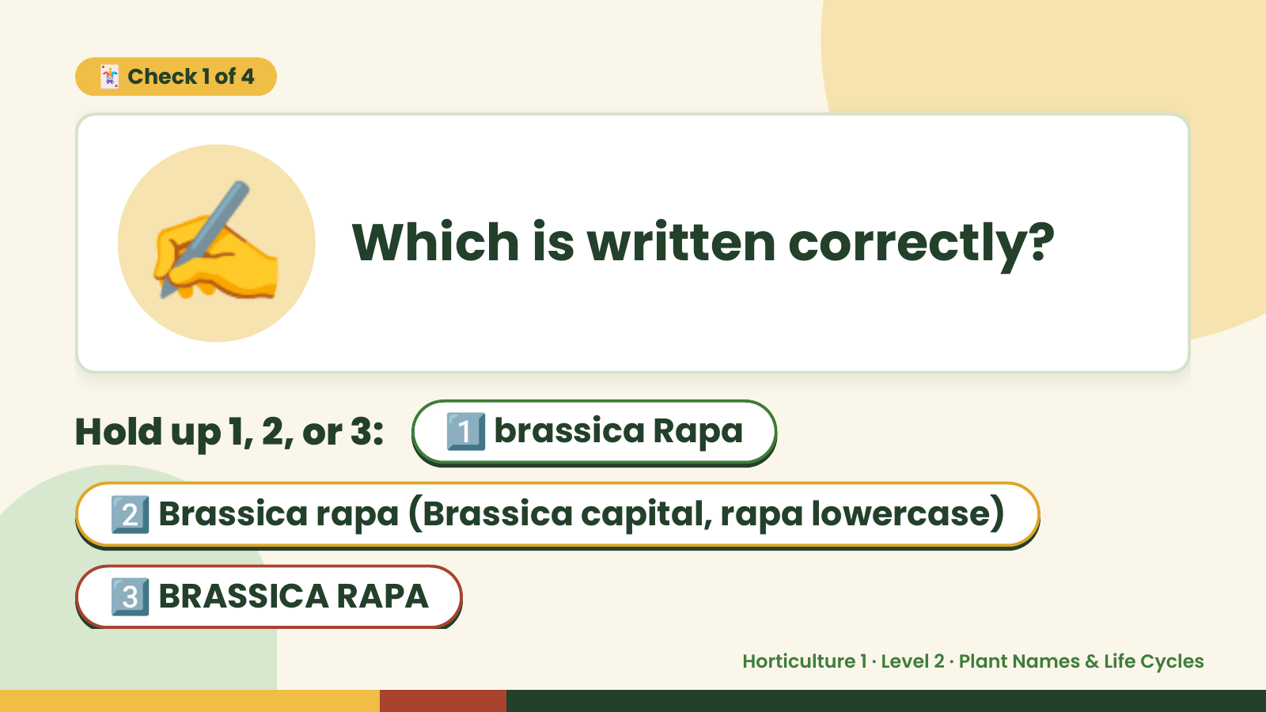
Notes:
✍️
🃏 Check 1 of 4
Which is written correctly?
Hold up 1, 2, or 3: 1️⃣ brassica Rapa
2️⃣ Brassica rapa (Brassica capital, rapa lowercase)
3️⃣ BRASSICA RAPA
Horticulture 1 · Level 2 · Plant Names & Life Cycles

Slide 8
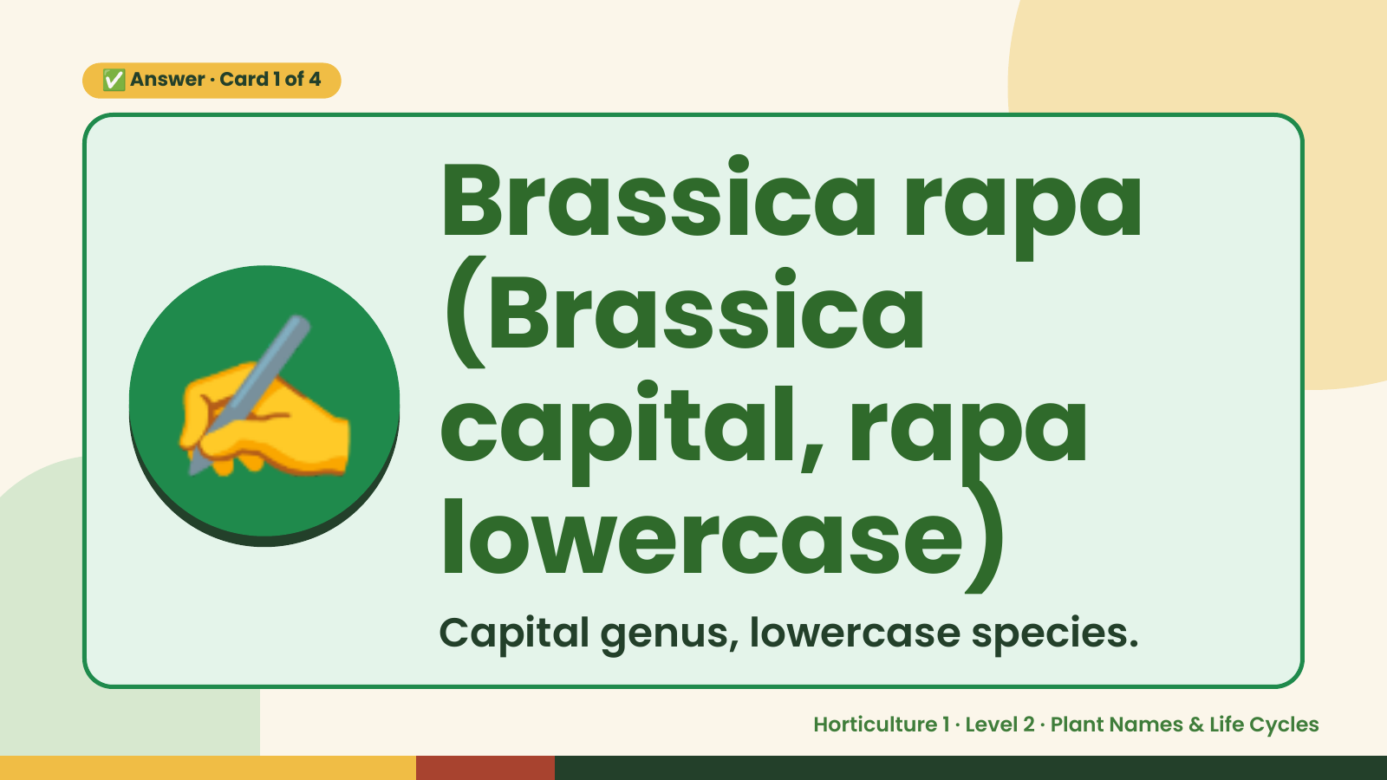
Notes:
✅ Answer · Card 1 of 4
✍️
Brassica rapa
(Brassica
capital, rapa
lowercase)
Capital genus, lowercase species.
Horticulture 1 · Level 2 · Plant Names & Life Cycles

Slide 9
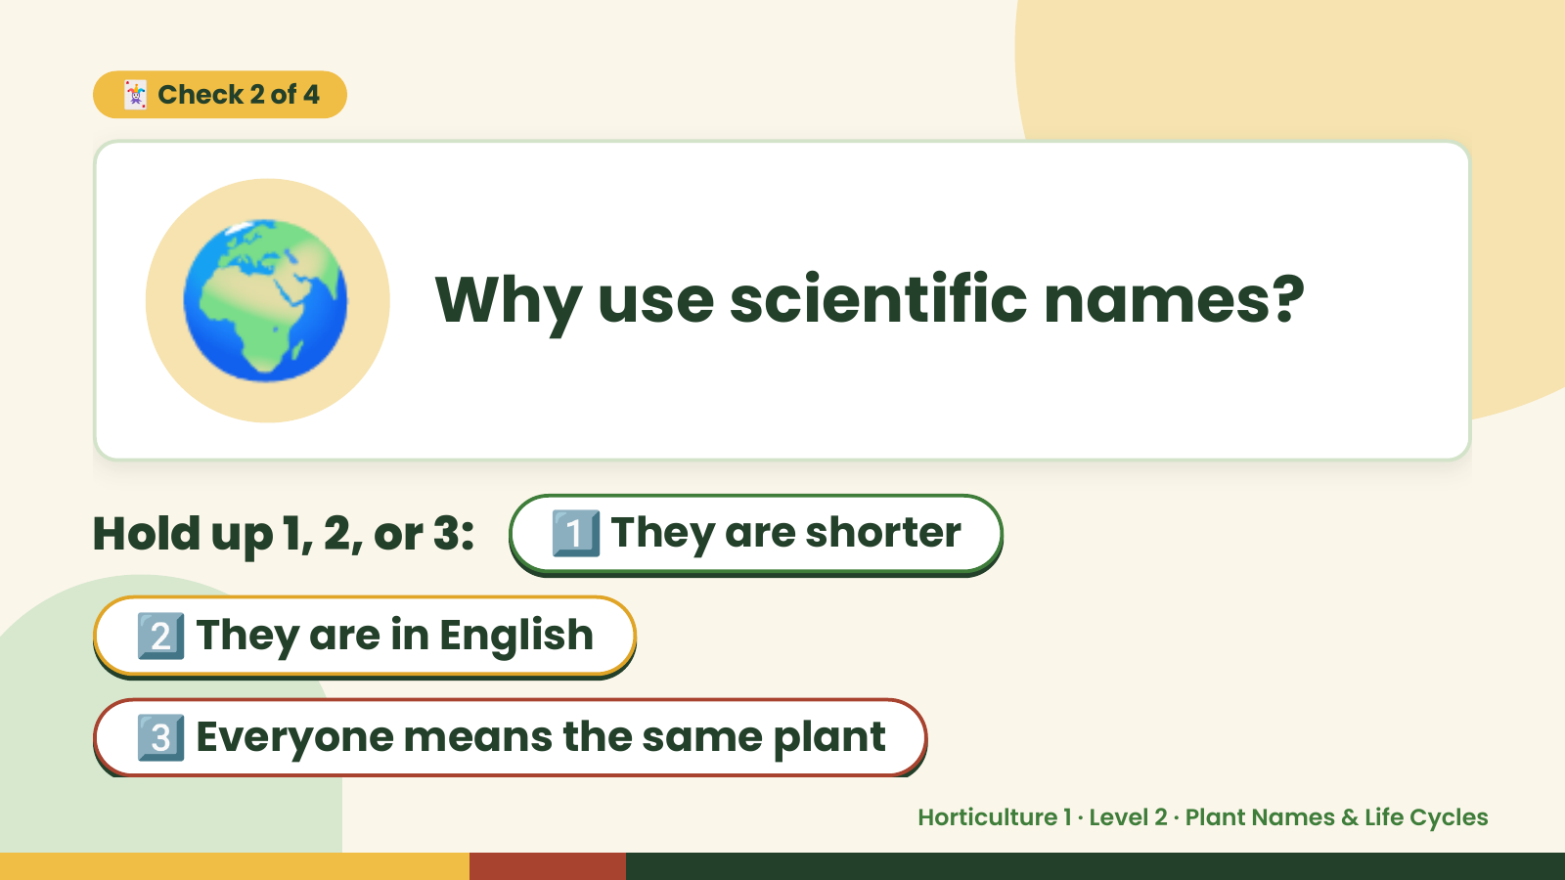
Notes:
🌍
🃏 Check 2 of 4
Why use scientific names?
Hold up 1, 2, or 3: 1️⃣ They are shorter
2️⃣ They are in English
3️⃣ Everyone means the same plant
Horticulture 1 · Level 2 · Plant Names & Life Cycles

Slide 10
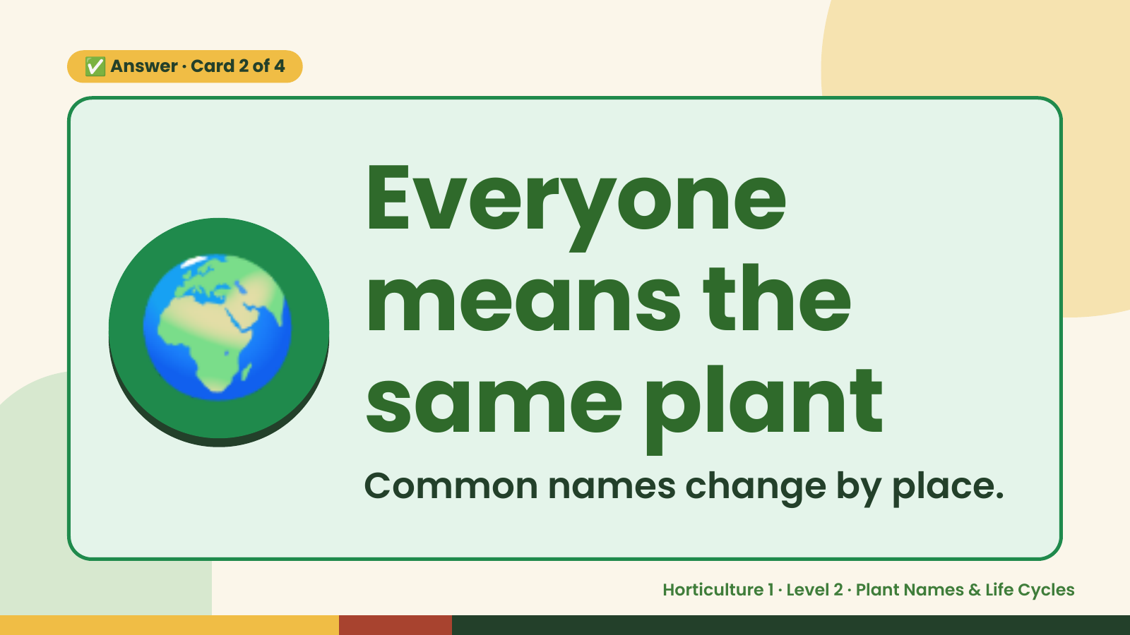
Notes:
✅ Answer · Card 2 of 4
🌍 Everyone
means the
same plant
Common names change by place.
Horticulture 1 · Level 2 · Plant Names & Life Cycles

Slide 11
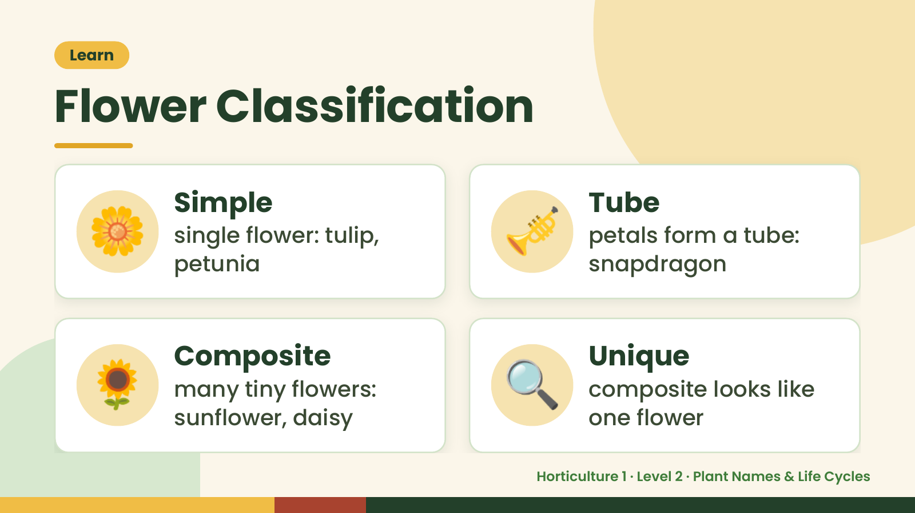
Notes:
Learn
Flower Classification
🌼 Simple
single flower: tulip,
petunia
🎺 Tube
petals form a tube:
snapdragon
🌻 Composite
many tiny flowers:
sunflower, daisy
🔍 Unique
composite looks like
one flower
Horticulture 1 · Level 2 · Plant Names & Life Cycles

Slide 12
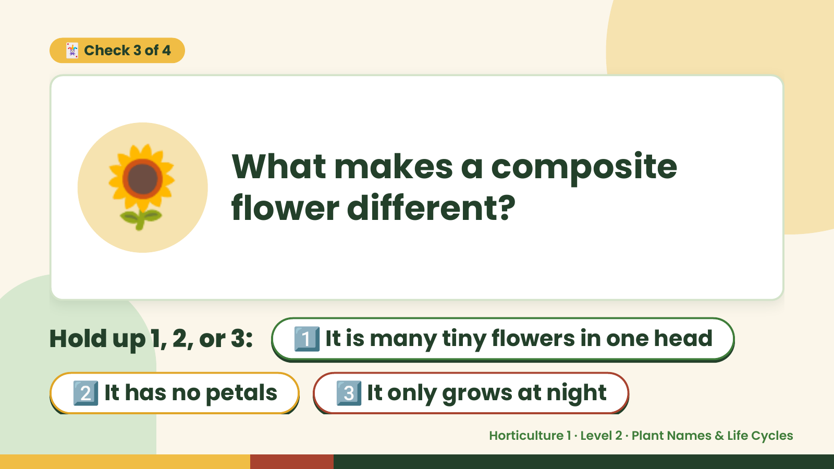
Notes:
🃏 Check 3 of 4
🌻 What makes a composite
flower different?
Hold up 1, 2, or 3: 1️⃣ It is many tiny flowers in one head
2️⃣ It has no petals 3️⃣ It only grows at night
Horticulture 1 · Level 2 · Plant Names & Life Cycles

Slide 13
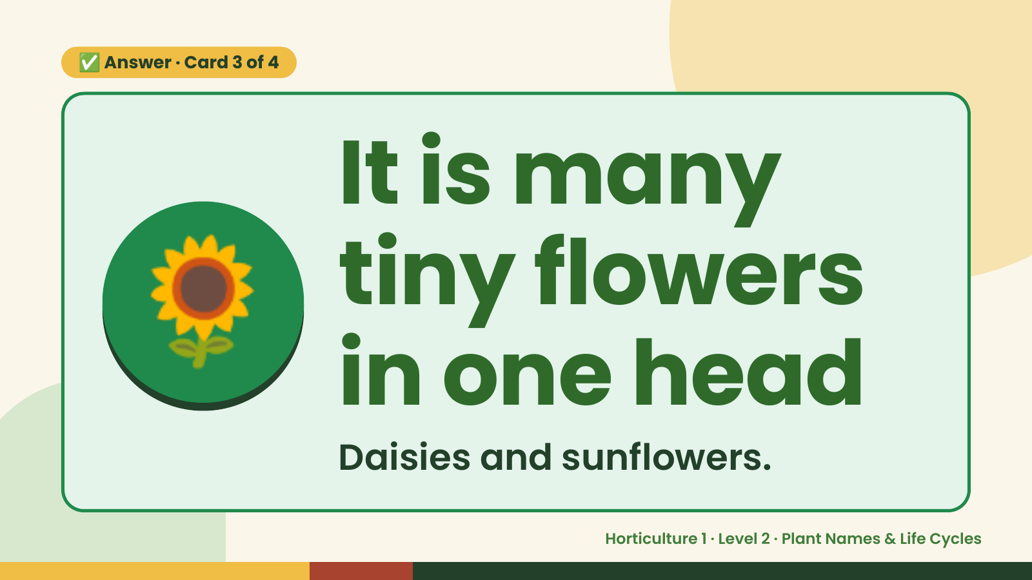
Notes:
✅ Answer · Card 3 of 4
🌻 It is many
tiny flowers
in one head
Daisies and sunflowers.
Horticulture 1 · Level 2 · Plant Names & Life Cycles

Slide 14
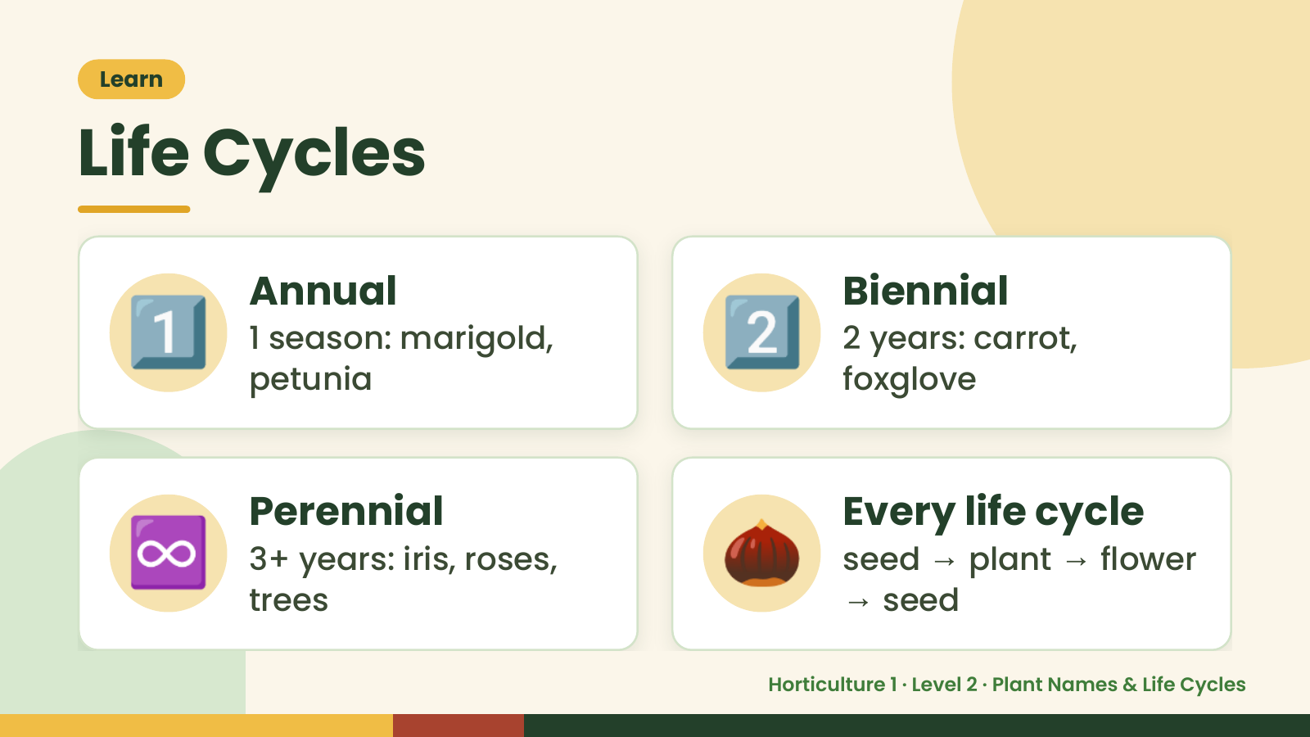
Notes:
Learn
Life Cycles
1️⃣ Annual
1 season: marigold,
petunia
2️⃣ Biennial
2 years: carrot,
foxglove
♾️ Perennial
3+ years: iris, roses,
trees
🌰 Every life cycle
seed → plant → flower
→ seed
Horticulture 1 · Level 2 · Plant Names & Life Cycles

Slide 15
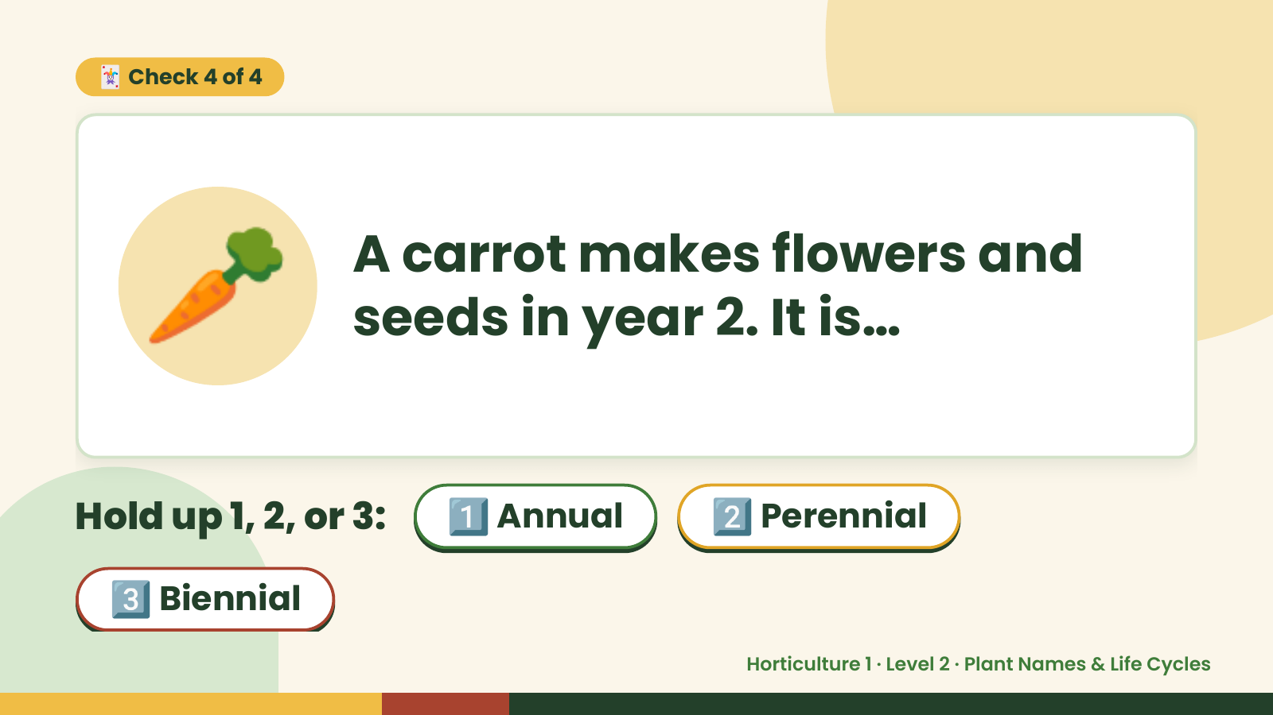
Notes:
🃏 Check 4 of 4
🥕 A carrot makes flowers and
seeds in year 2. It is…
Hold up 1, 2, or 3: 1️⃣ Annual 2️⃣ Perennial
3️⃣ Biennial
Horticulture 1 · Level 2 · Plant Names & Life Cycles

Slide 16
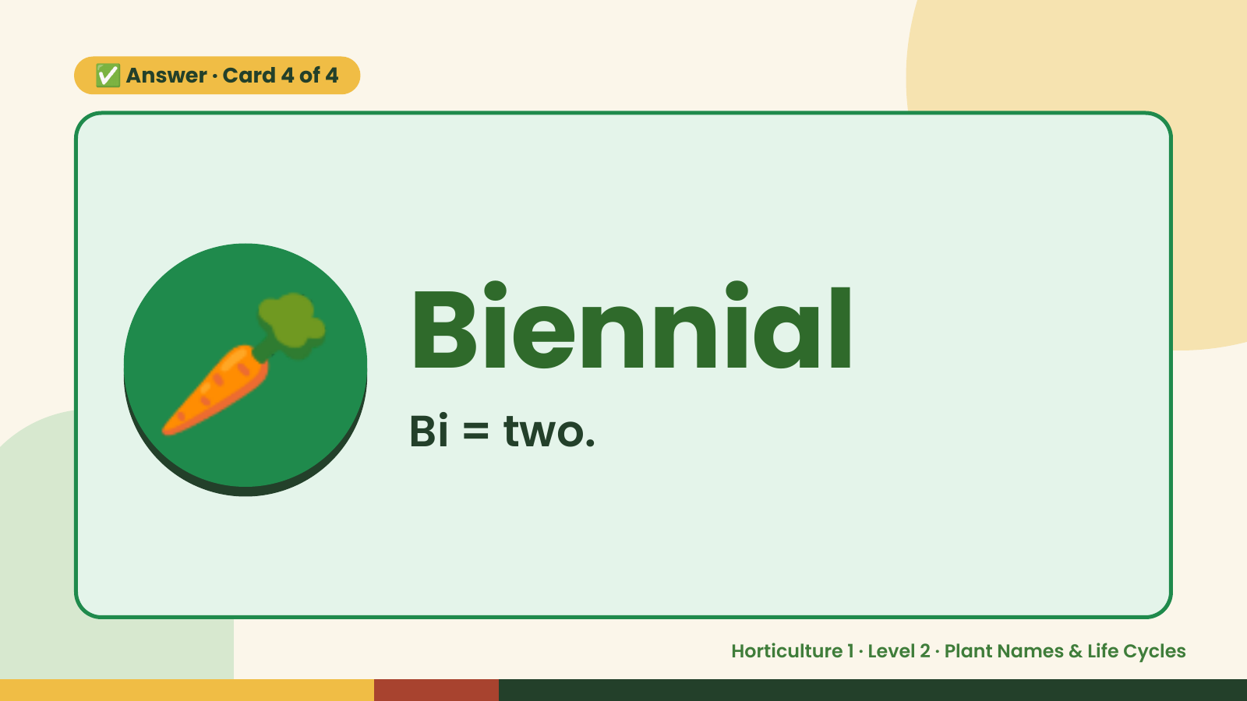
Notes:
✅ Answer · Card 4 of 4
🥕 Biennial
Bi = two.
Horticulture 1 · Level 2 · Plant Names & Life Cycles

Slide 17
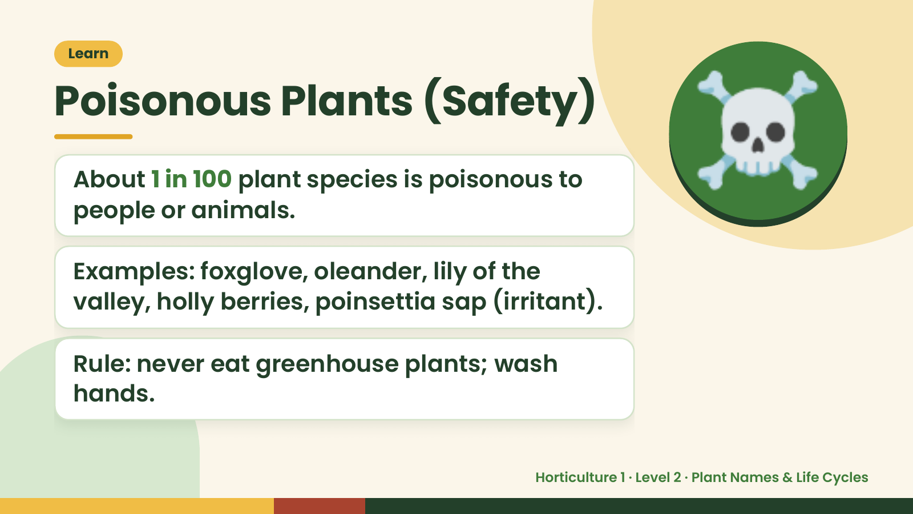
Notes:
Learn
Poisonous Plants (Safety)
About 1 in 100 plant species is poisonous to
people or animals.
Examples: foxglove, oleander, lily of the
☠️
valley, holly berries, poinsettia sap (irritant).
Rule: never eat greenhouse plants; wash
hands.
Horticulture 1 · Level 2 · Plant Names & Life Cycles

Slide 18
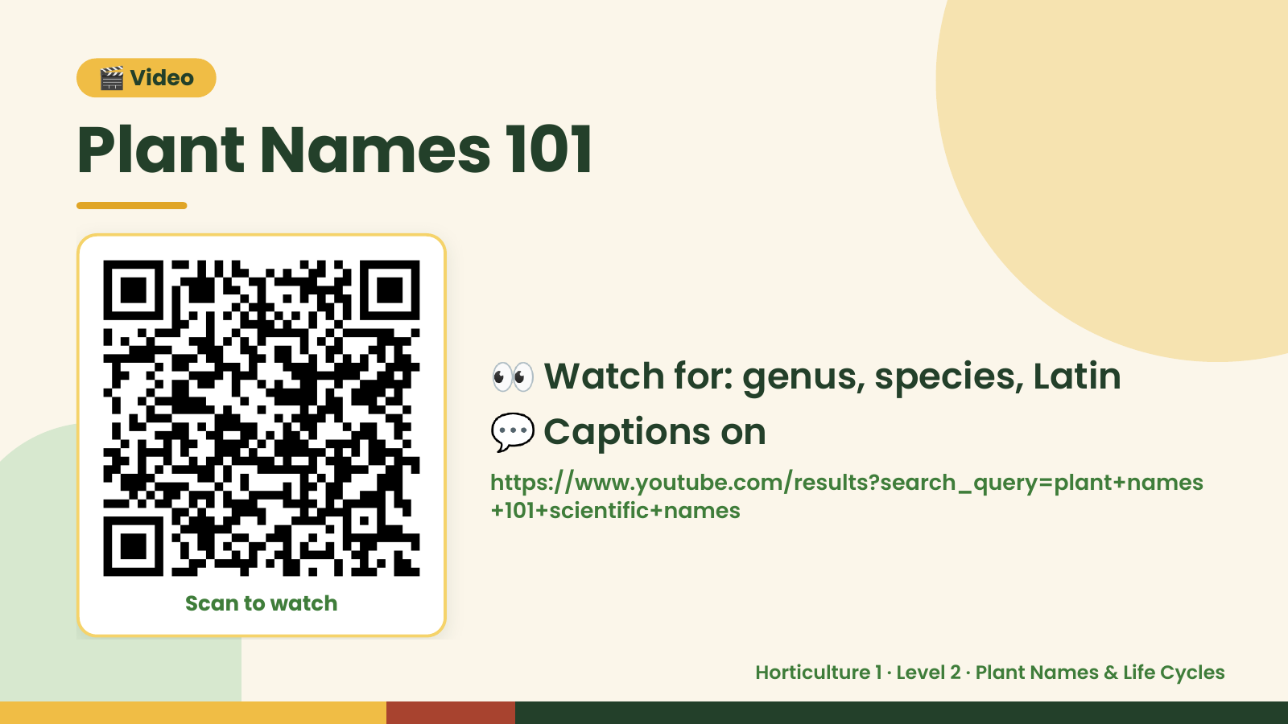
Notes:
🎬 Video
Plant Names 101
👀 Watch for: genus, species, Latin
💬 Captions on
https://www.youtube.com/results?search_query=plant+names
+101+scientific+names
Scan to watch
Horticulture 1 · Level 2 · Plant Names & Life Cycles

Slide 19
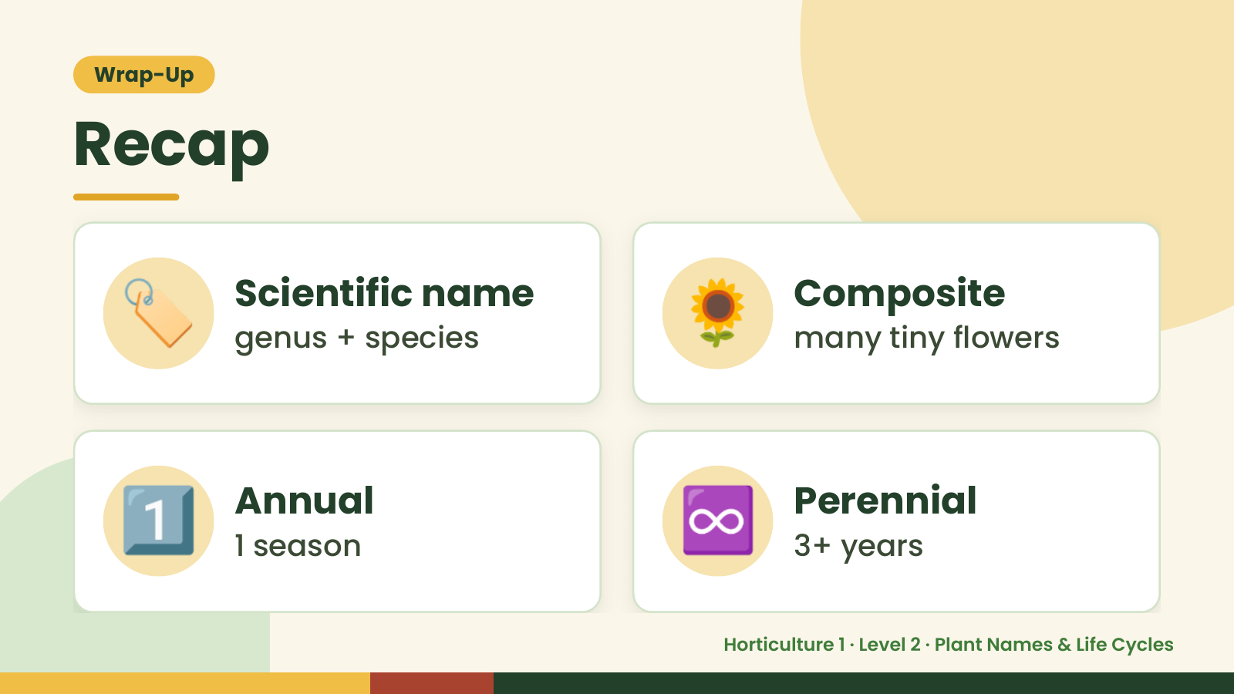
Notes:
Wrap-Up
Recap
🏷️ Scientific name
genus + species 🌻 Composite
many tiny flowers
1️⃣ Annual
1 season ♾️ Perennial
3+ years
Horticulture 1 · Level 2 · Plant Names & Life Cycles

Slide 20
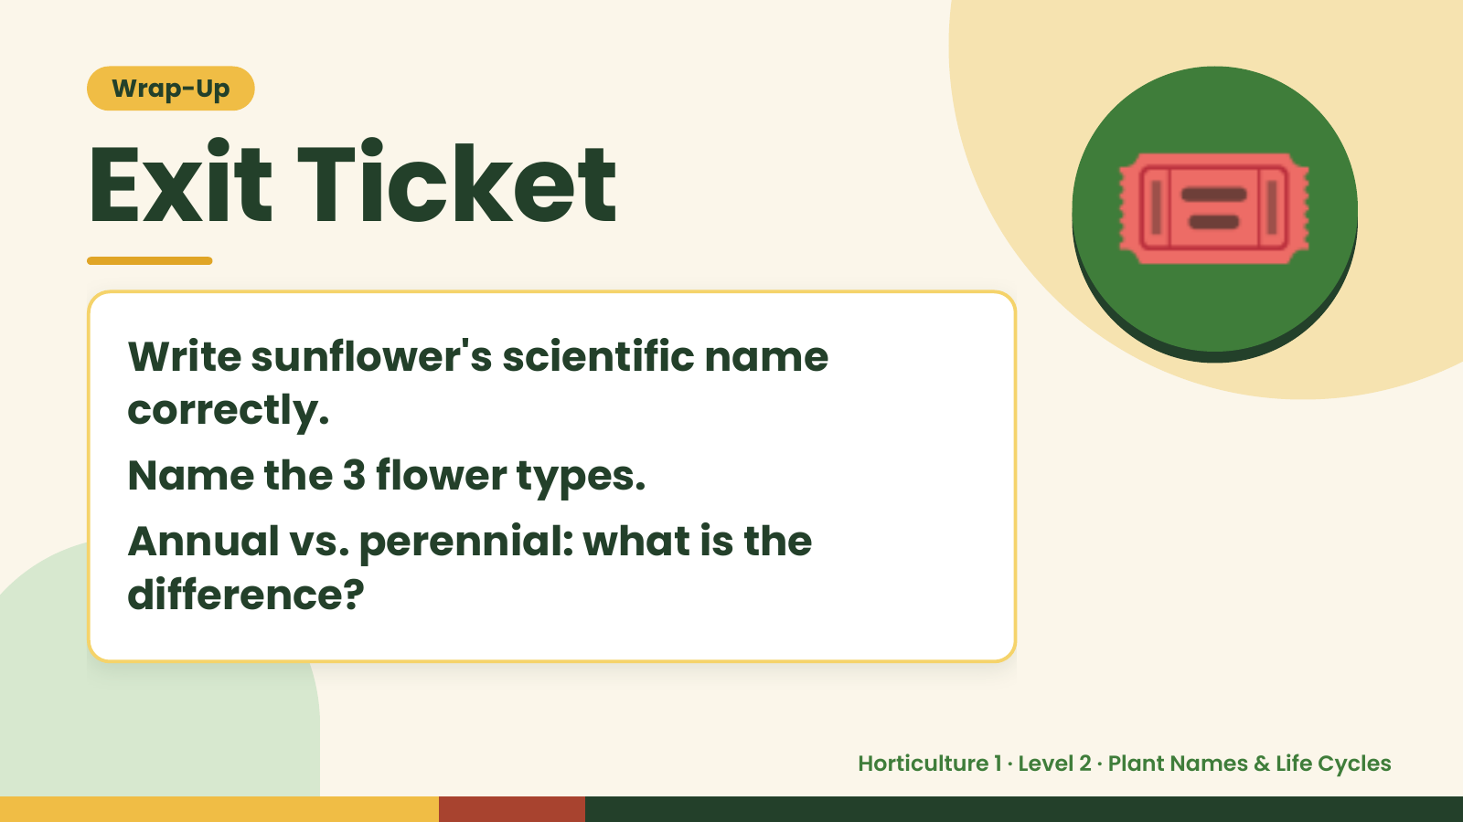
Notes:
Wrap-Up
Exit Ticket
Write sunflower's scientific name
correctly.
🎟️
Name the 3 flower types.
Annual vs. perennial: what is the
difference?
Horticulture 1 · Level 2 · Plant Names & Life Cycles

