Slide 1
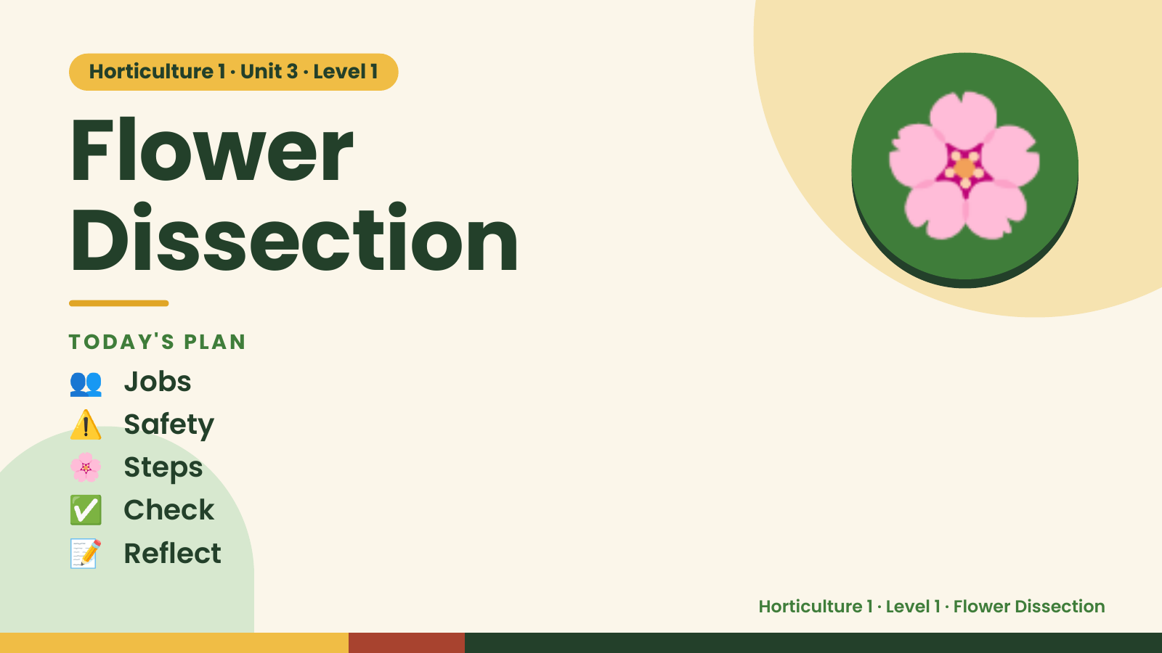
Notes:
Horticulture 1 · Unit 3 · Level 1
Flower
Dissection
TODAY'S PLAN
🌸
👥 Jobs
⚠️ Safety
🌸 Steps
✅ Check
📝 Reflect
Horticulture 1 · Level 1 · Flower Dissection

Slide 2

Notes:
Get ready
Jobs
🧑‍🌾 Grower
plants 🧺 Supply helper
gets tools
📸 Recorder
photos 🧽 Clean-up
captain
cleans
Horticulture 1 · Level 1 · Flower Dissection

Slide 3
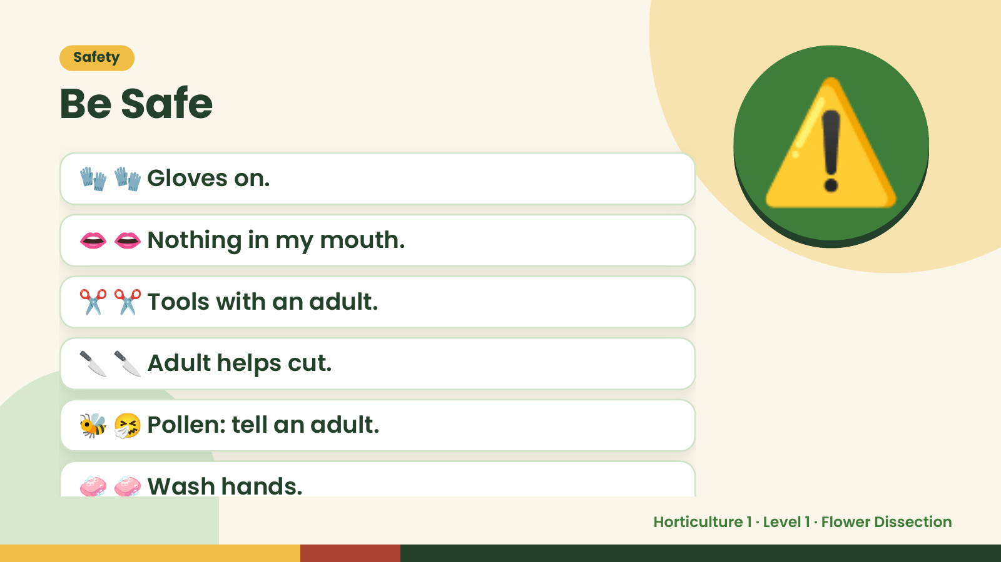
Notes:
Safety
Be Safe
🧤 🧤 Gloves on.
👄 👄 Nothing in my mouth.
✂️ ✂️ Tools with an adult.
⚠️
🔪 🔪 Adult helps cut.
🐝 🤧 Pollen: tell an adult.
🧼 🧼 Wash hands.
Horticulture 1 · Level 1 · Flower Dissection

Slide 4
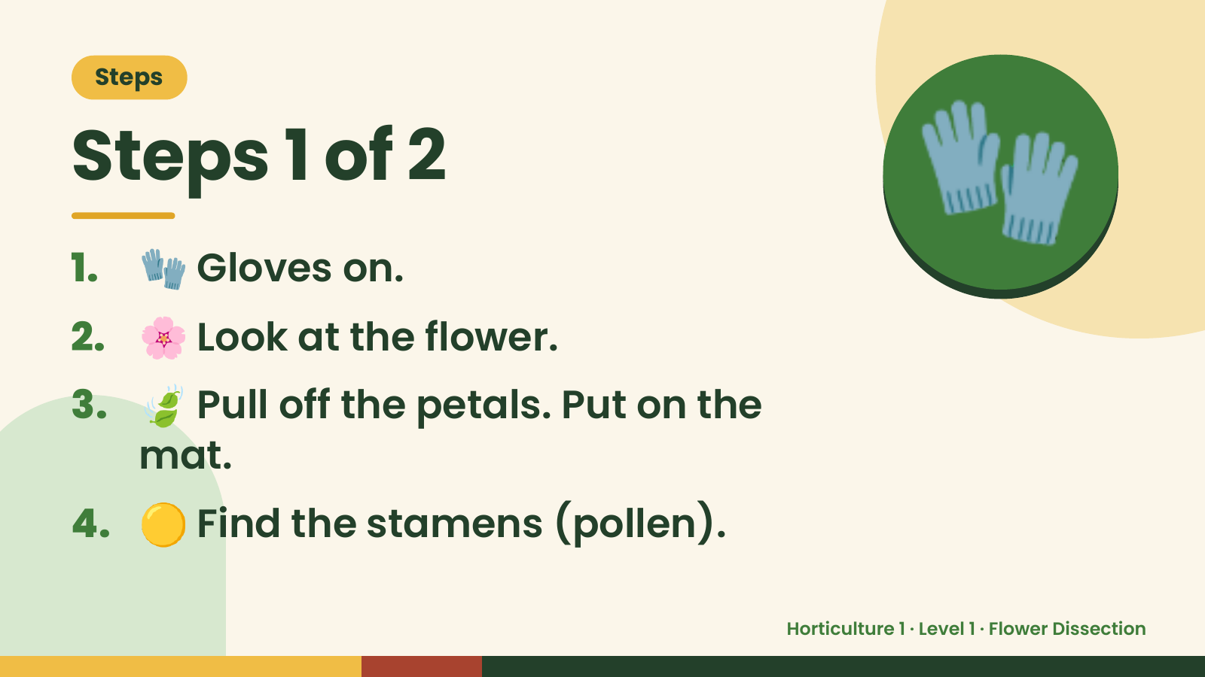
Notes:
Steps
Steps 1 of 2
1. 🧤 Gloves on.
2. 🌸 Look at the flower.
🧤
3. 🍃 Pull off the petals. Put on the
mat.
4. 🟡 Find the stamens (pollen).
Horticulture 1 · Level 1 · Flower Dissection

Slide 5
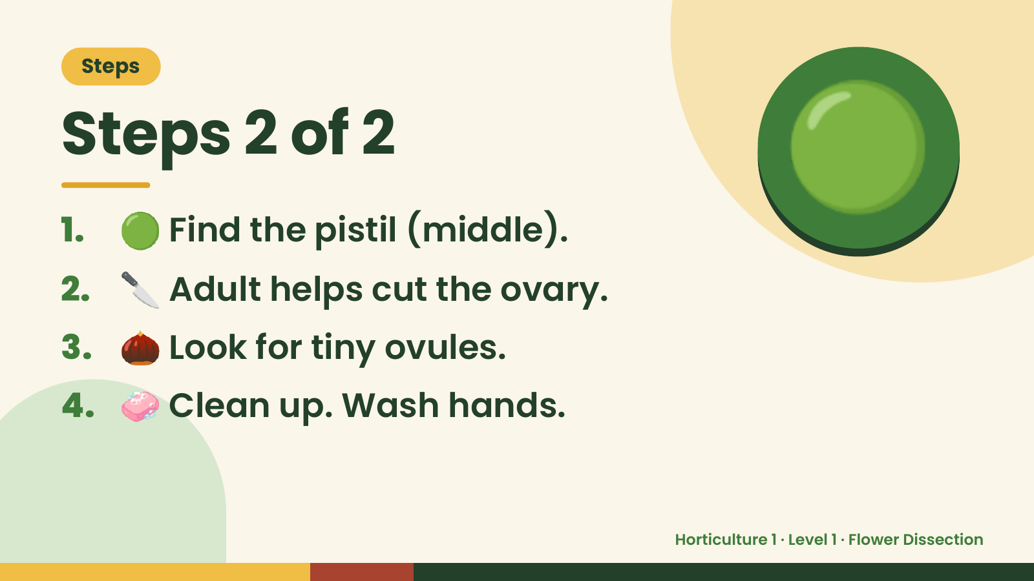
Notes:
Steps
Steps 2 of 2
1. 🟢 Find the pistil (middle).
2. 🔪 Adult helps cut the ovary.
🟢
3. 🌰 Look for tiny ovules.
4. 🧼 Clean up. Wash hands.
Horticulture 1 · Level 1 · Flower Dissection

Slide 6
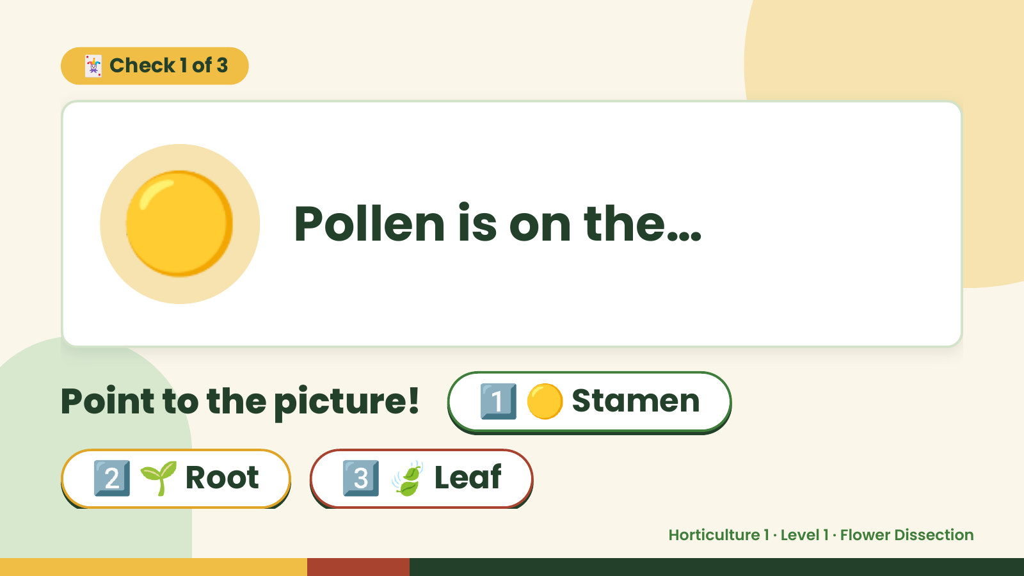
Notes:
🃏 Check 1 of 3
🟡 Pollen is on the…
Point to the picture! 1️⃣ 🟡 Stamen
2️⃣ 🌱 Root 3️⃣ 🍃 Leaf
Horticulture 1 · Level 1 · Flower Dissection

Slide 7
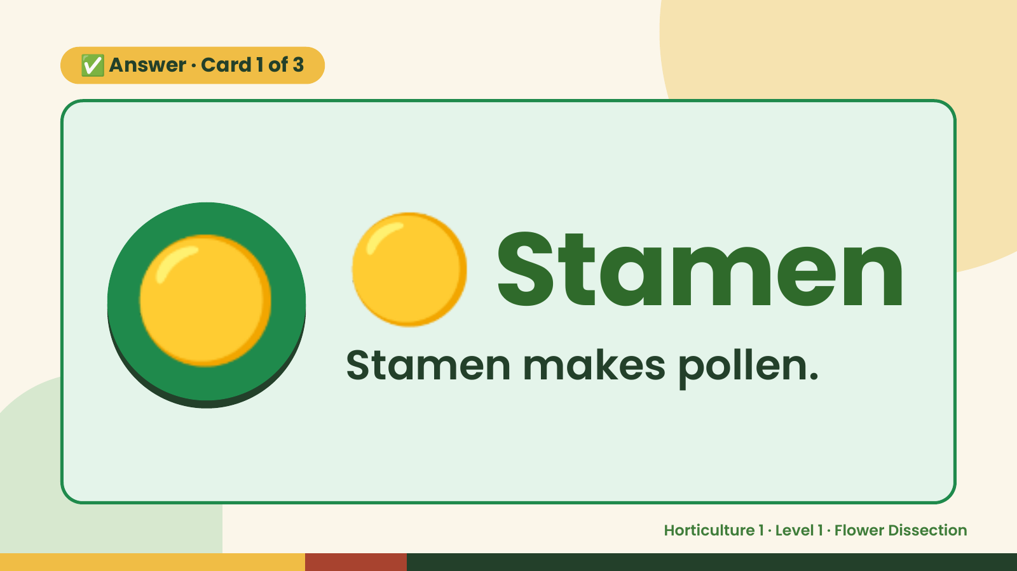
Notes:
✅ Answer · Card 1 of 3
🟡 🟡 Stamen
Stamen makes pollen.
Horticulture 1 · Level 1 · Flower Dissection

Slide 8
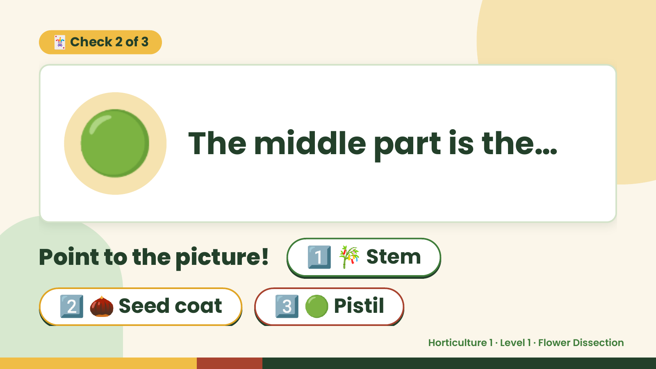
Notes:
🃏 Check 2 of 3
🟢 The middle part is the…
Point to the picture! 1️⃣ 🎋 Stem
2️⃣ 🌰 Seed coat 3️⃣ 🟢 Pistil
Horticulture 1 · Level 1 · Flower Dissection

Slide 9
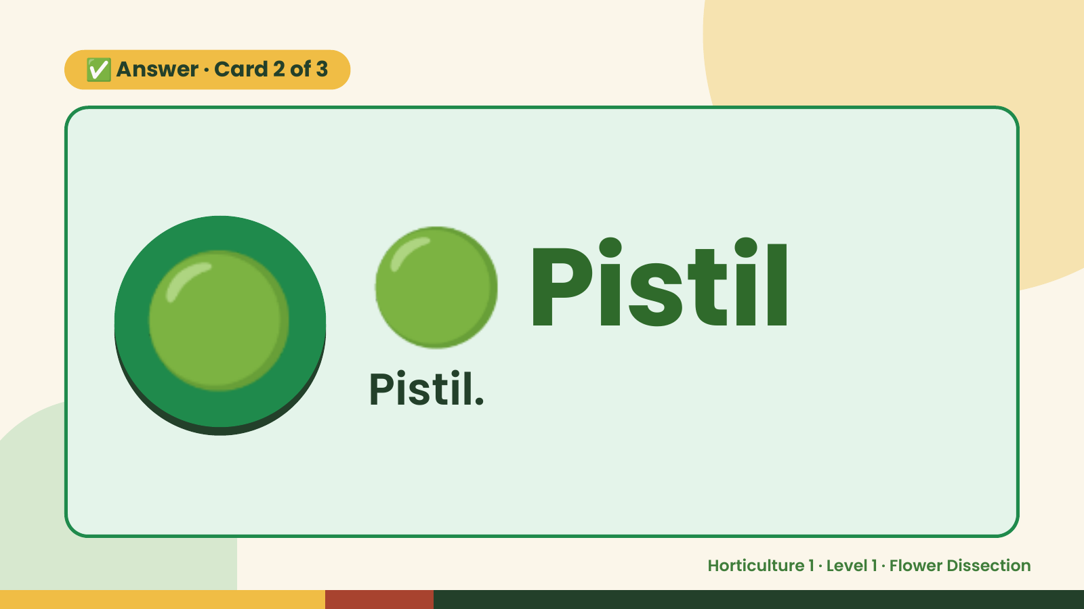
Notes:
✅ Answer · Card 2 of 3
🟢 🟢 Pistil
Pistil.
Horticulture 1 · Level 1 · Flower Dissection

Slide 10
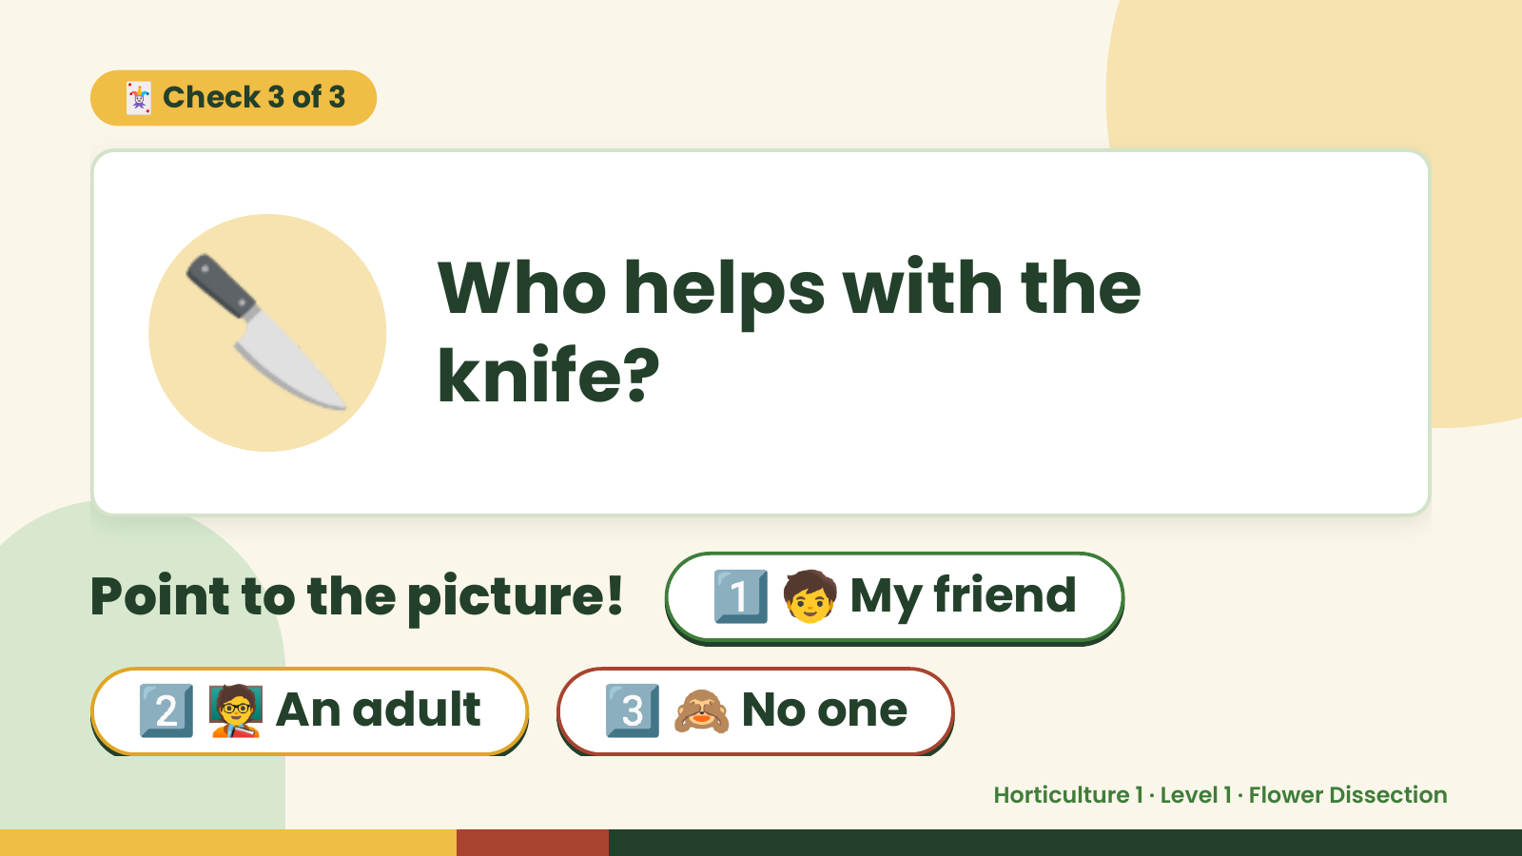
Notes:
🃏 Check 3 of 3
🔪 Who helps with the
knife?
Point to the picture! 1️⃣ 🧒 My friend
2️⃣ 🧑‍🏫 An adult 3️⃣ 🙈 No one
Horticulture 1 · Level 1 · Flower Dissection

Slide 11
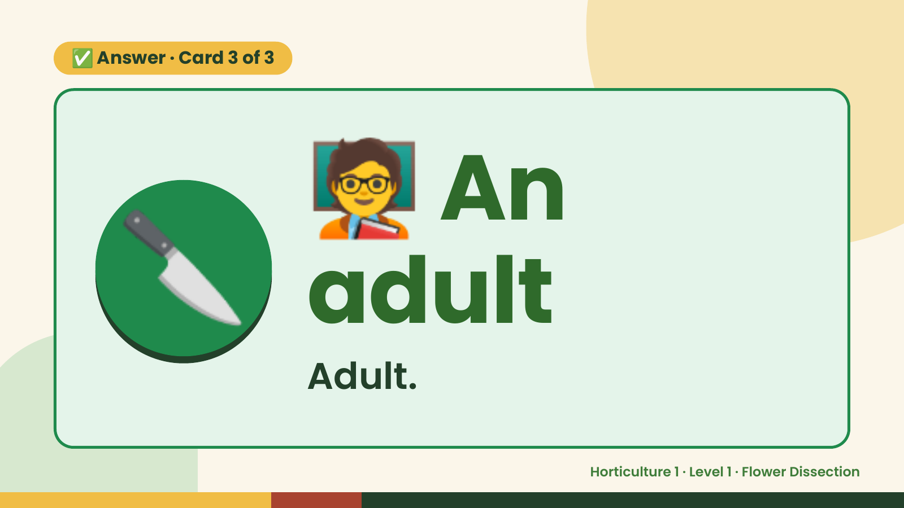
Notes:
🧑‍🏫
✅ Answer · Card 3 of 3
🔪 adult
An
Adult.
Horticulture 1 · Level 1 · Flower Dissection

Slide 12

Notes:
Wrap-Up
Clean Up +
Reflect
🧽
🧽 Clean the table.
🧰 Give tools back.
🧼 Wash hands.
Horticulture 1 · Level 1 · Flower Dissection

