Slide 1
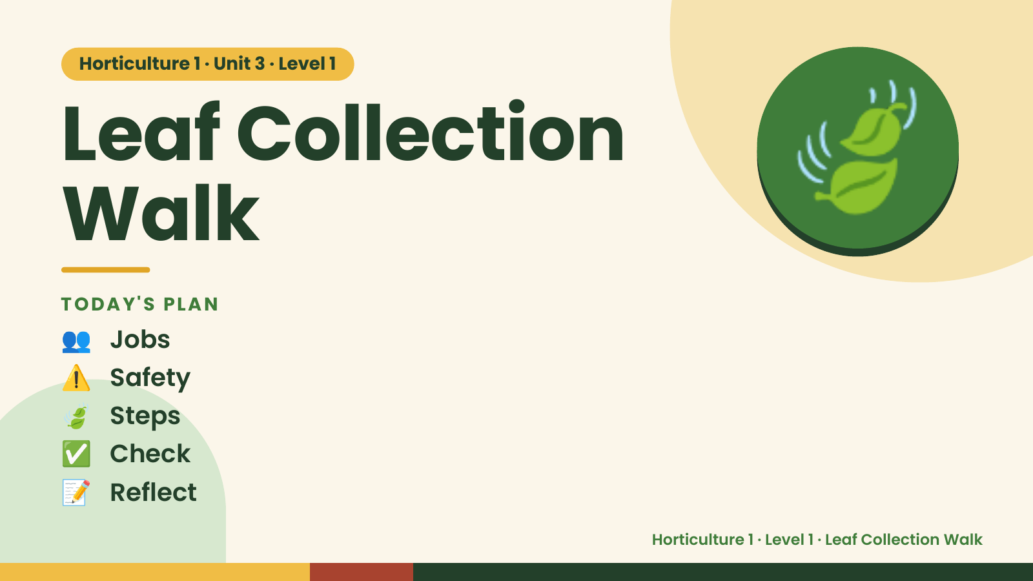
Notes:
Horticulture 1 · Unit 3 · Level 1
Leaf Collection
Walk
TODAY'S PLAN
🍃
👥 Jobs
⚠️ Safety
🍃 Steps
✅ Check
📝 Reflect
Horticulture 1 · Level 1 · Leaf Collection Walk

Slide 2

Notes:
Get ready
Jobs
🧑‍🌾 Grower
plants 🧺 Supply helper
gets tools
📸 Recorder
photos 🧽 Clean-up
captain
cleans
Horticulture 1 · Level 1 · Leaf Collection Walk

Slide 3
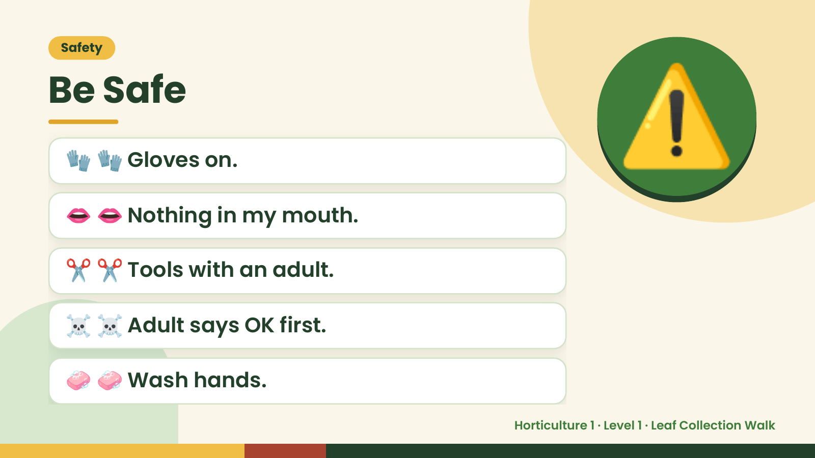
Notes:
Safety
Be Safe
🧤 🧤 Gloves on.
👄 👄 Nothing in my mouth.
⚠️
✂️ ✂️ Tools with an adult.
☠️ ☠️ Adult says OK first.
🧼 🧼 Wash hands.
Horticulture 1 · Level 1 · Leaf Collection Walk

Slide 4
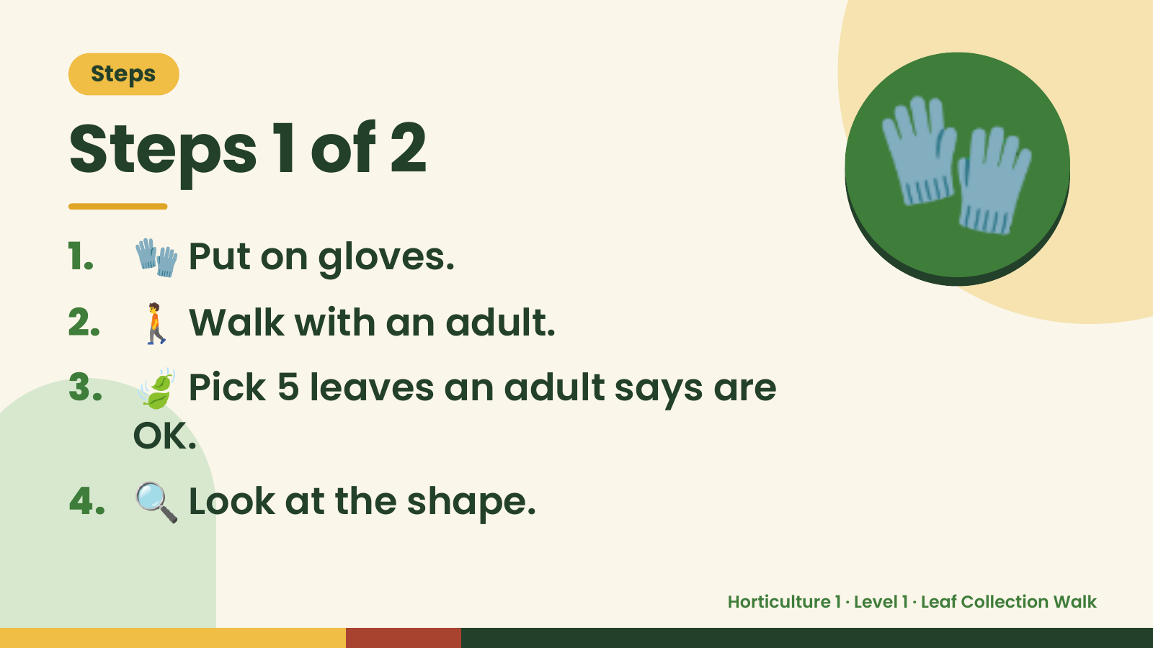
Notes:
Steps
Steps 1 of 2
1. 🧤 Put on gloves.
2. 🚶 Walk with an adult.
🧤
3. 🍃 Pick 5 leaves an adult says are
OK.
4. 🔍 Look at the shape.
Horticulture 1 · Level 1 · Leaf Collection Walk

Slide 5
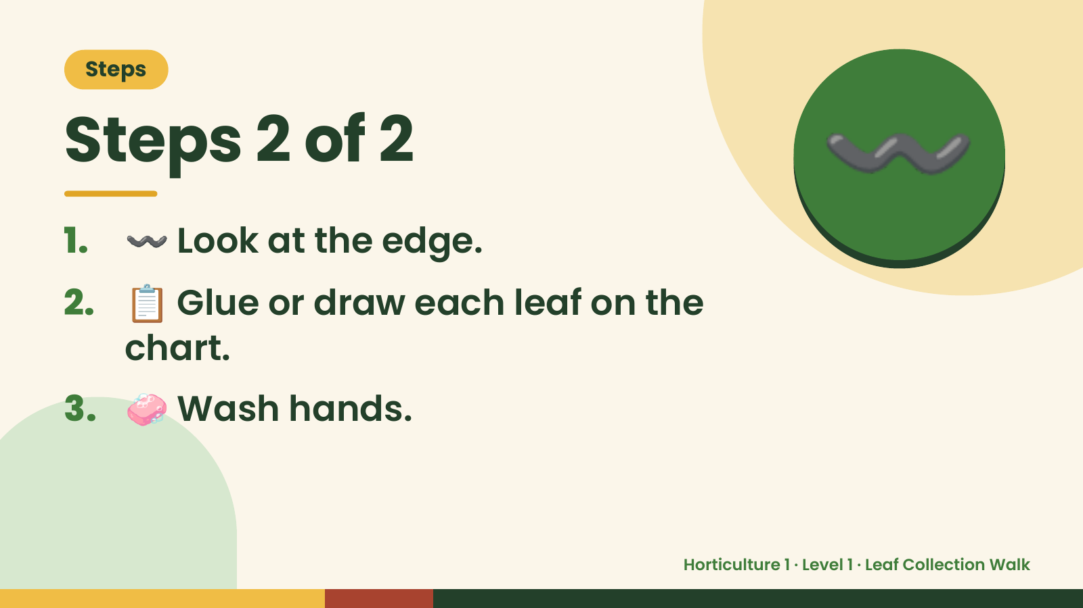
Notes:
Steps
Steps 2 of 2
1. 〰️ Look at the edge.
2. 📋 Glue or draw each leaf on the
〰️
chart.
3. 🧼 Wash hands.
Horticulture 1 · Level 1 · Leaf Collection Walk

Slide 6
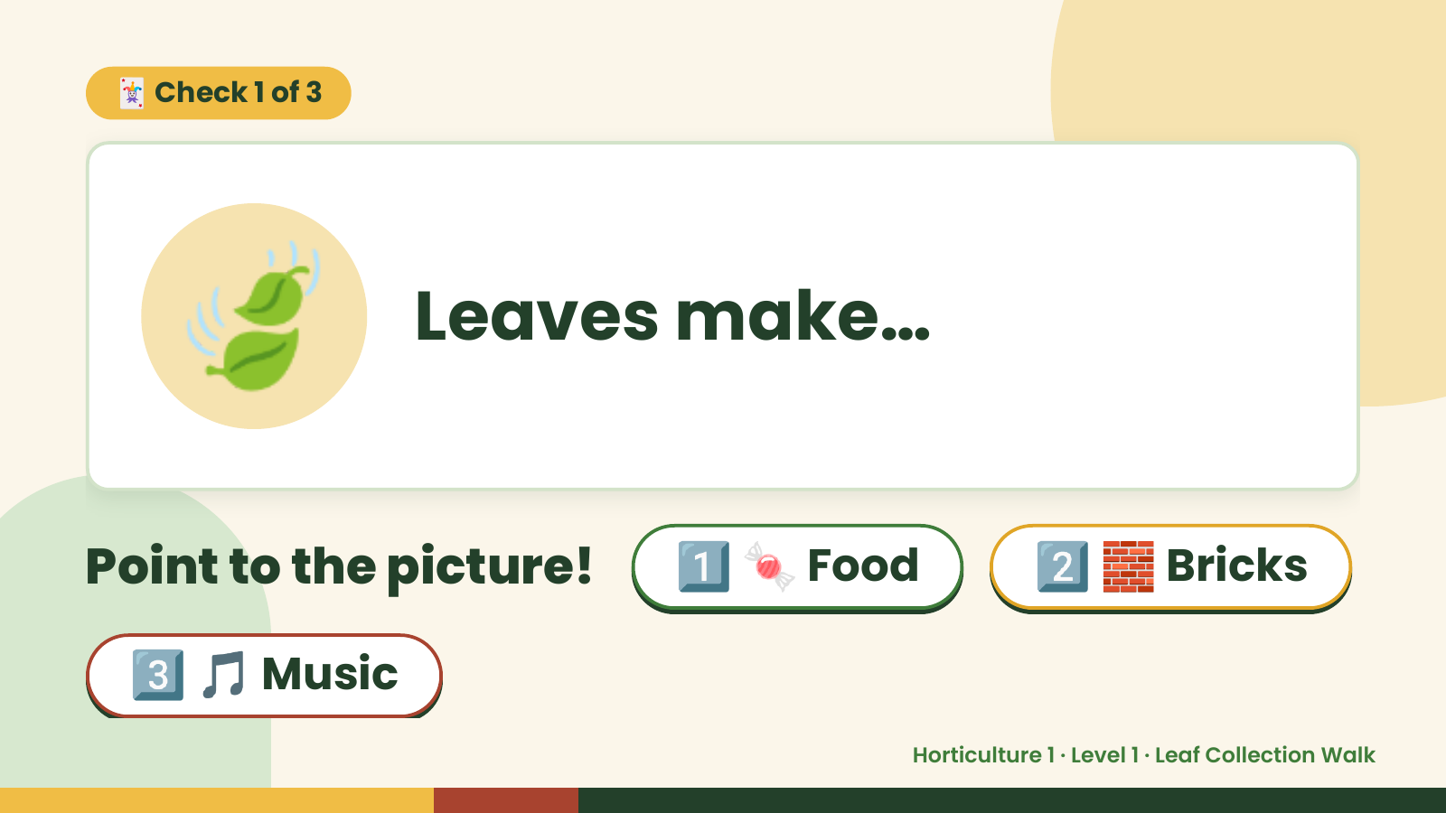
Notes:
🃏 Check 1 of 3
🍃 Leaves make…
Point to the picture! 1️⃣ 🍬 Food 2️⃣ 🧱 Bricks
3️⃣ 🎵 Music
Horticulture 1 · Level 1 · Leaf Collection Walk

Slide 7
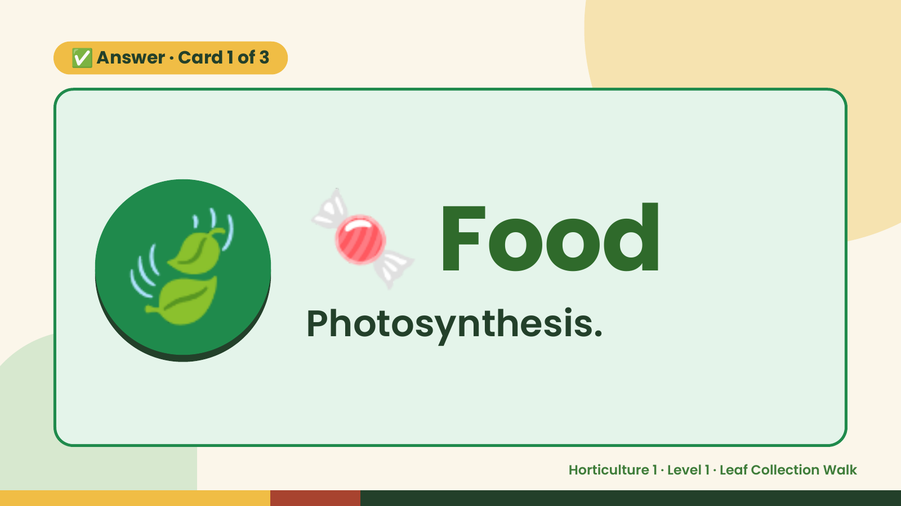
Notes:
✅ Answer · Card 1 of 3
🍃 🍬 Food
Photosynthesis.
Horticulture 1 · Level 1 · Leaf Collection Walk

Slide 8
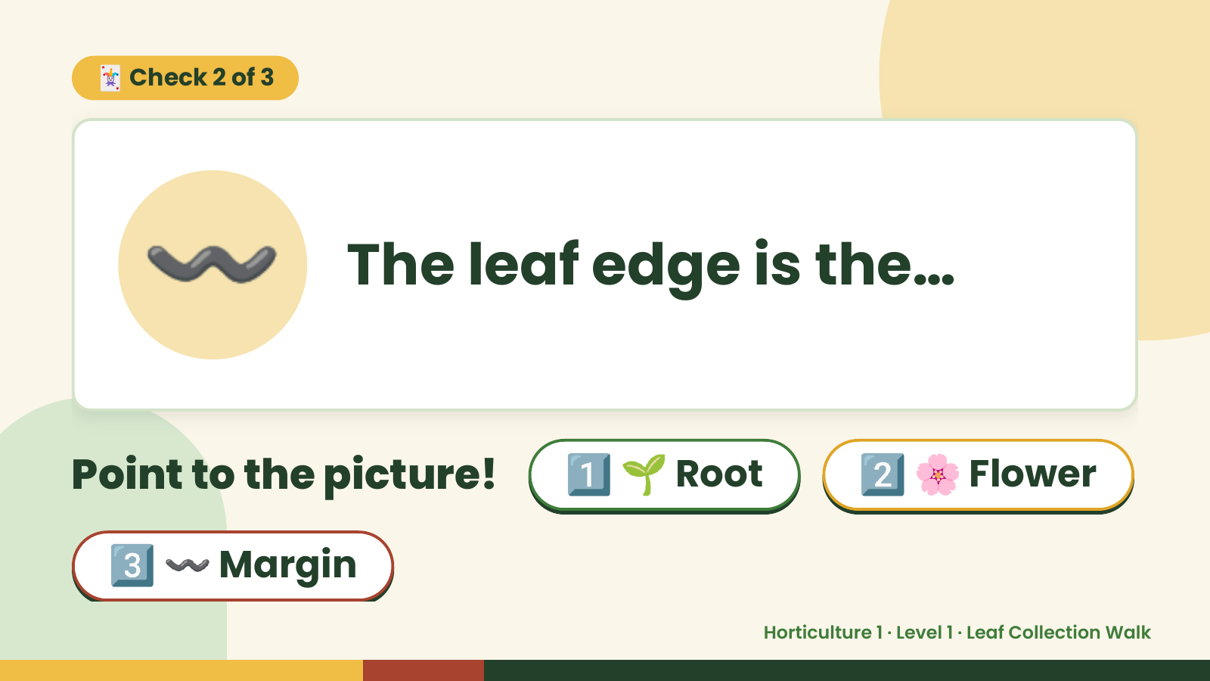
Notes:
🃏 Check 2 of 3
〰️ The leaf edge is the…
Point to the picture! 1️⃣ 🌱 Root 2️⃣ 🌸 Flower
3️⃣ 〰️ Margin
Horticulture 1 · Level 1 · Leaf Collection Walk

Slide 9
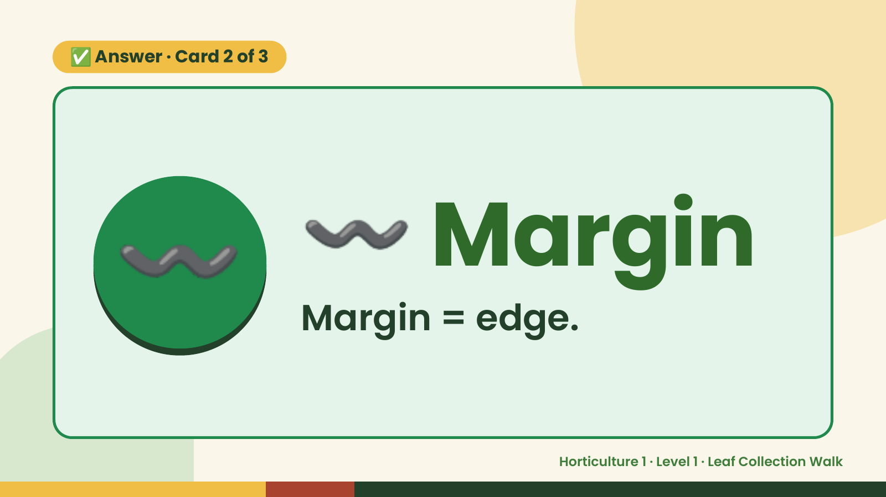
Notes:
✅ Answer · Card 2 of 3
〰️ 〰️ Margin
Margin = edge.
Horticulture 1 · Level 1 · Leaf Collection Walk

Slide 10
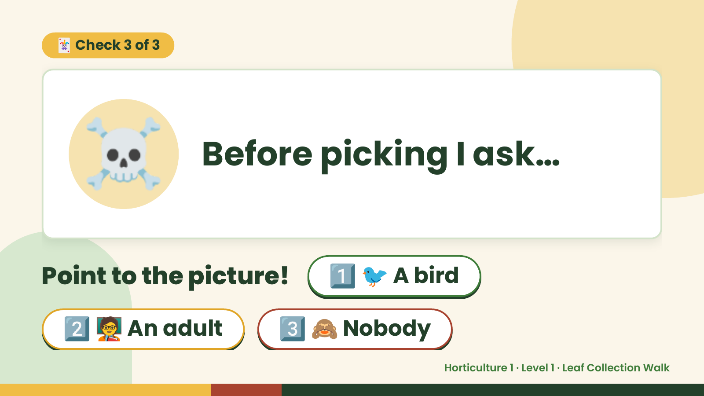
Notes:
🃏 Check 3 of 3
☠️ Before picking I ask…
Point to the picture! 1️⃣ 🐦 A bird
2️⃣ 🧑‍🏫 An adult 3️⃣ 🙈 Nobody
Horticulture 1 · Level 1 · Leaf Collection Walk

Slide 11
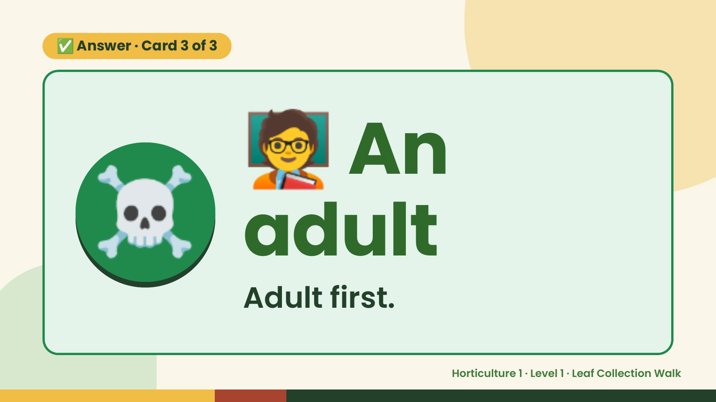
Notes:
🧑‍🏫
✅ Answer · Card 3 of 3
☠️ adult
An
Adult first.
Horticulture 1 · Level 1 · Leaf Collection Walk

Slide 12

Notes:
Wrap-Up
Clean Up +
Reflect
🧽
🧽 Clean the table.
🧰 Give tools back.
🧼 Wash hands.
Horticulture 1 · Level 1 · Leaf Collection Walk

