Slide 1
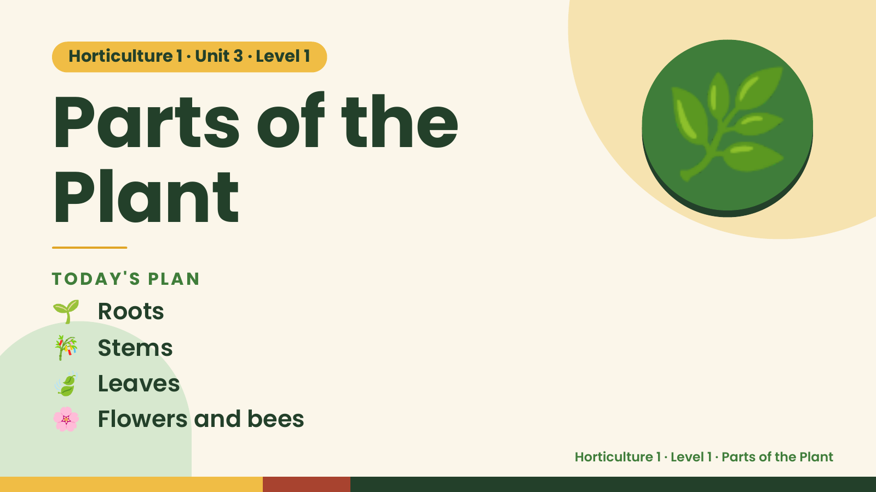
Notes:
Horticulture 1 · Unit 3 · Level 1
Parts of the
Plant
🌿
🌱 Roots
TODAY'S PLAN
🎋 Stems
🍃 Leaves
🌸 Flowers and bees
Horticulture 1 · Level 1 · Parts of the Plant

Slide 2
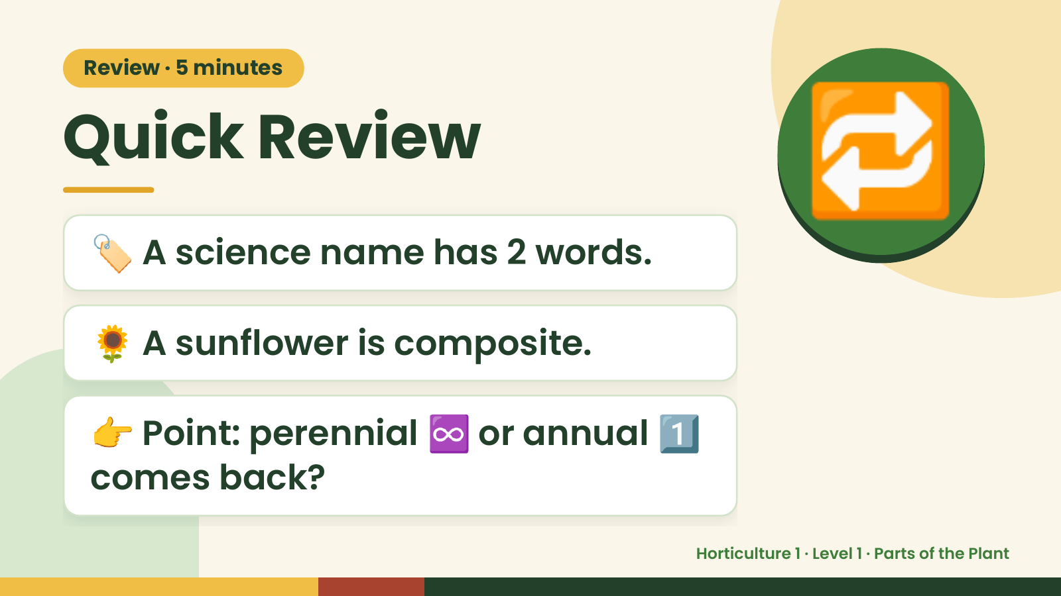
Notes:
Review · 5 minutes
Quick Review
🏷️ A science name has 2 words.
🔁
🌻 A sunflower is composite.
👉 Point: perennial ♾️ or annual 1️⃣
comes back?
Horticulture 1 · Level 1 · Parts of the Plant

Slide 3
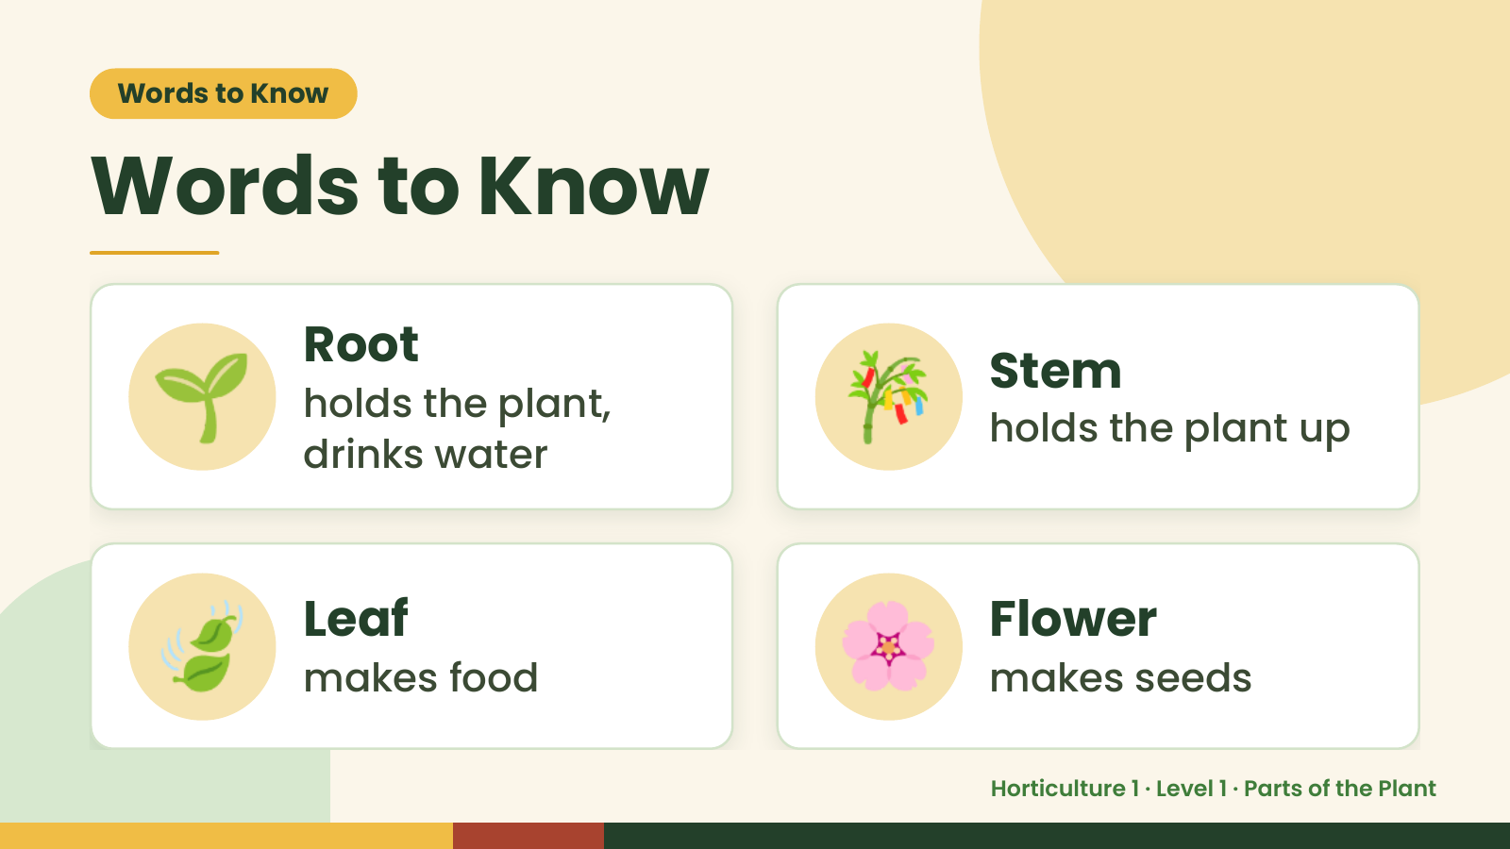
Notes:
Words to Know
Words to Know
🌱 Root
holds the plant,
drinks water
🎋 Stem
holds the plant up
🍃 Leaf
makes food 🌸 Flower
makes seeds
Horticulture 1 · Level 1 · Parts of the Plant

Slide 4
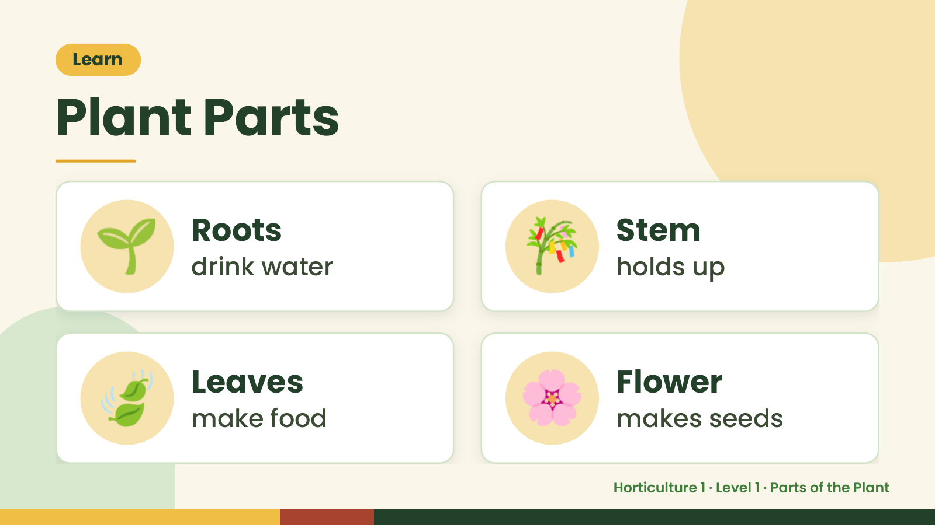
Notes:
Learn
Plant Parts
🌱 Roots
drink water 🎋 Stem
holds up
🍃 Leaves
make food 🌸 Flower
makes seeds
Horticulture 1 · Level 1 · Parts of the Plant

Slide 5
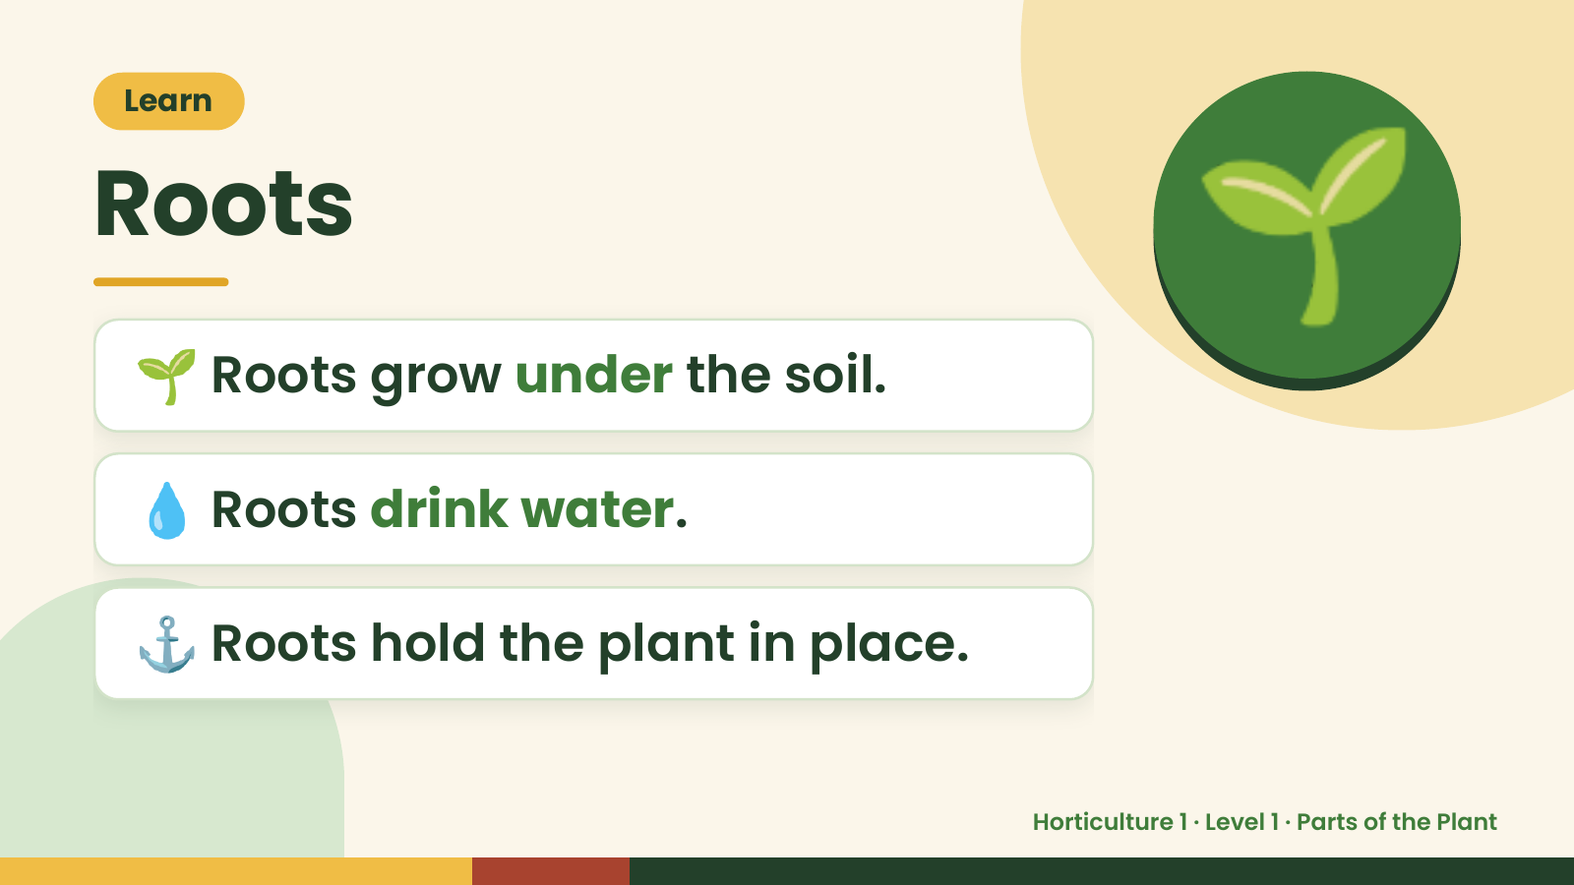
Notes:
Learn
Roots
🌱 Roots grow under the soil.
🌱
💧 Roots drink water.
⚓ Roots hold the plant in place.
Horticulture 1 · Level 1 · Parts of the Plant

Slide 6
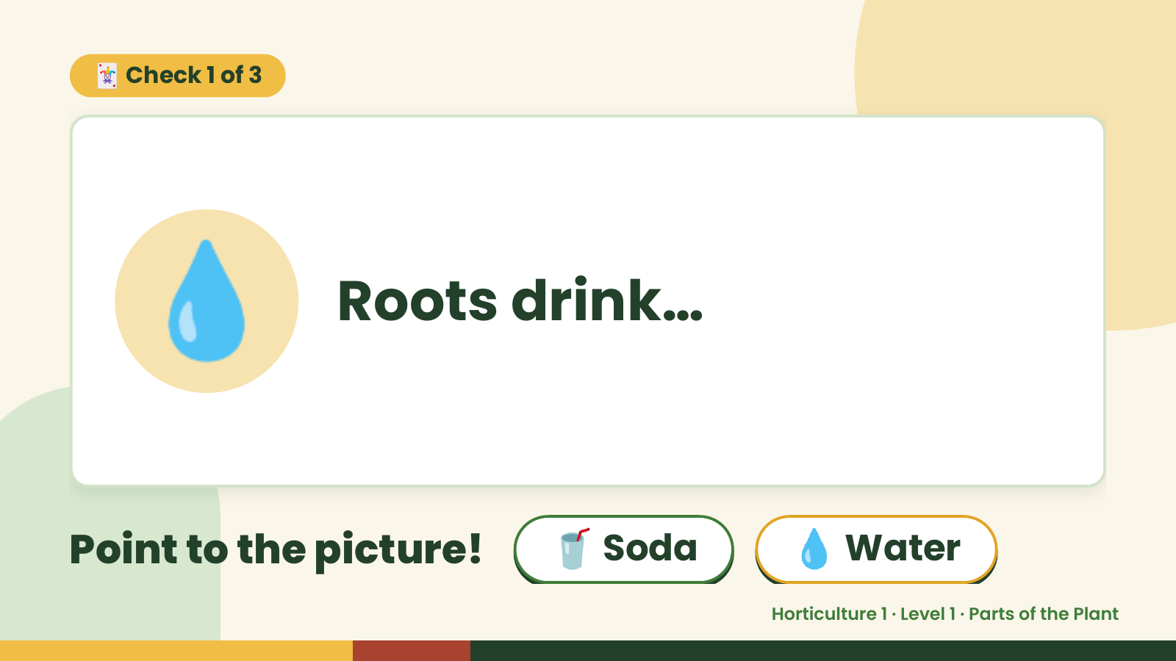
Notes:
🃏 Check 1 of 3
💧 Roots drink…
Point to the picture! 🥤 Soda 💧 Water
Horticulture 1 · Level 1 · Parts of the Plant

Slide 7
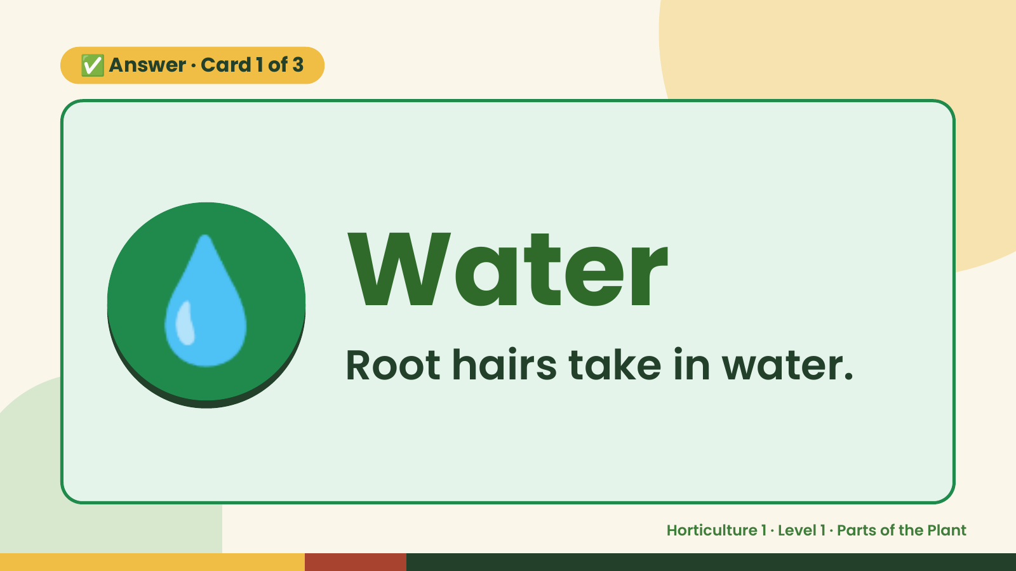
Notes:
✅ Answer · Card 1 of 3
💧 Water
Root hairs take in water.
Horticulture 1 · Level 1 · Parts of the Plant

Slide 8
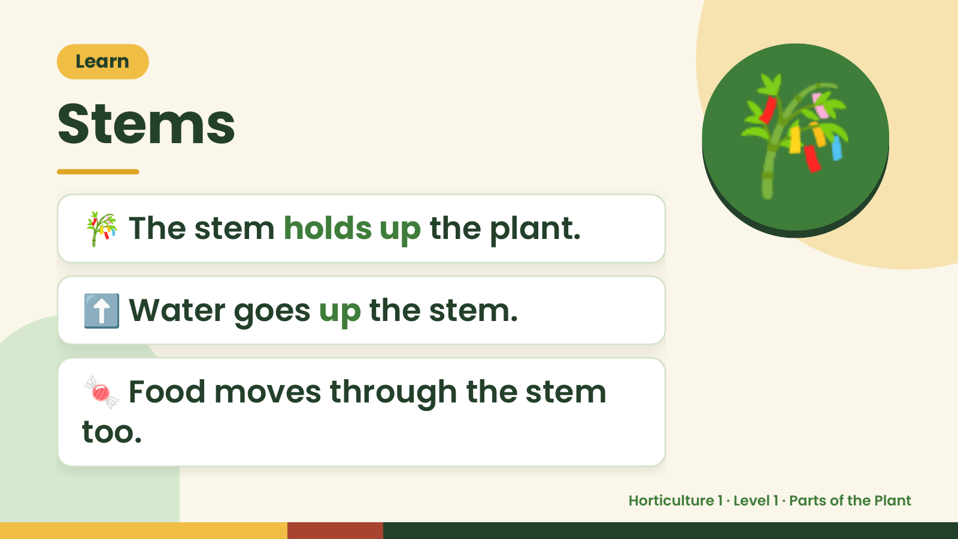
Notes:
Learn
Stems
🎋 The stem holds up the plant.
🎋
⬆️ Water goes up the stem.
🍬 Food moves through the stem
too.
Horticulture 1 · Level 1 · Parts of the Plant

Slide 9
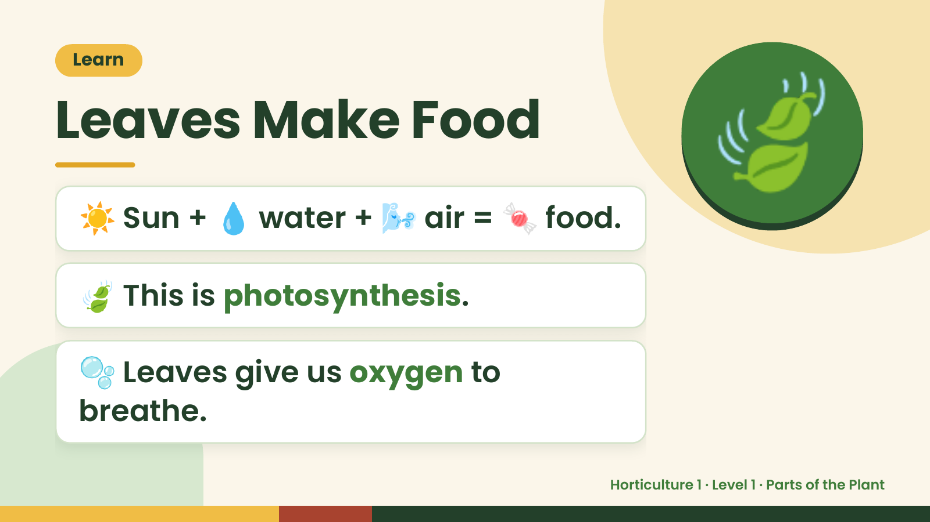
Notes:
Learn
Leaves Make Food
☀️ Sun + 💧 water + 🌬️ air = 🍬 food.
🍃
🍃 This is photosynthesis.
🫧 Leaves give us oxygen to
breathe.
Horticulture 1 · Level 1 · Parts of the Plant

Slide 10
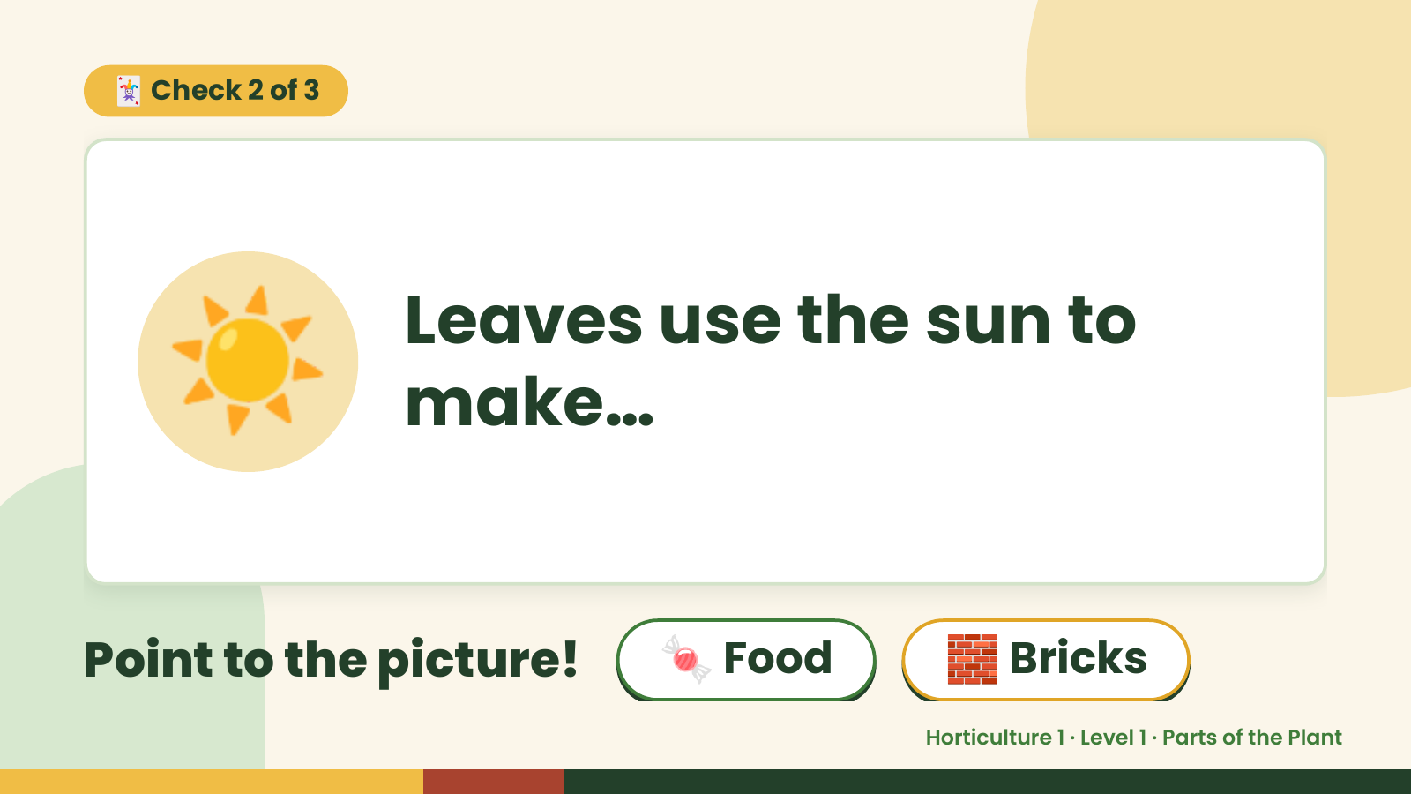
Notes:
🃏 Check 2 of 3
☀️ Leaves use the sun to
make…
Point to the picture! 🍬 Food 🧱 Bricks
Horticulture 1 · Level 1 · Parts of the Plant

Slide 11
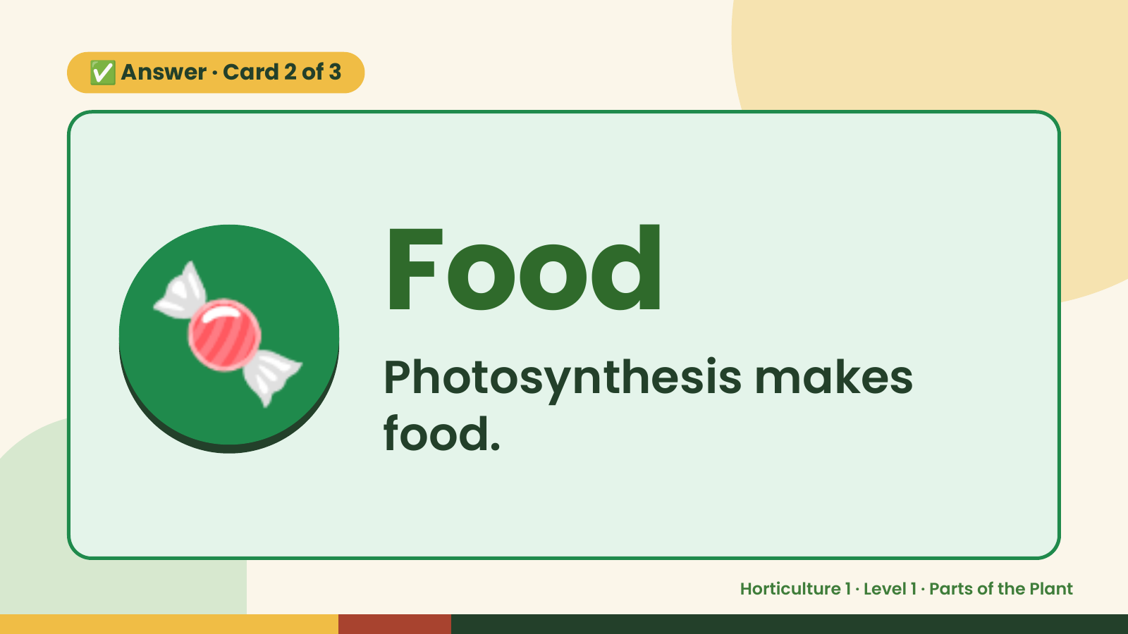
Notes:
✅ Answer · Card 2 of 3
🍬 Food
Photosynthesis makes
food.
Horticulture 1 · Level 1 · Parts of the Plant

Slide 12
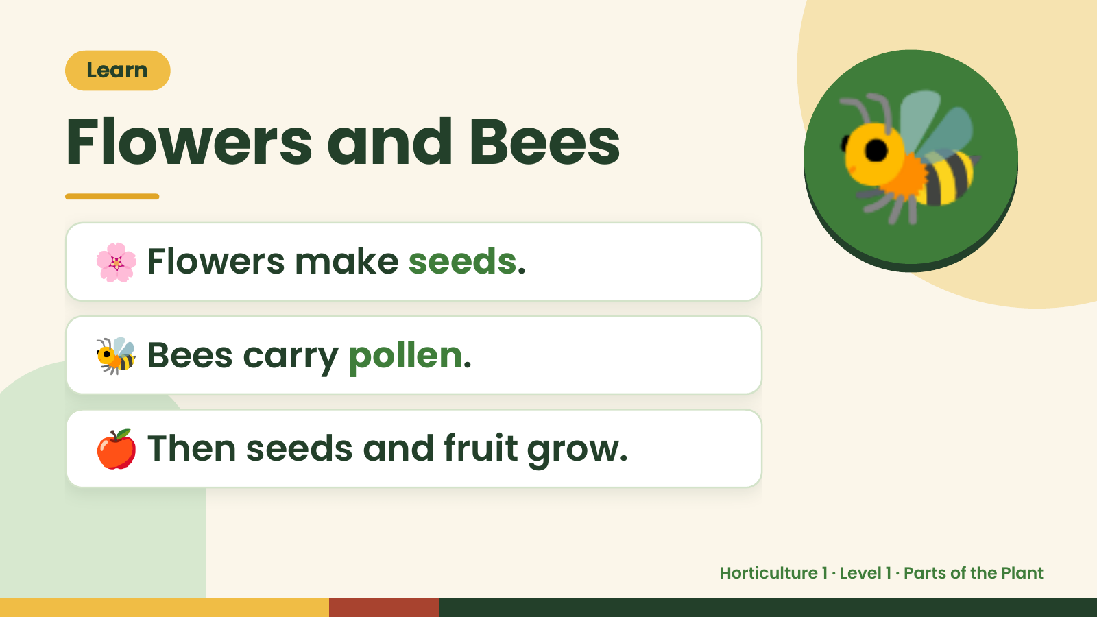
Notes:
Learn
Flowers and Bees
🌸 Flowers make seeds.
🐝
🐝 Bees carry pollen.
🍎 Then seeds and fruit grow.
Horticulture 1 · Level 1 · Parts of the Plant

Slide 13
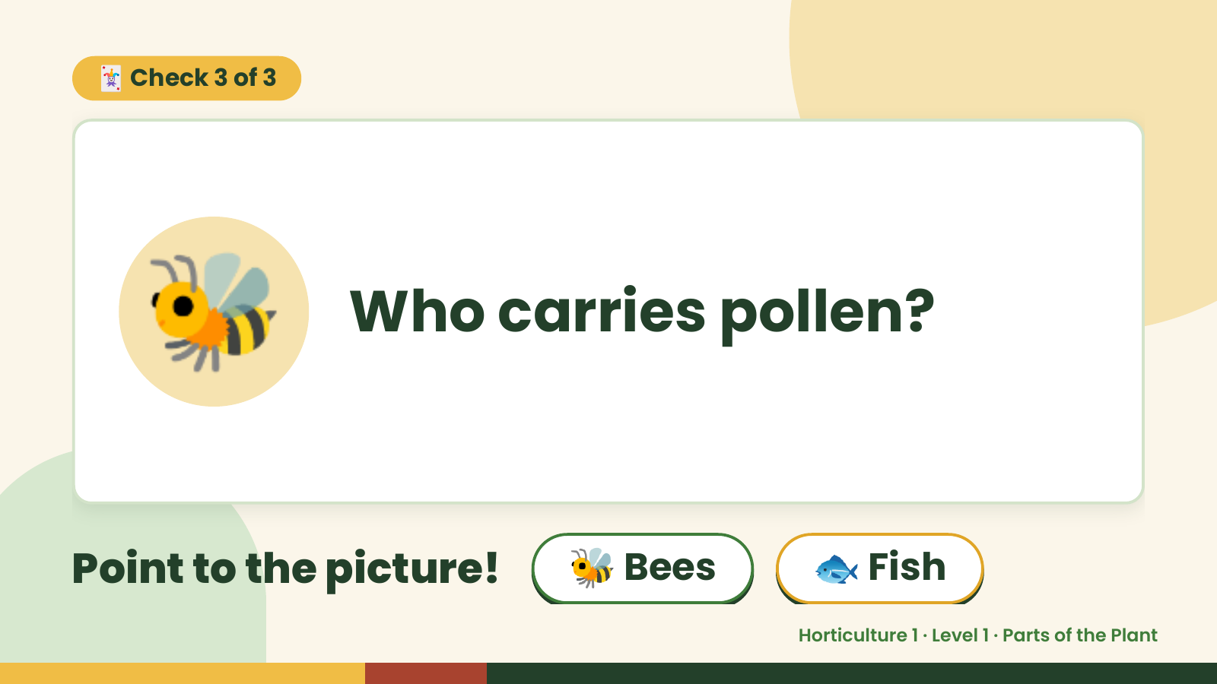
Notes:
🃏 Check 3 of 3
🐝 Who carries pollen?
Point to the picture! 🐝 Bees 🐟 Fish
Horticulture 1 · Level 1 · Parts of the Plant

Slide 14
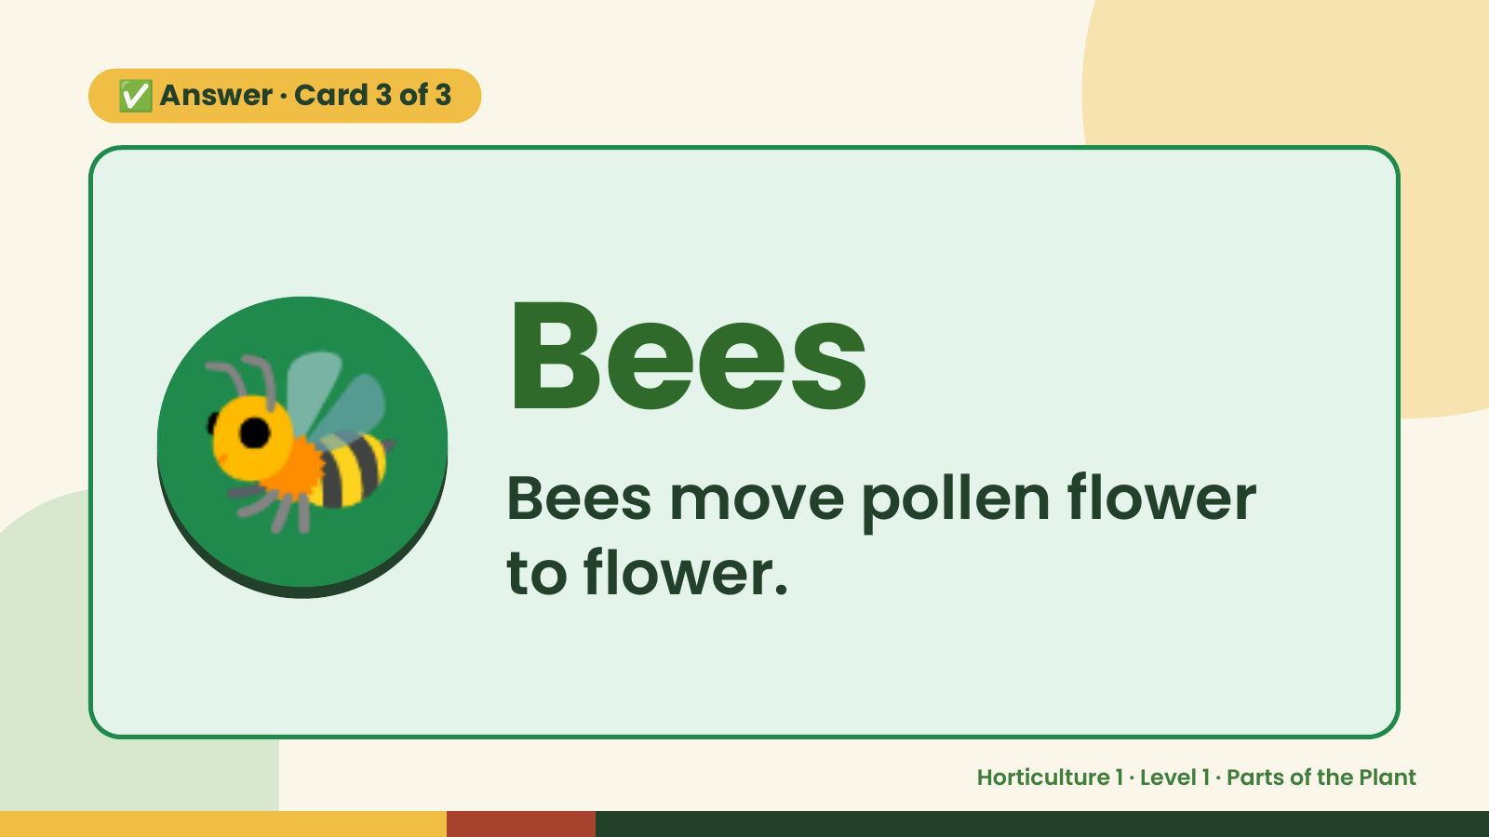
Notes:
✅ Answer · Card 3 of 3
🐝 Bees
Bees move pollen flower
to flower.
Horticulture 1 · Level 1 · Parts of the Plant

Slide 15
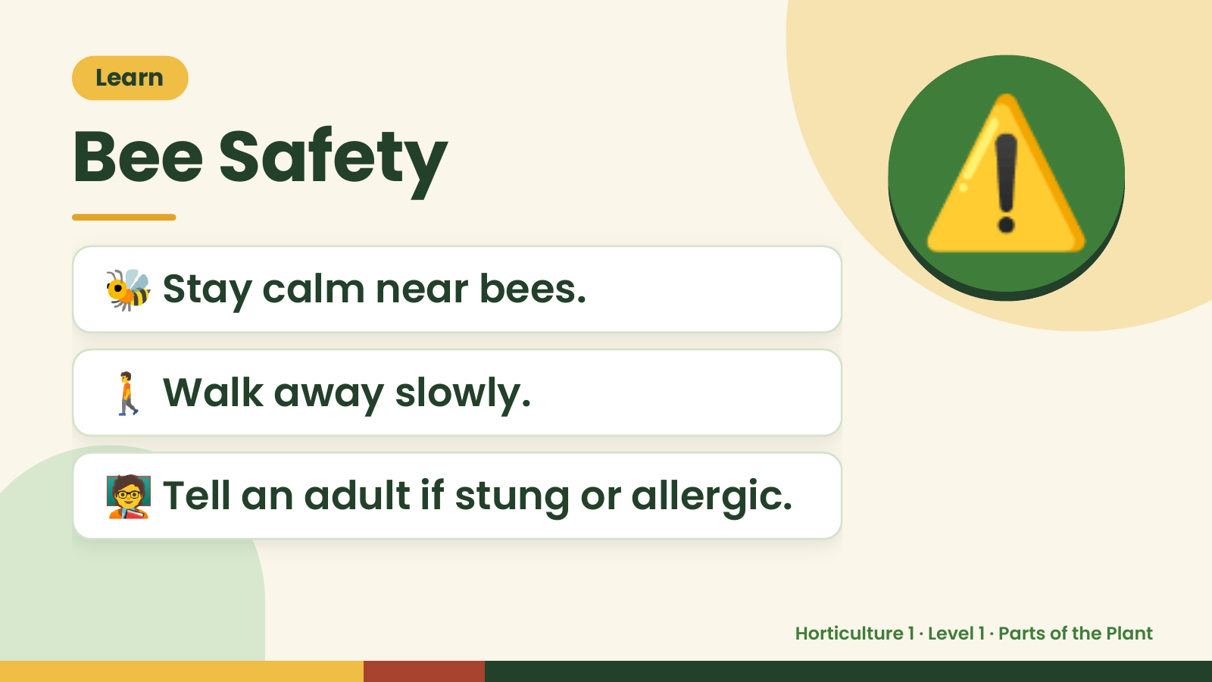
Notes:
Learn
Bee Safety
🐝 Stay calm near bees.
⚠️
🚶 Walk away slowly.
🧑‍🏫 Tell an adult if stung or allergic.
Horticulture 1 · Level 1 · Parts of the Plant

Slide 16
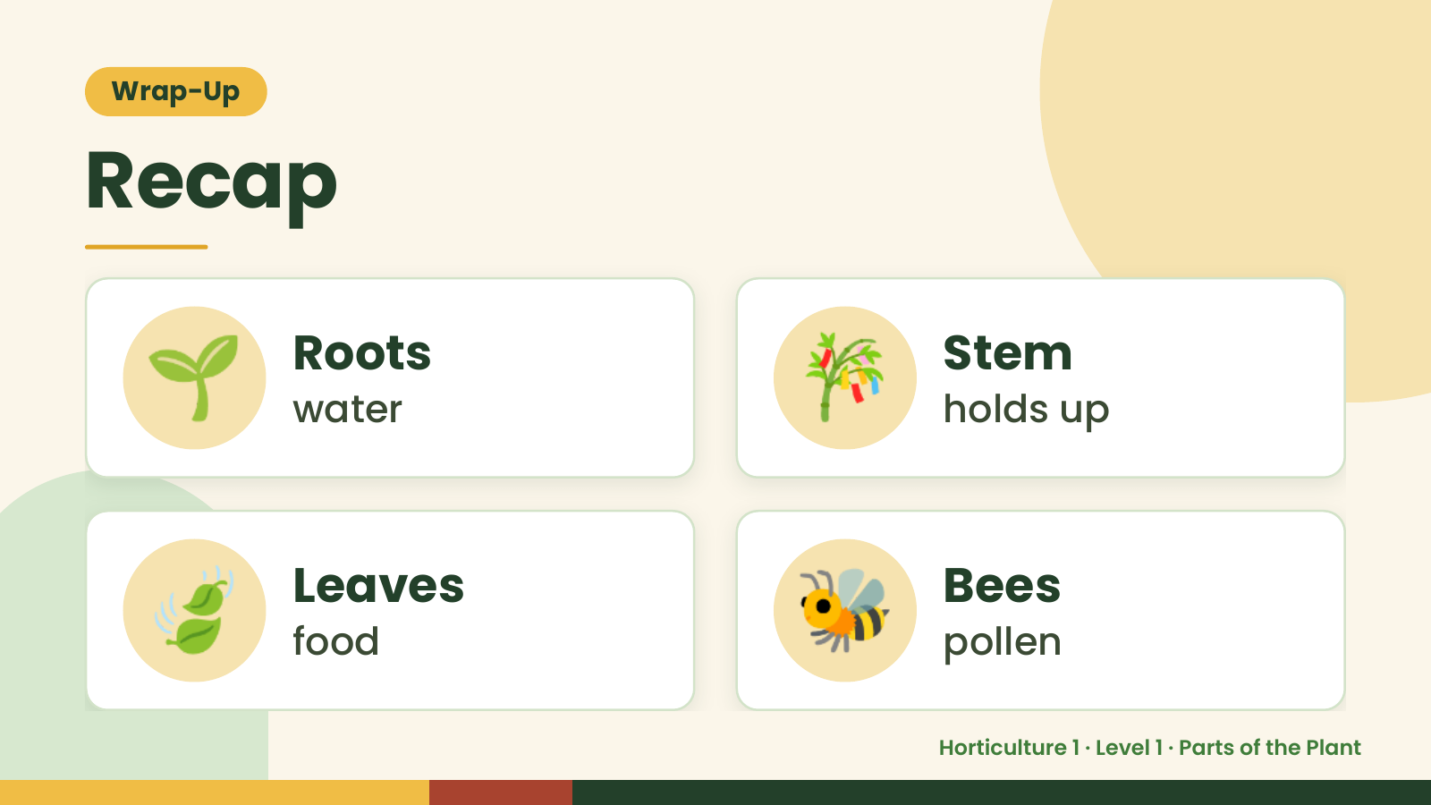
Notes:
Wrap-Up
Recap
🌱 Roots
water 🎋 Stem
holds up
🍃 Leaves
food 🐝 Bees
pollen
Horticulture 1 · Level 1 · Parts of the Plant

Slide 17
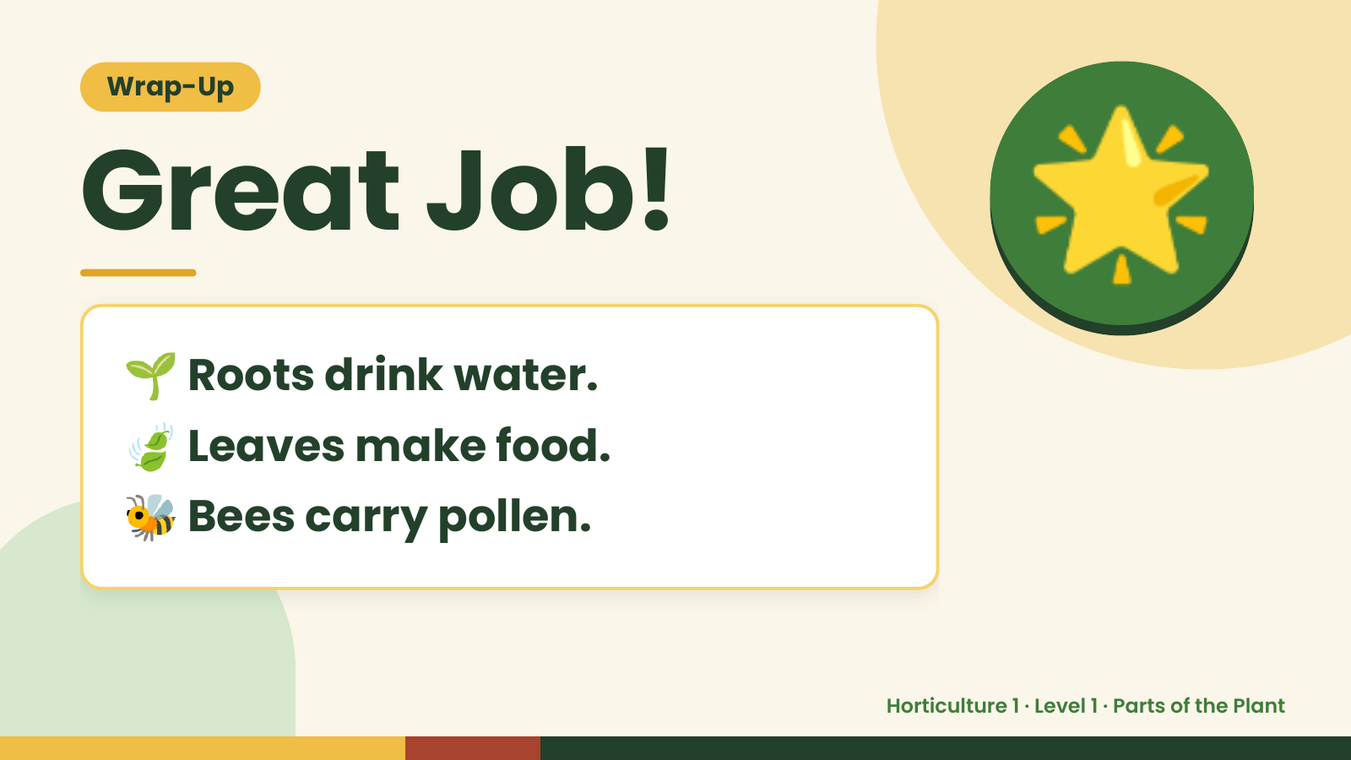
Notes:
Wrap-Up
Great Job!
🌱 Roots drink water.
🌟
🍃 Leaves make food.
🐝 Bees carry pollen.
Horticulture 1 · Level 1 · Parts of the Plant

